Slide 1
THERMAL INSULATION

Slide 2
WHAT IS THERMAL INSULATION?
Insulation is defined as a material or combination of materials which retard the flow of heat.
The material can be adopted to shape or surface.
A variety of finishes are used to protect the insulation from mechanical and environmental damage, and to enhance appearance.
any size,

Slide 3
UNDERSTANDING HEAT FLOW
/HEAT TRANSFER
In order to understand how insulation works, it is important to understand the concept of heat flow or heat transfer. In general , heat always flows from warmer to cooler surfaces. This flow does not stop until the temperature in the two surfaces is equal. Heat is
‘transferred’ by three different means: conduction , convection , and radiation. Insulation reduces the transference of heat.

Slide 4
CONDUCTION
Conduction is when heat is transferred through touching. Conduction is direct heat flow through solids. It results from the physical contact of one object with another .Heat is transmitted by molecular motion. Molecules transmit their energy to adjoining molecules of lesser heat content, whose motion is thereby increased.
For example, when a hot coffee mug touches your hand , the quickly vibrating molecules in your hand, causing them to vibrate faster. The result :your hand heats up.

Slide 5
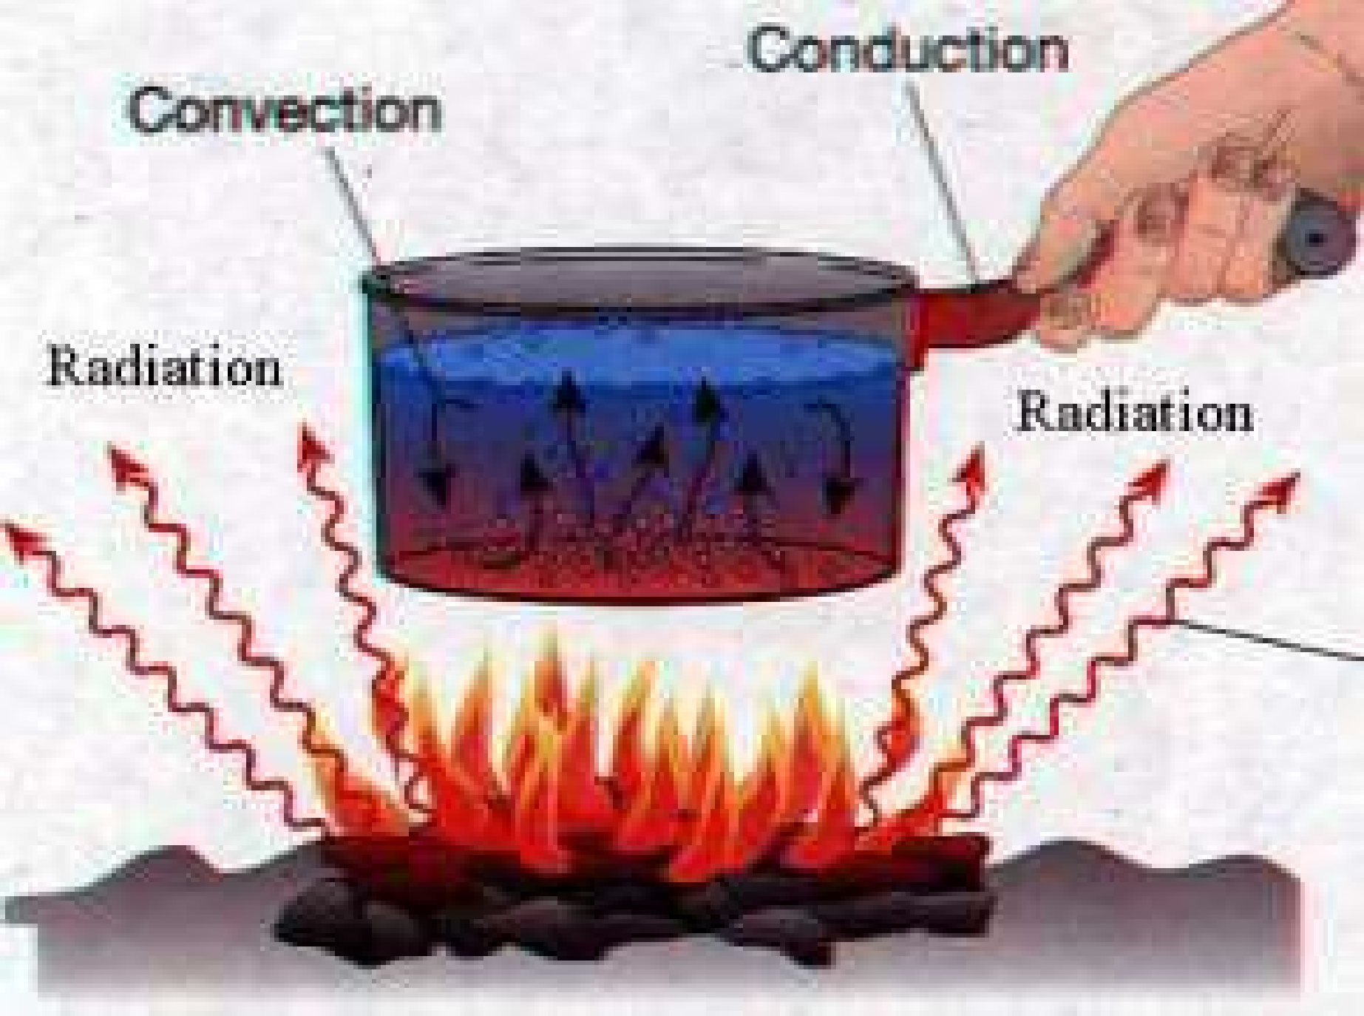

Slide 6
CONVECTION
Convection is the flow of heat (forced and natural) within a fluid. A fluid is a substance that may be either a gas or a liquid. The movement of a heat carrying fluid occurs either by natural convection or by forced convection as in the case of a forced air furnace.

Slide 7
RADIATION
It is the transmission of energy through space by means of electromagnetic waves. Radiated heat moves at the speed of light through the air without heating the space between the surfaces. And example is the warmth you feel on your skin from the sun. The sun is unavailable hot, and the space between it and us is still unbelievable cold.

Slide 8
PURPOSE AND REQUIREMENT OF THERMAL INSULATION
The thermal insulation in building is to maintain a comfortable temperature in building.
The thermal insulation is required to protect the constructional elements against the thermal impact and moisture related damage.
The main purpose of thermal insulation in winter is energy conservation leading to decrease in heating damage.
It prevent summertime overheating of building.

Slide 9

THERMAL INSULATION METHODS
heat insulation by orientation
Heat insulation by shading
Heat insulation by proper ceiling

Slide 10
1. heat insulation by orientation
1. internal building surfaces which can receive direct incident solar radiation from winter to summer the orientation of the building with respect to the sun has a very important bearing on its thermal behaviour. For optimum orientation, there are usually conflicting requirements. Minimum transfer of solar heat desired during the day in summer, while maximum heating of rooms by solar heat is required during winter
.
2. Optimum inclination of solar cells for global radiation throughout the year

Slide 11
2. Heat insulation by shading
Shading of roof brings down the surface temperature, but it is very difficult to achieve this effect in practice, especially when the altitude angle of the sun is high during the peak heat gains in the afternoon.
Raising the parapet walls can help only when the altitude angle of the sun is low.

Slide 12
3. Heat insulation by proper height of ceiling
While the surface temperature of the ceiling does not vary with its height, the intensity of the long wave radiation, emitted by the ceiling decreases as it travels downwards. The effect of vertical gradient of radiation intensity is not significant beyond 1 to 3m. Hence it should be adequate to provide ceiling at a height of about 1 to 1.3m above the occupant.

Slide 13
ADVANTAGES OF THERMAL INSULATION
Thermal insulation keeps the rooms cool in summer and warm in winter, So it result in comfortable living and working condition.
Due to thermal insulation demand , heating in winter and refrigeration in summer is considerably reduce. This result in lot fuel saving and maintenance cost.
The use of thermal insulation material inside a room prevents the moisture deposition on interior walls ceiling, etc

Slide 14
MATERIALS
FIBERGLASS
MINERAL WOOL
CELLULOSE
POLYURETHANE FOAM
POLYSTRENE

Slide 15
FIBERGLASS
It is a most common insulation used in modern time.
It is able to minimize heat transfer.
It is made out of finely woven silicon, glass powder and tiny shards of glass.

Slide 16
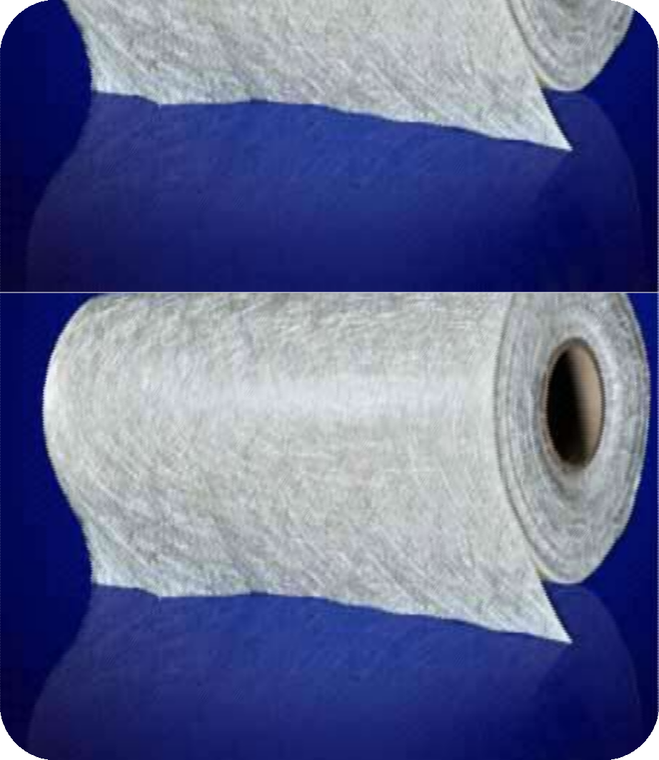
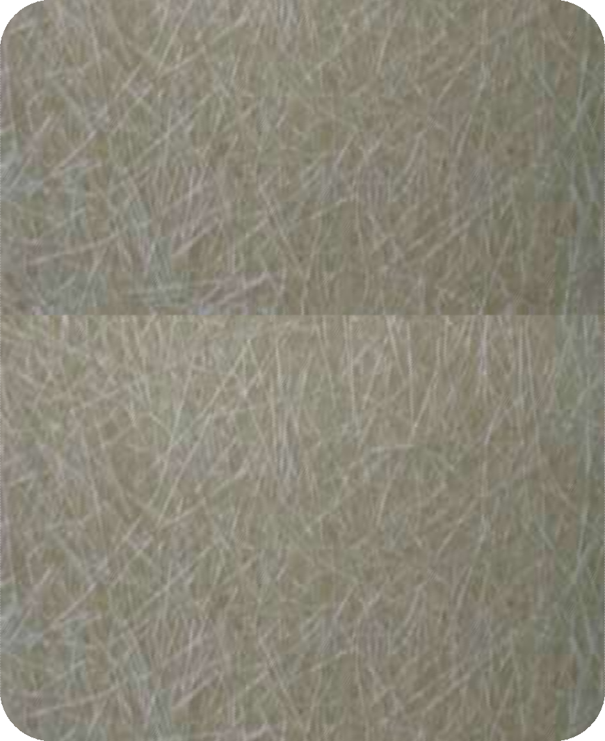



Slide 17

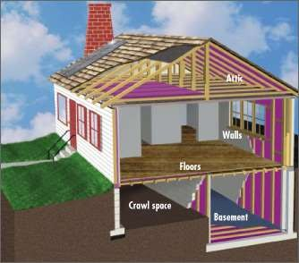

Slide 18
CELLULOSE
Cellulose insulation is one of the most eco-friendly form of insulation.
Cellulose is made from recycled cardboard, paper, and other similar material comes in loose foam.
Cellulose is also most fire resistance forms of insulation.
It is use to reduce building heat loss and gain , noise trance mission.

Slide 19
APPLICATION OF CELLULOSE
It is install on walls, ceiling and flooring.
For installation blowing equipment is required.
For this 3 inch diameter hose pipe is use.
Cellulose spread in cavity made by studs in walls.

Slide 20
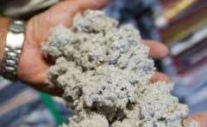
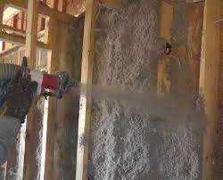
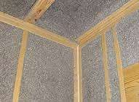

Slide 21
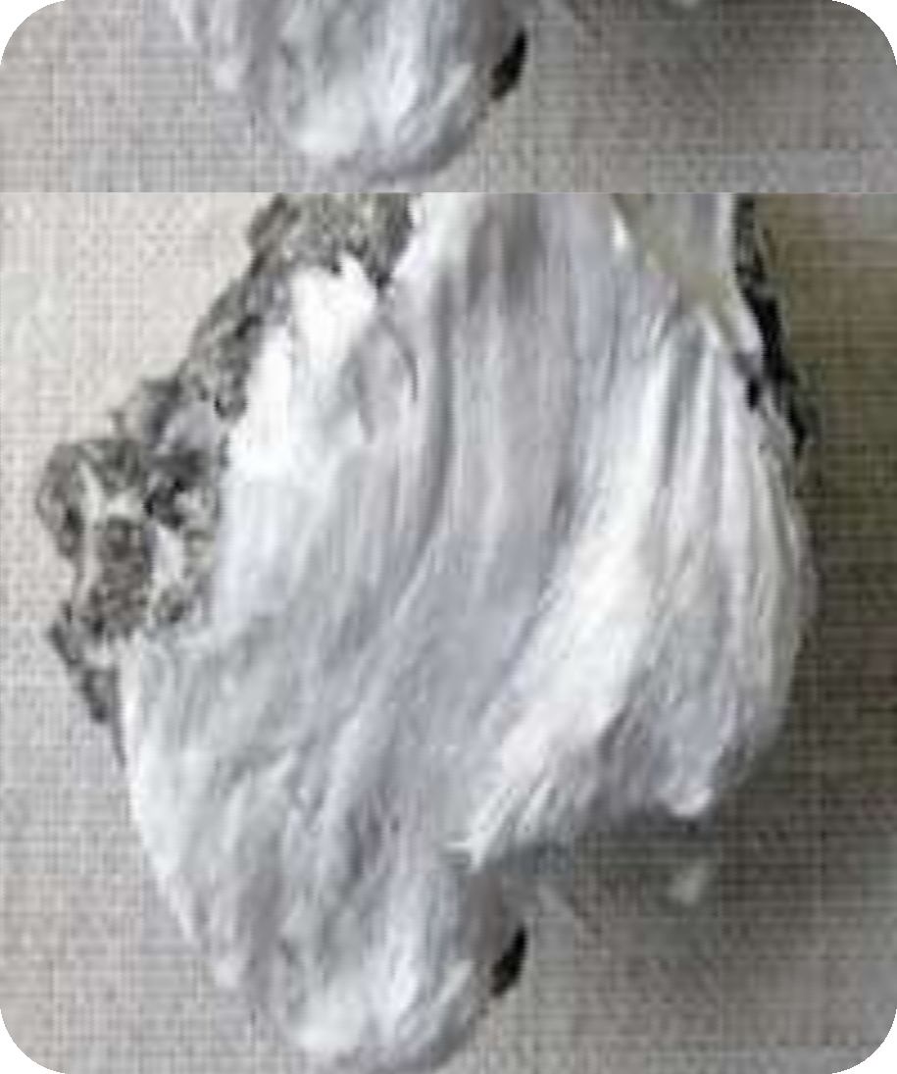
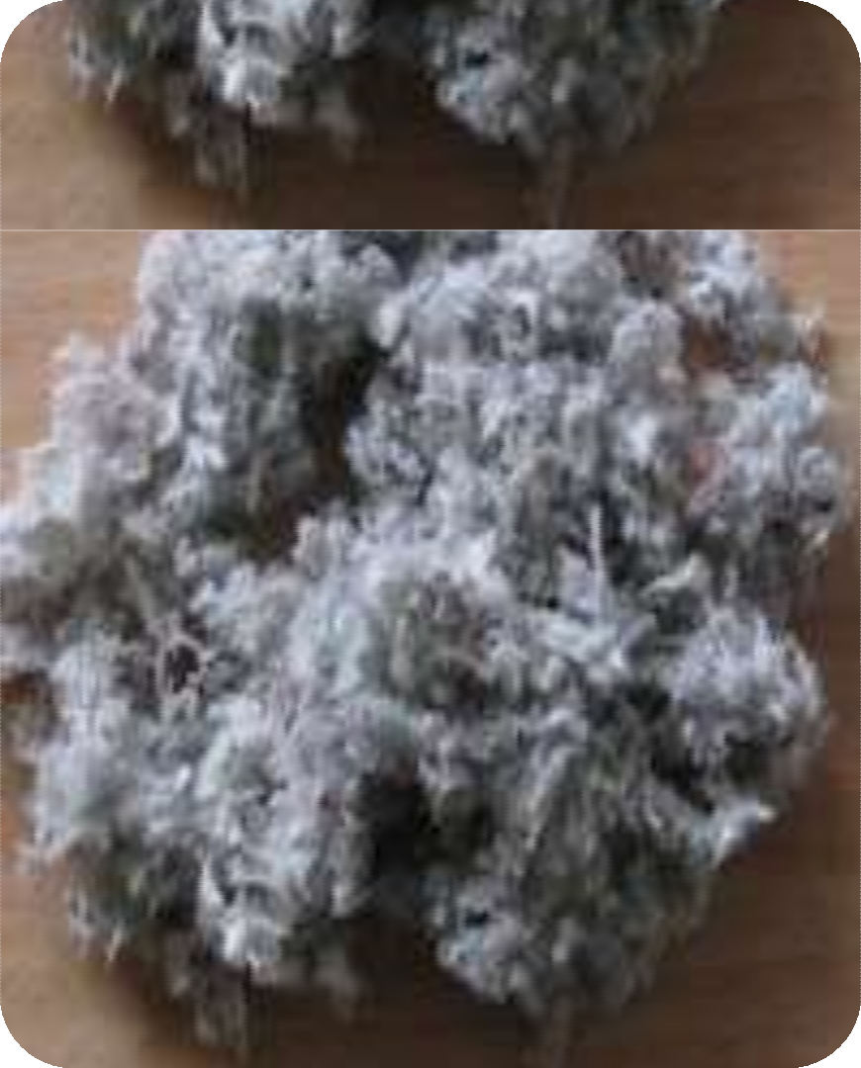



Slide 22
MINERAL WOOL
It is one type of fiber glass which is manufacture from recycled glass.
It is also known as glass wool.
It may refer to rock wool which is a type of insulation made from basalt.
Finally it may refer to slag wool which is produce from the slag from steel mills.
It can be purchased in bats or as a loose material.

Slide 23


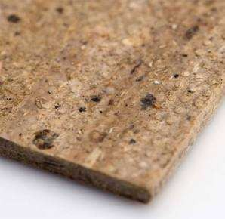
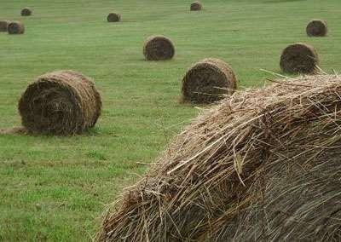

Slide 24


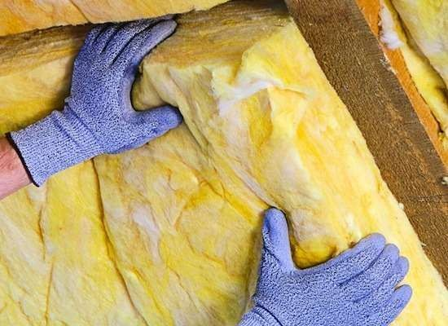
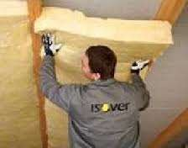

Slide 25
POLYSTYRENE
It is also known as Styrofoam.
It is water proof thermoplastic foam which is excellent sound and temperature insulation material.
It comes in 2 types: Expanded and Extruded.
This two types are differing in performance and cost.
It is insulation has a unequally smooth surface which no other type of insulation possesses.
Usually the foam is created or cut into blocks , ideal foam wall insulation.

Slide 26
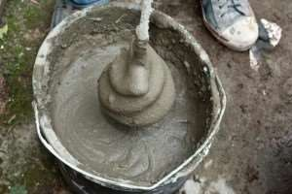
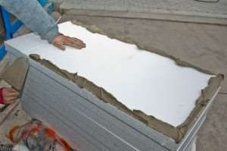
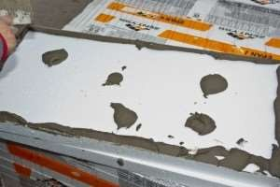

Slide 27
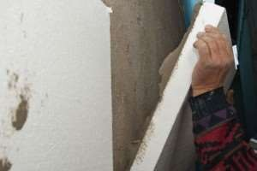
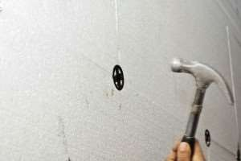

Slide 28
POLYURETHANEFORM
It is most excellent form of insulation.
Nowadays, it is used non-chlorofluorocarbon gas for use as a blowing agent.
This helps to decrease the amount of damage to the ozone layer.
The material contains low conductivity gas in its sells.
Polyurethane insulation is available as a liquid sprayed form and rigid foam board.

Slide 29


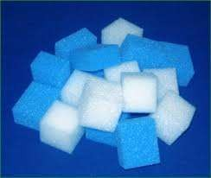
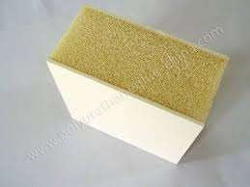

Slide 30
APPLICATION OF POLYURETHANE FOAM
It is directly fixed on surfaces like brick blocks, concrete, etc.
It is also use in unfinished masonry.
Cut the polyurethane foam in the require size.
Then cover the back of foam with “foam construction adhesive”.
Press the adhesive side of the sheet against masonry surface, seal the joints between the sheets with expanding foam.

