Slide 1

ACOUSTICAL DESIGN FOR
AUDITORIUM

Slide 2
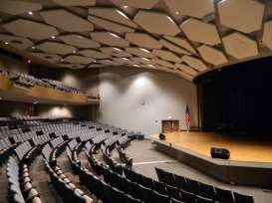
INTRODUCTION
WHAT IS AUDITORIUM?
THE AUDITORIUM IS A ROOM BUILT TO ENABLE AN AUDIENCE TO HEAR AND WATCH PERFORMANCES AT VENUES SUCH AS THEATRES.
The auditorium ,as a place for listening developed from the classical open-air theaters.
An auditorium includes any room intended for:
1. Listening to music including theaters 2. churches
3. Classrooms 4. meeting rooms
The design of various types of auditoriums has become a complex problem, because in addition to its various , sometimes conflicting, aesthetics, Functional , technical ,artistic and economical requirements
,an auditorium of ten has to accommodate a large audience.
AUDITORIUM ACOUSTICS
The room in which we listen to sounds has an important influence on what we hear. This section will identify some of the principal means currently available for judging the quality of an auditorium.
.
AUDITORIUM

Slide 3
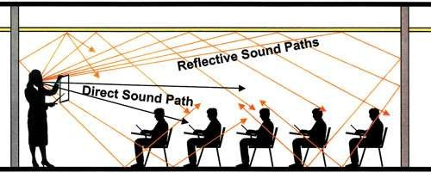
The basic acoustic criteria are :
Must have a low ambient noise level from the internal and external sources
Provide a reasonable level of acoustic gain
Provide appropriate reverberation time
Avoid artifacts such as echoes.
Hearing conditions in any auditorium are considerably affected by purely architectural considerations like:
Shape
Layout of boundary surfaces
Dimensions
Seating arrangements
Volume
Audience capacity
REVERBERATION
A reverberation, is created when a sound or signal is reflected causing a large number of reflections to build up and then decay as the sound is absorbed by the surfaces of objects in the space – which could include furniture, people, and air.
Reverberation is an important parameter that helps define the sound quality of an acoustic space.

Slide 4
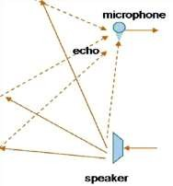
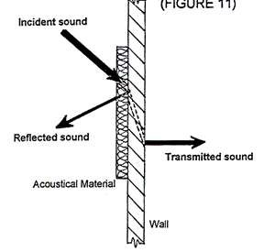
ECHO
Echo is a reflection of sound that arrives at the listener with a delay after the direct sound. The delay is proportional to the distance of the reflecting surface from the source and the listener.
Large enclosed spaces are all potentially
subject to the problem of discrete echoes.
The long path lengths and multiplicity of seating positions near and far from the sound source can easily create echo problems.
ABSORPTION
the majority of absorption is provided by the audience, therefore, the room surfaces can be relatively reflective.
In larger halls, where there is greater room volume per seat , relatively greater room absorption is needed.
a reflective front stage provides strong early reflections that are integrated with the direct sound and enhance it.
strong late reflections and reverberation, such as from rear walls, would not be integrated and may produce echoes.
To accommodate this, the stage area and front of the hall are made
reflective and absorption is placed in the seating area and rear of the
hall.

Slide 5
ACOUSTICAL INSTRUMENTS
1. LOUDSPEAKERS
Sound amplification system are used for the following purpose:
To reinforce the sound level when the sound source is too weak to be heard.
To provide amplified sound for overflow audience.
To minimize sound reverberation.
To provide artificial reverberation in rooms which are too dead for satisfactory listening.
To operate electronic organs ,chimes etc.
TYPES OF LOUDSPEAKER SYSTEM
Three principal type of loudspeaker system are available:
The CENTRALLY LOCATED SYSTEM with a single cluster of loudspeakers over a sound source.
This system gives max. realism as the amplified sound comes from the same direction as original sound.
  The DISTRIBUTED SYSTEM, using a
number of over head loudspeakers located
through out the auditorium.
  The STEREOPHONIC SYSTEM ,with two or more clusters of loudspeakers
Around the proscenium opening or the sound source.
Stereophonic system preserves the illusion that ,the sound is coming from the original, unamplified source.

Slide 6
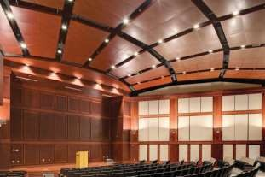
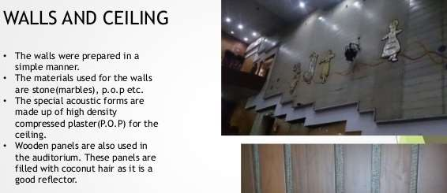
CEILING
In many reflectors,
large some
halls times
,ceiling called
clouds, are used to
Direct sound energy from the stage to the seating area.
When ceilings are high, care must be taken to ensure that path-length Differences between direct and reflected sound are not too great, and particularly should not exceed 20msec.
WALLS
Because of its potential to create undesirable late reflections, the rear wall of a large hall requires special attention.
Reflections from the rear wall would create along path-length difference to a listener at the front of the hall.
This can result in audible echoes, particularly because of the otherwise low reverberation level.
A reflective concave rear wall would also undesirably focus sound.

Slide 7
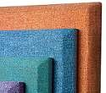
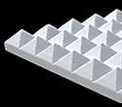
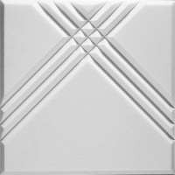
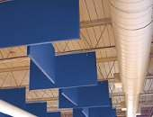

TYPES OF MATERIALS
SOUND ABSORBERS
These sound absorbing acoustical panels and soundproofing materials are used to eliminate sound reflections
Typical materials are open cell polyurethane foam, cellular melamine, fiberglass, fluffy fabrics and other porous materials.
These materials vary in thickness and in shape to achieve different absorption ratings depending on the specific sound requirements.
TYPES –
  Acoustical foam panels
  White paintable acoustical wall panels
  Fabric wrapped panels
  Acoustical wall coverings
  Ceiling tiles
  Baffles and banners for ceiling
  Fiber glass blankets and roll

Slide 8
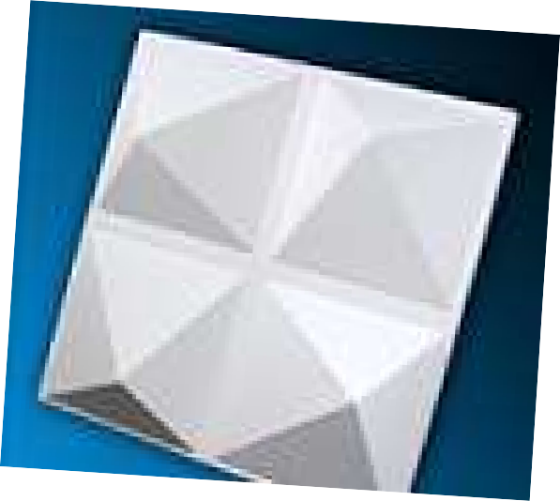
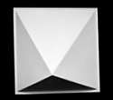
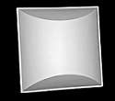
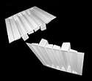
SOUND DIFFUSERS
These devices reduce the intensity of sound by scattering it over an expanded area, rather than eliminating the sound reflections as an absorber would.
Traditional spatial diffusers, such as the polycylindrical (barrel) shapes also double as low frequency traps.
Temporal diffusers, such as binary arrays and quadratics, scatter sound in a manner similar to diffraction of light, where the timing of reflections from an uneven surface of varying depths causes interference which spreads the sound.
QUADRA PYRAMID DIFFUSER
PYRAMIDAL DIFFUSER
DOUBLE DUTY DIFFUSER
QUADRATIC DIFFUSER

Slide 9
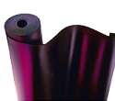
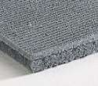
NOISE BARRIERS
These materials range from dense materials to block the transmission of airborne sound to devices and compounds used to isolate structures from one another and reduce impact noise.
COMPOSITES
Composite materials are manufactured from combinations of various materials from open and closed celled foams to quilted fiberglass and barrier. These products are used to block and absorb sound for machine enclosures as well as blocking airborne sound and impact noise. Some of these products include Composite Foams, StratiQuilt Blankets and Floor Underlayment.
BARRIERS
Sound barrier materials are used to reduce the transmission of airborne sound. The Block Aid series of products include the standard one pound per square foot non reinforced barrier, transparent material when observation or supervision is required, reinforced vinyl to create a hanging barrier partition.
VIBRATION CONTROL
Vibration control products are used to absorb vibration energy and prevent structural noise transmission. These include vibration damping compounds and vibration pads, isolation hangers, and resilient clips. They improve sound transmission loss.

