Slide 1

COURSE TITLE: FLUID MECHANICS SESSIONAL
COURSE NO. CE 2122
ZAHIDUL ISLAM
LECTURER
Dept. of Civil Engineering
RUET, Rajshahi-6204.
ONLINE CLASS

Slide 2
FLOW OVER A V-NOTCH
  Theory
A V-notch weir is simply a ‘v notch’ in a plate that is placed so that it obstructs an open channel flow, causing the water to flow over the V-notch. It is used to meter flow of water in the channel, by measuring the head of water over the V-notch crest. The triangular weir or V-notch is preferable to the rectangular weir for the measurement of wide range of flow.

Slide 3
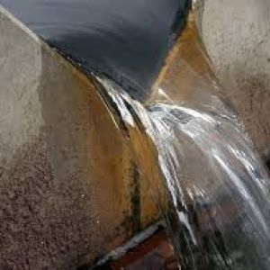
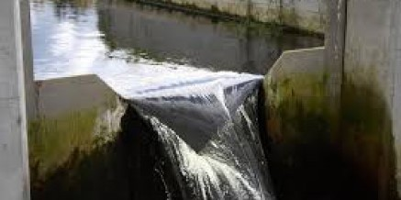
FLOW OVER A V-NOTCH
Figure: V- Notch

Slide 4
FLOW OVER A V-NOTCH
Types of notch
Rectangular notch.
Triangular notch.
Trapezoidal notch.
Stepped notch

Slide 5
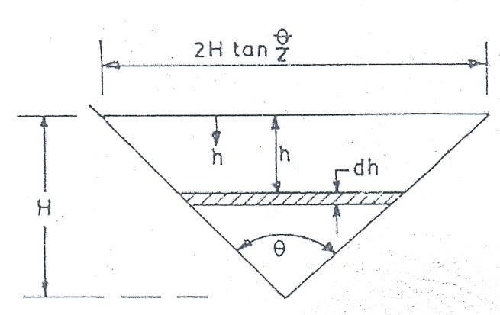
FLOW OVER A V-NOTCH
A triangular -notch shown in the figure.
Figure: . Flow over a V-Notch

Slide 6
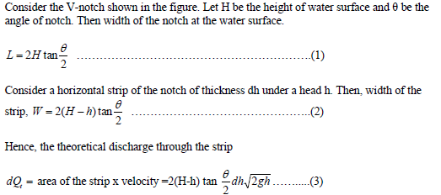
FLOW OVER A V-NOTCH

Slide 7
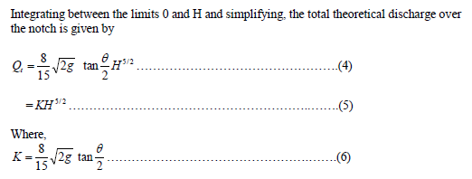
FLOW OVER A V-NOTCH

Slide 8
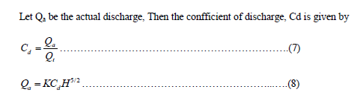
FLOW OVER A V-NOTCH

Slide 9
FLOW OVER A V-NOTCH
  2. Objective
To find the value of C_{d} for the V-notch.
To plot Q_{t} vs. Q_{a} in a plain graph paper.
To plot Q_{a} vs. H in a log-log paper and to find
(a) the exponent of H and
(b) the co-efficient of discharge, Cd

Slide 10
FLOW OVER A V-NOTCH
  3. Apparatus
V-notch weir plate
Constant steady water supply
Channel
Flow rate measuring facility
Point gauge

Slide 11
FLOW OVER A V-NOTCH
  4. Procedure
Place the notch plate at the end of the nappe with the sharp edge on the upstream side in a vertical plane.
Allow water to channel until the water discharges over the notch plate and close the flow control valve and allow water to stop flowing over weir.

Slide 12
FLOW OVER A V-NOTCH
  4. Procedure
Allow water to the channel and adjust flow control valve to obtain head.
Measure and record head for each flow rate in the stabilize conditions.

Slide 13
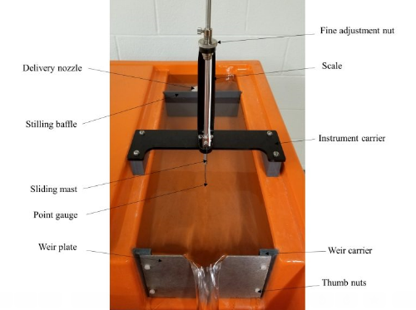
FLOW OVER A V-NOTCH
Figure: Typical Experimental Setup

Slide 14
FLOW OVER A V-NOTCH
  5. Observation Sheet
Angle of the notch, =
K=
Cross-sectional area of the measuring tank =
Initial point gauge reading =
Final point gauge reading =

Slide 15
FLOW OVER A V-NOTCH
  5. Table : For Calculating Discharge
No. of Obs. | Vol. of water | Collection time T | Actual discharge Q_{a} | Effective head H | Theoretical discharge Q_{t} | Co-eff. of discharge
Average

Slide 16
FLOW OVER A V-NOTCH
  6. Results
  7. Discussion

Slide 17
FLOW OVER A V-NOTCH
  8. Assignments
Why does the V notch give more accurate flow measurement?
Why CD of rectangular notch is less than triangular notch?

Slide 18
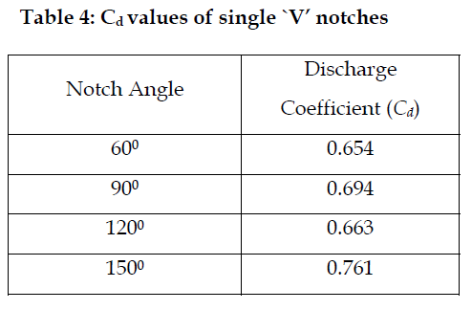
FLOW OVER A V-NOTCH
Source:https://www.researchgate.net/publication/279848764_Discharge_Measurements_in_Open_Channels_using_Compound_Sharp-Crested_Weirs/figures

Slide 19
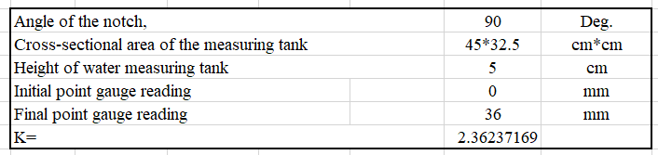
FLOW OVER A V-NOTCH
Source:https://www.researchgate.net/publication/279848764_Discharge_Measurements_in_Open_Channels_using_Compound_Sharp-Crested_Weirs/figures

Slide 20
FLOW OVER A V-NOTCH
No. of Obs. | Area of water (m2) | Vol. of water (m3) | Collection time T ( sec) | Actual discharge Q_{a (} | Effective head H | Theoretical discharge Q_{t} | Co-eff. of discharge
1 | 0.13725 | 0.006863 | 18.0 | 0.000381 | 0.036000 | 0.000581 | 0.66
2 | 0.13725 | 0.006863 | 30.0 | 0.000229 | 0.029000 | 0.000338 | 0.68
3 | 0.13725 | 0.006863 | 36.0 | 0.000191 | 0.027000 | 0.000283 | 0.67
4 | 0.13725 | 0.006863 | 42.0 | 0.000163 | 0.026000 | 0.000258 | 0.63
5 | 0.13725 | 0.006863 | 53.0 | 0.000129 | 0.023000 | 0.000190 | 0.68
Average |  |  |  |  |  |  | 0.66

Slide 21
FLOW OVER A V-NOTCH

Slide 22
References
A Textbook of Fluid Mechanics and Hydraulic Machines
- By R.K. Bansal
2.https://www.rsisinternational.org/journals/ijrias/DigitalLibrary/Vol.4&Issue9/95-99.pdf
3. https://www.youtube.com/watch?v=brNnUz7pWhM&app=desktop

Slide 23
ANY QUESTION?

Slide 24
Stay Safe at Home

