Slide 1

DEPARTMENT OF CIVIL ENGINEERING RAJSHAHI UNIVERSITY OF ENGINEERING &TECHNOLOGY
Heaven ‘s Light is Our Guide
Prepared by
Dr. S. M. ZAHURUL ISLAM
PhD, The University Of Hong Kong, HONG KONG)
M.Sc Engineering, Universiti Putra Malaysia, Malaysia
B Sc. Engineering, Rajshahi University of Engineering & Technology (RUET)
&
Head, Department of Architecture, RUET &
Professor
Department of Civil Engineering
Rajshahi University of Engineering & Technology (RUET), Rajshahi – 6204, BANGLADESH

Slide 2
DEPARTMENT OF CIVIL ENGINEERING RAJSHAHI UNIVERSITY OF ENGINEERING &TECHNOLOGY
Heaven ‘s Light is Our Guide
Course Title : Mechanics of Materials-II
Course Code: CE 2213
Lecture: 3 hrs/ week , Credit: 3.00
Prereq. CE 211
Content of Course:
Torsional stresses in shafts and tubes, helical springs, combined stresses, transformation of stresses. Deflection of beam by direct integration, moment area and conjugate beam methods. Buckling of columns.

Slide 3
Reference Books
1. Strength of Materials by Ferdinand L. Singer
2. Engineering Mechanics of Solids by Egor P. Popov
3. Mechanics of Materials by by Laurson and Cox
4. Mechanics of Materials by R.C. Hibbeler
5. Strength of Materials by William Nash
6. Indeterminate Structural Analysis by J. Sterling Kinney

Slide 4
Torsional stresses in shafts and tubes
Topics:

Slide 5
Topics to be Covered
Introduction
Define Torsional Stresses
Example of Torsional stresses
Assumption for Torsion Formula
Derives Torsional Formula
Sample Example to Analysis and Design of Shafts and Tubes

Slide 6
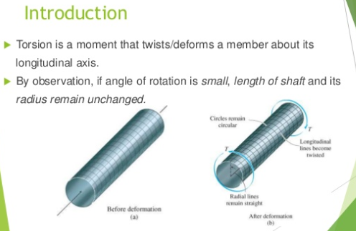
Introduction

Slide 7
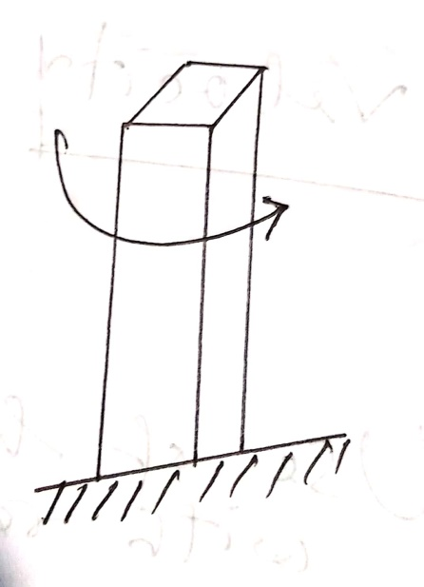
Torsion is the twisted of an object due to an applied torque. it is expressed in newton-meters/ft-lb.
In sections perpendicular to toque axis the resultant shear stress in this section is perpendicular to the radius.
Torsion is the action of twisted or the state of being twisted especially of one end of an object relative to the other.

Slide 8
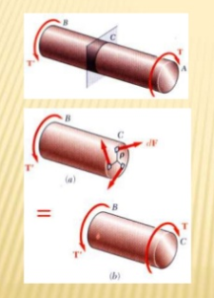
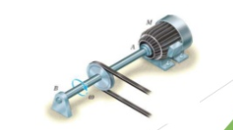
Example of Torsion on shaft

Slide 9
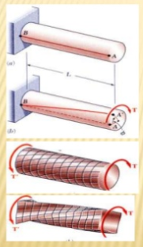
Example of Torsion on shaft

Slide 10
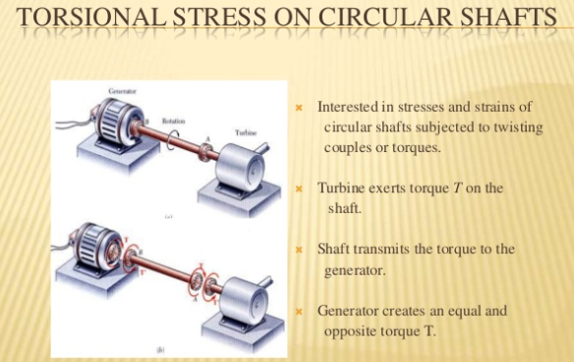

Slide 11
Assumption:
Circular sections remain circular.
plane section remain plane and do not worp.
The projection upon an transverse section of straight radial lines in the section remains straight.
Shaft is loaded by twisting couples in planes that are perpendicular to the axis of the shaft.
Stresses do not exceed the proportional limit.

Slide 12
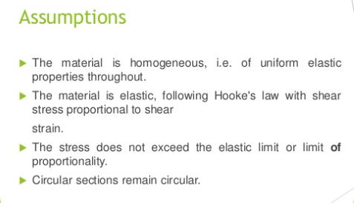

Slide 13
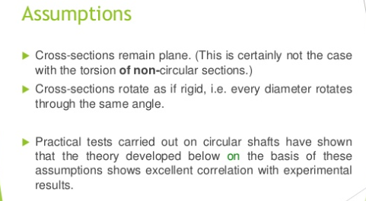

Slide 14
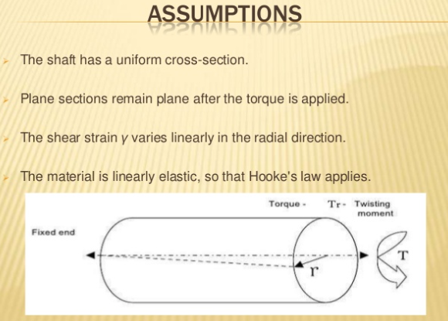

Slide 15
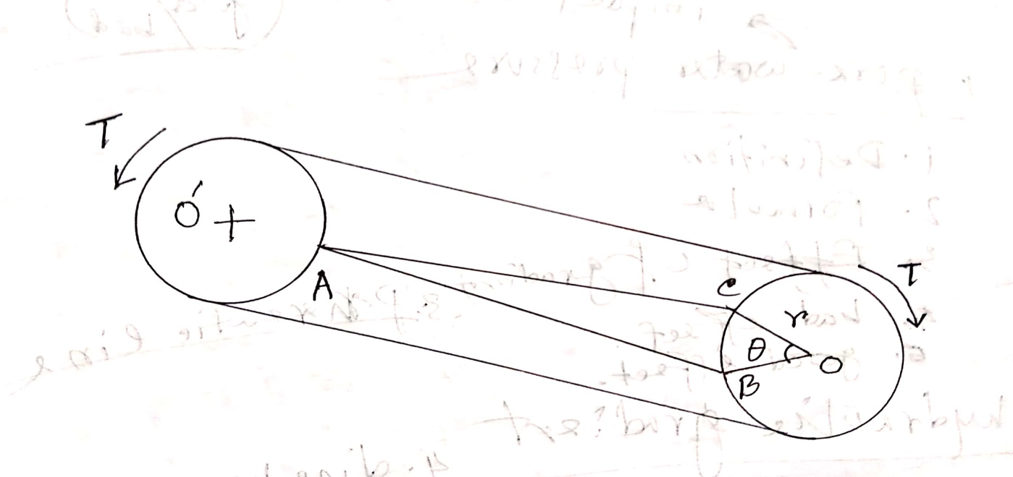
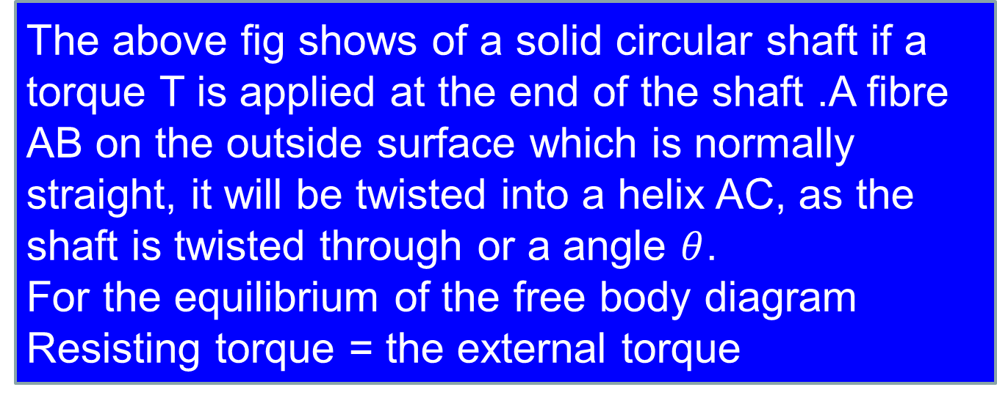
Derive torsion formula to determine maximum stress in a circular shaft.
The above fig shows of a solid circular shaft if a torque T is applied at the end of the shaft .A fibre AB on the outside surface which is normally straight, it will be twisted into a helix AC, as the shaft is twisted through or a angle $θ$.
For the equilibrium of the free body diagram
Resisting torque = the external torque

Slide 16
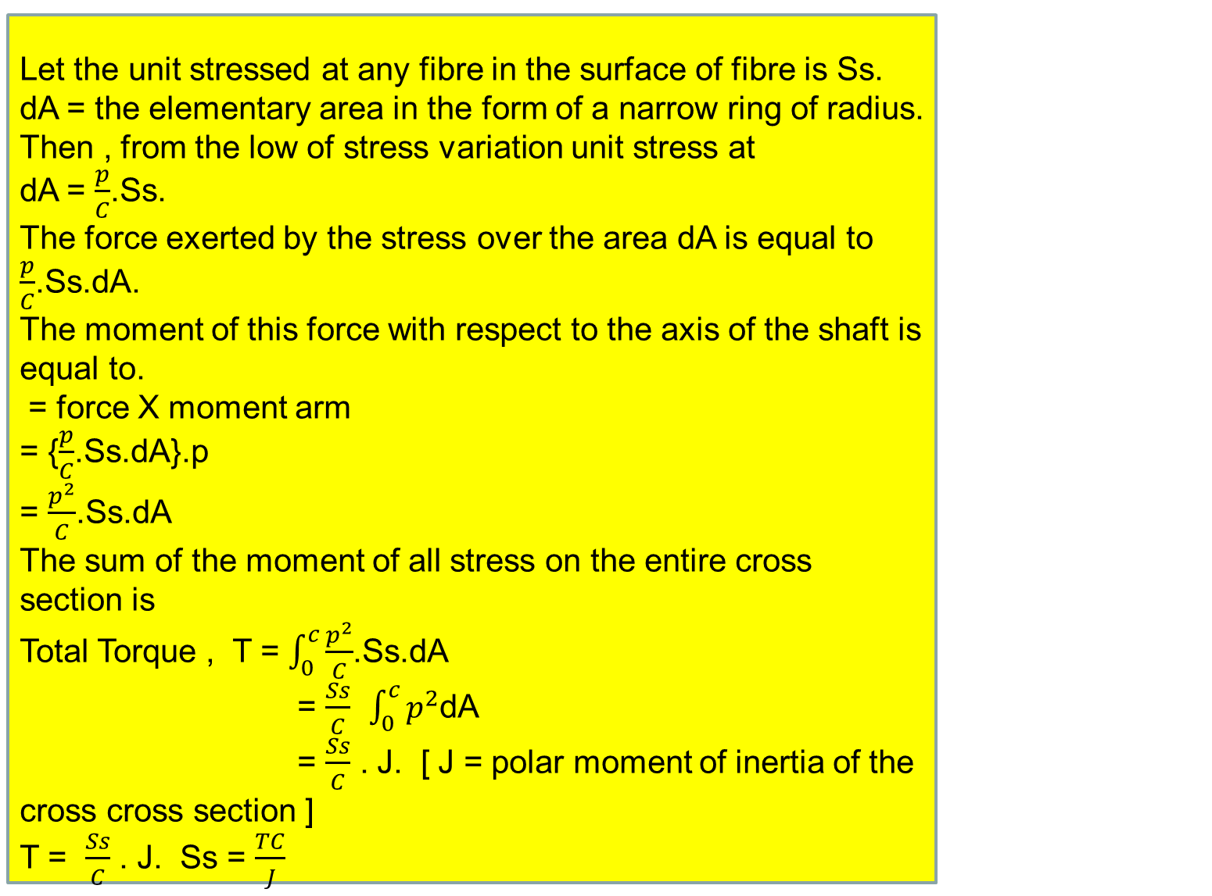
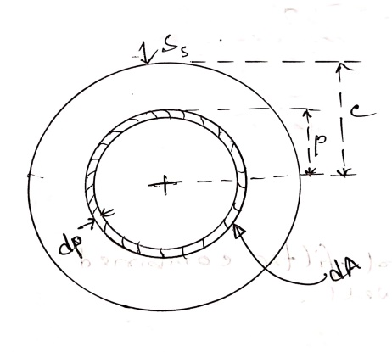

Slide 17
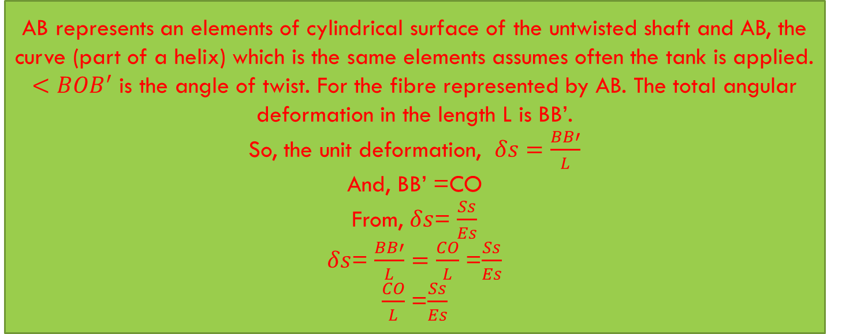
Determination of torsion formula for angle of twist.

Slide 18
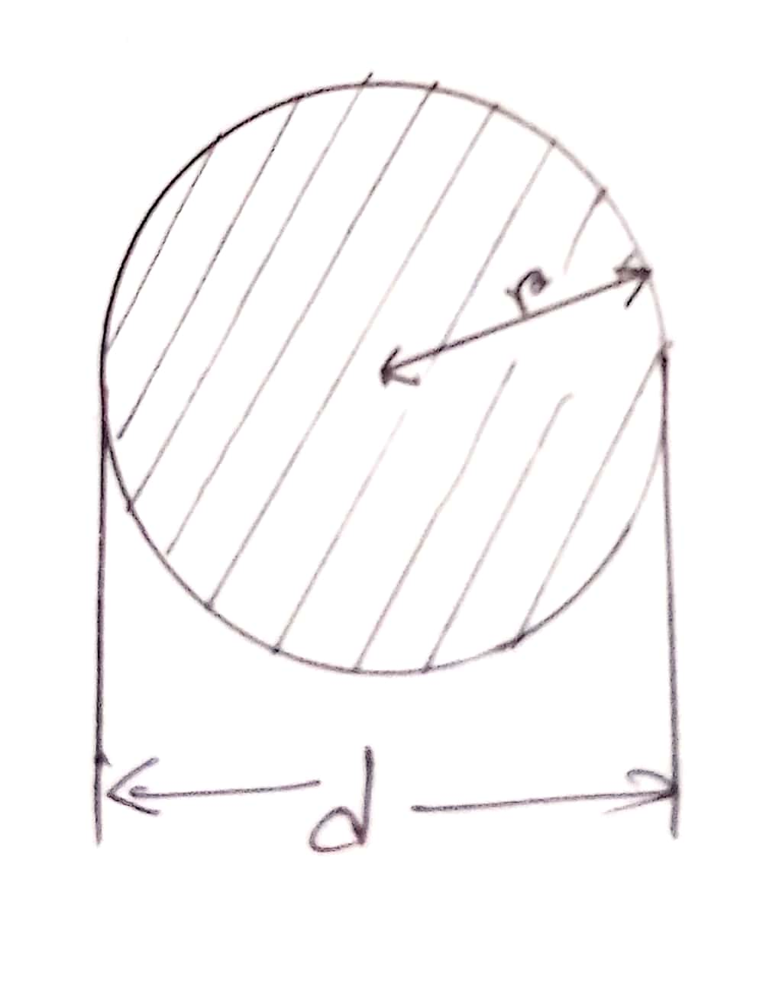
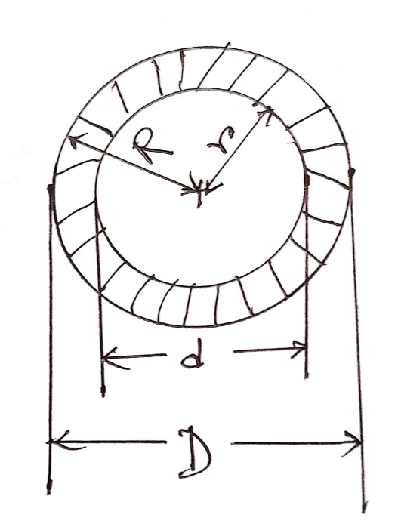

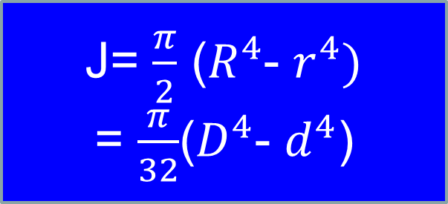
$θ=\frac{Ss. L}{Es.C}$= $\frac{TC. L}{J. Es. C }$
= $\frac{T. L}{J. Es }$
Polar moment of inertia.
J= $\frac{π}{2}$ ($R^{4}$- $r^{4})$
= $\frac{π}{32}$($D^{4}$- $d^{4}$)

Slide 19
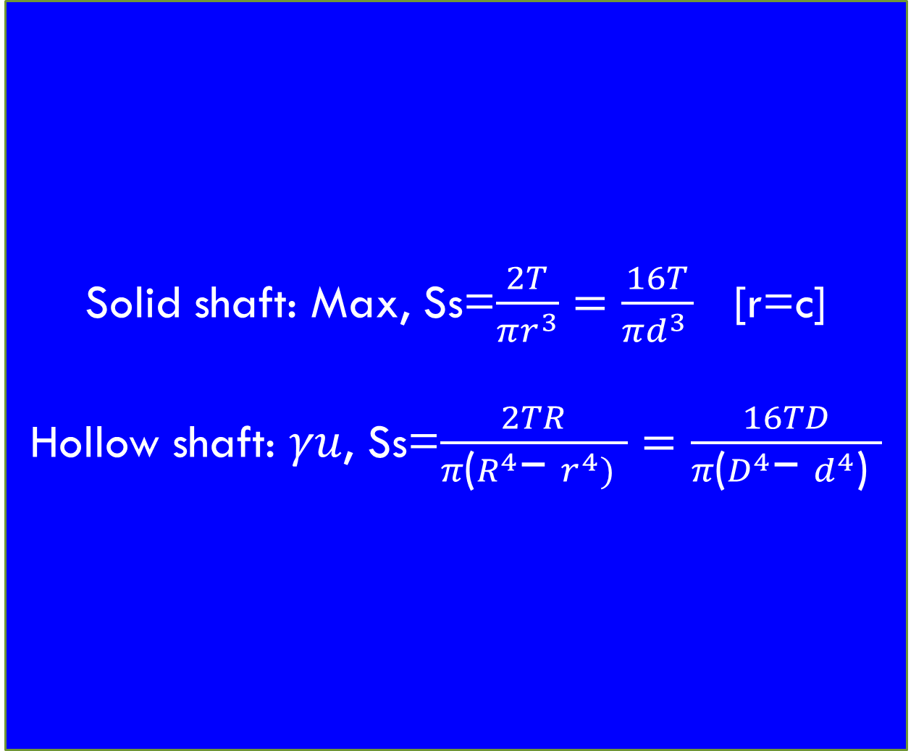

Slide 20
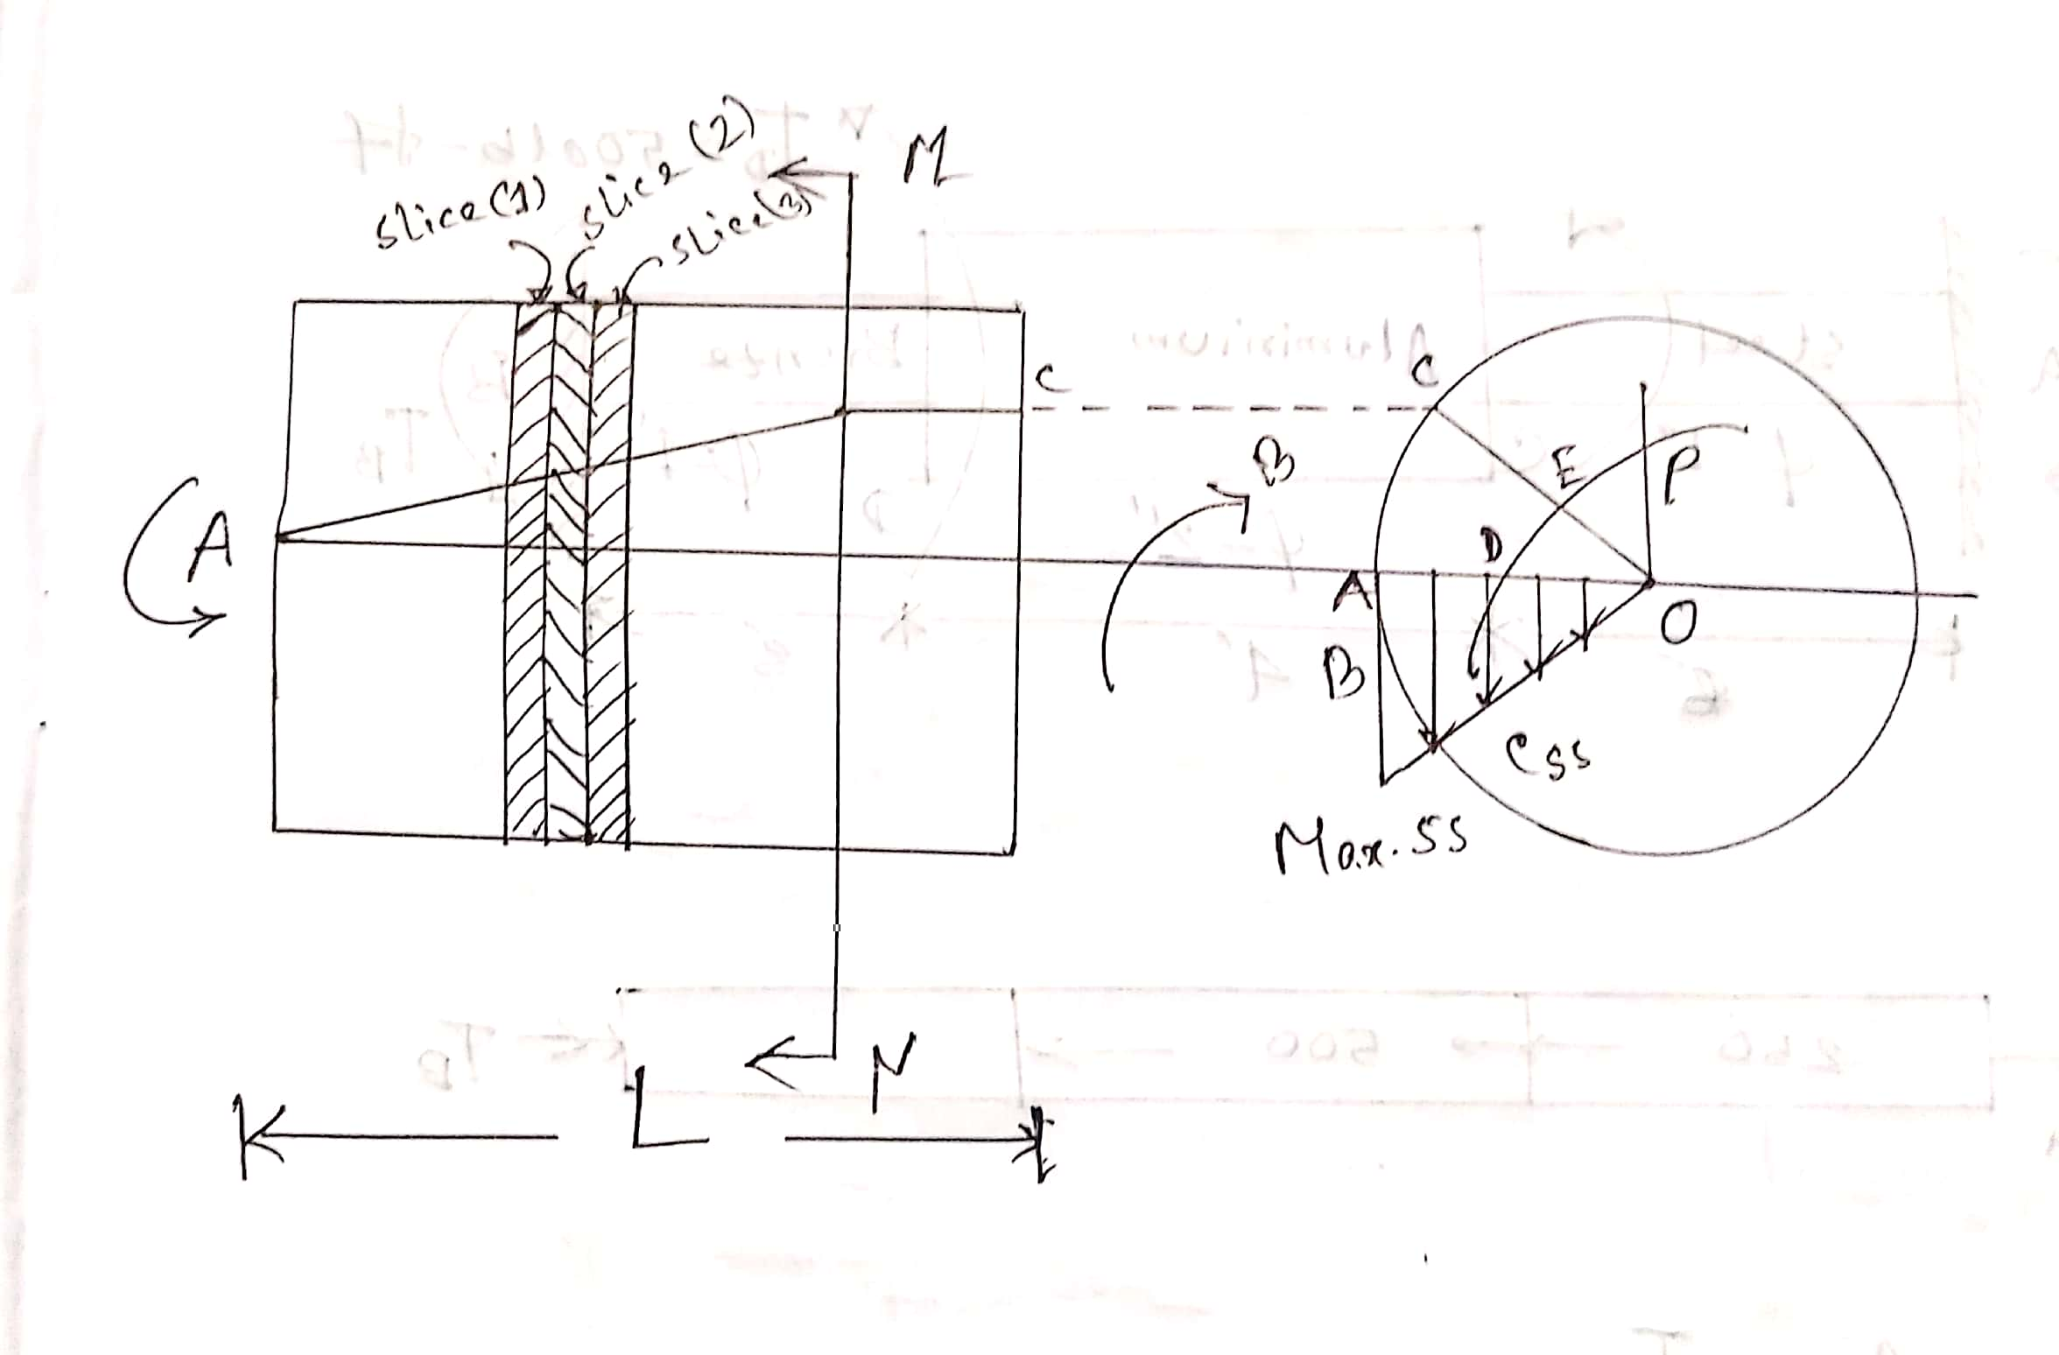
Determination of circular shaft.

Slide 21
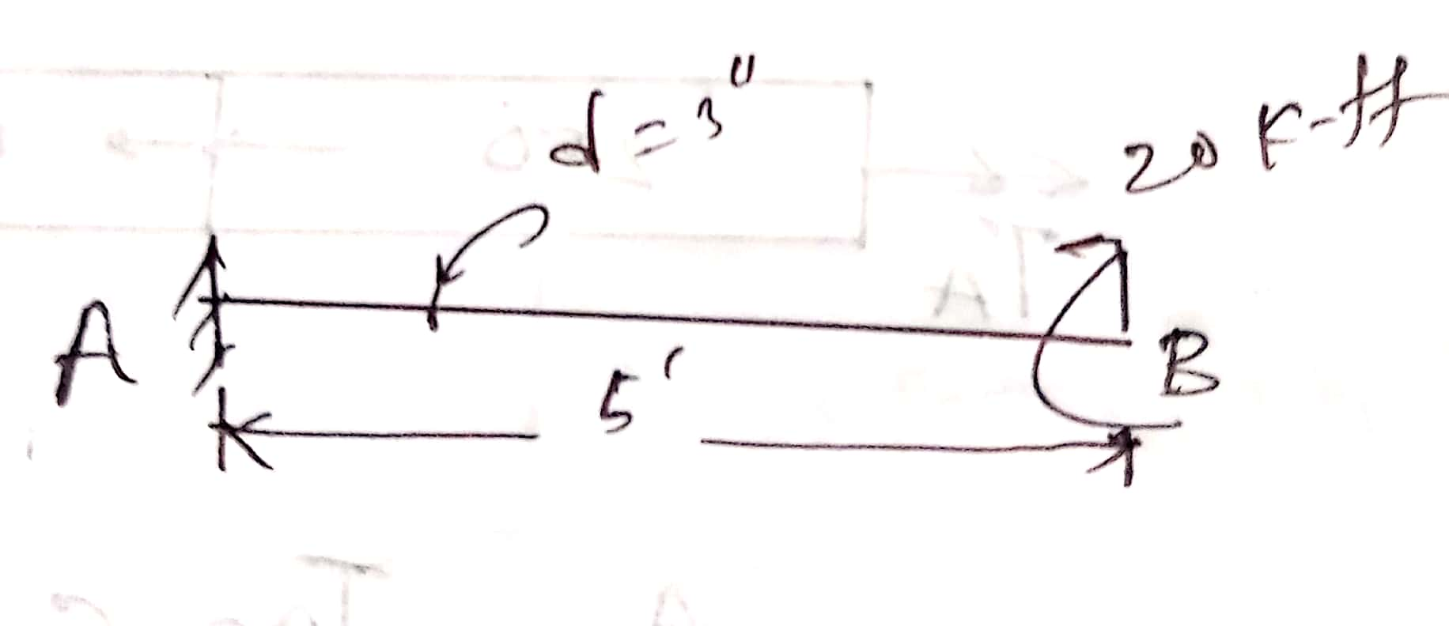
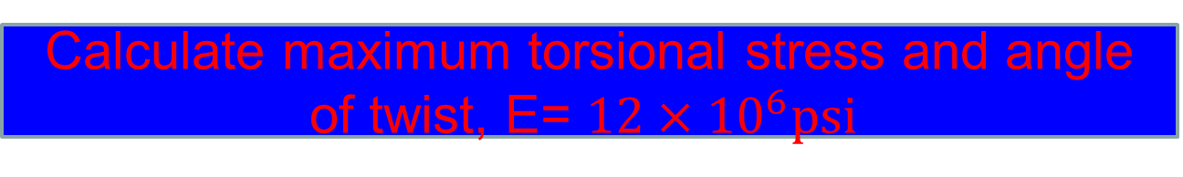
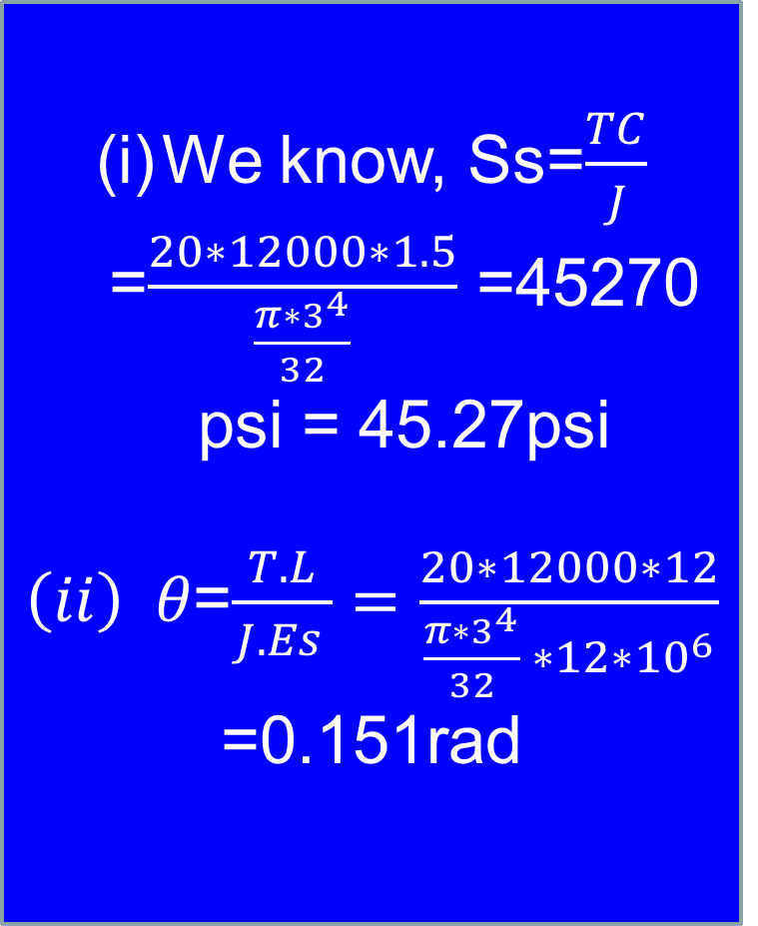
Calculate maximum torsional stress and angle of twist, E= ${12×10}^{6}psi$
We know, Ss=$\frac{TC}{J}$ =$\frac{20∗12000∗1.5}{\frac{π∗3^{4}}{32}}$ =45270 psi = 45.27psi
$\left(ii\right) θ$=$\frac{T. L}{J. Es }=\frac{20∗12000∗12}{\frac{π∗3^{4}}{32} ∗12∗{10}^{6}}$ =0.151rad

Slide 22
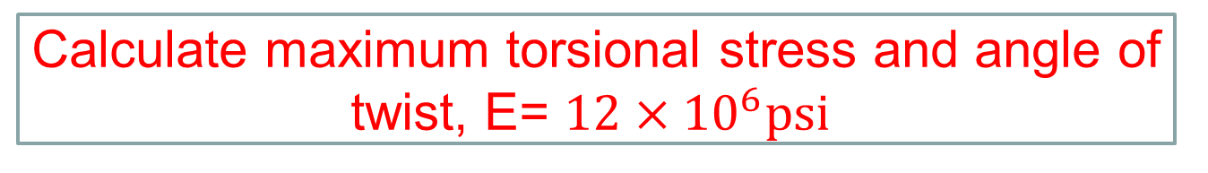
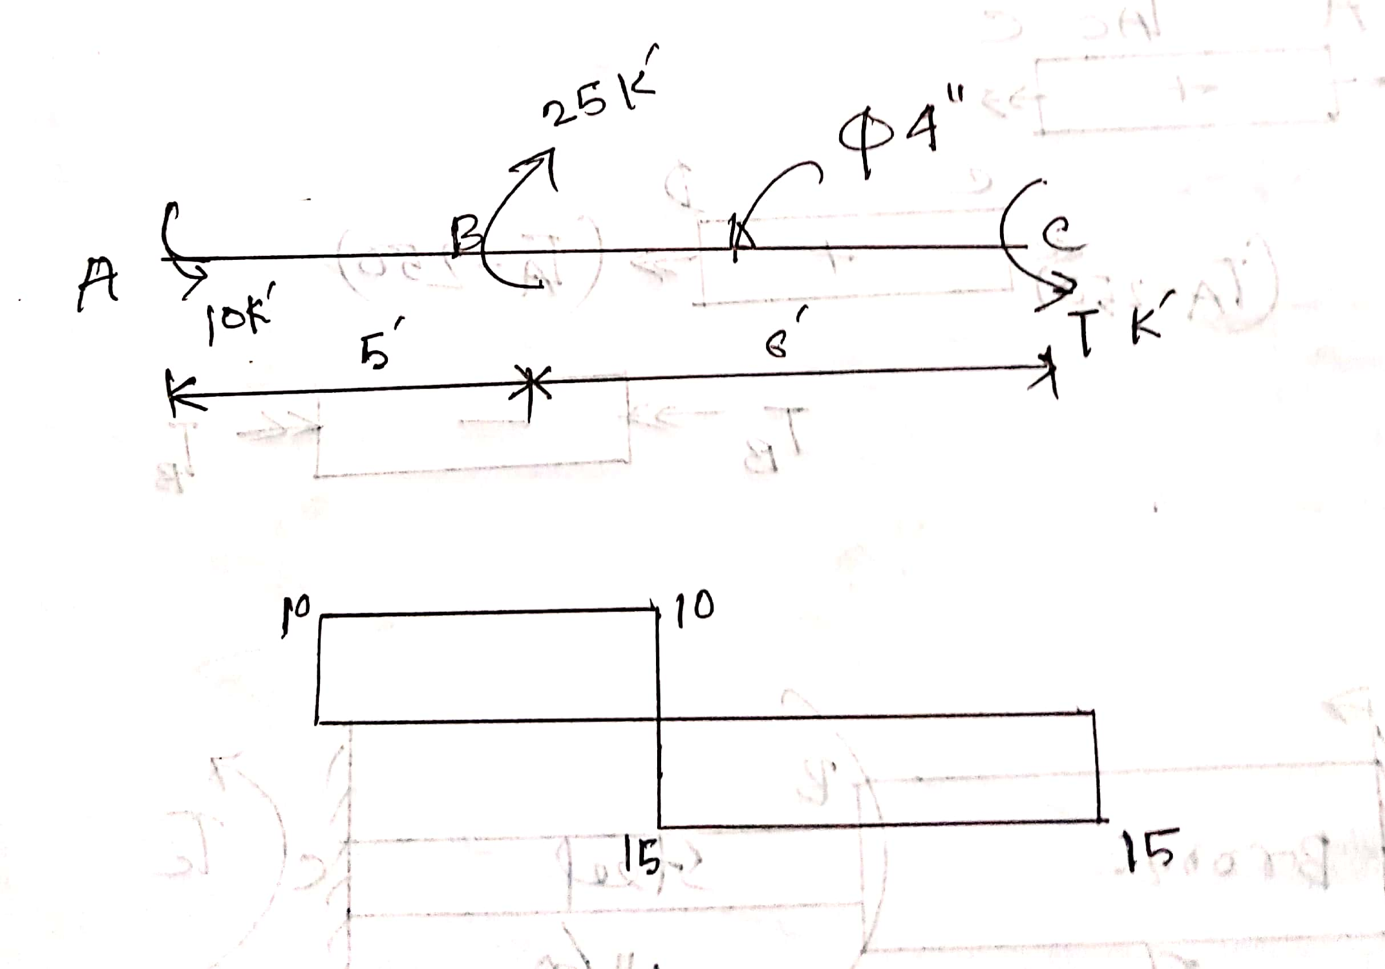
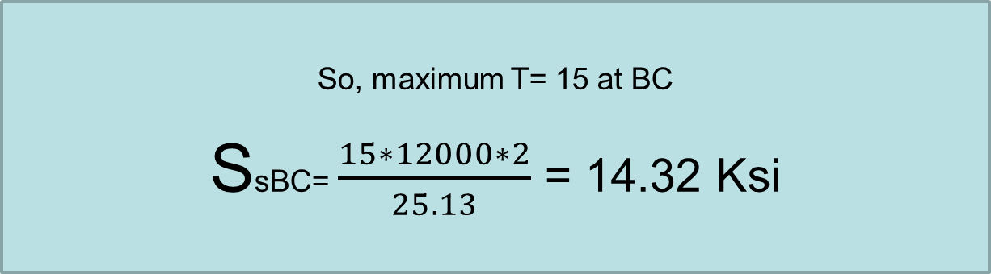
Here maximum moment is on BC

Slide 23
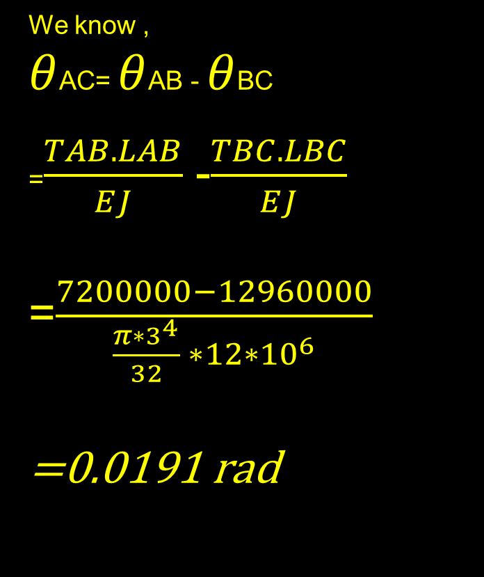

Slide 24
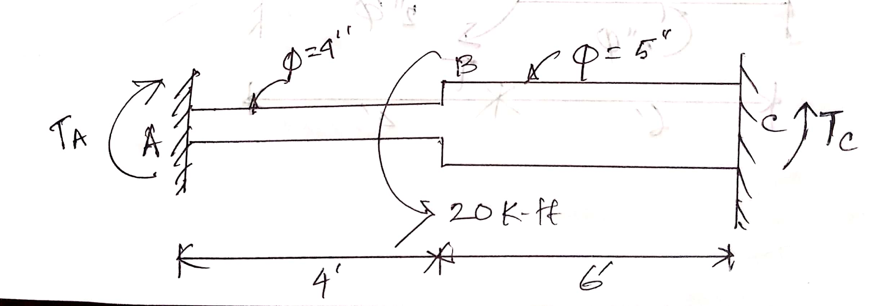
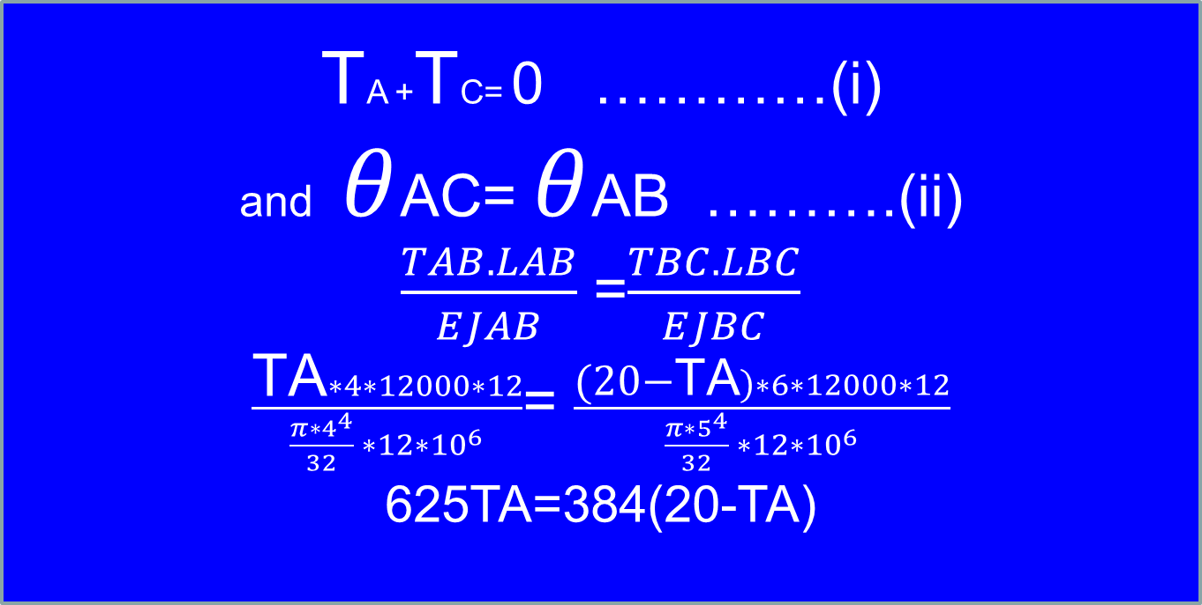
Calculate the max. Ss which is developed in the following shaft.
TA +TC= 0 …………(i)
and $θ$AC= $θ$AB ……….(ii)
$\frac{TAB. LAB}{EJAB}$ =$\frac{TBC. LBC}{EJBC}$
$\frac{\text{TA}∗4∗12000∗12}{\frac{π∗4^{4}}{32} ∗12∗{10}^{6}}$= $\frac{\text{(20−}\text{TA})∗6∗12000∗12}{\frac{π∗5^{4}}{32} ∗12∗{10}^{6}}$
625TA=384(20-TA)

Slide 25
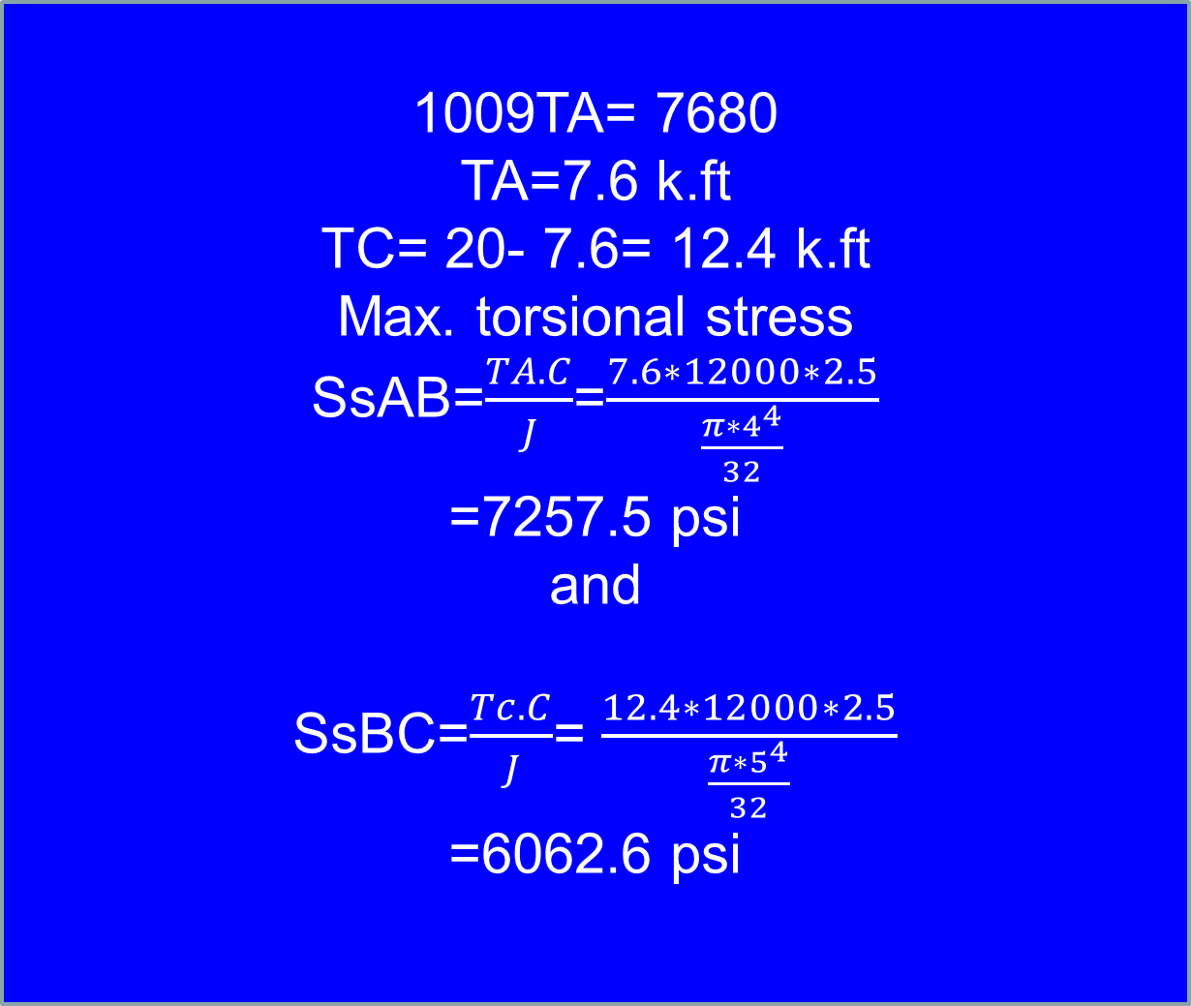

Slide 26
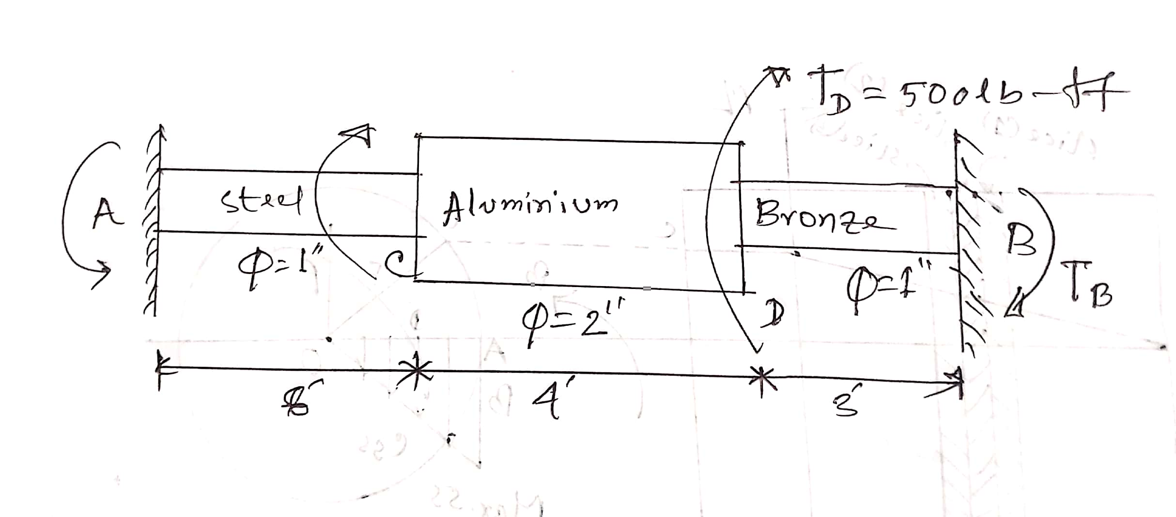
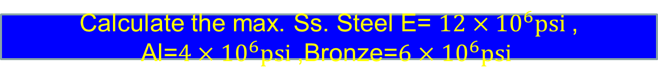
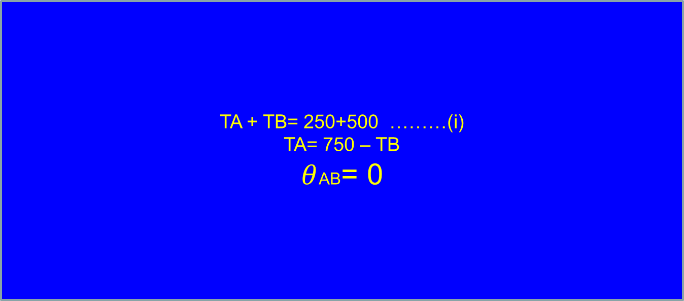
Calculate the max. Ss. Steel E= ${12×10}^{6}psi$, Al=${4×10}^{6}psi$,Bronze=${6×10}^{6}psi$
TA + TB= 250+500 ………(i)
TA= 750 – TB
$θ$AB= 0

Slide 27
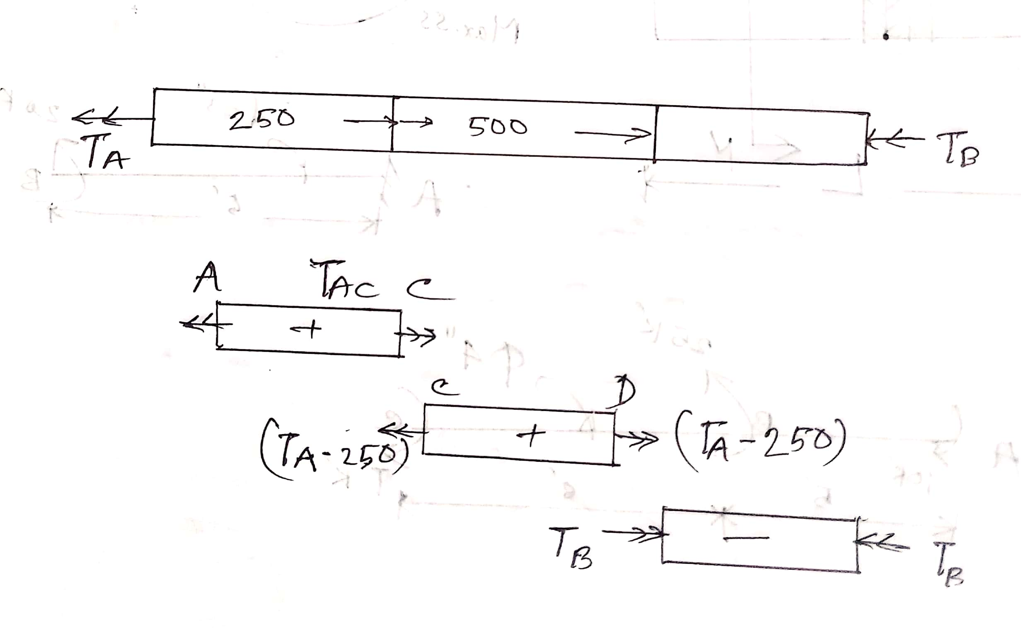
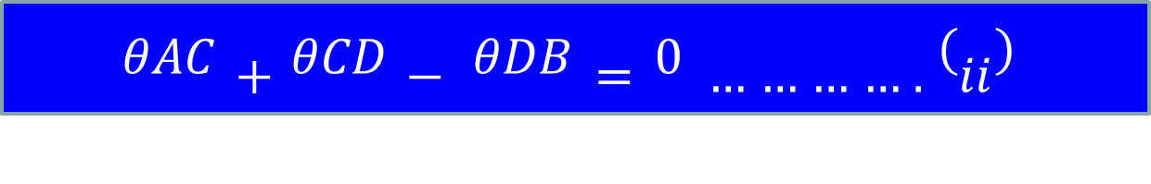

Slide 28
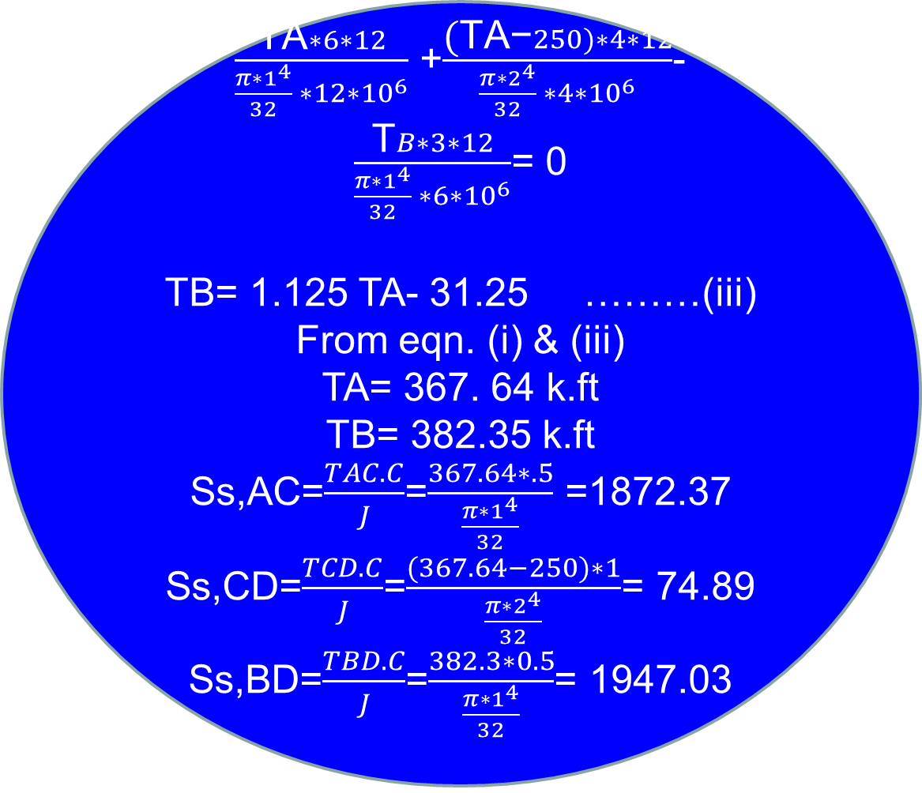

Slide 29
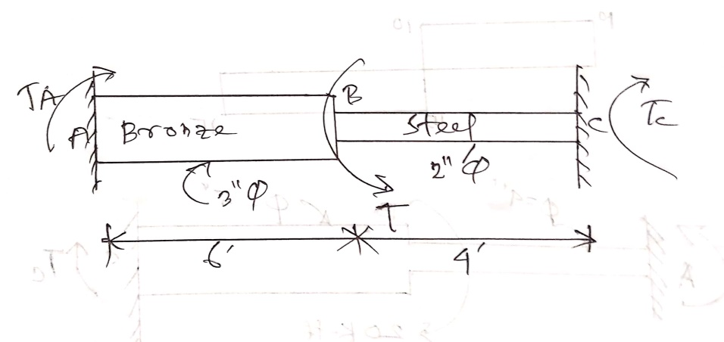
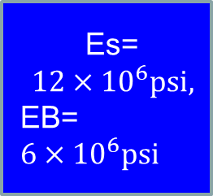
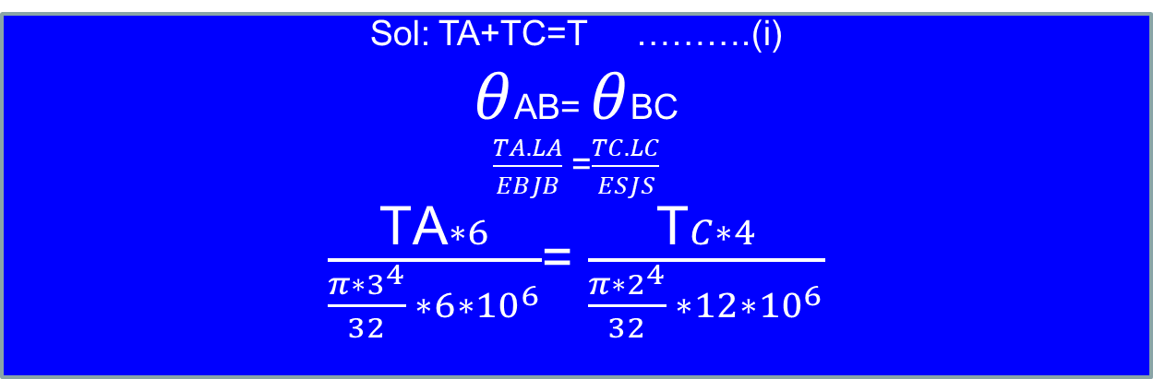
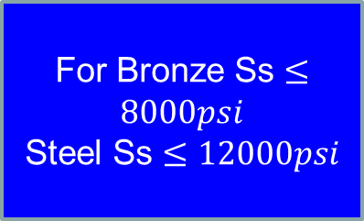
Calculate T applied in the shaft.
Es= ${12×10}^{6}psi,$
$$\text{EB}\text{= }{6×10}^{6}psi$$
For Bronze Ss $≤8000psi$
Steel Ss $≤12000psi$
Sol: TA+TC=T ……….(i)
$θ$AB= $θ$BC
$\frac{TA. LA}{EBJB}$ =$\frac{TC. LC}{ESJS}$
$\frac{\text{TA}∗6}{\frac{π∗3^{4}}{32} ∗6∗{10}^{6}}$= $\frac{\text{T}C∗4}{\frac{π∗2^{4}}{32} ∗12∗{10}^{6}}$

Slide 30
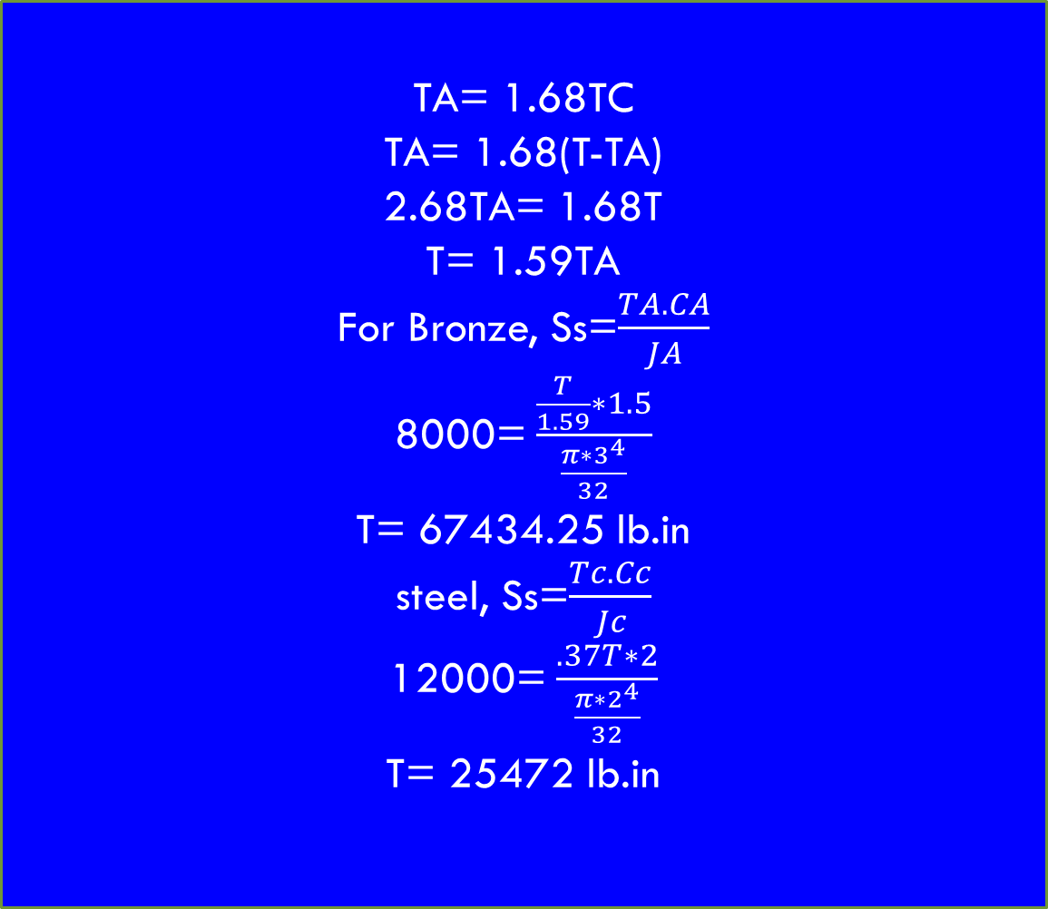

Slide 31
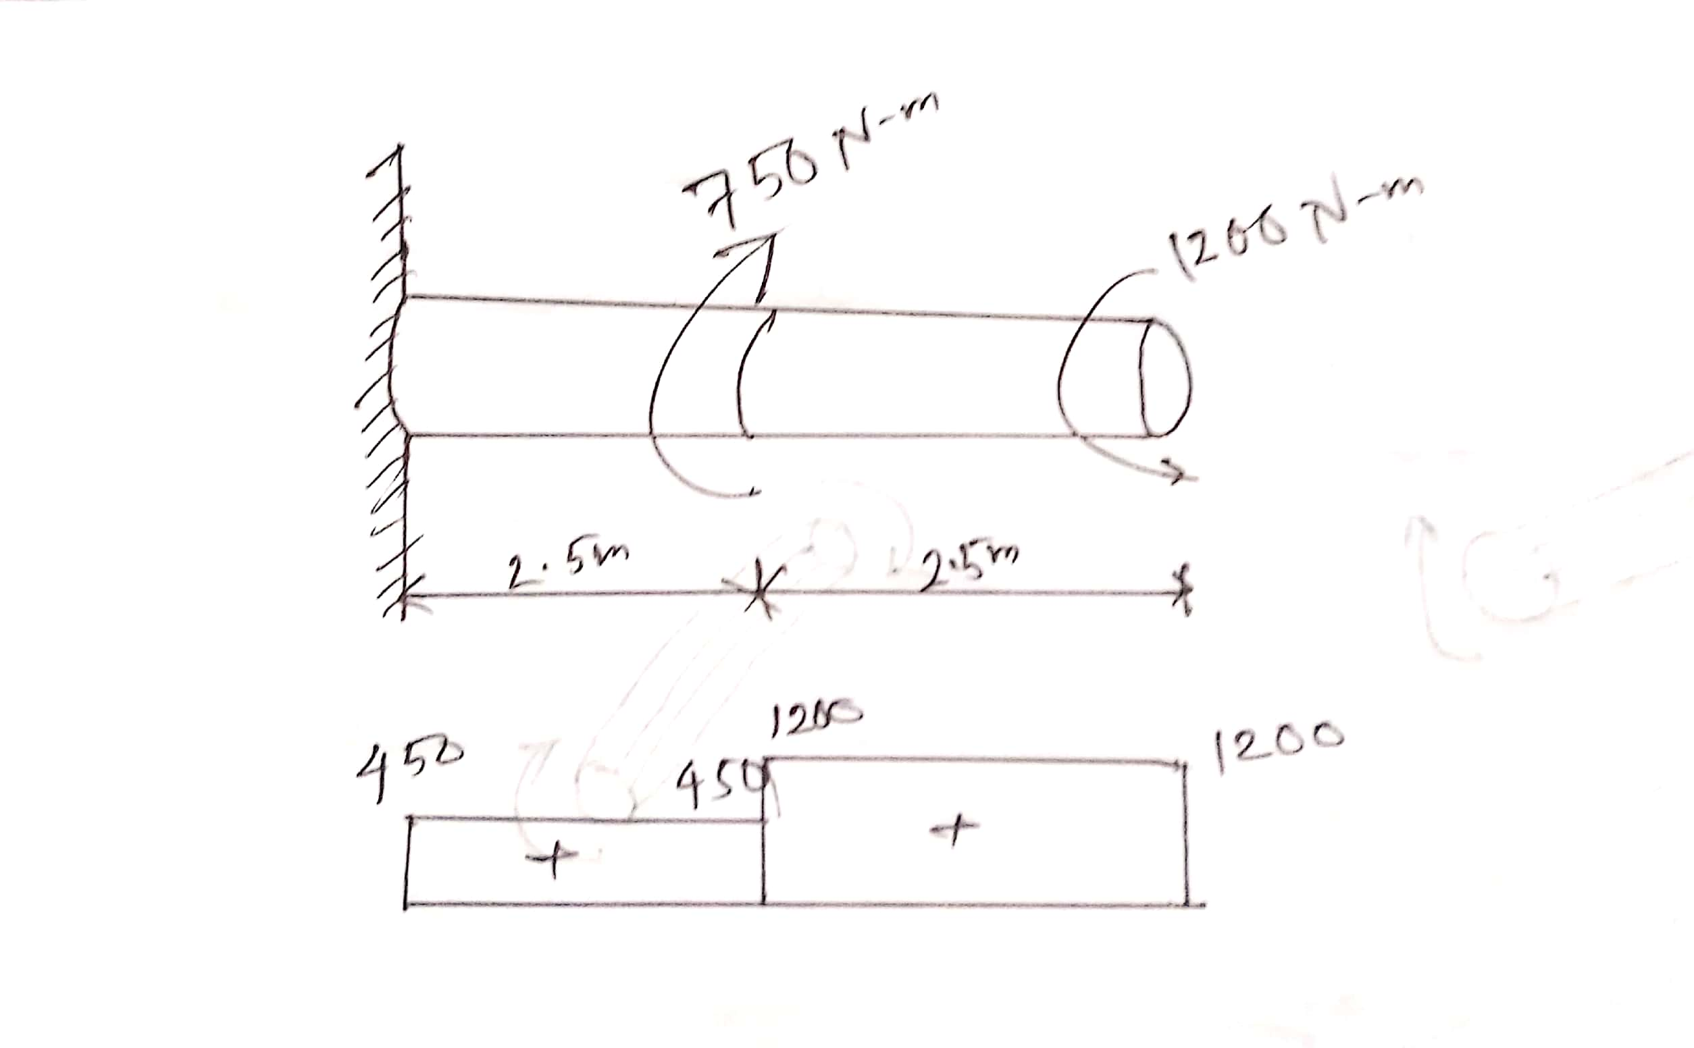
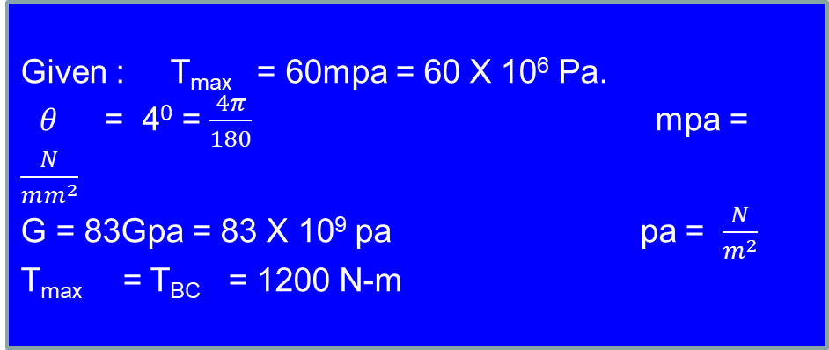
A Solid shaft is loaded as shown in Fig below using G = 83 GPa determine The required diameter of the shaft if the shearing stress is limited to 60mpa and the angle of rotation at the free ends is not to exceed 4 deg.
Given : T_{max} = 60mpa = 60 X 10⁶ Pa.
$θ$ = 4⁰ = $\frac{4π}{180}$ mpa = $\frac{N}{{mm}^{2}}$
G = 83Gpa = 83 X 10⁹ pa pa = $\frac{N}{m^{2}}$
T_{max} = T_{BC} = 1200 N-m

Slide 32
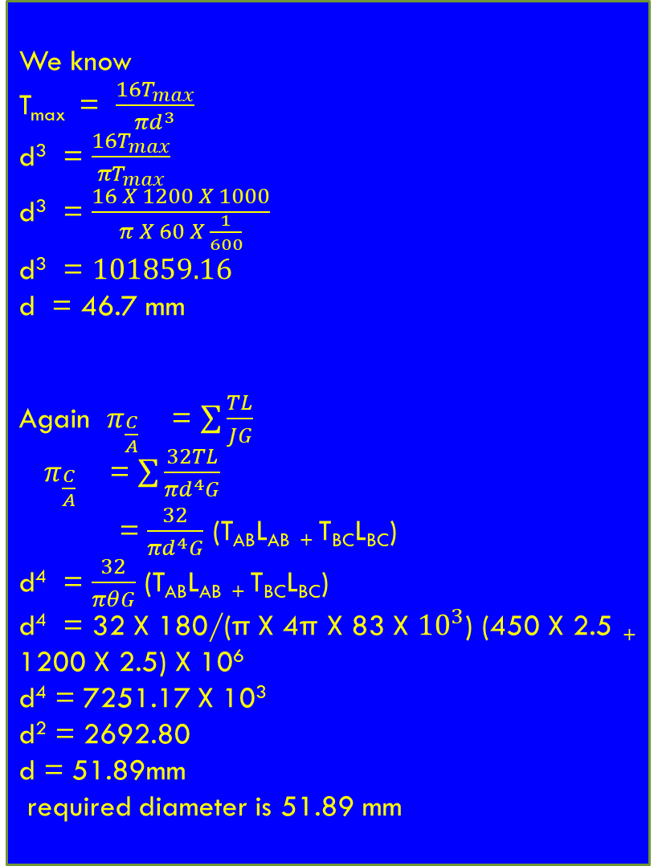

Slide 33
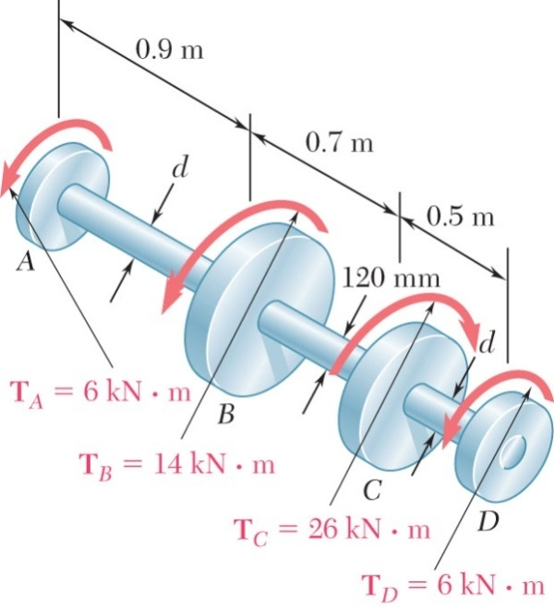
Sample Problem 3.1
SOLUTION:
Cut sections through shafts AB and BC and perform static equilibrium analyses to find torque loadings.
Apply elastic torsion formulas to find minimum and maximum stress on shaft BC.
Shaft BC is hollow with inner and outer diameters of 90 mm and 120 mm, respectively. Shafts AB and CD are solid and of diameter d. For the loading shown, determine (a) the minimum and maximum shearing stress in shaft BC, (b) the required diameter d of shafts AB and CD if the allowable shearing stress in these shafts is 65 MPa.
Given allowable shearing stress and applied torque, invert the elastic torsion formula to find the required diameter.

Slide 34
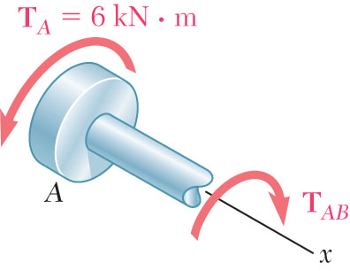
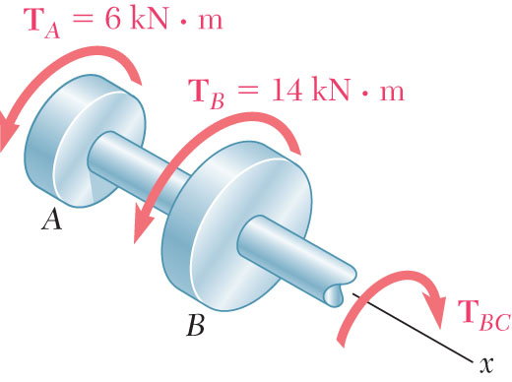
Sample Problem 3.1
SOLUTION:
Cut sections through shafts AB and BC and perform static equilibrium analysis to find torque loadings.
Fig. 1 Free-body diagram for section between A and B.
Fig. 2 Free-body diagram for section between B and C.

Slide 35
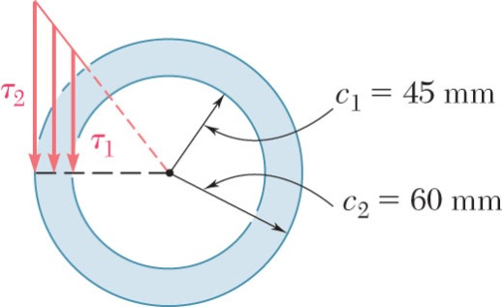
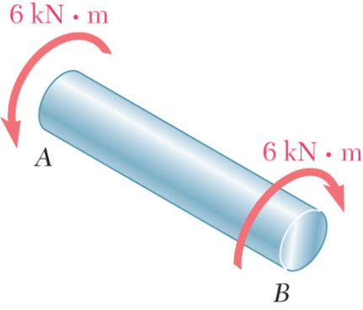
Sample Problem 3.1
Apply elastic torsion formulas to find minimum and maximum stress on shaft BC.
Given allowable shearing stress and applied torque, invert the elastic torsion formula to find the required diameter.
Fig. 3 Shearing stress distribution on cross section.
Fig. 4 Free-body diagram of shaft portion AB.

Slide 36
Thanks All

