Slide 1
Definition of Economics
Chapter 1

Slide 2
Define Economics
Economics is the science that deals with the production and consumption of goods & services and distribution and rendering of these for human welfare.
With time the definition changes since the scope of economics increase. For a better idea, from three different period of time, we can define economics
classical definition:
According to Adam Smith,” Economics was concerned with an enquiry into the nature and causes of wealth of nations.”
Neo-Classical definition:
According to Alfred Marshall, ” Political economy or economics is a study of mankind in the ordinary business of life. It examines that part of individuals and social actions which are most closely connected with the material requisites of well-being.”

Slide 3
Modern definition:
According to Lionel Robins, “Economics is a science which discusses human behavior as a relationship between ends and scarce means which have alternative uses.”
Ends means unlimited wants
Scarce means indicate limited resources to fulfill the wants and
Alternative uses indicate various types of uses of the same resource.

Slide 4
Economic Goals
The following are the economic goals:
A high level of employment
Price stability
Efficiency
An equitable distribution of income
Growth
Some of the above goals are interdependent. The economic goals are not always complementary; in many cases they are in conflict.

Slide 5
Scope of economics
Scope means province or field of study. In discussing the scope of economics, we have to indicate whether it is a science or an art and a positive science or a normative science. It also covers the subject matter of economics.
i) Economics - A Science and an Art
a) Economics is a science: Science is a systematized body of knowledge that traces the relationship between cause and effect. Another attribute of science is that its phenomena should be amenable to measurement. Applying these characteristics, we find that economics is a branch of knowledge where the various facts relevant to it have been systematically collected, classified and analyzed. Economics investigates the possibility of deducing generalizations as regards the economic motives of human beings. The motives of individuals and business firms can be very easily measured in terms of money. Thus, economics is a science.
b) Economics is also an art. An art is a system of rules for the attainment of a given end. A science teaches us to know; an art teaches us to do. Applying this definition, we find that economics offers us practical guidance in the solution of economic problems.
Science and art are complementary to each other and economics is both a science and an art.
Economics - A Social Science

Slide 6
ii) Positive and Normative Economics
Economics is both positive and normative science.
a) Positive science: It only describes what it is and normative science prescribes what it ought to be. Positive science does not indicate what is good or what is bad to the society. It will simply provide results of economic analysis of a problem.
b) Normative science: It makes distinction between good and bad. It prescribes what should be done to promote human welfare. A positive statement is based on facts. A normative statement involves ethical values. For example, “12 per cent of the labour force in India was unemployed last year” is a positive statement, which could is verified by scientific measurement. “Twelve per cent unemployment is too high” is normative statement comparing the fact of 12 per cent unemployment with a standard of what is unreasonable. It also suggests how it can be rectified.
Therefore, economics is a positive as well as normative science.

Slide 7
iii) Methodology of Economics
Economics as a science adopts two methods for the discovery of its laws and principles, viz., (a) deductive method and (b) inductive method.
a) Deductive method: Here, we descend from the general to particular, i.e., we start from certain principles that are self-evident or based on strict observations. Then, we carry them down as a process of pure reasoning to the consequences that they implicitly contain.
b) Inductive method: This method mounts up from particular to general, i.e., we begin with the observation of particular facts and then proceed with the help of reasoning founded on experience so as to formulate laws and theorems on the basis of observed facts. E.g. Data on consumption of poor, middle and rich income groups of people are collected, classified, analyzed and important conclusions are drawn out from the results. In inductive method, a particular case is examined to establish a general or universal fact.
Both deductive and inductive methods are useful in economic analysis.

Slide 8
iv) Subject Matter of Economics
Economics can be studied through a) traditional approach and (b) modern approach.
a) Traditional Approach: Economics is studied under five major divisions namely
consumption,
production,
exchange,
distribution and
public finance.
b) Modern Approach
The study of economics is divided into:
i) Microeconomics and
ii) Macroeconomics

Slide 9
Micro & Macro Economics
Microeconomics analyses the economic behaviour of any particular decision making unit such as a household or a firm. Microeconomics studies the flow of economic resources or factors of production from the households or resource owners to business firms and flow of goods and services from business firms to households. It studies the behaviour of individual decision making unit with regard to fixation of price and output and its reactions to the changes in demand and supply conditions. Hence, microeconomics is also called price theory.
Macroeconomics studies the behaviour of the economic system as a whole or all the decision-making units put together. Macroeconomics deals with the behaviour of aggregates like total employment, gross national product (GNP), national income, general price level, etc. So, macroeconomics is also known as income theory.

Slide 10
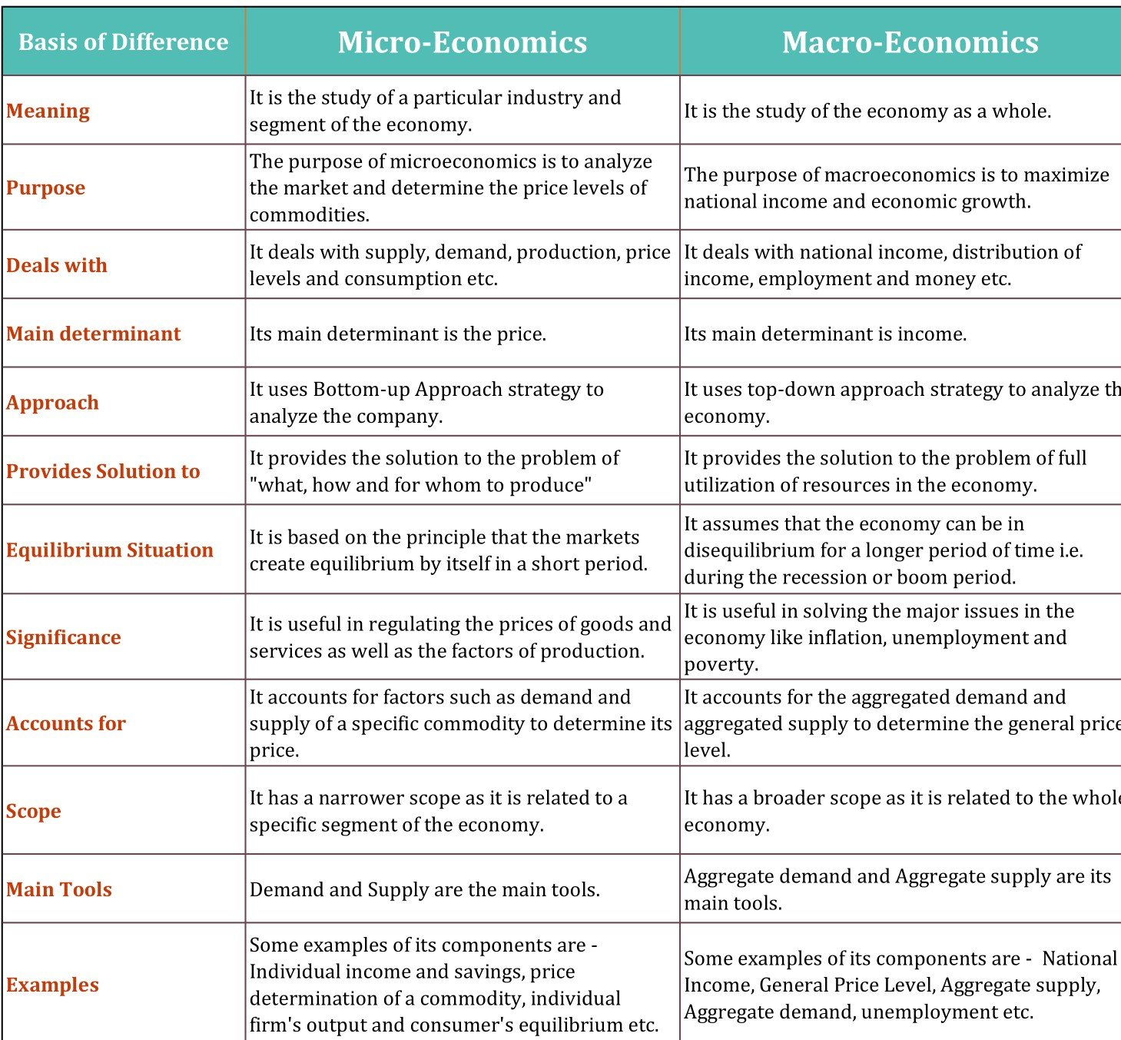

Slide 11
Basic economic problems of an economy
The fundamental economic problem is the issue of scarcity and how best to produce and distribute these scare resources.
Scarcity means there is a finite supply of goods and raw materials.
Finite resources mean they are limited and can run out.
Unlimited wants mean that there is no end to the quantity of goods and services people would like to consume.
Because of unlimited wants – People would like to consume more than it is possible to produce (scarcity).
Therefore because of scarcity, economics is concerned with:
What to produce?
How to produce?
For whom?

Slide 12
America’s first Nobel Prize winner for economics, the late Paul Samuelson, is often credited with providing the first clear and simple explanation of the economic problem – namely, that in order to solve the economic problem societies must endeavor to answer three basic questions –
What to produce?
How to produce? And,
For whom to produce?

Slide 13
Problem # 1. What to Produce and in What Quantities?
The first central problem of an economy is to decide what goods and services are to be produced and in what quantities. This involves allocation of scarce resources in relation to the composition of total output in the economy. Since resources are scarce, the society has to decide about the goods to be produced.
Suppose the economy produces capital goods and consumer goods. In deciding the total output of the economy, the society has to choose that combination of capital goods and consumer goods which is in keeping with its resources.

Slide 14
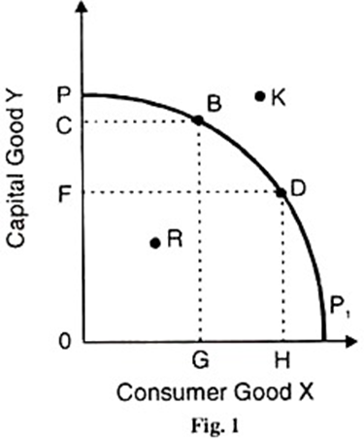
Explanation with the help of production possibility curve
It cannot choose the combination R which is inside the production possibility curve PP₁ because it reflects economic inefficiency of the system in the form of unemployment of resources. Nor can it choose the combination R which is outside the current production possibilities of the society. The society lacks the resources to produce this combination of capital goods and consumer goods.
It will, therefore, have to choose among the combinations В, E, or D which give the highest level of satisfaction. If the society decides to have more capital goods, it will choose combination B; and if it wants more consumer goods, it will choose combination D

Slide 15
Problem # 2. How to Produce these Goods?
The next basic problem of an economy is to decide about the techniques or methods to be used in order to produce the required goods. This problem is primarily dependent upon the availability of resources within the economy.
For example, precisely how much land, labour, and capital should be used to produce consumer goods such as computers and motor cars?
Two techniques of production by using the factors of production are:
Labor intensive technique and
Capital intensive technique

Slide 16
Problem # 3. For whom is the Goods Produced?
Finally, all societies need to decide who will benefit from the output from its economic activity, and how much they will get. This is often called the problem of distribution. Different societies may develop different ways to answer these questions.
Besides these three problems, some new problems are identified. These are:
Problem # 4. How Efficiently are the Resources being Utilised?
Problem # 5. Is the Economy Growing?
All these central problems of an economy are interrelated and interdependent. They arise from the fundamental economic problems of scarcity of means and multiplicity of ends which lead to the problem of choice or economizing of resources.

Slide 17
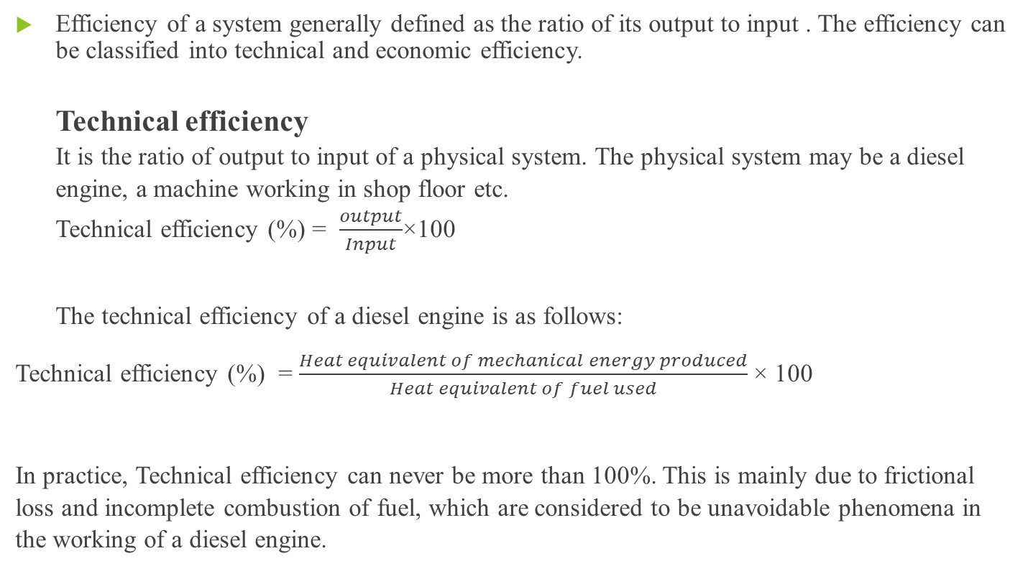
Efficiency
Efficiency of a system generally defined as the ratio of its output to input . The efficiency can be classified into technical and economic efficiency.
Technical efficiency
It is the ratio of output to input of a physical system. The physical system may be a diesel engine, a machine working in shop floor etc.
Technical efficiency (%) = $\frac{output}{Input}$×100
The technical efficiency of a diesel engine is as follows:
Technical efficiency (%) = $\frac{Heat equivalent of mechanical energy produced}{Heat equivalent of fuel used}$ × 100
In practice, Technical efficiency can never be more than 100%. This is mainly due to frictional loss and incomplete combustion of fuel, which are considered to be unavoidable phenomena in the working of a diesel engine.

Slide 18
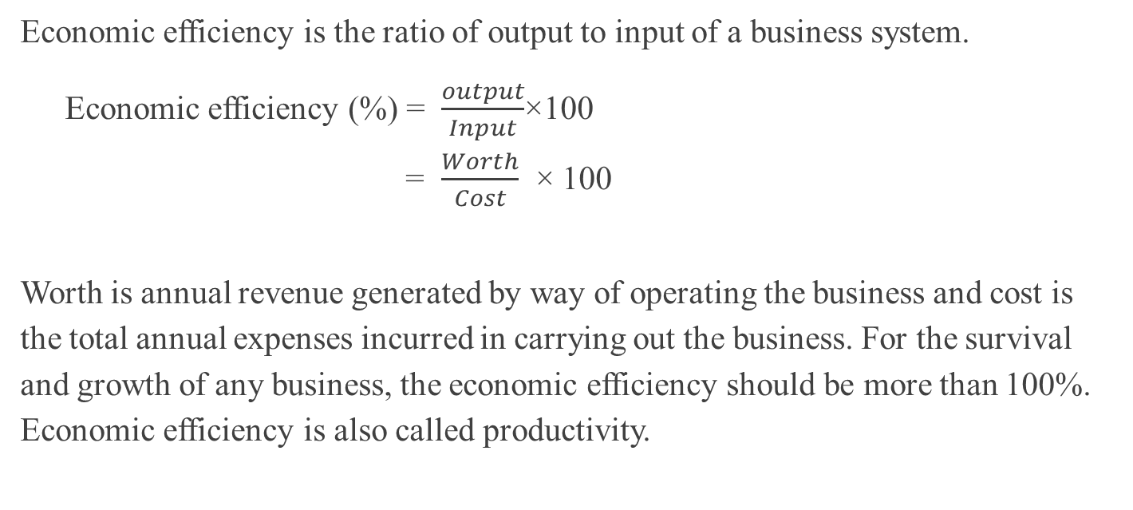
Economic efficiency
Economic efficiency is the ratio of output to input of a business system.
Economic efficiency (%) = $\frac{output}{Input}$×100
= $\frac{Worth}{Cost}$ × 100
Worth is annual revenue generated by way of operating the business and cost is the total annual expenses incurred in carrying out the business. For the survival and growth of any business, the economic efficiency should be more than 100%. Economic efficiency is also called productivity.

Slide 19
Some basic concepts of economics for engineers
Opportunity Cost
The maximum profit that could have been obtained from investing in other options aside from what you did invest in.
Economic Cycle
The stages of expansion and contraction in economic activity experienced by industry, a fact that occurs at certain periods of time.
Externality
Benefits or social costs arising as a result of a private activity for parties not included in this activity. An example of a negative externality is traffic produced by a building with a lot of parking, where damage is suffered by the neighborhood, but is not an expense that the private producer paid accordingly.
A positive externality was the increase in tourism generated by the construction of the Guggenheim Museum in Bilbao, which meant an increase in hotels, sales, restaurants, etc.

Slide 20
Depreciation
Loss of value of an asset (house, car, household appliances, etc.) due to use and function, which can not be compensated for by repairs, maintenance or even by replacement of all components.
Economies of Scale
Any production situation in which the cost per unit produced decreases as the number of units produced increases. Architecture often fails in this area as in many cases mass production reduces quality.
Investment
Placing funds in a project (operational, financial, real estate, etc.) with the intention of making a profit in the future.
Supply
The quantity of goods or services that are available to be sold in a market. For example the number of apartments for sale in a city.
Capital Gain
The increase in the value of an object for reasons extrinsic to them. The existence of a park brings increased value of property next to it, since most people prefer to live near a public space.
Appraisal
Report or document to determine the value of property on the market in relation to supply and demand at any given time.

Slide 21
The relation between engineering & economics
Science is a field of study where the basic principles of different physical systems are formulated & tested. Engineering is the application of science. It establishes varied application systems based on different scientific principles.
Economics is the science that deals with the production & consumption of goods & services and the distribution & rendering of these for human welfare.
Engineering economics deals with the methods that enable one to take economic decisions towards minimizing cost, maximizing benefits to a business organization.
The primary objective for the study of economics is in order for us to find more and more efficient ways to utilize resources. To highlight the relationship between the study of economics and engineering, much is to be said about solving the problem of limited resources. This would perhaps be the most obvious connection between engineering and economics.
It is a technological change that brought about an increased production output in every economy. Graphically, it is marked by a shift in the curve in the production function. The popular mode of exchange also was greatly affected by technological change. ATM cards and credit cards are examples of this.
As firms are driven to find ways to increase profit, they are motivated to stimulate research and development in the field of engineering. With this in mind, the engineering sector should take advantage of the demands in the economy.

Slide 22
a fundamental understanding of economics, especially consumer demand patterns, would serve as a guide for innovations.
the knowledge of current market activities will definitely help engineers.
A study of an economy without taking into account the latest development in technology would prove to be inadequate. Without the basic understanding of what used to be just technicalities for engineers, one would not be able to completely grasps the workings of the modern economy.
For a soon-to-be engineer, the concepts in economics are handy not only for everyday life. Economics and engineering together partake in interplay towards the betterment of the lives of men. For millennia, we have tried and succeeded (to some degree) to do such. In the end, it’s all about economics.

Slide 23
That’s all for today.

