Slide 1
Supply

Slide 2
Definition & Example
Supply is the willingness and ability of producers to create goods and services to take them to market.
Supply is positively related to price given that at higher prices there is an incentive to supply more as higher prices may generate increased revenue and profits.
Supply and stock are not the same thing. example of stock and supply will be suppose a television manufacturer has 20000 television stock, out of which the manufacturer supplies only 2000 television at prevailing market price. Hence remaining 18000 units will be called stock and 2000 units will be called as supply.

Slide 3
Differences between supply & stock
Supply
Stock
supply refers to the quantity which the seller is prepared to sell in the market at given price at any point of time.
Supply can be increased and decreased depending on the price prevailing in the market
supply is dependent on the price
stock refers to total available quantity with the seller at any given point of time.
stock at a particular point of time is fixed and it cannot be increased or decreased,
stock is not dependent on the price.

Slide 4
Law of Supply
The law of supply is the microeconomic law that states that, all other factors being equal, as the price of a good or service increases, the quantity of goods or services that suppliers offer will increase, and vice versa.
The supply function can also be expressed in symbols.
Q_{x}^{S} = Φ (Px, Tech, S_{i}, F_{n}, X,........)
Here:
Q_{x}^{s} =Quantity supplied of commodity x by the producers.
Φ = Function of.
P_{x} = Price of commodity x.
Tech = Technology.
S = Supplies of inputs.
F = Features of nature.
X = Taxes/Subsidies

Slide 5
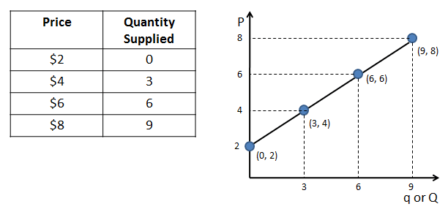
Supply schedule
Supply schedule shows a tabular representation of law of supply. It presents the different quantities of a product that a seller is willing to sell at different price levels of that product.

Slide 6
Supply curve
The graphical representation of supply schedule is called supply curve. In a graph, price of a product is represented on Y-axis and quantity supplied is represented on X-axis.
S = f (P)

Slide 7
For practice
Suppose the market supply for pizza is Q s = 20P – 100 where p=price per pizza, draw a supply schedule and supply curve from the given supply equation.

Slide 8
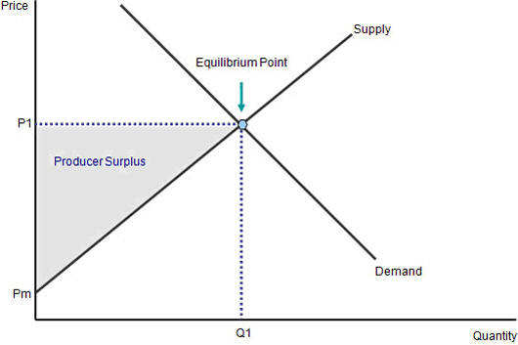
Producer’s surplus
Producer surplus is the difference between how much a person would be willing to accept for given quantity of a good versus how much they can receive by selling the good at the market price.
The total revenue that a producer receives from selling their goods minus the total cost of production equals the producer surplus.
The area below the price and above the supply curve measures the producer surplus in a market.

Slide 9
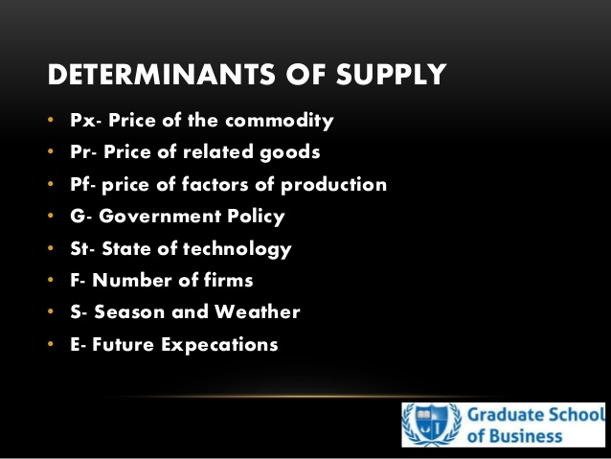
Determinants of supply

