Slide 1
Cost of Production

Slide 2
Cost of Production
Cost of production refers to the total cost incurred by a business to produce a specific quantity of a product or offer a service.
In economics, the cost of production is defined as the expenditures incurred to obtain the factors of production such as labor, land, and capital, that are needed in the production process of a product.
Cost is a function of output,
C = f(X), ceteris paribus.

Slide 3
Cost function
Cost functions are derived functions. They are derived from the production function, which describes the available efficient methods of production at any one time. Economic theory distinguishes between short-run costs and long-run costs.

Slide 4

Short run cost function
the short-run cost function
C = f (X, T,$P_{f}$ , K)
where
C = total cost
X= output
T = technology
$P_{f}$ = prices of factors
K = fixed factor(s)
Short-run costs are the costs over a period during which some factors of production (usually capital equipment and management) are fixed.
The short-run costs are the costs at which the firm operates in any one period.

Slide 5
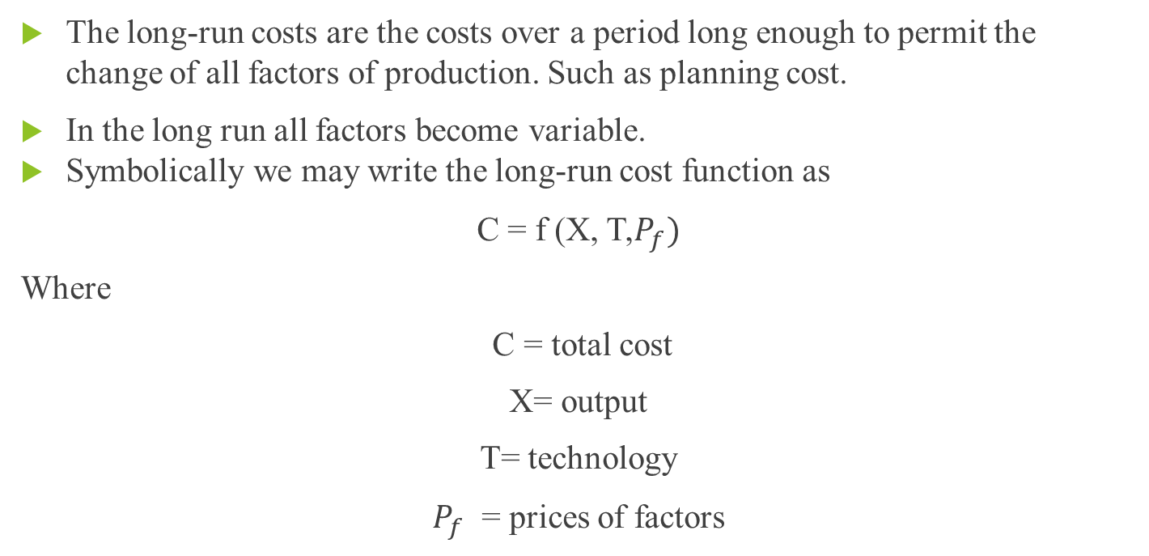
Long run cost function
The long-run costs are the costs over a period long enough to permit the change of all factors of production. Such as planning cost.
In the long run all factors become variable.
Symbolically we may write the long-run cost function as
C = f (X, T,$P_{f})$
Where
C = total cost
X= output
T= technology
$P_{f}$ = prices of factors

Slide 6
Different types of costs
Total costs: In the traditional theory of the firm total costs are split into two groups: total fixed costs and total variable costs.
TC = TFC + TVC
Fixed costs are those expenditures that do not change based on sales (or lack thereof). That is, they are set expenses the business has committed to that are not tied to production volume.
The fixed costs include:
(a) salaries of administrative staff
(b) depreciation (wear and tear) of machinery
(c) expenses for building depreciation and repairs
(d) expenses for land maintenance and depreciation (if any).

Slide 7
A variable cost is an expense that rises or falls in direct proportion to production volume.
The variable costs include:
(a) the raw materials
(b) the cost of direct labour
(c) the running expenses of fixed capital, such as fuel, ordinary repairs and routine maintenance

Slide 8
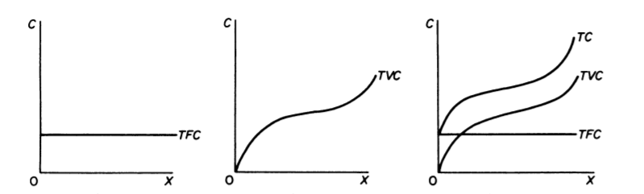
The total fixed cost is graphically denoted by a straight line parallel to the output axis. The total variable cost in the traditional theory of the firm has broadly an inverse-S shape. which reflects the law of variable proportions. According to this law, at the initial stages of production with a given plant, as more of the variable factor(s) is employed, its productivity increases and the average variable cost falls.

Slide 9
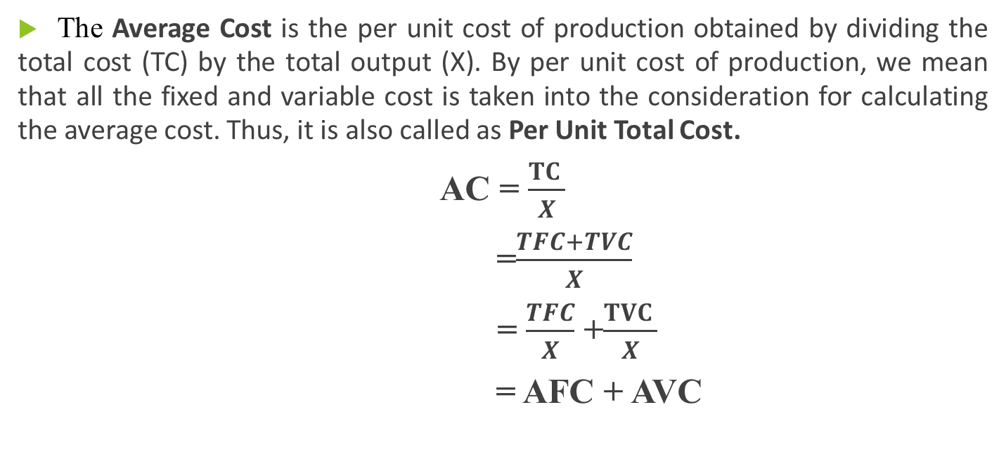
Average cost
The Average Cost is the per unit cost of production obtained by dividing the total cost (TC) by the total output (X). By per unit cost of production, we mean that all the fixed and variable cost is taken into the consideration for calculating the average cost. Thus, it is also called as Per Unit Total Cost.
AC = $\frac{TC }{X}$
=$\frac{TFC+TVC}{X}$
= $\frac{TFC}{X}$ +$\frac{TVC }{X}$
= AFC + AVC

Slide 10
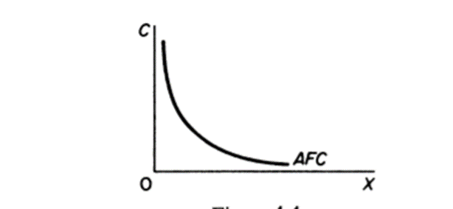

Average Fixed Cost
The average fixed cost is found by dividing TFC by the level of output:
AFC= $\frac{TFC}{X}$
Graphically the AFC is a rectangular hyperbola, showing at all its points the same magnitude, that is, the level of TFC

Slide 11
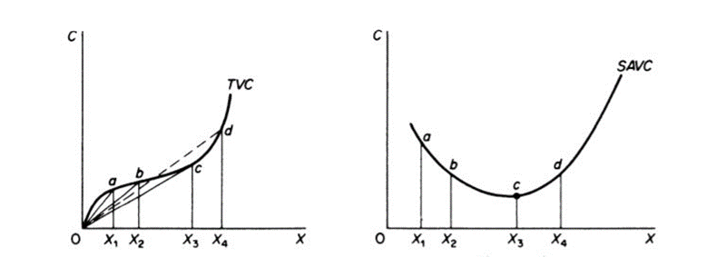
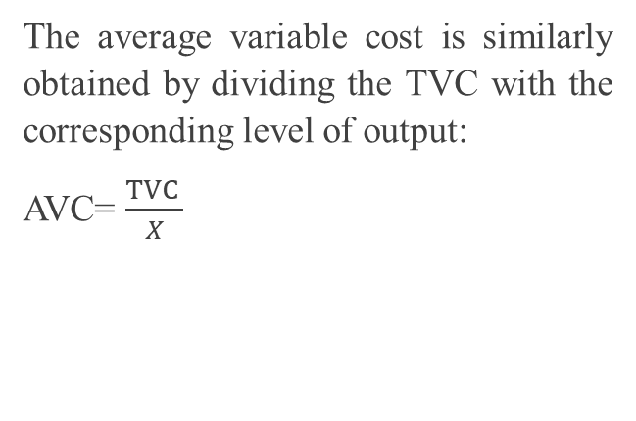
Average variable cost
The average variable cost is similarly obtained by dividing the TVC with the corresponding level of output:
AVC= $\frac{TVC }{X}$

Slide 12
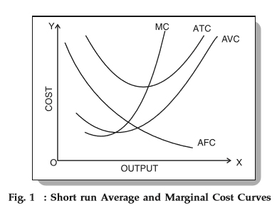
Short run average curve is U-shaped

Slide 13
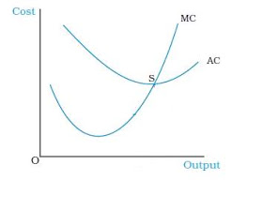

Marginal cost
The marginal cost is defined as the change in TC which results from a unit change in output. Mathematically the marginal cost is the first derivative of the TC function. Denoting total cost by C and output by X we have
MC= $\frac{ΔTC}{ΔX}$

Slide 14
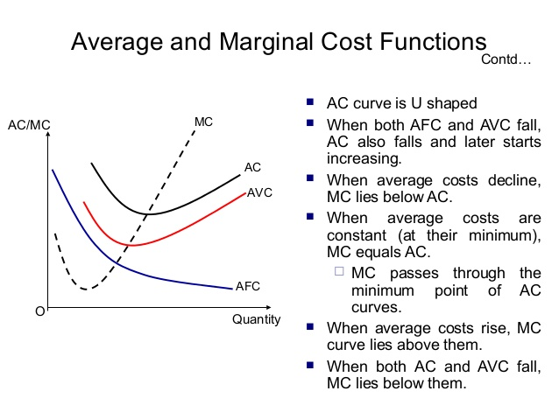

Slide 15
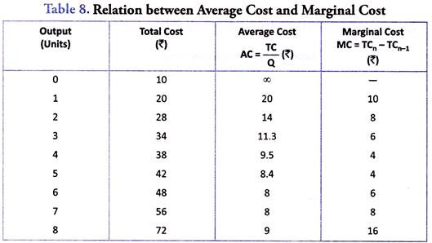

Slide 16
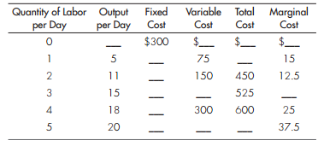

Slide 17
Explain the relationship between cost and revenue
Each business, regardless of size or complexity, tries to earn a profit:
Profit = Total Revenue – Total Cost
Total revenue is the income the firm generates from selling its products. We calculate it by multiplying the price of the product times the quantity of output sold:
Total Revenue = Price × Quantity
Total cost is what the firm pays for producing and selling its products. Recall that production involves the firm converting inputs to outputs. Each of those inputs has a cost to the firm. The sum of all those costs is total cost.
We can distinguish between two types of cost: explicit and implicit which are related with accounting & economic profit.

Slide 18
Explicit cost
Such examples include:
Advertising and marketing costs.
Employee wages, bonuses, commissions, and any other compensation to employees.
Employee benefits that are not paid directly to the employee, I.e. healthcare, staff restaurant, or staff gym.
Equipment that businesses purchase to make production and output more efficient.
Rent or other mortgage payments required for the land the firm is using.
Supplies that the firm requires in order to supply its output to consumers.
Explicit costs are out-of-pocket costs, that is, payments that are actually made. Wages that a firm pays its employees or rent that a firm pays for its office are explicit costs.
Explicit costs involve a transfer of money and can be recorded on a balance sheet. (e.g. purchase of raw materials)

Slide 19
Implicit cost
Examples
Training a new employee presents an implicit cost in the fact that those seven hours could have been used doing other work
Going to University means that there is an implicit cost which is the money which could have been earned during that period.
Maintenance means the firm has to stop production for a time which can lead to a lower level of output or dissatisfied customers.
Implicit costs are costs that occur due to a specific path or option being chosen. It represents an opportunity cost when the firm uses resources for one use over another. The implicit cost is the cost of the action that is foregone.
Implicit costs are more subtle, but just as important. They represent the opportunity cost of using resources already owned by the firm.

Slide 20
Accounting and Economic Profit
In economics, there are two main types of costs for a firm. First are explicit costs. When looking at a firm’s financial statements, these costs are subtracted from the firm’s revenue to obtain its accounting profit. These explicit costs include employees’ wages, materials, utility bills, and rent.
Second of all, there are implicit costs, which is a factor in calculating the firm’s economic profit. This is simply the same as accounting profits, but also subtract the implicit costs. So the economic profit is calculated by obtaining the firm’s revenue and subtracting BOTH explicit and implicit costs.
Try this one

Slide 21
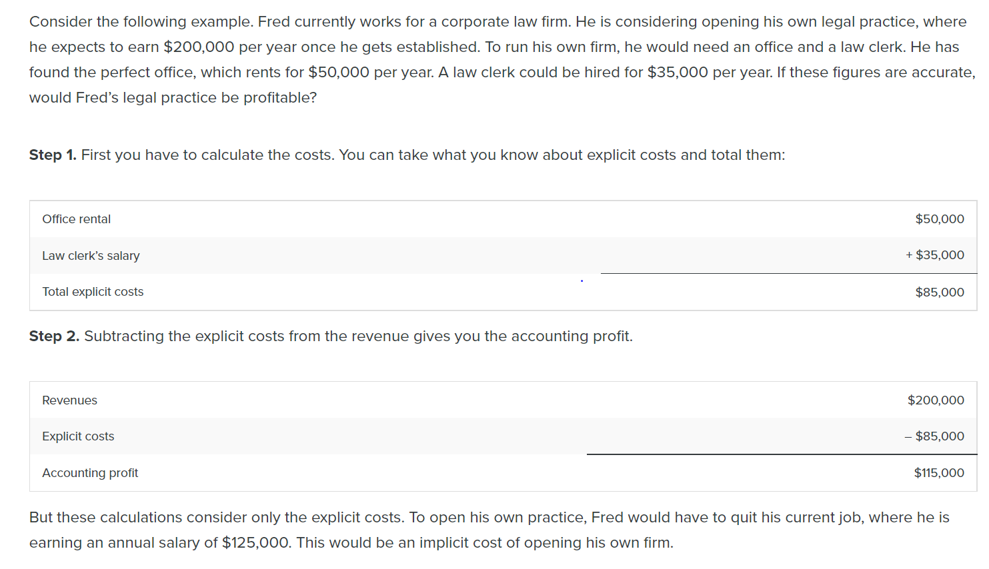

Slide 22
Step 3. You need to subtract both the explicit and implicit costs to determine the true economic profit. The equation is:
Economic Profit = Total Revenues – Explicit Costs – Implicit Costs
Now let’s plug in Fred’s figures to the true economic profit equation:
Economic Profit = $200,000 – $85,000 – $125,000 = –$10,000 per year
Fred would be losing $10,000 per year. That does not mean he would not want to open his own business, but it does mean he would be earning $10,000 less than if he worked for the corporate firm.
Implicit costs can include other things as well. Maybe Fred values his leisure time, and starting his own firm would require him to put in more hours than at the corporate firm. In this case, the lost leisure would also be an implicit cost that would subtract from economic profits.

Slide 23
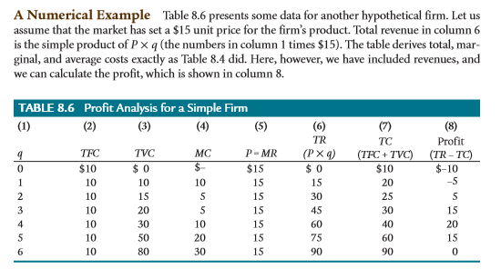

Slide 24
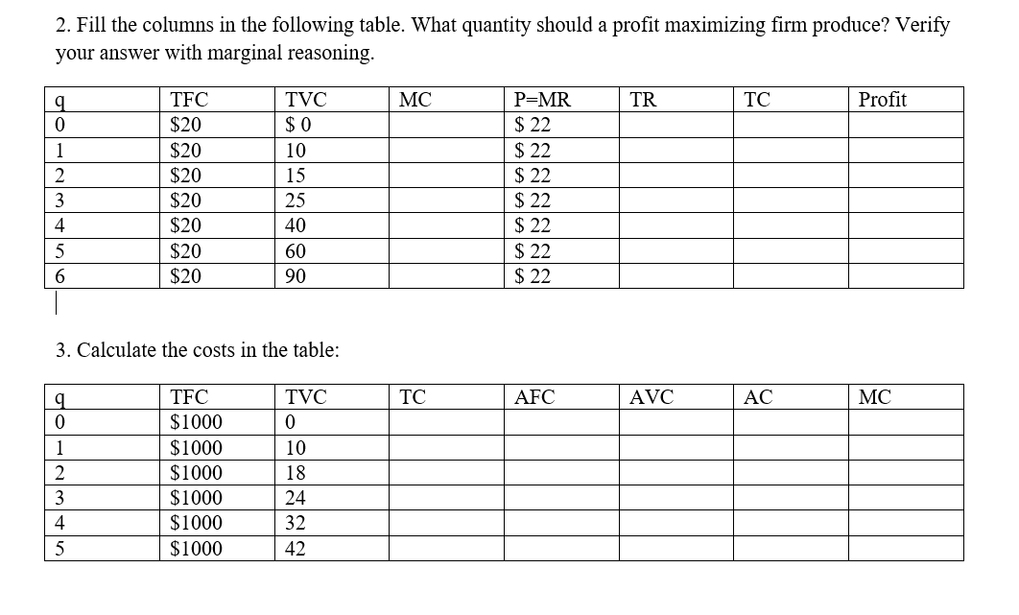

Slide 25
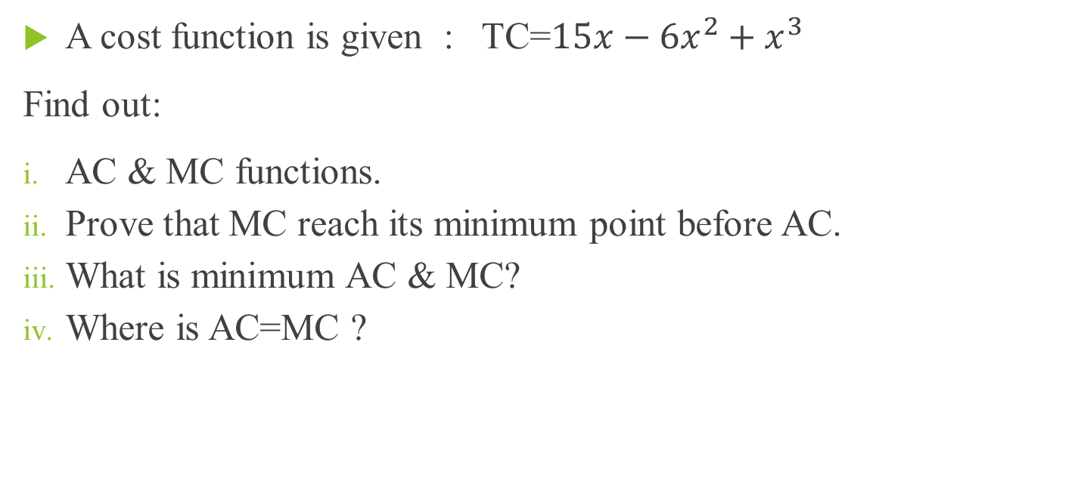
A cost function is given : TC=$15x−6x^{2}+x^{3}$
Find out:
AC & MC functions.
Prove that MC reach its minimum point before AC.
What is minimum AC & MC?
Where is AC=MC ?

Slide 26
Thank you

