Slide 1
National Income
Prepared by
Tahmina Khatun

Slide 2
Definition of National Income
Traditional Definition
According to Marshall: “The labor and capital of a country acting on its natural resources produce annually a certain net aggregate of commodities, material and immaterial including services of all kinds. This is the true net annual income or revenue of the country or national dividend.”
Modern

Slide 3
Modern Definition
The concept of national income has three interpretations:
(a) It represents a receipts total;
(b) It represents an expenditure total and
(c) It represents a total value of production.
In short, National Income is the aggregate factor income (i.e., earning of labour and property) which arises from the current production of goods and services by the nation’s economy.

Slide 4
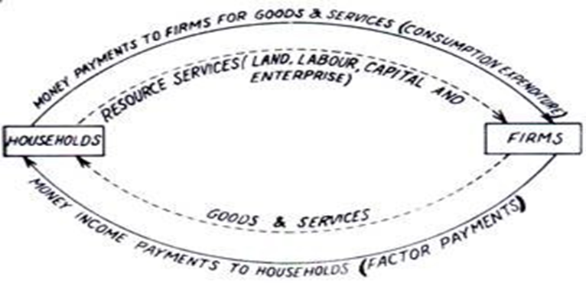
Circular flow of National Income

Slide 5
The inner circuit shows the real flows where goods/services are exchanged for goods/services and money is not used as a medium of exchange.
The outer circular flow also makes clear that process of production by firms generates incomes in the hands of households (or resource suppliers); this income enables households to spend on consumption and thus creates demand for production by firms. There is thus a circular flow of economic activity which demonstrates so effectively the intricate inter-dependence inside an economic system.

Slide 6
Some concepts of National Income
GDP
NDP
GNP
NNP
PI
DPI
Gross Investment
Net Investment
Per capita income

Slide 7
GDP
GDP measures the aggregate money value of output produced by the economy over a year. In other words, GDP is obtained by valuing all final goods and services produced domestically in a year at market prices. GDP is also calculated by adding all the incomes generated by the act of production.
GDP = market value of goods and services produced in the country + incomes earned in the country by the foreigners — incomes received by resident nationals from abroad
Symbolically
GDP= C+I+G
Where
C= Gross Consumption
I= Gross Investment
G= Govt. expenditure

Slide 8
Net Domestic Product (NDP):
NDP is the value of net output of the economy during the year. Some of the country’s capital equipment wears out or becomes obsolete each year during the production process. The value of this capital consumption is some percentage of gross investment which is deducted from GDP.
Thus Net Domestic Product = GDP at Factor Cost – Depreciation.
Gross National Product (G.N.P.):
Gross National Product is defined as the total market value of all final goods and services produced in a year. GNP is the total of incomes earned by the residents of a country, regardless of where the assets are located. In other words,
GNP = market value of domestically produced goods and services + incomes earned by the nationals in foreign countries — incomes earned in the country by the foreigners.
Thus,
GNP = GDP + net export
GNP= GDP+(X-M)
= C+I+G+(X-M)

Slide 9
Net National Product (N.N.P.):
If we deduct depreciation from gross product we obtain net product. GNP minus depreciation is called NNP. NNP is sometimes called national income at market prices.
NNP = GNP – depreciation
In the production of gross national product of a year, we consume or use up some capital, i.e., equipment, machinery, etc. This consumption of fixed capital or fall in value of capital due to wear and tear is called depreciation.
Although NNP gives us the better measure of an economy’s performance, we pay more attention to GNP. This is because estimation of NNP is difficult in practice, as one has to measure depreciation to obtain the net investment figure. In practice, GNP is the more commonly used indicator than NNP.

Slide 10
Distinguish between GDP & GNP
GDP
GNP
Gross Domestic Product
An estimated value of the total worth of a country’s production and services, within its boundary, by its nationals and foreigners, calculated over the course on one year.
To see the strength of a country’s local economy.
GDP= C+I+G
Gross National Product
An estimated value of the total worth of production and services, by citizens of a country, on its land or on foreign land, calculated over the course on one year.
To see how the nationals of a country are doing economically.
GNP= C+I+G+(X-M)

Slide 11
Distinguish between GNP & NNP
GNP
NNP
Do Yourself

Slide 12
Personal Income (P.I.):
Personal Income is the sum of all incomes actually received by all individuals or households during a given year.
Personal Income =National Income —Social Security Contributions —Cor­porate Income Taxes—Undistributed Corporate Profits + Transfer Payments.
Disposal Income (D.I.):
After a good part of personal income is paid to government in the form of personal taxes like income tax and personal property taxes, what remains of personal income is called disposable income.
Disposable Income = Personal Income—Personal Taxes.
Disposable Income can either be consumed or saved. Therefore
Disposable Income = Consumption + Saving.

Slide 13
Methods of Calculating National Income
Production Method
Income Method
Expenditure Method

Slide 14
Product Method:
According to this method, the total value of final goods and services produced in a country during a year is calculated at market prices. We can know Sectoral distribution of NI by this method.
Note:
Double counting should be avoided.
Services without payment will not be included in NI.
Income Method:
According to this method, the net income payments received by all citizens of a country in a particular year are added up, i.e., net incomes that accrue to all factors of production by way of net rents, net wages, net interest and net profits are all added together.
NI= r + w + i + p
Note:
incomes received in the form of transfer payments are not included
undistributed Profit of multinational companies will be included in NI
Interest from unproductive debt will be excluded

Slide 15
Expenditure Method:
According to this method, the total expenditure incurred by the society in a particular year is added together and includes personal consumption expenditure, net domestic investment, government expenditure on goods and services, and net foreign investment. This concept is based on the assumption that national income equals national expenditure.
NI= C+I+G+(X-M)
Which methods are used in Bangladesh?
Product Method
Income Method

Slide 16
Difficulties in the measurement of national income
Lack of statistical data
The danger of double counting
Lack of trained staff
Transfer earning
Non-marketed services
Self consumed production
Different sectors of the economy are usually mixed with one another

Slide 17
Importance of national income
To indicate economic welfare
To compare standards of living in different countries.
To measure the rate of growth
To analyze the behavior of the different sectors of the economy
To measure inflationary and deflationary pressures
For planned economic development
To determine the fee of international organizations

Slide 18
Math of National Income
1. GDP of a country is $5000 billion. Income of the citizens who lives in foreign country is $150 billion & income of the foreigners living in that country is $ 90 billion. Find out the GNP of that country?
2. Suppose , GNP=$5000 billion. If depreciation cost is $550 billion & indirect tax is $ 800 billion, what will be the national income?
3. The following information from the national income accounts for a hypothetical country:
GDP $6000
Gross investment 800
Net investment 200
Consumption 4000
Govt. purchase of goods & services 1100
Govt. budget surplus 30
Find out:
(a). NDP?( b). Net exports? (c). Government taxes minus transfer? (d). Disposable personal income? ( e). Personal savings?
4. The information of GNP are:
GNP= $ 4527
NNP= $ 4047
Indirect tax =366
Others net = -2
Find out:
(a). Depreciation? (b). NI? (c). why indirect taxes are deducted from NI to calculate NNP?

Slide 19
5. Suppose, GNP = $5000
Personal disposable income =$ 4100
Govt. budget deficit = 200
Consumption = 3800
And Trade deficit = 100
Find out : (i) Savings? (ii) Investment? (iii) Govt. expenditure?
6. given that, GNP = 5000, C= 3200, G = 900, NX = 80.
Find out: (i) Investment? (ii) If export is $ 350, what will be import? (iii) find NNP if depreciation cost is 130? (iv) Can net export be negative?
Thank you

