Slide 1
Inflation

Slide 2
Definition of Inflation
inflation occurs when prices rise throughout the economy. When overall prices rise, our budget is affected; we can buy less with our income.
Now imagine that prices double every day. This was the situation in Zimbabwe in 2008 when the inflation rate reached almost 80 billion percent per month! The Zimbabwe situation is an example of hyperinflation, an extremely high rate of inflation that completely stymies economic activity.
Deflation occurs when overall prices fall; it is negative inflation.
Stagflation occurs when inflation rises during times of recession. (The term is a combination of the words “stagnation” and “inflation.”)

Slide 3
Measuring inflation accurately requires great care. First, prices don’t all move together; some prices fall even when most others rise. Second, some prices affect consumers more than others.
Before we arrive at a useful measure of inflation, we have to agree on what prices to monitor and how much weight we’ll give to each price. In the United States, the Bureau of Labor Statistics (BLS) measures and reports inflation data.
The BLS estimates the overall price level. The price level (P) is a measure of the average prices of goods and services throughout an economy.

Slide 4
CPI
the most common price level used to compute inflation is CPI.
The consumer price index (CPI) is a measure of the price level based on the consumption patterns of a typical consumer.
The CPI reflects the overall rise in prices for consumers on average.
For computing CPI, The BLS estimates prices on everything. In addition to inputting price information, the BLS surveyors estimate how each good and service affects a typical consumer’s budget. Once they do this, they attach a weight to the price of each good in the consumer’s “basket” so that the things people spend more money on are counted more heavily.

Slide 5

Measuring Inflation Rates
Once the CPI is computed, economists use it to measure the inflation rate. The inflation rate (i) is calculated as the percentage change in the price level (P).
Using the CPI as the price level, the inflation rate from period 1 to period 2 is:
Assume the CPI rises from 100 to 125 in one year. The inflation for that year would be 25%,

Slide 6
What problems does inflation bring?
Inflation causes uncertainty about future price levels and
can lead to a redistribution of wealth.
Inflation can also impact how much people save. Inflation erodes purchasing power over time, so you need to save more to meet savings targets.

Slide 7
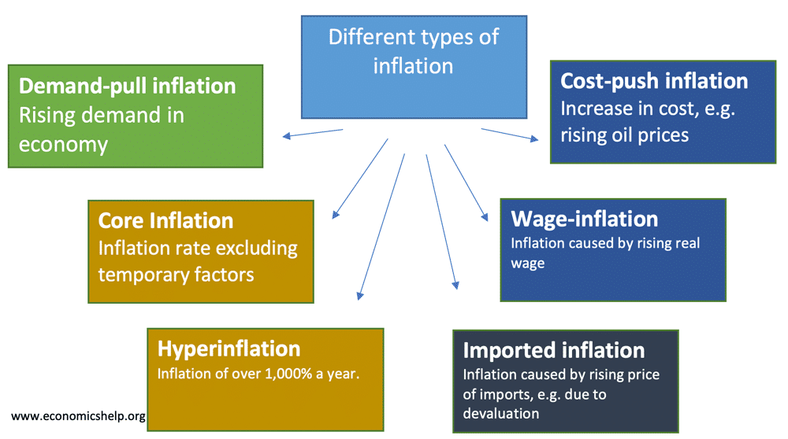
Types of inflation

Slide 8
What Is Demand-Pull Inflation?
Demand-pull inflation is the upward pressure on prices that follows a shortage in supply. Economists describe it as "too many dollars chasing too few goods."
Demand-pull inflation is a tenet of Keynesian economics that describes the effects of an imbalance in aggregate supply and demand. When the aggregate demand in an economy strongly outweighs the aggregate supply, prices go up.
This is the most common cause of inflation.

Slide 9
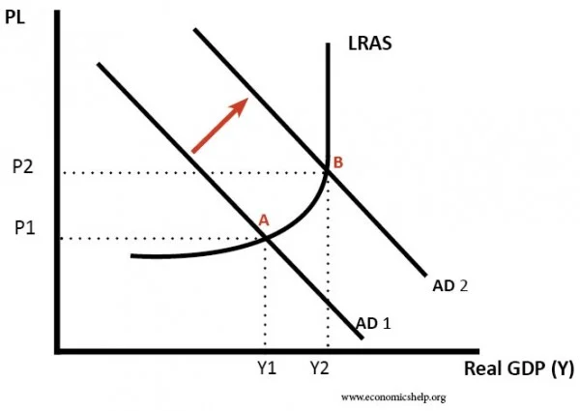
Demand pull inflation
According to Keynesians, aggregate demand may rise due to a rise in consumer demand or investment demand or govern­ment expenditure or net exports or the com­bination of these four components of aggregate demand. Given full employment, such in­crease in aggregate demand leads to an up­ward pressure in prices. Such a situation is called DPI.
However, how much price level will rise following an increase in aggregate demand depends on the slope of the AS curve.
The essence of this type of in­flation is that “too much spending chas­ing too few goods.”

Slide 10
Increased income
additional demand
Increase in price level
Demand pull inflation

Slide 11
Cost-Push Inflation
Cost-push inflation occurs when we experience rising prices due to higher costs of production and higher costs of raw materials. Cost-push inflation is determined by supply-side factors, such as higher wages and higher oil prices.
Cost-push inflation is different to demand-pull inflation which occurs when aggregate demand grows faster than aggregate supply.
Cost-push inflation can lead to lower economic growth and often causes a fall in living standards, though it often proves to be temporary.

Slide 12
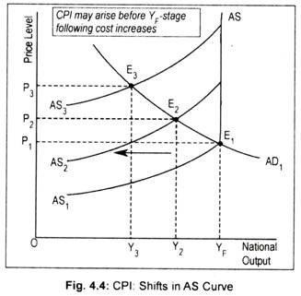
Cost-Push Inflation
AS₁ is the initial aggregate supply curve. Below the full employment stage this AS curve is positive sloping and at full em­ployment stage it becomes perfectly inelastic.
Intersection point (E₁) of AD₁ and AS₁ curves determine the price level (OP₁). Now there is a leftward shift of aggregate supply curve to AS₂. With no change in aggregate demand, this causes price level to rise to OP₂ and output to fall to OY₂. With the reduction in output, employment in the economy de­clines or unemployment rises. Further shift in AS curve to AS₃ results in a higher price level (OP₃) and a lower volume of aggregate out­put (OY₃). Thus, CPI may arise even below the full employment (Y_{F}) stage.

Slide 13
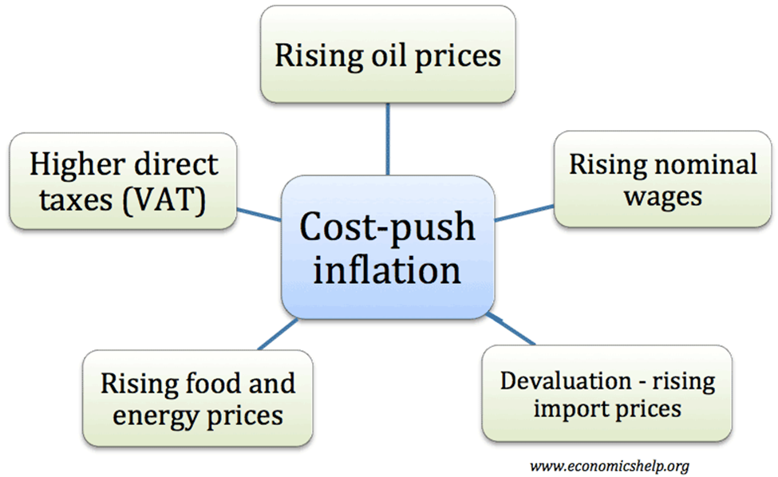

Slide 14
Causes of demand pull inflation
Increase in disposable income
Increase in money supply and bank credit
Increase in export earning
Decrease in import
Increase in population
Increase in speculative hoarding
Increase in govt. expenditure
Increase in foreign demand for domestic good
Money earned by illegal activities

Slide 15
Causes of cost push inflation
Increase the price of raw materials
Increase in wage rate
Higher taxes
Inefficiency, corruption, mismanagement of the economy
Expectations of increasing price level
A fall in the exchange rate

Slide 16
Methods to control inflation
Monetary policy
Fiscal policy
Physical or non monetary policy

Slide 17
Monetary policy
In a period of rapid economic growth, demand in the economy could be growing faster than its capacity to meet it. This leads to inflationary pressures as firms respond to shortages by putting up the price. We can term this demand-pull inflation. Therefore, reducing the growth of aggregate demand (AD) should reduce inflationary pressures.
The Central bank could increase interest rates. Higher rates make borrowing more expensive and saving more attractive. This should lead to lower growth in consumer spending and investment.
A higher interest rate should also lead to a higher exchange rate, which helps to reduce inflationary pressure by:
Making imports cheaper. (lower price of imported goods)
Reducing demand for exports.
Increasing incentive for exporters to cut costs.

Slide 18
Fiscal policy
Monetary policy alone is incapable of controlling inflation. It should, therefore, be supplemented by fiscal measures. Fiscal measures are highly effective for controlling government expenditure, personal consumption expenditure, and private and public investment.
The principal fiscal measures are the following:
Reduction in unnecessary expenditure
Increase in taxes

Slide 19
Non monetary or others policy
To increase production: One of the foremost measures to control inflation is to increase the production of essential consumer goods like food, clothing, kerosene oil, sugar, vegetable oils, etc.
Rational Wage Policy: Another important measure is to adopt a rational wage and income policy. Under hyperinflation, there is a wage-price spiral. To control this, the government should freeze wages, incomes, profits, dividends, bonus, etc.
Price Control: Price control and rationing is another measure of direct control to check inflation. Price control means fixing an upper limit for the prices of essential consumer goods.
Rationing : It is meant to stabilize the prices of necessaries and assure distributive justice. But it is very inconvenient for consumers because it leads to queues, artificial shortages, corruption and black marketing.

Slide 20
Stay Home, Stay Safe. Thank you

