Slide 1

MECHANICS OF MATERIALS SESSIONAL-II
Experiment no: 05 Group: 05
ROLL: (Roll 1700041-1700050) Date: 11.11.20
Course No: CE 2214
Course Credit: 1.50

Slide 2
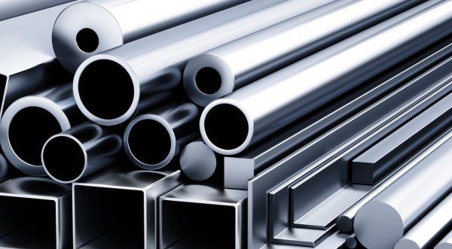
Experiment no: 05
Name of The Experiment: Determination of impact test of Mild Steel

Slide 3
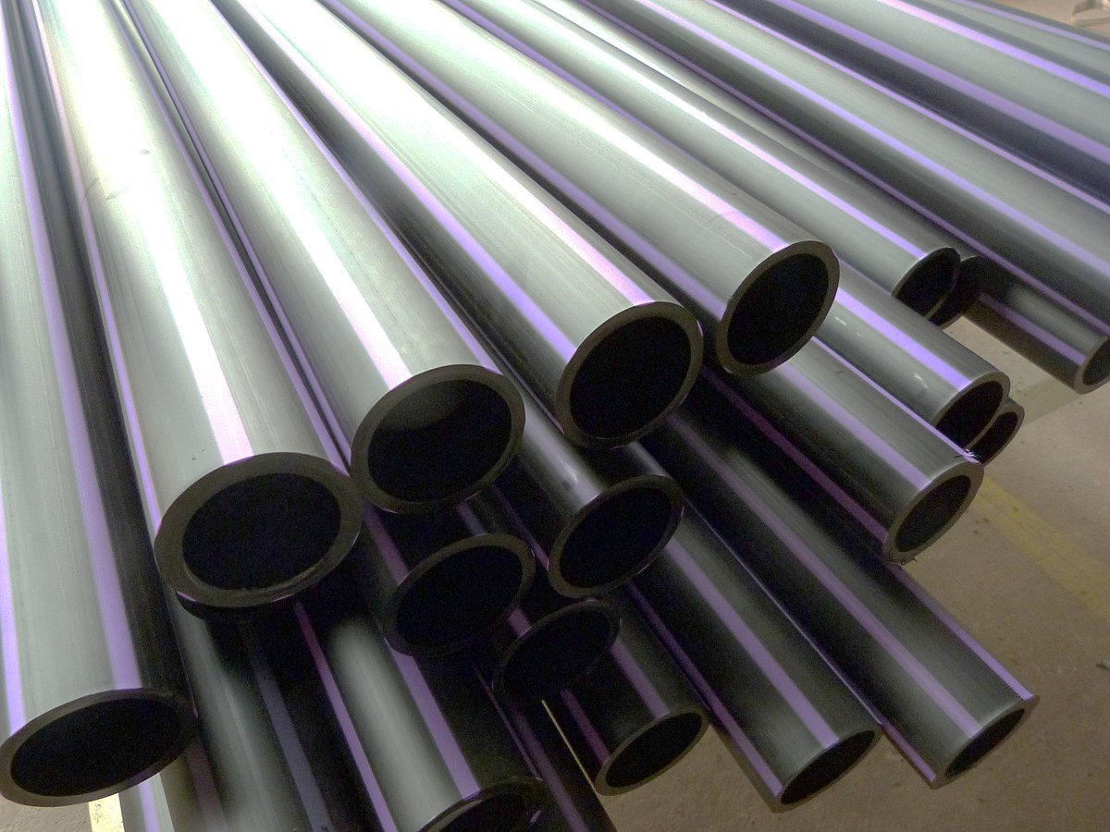
Impact: A high force or shock over a short time period. In mechanics, an impact is a high force or shock applied over a short time period when two or more bodies collide.
Impact Test : Impact testing, ASTM E23, and ISIBS Standard; The impact test is a method for evaluating the toughness and notch sensitivity of engineering materials. It is usually used to test the toughness of materials.
Introduction:

Slide 4
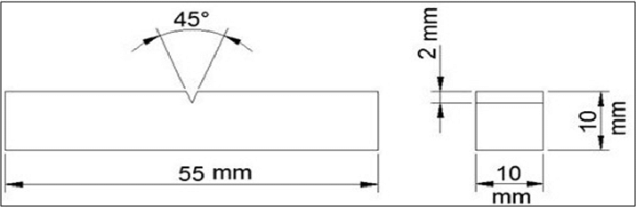
Charpy Impact Test
A test specimen ‘B’ machined to a 10mm x 10mm cross-section, with either a ‘V’ or ‘U’ notch. Subsize specimens are used where the material thickness is restricted. The specimen can be tested down the cryogenic temperature.
Figure 1: Charpy Test Specimen

Slide 5
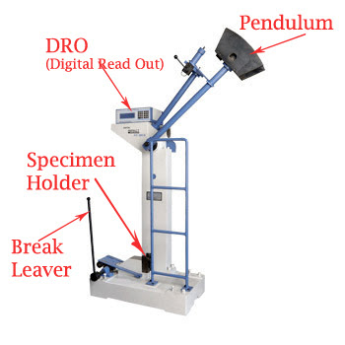
Figure 2: Charpy Impact Test machine

Slide 6

Principle:
The Charpy impact test is a dynamic test piece U-notched or V-notched in the middle and supported at each end, is broken by a single blow of a freely swinging pendulum (Fig. 1) Then the energy is measured by the impact strength of materials. The impact test helps to measure the energy absorbed.

Slide 7
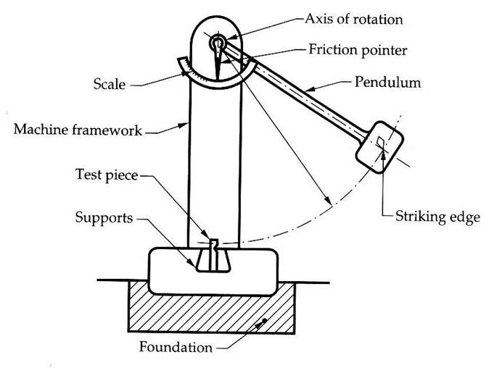
Izod Impact Test:
The test specimen is machined to a square or round section, with either one, two, or three notches. The specimen is clamped vertically on the anvil with the notch facing the hammer.
Figure 3: Izod Impact Test

Slide 8
Principle:
The Izod in which a test piece V-notched test piece gripped vertically, is broken by a single blow of freely swinging pendulum. The blow B struck on the same face as the notch and at the fixed height above it. The energy absorbed is measured. The absorbed energy is a measure of the impact strength of the material.

Slide 9
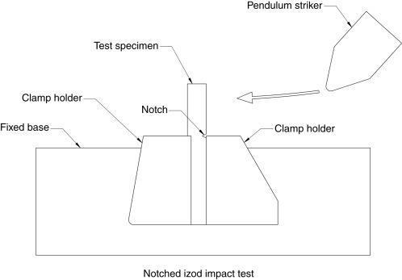
Figure 4: Izod Impact Test Specimen.

Slide 10
Difference Between the Charpy Impact Test & Izod Impact Test
Charpy Impact Test | Izod Impact Test
The specimen was set to be simply supported. | The specimen is set to be cantilever.
Both ‘V’ notch and ‘U’ notch is used. | Only ‘V’ notch is used.
The length of the specimen is 55mm and the notch is equidistance from both ends. | The length of the specimen is 75mm and the notch is 47mm from one end and 28mm from the other end.
V-notch or U-notch is set in position in the opposite direction of load | V-notch is set in position, in the direction of load.

Slide 11
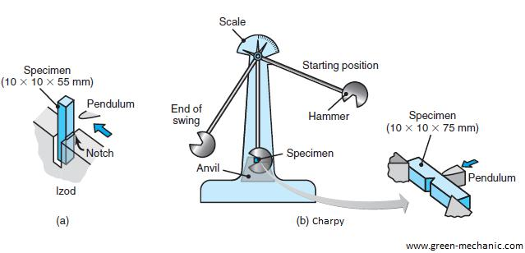
Difference Between the Charpy Impact Test & Izod Impact Test.

Slide 12
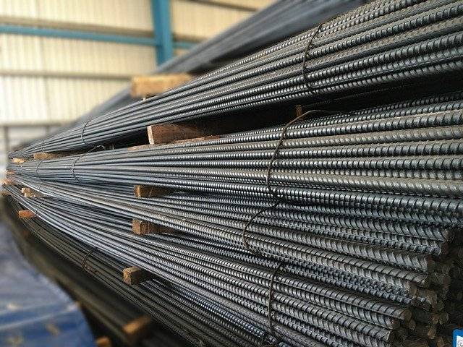
Objective:
To determine the absorbed energy capacity of mild steel.

Slide 13
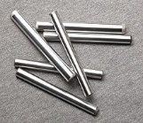
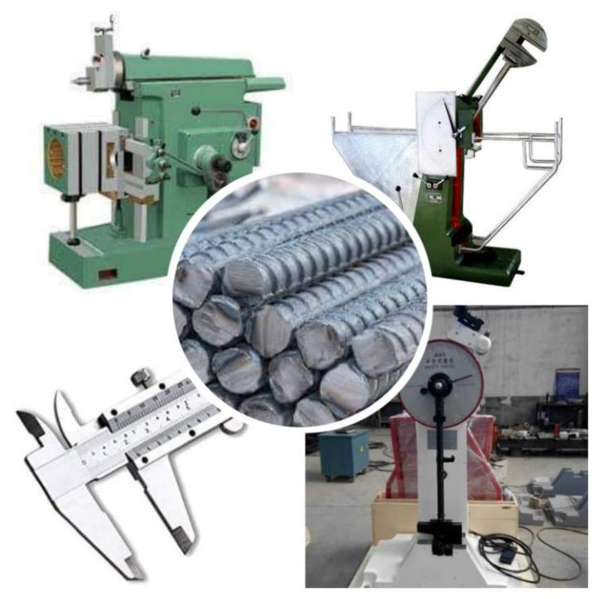
Apparatus:
Specimen of steel
Scale
Slide calipers
Shaper machine
Izod impact test machine
The Charpy impact test machine
Figure 6: Apparatus

Slide 14
Procedure:
The first sample of required dimensions was taken.
A V-notch was made equidistance from both ends by using a shaper machine.
Before setting the specimen to the Charpy impact test machine, the hammer was set to fall freely from the starting point and the maximum reading was taken.
The difference between the starting point and maximum reading was calculated.
For the Charpy impact test:

Slide 15
The specimen was set and the hammer was again allowed to fall from the starting point and the reading of the needle of the machine was taken.
Again the difference between the maximum point and the starting point was calculated.
The first difference was the initial reading, and the 2nd difference was the final reading.
The difference between the initial and final reading was calculated which was the energy absorption capacity of the specimen.
For the Charpy impact test:

Slide 16
At first, the specimen of required dimensions was taken.
V-notch was made, as shown in the figure using a shaper machine.
Before setting the specimen, the hammer of the Izod impact test specimen machine was allowed to fall freely from the starting point and the maximum deflection was taken. The difference between these two points was noted as initial reading.
For the Izod impact test:

Slide 17
Then the specimen was set as discussed in the introduction and the hammer was allowed to fall from the starting point and the maximum deflection was noted. The difference between these two points was noted as the final reading.
The difference between the initial and final reading was calculated which was the energy absorption capacity of the specimen.
For the Izod impact test:

Slide 18
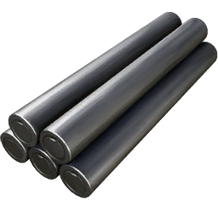
Calculation:
For Charpy impact test:
Initial reading (without specimen) = (220-0) lb-ft = 220 lb-ft
Final reading (with specimen) = (220-180) lb-ft = 40 lb-ft
Energy absorption capacity of specimen = (220-40) lb-ft = 180 lb-ft
For Izod impact test:
Initial reading (without specimen) = (220-0) lb-ft = 220 lb-ft
Final reading (with specimen) = (220-120) lb-ft = 100 lb-ft
Energy absorption capacity of specimen = (220-100) lb-ft = 120 lb-ft

Slide 19
Result:
Energy absorption (Charpy impact test) = 180 lb-ft
Energy absorption (Izod impact test) = 120 lb-ft

Slide 20
Discussions:
The face of the notch was the most important factor to be kept in right direction to break or to fail.
The specimen supported for the two testing machine was also important because its absorption capacity would be changed for its supporting system.

