Slide 1
Centrifugal Pumps Course Co-ordinator Dr. Anupam Chowdhury Associate Professor Department of Civil Engineering, RUET

Slide 2
Centrifugal Pumps
Demour’s centrifugal pump - 1730
Theory
conservation of angular momentum
conversion of kinetic energy to potential energy
Pump components
rotating element - impeller
encloses the rotating element and seals the pressurized liquid inside – casing or housing

Slide 3
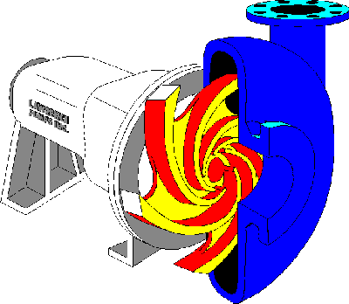
Centrifugal Pumps
Broad range of applicable for flows and heads
Higher heads can be achieved by increasing the diameter or the rotational speed of the impeller
Flow Expansion
Discharge
Casing
Suction Eye
Impeller
Impeller
Vanes

Slide 4
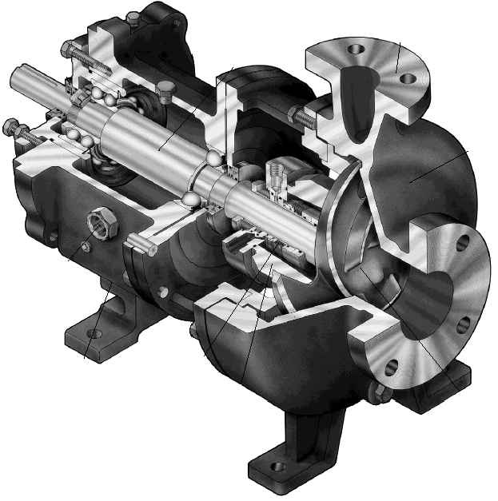
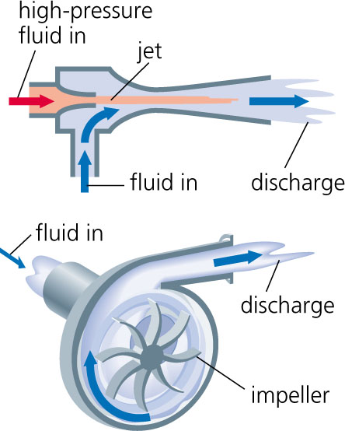
Centrifugal Pump
Centrifugal pumps (radial-flow pumps) are the most used pumps for hydraulic purposes. For this reason, their hydraulics will be studied in the following sections.

Slide 5
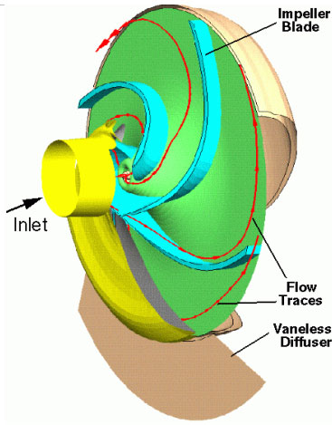
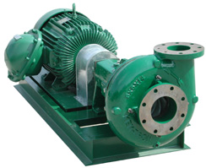

Slide 6
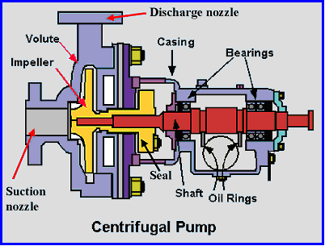
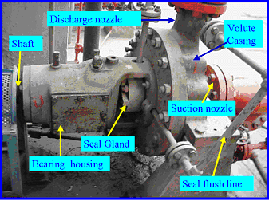

Slide 7
Main Parts of Centrifugal Pumps
Impeller:
which is the rotating part of the centrifugal pump.
It consists of a series of backwards curved vanes (blades).
The impeller is driven by a shaft which is connected to the shaft of an electric motor.

Slide 8
Main Parts of Centrifugal Pumps
Casing
Which is an air-tight passage surrounding the impeller
designed to direct the liquid to the impeller and lead it away
Volute casing: It is of spiral type in which the area of the flow increases gradually.

Slide 9
Suction Pipe.
Delivery Pipe.
The Shaft: which is the bar by which the power is transmitted from the motor drive to the impeller.
The driving motor: which is responsible for rotating the shaft. It can be mounted directly on the pump, above it, or adjacent to it.

Slide 10
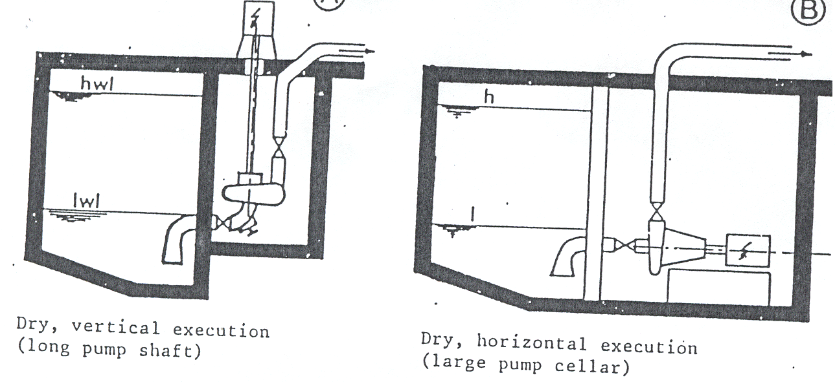
Note that a centrifugal pump can be either submersible (wet) or dry.

Slide 11
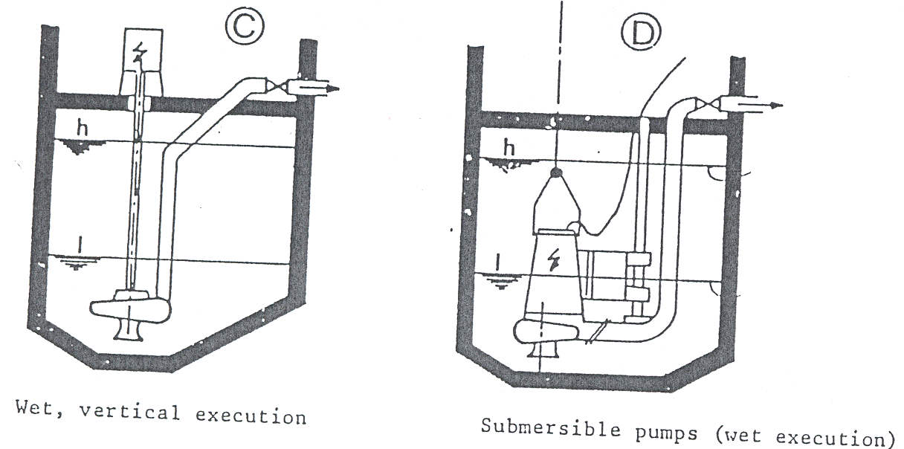

Slide 12
Pump Efficiency
or
Which is the power input delivered from the motor to the impeller of the pump.

Slide 13
Motor efficiency :
which is the power input delivered to the motor.
Overall efficiency of the motor-pump system:

Slide 14
Cavitation of Pumps and NPSH
In general, cavitation occurs when the liquid pressure at a given location is reduced to the vapor pressure of the liquid.
For a piping system that includes a pump, cavitation occurs when the absolute pressure at the inlet falls below the vapor pressure of the water.
This phenomenon may occur at the inlet to a pump and on the impeller blades, particularly if the pump is mounted above the level in the suction reservoir.

Slide 15
Under this condition, vapor bubbles form (water starts to boil) at the impeller inlet and when these bubbles are carried into a zone of higher pressure, they collapse abruptly and hit the vanes of the impeller (near the tips of the impeller vanes). causing:
Damage to the pump (pump impeller)
Violet vibrations (and noise).
Reduce pump capacity.
Reduce pump efficiency

Slide 16
How we can avoid Cavitation ??
To avoid cavitation, the pressure head at the inlet should not fall below a certain minimum which is influenced by the further reduction in pressure within the pump impeller.
To accomplish this, we use the difference between the total head at the inlet , and the water vapor pressure head

Slide 17
Where we take the datum through the centerline of the pump impeller inlet (eye). This difference is called the Net Positive Suction Head (NPSH), so that
There are two values of NPSH of interest. The first is the required NPSH, denoted (NPSH)_{R} , that must be maintained or exceeded so that cavitation will not occur and usually determined experimentally and provided by the manufacturer.
The second value for NPSH of concern is the available NPSH, denoted (NPSH)_{A} , which represents the head that actually occurs for the particular piping system. This value can be determined experimentally, or calculated if the system parameters are known.

Slide 18
How we can avoid Cavitation ??
For proper pump operation (no cavitation) :
(NPSH)_{A} > (NPSH)_{R}

Slide 19
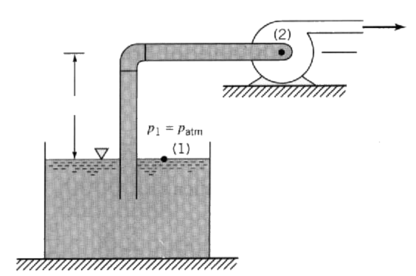
Determination of (NPSH)_{A}
datum
h_{s}
applying the energy equation between point (1) and (2), datum at pump center line

Slide 20

Note that (+) is used if h_{s} is above the pump centerline (datum).

Slide 21
Thoma’s cavitation constant
The cavitation constant: is the ratio of (NPSH)_{R} to the total dynamic head (H_{t}) is known as the Thoma’s cavitation constant ( )
Note: If the cavitation constant is given, we can find the maximum allowable elevation of the pump inlet (eye) above the surface of the supply (suction) reservoir.

Slide 22
Example 1
A Pump has a cavitation constant = 0.12, this pump was instructed on well using UPVC pipe of 10m length and 200mm diameter, there are elbow (k_{e}=1) and valve (k_{e}=4.5) in the system. the flow is 35m³ and The total Dynamic Head H_{t} = 25m (from pump curve) f=0.0167
Calculate the maximum suction head

Slide 24
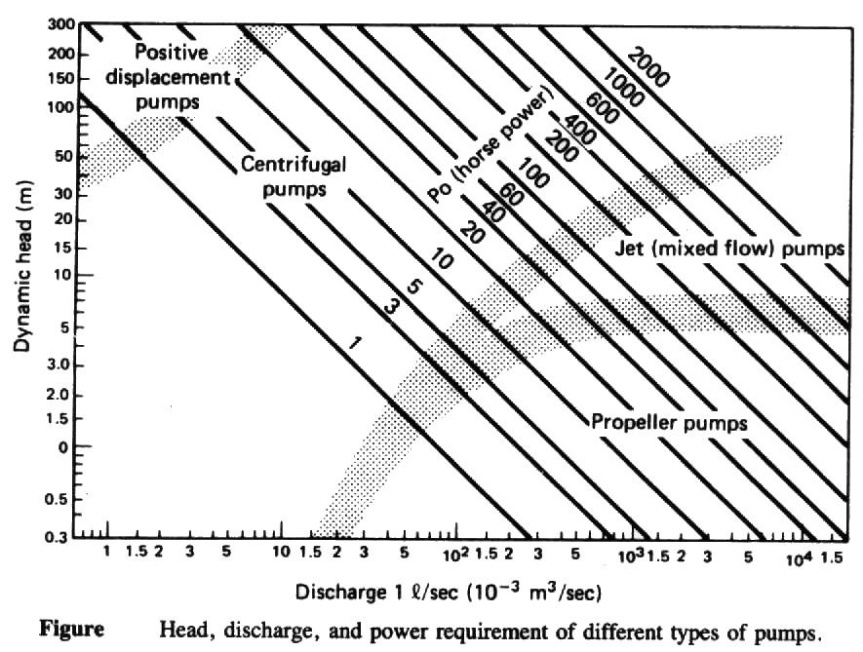
Selection of A Pump
It has been seen that the efficiency of a pump depends on the discharge, head, and power requirement of the pump. The approximate ranges of application of each type of pump are indicated in the following Figure.

Slide 25
Selection of A Pump
In selecting a particular pump for a given system:
The design conditions are specified and a pump is selected for the range of applications.
A system characteristic curve (H-Q) is then prepared.
The H-Q curve is then matched to the pump characteristics chart which is provided by the manufacturer.
The matching point (operating point) indicates the actual working conditions.

Slide 26
System Characteristic Curve
The total head, H_{t} , that the pump delivers includes the elevation head and the head losses incurred in the system. The friction loss and other minor losses in the pipeline depend on the velocity of the water in the pipe, and hence the total head loss can be related to the discharge rate.
For a given pipeline system (including a pump or a group of pumps), a unique system head-capacity (H-Q) curve can be plotted. This curve is usually referred to as a system characteristic curve or simply system curve. It is a graphic representation of the system head and is developed by plotting the total head, over a range of flow rates starting from zero to the maximum expected value of Q.

Slide 28
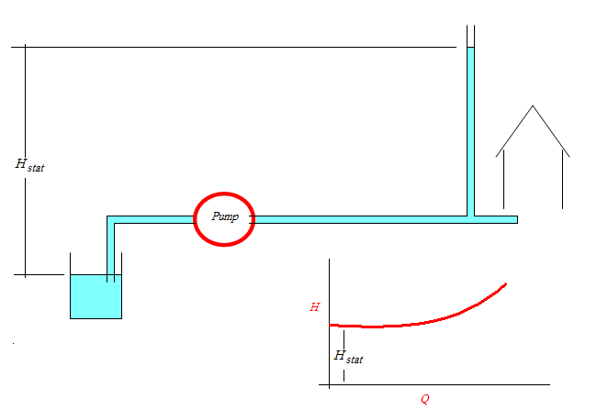
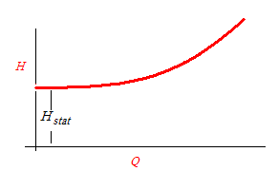
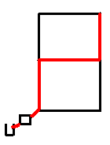
System Characteristic Curve

Slide 29
Pump Characteristic Curves
Pump manufacturers provide information on the performance of their pumps in the form of curves, commonly called pump characteristic curves (or simply pump curves).
In pump curves the following information may be given:
the discharge on the x-axis,
the head on the left y-axis,
the pump power input on the right y-axis,
the pump efficiency as a percentage,
the speed of the pump (rpm = revolutions/min).
the NPSH of the pump.

Slide 31
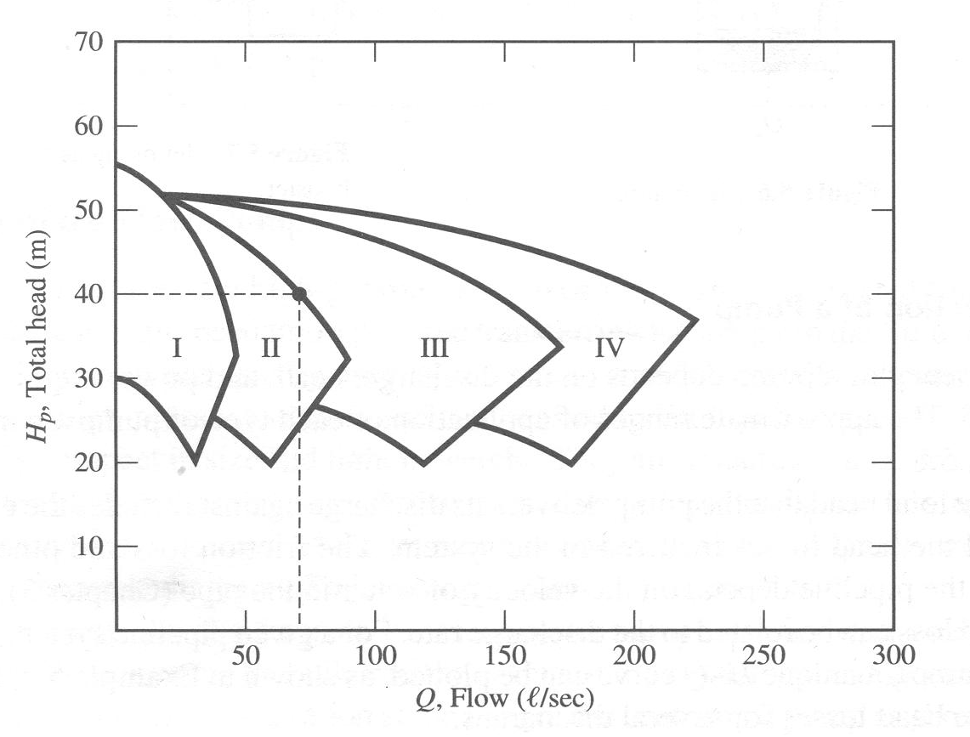
Pumps Group

Slide 32
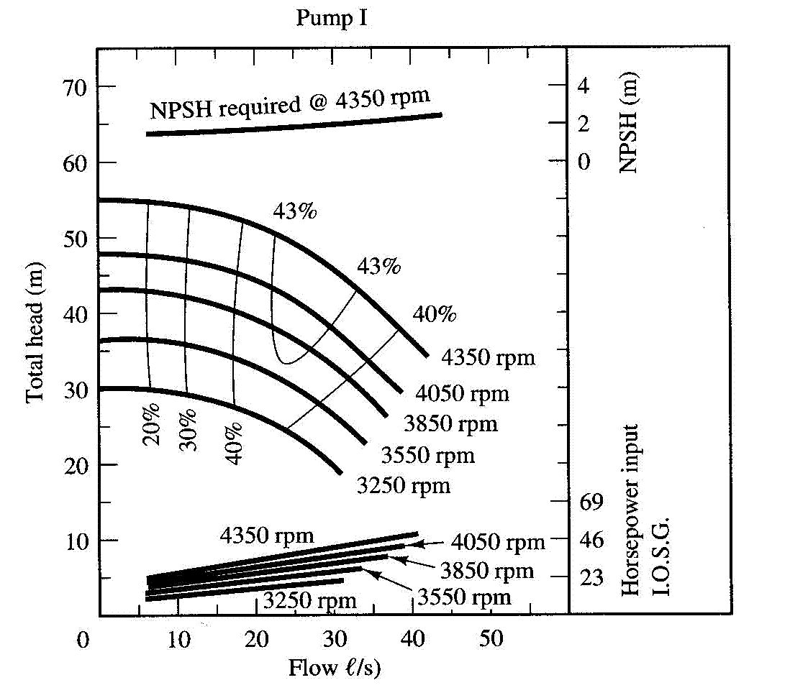
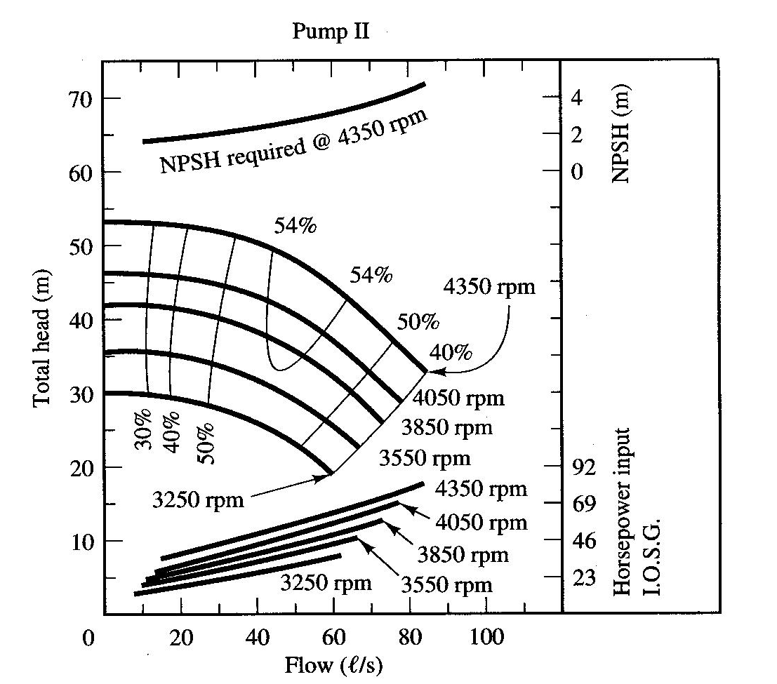

Slide 33
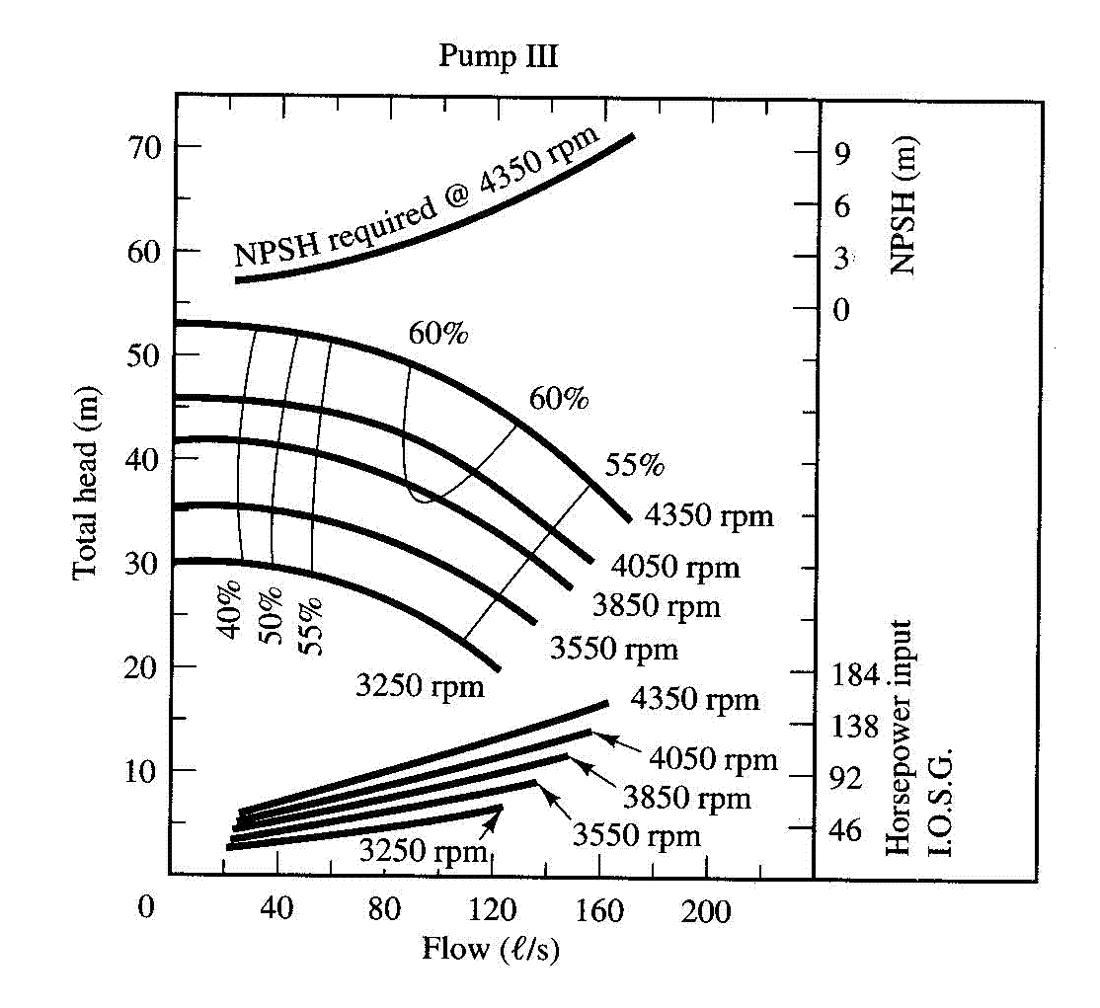
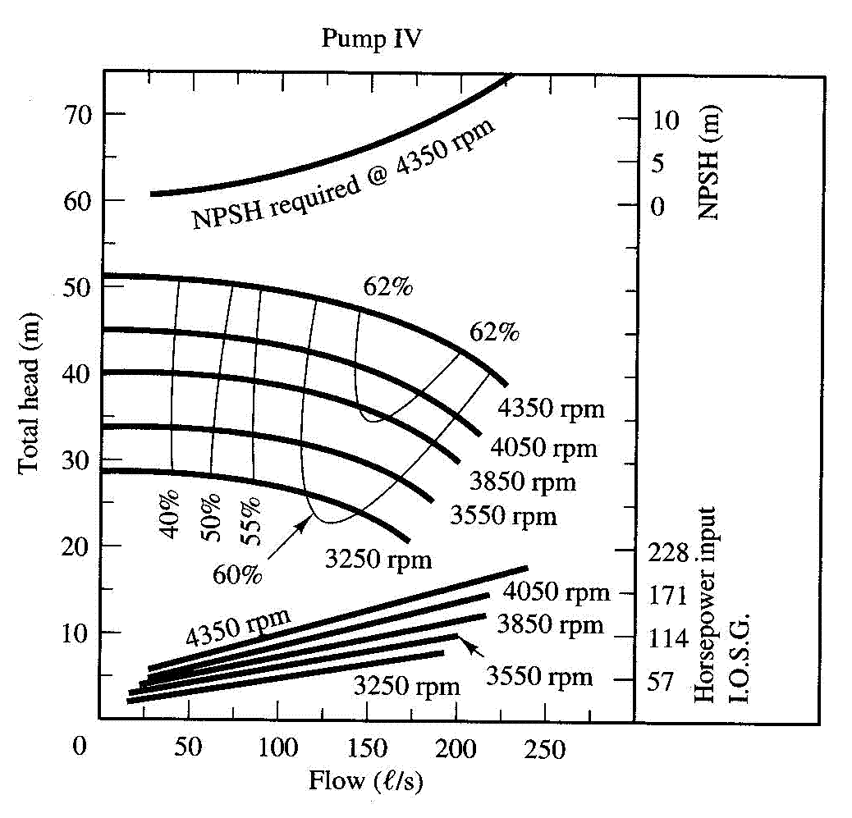

Slide 34
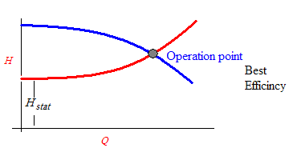
The pump characteristic curves are very important to help select the required pump for the specified conditions.
If the system curve is plotted on the pump curves in we may produce the following Figure:
The point of intersection is called the operating point.
This matching point indicates the actual working conditions, and therefore the proper pump that satisfy all required performance characteristic is selected.
Matching the system and pump curves.

Slide 36
Example 2
For the following pump, determine the required pipes diameter to pump 60 L/s and also calculate the needed power.
Minor losses 10 v²/2g
Pipe length 10 km
roughness = 0.15 mm
H_{s} = 20 m
0 | 10 | 20 | 30 | 40 | 50 | 60 | 70 | Q L/s
45 | 44.7 | 43.7 | 42.5 | 40.6 | 38 | 35 | 31 | H_{t}
- | 35 | 50 | 57 | 60 | 60 | 53 | 40

Slide 37
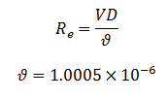
To get 60 L/s from the pump H_{s} + h_{L} must be < 35 m
Assume the diameter = 300mm
Then:

Slide 38
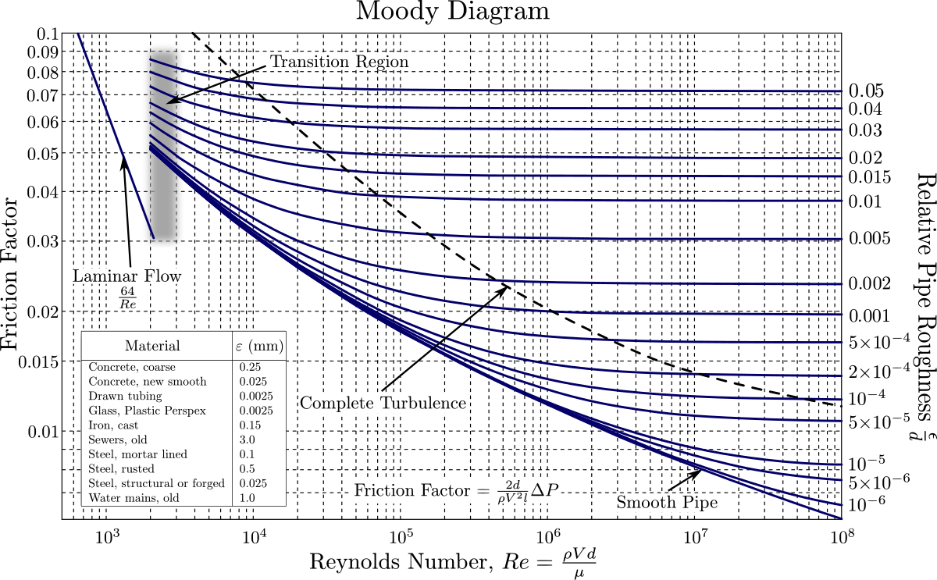

Slide 39
Assume the diameter = 350mm
Then:

Slide 40
Multiple-Pump Operation
To install a pumping station that can be effectively operated over a large range of fluctuations in both discharge and pressure head, it may be advantageous to install several identical pumps at the station.
Pumps in Parallel
Pumps in Series

Slide 41
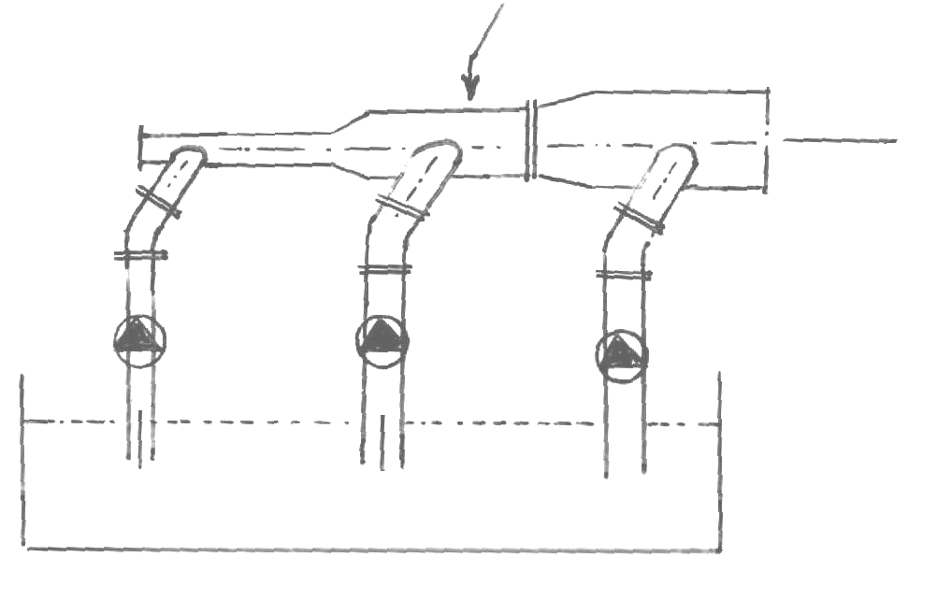
(a) Parallel Operation
Pumping stations frequently contain several (two or more) pumps in a parallel arrangement.
Manifold
Q_{total}
Q_{total} =Q₁+Q₂+Q₃
Pump
Pump
Pump
Q₁
Q₂
Q₃

Slide 42
In this configuration any number of the pumps can be operated simultaneously.
The objective being to deliver a range of discharges, i.e.; the discharge is increased but the pressure head remains the same as with a single pump.
This is a common feature of sewage pumping stations where the inflow rate varies during the day.
By automatic switching according to the level in the suction reservoir any number of the pumps can be brought into operation.

Slide 43
How to draw the pump curve for pumps in parallel???
The manufacturer gives the pump curve for a single pump operation only.
If two or more pumps are in operation, the pumps curve should be calculated and drawn using the single pump curve.
For pumps in parallel, the curve of two pumps, for example, is produced by adding the discharges of the two pumps at the same head (assuming identical pumps).

Slide 44
Pumps in series & Parallel
Pumps in Parallel:

Slide 46
(b) Series Operation
The series configuration which is used whenever we need to increase the pressure head and keep the discharge approximately the same as that of a single pump
This configuration is the basis of multistage pumps; the discharge from the first pump (or stage) is delivered to the inlet of the second pump, and so on.
The same discharge passes through each pump receiving a pressure boost in doing so

Slide 47
Pump
Pump
Pump
Q
Q
H_{total} =H₁+H₂+H₃

Slide 48
How to draw the pump curve for pumps in series???
the manufacturer gives the pump curve for a single pump operation only.
For pumps in series, the curve of two pumps, for example, is produced by adding the heads of the two pumps at the same discharge.
Note that, of course, all pumps in a series system must be operating simultaneously

Slide 49
H
3H₁
Three pumps in series
H₁
2H₁
Two pumps in series
H₁
H₁
Single pump
H₁
Q
Q₁

Slide 50
Similarity Laws: Affinity laws
The actual performance characteristics curves of pumps have to be determined by experimental testing.
Furthermore, pumps belonging to the same family, i.e.; being of the same design but manufactured in different sizes and, thus, constituting a series of geometrically similar machines, may also run at different speeds within practical limits.
Each size and speed combination will produce a unique characteristics curve, so that for one family of pumps the number of characteristics curves needed to be determined is impossibly large.

Slide 51
The problem is solved by the application of dimensional analysis and by replacing the variables by dimensionless groups so obtained. These dimensionless groups provide the similarity (affinity) laws governing the relationships between the variables within one family of geometrically similar pumps.
Thus, the similarity laws enable us to obtain a set of characteristic curves for a pump from the known test data of a geometrically similar pump.

Slide 52
Change in pump speed (constant size)
If a pump delivers a discharge Q₁ at a head H₁ when running at speed N₁, the corresponding values when the same pump is running at speed N₂ are given by the similarity (affinity) laws:
where Q = discharge (m³/s, or l/s).
H = pump head (m).
N = pump rotational speed (rpm).
P_{i} = power input (HP, or kw).

Slide 53
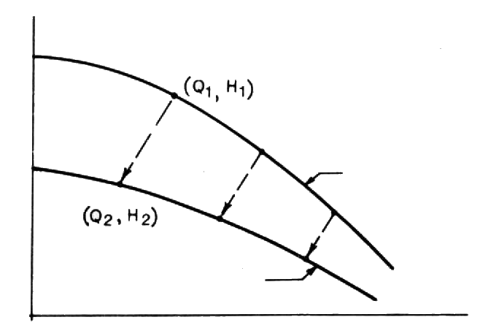
Therefore, if the pump curve for speed N₁ is given, we can construct the pump curve for the speed N₂ using previous relationships.
N₁
N₂
Effect of speed change on pump characteristic curves.

Slide 54
(b) Change in pump size (constant speed)
A change in pump size and therefore, impeller diameter (D), results in a new set of characteristic curves using the following similarity (affinity) laws:
where D = impeller diameter (m, cm).
Note : D indicated the size of the pump

Slide 55
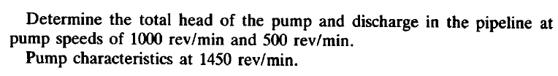
Example 3

Slide 56

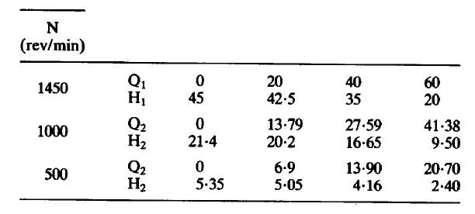
Solution

Slide 57
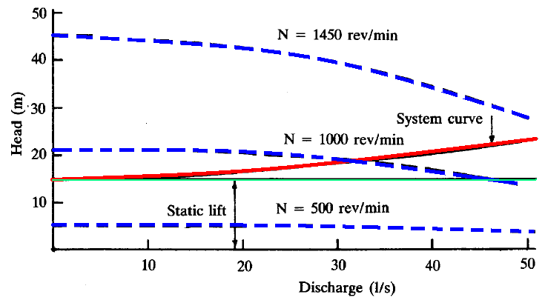

Slide 58
Specific Speed
Pump types may be more explicitly defined by the parameter called specific speed (N_{s}) expressed by:
Where: Q = discharge (m³/s, or l/s).
H = pump total head (m).
N = rotational speed (rpm).

Slide 59
This expression is derived from dynamical similarity considerations and may be interpreted as the speed in rev/min at which a geometrically scaled model would have to operate to deliver unit discharge (1 l/s) when generating unit head (1 m).
The given table shows the range of N_{s} values for the turbo-hydraulic pumps:
Pump type | N_{s} range (Q - l/s, H-m)
centrifugal | up to 2600
mixed flow | 2600 to 5000
axial flow | 5000 to 10 000

Slide 60
Example 4
A centrifugal pump running at 1000 rpm under current operating condition. The pump and system curve are given in the figure. Estimate the speed to reduce the flow to one-half.
Discharge (m³/min) | 0 | 4.5 | 9.0 | 13.5 | 18.0 | 22.5
Head available (m) | 22.5 | 22.2 | 21.6 | 19.5 | 14.1 | 0
Head required (m) | 15.0 | 15.4 | 16.6 | 18.6 | 21.4 | 25.0

Slide 62
From the previous Figure, The operating point is:
Q_{A} = 14 m³/min
H_{A} = 19 m
At reduced speed: For half flow (Q = 7 m³/min) there will be a new operating point B at which:
Q_{B} = 7 m³/min
H_{B} = 16 m
How to estimate the new speed ?????

Slide 63
A
B

Slide 64
This curve intersects the original curve for N₁ = 1000 rpm at C where Q_{c}= 8.2 m³/ hr and H_{c}= 21.9 m, then
N₂ = 855rpm

Slide 65
C
A
B

Slide 66
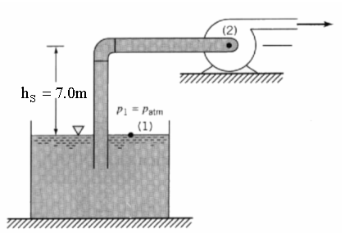
Example 5
A pump was designed to satisfy the following system
9 | 6 | 3 | Q (m³/hr)
38 | 20 | 12 | h_{f} (m)
Check whether the pump is suitable or not
Pipe diameter is 50mm

Slide 67
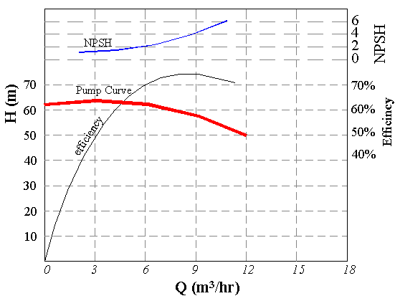

Slide 68
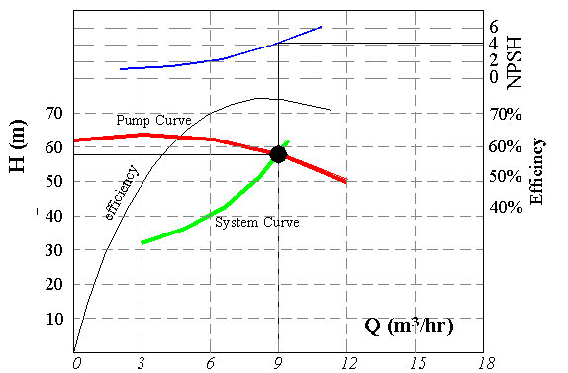
1- Draw the system curve and check the operation point

Slide 69
There are an operation point at:
Q = 9 m³/hr
H =58m
NPSH_{R} =4.1
Then Check NPSH_{A}
pump is not suitable, the cavitation will occur

Slide 70
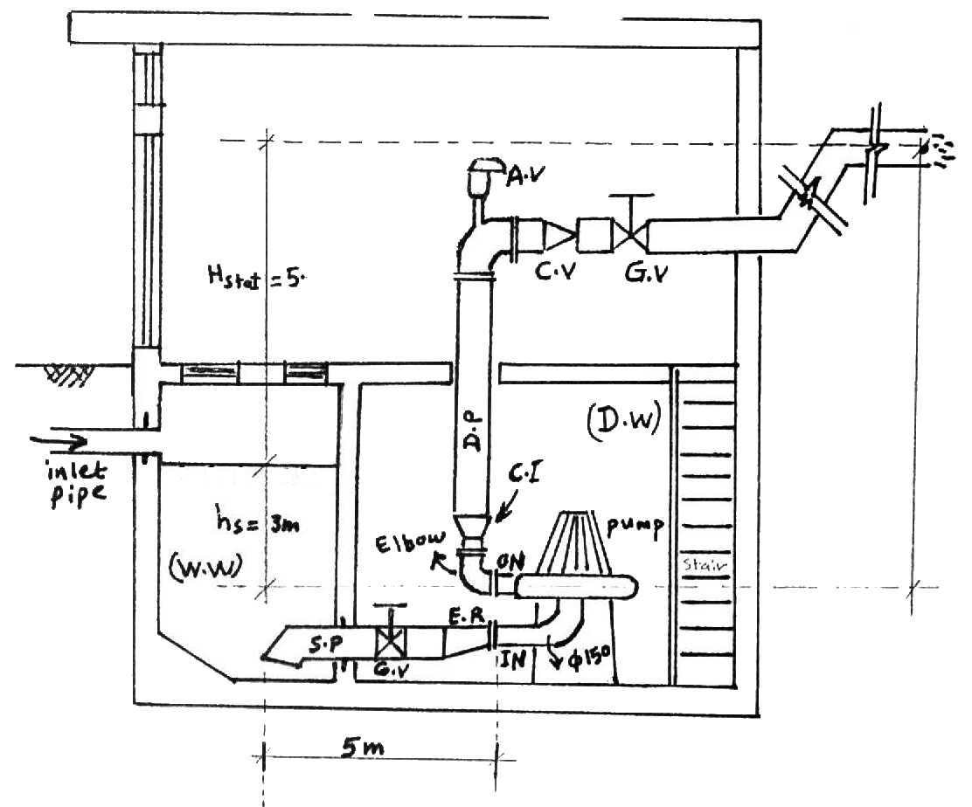
Example 6
Abbreviations:
G.V = Gate Valve
C.V = Check Valve
A.V = Air release Valve
E.R = Eccentric Reducer
C.I = Concentric increase
I.N = Inlet Nozzle
O.N = Outlet Nozzle
S.P = Suction Pipe
D.P = Delivery Pipe
W.W = Wet Well
D.W = Dry Well

Slide 71

Data:
Flow rates and dimensions:
Q_{max} = 0.05 m³/s Q_{min} = 0.025 m³/s
L_{S.P} = 5.0 m L_{D.P} = 513.5 m
D_{S.P} = 250mm D_{D.P} = 200mm
H_{stat} = 5.3 m, h_{S} = 3.0 m
Minor Losses Coefficients (k):
G.V = 0.1 C.V = 2.5 A.V = 0.05,
E.R = 0.1 C.I = 0.05 Elbow = 0.2
Bends in D.P = 0.05,
Entrance of S.P = 0.3 (bell mouth)
Coefficient of friction:
f = 0.02 (assumed constant).

Slide 72
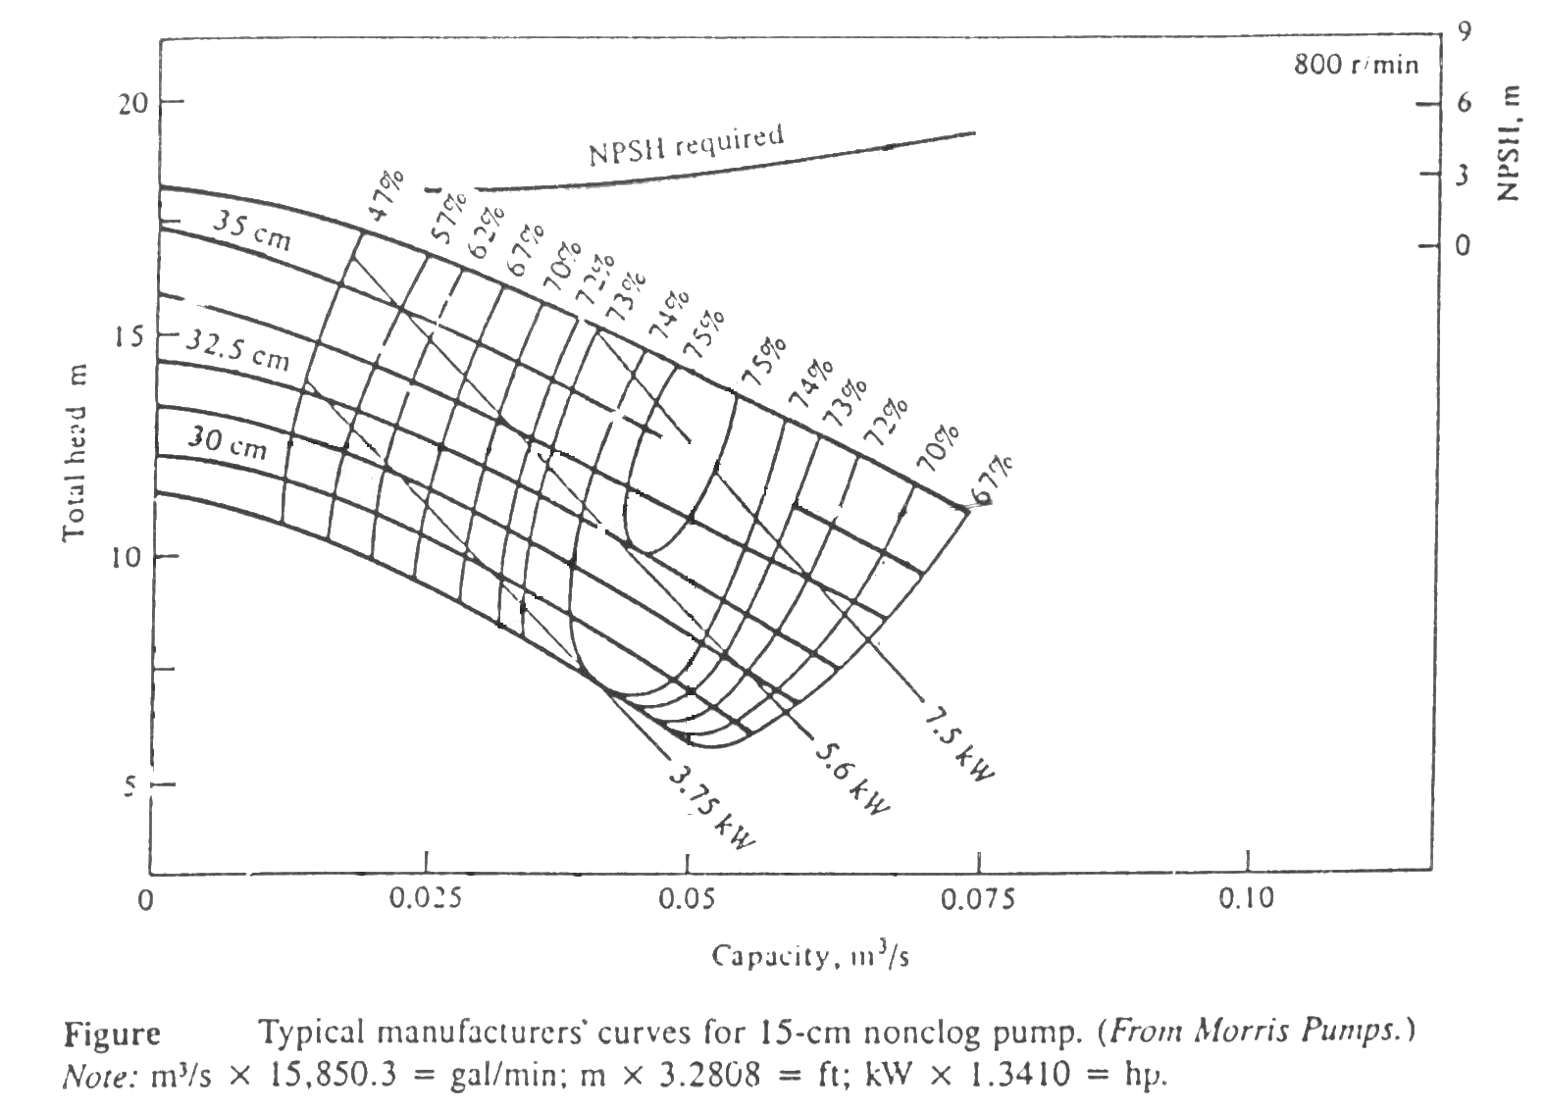
Pump characteristic curves:

Slide 73
Required??
The given Figure shows a pump station.
Use the pump characteristic curves and the data given above to:
Choose a suitable pump which satisfies the requirements of the piping system shown,
Find the power and efficiency of the pump,
Find the overall efficiency (motor and pump) if the motor efficiency is given to be 90%, also find the required power input to the motor.
Check the pump for cavitation at T = 25ºC

Slide 74
Solution
A. Pump Selection:
The first step in selecting a pump is to draw the system curve:
To draw the system curve we need to calculate the values of H_{t} that correspond to several values of Q, using :
We start with Q_{max} = 0.05 m³/s as the first value of Q in the system and find the corresponding H_{t}
or

Slide 75
Head losses in the suction pipe:
For Q_{max} = 0.05 m³/s.
Friction losses:
Minor losses:

Slide 76

Head losses in the delivery pipe:
For Q_{max} = 0.05 m³/s.
Friction losses:
Minor losses:

Slide 77
Therefore
therefore, we found the first point on the system curve:
(Q, H) = (0.05, 12.6)
which is the operating point of the system at Q_{max}.
Similarly, we need to determine at least three points (Q, H) to draw the system curve.

Slide 78
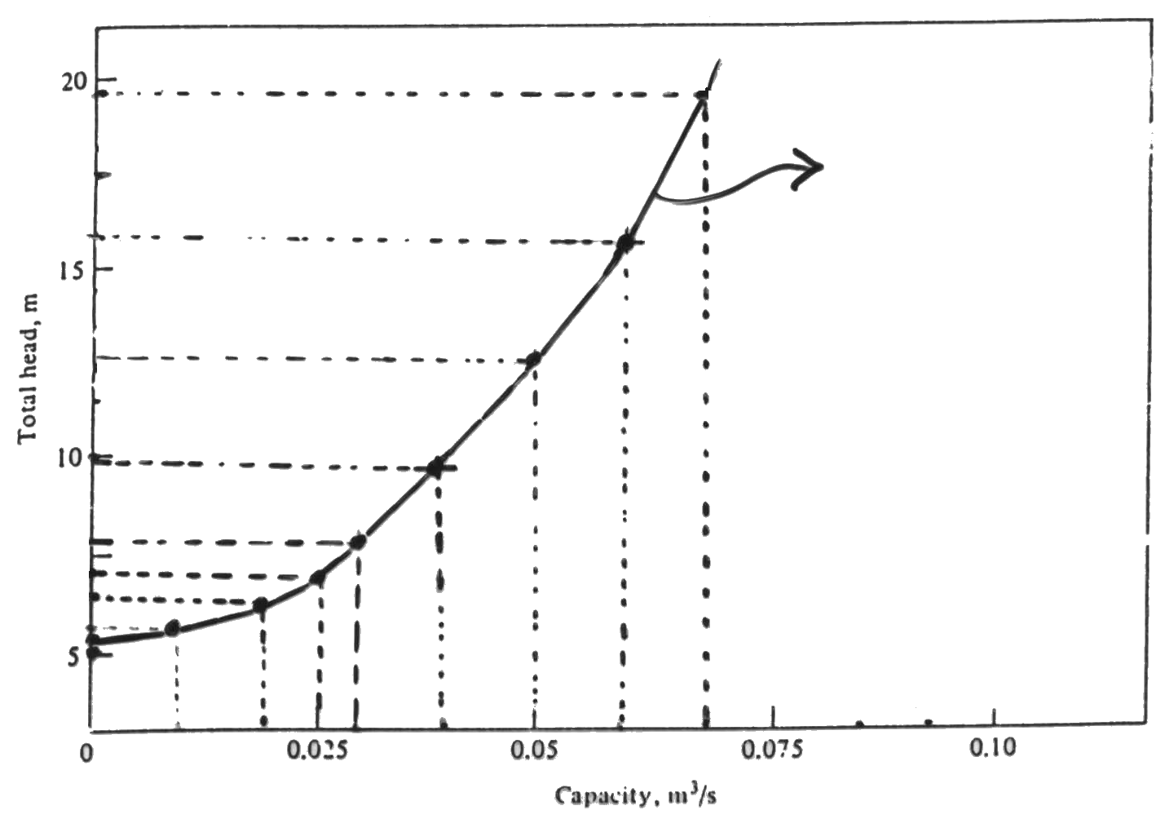
System curve

Slide 79
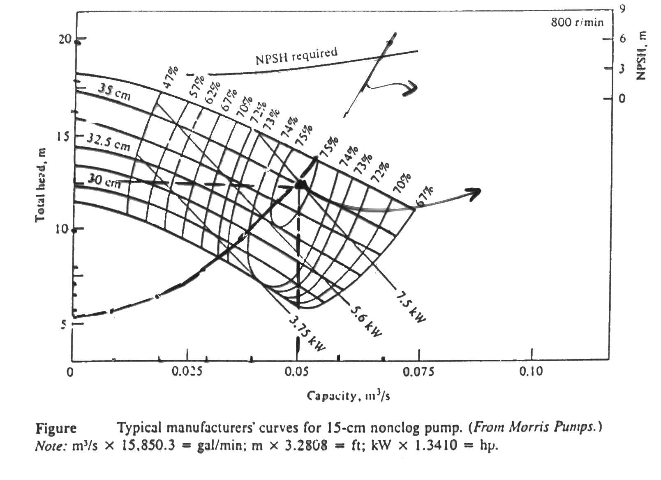
System curve
Operating point
12.6
It is clear from the above figure that the required pump is the
35-cm impeller pump

Slide 80
Pump Power Input and Efficiency
From the pump curve we can read P_{i} = 7.5 kw
and hence

Slide 81
Overall Efficiency and Motor Power Input
Overall efficiency
and hence

Slide 82
Check for Cavitation:
To prevent cavitation we must have:
(NPSH)_{A} (NPSH)_{R}
From pump curve figure we can read:
(NPSH)_{R} = 3 m at Q_{max} = 0.05 m³/s.
For water at T=25ºC, P_{atm}= 101 kN/m², and P_{vapor} = 3.17 kN/m².
Using the equation
we can write
no cavitation.

Slide 83
Home Work

