Slide 1
CE 3121 Engineering Hydraulics
Course Co-ordinator: Dr. Anupam Chowdhury Assistant Professor Department of Civil Engineering, RUET
Email: anupam.19ce@gmail.com

Slide 2
Gradually Varied Flow Profile Computation
The main objective of the computation is to determine the shape of the flow profile.
Methods of Computation:
Graphical Integration Method
Direct Integration Method
Direct Step Method
Standard Step Method

Slide 3
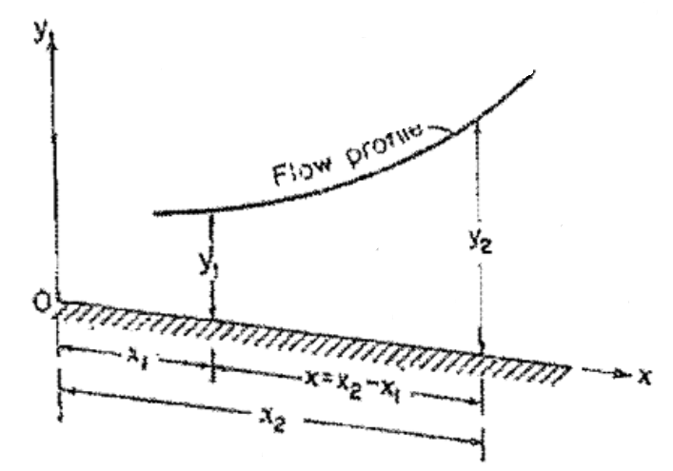
Graphical Integration Method
This method is to integrate the dynamic equation of gradually varied
flow by a graphical procedure.
Consider two channel sections (Fig. a) at distances X1 and X2, respectively,
from a chosen origin and with corresponding depths of flow y1 and y2.
Fig. a

Slide 4



Graphical Integration Method
The distance along the channel floor is
Assume several values of y, and compute the corresponding values of dx/dy, which is the reciprocal of the gradually varied flow equation.
Here, Kn is the conveyance for uniform flow at a depth yn
Zc is the section factor for critical flow computation for discharge Q at depth Yc

Slide 5
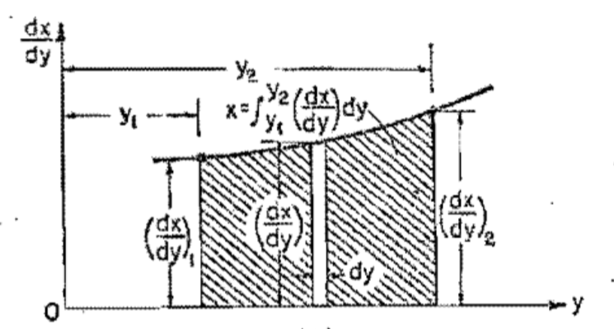
Graphical Integration Method
A Curve of y against dx/dy is then constructed (Fig. b). According to Eq. (1), it
is apparent that the value of x is equal to the shaded area formed by the
curve, the y axis, and the ordinates of dx/ dy corresponding to y1 and y2. This
area call be measured and the value of x determined.
Fig. b

Slide 6
Graphical Integration Method
A trapezoidal channel having b = 20 ft, z = 2, So = 0.0016, and n = 0.025
carries a discharge of 400 cfs. Compute the backwater profile created by a
dam which backs up the water to a depth of 5 ft immediately behind the dam.
The upstream end of the profile is assumed at a depth equal to 1% greater
than the normal depth. The energy coefficient α = 1.10.
T
Top width, T
Hydraulic depth, D=A/T
Hydraulic radius, R = A/P
1
z
y
b

Slide 7



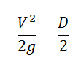

Graphical Integration Method
Determination of critical depth:
yc = 2.22 ft

Slide 8


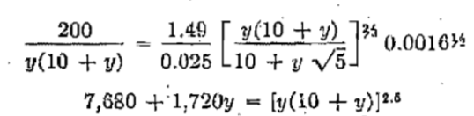
Graphical Integration Method
Determination of normal depth:
yn = 3.36 ft

Slide 9
Graphical Integration Method
Here, yn = 3.36 ft > yc = 2.22 ft
The flow starts with a depth greater than yn
Hence, the flow profile is M1 type

Slide 10



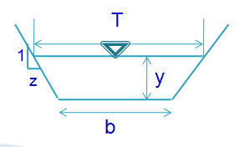


Graphical Integration Method
Yc = 2.22 ft
Yn = 3.36 ft

Slide 11
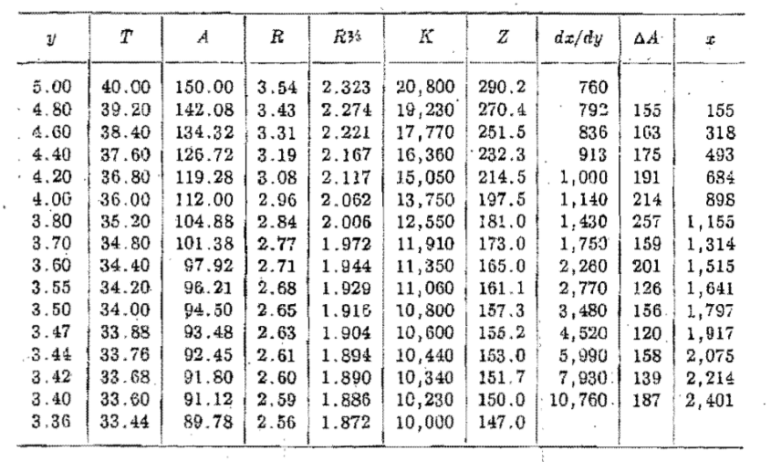
Graphical Integration Method

Slide 12
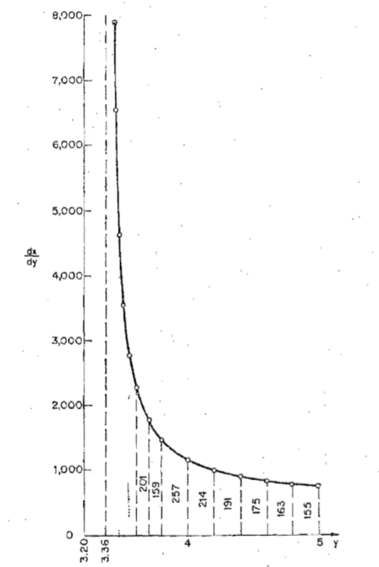
Graphical Integration Method

Slide 13
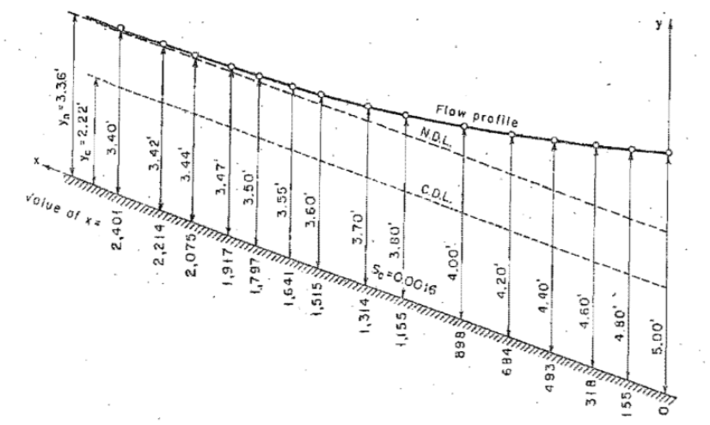
Graphical Integration Method

Slide 14
Direct Step Method
A step method is characterized by dividing the channel into short reaches and carrying the computation step by step from one end of the reach to the other.
The direct step method is a simple step method applicable to prismatic channels.

Slide 15
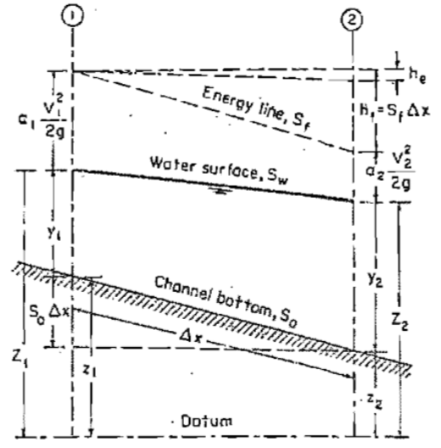
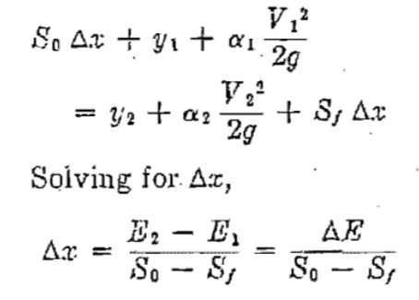
Direct Step Method
Fig. 1, illustrates a short channel reach of length Δx. Equating the total heads at the two end sections 1 and 2, the following may be written:
Fig. 1

Slide 16

Direct Step Method
Where, E is the specific energy or, assuming α1 = α2= α,
Here, y = depth of flow,
V = mean velocity,
α = energy coefficient,
So = bottom slope, and
Sf = friction slope

Slide 17

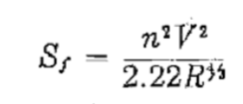
Direct Step Method
The average value of Sf is denoted by . When the Manning’s formula is used, the friction slope is expressed by

Slide 18
Direct Step Method
A trapezoidal channel having b = 20 ft, z = 2, So = 0.0016, and n = 0.025
carries a discharge of 400 cfs. Compute the backwater profile created by a
dam which backs up the water to a depth of 5 ft immediately behind the dam.
The upstream end of the profile is assumed at a depth equal to 1% greater
than the normal depth. The energy coefficient α = 1.10. Compute the flow
profile using direct step method.
Yc = 2.22 ft
Yn = 3.36 ft

Slide 19
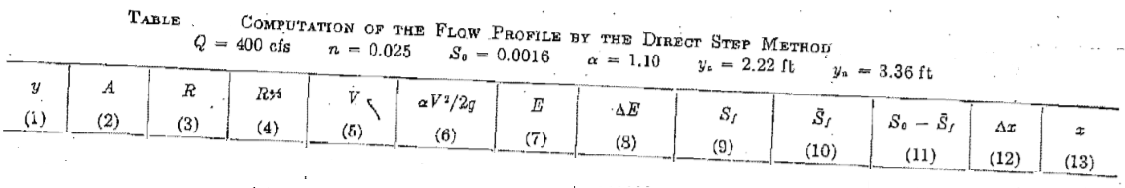

Direct Step Method

Slide 20
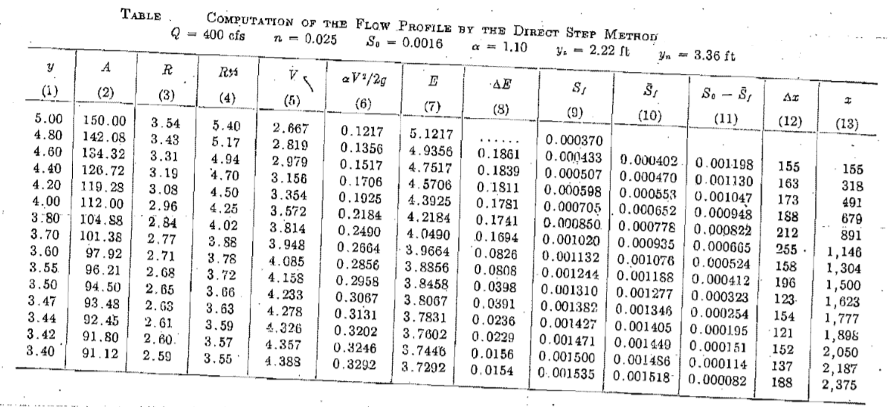
Direct Step Method

