Slide 1
CE 3121 Engineering Hydraulics
Course Co-ordinator: Dr. Anupam Chowdhury Assistant Professor Department of Civil Engineering, RUET
Email: anupam.19ce@gmail.com

Slide 2
Course Contents
Theory and analysis of gradually varied flow
Computation of flow profiles
Hydraulic jump
Stilling basin
Impact of water jet
Principles of hydraulic machines: pumps-Reciprocating and Centrifugal pump

Slide 3
Reference Books
Open Channel Flow Hydraulics – Ven Te Chow
A textbook of Hydraulics, Fluid Mechanics and Hydraulic Machines – R. S. Khurmi
A textbook of Fluid Mechanics and Hydraulic Machines- R. K. Bansal
Hydraulics and Fluid Mechanics including Hydraulics Machines – P. N. Modi and S. M. Seth.

Slide 4
Open Channel Flow
Open Channel Flow is defined as fluid flow with a free surface open to the atmosphere.
Examples: streams, rivers and culverts not flowing full.
Open channel flow assumes that the pressure at the surface is constant and the hydraulic grade line is at the surface of the fluid.

Slide 5
Classifications of Open Channel Flow
Classification based on the time criterion:
Steady Flow (time independent)
(discharge and water depth do not change with time)
Unsteady Flow (time dependent)
(discharge and water depth at any section change with time)
Classification based on the space criterion:
Uniform flow (are mostly steady)
(discharge and water depth remains the same at every section in the channel)
Non-uniform Flow/Varied flow
(discharge and water depth change at any section in the channel)

Slide 6
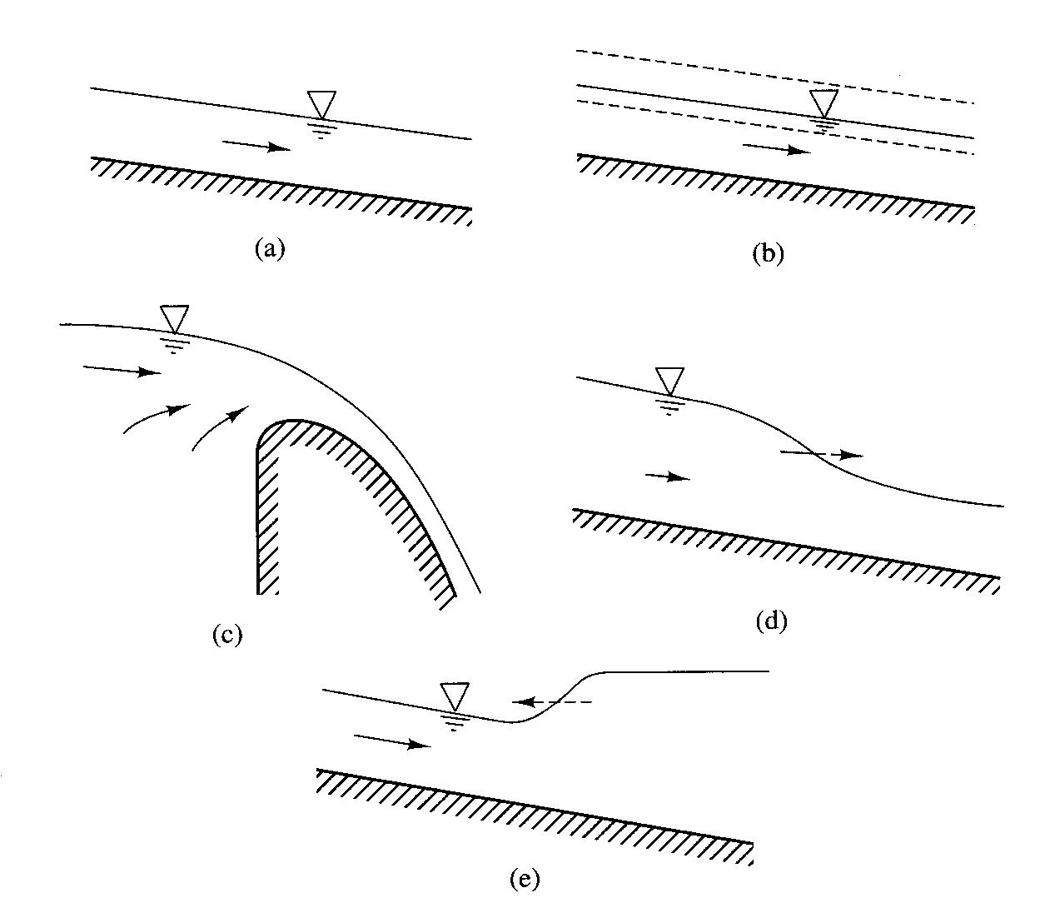
Uniform flow are mostly steady
Unsteady uniform flows are very rare in nature
Water depth
Discharge
Steady varied flow
(over a spillway crest)
Unsteady varied flow (flood wave)
Unsteady varied flow (tidal surge)

Slide 7
Non-uniform flow is also called varied flow ( the flow in which the water depth and or discharge change along the length of the channel), it can be further classified as:
Gradually varied flow (GVF): where the depth of the flow changes gradually along the length of the channel.
Rapidly varied flow (RVF): where the depth of flow changes suddenly over a small length of the channel.

Slide 8
Uniform flow are mostly steady
Unsteady uniform flows are very rare in nature
Steady varied flow
(over a spillway crest)
Unsteady varied flow (flood wave)
Unsteady varied flow (tidal surge)

Slide 9
Gradually-Varied Flow in Open Channels

Slide 10
Gradually-Varied Flow
Gradually-Varied Flow: A steady non-uniform flow in a prismatic channel with gradual changes in its water-surface elevation is named as gradually-varied flow (GVF).
Gradually varied flow (GVF) where the depth of the flow changes gradually along the length of the channel.

Slide 11
Dynamic Equation of Gradually Varied Flow
Objective: To get the relationship between the water surface slope and other characteristics of flow.
The following assumptions are made in the derivation of the equation
The flow is steady.
The streamlines are practically parallel (true when the variation in depth along the direction of flow is very gradual). Thus the hydrostatic distribution of pressure is assumed over the section.
The loss of head at any section, due to friction, is equal to that in the corresponding uniform flow with the same depth and flow characteristics. (Manning’s formula may be used to calculate the slope of the energy line)
The slope of the channel is small.
The channel is prismatic.
The velocity distribution across the section is fixed.
The roughness coefficient is constant in the reach.
.

Slide 12
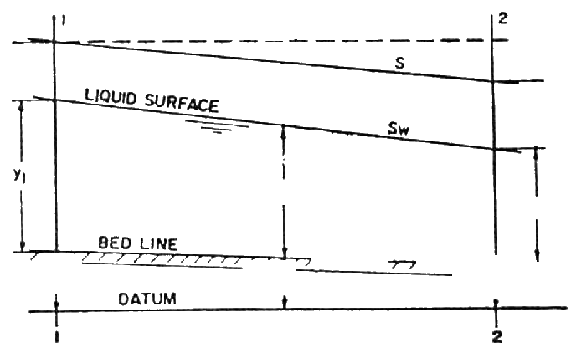

Consider the profile of a gradually varied flow in a small length dx of an open channel as shown in the figure below.
Y
The total head (H) at any section is given by:
dx
X
Taking x-axis along the bed of the channel and differentiating the equation with respect to x:

Slide 13
dH/dx = the slope of the energy line (S_{e}).
dZ/dx = the bed slope (S₀) .
Therefore,
Multiplying the velocity term by dy/dy and transposing, we get
or
This Equation is known as the dynamic equation of gradually varied flow. It gives the variation of depth (y) with respect to the distance along the bottom of the channel (x).

Slide 14

Gradually-Varied Flow
Derive the Basic Differential Equation for the Gradually-Varied Flow Water Surface Profile:
dy/dx gives the variation of water depth along the channel in the flow direction.
S0 = Channel bed slope for uniform flow depth y0
Se = Energy slope
Fr = Froude number

Slide 15
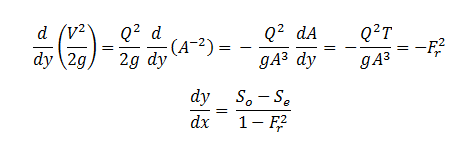
Gradually-Varied Flow

Slide 16

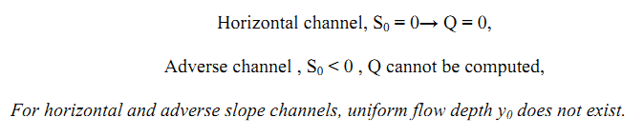
Gradually-Varied Flow
Classification of Flow Surface Profiles
For a given channel with a known Q = Discharge, n = Manning coefficient, and S0 = Channel bed slope, yc = critical water depth and y0 = Uniform flow depth can be computed. There are three possible relations between y0 and yc as 1) y0 > yc , 2) y0 < yc , 3) y0 = yc .
For horizontal (S0 = 0), and adverse slope ( S0 < 0) channels,

Slide 17
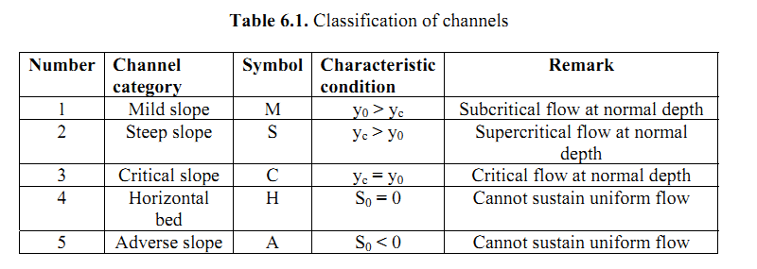
Gradually-Varied Flow
Classification of Flow Surface Profiles

Slide 18
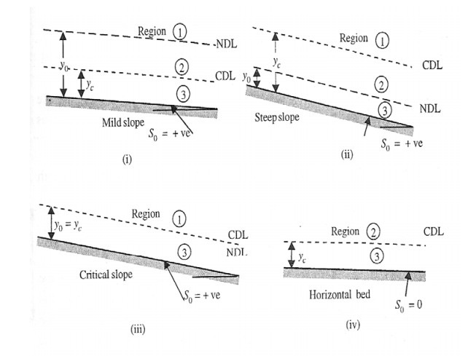
Gradually-Varied Flow

Slide 19
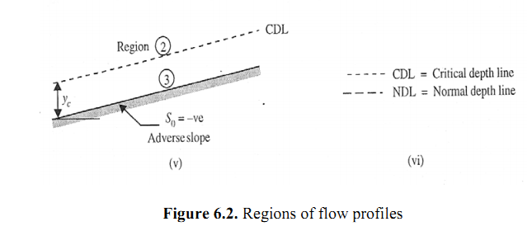
Gradually-Varied Flow

Slide 20
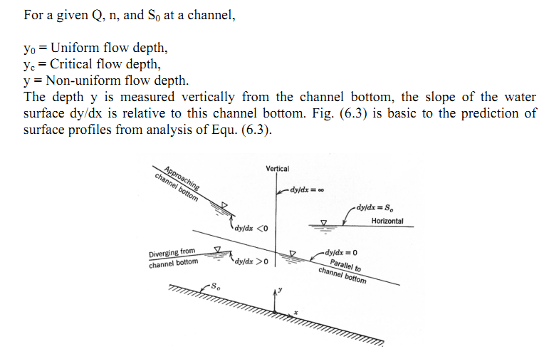
Gradually-Varied Flow

Slide 21
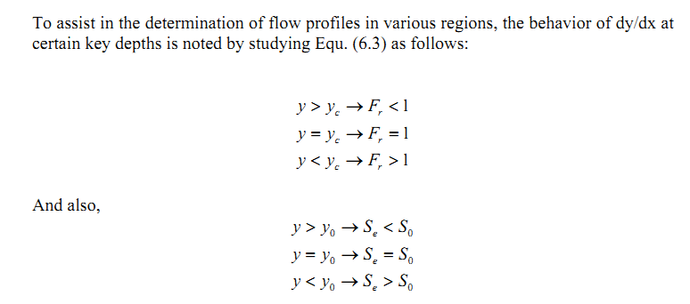
Gradually-Varied Flow

Slide 22
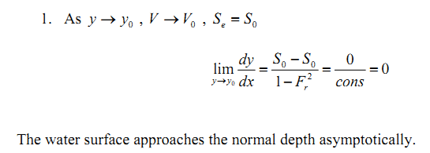
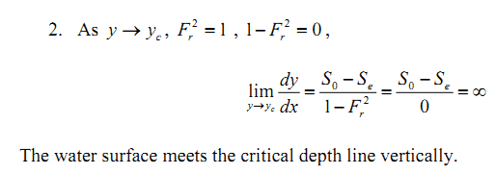
Gradually-Varied Flow

Slide 23
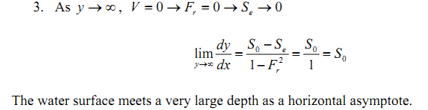
Gradually-Varied Flow

Slide 24
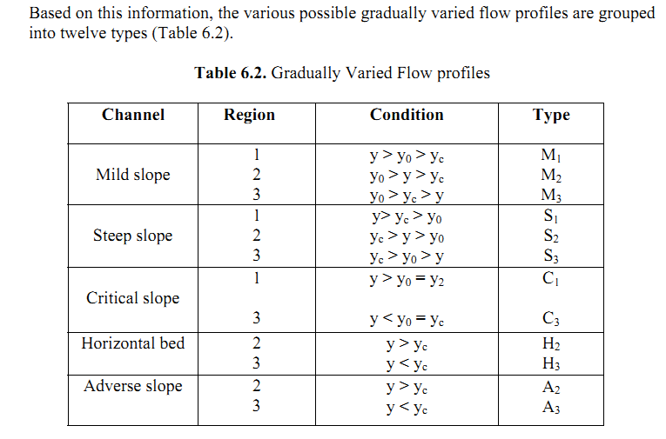
Gradually-Varied Flow

Slide 25
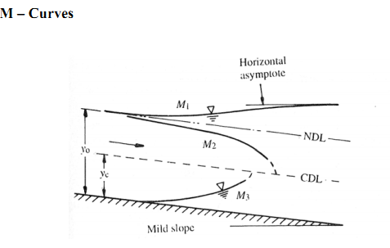
Gradually-Varied Flow

Slide 26
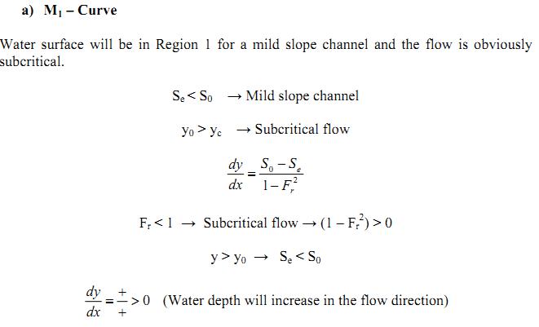
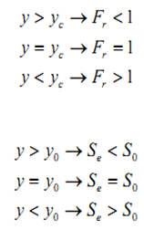
Gradually-Varied Flow

Slide 27
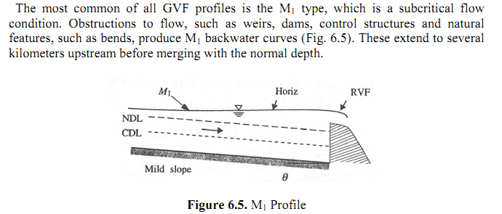
Gradually-Varied Flow

Slide 28
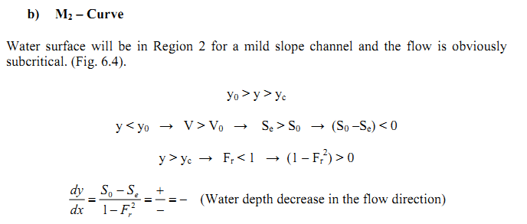
Gradually-Varied Flow

Slide 29
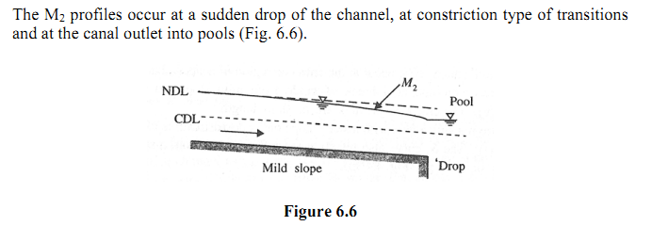
Gradually-Varied Flow

Slide 30
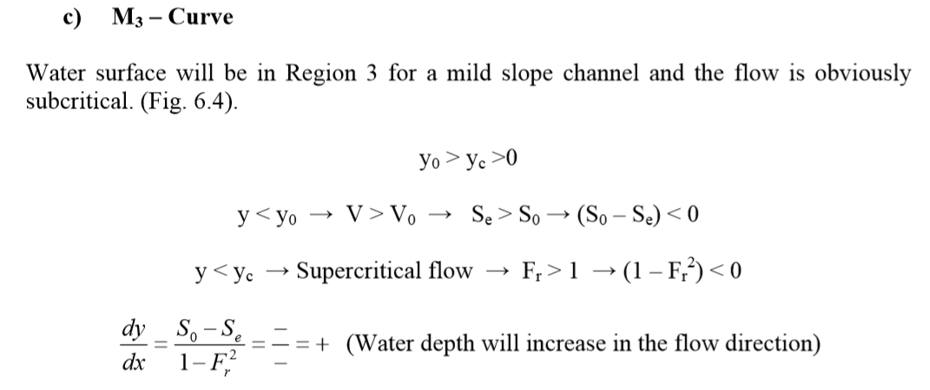
Gradually-Varied Flow

Slide 31
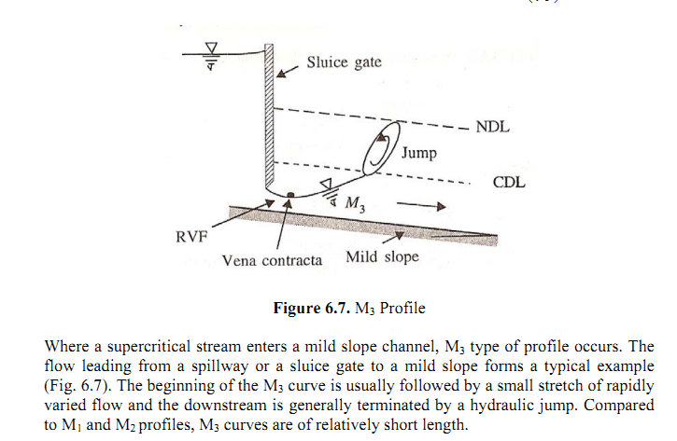
Gradually-Varied Flow

Slide 32
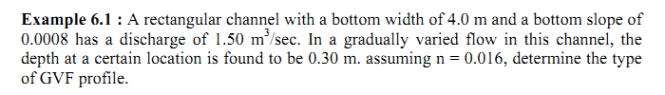


Gradually-Varied Flow
Home Task

Slide 33
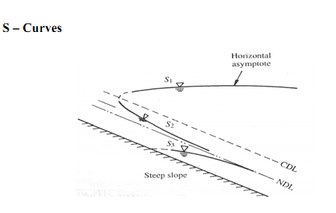

Gradually-Varied Flow

Slide 34
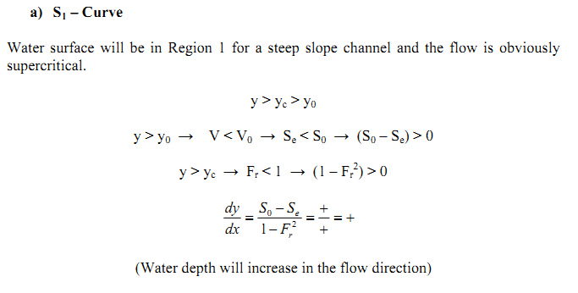
Gradually-Varied Flow

Slide 35
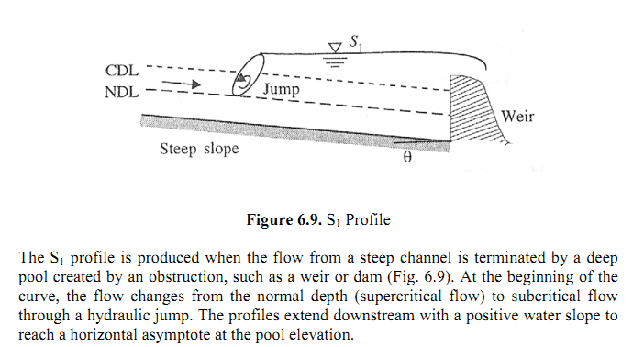
Gradually-Varied Flow

Slide 36
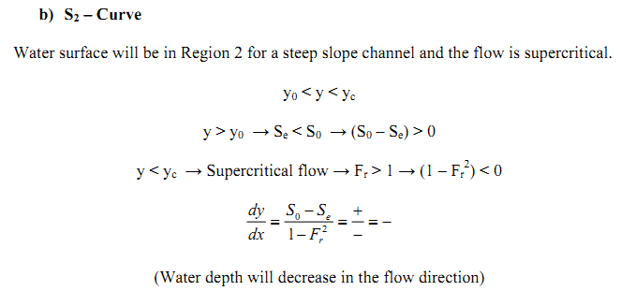
Gradually-Varied Flow

Slide 37
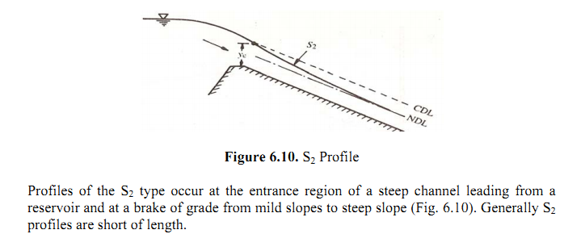
Gradually-Varied Flow

Slide 38
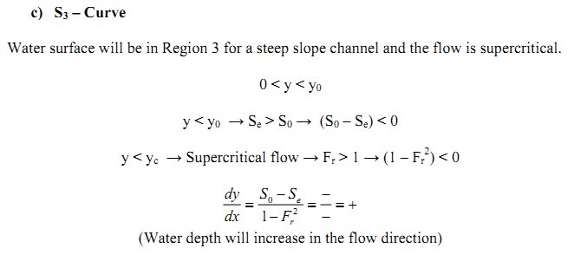
Gradually-Varied Flow

Slide 39
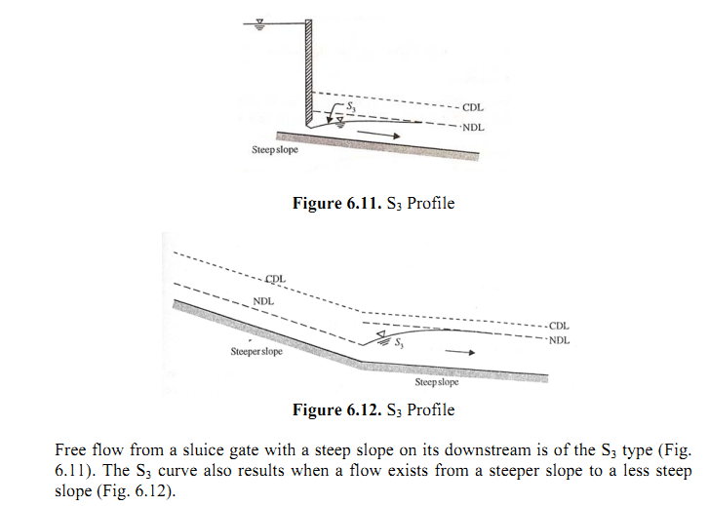
Gradually-Varied Flow

Slide 40
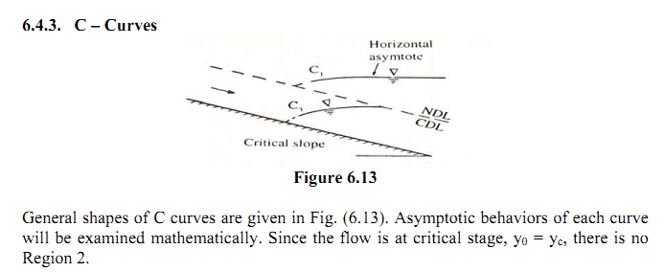


Gradually-Varied Flow

Slide 41
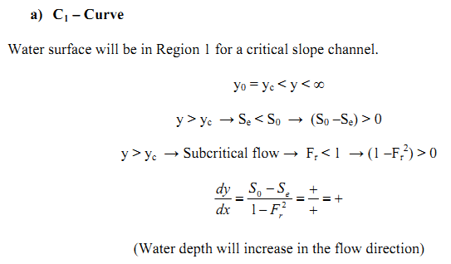
Gradually-Varied Flow

Slide 42
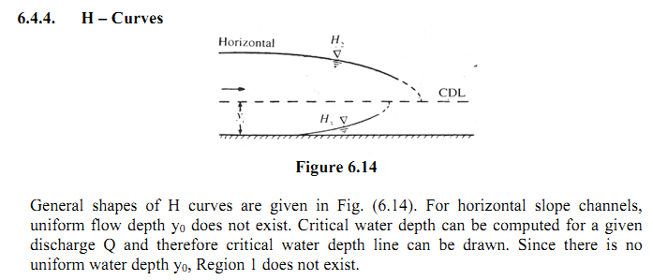

Gradually-Varied Flow

Slide 43
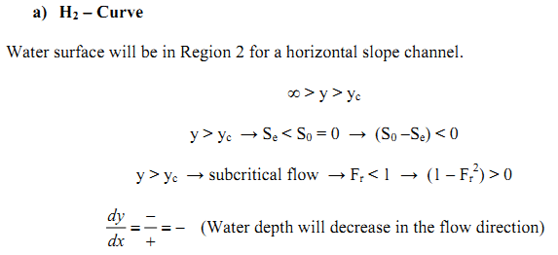
Gradually-Varied Flow

Slide 44
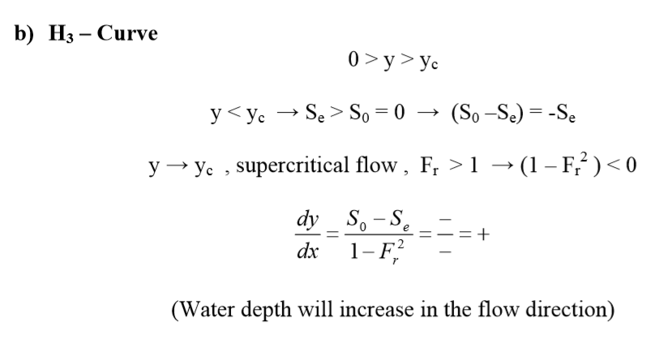
Gradually-Varied Flow

Slide 45
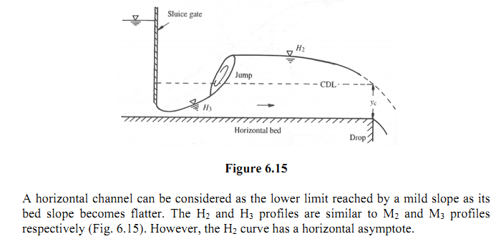
Gradually-Varied Flow

Slide 46
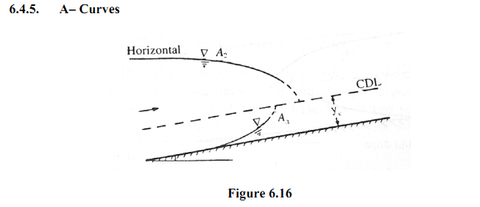
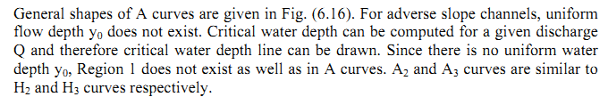
Gradually-Varied Flow

Slide 47
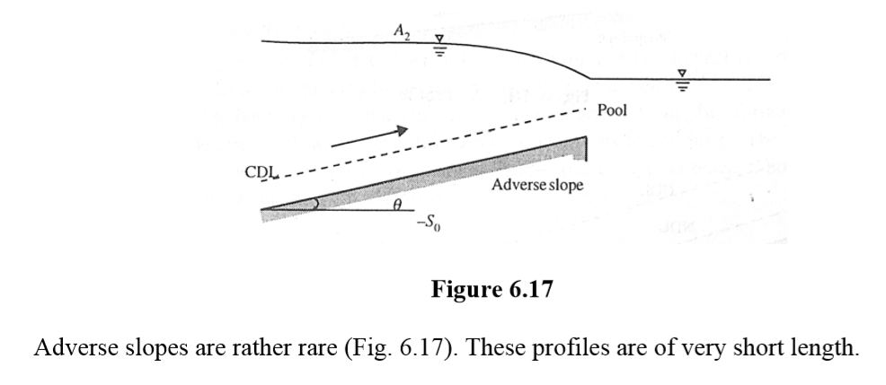
Gradually-Varied Flow

Slide 48
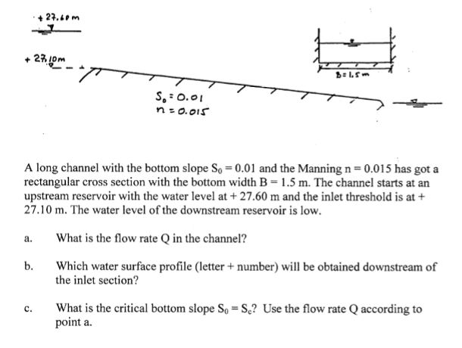
Gradually-Varied Flow

Slide 49
See You Next Week!!!
Next Lecture.........
Computation of flow profiles

