Slide 1
Impact of Jet
Course Co-ordinator:
Dr. Anupam Chowdhury
Associate Professor
Department of Civil Engineering, RUET
Email: anupam.19ce@gmail.com

Slide 2
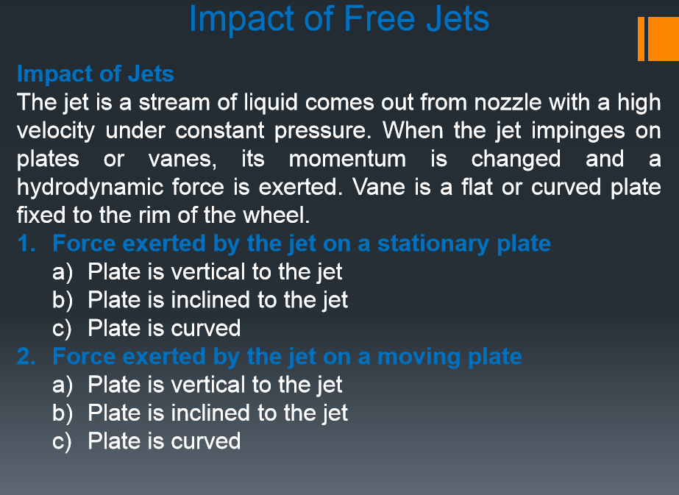

Slide 3
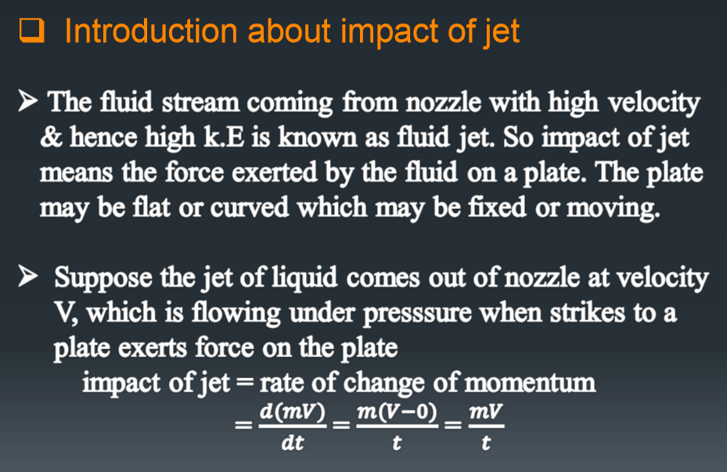

Slide 4
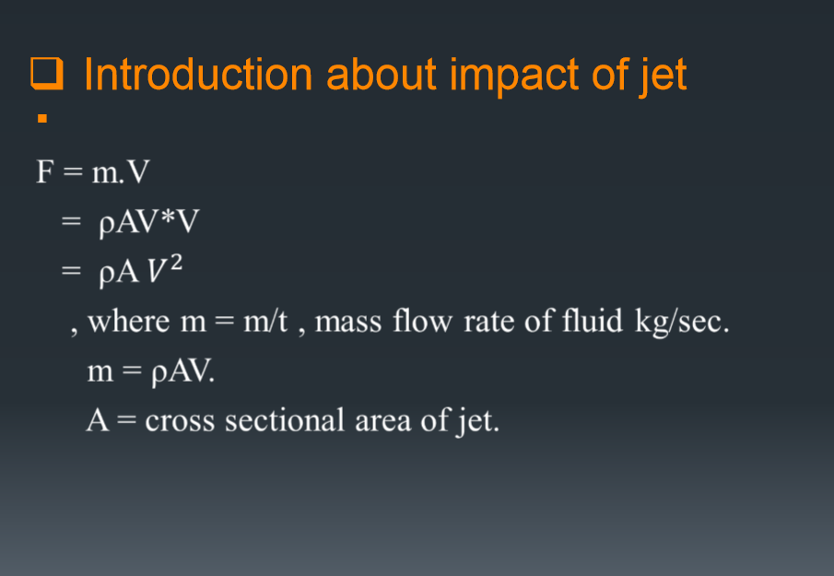

Slide 5
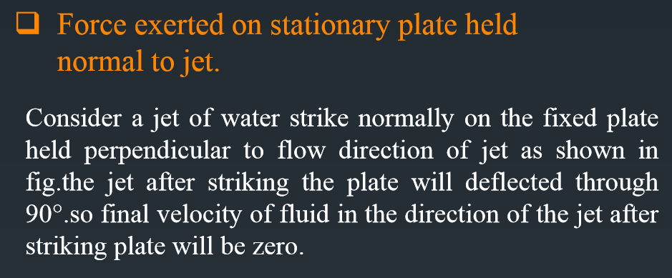
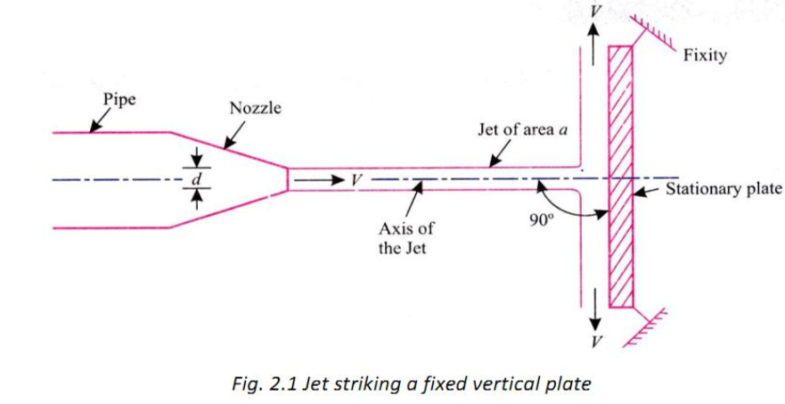

Slide 6
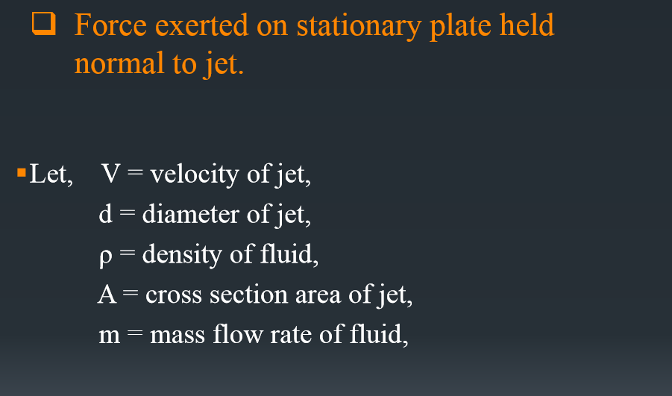

Slide 7
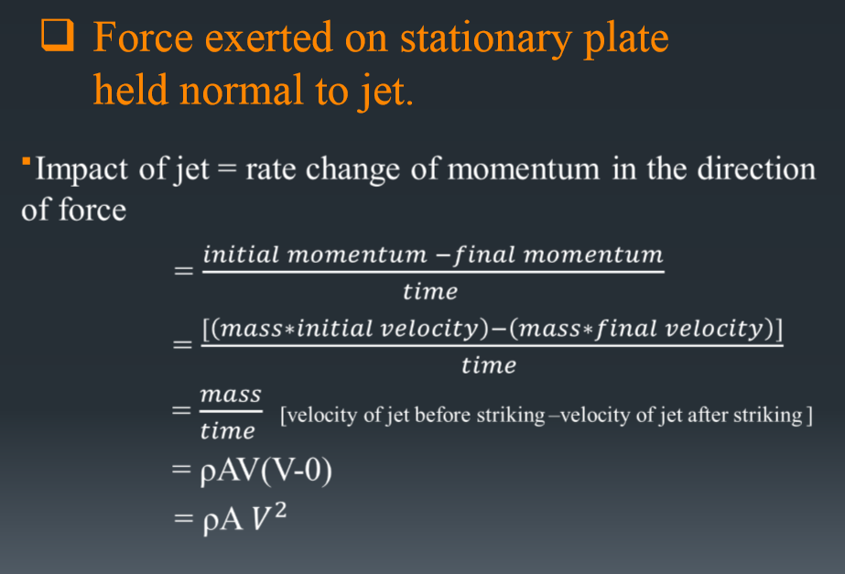

Slide 8
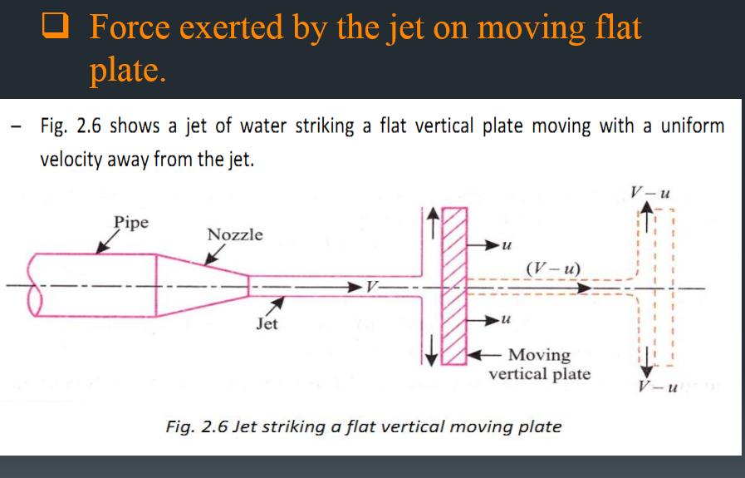

Slide 9
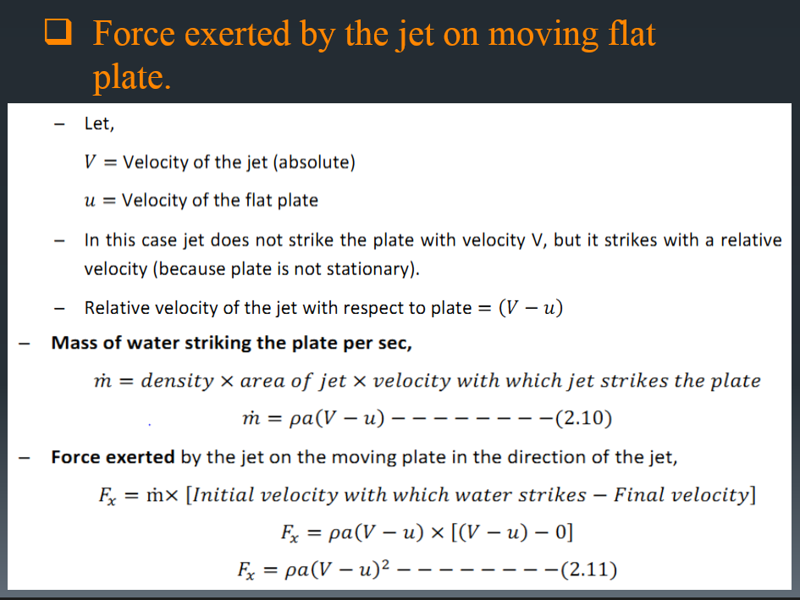

Slide 10
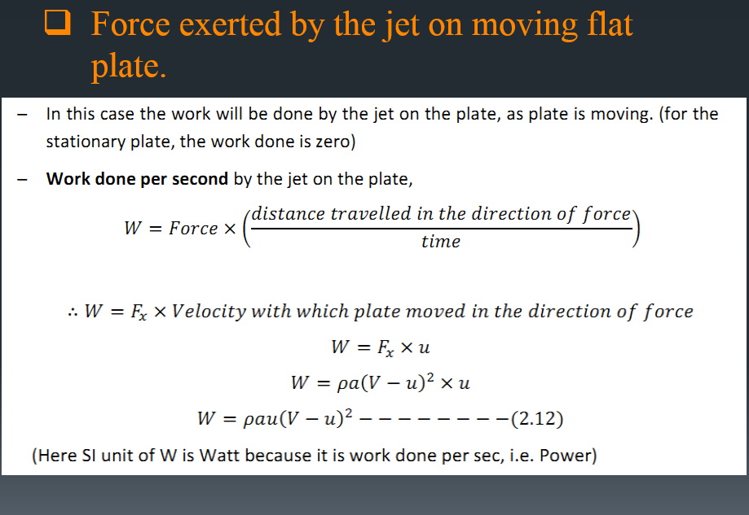

Slide 11
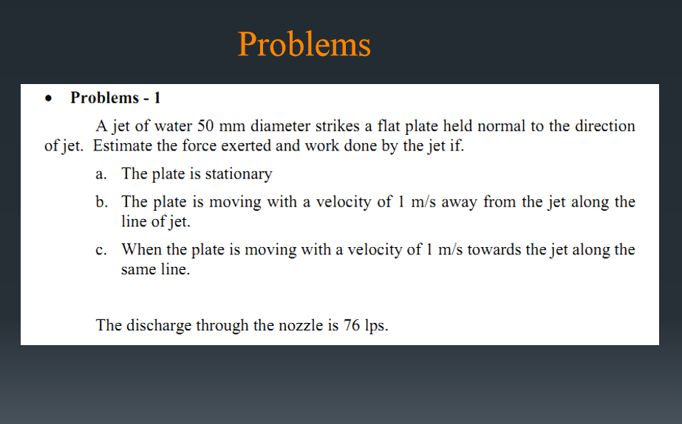

Slide 12
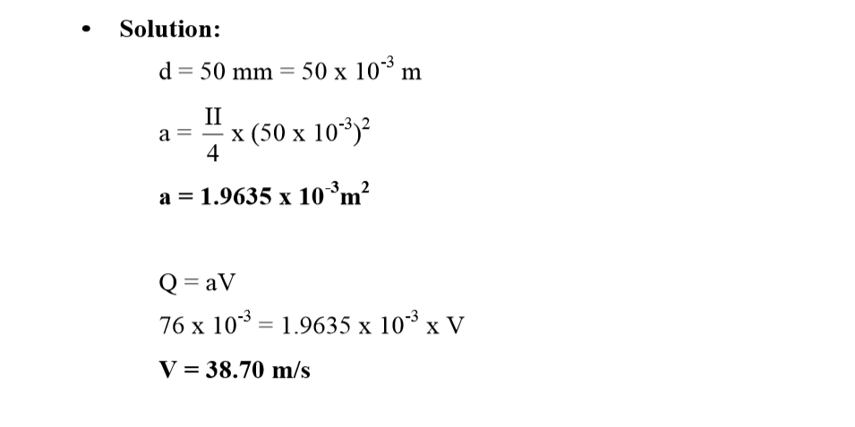

Slide 13
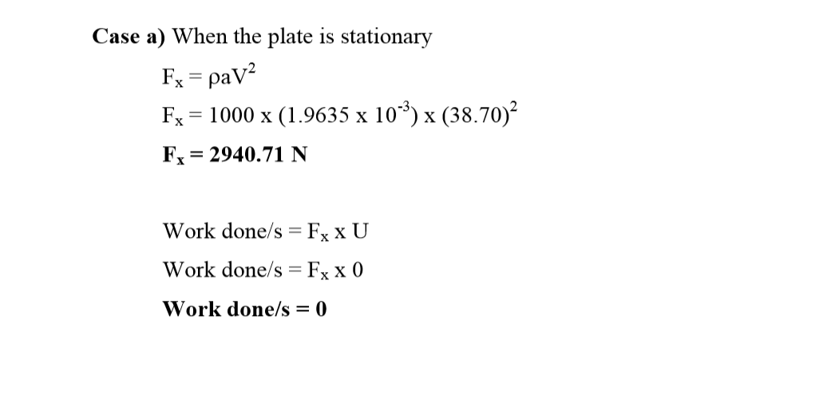

Slide 14
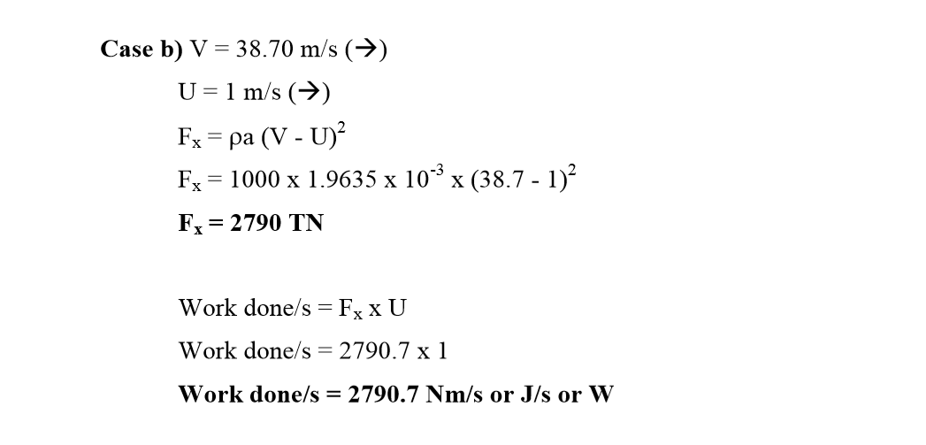

Slide 15
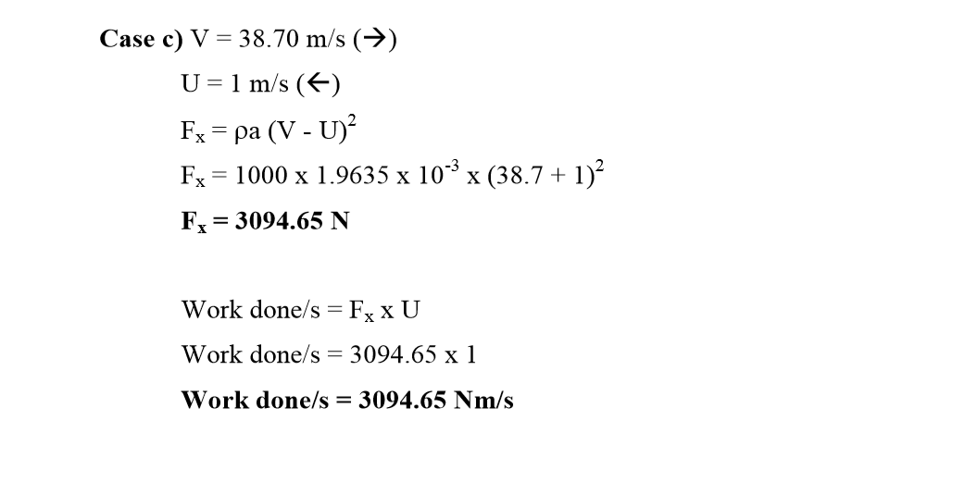

Slide 16
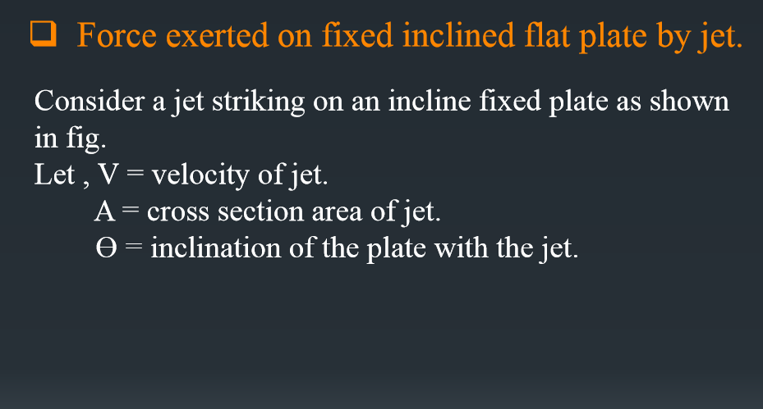

Slide 17
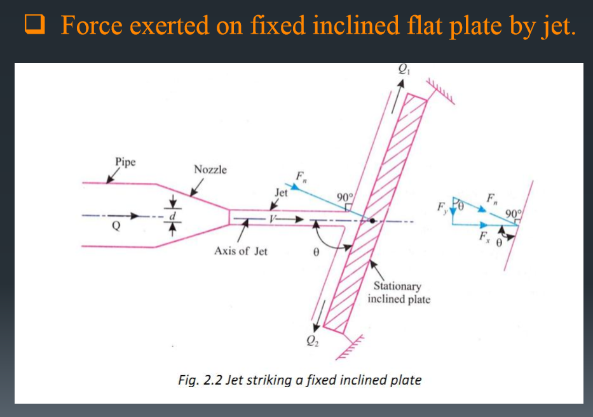

Slide 18
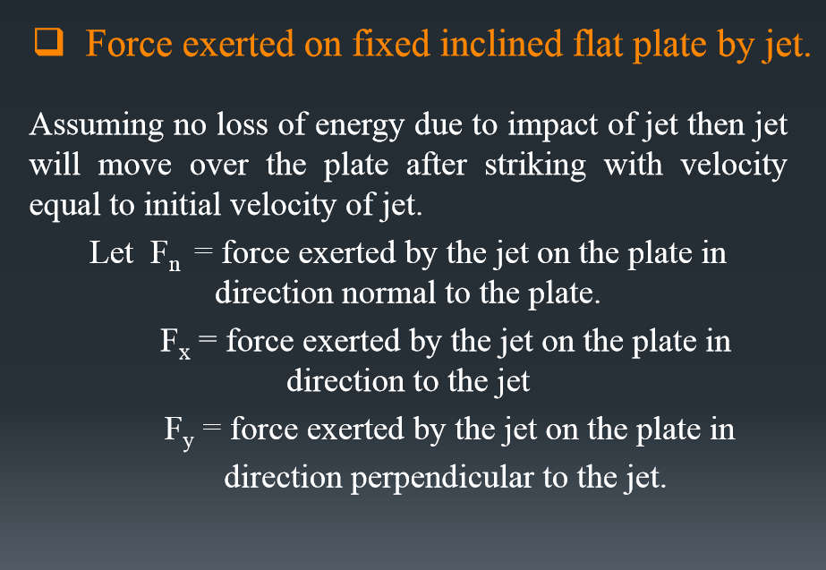

Slide 19
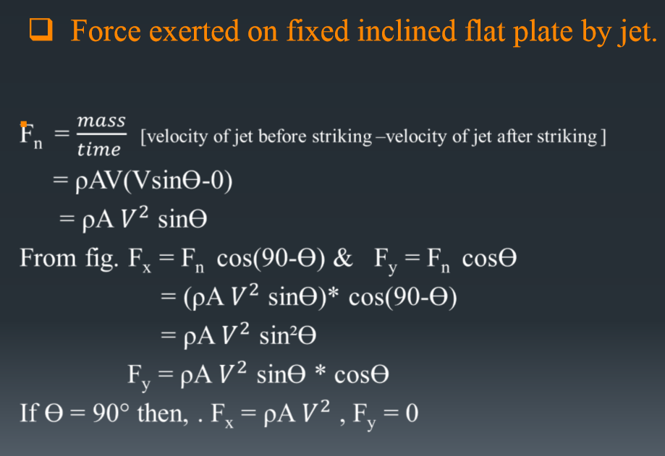

Slide 20
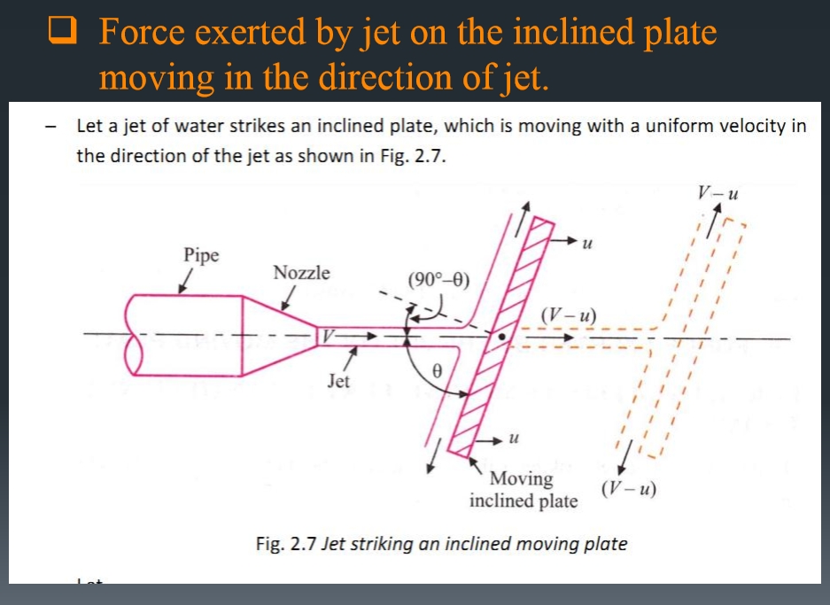

Slide 21
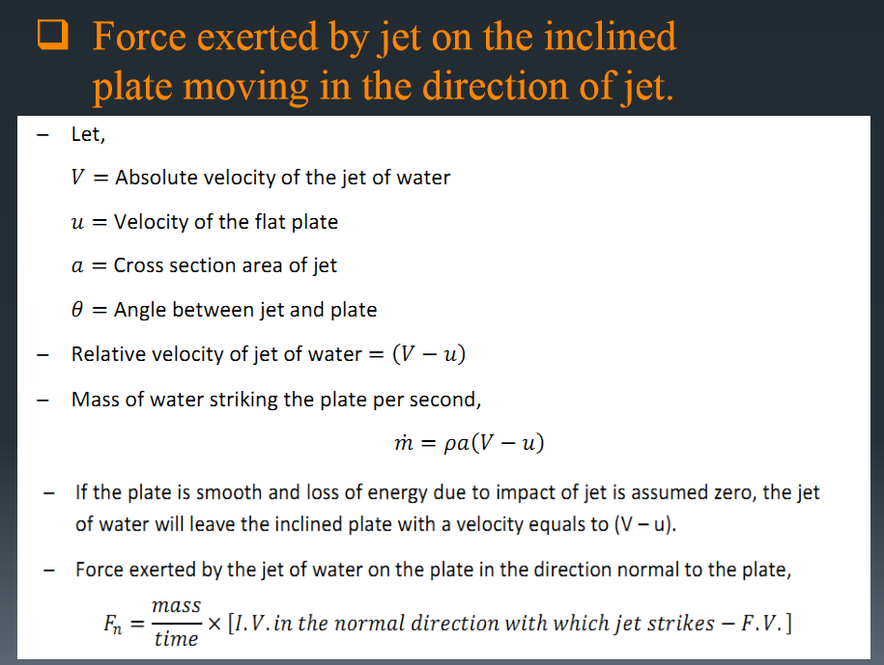

Slide 22
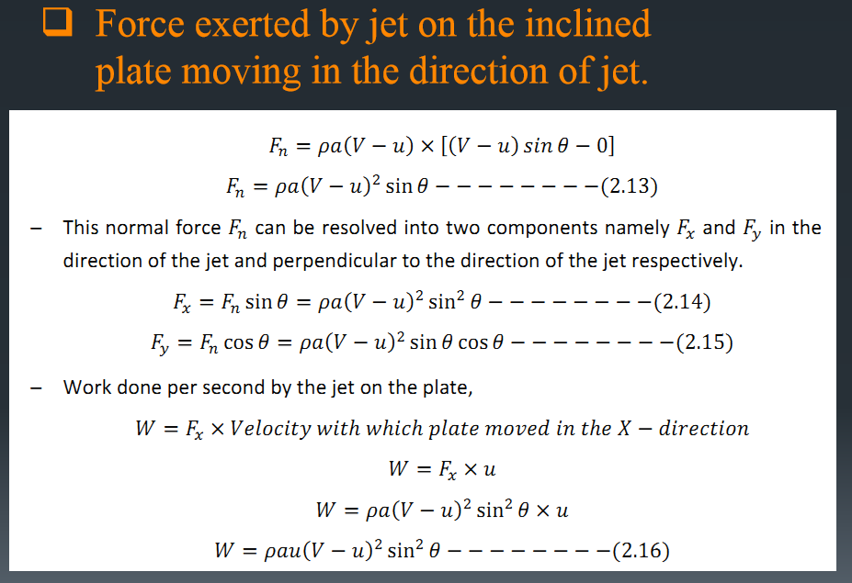

Slide 23
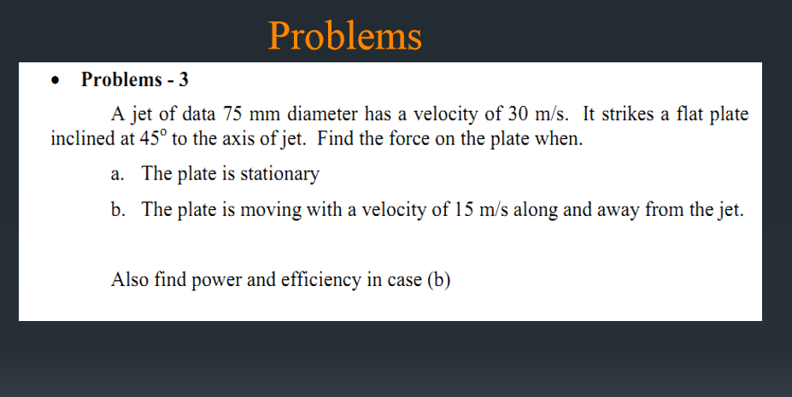

Slide 24
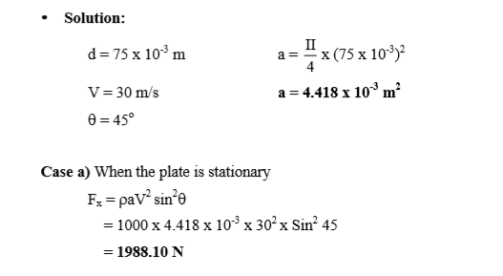

Slide 25
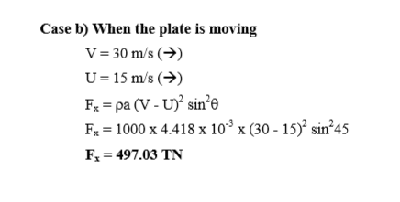
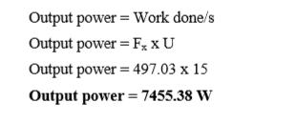

Slide 26
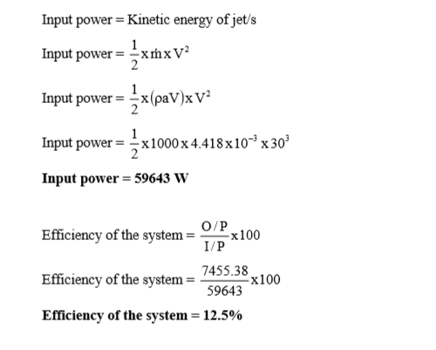

Slide 27
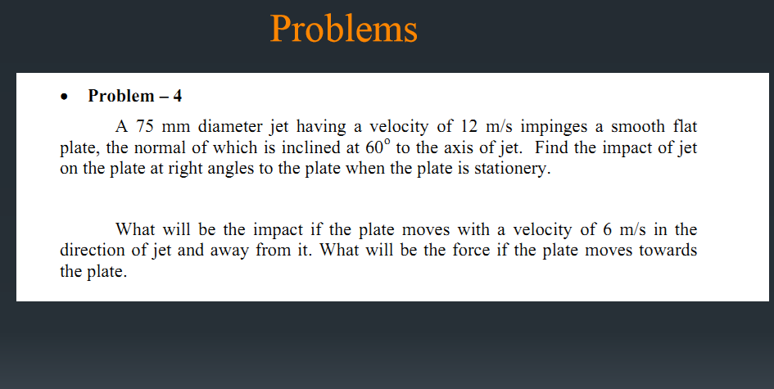

Slide 28
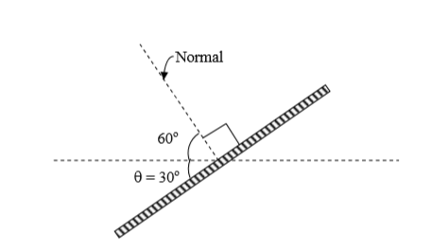
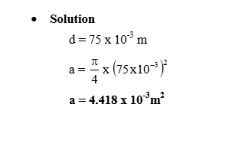

Slide 29
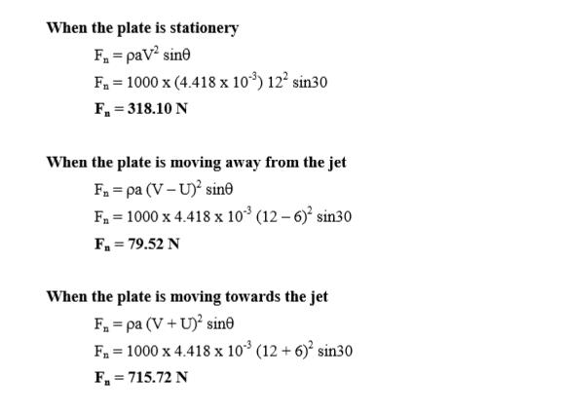

Slide 30
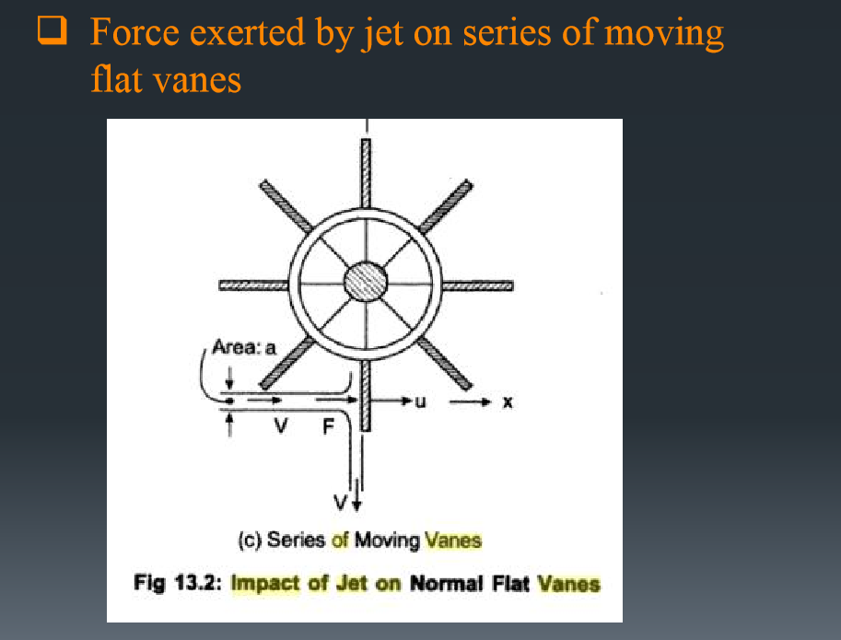

Slide 31
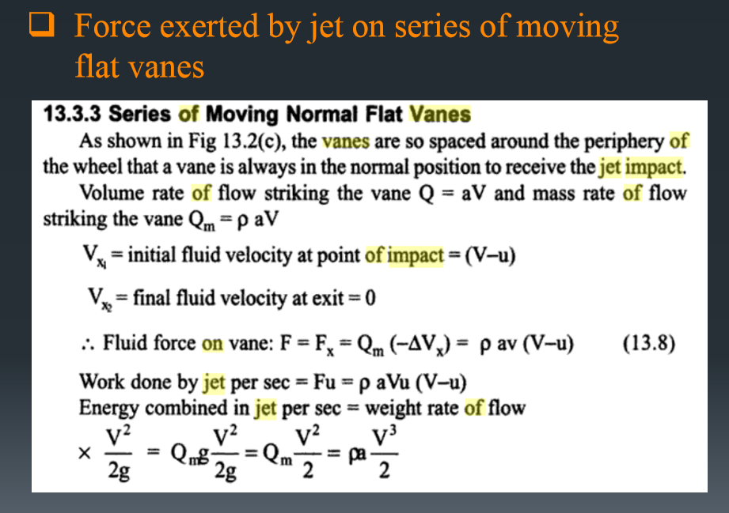

Slide 32
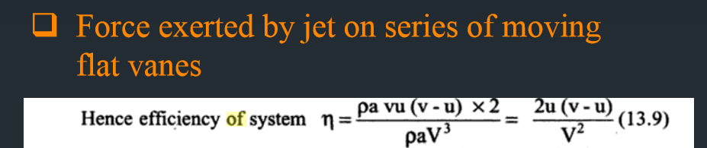


Slide 33
A jet of water 50 mm in diameter, moving with velocity of 15 m/s, impinges on a series of vanes moving with a velocity of 6 m/s. Find (a) force exerted by the jet (b) Work done by the jet (c) Efficiency of the jet.

Slide 34
A jet of water 50 mm in diameter, moving with velocity of 15 m/s, impinges on a series of vanes moving with a velocity of 6 m/s. Find (a) force exerted by the jet (b) Work done by the jet (c) Efficiency of the jet.
Answers:
265 N
1590 W
48%

Slide 35
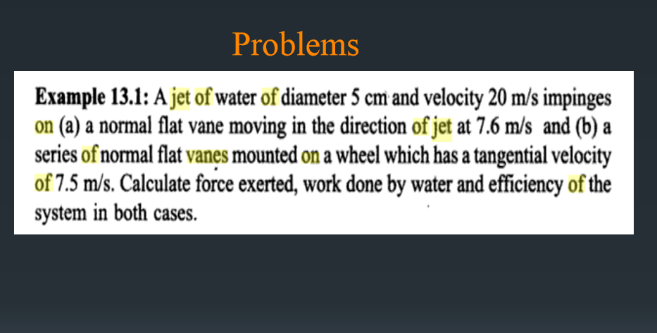

Slide 36
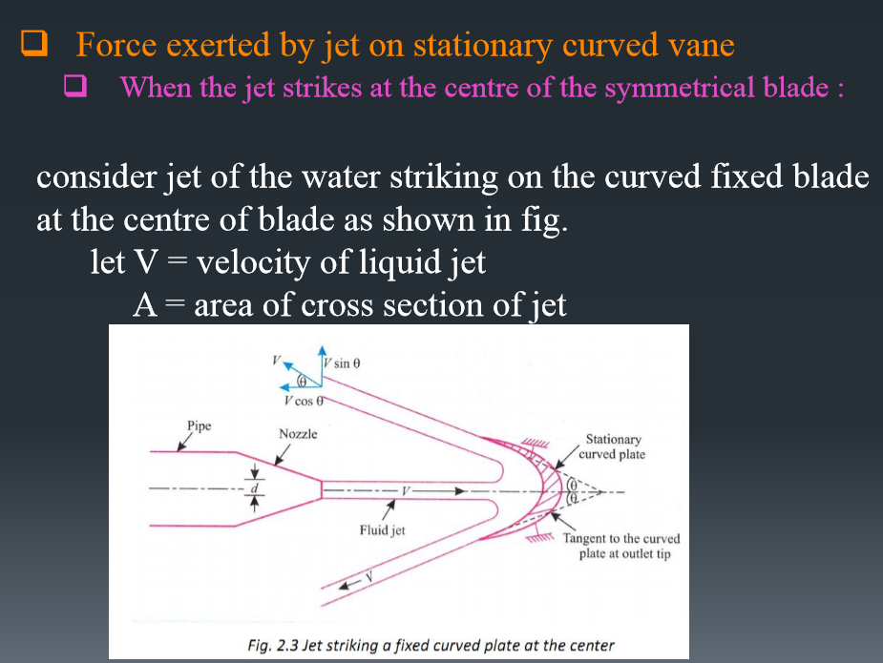

Slide 37
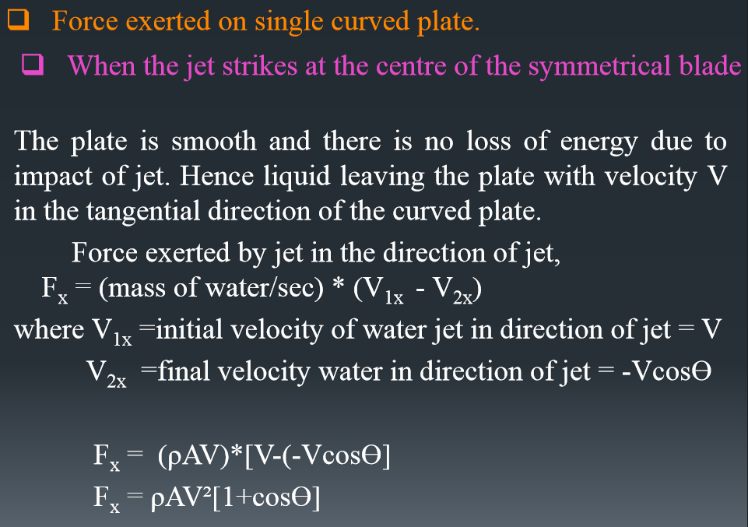

Slide 38
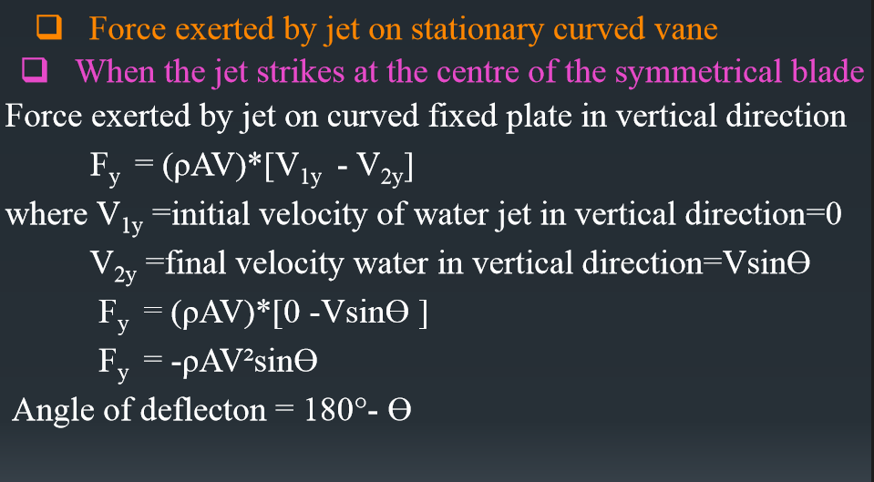

Slide 39
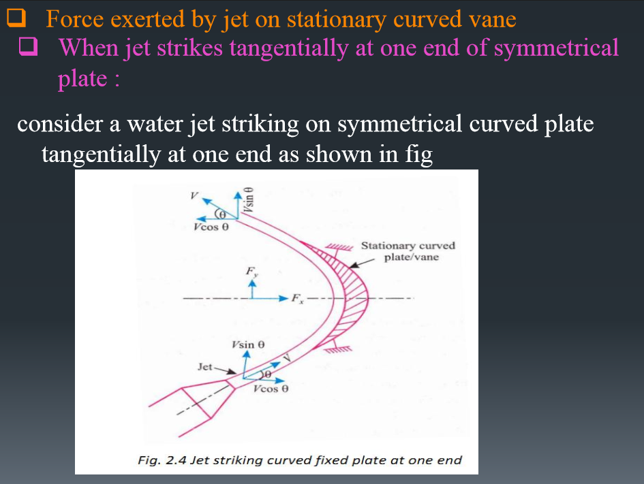

Slide 40
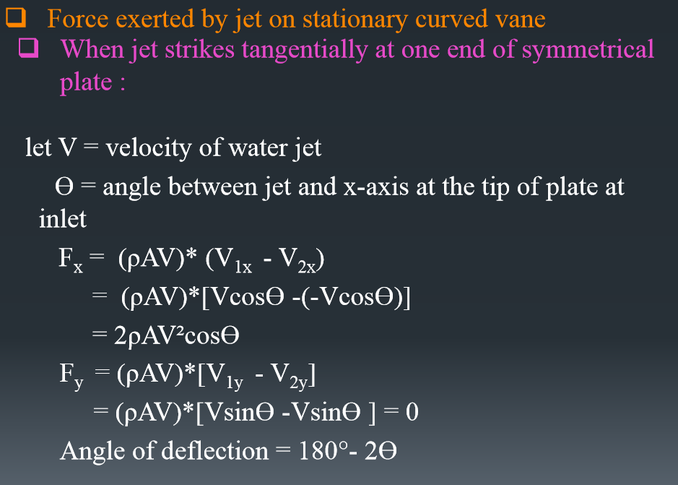

Slide 41
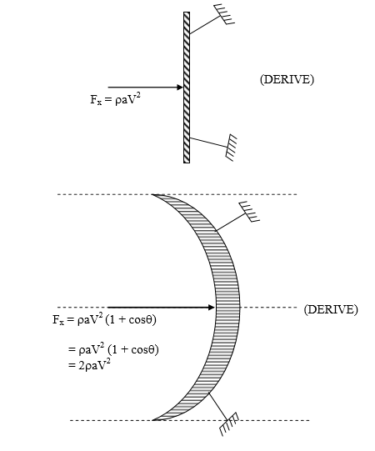
Show that the force exerted by a jet on a hemispherical stationery vane is twice the force exerted by the same jet on flat stationery normal vane.

Slide 42

Show that the force exerted by a jet on a hemispherical stationery vane is twice the force exerted by the same jet on flat stationery normal vane.

Slide 43
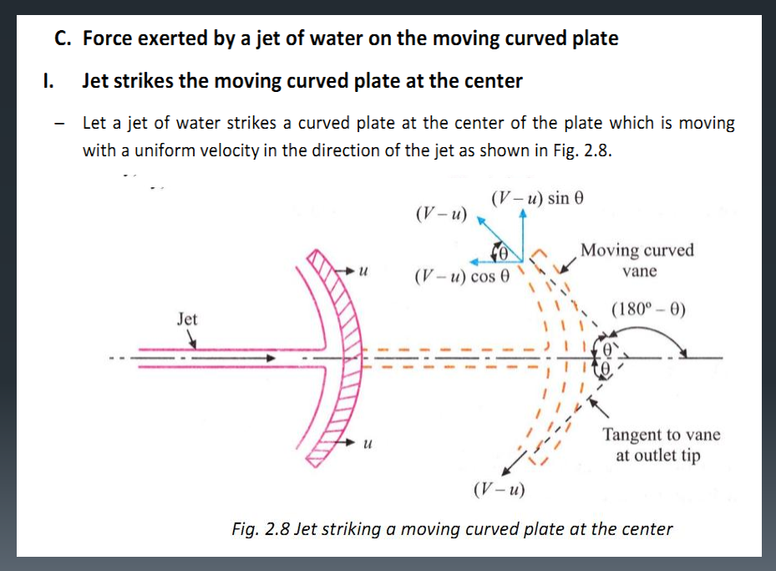

Slide 44
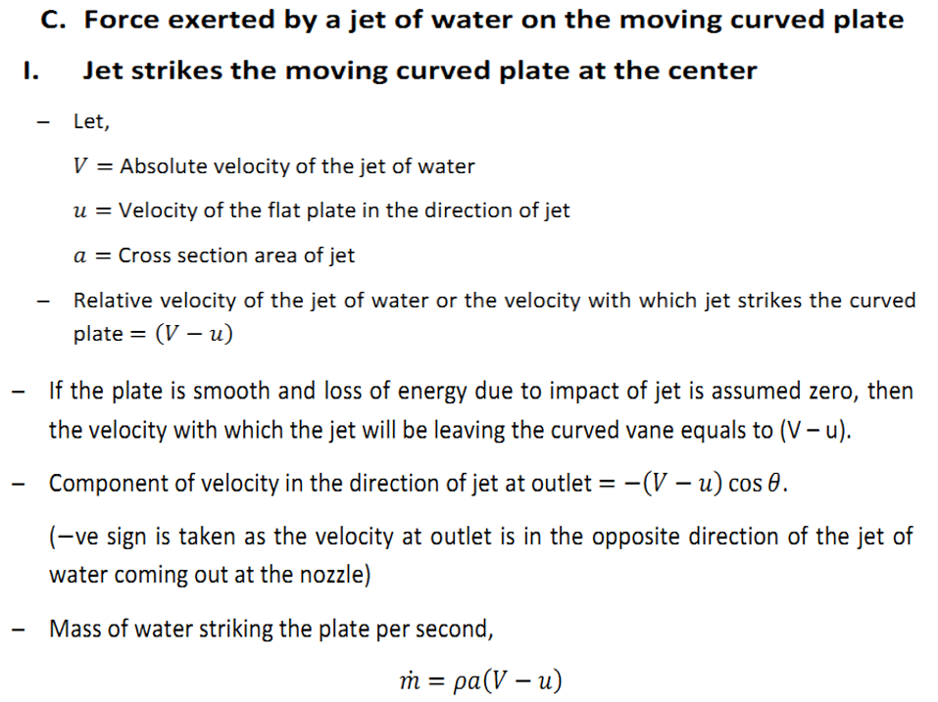

Slide 45
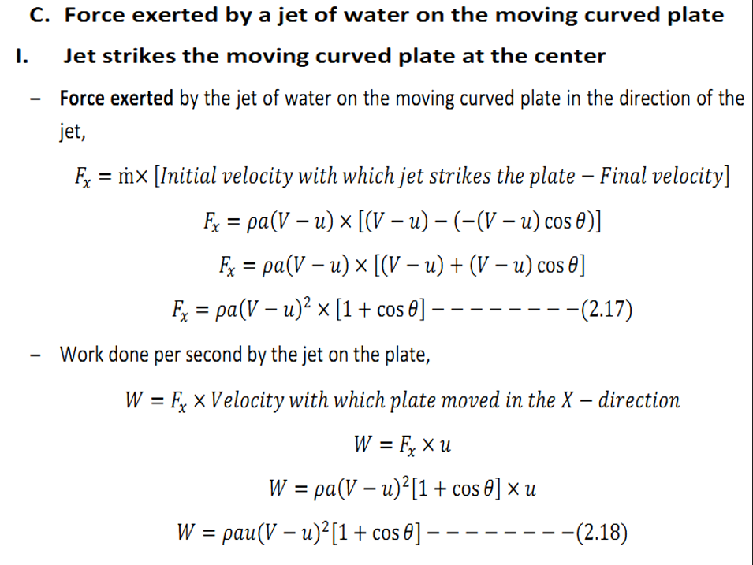

Slide 46
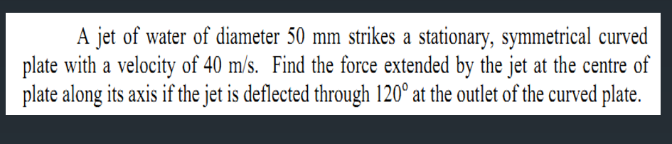

Slide 47
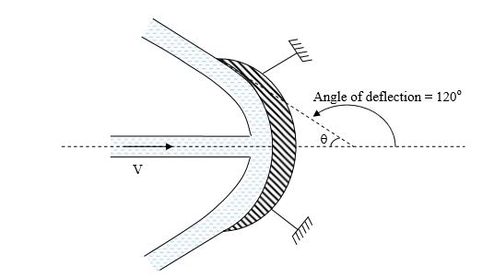

Slide 48
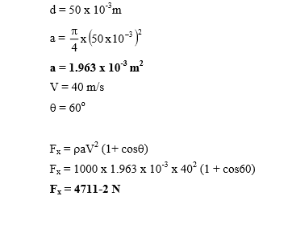

Slide 49
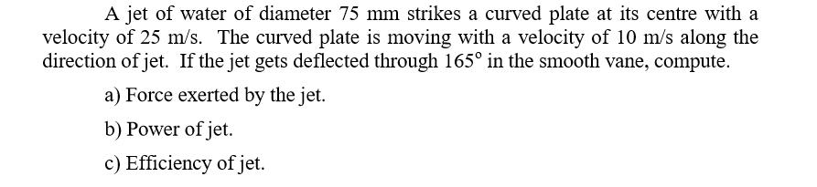

Slide 50
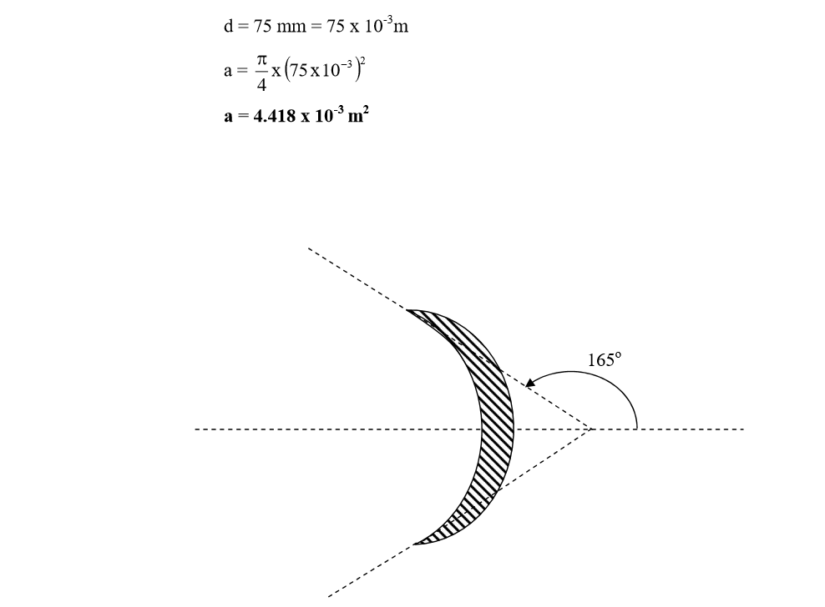

Slide 51
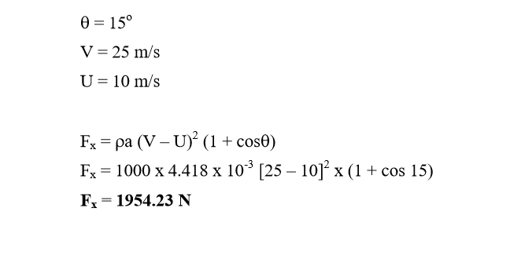

Slide 52


Slide 53


Slide 54


Slide 55


Slide 56


Slide 57


Slide 58


Slide 59


Slide 60


Slide 61


Slide 62


Slide 63


Slide 64



Slide 65



Slide 66


Slide 67

A jet of water, having a velocity of 30 m/s impinges on a curve vane with a velocity of 15 m/s. The jet makes an angle of 30⁰ to the direction of motion of vanes when entering and leaves at an angle of 120⁰. Sketch velocity triangles at entrance and exit, and determine the vane angles, so that the water enters and leaves without shock. Also, determine the force and work done per unit weight of fluid.

Slide 68
A jet of water, having a velocity of 30 m/s impinges on a curve vane with a velocity of 15 m/s. The jet makes an angle of 30⁰ to the direction of motion of vanes when entering and leaves at an angle of 120⁰. Sketch velocity triangles at entrance and exit, and determine the vane angles, so that the water enters and leaves without shock. Also, determine the force and work done per unit weight of fluid.
θ = 53.8
Φ = 15.7

Slide 69


