Slide 1
Hydraulic Jump
Course Co-ordinator: Dr. Anupam Chowdhury Assistant Professor Department of Civil Engineering, RUET
Email: anupam.19ce@gmail.com

Slide 2
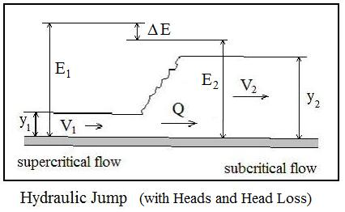
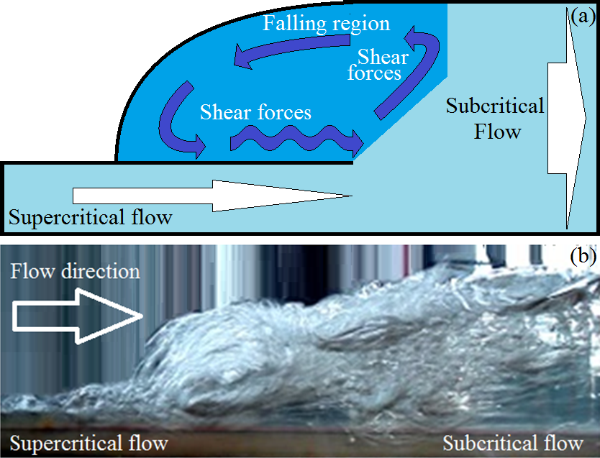
Definition of Hydraulic Jump
A hydraulic jump is a phenomenon in the science of hydraulics which is frequently observed in open channel flow such as rivers and spillways. When liquid at high velocity discharges into a zone of lower velocity, a rather abrupt rise occurs in the liquid surface.

Slide 3
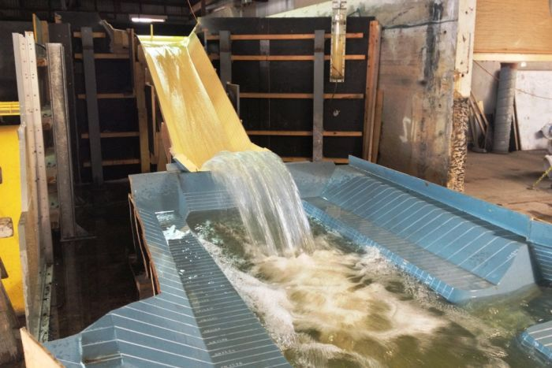
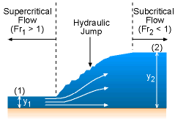
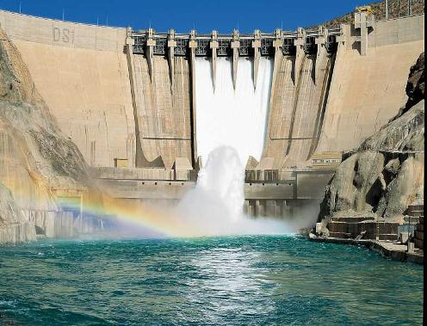
Hydraulic Jump Cont…

Slide 4

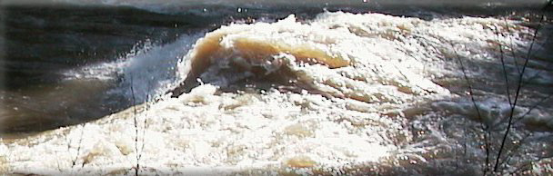
Hydraulic Jump Cont…

Slide 5
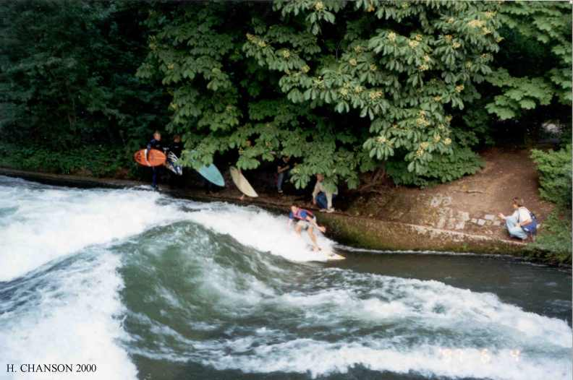
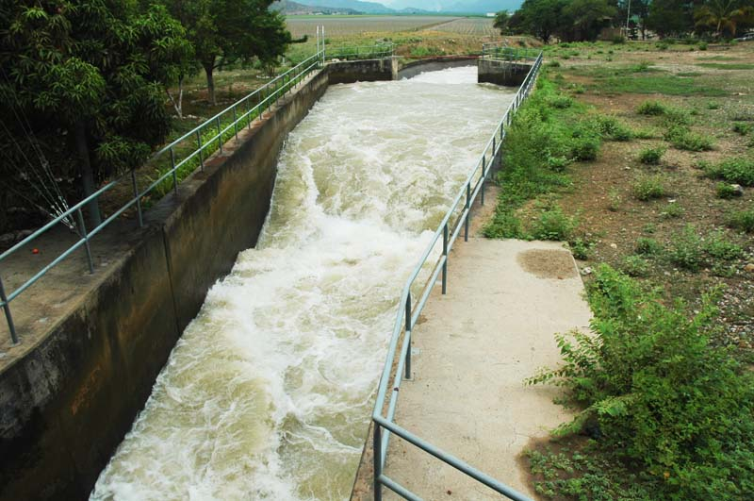
Hydraulic Jump Cont…

Slide 6
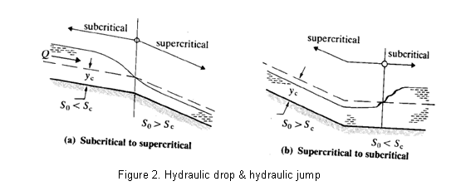
Hydraulic Drop and Jump

Slide 7
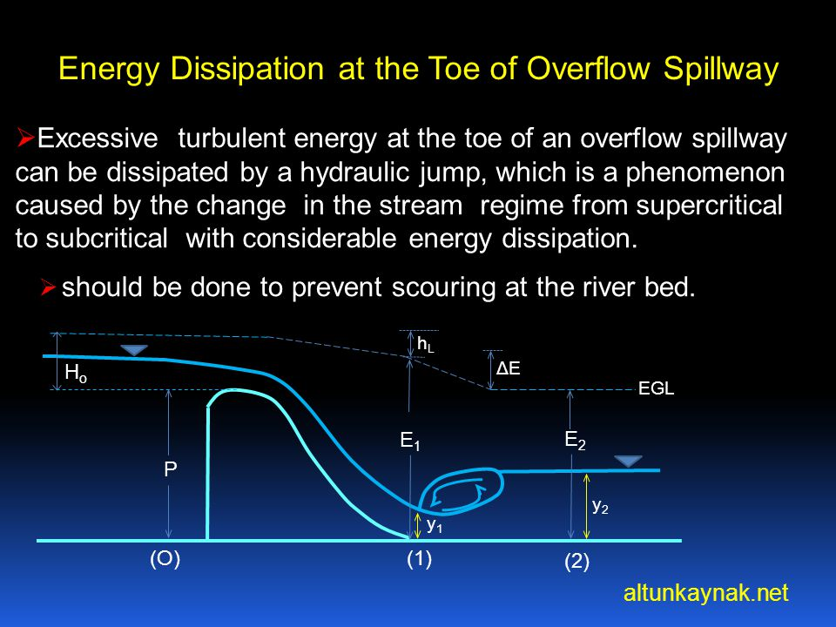
Effect of Hydraulic Jump
It is very common in the field of hydraulics to use hydraulic jump. It is used to perform different functions. Some of the effects of the hydraulic jump are as under:
Actually the hydraulic jump usually acts as the energy dissipater. It distributes the surplus energy of water.

Slide 8
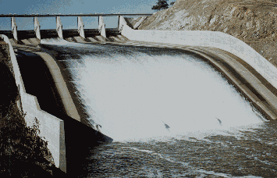
Effect of Hydraulic Jump Cont..
Burrendong Dam spillway showing fully lined chute and full energy dissipator.

Slide 9
Effect of Hydraulic Jump Cont.…
Due to the hydraulic jump, many noticeable disturbances are created in the flowing water like eddies, reverse flow.
Usually when the hydraulic jump takes place, the considerable amount of air is trapped in the water. That air can be helpful in removing the wastes in the streams that are causing pollution.
Hydraulic jump also make the work of different hydraulic structures, effective like weirs, notches and flumes etc.

Slide 10
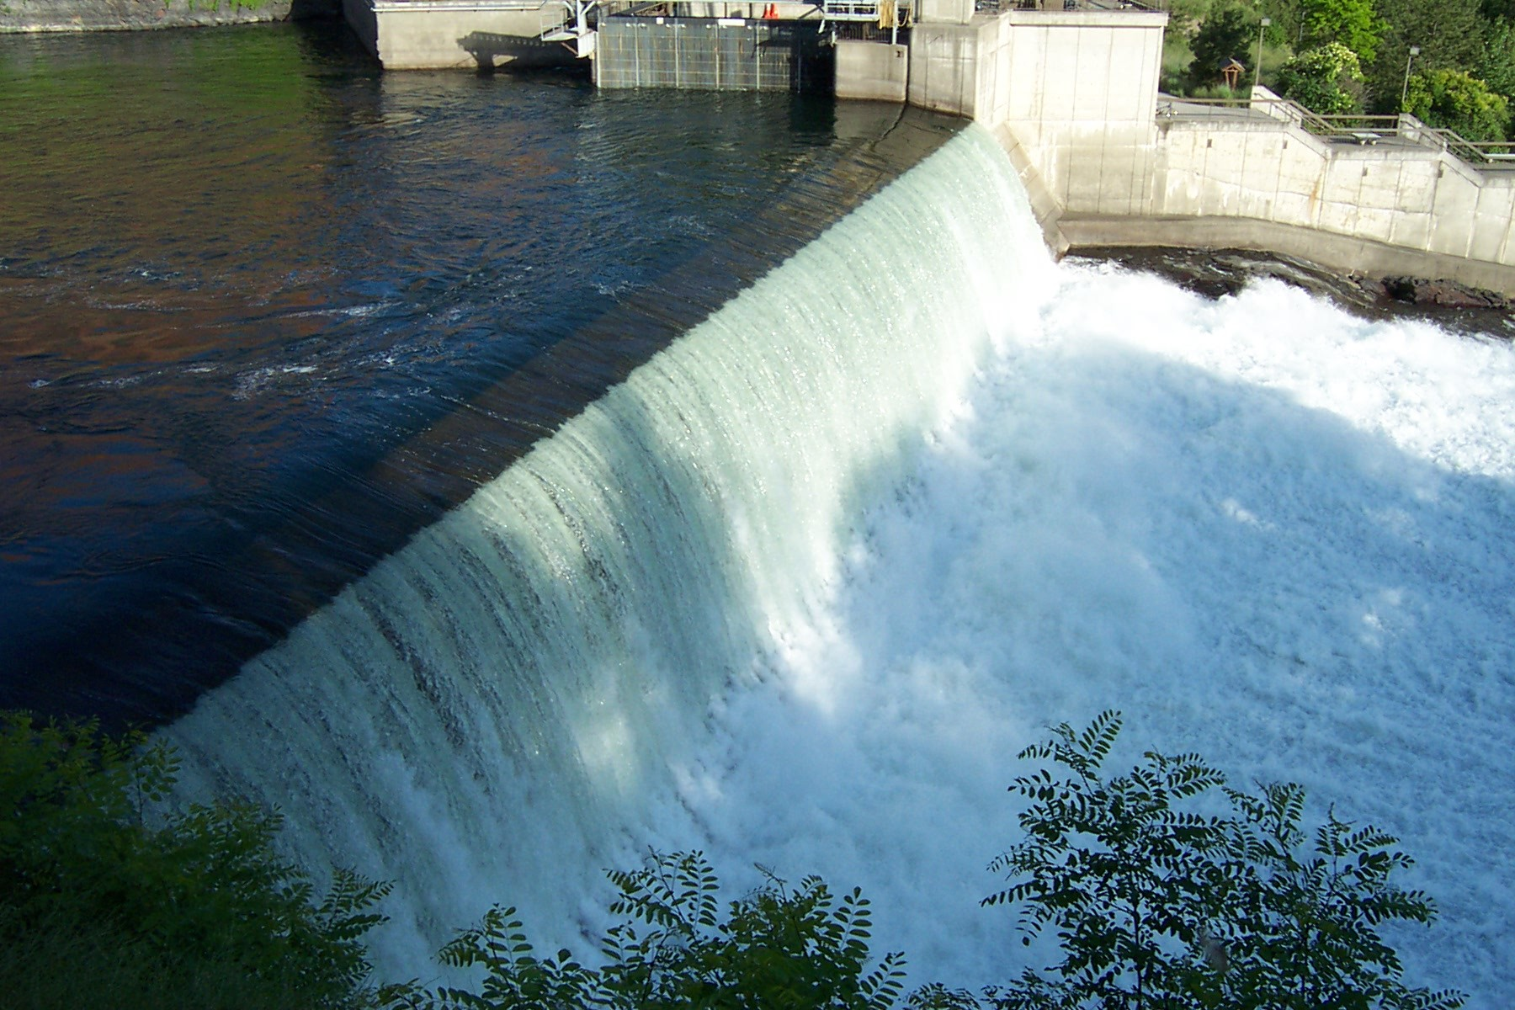
Applications of Hydraulic Jump:
01. Usually hydraulic jump reverses the flow of water. This phenomenon can be used to mix chemicals for water purification.
Weir in Riverfront Park, WA (left) and Hydraulic Jump in Coagulation Chamber (right)

Slide 11
Applications of Hydraulic Jump Cont..
02. Hydraulic jump usually maintains the high water level on the down stream side. This high water level can be used for irrigation purposes.
03. Hydraulic jump can be used to remove the debris from water supply and sewage lines to prevent the blocking.
04. It prevents the scouring action on the down stream side of the dam structure.
05. The reduction of uplift pressure under a structure by increasing weight on its apron.

Slide 12
Classification of Jumps
As mentioned earlier, the Froude number of supercritical flow influences the characteristics of the hydraulic jump. Bradley and Peterka, after extensive experimental investigations, have classified the hydraulic jump into five categories as shown in Figure 28.4. The hydraulic jump is the phenomenon that occurs where there is an abrupt transition from supercritical (inertia dominated) flow to sub critical (gravity dominated) flow. The most important factor that affects the hydraulic jump is the initial Froude number F1.

Slide 13
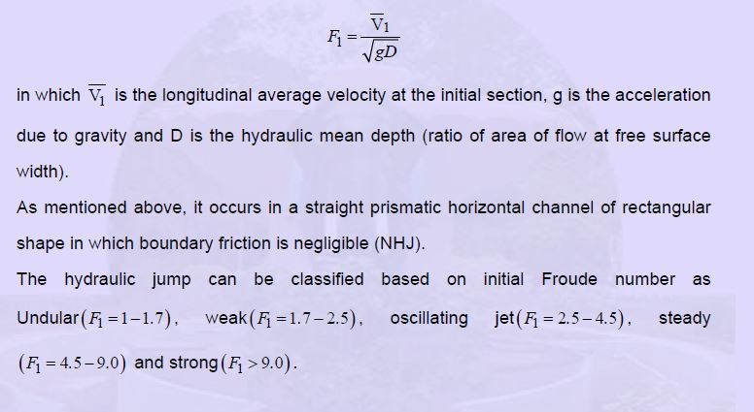
Classification of Jumps Cont..

Slide 14
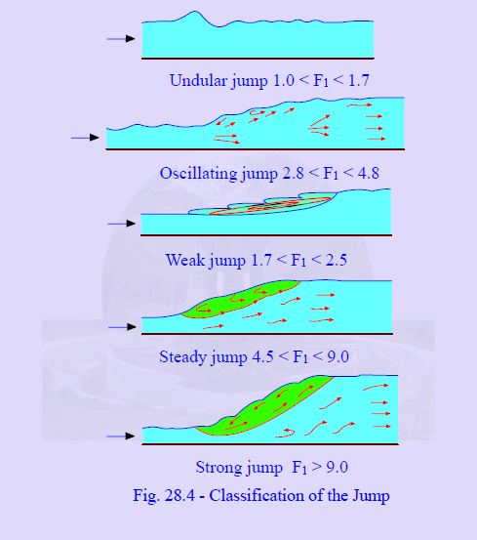
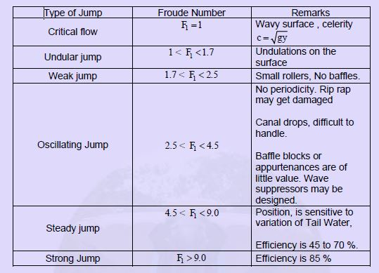
Classification of Jumps Cont..

Slide 15
Sub-critical flow also called Tranquil flow
Super-critical flow also called Torrential flow
Critical depth, Alternate depth……

Slide 16
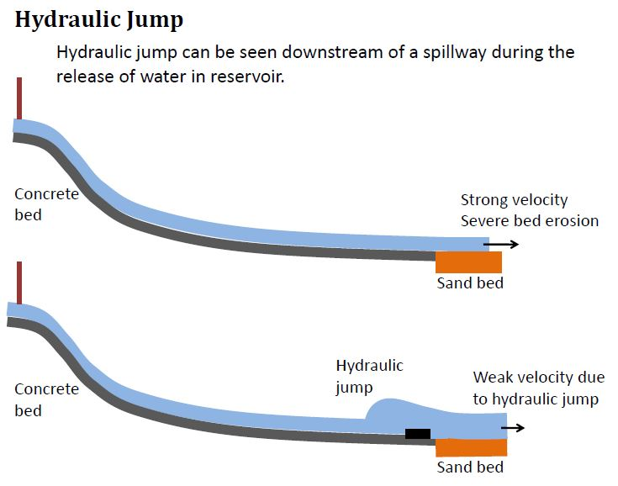

Slide 17
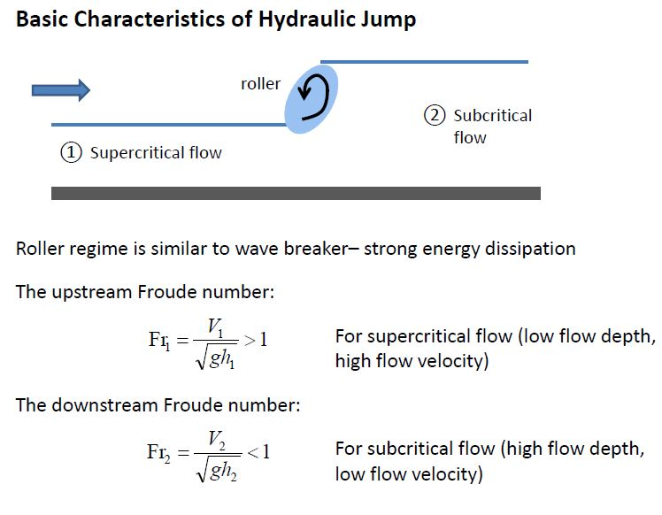

Slide 18
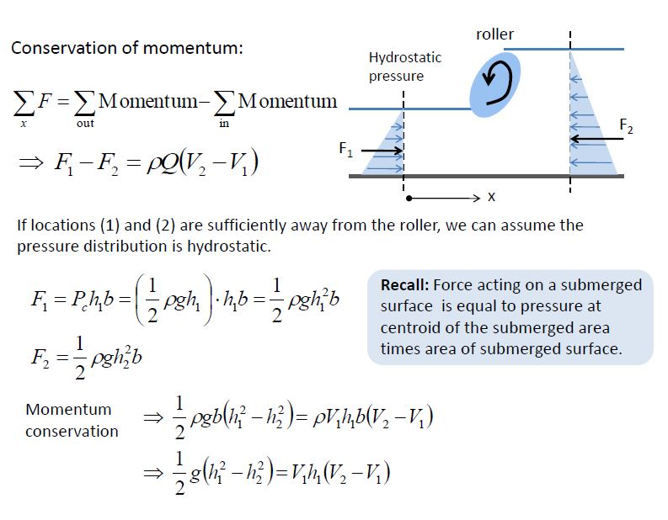

Slide 19
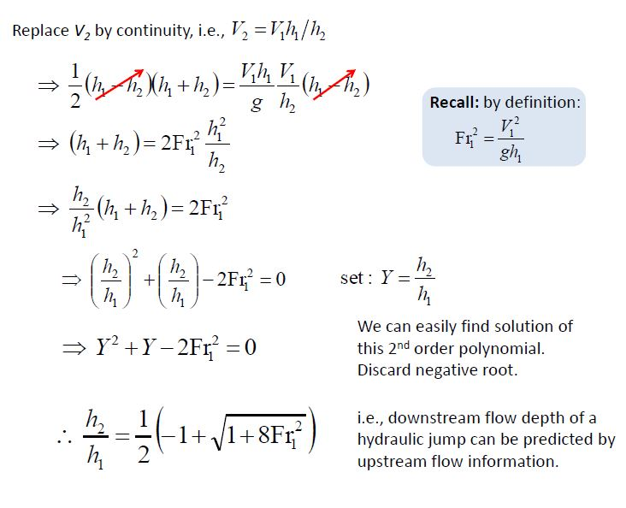

Slide 20
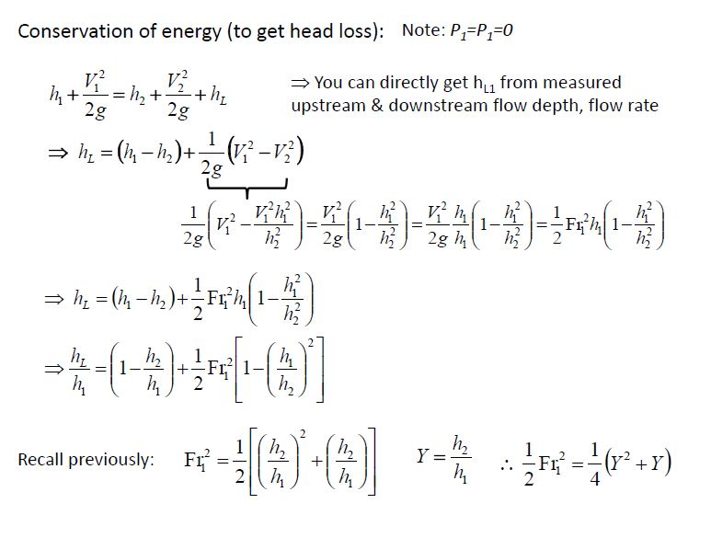

Slide 21
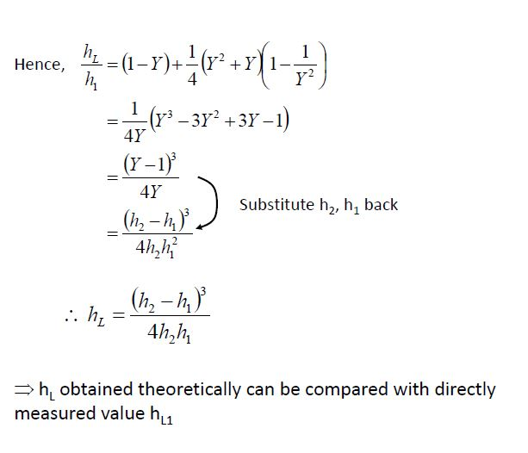

Slide 22
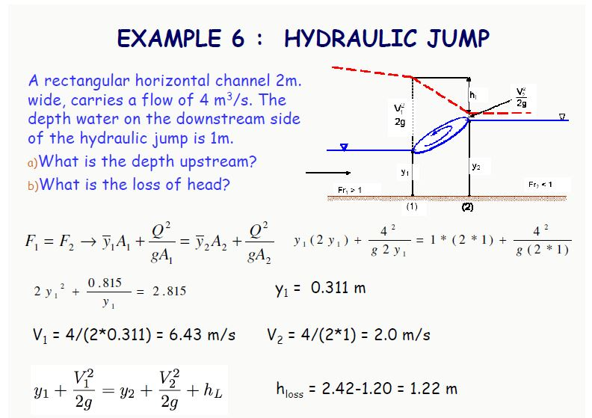

Slide 24
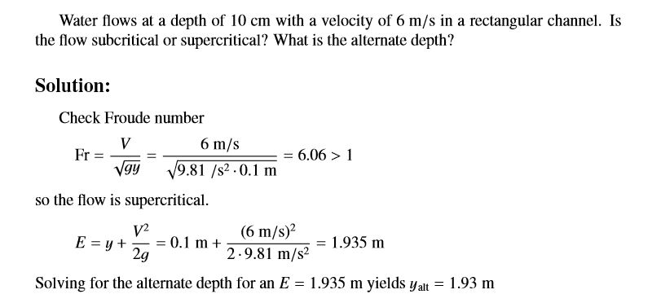
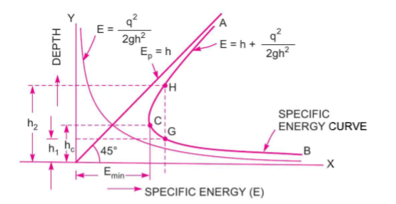

Slide 26
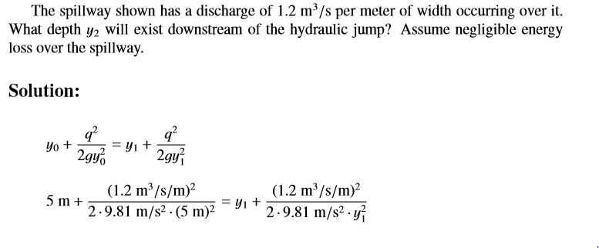
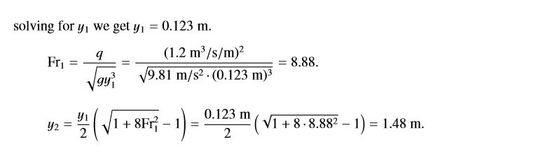

Slide 28
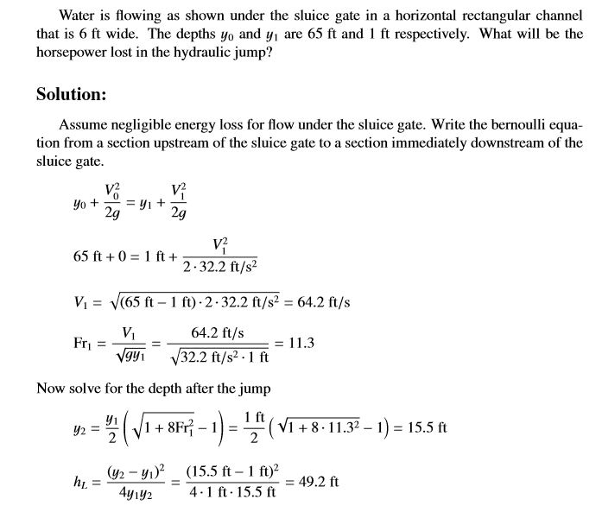


Slide 29
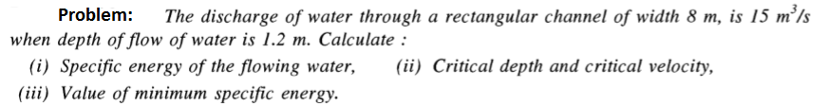

Slide 30
Thank you

