Slide 1
Pumps Course Co-ordinator Dr. Anupam Chowdhury Associate Professor Department of Civil Engineering, RUET

Slide 2
Pumps
Pumps: A pump may be defined as a mechanical device which when imposed in a pipeline, converts the mechanical energy supplied to it from some external source into hydraulic energy and transfers the same to the liquid through the pipeline, thereby increasing the energy of flowing fluid.
There are two main categories of pump:
Rotodynamic pumps
Positive displacement pumps

Slide 3
Pumps
Positive displacement pumps: are defined as those which displace a fixed quantity of liquid with each motion of its pumping elements. They provide pressure by expanding and contracting space between the pumping elements.
A rotodynamic pump: is a pump that uses the rotation of an impeller or propeller to impart velocity to a liquid.

Slide 4
PUMP
Rotodynamic
Positive displacement
Centrifugal
Rotary
Reciprocating
Axial flow
Gear
Piston
Mixed flow
Lobe
Diaphragm
Turbine
Sliding Vane
Plunger
Screw

Slide 5
Difference between Centrifugal Pump and Reciprocating Pump:
S. No. | Centrifugal pump | Reciprocating pump
1. | It is one of the rotary pumps which used kinetic energy of impeller. | It is a positive displacement type pump which is forced by piston.
2. | It continuously discharges the fluid. | It does not discharge the fluid continuously.
3. | In centrifugal pump the flow rate decreases which increasing the pressure. | The pressure does not affect flow rate in reciprocating pumps.
4. | It is used for pumping high viscous fluid. | It is used for pump low viscous fluid.
5. | In this pumps discharge is inversely promotional to the viscosity of fluid. | In reciprocating pump viscosity of fluid does not affect the discharge rate.

Slide 6
Difference between Centrifugal Pump and Reciprocating Pump:
S. No. | Centrifugal pump | Reciprocating pump
6. | Efficiency of these pumps are low compare to reciprocating pump. | Efficiency is high.
7. | Centrifugal pump have problem of priming. | It does not have any problem of priming.
8. | It uses impellers to transfer energy to fluid. | It uses piston cylinder device to transfer energy to fluid.
9. | They are lighter than reciprocating pumps. | These are heavier compare to centrifugal pump.

Slide 7
Difference between Centrifugal Pump and Reciprocating Pump:
S. No. | Centrifugal pump | Reciprocating pump
10. | It gives higher discharge at low heads. | These gives higher heads at low discharge.
11. | It is less costly. | These are costly.
12. | These pumps required less maintenance. | These required higher maintenance.

Slide 8
Difference between Centrifugal Pump and Reciprocating Pump:
S. No. | Centrifugal pump | Reciprocating pump
13. | Centrifugal pumps are easy to install. These required less floor space. | These pumps are difficult to install. These required more floor area.
14. | It is mostly used for domestic purpose and where higher discharge at low head required. | These are mostly used in industries and high viscous fluid pumped at a high head.

Slide 9
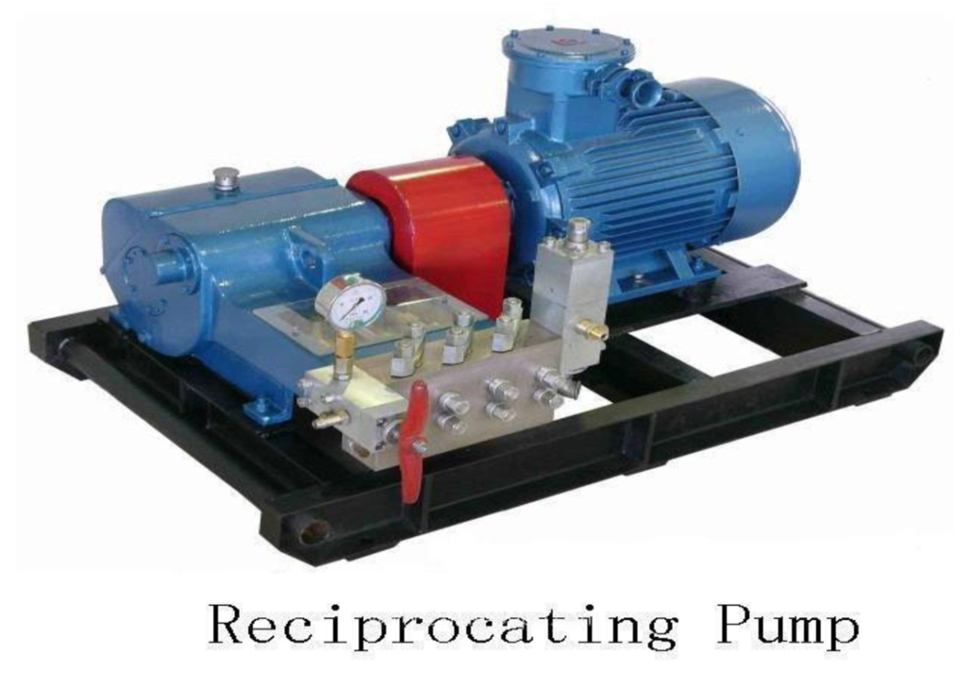
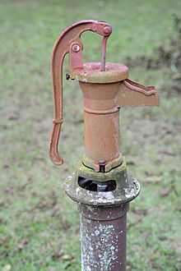
Reciprocating pump
Reciprocating pumps are positive displacement pump, i.e. initially, a small quantity of liquid is taken into a chamber and is physically displaced and forced out with pressure by a moving mechanical elements.
The use of reciprocating pumps is being limited these days and being replaced by centrifugal pumps.
Notes:
9

Slide 10
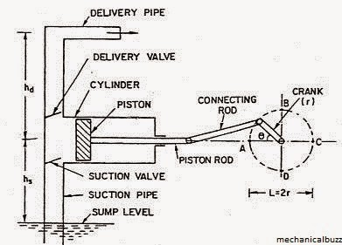
Reciprocating pump
Main components:
Notes:
10

Slide 11
Working of Reciprocating Pump
When the piston moves from the left to the right, a suction pressure is produced in the cylinder. If the pump is started for the first time or after a long period, air from the suction pipe is sucked during the suction stroke, while the delivery valve is closed. Liquid rises into the suction pipe by a small height due to atmospheric pressure on the sump liquid.
During the delivery stroke, air in the cylinder is pushed out into the delivery pipe by the thrust of the piston, while the suction valve is closed. When all the air from the suction pipe has been exhausted, the liquid from the sump is able to rise and enter the cylinder.
During the delivery stroke it is displaced into the delivery pipe. Thus the liquid is delivered into the delivery tank intermittently, i.e. during the delivery stroke only.
Notes:
11

Slide 12
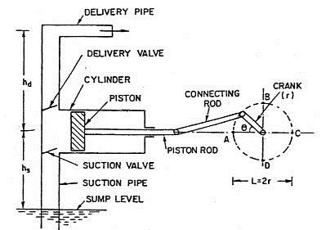
Classification of Reciprocating Pump
Following are the main types of reciprocating pumps:
According to use of piston sides
Single acting Reciprocating Pump:
If there is only one suction and one delivery pipe and the liquid is filled only on one side of the piston, it is called a single-acting reciprocating pump.
Notes:
12

Slide 13
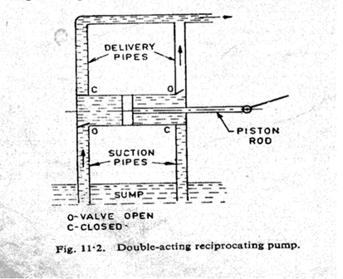
Classification of Reciprocating Pump
Following are the main types of reciprocating pumps:
According to use of piston sides
Double acting Reciprocating Pump:
A double-acting reciprocating pump has two suction and two delivery pipes, Liquid is receiving on both sides of the piston in the cylinder and is delivered into the respective delivery pipes.
Notes:
13

Slide 14
Classification of Reciprocating pumps
According to number of cylinder
Reciprocating pumps having more than one cylinder are called multi-cylinder reciprocating pumps.
Single cylinder pump
A single-cylinder pump can be either single or double acting
Double cylinder pump (or two throw pump)
A double cylinder or two throw pump consist of two cylinders connected to the same shaft.
Notes:
14

Slide 15
Classification of Reciprocating pumps
According to number of cylinder
Triple cylinder pump (three throw pump)
A triple-cylinder pump or three throw pump has three cylinders, the cranks of which are set at 120⁰ to one another. Each cylinder is provided with its own suction pipe delivery pipe and piston.
There can be four-cylinder and five cylinder pumps also, the cranks of which are arranged accordingly.
Notes:
15

Slide 16
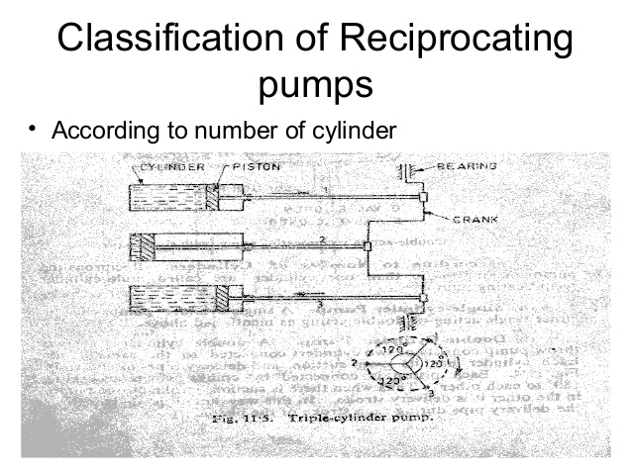
Notes:
16

Slide 17
Discharge through a Reciprocating Pump
Let
A = cross sectional area of cylinder
r = crank radius
N = rpm of the crank
L = stroke length (2r)
Discharge through pump per second=
Area x stroke length x rpm/60
This will be the discharge when the pump is single acting.
Notes:
17

Slide 18
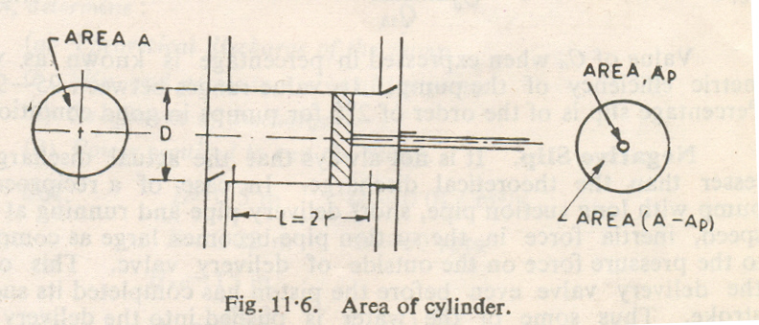
Discharge through a Reciprocating Pump
Notes:
18

Slide 19
Discharge through a Reciprocating Pump
Discharge in case of double acting pump
Discharge/Second =
Where, A_{p} = Area of cross-section of piston rod
However, if area of the piston rod is neglected
Discharge/Second =
Notes:
19

Slide 20
Discharge through a Reciprocating Pump
Thus discharge of a double-acting reciprocating pump is twice than that of a single-acting pump.
Owing to leakage losses and time delay in closing the valves, actual discharge Q_{a} usually lesser than the theoretical discharge Q_{th}.
Notes:
20

Slide 21
Slip
Slip of a reciprocating pump is defined as the difference between the theoretical and the actual discharge.
i.e. Slip = Theoretical discharge - Actual discharge
= Q_{th}- Q_{a}
Slip can also be expressed in terms of % and given by
Notes:
21

Slide 22
Slip & co-efficient of discharge
Where, C_{d} is known as co-efficient of discharge and is defined as the ratio of the actual discharge to the theoretical discharge.
C_{d} = Q_{a} / Q_{th}.
Value of C_{d} when expressed in percentage is known as volumetric efficiency of the pump. Its value ranges between 95-98%.
Percentage slip is of the order of 2% for pumps in good conditions.
Notes:
22

Slide 23
Negative slip
It is not always that the actual discharge is lesser than the theoretical discharge. In case of a reciprocating pump with long suction pipe, short delivery pipe and running at high speed, inertia force in the suction pipe becomes large as compared to the pressure force on the outside of delivery valve. This opens the delivery valve even before the piston has completed its suction stroke. Thus some of the water is pushed into the delivery pipe before the delivery stroke is actually commenced. This way the actual discharge becomes more than the theoretical discharge.
Thus co-efficient of discharge increases from one and the slip becomes negative.
Notes:
23

Slide 24
Power Input
Consider a single acting reciprocating pump.
Let
h_{s} = Suction head or difference in level between centre line of cylinder and the sump.
h_{d} = Delivery head or difference in between centre line of cylinder and the outlet of delivery pipe.
H_{st} = Total static head
= h_{s} + h_{d}
Theoretical work done by the pump
= ρ Q_{th} g H_{st}
Notes:
24

Slide 25
Power Input
Power input to the pump
However, due to the leakage and frictional losses, actual power input will be more than the theoretical power.
Let η = Efficiency of the pump.
Then actual power input to the pump
Notes:
25

Slide 26
Problem-1: A single-acting reciprocating pump discharge 0.018 m³ /s of water per second when running at 60 rpm. Stroke length is 50 cm and the diameter of the piston is 22 cm. If the total lift is 15 m, determine: a) Theoretical discharge of the pump b) Slip and percentage slip of the pump c) Co-efficient of discharge d) Power required running the pump

Slide 27
Problem-1: A single-acting reciprocating pump discharge 0.018 m³ /s of water per second when running at 60 rpm. Stroke length is 50 cm and the diameter of the piston is 22 cm. If the total lift is 15 m, determine: a) Theoretical discharge of the pump b) Slip and percentage slip of the pump c) Co-efficient of discharge d) Power required running the pump
Solution:
L = 0.5 m
Q_{a} = 0.018m³ /s
D = 0.22 m
N = 60 rpm
H_{st} = 15 m

Slide 28
Problem-1
Solution:
(a)
Q_{th} = (π/4)x(0.22)²x(0.5x60/60)
Q_{th} = 0.019 m³ /s
(b) Slip = Q_{th} - Q_{a}
Slip = 0.019 – 0.018
= 0.001 m³ /s
Percentage slip = (Q_{th} - Q_{a})/ Q_{th}
= (0.019-0.018)/0.019
= 0.0526 or 5.26%
.
Notes:
28

Slide 29
Problem-1
Solution:
(c) C_{d} = Q_{a} / Q_{th}
= 0.018/0.019
= 0.947
(d) Power Input
= ρ Q_{th} g H_{st} (Neglecting Losses)
= 1000 x 0.019 x 9.81x 15
= 2796 w or 2.796 kW
.
Notes:
29

Slide 30
Problem-2: A three-throw reciprocating pump delivering 0.1 m³ /s of water against a head of 100 m. Diameter and stroke length of the cylinder are 25 cm and 50 cm respectively. Friction losses amount to 1 m in the suction pipe and 16 m in the delivery pipe. If the velocity of water in the delivery pipe is 1.4 m/s, pump efficiency 90% and slip 2%, determine the rotational speed and the power required.

Slide 31
Problem-2: A three-throw reciprocating pump delivering 0.1 m³ /s of water against a head of 100 m. Diameter and stroke length of the cylinder are 25 cm and 50 cm respectively. Friction losses amount to 1 m in the suction pipe and 16 m in the delivery pipe. If the velocity of water in the delivery pipe is 1.4 m/s, pump efficiency 90% and slip 2%, determine the rotational speed and the power required.
Solution:
H_{st} = 100 m Qa = 0.1 m³ /s
D = 0.25 m L = 0.5 m
h_{fs} = 1 m h_{fd} = 16 m
η_{h} = 0.9 s = 0.02
Vd = 1.4 m/s

Slide 32
Problem-2
Solution:
We know that, s = (Q_{th} - Q_{a})/ Q_{th}
0.02 = 1 – Q_{a} / Q_{th}
Q_{a} / Q_{th} = 0.98
Q_{th} = Q_{a} / 0.98
Q_{a} / 0.98 = 3/60xπ/4 D²xLxN
0.1/ 0.98 = 3/60xπ/4 (0.25)²x0.5xN
N = 83.15 rpm
Total head generated
H = H_{st} + h_{fs} + h_{fd} + Vd²/(2g)
H = 100+1+16+ (1.4)²/(2x9.81)
H = 117.1 m
Notes:
32

Slide 33
Problem-2
Solution:
Power required = 1/ η_{h} ( ρ Q_{th} g H)
= 1/0.9 (1000 x 0.1/0.98 x 9.81 x 117.1)
= 130.21 x 10³ W
= 130.21 KW
Notes:
33

Slide 34
Problem-3: A double acting reciprocating pump has a stroke of 300 mm and a piston of diameter 150 mm. The delivery and suction heads are 26 m and 4 m respectively including friction heads. If the pump is working at 60 rpm, find the power required to drive the pump with 80% efficiency. Take diameter of piston rod are 25 mm.
Notes:
34

Slide 35
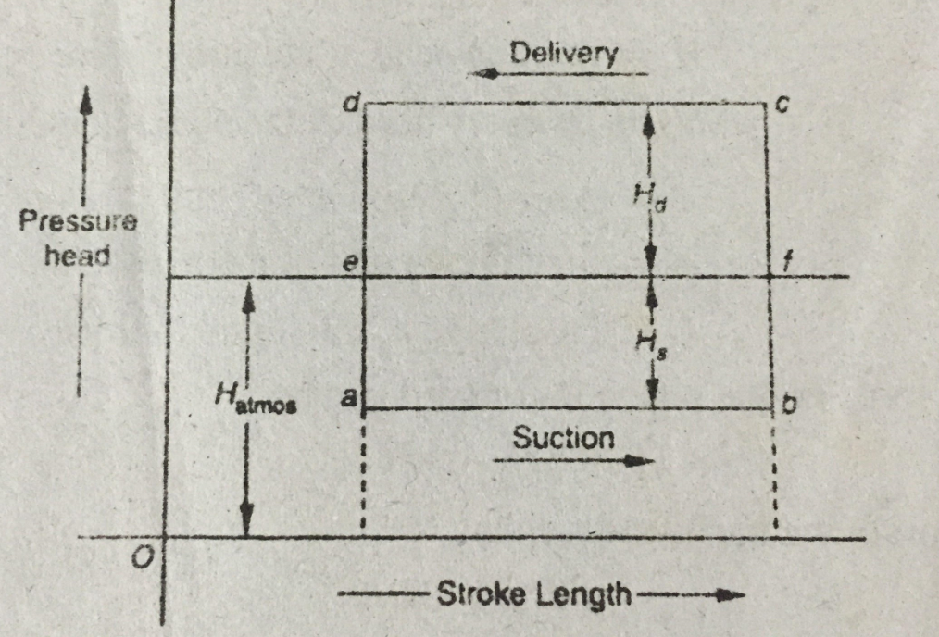
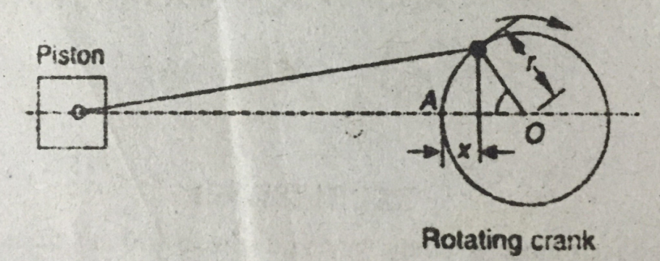
Indicator Diagram of a Reciprocating Pump
When the stroke length shows as abscissa and pressure head as ordinate, the diagram is known as indicator diagram.
Here,
Hs = Suction head of the pump
Hd = Delivery head of the pump
L = stroke length
Indicator diagram
Notes:
35

Slide 36
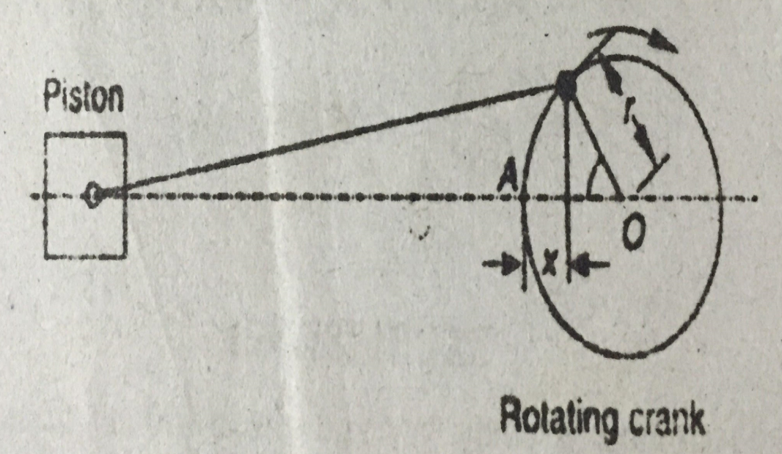
Variation of Pressure in the Suction and Delivery Pipes due to Acceleration of the Piston
Let,
A = Area of cylinder
a = Area of the pipe
ω = Angular velocity of the rotating crank (rad/s)
r = radius of the rotating crank
l = Length of the pipe
θ = ωt
Displacement of the piston in t seconds
x = r – r cos θ = r – r cos ωt
Indicator diagram
Notes:
36

Slide 37
Variation of Pressure in the Suction and Delivery Pipes due to Acceleration of the Piston
Velocity of the piston,
V_{pst} = dx/dt = ωr sin ωt
Acceleration of the piston = dv/dt = ω²r cos ωt
Flow of water in the pipe = flow of water in the cylinder
Q_{p} = Q_{cyl}
a v_{p} = A V_{pst}
v_{p} = A/a x V_{pst} = A/a x ωr sin ωt
Indicator diagram
Notes:
37

Slide 38
Variation of Pressure in the Suction and Delivery Pipes due to Acceleration of the Piston
Acceleration of water in the pipe = A/a x ω²r cos ωt
Weight of water in the pipe = wal
Mass of water in the pipe = wal/g
Acceleration force = Mass x Acceleration= wal/g x A/a x ω²r cos ωt
Intensity of pressure due to acceleration = Acceleration force/Area
= wl/g x A/a x ω²r cos ωt
Acceleration pressure head, Ha = Intensity of pressure / Sp. wt. of liquid
= l/g x A/a x ω²r cos ωt
Notes:
38

Slide 39
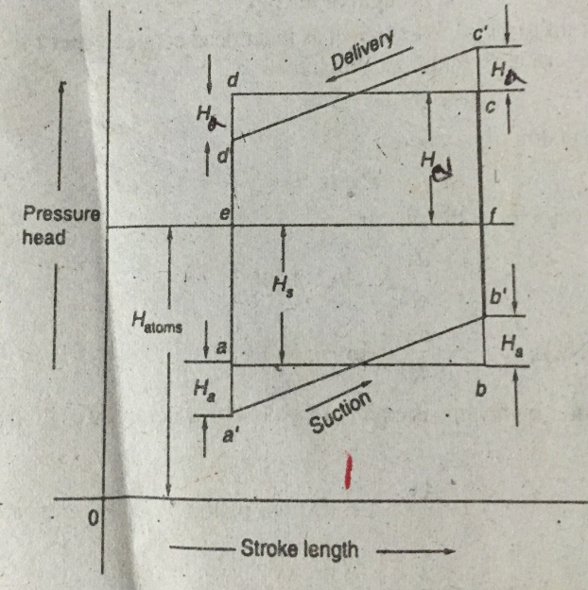
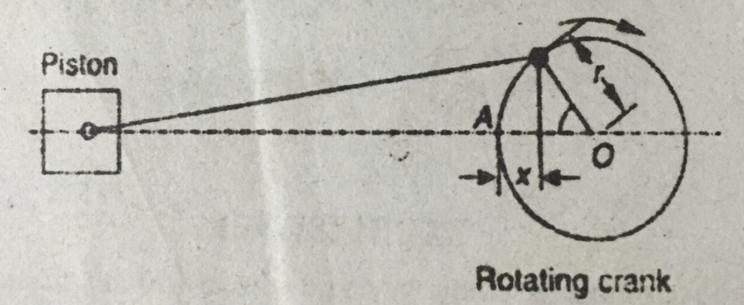
Effect of Acceleration of Piston on the Indicator Diagram
We know,
Acceleration pressure head, Ha = l/g x A/a ω²r cosɵ
At the beginning of suction stroke, ɵ = 0
The pressure head, (H_{s} + H_{a}) < atmospheric pressure head, H_{atm}
In the middle of the suction stroke, ɵ = 90⁰
The pressure head, H_{s} < atmospheric pressure head, H_{atm}
At the end of the suction stroke, ɵ = 180⁰
The pressure head, (H_{s} – H_{a}) < atmospheric pressure head, H_{atm}
Notes:
39

Slide 40
Effect of Acceleration of Piston on the Indicator Diagram
We know,
Acceleration pressure head, Ha = l/g x A/a ω²r cosɵ
At the beginning of delivery stroke, ɵ = 0
The pressure head, (H_{d} + H_{a}) > atmospheric pressure head, H_{atm}
In the middle of the delivery stroke, ɵ = 90⁰
The pressure head, H_{d} > atmospheric pressure head, H_{atm}
At the end of the delivery stroke, ɵ = 180⁰
The pressure head, (H_{d} – H_{a}) > atmospheric pressure head, H_{atm}
Notes:
40

Slide 41
Effect of Friction in the suction and delivery pipes, on the Indicator Diagram
A = Area of cylinder or bore
D = diameter of the pipe
a = Area of the pipe
ω = Angular velocity of the rotating crank (rad/s)
R = radius of the rotating crank
L = Length of the pipe
f = Coefficient of friction
v = velocity of water in the pipe
Velocity of the piston at any instant,
V_{pst} = ωr sin ɵ
Velocity of water in the pipe,
v = A/a x ωr sin ɵ
Loss of head due to friction, H_{f} = 4flv²/2gd = 4fl/2gd (A/a x ωr sin ɵ)²
Notes:
41

Slide 42
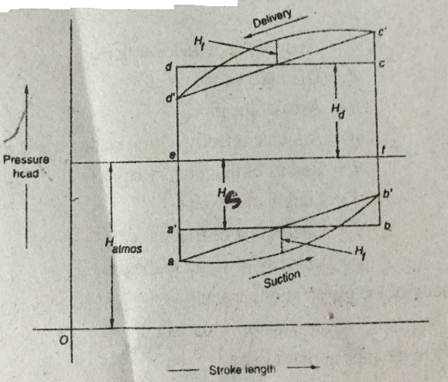

Effect of Friction in the suction and delivery pipes, on the Indicator Diagram
At the beginning of the stroke, ɵ = 0, no loss of head
At the middle of the stroke, ɵ = 90⁰, loss of head due to friction H_{f} = 4fl/2gd (A/a x ωr)²
At the end of the stroke, ɵ = 180⁰, no loss of head
Combine effect of friction and acceleration on the indicator diagram
At the beginning of the stroke, ɵ = 0, H_{f} = 0.
The pressure head, (H_{s} + H_{a}) < atmospheric pressure head, H_{atm}
Notes:
42

Slide 43
Effect of Friction in the suction and delivery pipes, on the Indicator Diagram
In the middle of the suction stroke, ɵ = 90⁰ , H_{a} = 0.
The pressure head, (H_{s} + H_{f}) < atmospheric pressure head, H_{atm}
At the end of the suction stroke, ɵ = 180⁰ , H_{f} = 0.
The pressure head, (H_{s} – H_{a}) < atmospheric pressure head, H_{atm}
For delivery stroke
At the beginning of delivery stroke, ɵ = 0, H_{f} = 0.
The pressure head, (H_{d} + H_{a}) > atmospheric pressure head, H_{atm}
Notes:
43

Slide 44
Effect of Friction in the suction and delivery pipes, on the Indicator Diagram
In the middle of the delivery stroke, ɵ = 90⁰ ,H_{a} = 0.
The pressure head, (H_{d} + H_{f}) > atmospheric pressure head, H_{atm}
At the end of the delivery stroke, ɵ = 180⁰ , H_{f} = 0.
The pressure head, (H_{d} – H_{a}) > atmospheric pressure head, H_{atm}
Notes:
44

Slide 45
Problem-1: A single acting reciprocating pump, having plunger diameter 125 mm and stroke length 300 mm is drawing water from a depth of 4 m from the axis of the cylinder at 24 r.p.m. The length and diameter of suction pipe is 9 m and 75 mm respectively. Find the pressure head on the piston at the beginning and end of the suction stroke , if the barometer reads 10.3 m of water.
Notes:
45

Slide 46
Problem-1: A single acting reciprocating pump, having plunger diameter 125 mm and stroke length 300 mm is drawing water from a depth of 4 m from the axis of the cylinder at 24 r.p.m. The length and diameter of suction pipe is 9 m and 75 mm respectively. Find the pressure head on the piston at the beginning and end of the suction stroke , if the barometer reads 10.3 m of water.
Ha = 2.4 m
Hp = 3.9 m (beginning)
Hp = 8.7 m (end)
Notes:
46

Slide 47
Problem-2: A single acting reciprocating pump, having plunger diameter 200 mm and stroke length 300 mm. The length and diameter of suction pipe is 8 m and 100 mm respectively. The pump draws water from a depth of 4 m below the axis of the cylinder at 30 r.p.m. Find the pressure head on the piston at the beginning, in the middle and end of the suction stroke , if the atmospheric pressure head = 10.3 m of water and f= 0.01.
Notes:
47

Slide 48
Problem-2: A single acting reciprocating pump, having plunger diameter 200 mm and stroke length 300 mm. The length and diameter of suction pipe is 8 m and 100 mm respectively. The pump draws water from a depth of 4 m below the axis of the cylinder at 30 r.p.m. Find the pressure head on the piston at the beginning, in the middle and end of the suction stroke , if the atmospheric pressure head = 10.3 m of water and f= 0.01.
Ha = 4.8 m
Hp = 1.5 m (beginning)
v = 1.88 m/s
Hf = 0.6 m
Hp = 5.7 m(middle)
Hp = 11.1 m (end)
Notes:
48

Slide 49
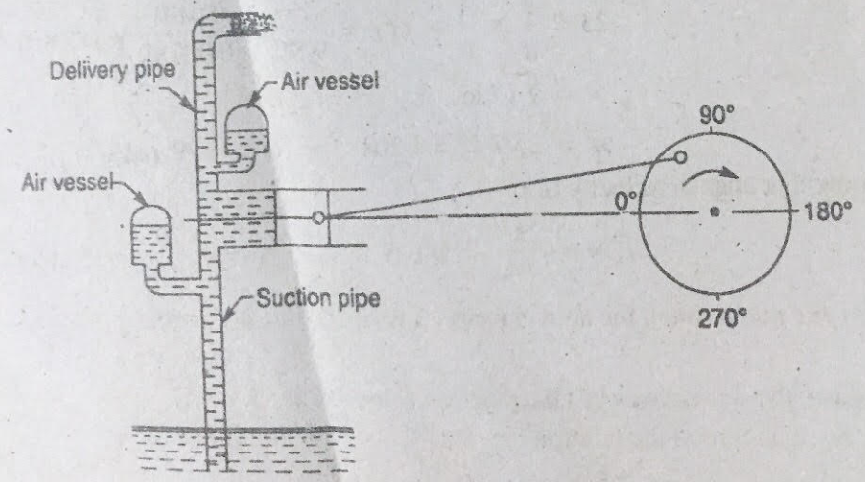
Air Vessels
Objective:
To obtain a uniform discharge from a reciprocating pump.
Notes:
49

Slide 50
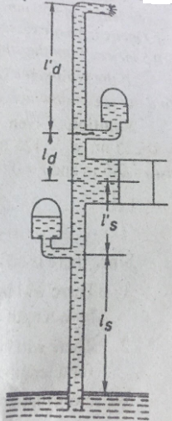
Maximum Speed of the Rotating Crank With Air Vessels
Separation Head:
Separation head, H_{sep} = H – [H_{s} + (H_{a} for l’_{s}) + (H_{f} for l_{s})] = H – (H_{s} + H_{a} + H_{f})
Notes:
50

Slide 51
Maximum Speed of the Rotating Crank With Air Vessels
For single acting reciprocating pump:
Discharge, Q = LAN/60
Velocity of water, v = Q/a = LAN/60a = A/a x LN/60
Substituting, L = 2r, ω = 2πN/60 or N = 60ω/2π
v = A/a x 2r x (60ω/2π)/60 = A/a x ωr/π
Similarly, for double acting reciprocating pump:
v = 2A/a x ωr/π
Notes:
51

Slide 52
Problem-1: A single acting reciprocating pump has a plunger diameter of 250 mm and stroke length of 450 mm. The suction pipe is 125 mm diameter and 12 m long with a suction lift of 3 m. An air vessel is fitted to the suction pipe at a distance of 1.5 m from the cylinder and 10.5 m from the sump of water level. If the barometer reads 10 m of water and separation takes place at 2.5 m vacuum, find the speed at which the crank can operate without separation to occur. Take, f= 0.01.
Notes:
52

Slide 53
Problem-1: A single acting reciprocating pump has a plunger diameter of 250 mm and stroke length of 450 mm. The suction pipe is 125 mm diameter and 12 m long with a suction lift of 3 m. An air vessel is fitted to the suction pipe at a distance of 1.5 m from the cylinder and 10.5 m from the sump of water level. If the barometer reads 10 m of water and separation takes place at 2.5 m vacuum, find the speed at which the crank can operate without separation to occur. Take, f= 0.01.
H_{a} = 0.137 ω²
v = 0.286 ω m/s
H_{f} = 0.014 ω²
ω = 5.46 rad/s
N = 52 r.p.m
Notes:
53

