Slide 1
Course No. CE 3141
Credits : 3
Conduct hours/week : 3
Course Title : Environmental Engineering-I

Slide 2
Course Content:
Water quality and treatment
Water quality parameters and standards,
Introduction to Environmental Engineering, community and environment, clean water, sanitation and health, introduction to water supply, population and water requirement.
Water supply sources, ground water and surface water, common water supply with specific reference to Bangladesh
Different types of hand pumps, installation and O & M of hand pumps, problems of water supply, presence of iron and arsenic, hardness, salinity.

Slide 3
Course Content:
Alternative technologies for problem areas in Bangladesh: Shallow Shrouded Tube well (SST), Very Shallow Shrouded Tube well (VSST), Pond Sand Filter (PSF), Deep set technologies

Slide 4
Reference Books:
Water Supply and Sanitation
M.F Ahmed
M.M.Rahman
Environmental Engineering
H.S.Peavy
D.R.Rowe
G. Tchobanoglous
Environmental Engineering
M.L Davis
D.A Cornwell
4. A Text book of Water Supply Engineering
M.A.Aziz
5. Water Supply and Sanitary Engineering
Rangwala

Slide 5
Wholesome water/ Potable water:
The term wholesome water is used to indicate the water which is not chemically pure, but does not contain anything harmful to the human body i.e. the water in which there is no pathogenic bacteria, no toxic substances and no excessive organic matter. Thus the wholesomeness is a must while the palatability of water is desirable.

Slide 6
Requirements for potable water:
It should be clear, odorless and colourless
It should be free from harmful and disease producing bacteria
It should be free from all objectionable substances
It should be fresh and cool
It should be palatable i.e. aesthetically attractive

Slide 7
Water quality parameters:
Water quality parameters are three types:
Physical parameters
Chemical parameters
Biological parameters

Slide 8
Physical Parameters:
Colour
Taste and odour
Temperature
Turbidity
Suspended solids

Slide 9
Colour
Pure water is always colourless, but in nature is often coloured by foreign substances. Water whose colour is partly due to suspended matter is said to have apparent colour. Colour contributed by dissolved solids that remain after removal of suspended matter is known as true colour

Slide 10
Source:
Algae metabolism
End products of degraded organic matter
Discharge of untreated and partially treated waste water from various industries like food processing, textile industries, paper production etc
Divalent species containing iron and manganese etc

Slide 11
Impact:
Coloured water is not aesthetically acceptable to the general public
Highly coloured water is unsuitable for laundering, dyeing, papermaking, beverage manufacturing, dairy production and other food processing and textile and plastic production
Coloured water effects its marketability for both domestic and industrial use

Slide 12
Measurement
One true colour unit (TCU) corresponds to the amount of colour exhibited under the specified test conditions by a solution containing 1.0 mg of platinum per litre of water in the form of chloroplatinate ion. Most consumers can detect a colour of 15 TCU (WHO guideline value and Bangladesh standard for drinking water) in a glass of water.

Slide 13
Taste and Odour
Many substances with which water comes into contact in nature or during human use may impart perceptible taste and odour. These include minerals, metals and salts from soil end products from biological reactions and constituents of wastewater.

Slide 14
Impact:
Consumers find taste and odour aesthetically displeasing for obvious reasons. It is unpleasant for drinking and bad for health
Measurement:
Measurement of taste and odour casing organics can be made using gas or liquid Chromatography. As Chromatographic analysis is time consuming and requires expensive equipment it is not routinely performed on water samples, but should be done if problem organics are suspected.

Slide 15
Quantitative tests that employ the human senses of taste and smell can be used for this purpose. An example of this test is the threshold odour number (TON).
Varying amounts of odourous water are poured into containers and diluted with enough odour free distilled water to make a 200 ml mixture
An assembled panel of five or ten noses is used to determine in which the odour is just barely detectable to the sense of smell. For public water supply the threshold water number should not be more than 3

Slide 16
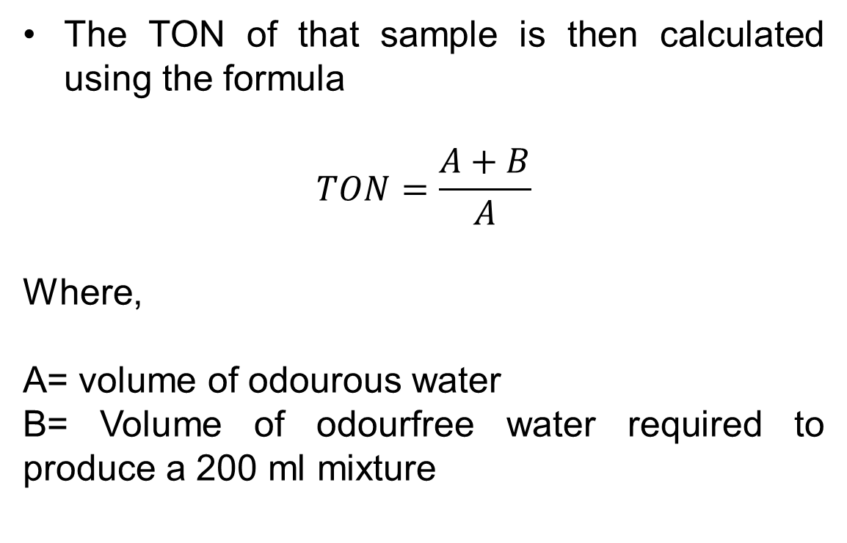
The TON of that sample is then calculated using the formula
$$TON=\frac{A+B}{A}$$
Where,
A= volume of odourous water
B= Volume of odourfree water required to produce a 200 ml mixture

Slide 17
Temperature:
Source:
The temperature of natural water systems respond to many factors. The ambient are the most universal. Generally shallow bodies of water are more affected by ambient temperatures than are deeper bodies. Removal of forest canopies and irrigation return flows can also result in increased stream temperature

Slide 18
Impact:
If the temperature is increased, biological activity increases. An increase of 10 degree is usually sufficient to double the biological activity
Temperature changes affects the reaction rates and solubility levels of chemicals
Temperature also affects other physical properties of water. The viscosity of water increases with decreasing temperature.
Measurement:
The measurement of temperature is done with the help of ordinary temperature

Slide 19
Turbidity:
The colloidal materials present in water interferes with passage of light and thus imparts turbidity to the water.
Source:
Erosion of colloidal material such as clay, silt, rock fragments and metal oxides from the soil.
Vegetables fibers and microorganisms may also contribute to the turbidity.
Household and industrial waste water may contain a wide variety of turbidity producing material.

Slide 20
iv. Soaps, detergents and emulsifying agents produce stable colloids that result turbidity
Impact:
The cloudy appearance developed in water due to turbidity is aesthetically unattractive and it may also be harmful to the consumers.
It also disturbs the disinfection process because the solids may partially shield the organisms from the disinfection

Slide 21
Measurement:
Turbidity is measured by photo metrically by determining the percentage of light of a given intensity that is either absorbed or scattered. The original measuring apparatus, called a Jackson Turbidity Meter. 1 JTU being equal to the turbidity produced by 1 mg ${SiO}_{2 }$in IL of distilled water.
Turbidity is measured by photo metrically by determining the percentage of light of a given intensity that is either absorbed or scattered. The original measuring apparatus, called a Jackson Turbidity Meter. 1 JTU being equal to the turbidity produced by 1 mg 〖𝑆𝑖𝑂〗_(2 ) in IL of distilled water.
Formaizin, a chemical compound, provides more reproducible standards than ${SiO}_{2 }$and has replaced it as a reference. Turbidity meter readings are now expressed as formazin turbidity units or FTUs. The term neophelometry turbidity units (NTU) is often used to indicate that the test was run according to the scattering principle
Formaizin, a chemical compound, provides more reproducible standards than 〖𝑆𝑖𝑂〗_(2 )and has replaced it as a reference. Turbidity meter readings are now expressed as formazin turbidity units or FTUs. The term neophelometry turbidity units (NTU) is often used to indicate that the test was run according to the scattering principle

Slide 22
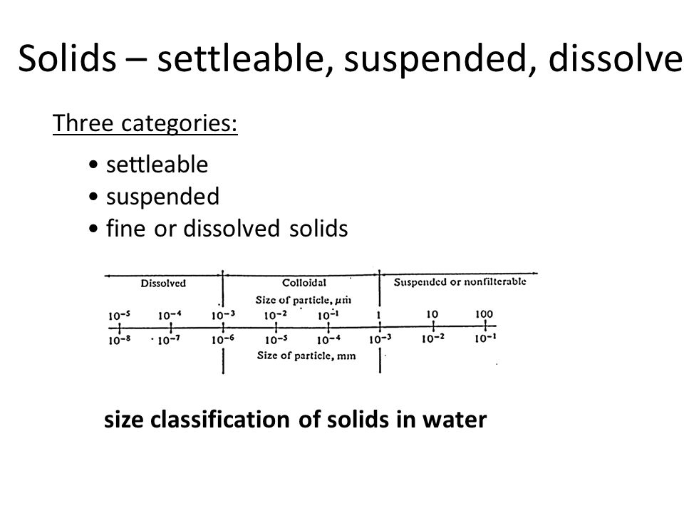
Suspended solids:

Slide 23
Source:
Inorganic solids such as clay, silt and other soil constituents
Organic material such as plant, fibers and biological solids such as algal cells. Bacteria etc.
Industrial waste, domestic waste, oils greases etc
Measurement:
There are several tests available for measuring solids. Most are gravimetric tests involving the mass of residue.

Slide 24
Chemical water quality parameter:
pH
Alkalinity
Acidity
Total solids
Hardness
Chlorides
Dissolved gases
Metals
Nitrates and its compounds

Slide 25
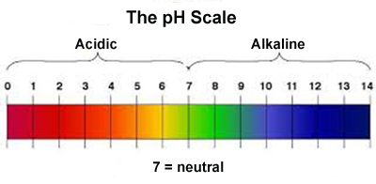
pH:
The acidity or alkalinity of water is measured in terms of its pH value or H-ion concentration

Slide 26
Impact:
For potable water, the pH value should be between 6.5 and 8.5 and it is found that if this range is maintained, there is no direct effect on health of human being.
If pH value of water is below 4, it will produce a sour taste and if it is more than 8.5 it will impart a bitter taste.
The higher value of pH induces the formation of Trihalomethane which are responsible for causing cancer in human beings
The lower value of pH starts corrosion in pipes and thereby the toxic metals like Zn, Pb, Cu are released.

Slide 27
Measurement:
There are two methods for measurement
Electrometric method
Colorimetric method
Electrometric method:
In this method the potentiometer is used to measure the electrical pressure exerted by positivity charged H-ions. The pH value then correspondingly expressed.

Slide 28
ii) Colourimetric method:
In this method the chemical reagents or indicators are added in water and the colour produces id compared with standard colours of known pH value

Slide 29
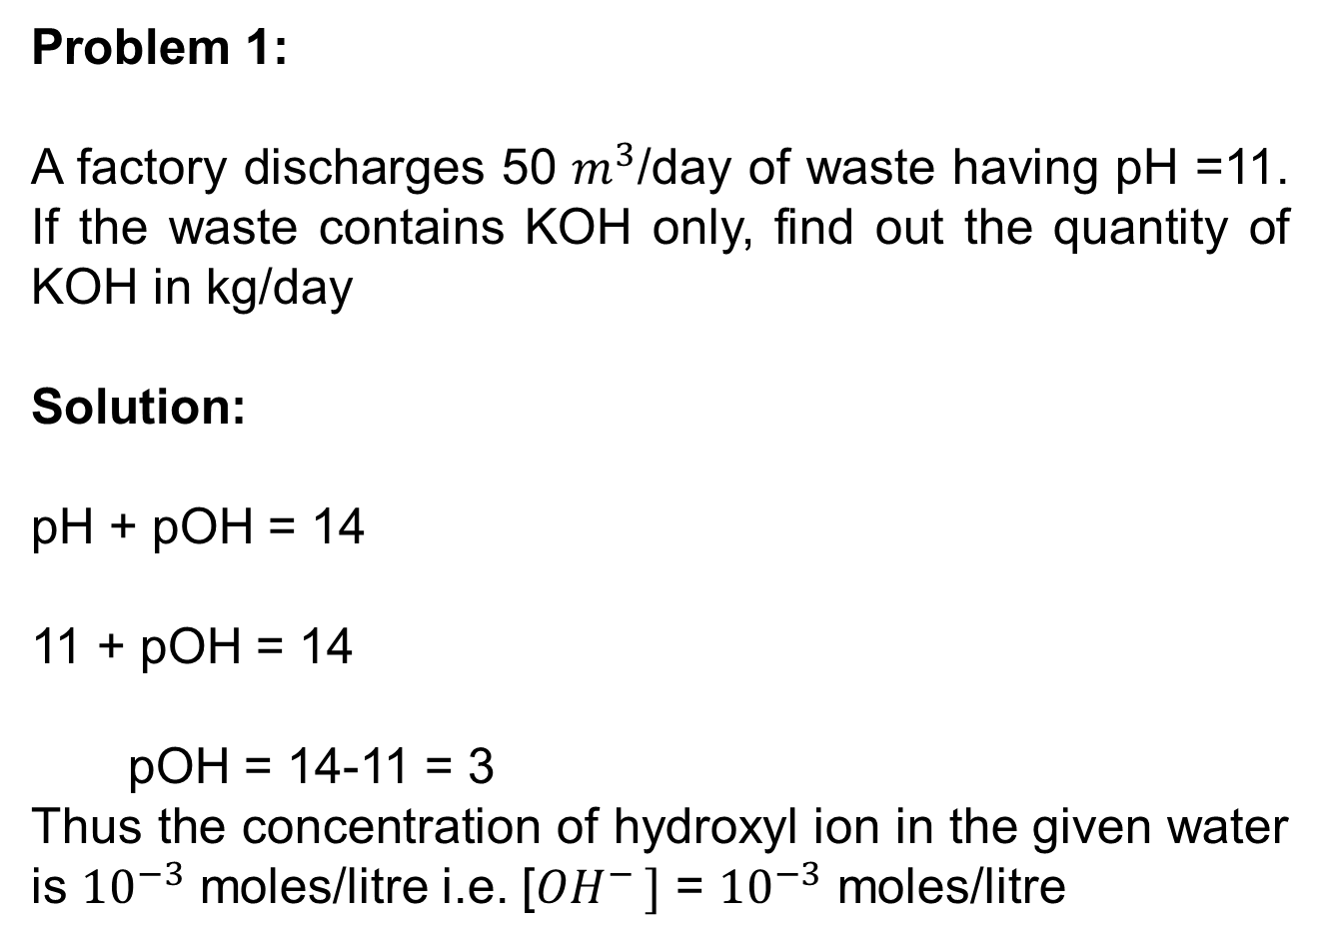
Problem 1:
A factory discharges 50 $m^{3}$/day of waste having pH =11. If the waste contains KOH only, find out the quantity of KOH in kg/day
Solution:
pH + pOH = 14
11 + pOH = 14
pOH = 14-11 = 3
Thus the concentration of hydroxyl ion in the given water is ${10}^{−3}$ moles/litre i.e. [${OH}^{− }]$ = ${10}^{−3}$ moles/litre

Slide 30
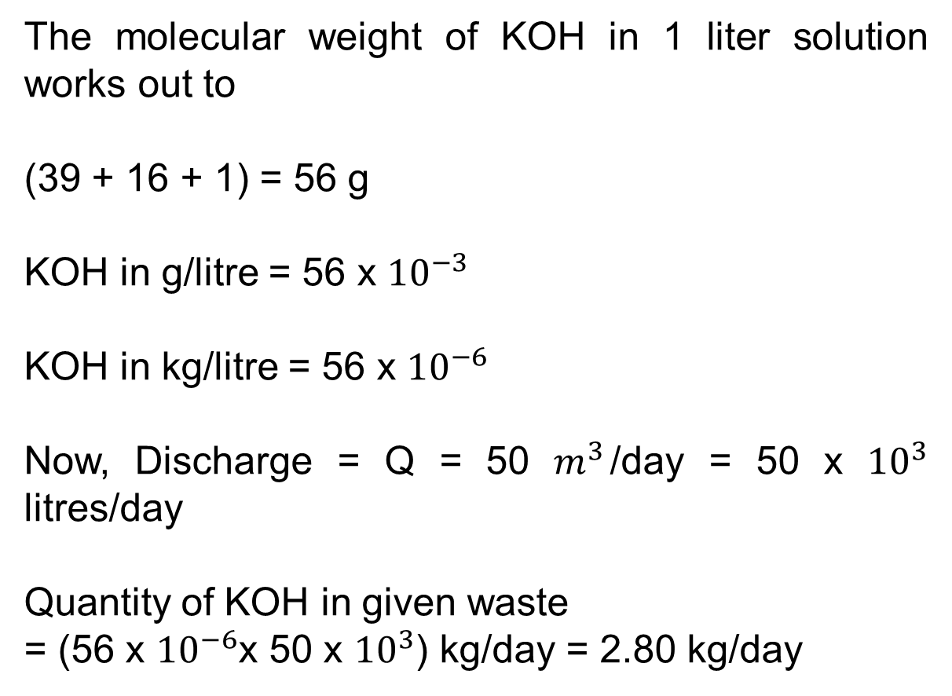
The molecular weight of KOH in 1 liter solution works out to
(39 + 16 + 1) = 56 g
KOH in g/litre = 56 x ${10}^{−3}$
KOH in kg/litre = 56 x ${10}^{−6}$
Now, Discharge = Q = 50 $m^{3}$/day = 50 x ${10}^{3}$ litres/day
Quantity of KOH in given waste
= (56 x ${10}^{−6}$x 50 x ${10}^{3}$) kg/day = 2.80 kg/day

Slide 31
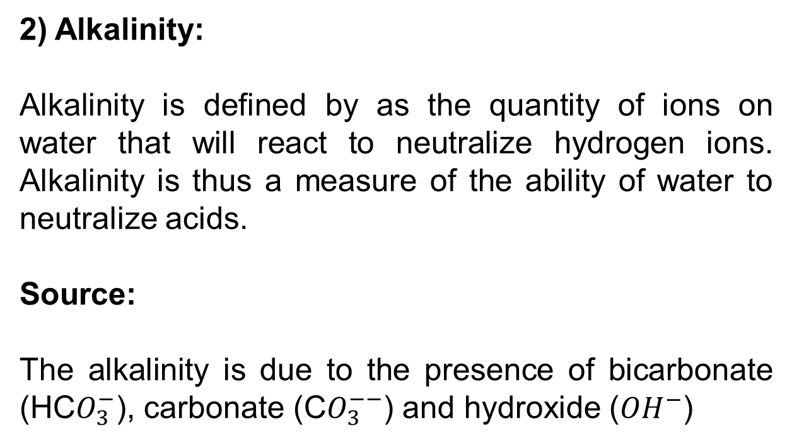
2) Alkalinity:
Alkalinity is defined by as the quantity of ions on water that will react to neutralize hydrogen ions. Alkalinity is thus a measure of the ability of water to neutralize acids.
Source:
The alkalinity is due to the presence of bicarbonate (HC$O_{3}^{−}$), carbonate (C$O_{3}^{−−}$) and hydroxide (${OH}^{−}$)

Slide 32
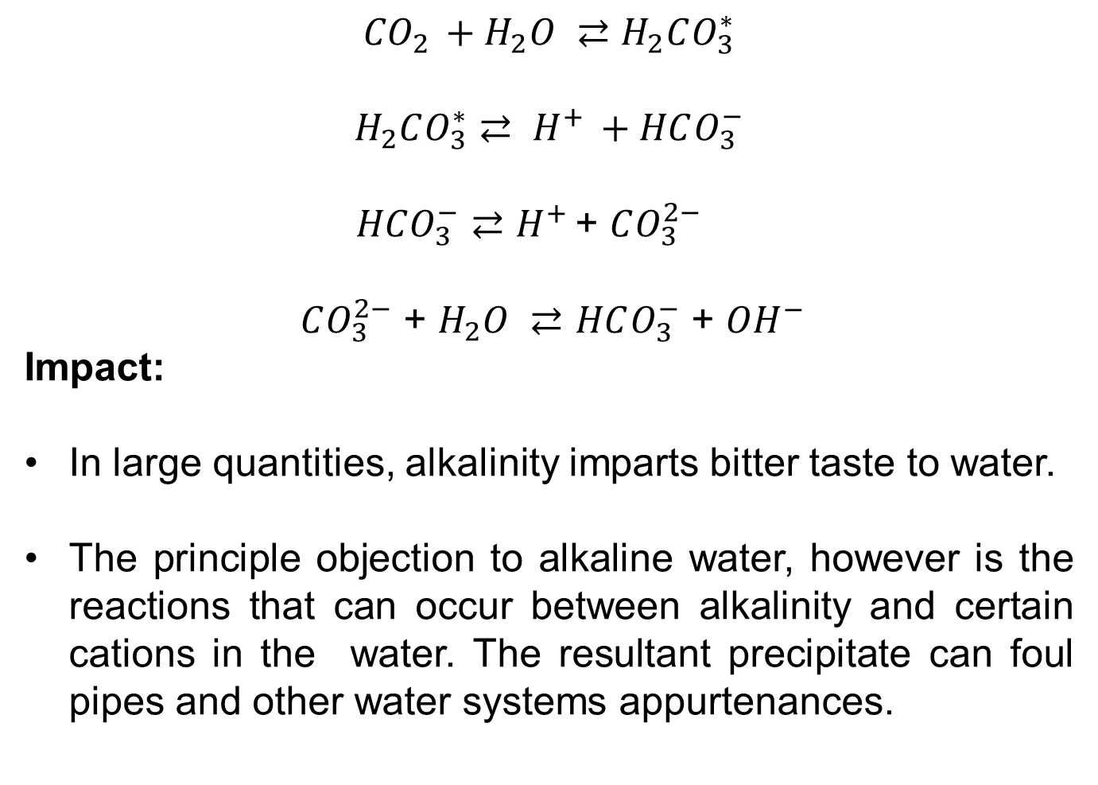
$${CO}_{2 }+H_{2}O ⇄H_{2}CO_{3}^{∗}$$
$$H_{2}CO_{3}^{∗}⇄ H^{+ }+HCO_{3}^{−}$$
$HCO_{3}^{−}$ $⇄$ $H^{+ }$+ $CO_{3}^{2−}$
$CO_{3}^{2−}$ + $H_{2}O ⇄$ $HCO_{3}^{−}$ + ${OH}^{−}$
Impact:
In large quantities, alkalinity imparts bitter taste to water.
The principle objection to alkaline water, however is the reactions that can occur between alkalinity and certain cations in the water. The resultant precipitate can foul pipes and other water systems appurtenances.

Slide 33
Measurement:
The alkalinity is measured by volumetric analysis. The various types of indicators are available for this purpose. The commonly adopted two indicators are-
1) Phenolphthalein
2) Methyl orange

Slide 34
1) Phenolphthalein :
Pink above pH 8.2 and
Colourless below pH 8.2
2) Methyl orange:
Red below pH 4.5 and
Yellow-orange above pH 4.5

Slide 35
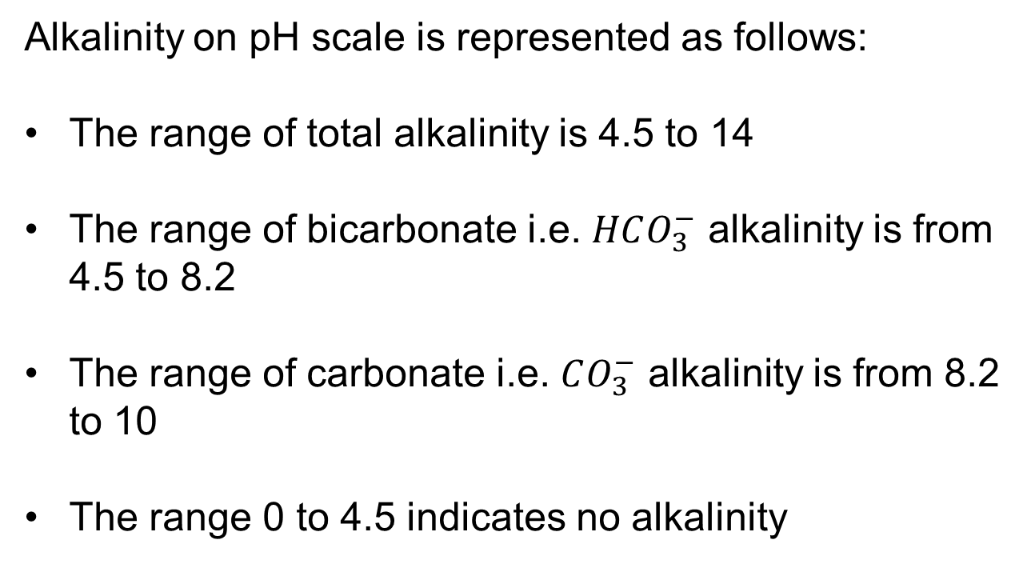
Alkalinity on pH scale is represented as follows:
The range of total alkalinity is 4.5 to 14
The range of bicarbonate i.e. $HCO_{3}^{−}$ alkalinity is from 4.5 to 8.2
The range of carbonate i.e. $CO_{3}^{−}$ alkalinity is from 8.2 to 10
The range 0 to 4.5 indicates no alkalinity

Slide 36
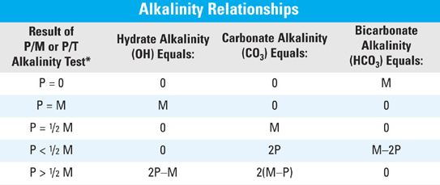
P = Phenolphthalein
M= Methyl orange
T= Total alkalinity

Slide 37
Problem: From the following data of volumetric analysis, calculate the hydroxide, carbonate and bicarbonate alkalinities:
Sample 100 ml | Total ml of titrant to reach end point
 | Phenolphthalin | Mythyl orange
A | 10 | 15.5
B | 14.4 | 38.6
C | 8.2 | 8.4
D | 0 12.7

Slide 38
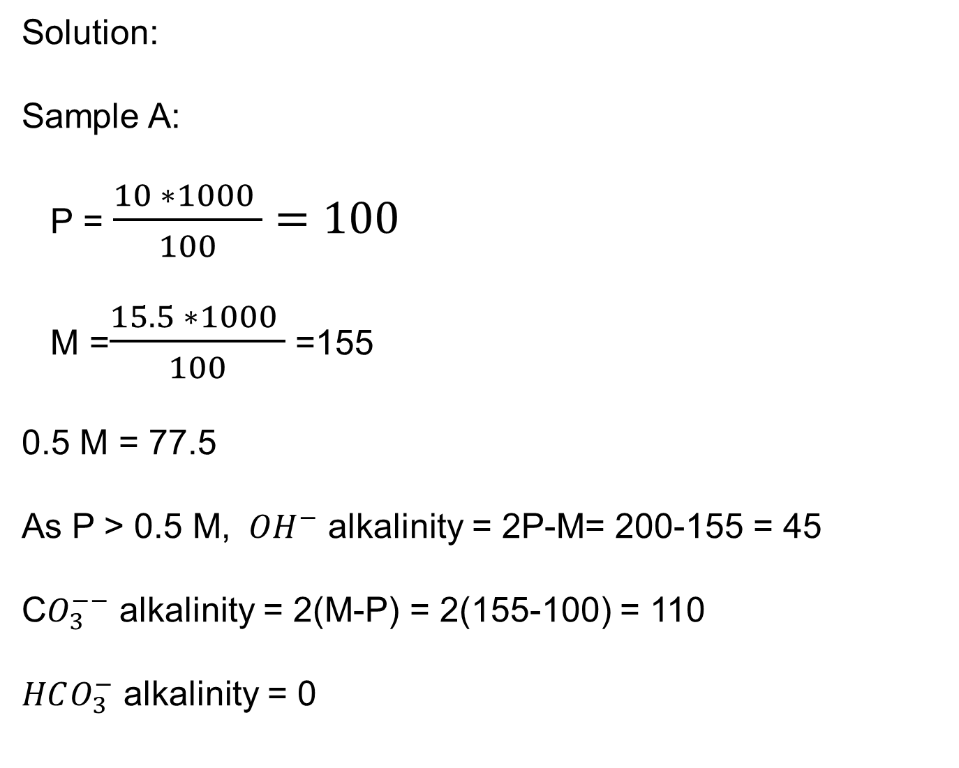
Solution:
Sample A:
P = $\frac{10 ∗1000 }{100}=100$
M =$\frac{15.5 ∗1000 }{100}$ =155
0.5 M = 77.5
As P > 0.5 M, ${ OH}^{−}$ alkalinity = 2P-M= 200-155 = 45
C$O_{3}^{−−}$ alkalinity = 2(M-P) = 2(155-100) = 110
$HCO_{3}^{−}$ alkalinity = 0

Slide 39
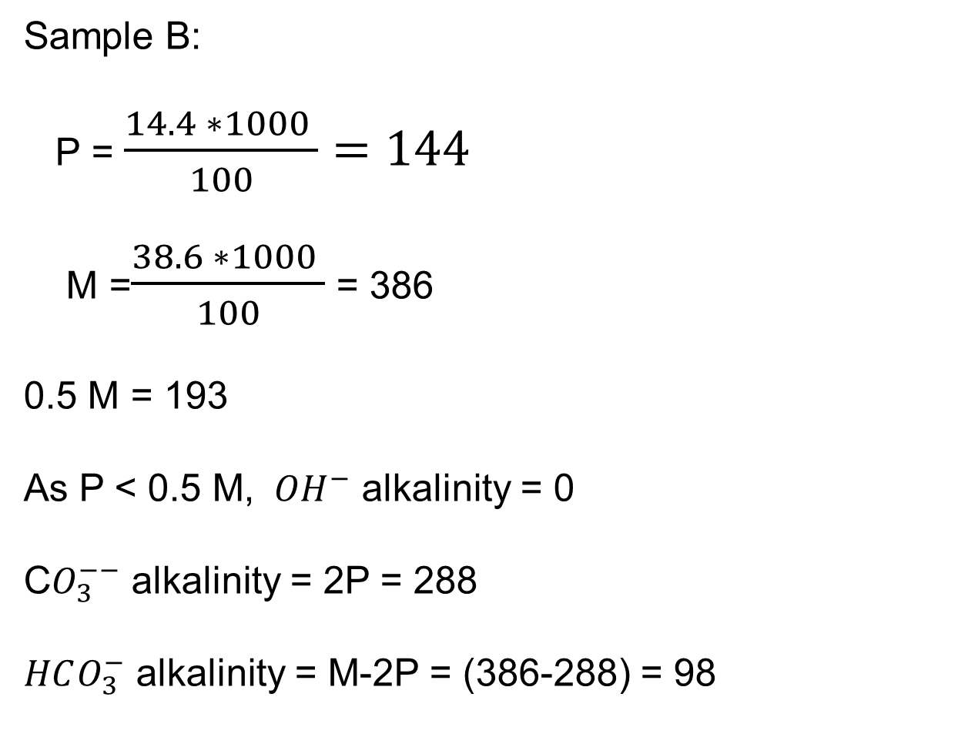
Sample B:
P = $\frac{14.4 ∗1000 }{100}=144$
M =$\frac{38.6 ∗1000 }{100}$ = 386
0.5 M = 193
As P < 0.5 M, ${ OH}^{−}$ alkalinity = 0
C$O_{3}^{−−}$ alkalinity = 2P = 288
$HCO_{3}^{−}$ alkalinity = M-2P = (386-288) = 98

Slide 40
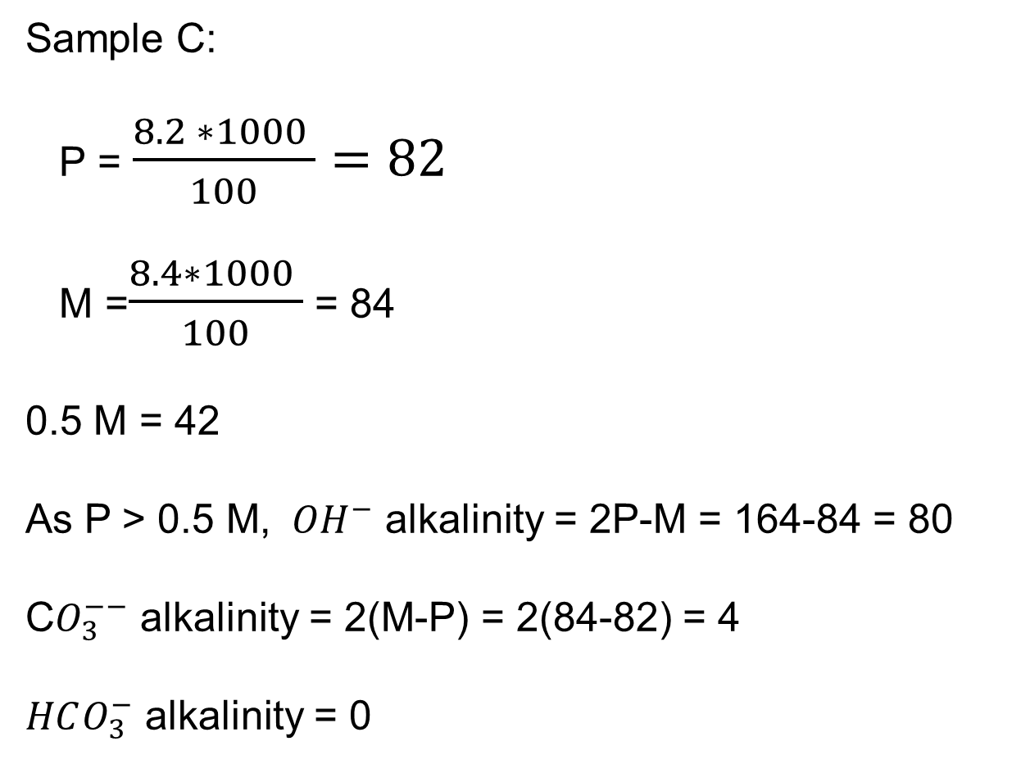
Sample C:
P = $\frac{8.2 ∗1000 }{100}=82$
M =$\frac{8.4∗1000 }{100}$ = 84
0.5 M = 42
As P > 0.5 M, ${ OH}^{−}$ alkalinity = 2P-M = 164-84 = 80
C$O_{3}^{−−}$ alkalinity = 2(M-P) = 2(84-82) = 4
$HCO_{3}^{−}$ alkalinity = 0

Slide 41

Sample D:
P = 0
M =$\frac{12.7∗1000 }{100}$ = 127
As P = 0, ${ OH}^{−}$ alkalinity = 0
C$O_{3}^{−−}$ alkalinity = 0
$HCO_{3}^{−}$ alkalinity = M = 127

Slide 42
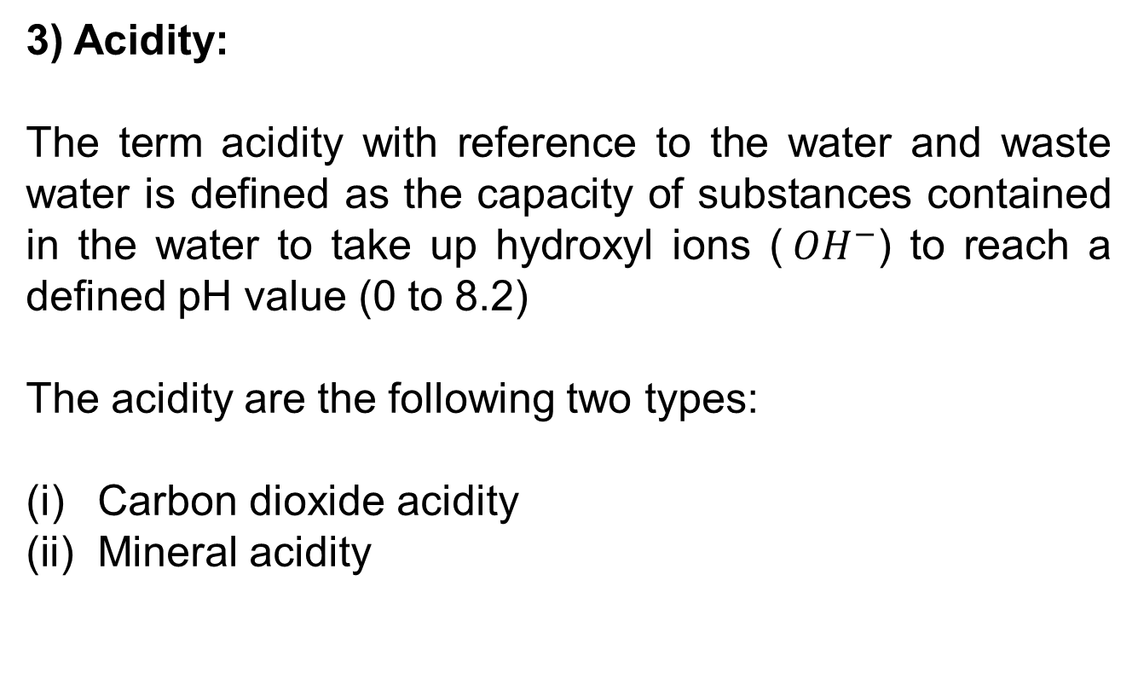
3) Acidity:
The term acidity with reference to the water and waste water is defined as the capacity of substances contained in the water to take up hydroxyl ions (${ OH}^{−}$) to reach a defined pH value (0 to 8.2)
The acidity are the following two types:
Carbon dioxide acidity
Mineral acidity

Slide 43
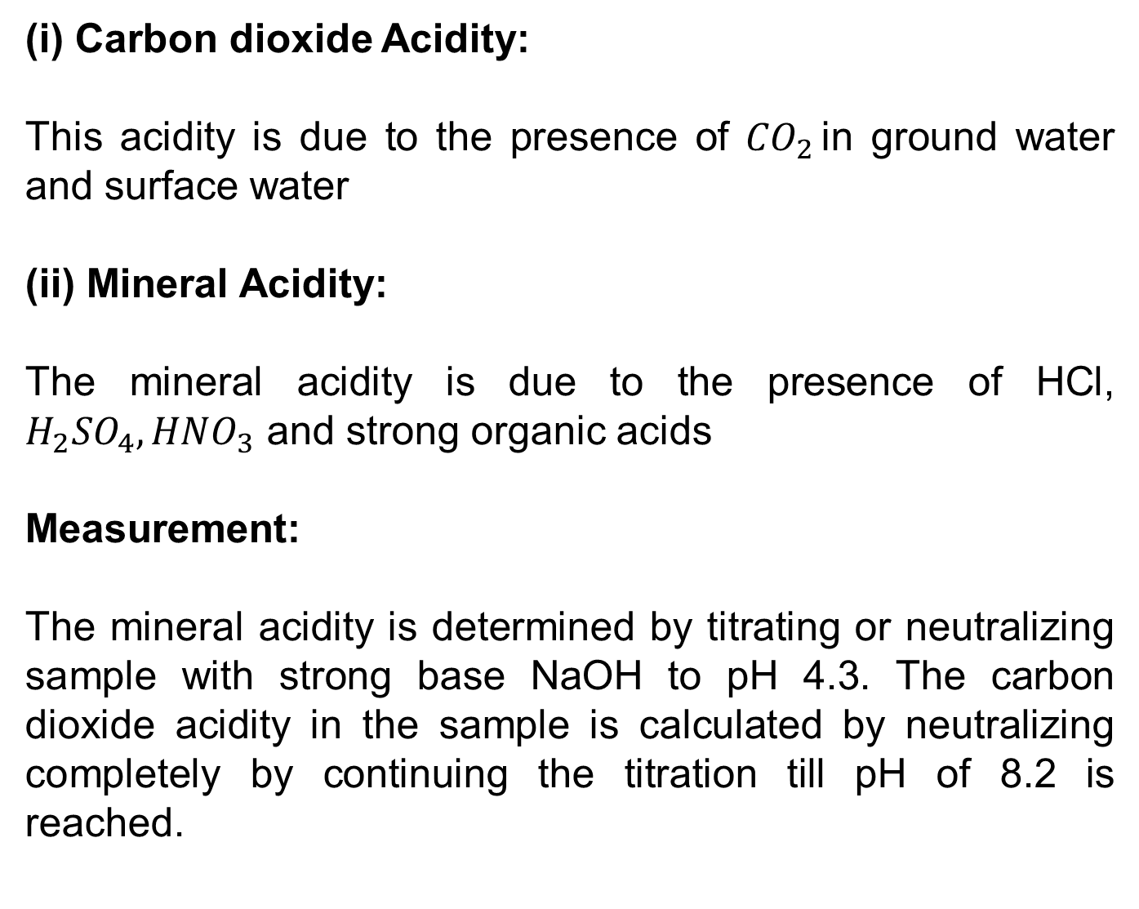
(i) Carbon dioxide Acidity:
This acidity is due to the presence of ${CO}_{2 }$in ground water and surface water
(ii) Mineral Acidity:
The mineral acidity is due to the presence of HCl, $H_{2}{SO}_{4}, {HNO}_{3}$ and strong organic acids
Measurement:
The mineral acidity is determined by titrating or neutralizing sample with strong base NaOH to pH 4.3. The carbon dioxide acidity in the sample is calculated by neutralizing completely by continuing the titration till pH of 8.2 is reached.

Slide 44
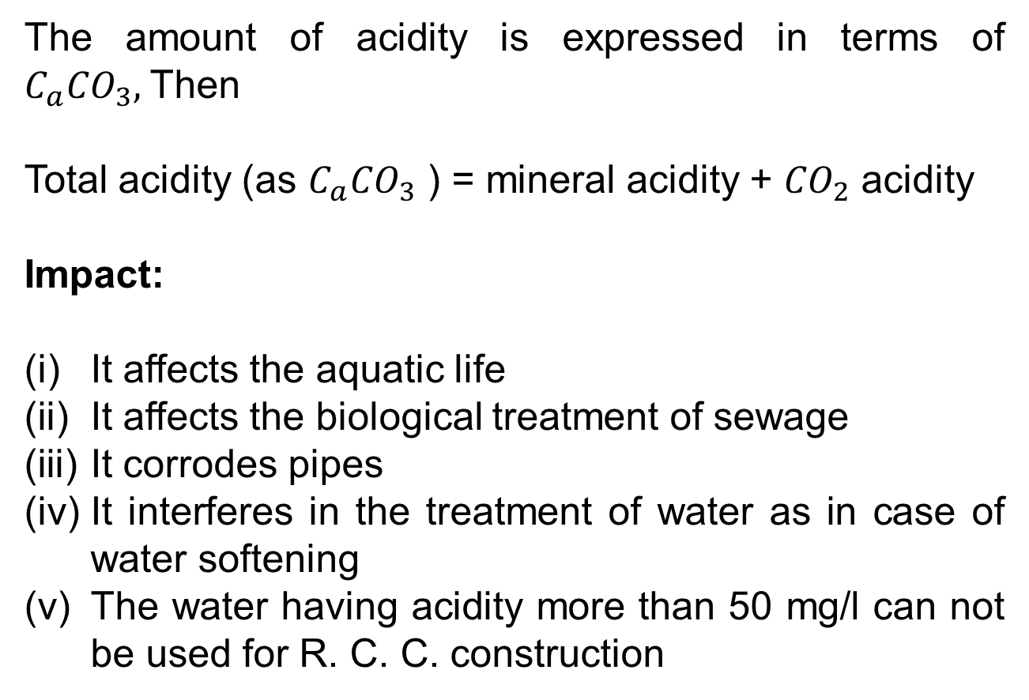
The amount of acidity is expressed in terms of $C_{a}{CO}_{3},$Then
Total acidity (as $C_{a}{CO}_{3}$ ) = mineral acidity + ${CO}_{2}$ acidity
Impact:
It affects the aquatic life
It affects the biological treatment of sewage
It corrodes pipes
It interferes in the treatment of water as in case of water softening
The water having acidity more than 50 mg/l can not be used for R. C. C. construction

Slide 45
4) Total Dissolved Solids:
The material remaining in the water after filtration for the suspended solids analysis is considered to be dissolved
Total solids = Total dissolved solids + Total Suspended solids
Sources:
Dissolved material results from the solvent action of water on solids, liquids, and gases
Materials from decay products of vegetation, from the organic chemicals and from the organic gases are common organic dissolved constituents of water.

Slide 46
Impact:
Dissolved minerals, gases and organic constituents may produce aesthetically displeasing colour, test and odour
Some chemicals may be toxic, and some of the dissolved organic constituents have been shown to be carcinogenic
In general water with a total solid content of less than 500 mg/l are most desirable for such purposes. Water with a higher solids content have a laxative and sometimes the reverse effect upon people.

Slide 47
Depending on the TDS water is often classed as follows:
Excellent TDS < 300 mg/l
Good 300-600 mg/l
Fair 600-900 mg/l
Poor 900-1200 mg/l
Unacceptable 1200 mg/l

Slide 48
(5) Hardness:
The term hardness is defined as the ability of the water to cause precipitation of insoluble calcium and magnesium salts of higher fatty acids from soap.
Source:
Hardness is two types:
Temporary hardness (Carbonate hardness)
Permanent hardness (Non Carbonate hardness)

Slide 49
Temporary hardness is mainly due to the presence of bicarbonates of calcium and magnesium. It can be removed by boiling or by adding lime to the water.
The permanent hardness is due to the presence of sulphates, chlorides, and nitrates of calcium and magnesium. It can not be removed simply by boiling the water

Slide 50
Impact:
Soap is more consumed due to hardness of water
Boiler scale, the result of the carbonate hardness precipitate may cause considerable economic loss
Corrosion may occur.

Slide 51
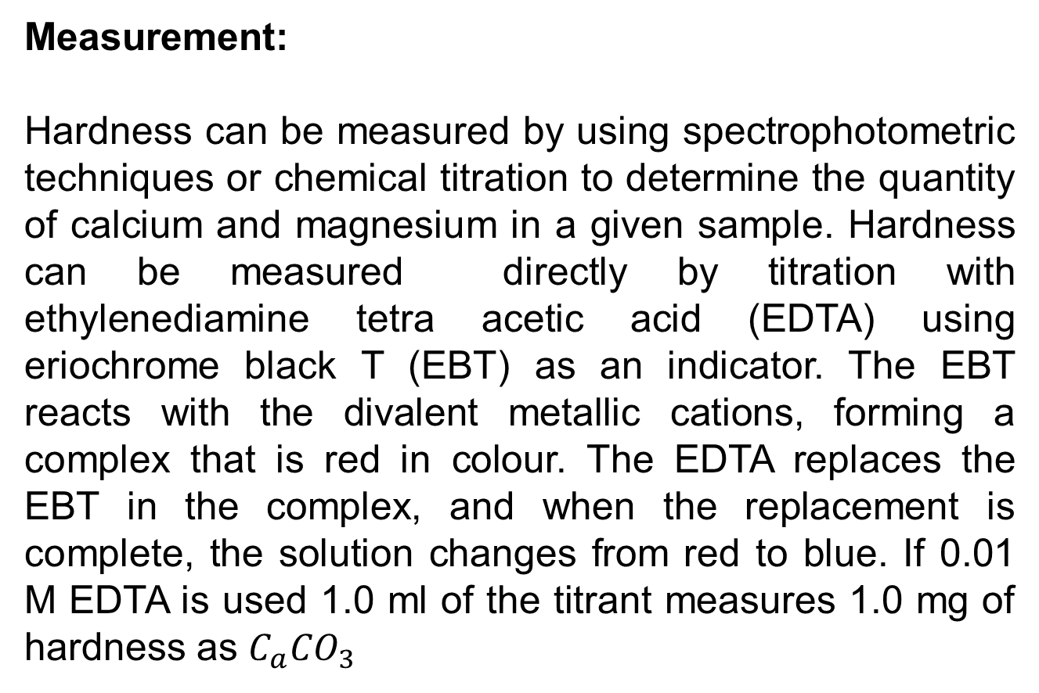
Measurement:
Hardness can be measured by using spectrophotometric techniques or chemical titration to determine the quantity of calcium and magnesium in a given sample. Hardness can be measured directly by titration with ethylenediamine tetra acetic acid (EDTA) using eriochrome black T (EBT) as an indicator. The EBT reacts with the divalent metallic cations, forming a complex that is red in colour. The EDTA replaces the EBT in the complex, and when the replacement is complete, the solution changes from red to blue. If 0.01 M EDTA is used 1.0 ml of the titrant measures 1.0 mg of hardness as $C_{a}{CO}_{3}$

Slide 52
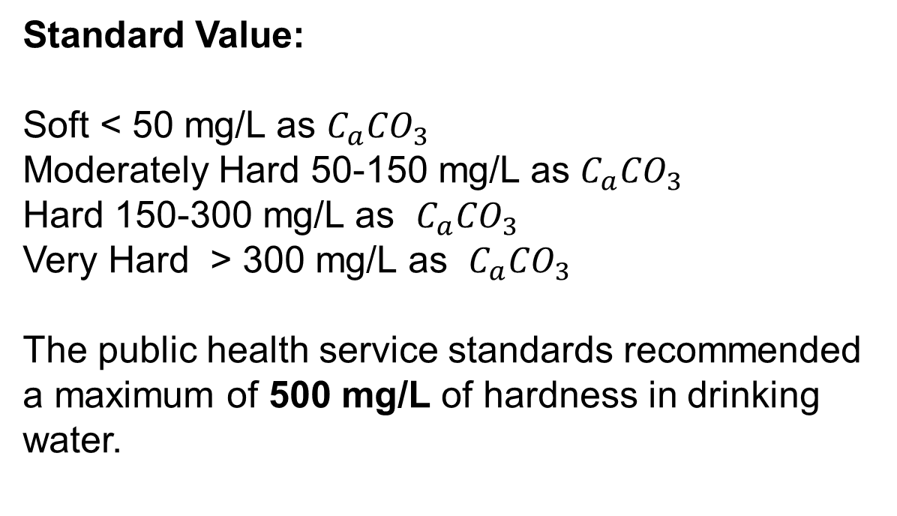
Standard Value:
Soft < 50 mg/L as $C_{a}{CO}_{3}$
Moderately Hard 50-150 mg/L as $C_{a}{CO}_{3}$
Hard 150-300 mg/L as $C_{a}{CO}_{3}$
Very Hard > 300 mg/L as $C_{a}{CO}_{3}$
The public health service standards recommended a maximum of 500 mg/L of hardness in drinking water.

Slide 53
Total Hardness = Carbonate Hardness or alkalinity + Non-carbonate hardness
Or T.H = C.H. + N.C.H
Following two rules should be remembered in this connection
When alkalinity < T.H then
C.H = Alkalinity
When alkalinity > T.H. then
C.H = T.H

Slide 54
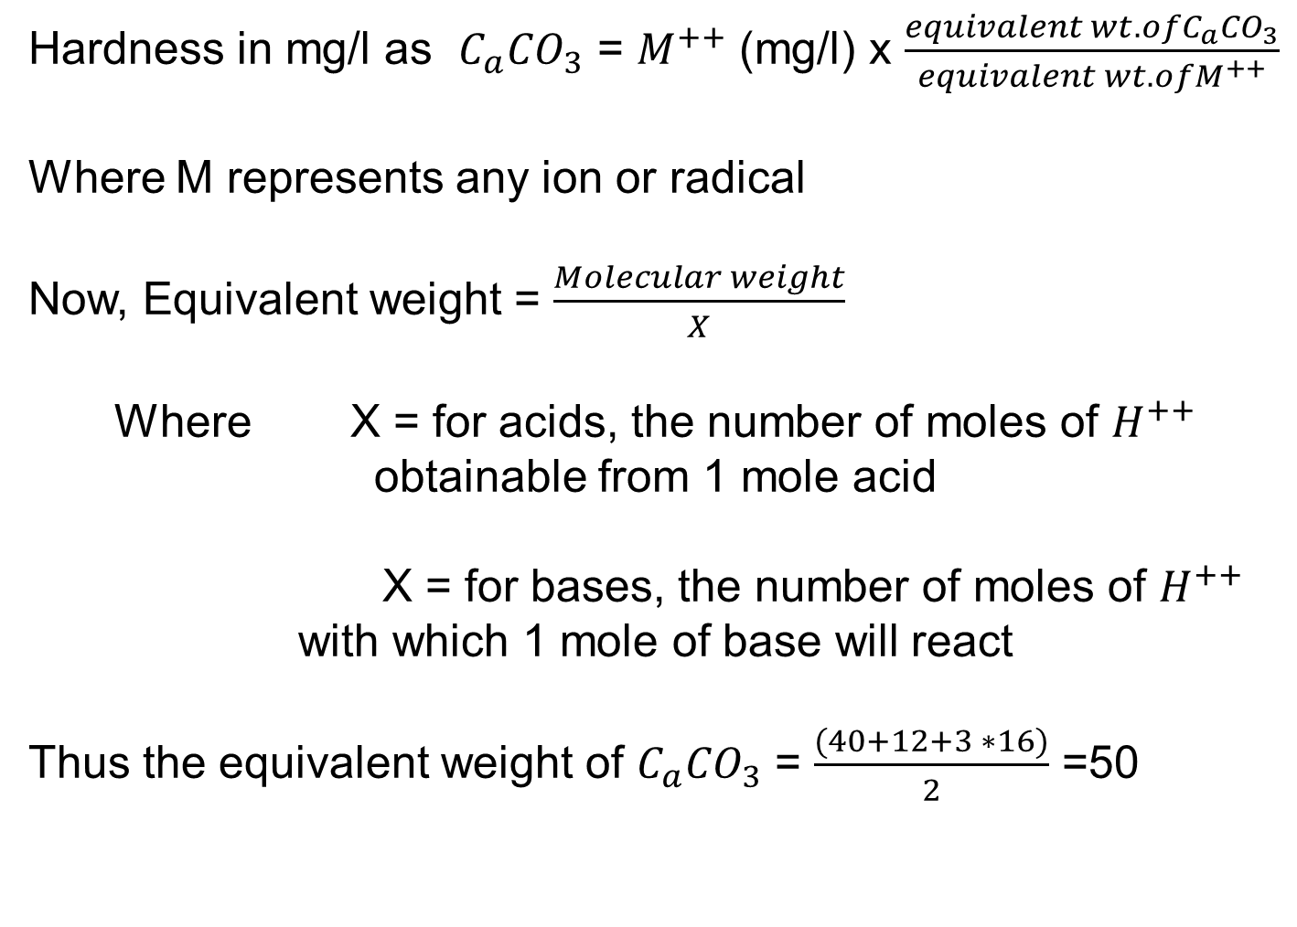
Hardness in mg/l as $C_{a}{CO}_{3}$ = $M^{++}$ (mg/l) x $\frac{equivalent wt. ofC_{a}{CO}_{3}}{equivalent wt. ofM^{++}}$
Where M represents any ion or radical
Now, Equivalent weight = $\frac{Molecular weight}{X}$
Where X = for acids, the number of moles of $H^{++}$ obtainable from 1 mole acid
X = for bases, the number of moles of $H^{++}$ with which 1 mole of base will react
Thus the equivalent weight of $C_{a}{CO}_{3}$ = $\frac{(40+12+3 ∗16)}{2}$ =50

Slide 55
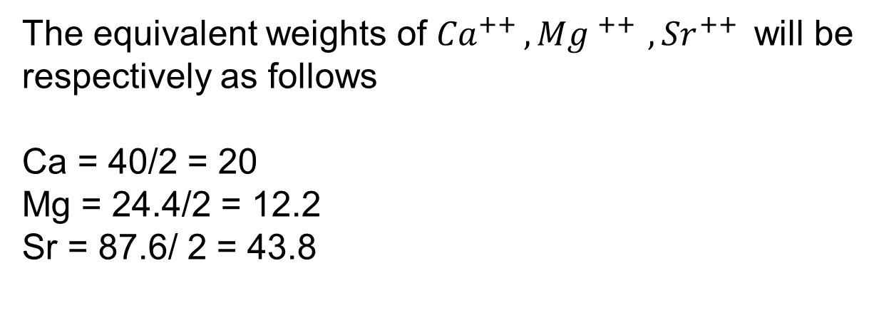
The equivalent weights of ${Ca}^{++ }{,Mg }^{++ }{,Sr}^{++ }$ will be respectively as follows
Ca = 40/2 = 20
Mg = 24.4/2 = 12.2
Sr = 87.6/ 2 = 43.8

Slide 56
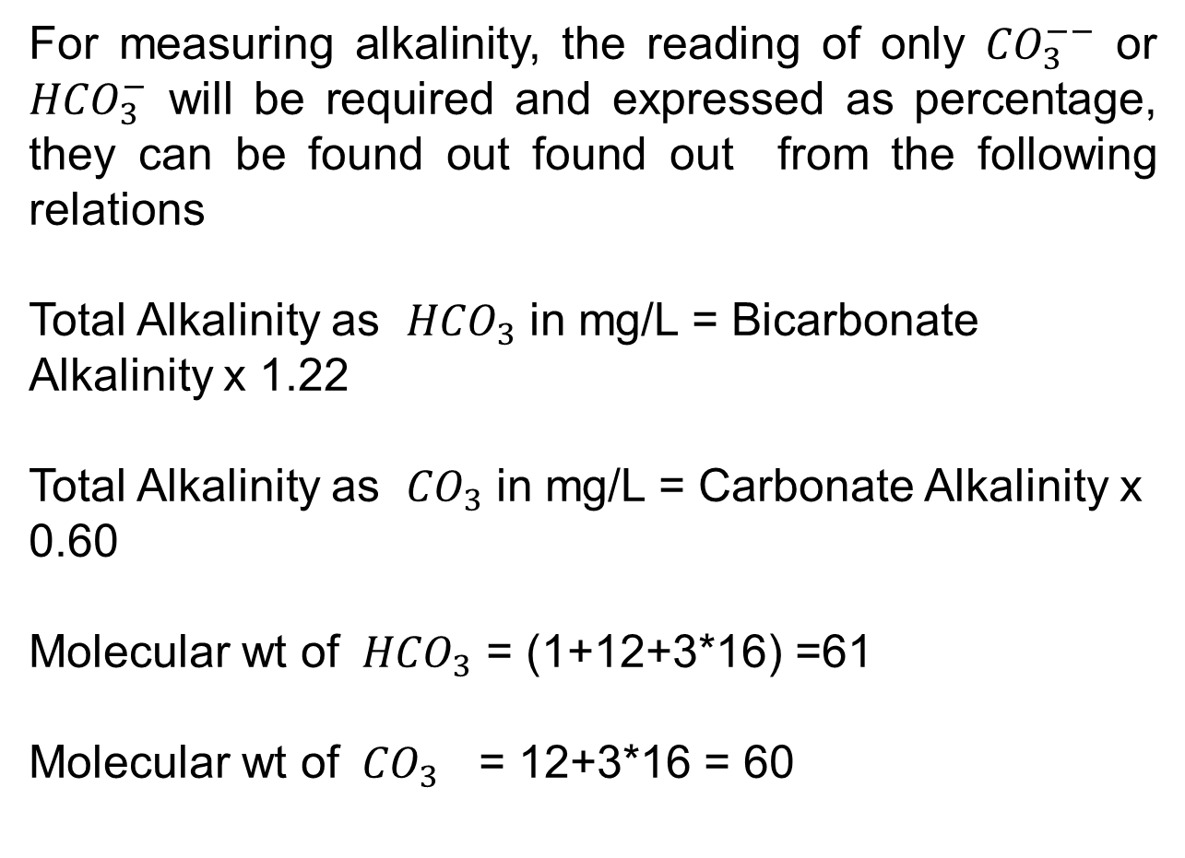
For measuring alkalinity, the reading of only ${CO}_{3}^{−−}$ or ${HCO}_{3}^{−}$ will be required and expressed as percentage, they can be found out found out from the following relations
Total Alkalinity as ${HCO}_{3}$ in mg/L = Bicarbonate Alkalinity x 1.22
Total Alkalinity as ${CO}_{3}$ in mg/L = Carbonate Alkalinity x 0.60
Molecular wt of ${ HCO}_{3}$ = (1+12+3*16) =61
Molecular wt of ${ CO}_{3}$ = 12+3*16 = 60

Slide 57
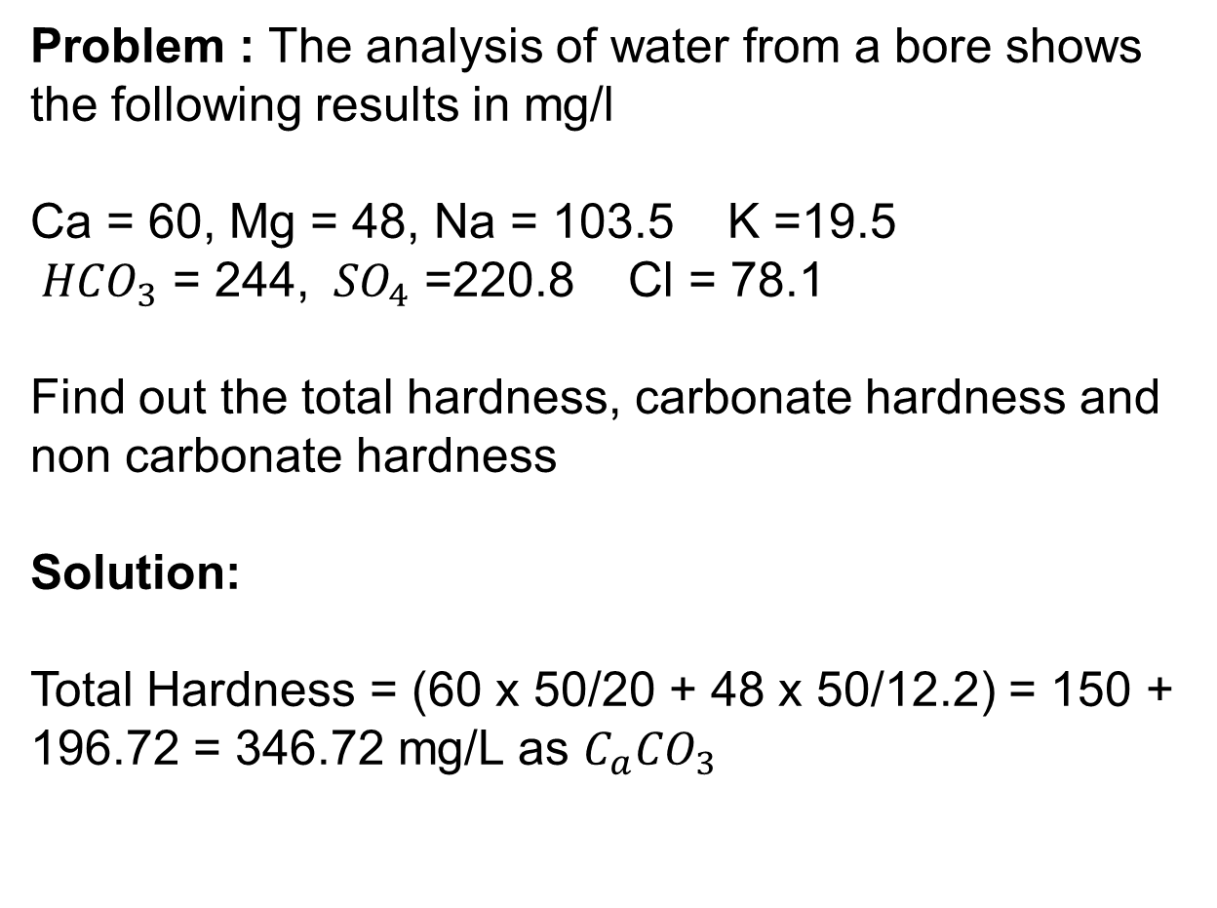
Problem : The analysis of water from a bore shows the following results in mg/l
Ca = 60, Mg = 48, Na = 103.5 K =19.5
${ HCO}_{3}$ = 244, ${ SO}_{4}$ =220.8 Cl = 78.1
Find out the total hardness, carbonate hardness and non carbonate hardness
Solution:
Total Hardness = (60 x 50/20 + 48 x 50/12.2) = 150 + 196.72 = 346.72 mg/L as $C_{a}{CO}_{3}$

Slide 58
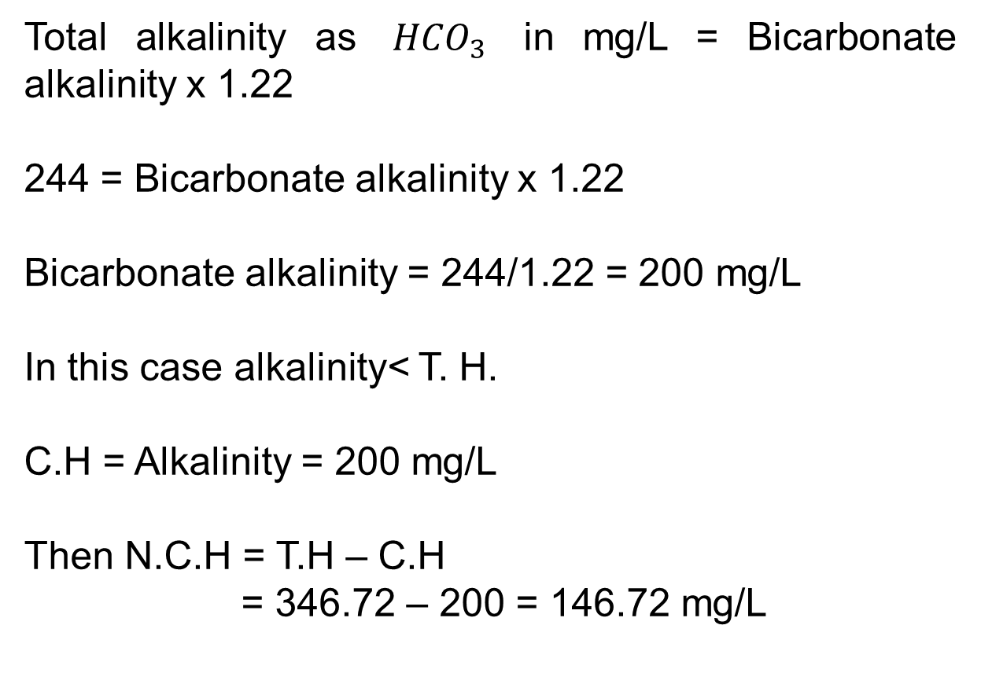
Total alkalinity as ${ HCO}_{3}$ in mg/L = Bicarbonate alkalinity x 1.22
244 = Bicarbonate alkalinity x 1.22
Bicarbonate alkalinity = 244/1.22 = 200 mg/L
In this case alkalinity< T. H.
C.H = Alkalinity = 200 mg/L
Then N.C.H = T.H – C.H
= 346.72 – 200 = 146.72 mg/L

Slide 59
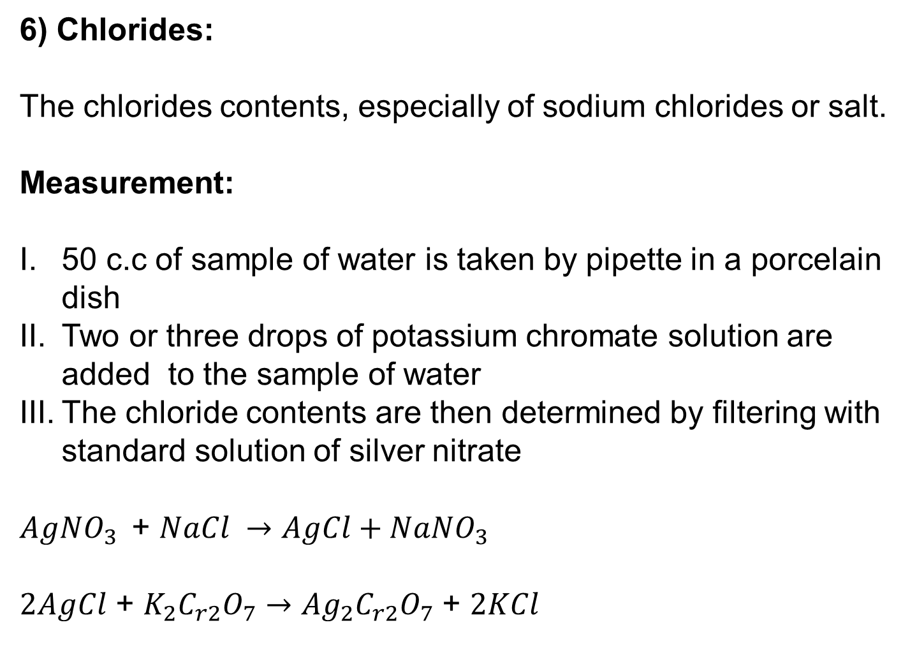
6) Chlorides:
The chlorides contents, especially of sodium chlorides or salt.
Measurement:
50 c.c of sample of water is taken by pipette in a porcelain dish
Two or three drops of potassium chromate solution are added to the sample of water
The chloride contents are then determined by filtering with standard solution of silver nitrate
${AgNO}_{3 }$ + $NaCl →AgCl+{NaNO}_{3 }$
$2AgCl$ + $K_{2}C_{r2}O_{7}$ $→{Ag}_{2}C_{r2}O_{7}$ + $2KCl$

Slide 60
Impact:
The presence of chlorides can corrode and such water cannot be used boilers because of formation of hydrochloride acid due to the presence of magnesium chloride in water.

Slide 61
Water Treatment
Plain Sedimentation
Sedimentation with coagulants/ flocculation
Filtration
Disinfection

Slide 62
Some of the treatment operations for removal of specific impurities are:
Aeration
Water softening
Arsenic removal
Iron removal
Activated Carbon application
Fluoridation and defluoridation
Demineralization
Desalinization

Slide 63
Plain Sedimentation:
Principles of particle settling in water:
This is a process causes the organic or inorganic particles heavier than water to settle by retaining water in the tank or basin. These particles are held suspension in natural water mainly by turbulence or current.
The particles travels with a constant vertical velocity called the terminal velocity or settling velocity of the particle.

Slide 64
The settling velocity of the particle depends upon
Horizontal flow velocity of the water
Shape and the size of the particle
Specific gravity of the particle
Viscosity of the water
Density of the water
Temperature of the water

Slide 65
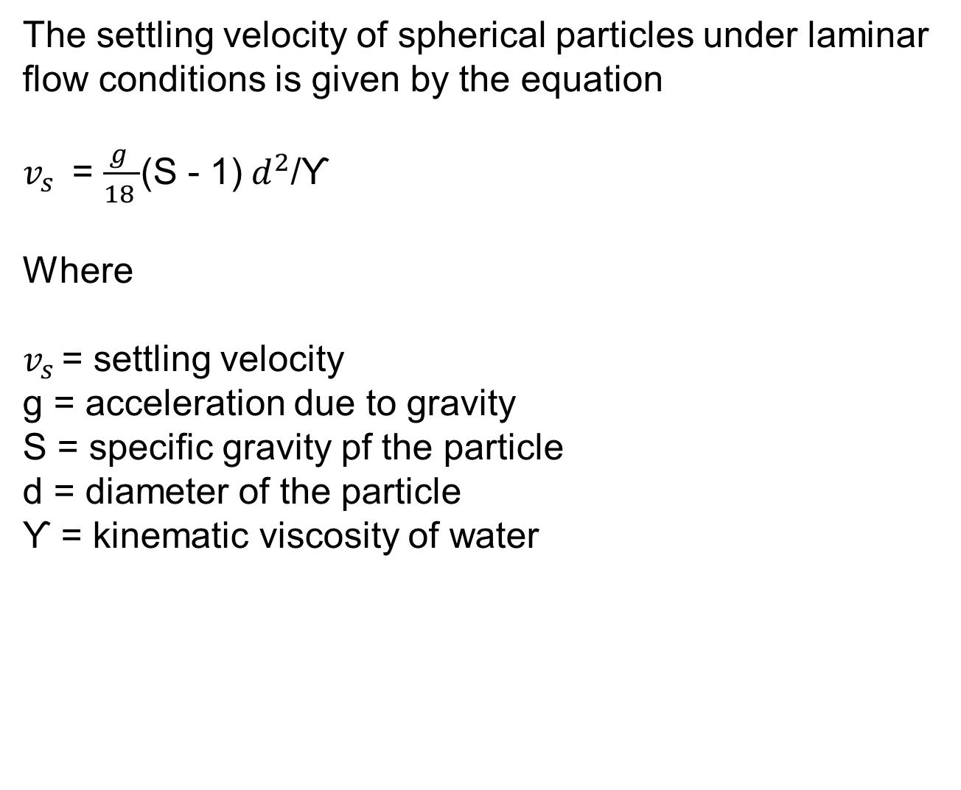
The settling velocity of spherical particles under laminar flow conditions is given by the equation
$v_{s }$ = $\frac{g }{18 }$(S - 1)$d^{2}$/Ƴ
Where
$v_{s }$= settling velocity
g = acceleration due to gravity
S = specific gravity pf the particle
d = diameter of the particle
Ƴ = kinematic viscosity of water

Slide 66
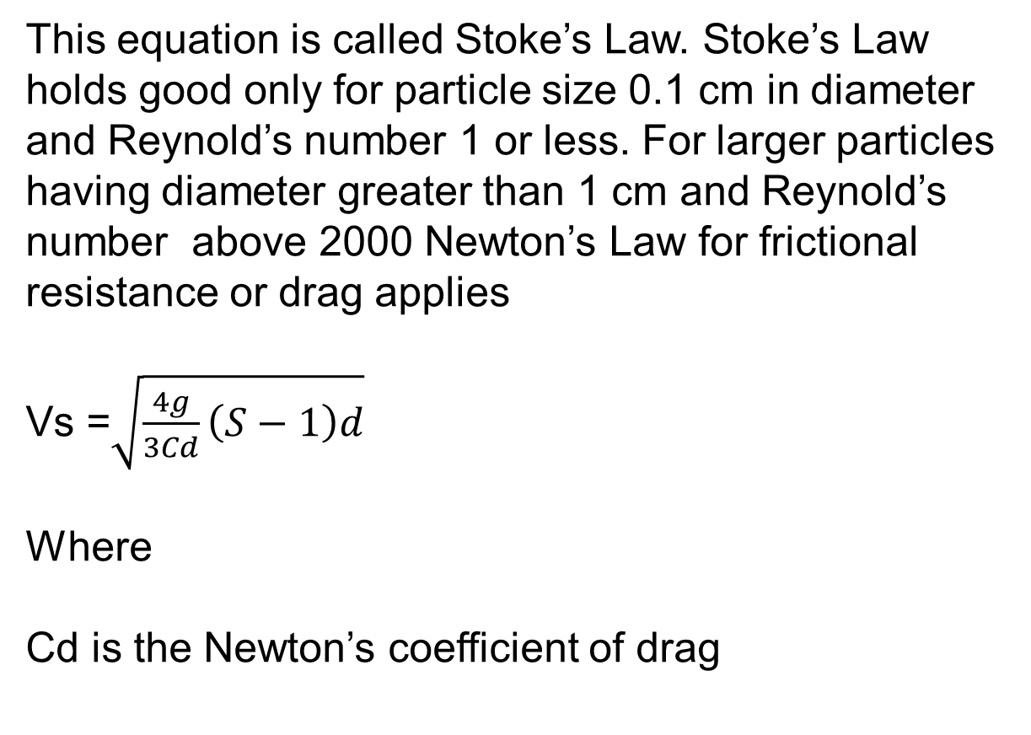
This equation is called Stoke’s Law. Stoke’s Law holds good only for particle size 0.1 cm in diameter and Reynold’s number 1 or less. For larger particles having diameter greater than 1 cm and Reynold’s number above 2000 Newton’s Law for frictional resistance or drag applies
Vs =$\sqrt{\frac{4g}{3Cd}\left(S−1\right)d}$
Where
Cd is the Newton’s coefficient of drag

Slide 67
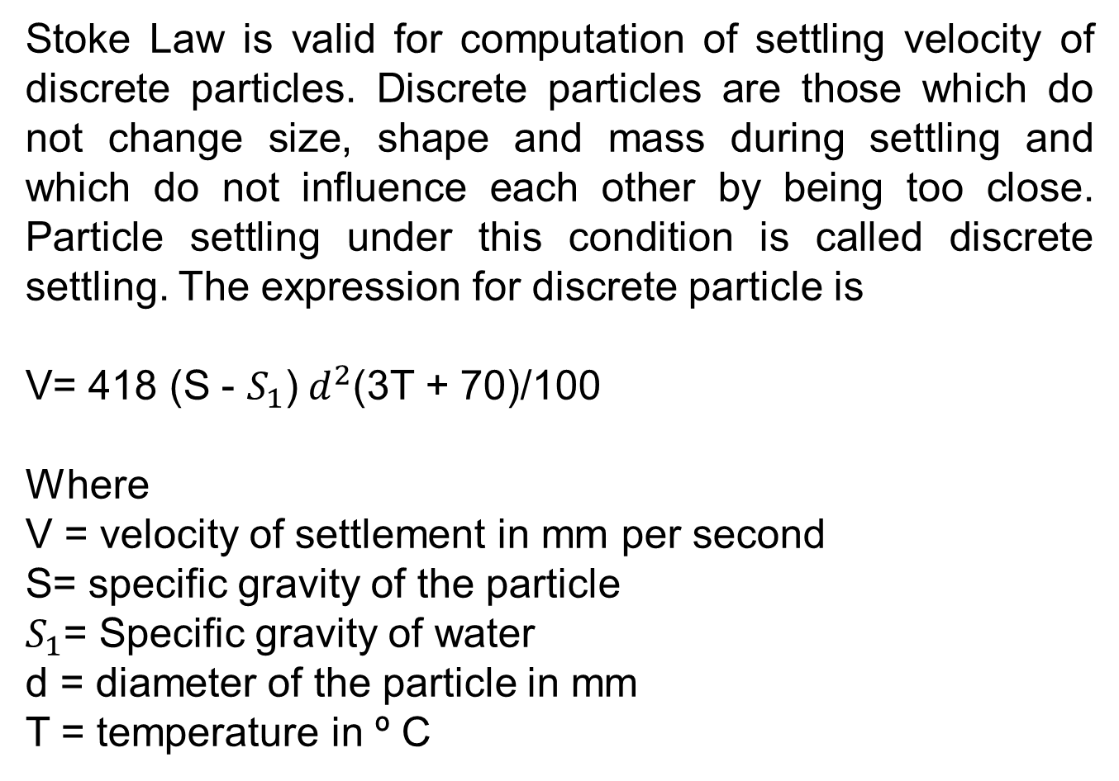
Stoke Law is valid for computation of settling velocity of discrete particles. Discrete particles are those which do not change size, shape and mass during settling and which do not influence each other by being too close. Particle settling under this condition is called discrete settling. The expression for discrete particle is
V= 418 (S - $S_{1}$)$d^{2}$(3T + 70)/100
Where
V = velocity of settlement in mm per second
S= specific gravity of the particle
$S_{1}$= Specific gravity of water
d = diameter of the particle in mm
T = temperature in º C

Slide 68
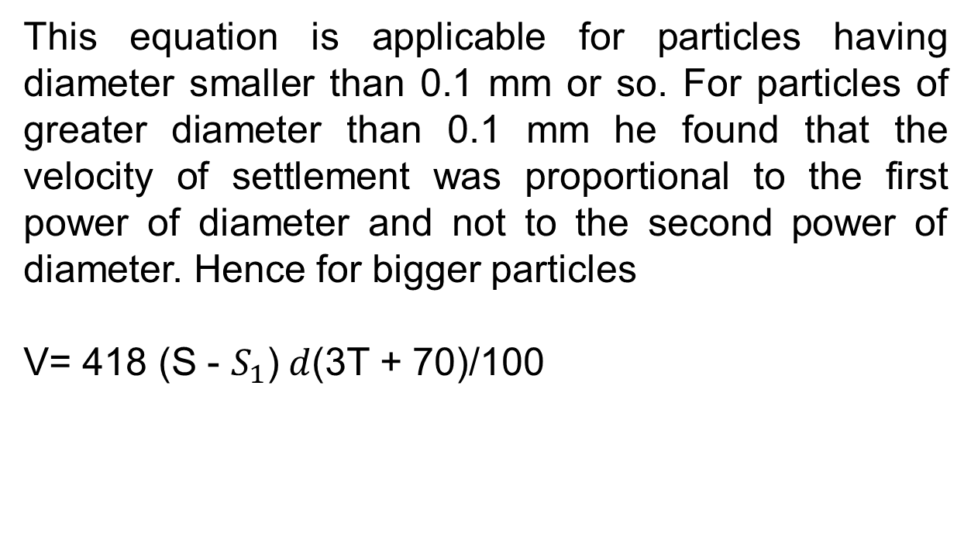
This equation is applicable for particles having diameter smaller than 0.1 mm or so. For particles of greater diameter than 0.1 mm he found that the velocity of settlement was proportional to the first power of diameter and not to the second power of diameter. Hence for bigger particles
V= 418 (S - $S_{1}$)$d$(3T + 70)/100

Slide 69
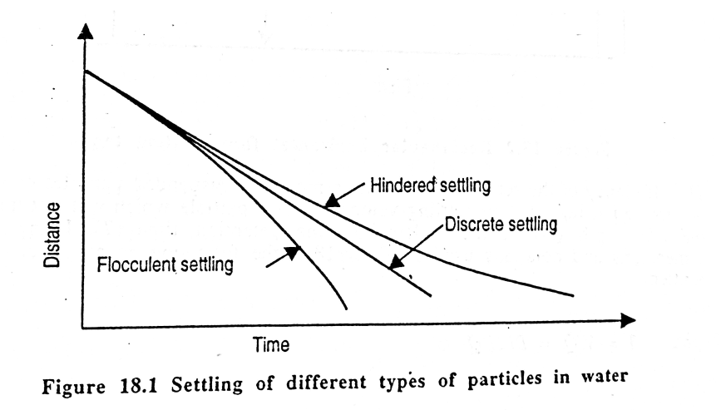

Slide 70
Hindered Settling:
In case of closely packed particles the water displaced by the particles may cause additional friction and the settling velocity is reduced. This termed as the Hindered Settling. Hindered settling becomes noticeable when the concentration of suspended solids is greater than 2000 mg/l

Slide 71
Flocculent Settling:
Sometimes settling particles may adhere to each other and grow in size and thus deviate from the settling characteristics represented by Stoke’s Law. This may occur in settling of algae or freshly formed floc by the process of flocculation with coagulant. These particles/flocs tend to stick together and form new bigger particles which settle at a faster rate. This type of settling is called flocculent settling.

Slide 72
Types of sedimentation tank:
Depending upon the nature of working the sedimentation tanks are the following two types.
Fill and draw type
Continuous flow type

Slide 73
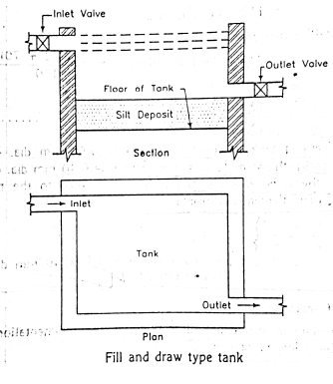

Slide 74
Working:
The working of the tank is simple. The water is filled the tank and it is then allowed to rest for a certain time. During the period of rest, the particle sin suspension will settle down at the bottom of the tank. The clear water is then drawn off and the tank is cleaned of silt and filled again.

Slide 75
The usual period of rest to cause settlement of particles is about 24 hours or so. If time required for inlet, outlet emptying and cleaning operations is added , a period of about 30 to 36 hours is required to put the tank again in working condition.

Slide 76
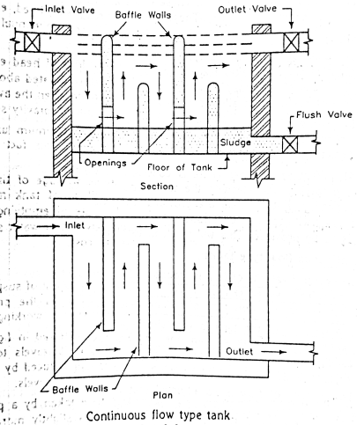

Slide 77
Design aspects of continuous flow type of sedimentation tank:
Following are the design aspects
Velocity of flow
Capacity of tank
Inlet and outlet arrangements
Shapes of the tanks
Miscellaneous considerations

Slide 78
Velocity of flow:
It should remain uniform through out the tank and it is generally not allowed to exceed 150 mm to 300 mm per minute.
2. Capacity of the tank:
Following are the two methods by which the capacity of sedimentation tank is determined
Detention period
Overflow rate

Slide 79
Detention period:
The relation between capacity of a tank and the detention period can be established as follows
Let C = Cubical contents or capacity of tank
Q = Discharge or rate of flow per hour
T= Detention period in hours
Then T = C/Q
Or C = Q x T
For plain sedimentation tanks, the detention period is vary from 4 to 8 hours and when coagulants are used it may vary from 3 to 4 hours

Slide 80
ii) Overflow rate:
In this method it is assumed that the settlement of a particle at the bottom of the tank does not depend on the depth of tank. But it depends on the surface area of tank
Let L = Length of tank
B = Breadth of tank
D = Depth of tank = Side Water Depth = S. W.D
C = Capacity of tank
T = Detention period
Q = Discharge of rate of flow
V = velocity of descend of a particle to the bottom of tank
= Surface Overflow Rate = S.O.R

Slide 81
Then T = C/Q = (L x B x D)/Q………………….(1)
Also, T = Distance of descend/ Velocity of descend
= D/V = S.W.D/S.O.R ………………..(2)
Equation 1 and 2
(L x B x D)/Q = D/V
Or S.O.R = V = Q/(L x B)………………….(3)
The equation 3 shows that the velocity of descend of particle is independent of the depth of tank and it inversely varies as the surface area of the tank

Slide 82
Introduction to environmental engineering
General:
Environmental engineering has been defined as the branch of engineering that is concerned with the protecting the environment from the potentially deleterious effect of human activity, protecting human populations from the effect of adverse environmental factors, and improving environmental quality for human health and well being

Slide 83
Environmental Engineering:
The Environmental Engineering Division of the American Society of Civil Engineers (ASCE) has published the following statement of purpose
Environmental engineering is manifest by sound engineering thought and practice in the solution of problems of environmental sanitation, notably in the provision of safe, palatable and ample public water supplies, the proper disposal of or recycle of waste water and solid wastes, the adequate drainage of urban and rural areas for proper sanitation and control of water, soil and atmospheric pollution, and the social and the environmental impact of these solutions.

Slide 84
Furthermore it is concerned with engineering problems in the field of public health, such as control of arthropod-borne diseases, the elimination of industrial health hazards and the provision of sanitation in urban, rural and recreational areas and the effect of the technological advances on the environment

Slide 85
From the definition the topic of environmental engineering are
Provision of safe, palatable and ample public water supplies
Proper disposal of recycling of waste water and solid wastes
Control of water, soil and atmospheric pollution

Slide 86
Sanitation:
Sanitation may be defined as the science and practice of effecting healthful and hygienic condition and involves the study and use of hygienic measures such as
Safe, reliable water supply
Proper drainage of waste water
Proper disposal of human waste
Prompt removal of all refuse

Slide 87
The principle objectives of providing sanitation facilities are
To have improved public health
To minimize environmental pollution

Slide 88
Classification of wastes:
In general wastes can be classified as follows:
Human waste or human excreta:
Refers to only human faeces and urine and usually are not combined with liquid or solid wastes. They are also widely known as night soil when collected without dilation in large volumes of water

Slide 89
Municipal sewage/Wastewater:
It is the liquid waste conveyed by a sewer and may include domestic and industrial discharges as well as storm water, groundwater infiltration and inflow
Domestic Sewage:
It is the liquid waste which originates in the sanitary conveniences, eg water closets, urinals , baths, sinks etc of dwellings, commercial facilities and institutions in a community. Sometimes it is referred to as sanitary sewage.

Slide 90
Sullage:
It is the liquid discharges from kitchens, wash basins etc. and excludes human excreta. Sullage is less foul than domestic sewage and can be discharged through open surface drains in unsewered areas.
Industrial wastes:
It includes the liquid discharges from spent water in different industrial processes such as manufacturing and food processing

Slide 91
Strom Water:
It is the surface runoff during and immediately after the rain fall, which enters sewers through inlets. Strom water is not as foul as sanitary or industrial sewage and hence can be carried through open drains or channels and disposed of in natural rivers or streams without any treatment.
Solid wastes:
It includes all materials which are normally solid and are discharged as useless or unwanted during human activities

Slide 92
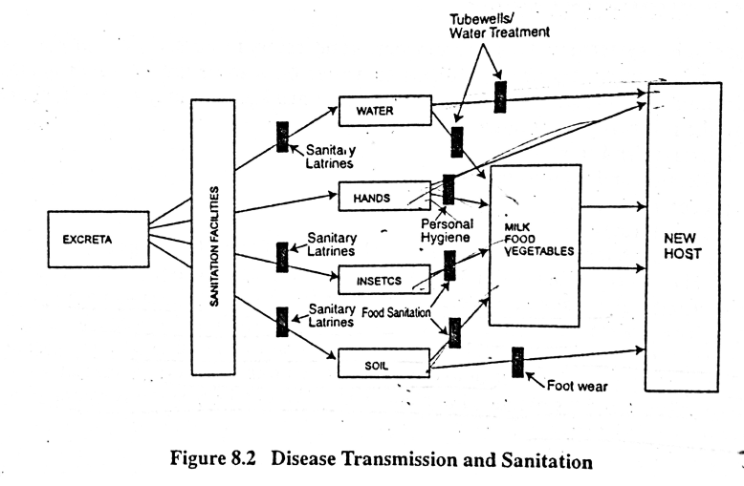

Slide 93
Sanitation system:
A sanitation system is involves all arrangements necessary to store, collect, process and deliver human wastes back to nature in a safe manner. Sanitary systems with respect to human waste management may be considered to have following functions:
Excretion and storage
Collection and transportation
Process /treatment
Disposal/recycle

Slide 94
Classification of sanitation system:
Onsite sanitation system
Offsite sanitation system
The classification of on-site or offsite sanitation system depends on whether the waste is stored, treated and disposed at the point of generation or transported to somewhere else for treatment and /or disposed.

Slide 95
Wet system
Dry system
Sanitation system can also be classified as wet or dry systems based on the methods of collection and conveyance of wastes produced in a community. Wet and dry systems can be either on site or off site systems.

Slide 96
On site systems:
When the wastes are collected, treated and disposed of at the point of generation it is called an on site system. On site systems are widely used in rural areas of both developed and developing countries and in absence of more costly sewerage system, is also extensively used in urban areas of developing countries.
The simplest onsite sanitation system is a pit latrine, which consists of manually dug pit covered by a concrete, wooden or bamboo slab with a squatting hole. Some form of super structure is erected over the pit to ensure privacy to the user.

Slide 97
The onsite sanitation system has over the years been developed and improved into a lot of different designs e.g ventilated improved pit latrines, pour flush single and double pit latrines, aqua privies, septic tank and so on.
The basic principles of on site systems however remain the same, liquids infiltrate into the soil and the solids are retained, anaerobically digested and have to be removed, or a new pits have to be dug at the regular intervals. The basic on site systems are primarily designed to dispose of human excreta.

Slide 98
Off – site systems:
When the waste is collected and transported to somewhere else for treatment and disposal, the system is called off site e.g. bucket latrine systems and conventional sewerage system. The basic elements of off site sanitation systems therefore include collection, transportation, treatment, disposal and /or reuse.
The waste is collected either through house sewers or manually using buckets or vaults
These are transported either by cart, truck or sewer system to a suitable distance place where it is treated prior to disposal or reuse
Notes:
efwfwf

Slide 99
Dry System:
In dry system no water is used for the dilution of the waste. They are usually applied to the unsewered areas with no piped water supply, e g, pit latrine systems (onsite), bucket latrine system (off site)
Wet system:
In the wet system the waste is diluted with flushes of water. Wet systems are suitable where piped water supply systems are available, e.g, septic tank system (on site), conventional sewerage systems (off site)

Slide 100
Sometimes a sanitation system can be classified as either permeable or confined depending on whether the system allows infiltration.
Confined systems do not allow infiltration of the liquid portion of the wastes into the ground, e.g aqua privies, septic tank
In the unconfined permeable system the liquid part of the wastes is allowed to infiltrate , causing potential pollution of the ground water e.g pit latrines

Slide 101
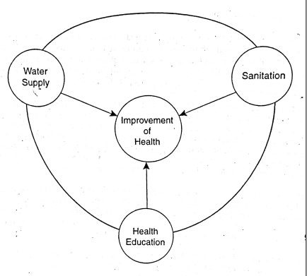
Fig : Interrelationship between water, sanitation and health education

Slide 102
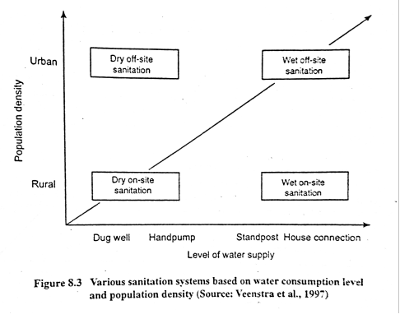

Slide 103
Important factors for sanitation in Bangladesh :
Housing density:
Simple single pit latrines are suitable for use in rural areas and low density urban areas up to about 300 people per hectare.
At higher densities alternating double pit latrines may be feasible, but other options such as small bore sewers, community latrine cum biogas plant etc may be more appropriate solutions

Slide 104
Water supply and service level :
In areas where water use is low (say less than 30l/c/d) and where water has to be hand carried from public stand posts, tube wells or communal wells, pit latrines of one type or another are technically feasible sanitation option.
Difficulties associated with pit latrines:
Digging pits in loose and unconsolidated soils (e.g sand or fine grained alluvium) is difficult and the lining must nit prevent the seepage of faecal liquids out of the pit into the surrounding soil. Pit latrines are vulnerable.

Slide 105
Soil Permeability:
Soils with permeability below 2.5 mm per hour are unsuitable for pit latrines, as the liquid fraction of the excreta in unable to infiltrate into the soil, thereby leading to overflow of the pits.
Infiltration capacity of the pits also greatly reduced where the water table is high e.g in the coastal region of the country.

Slide 106
Ground water pollution:
The deposition of excreta in pits may pollute water sources, particularly wells, tube wells pond etc located nearby. The danger of pollution increases if the pit is dug down to the water table . Bacteria will not penetrate more than 1.2 m in most unsaturated soil but they have been known to travel over 100 m in gravel below the water table
So, users are required to locate pits at least 10 m away from tube wells or other water sources to avoid potential pollution.

Slide 107
What is Water Supply Engineering
A branch of engineering concerned with the development of sources of supply, transmission, distribution, and treatment of water. The term is used most frequently in regard to municipal water works, but applies also to water systems for industry,
irrigation and other purposes.

Slide 108
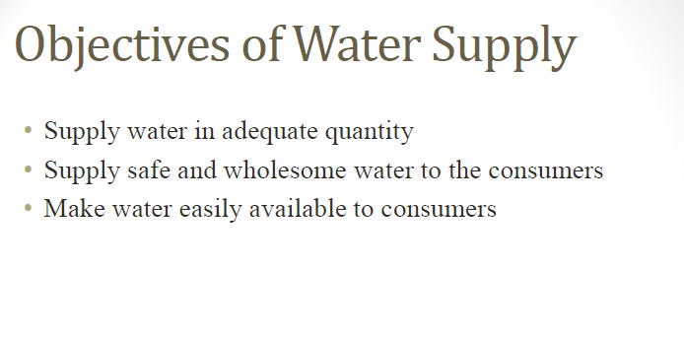

Slide 109
Elements of Water Supply System:
The planning of water supply system requires that the probable water use and its variation be estimates as accurately. The first step in the design of a water supply is the determination of the quantity of water that will be required with provision for the estimate requirements of the future. Next a reliable source of water must be located and finally a collection system, a treatment plant and a distribution system must be provided. The essential elements of a water supply system are (i) Source of supply, (ii) Collection system, (iii) Treatment of purification and (iv) Distribution system

Slide 110
Source of supply:
All fresh waters on earth come in the form of precipitation evaporated mainly form oceans, seas and other surface water sources. A part of this precipitated water flows as surface water and remains trapped in depressed areas and another part enters in to the earth to form groundwater. Therefore, surface water and groundwater are the main sources of water for water supply. Rainwater being relatively free from contamination, can be a good source of water supply. The main considerations for the selection of a source of water supply are quantity, quality and cost.

Slide 111
Collection system:
The collection system is dependent on the water supply. An intake with pumping facilities is required if the water is to be collected from a surface water source. Dug wells or tube wells are common collection devices for groundwater, while a permanent roof or an uncontaminated ground surface is needed for collection of rain water for water supply.

Slide 112
Treatment:
Natural waters usually contains impurities, which require treatment to make the water suitable for domestic water supplies. The type and degree of treatment processes involve removal of turbidity, color, taste and odour and removal and destruction of pathogenic (disease producing) micro-organisms. Ground waters are relatively free from disease-producing bacteria but rich in mineral substances and may require removal of iron, hardness, arsenic,, fluoride etc. If the dissolved minerals in ground waters are within acceptable limits, the water may be supplied without any treatment. The most common methods used for treatment include screening, sedimentation, aeration, treatment with treatment with chemicals, filtration, demineralization and disinfection.

Slide 113
Distribution system:
A distribution system is needed to deliver water to individual consumers. The piped water supplies require distribution networks of pipes with storage reservoirs, pumping devices, stand posts, valves and other appurtenances.
In unpiped water supplies, the sources of water are to be distributed to make them easily accessible to the consumers.

Slide 114
The rural water supply based on manually operated tubewells does not require a distribution network but the tubewells are required to be distributed over the area in such a way that the distance from the households are reasonable and each tubewell serves an optimum number of household.
In the location of community type treatment plants, accessibility and distances from the community are required to be taken into considerations.

Slide 115
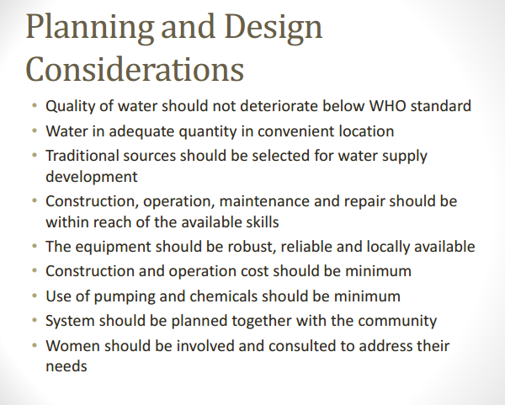

Slide 116


Slide 117
Population and Water requirement
Demand of water is generally done by the help of the two factors
Probable population estimated at the end of the design period
Rate of water supply per capita per day
The design period is the period into the future for which the estimate is to be made. The period should neither be too long so that full financial burden is not thrown on the present generation, not it should be too short so as to avoid the design becoming uneconomical. In practice it varies from 25 to 40 years

Slide 118
The per capita consumption of water is the total consumption divided by the population and the number of days in the year. It is generally expressed as liter per capita per day . Thus
Water consumption per capita per day = Total consumption/(Population X 365)

Slide 119
Factors affecting the consumption of water:
Size of the city:
The per capita use of water tends to be higher in larger cities than in small towns. The difference results from great industrial use, more parks and other public facilities , greater commercial use and perhaps more loss and waste in the larger cities
ii) Characteristics of the people:
Water use is influenced by the economic status of the people. The per capita use of the slum areas will be much less than that in the high class residential areas, because of extra water use for gardening, car washing, air conditioning and for some ornamental display

Slide 120
iii) Climate condition:
Water is used is warm, dry climates than humid and cold climates for bathing, lawn and garden watering, air conditioning etc. In extremely cold countries water may be wasted as faucets to prevent the freezing of pipes
iv) Commerce and industries

Slide 121
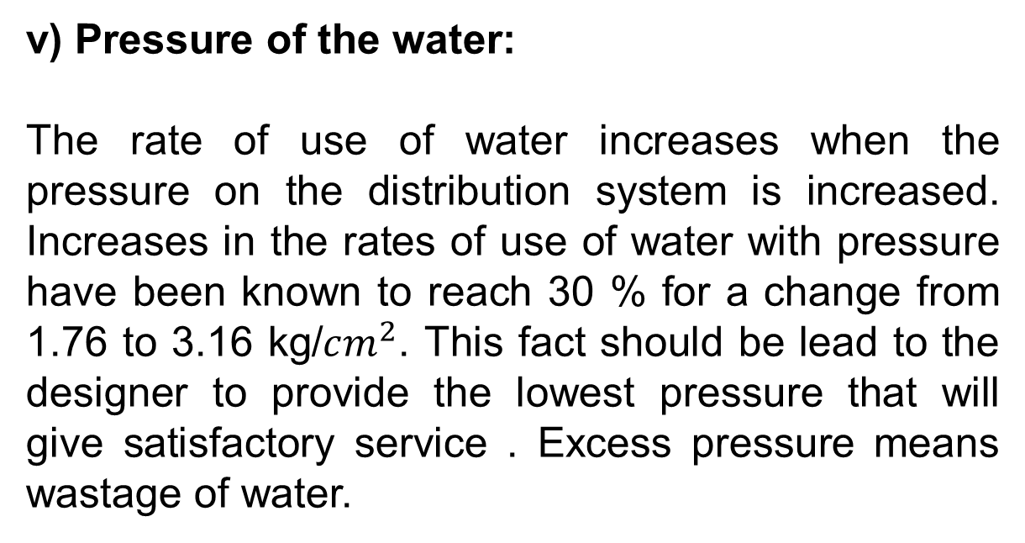
v) Pressure of the water:
The rate of use of water increases when the pressure on the distribution system is increased. Increases in the rates of use of water with pressure have been known to reach 30 % for a change from 1.76 to 3.16 kg/$cm^{2}$. This fact should be lead to the designer to provide the lowest pressure that will give satisfactory service . Excess pressure means wastage of water.

Slide 122
vi) Quality of water
vii) Sewerage facilities
viii) Water rates and metering
ix) Nature of supply
x) Availability of private supply
xi) Efficiency in management
x) Number of inhabitants

Slide 123
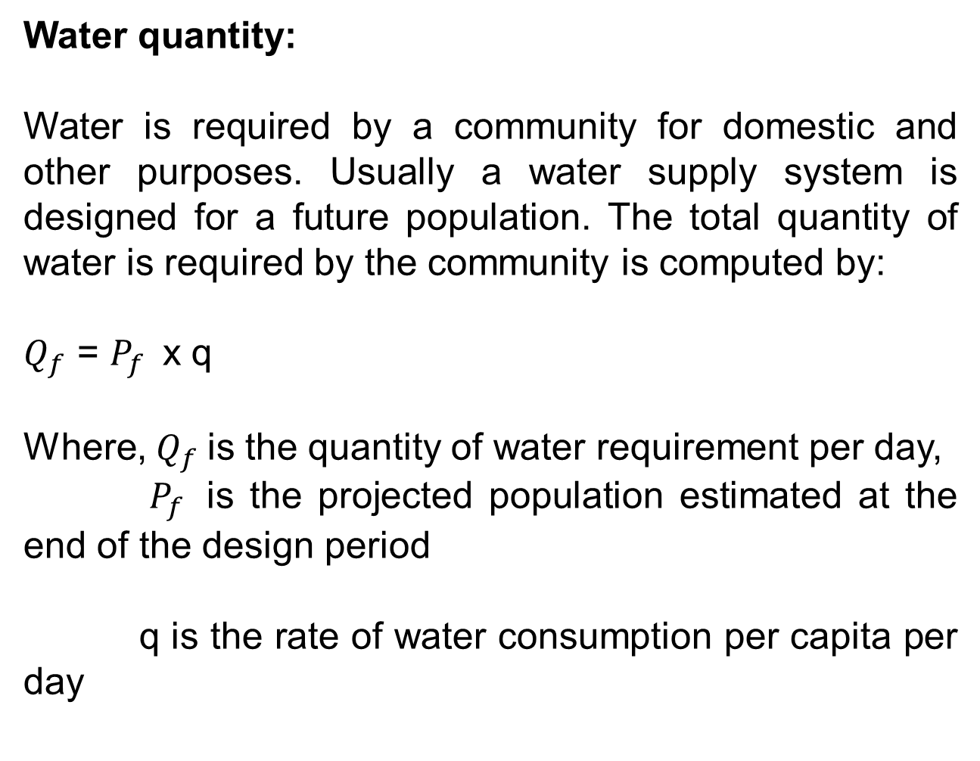
Water quantity:
Water is required by a community for domestic and other purposes. Usually a water supply system is designed for a future population. The total quantity of water is required by the community is computed by:
$Q_{f}$ = $P_{f }$ x q
Where, $Q_{f}$is the quantity of water requirement per day,
$P_{f }$ is the projected population estimated at the end of the design period
q is the rate of water consumption per capita per day

Slide 124
Population projection:
The following seven methods are generally used for predicting future population.
Uniform growth rate method:
In this method a constant increment of growth is added for a period based on the population growth of the same period in the recent past. For the example if the population increased from 10,000 to 11,000 over the last five years, it would increase by an increment of 1000 in the next five years.

Slide 125
Uniform percentage growth rate method:
In this method a constant percentage of growth is assumed for an equal period of time. For example, if the population of the community increased from 10,000 to 11,000 during the last five years, it would increase another 10% to a population of 12100 during the next five years.
Decreasing growth rate method:
The method is similar to the uniform growth rate method but with an assumption of a decreasing rather then the uniform rate of increase.

Slide 126
For example, if the population of a community increased from 10000 to 11000 during five year period, it would increase by the decreasing rate say 900 rather then 1000 at the end of next five year period. The decreasing growth may result when growth potential is reduced.
Graphical extension or curvilinear method:
In this method the population time curve is extended by an eye estimation to obtain the future population as shown in figure

Slide 127
Fig : Population projection by graphical method

Slide 128
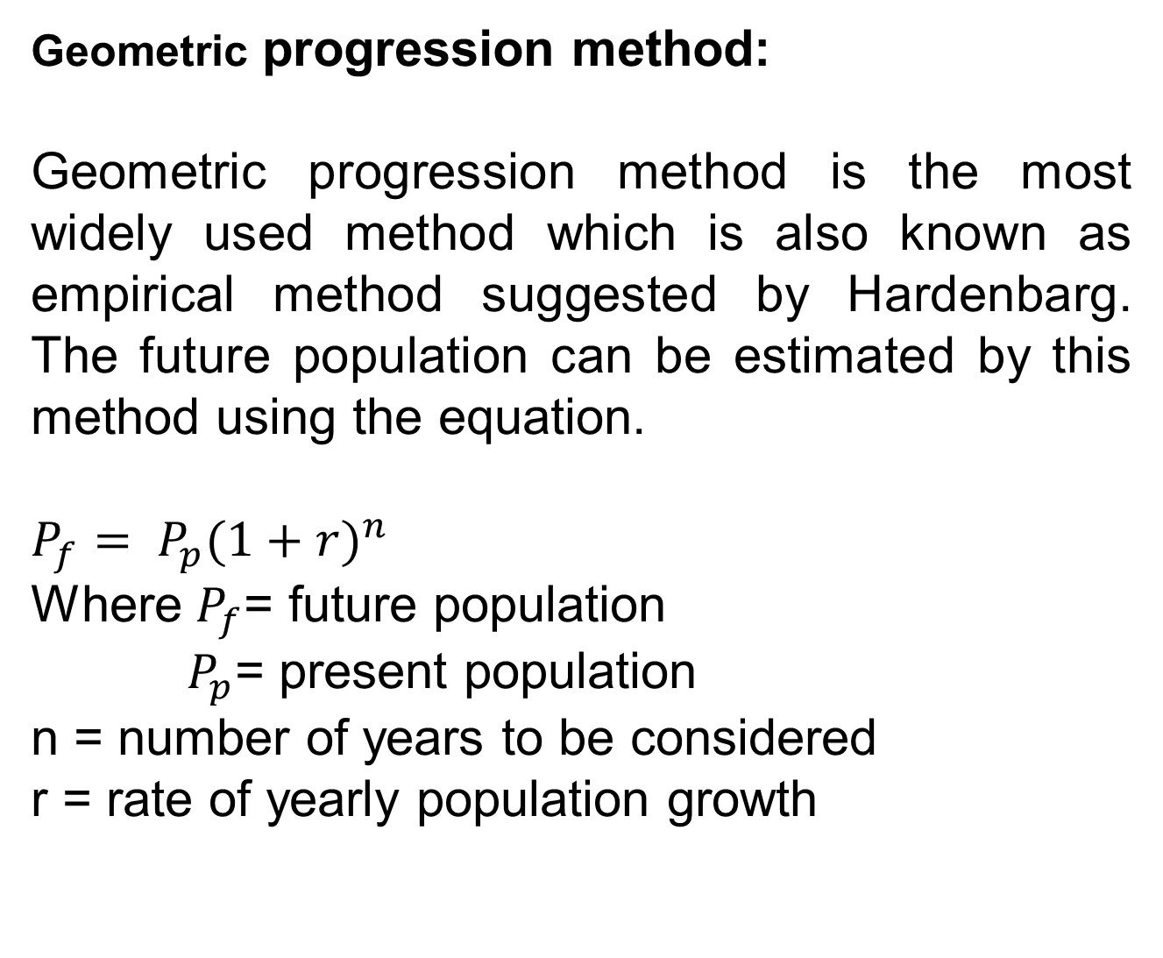
Geometric progression method:
Geometric progression method is the most widely used method which is also known as empirical method suggested by Hardenbarg. The future population can be estimated by this method using the equation.
$P_{f}= P_{p}{(1+r)}^{n }$
Where $P_{f}$= future population
$P_{p}$= present population
n = number of years to be considered
r = rate of yearly population growth

Slide 129
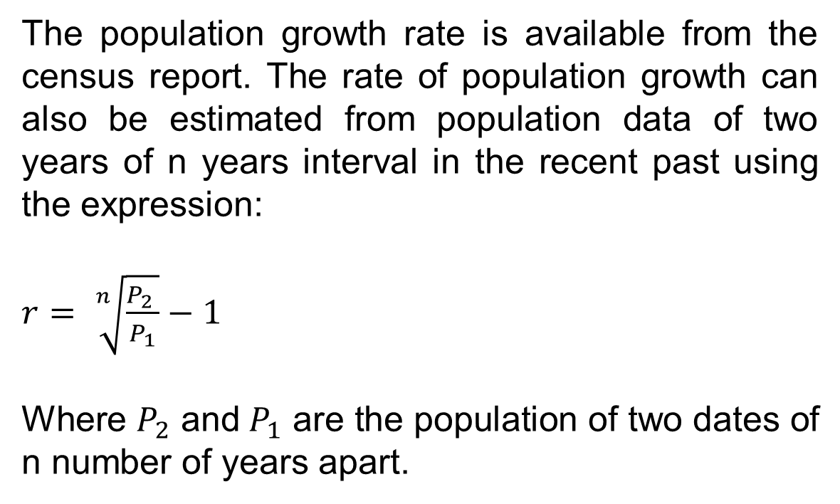
The population growth rate is available from the census report. The rate of population growth can also be estimated from population data of two years of n years interval in the recent past using the expression:
$r= \sqrt[n]{\frac{P_{2} }{P_{1}}}−1$
Where $P_{2}$ and${ P}_{1}$ are the population of two dates of n number of years apart.

Slide 130
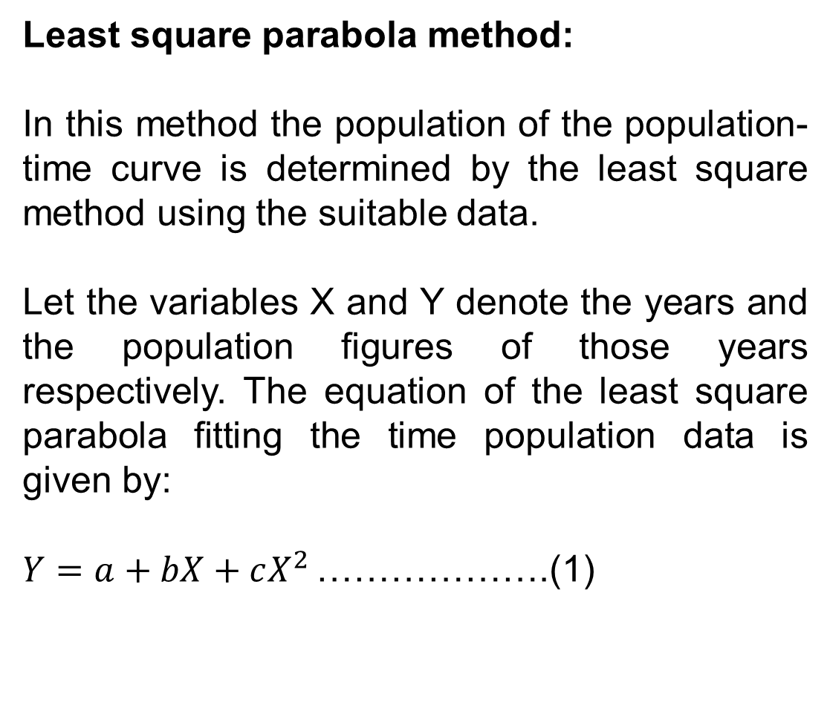
Least square parabola method:
In this method the population of the population-time curve is determined by the least square method using the suitable data.
Let the variables X and Y denote the years and the population figures of those years respectively. The equation of the least square parabola fitting the time population data is given by:
$Y=a+bX+cX^{2 }$……………….(1)

Slide 131
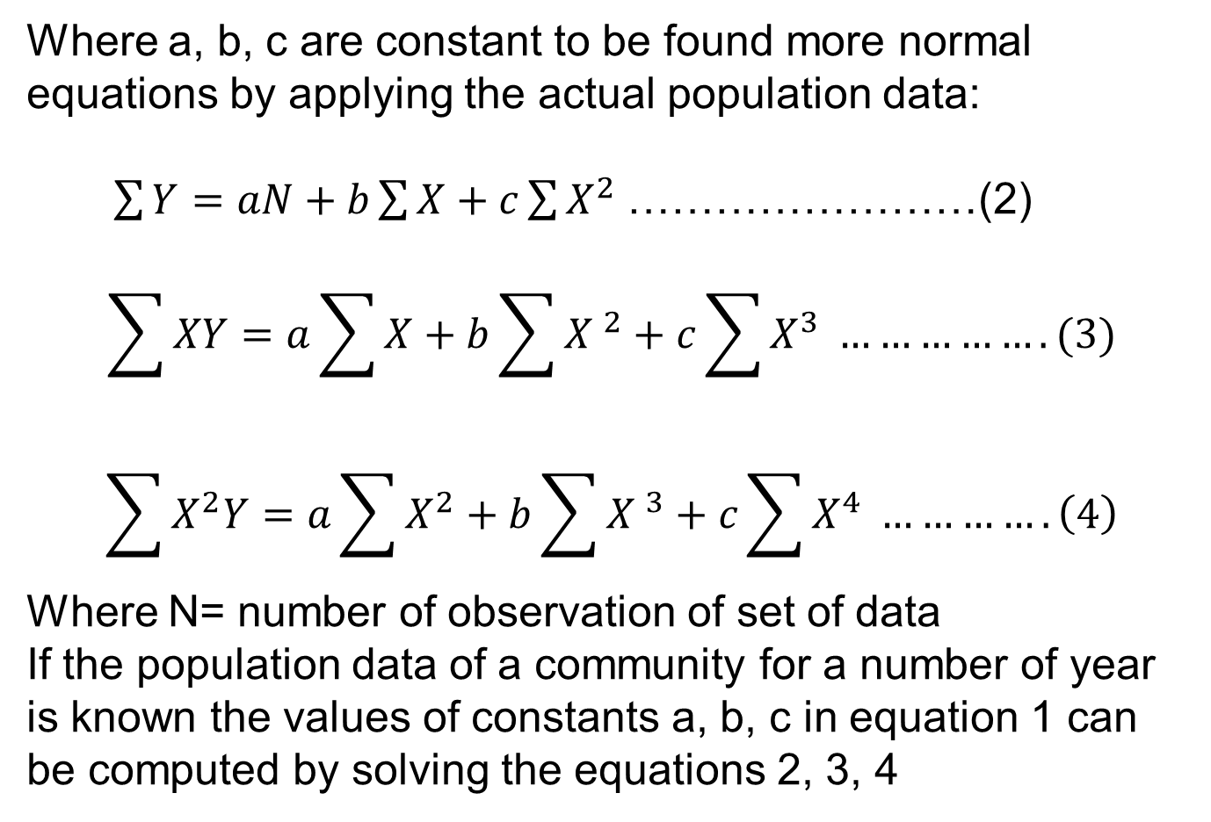
Where a, b, c are constant to be found more normal equations by applying the actual population data:
$\sum{Y}=aN+b\sum{X+c\sum{X^{2} }}$……………………(2)
$$\sum{XY}=a\sum{X+b\sum{{X }^{2}+c\sum{X^{3} …………….(3)}}}$$
$$\sum{X^{2}Y}=a\sum{X^{2}+b\sum{{X }^{3}+c\sum{X^{4} ………….\left(4\right)}}}$$
Where N= number of observation of set of data
If the population data of a community for a number of year is known the values of constants a, b, c in equation 1 can be computed by solving the equations 2, 3, 4

Slide 132
There are several methods also
Zoning Method:
This is rather the modern and the most useful method of population forecast. In this method the master plan of the city is prepared and it is divided into several zones such as residential zone, industrial zone, commercial zone etc.

Slide 133
Ratio and correlation method:
It is evident that the population growth of a small area is related to some extent to the population growth of a wide area. Thus the rate of population growth of a town is related to some extent to the rate of population growth of state or nation. Hence it is possible to estimate the population of the town under consideration by considering the rate of the population growth of state or nation

Slide 134
Growth composition analysis method:
There are only three ways by which change in the population occurs.
Through births
Through deaths
Through migration
If the above three factors for area under consideration are properly analyzed, the estimated population of some future period can be obtained by the following equation
Estimated population = present population + natural increase or decrease + migration

Slide 135
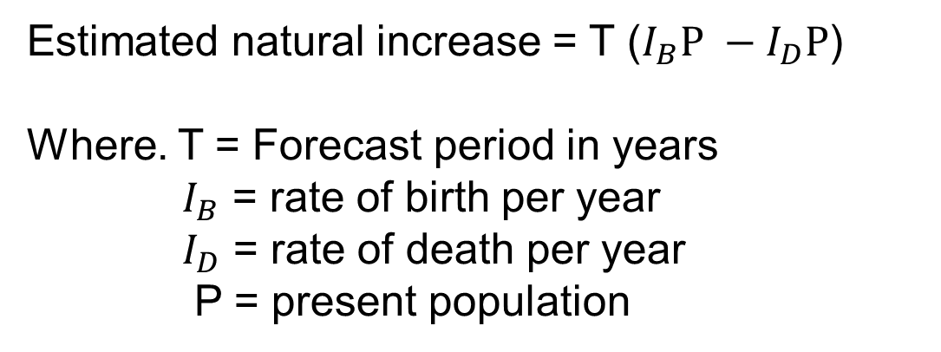
Estimated natural increase = T ($I_{B}P −I_{D}P$)
Where. T = Forecast period in years
$I_{B}$ = rate of birth per year
$I_{D}$ = rate of death per year
P = present population

Slide 136
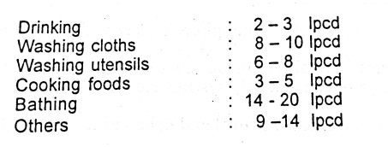
In the rural areas of Bangladesh, the water requirement for various purposes has been estimated as follows:

Slide 137
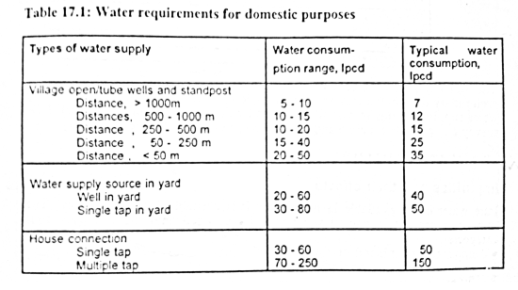
The typical water requirement for domestic purposes are given below:

Slide 138
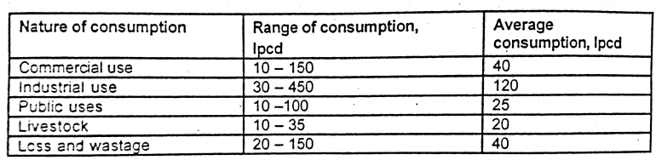
Water requirement for other purposes

Slide 139
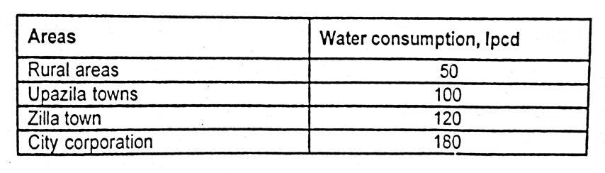
Water requirements in rural and urban areas in Bangladesh

Slide 140
Essential elements for designing a water supply system for a city:
The number of years, design period for which the proposed water supply system and its component structures and equipment are to be adequate.
The number of people or the design population to be served
The rates of water use, or design flows, in terms of per capita water consumption including industrial, commercial and fire equipment.
The area to be served, or design area, and the allowances to be made for population density and a real water consumption from residential and industrial districts

Slide 141
Design periods are chosen with the following factors in mind
Useful life of component structures and equipment taking into proper account of wear and tear
Ease of difficulty of extending or adding to the existing and planned works, including a considerations of their location
Anticipated rate of population growth, including possible shifts in community, industrial and commercial development
Availability of fund
Performance of the works during their early years when they will not be loaded to the capacity

Slide 142
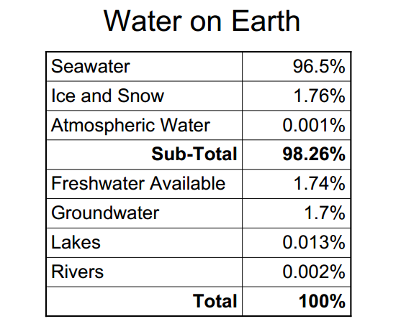
Sources of water supply

Slide 143
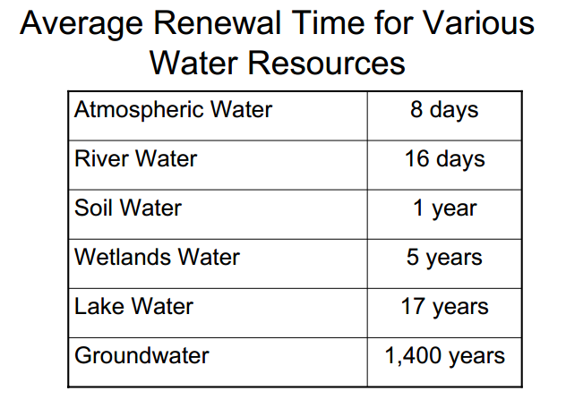

Slide 144
Sources of Groundwater:
The following are the major sources of groundwater:
Meteoric water
Connate water
Magmatic water
Meteoric water:
This is the main source of groundwater. This water is received in the form of rain and snow. Water from tanks, lakes, rivers and seas is again received by earth after vaporization. Water is received by melting of snow or rain, hence it is called ‘mete­oric’ or ‘shooting star water’. From the surface of the earth, this water infiltrates down below through rock joints, pores and fissures of rocks and is stored at the level of impermeable rocks in the form of groundwater.

Slide 145
Connate Water:
Water contained in pores and cavities of sedimentary rocks under seas and lakes is called connate water. It is also called ‘sediment water’. It is the second important source of groundwater. This is the water that is entrapped in the interstices of sedimentary and volcanic rocks at the time of deposition. Connate water is highly mineralized and salty and does not mix readily with meteoric groundwater. Connate water is usually found deep down in the lower layers of the zone of saturation.

Slide 146
Magmatic Water:
Hot magma enters rocks due to volcanic action after which its vapor drops are condensed and converted into water. This is called magmatic water. Apart from it, other sources are those in which groundwater becomes again available on the surface of the earth.
They are mainly springs, wells, and geysers. Such water is considered to have been generated in the interior of the earth. It has consequently travelled to the upper layers of the earth’s surface for the first time; this is also known as magmatic water.

Slide 147
Groundwater aquifer:
An aquifer is an underground layer of water-bearing permeable rock, rock fractures or unconsolidated materials (gravel, sand, or silt) from which groundwater can be extracted using a water well.
Aquifers are permeable formations having structures which permit appreciable quantity of water to move them under ordinary field conditions. Aquifers are mainly two types.
Unconfined aquifer
Confined aquifer

Slide 148
Unconfined aquifers are sometimes also called water table or phreatic aquifers, because their upper boundary is the water table or phreatic surface. Typically (but not always) the shallowest aquifer at a given location is unconfined, meaning it does not have a confining layer (an aquitard or aquiclude) between it and the surface.
Confined aquifers are aquifers that are overlain by a confining layer, often made up of clay. The confining layer might offer some protection from surface contamination.

Slide 149
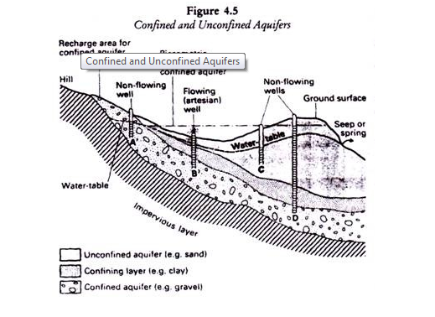

Slide 150
Forms of Groundwater sources:
There is four forms of groundwater sources are found
Infiltration galleries
Infiltration wells
Springs
Wells
Infiltration galleries:
When water can be obtained within a reasonable distance below ground level, for example, below the river bed, horizontal porous pipes with open joints can be laid under the ground. It is apparent that a very large proportion of the groundwater will be intercepted by galleries than by a vertical well.

Slide 151

The intercepted water can be collected at suitable points in vertical collecting wells and can be used. Inverted filter surrounding the pipes can be provided to prevent clogging of pipes. Horizontal galleries laid at a depth more than 8 meters are uneconomical. Figure 1.5 shows cross-section and longitudinal section of the infiltration gallery.

Slide 152
Infiltration Wells:
Sometimes water can be made available by sinking infiltration wells in the porous soil, for example, in the dry bed of a river. The infiltration well can be joined to vertical collecting wells or jack wells sunk on the bank of the river by means of horizontal underground porous pipeline. It intercepts water also and is called Infiltration gallery. Thus it can be recognized that infiltration wells and galleries supplement each other. Figure 1.6 shows the cross-sectional elevation and plan of an infiltration well.

Slide 153



Slide 154
Springs:
When groundwater appears at the surface for any reason, the springs are formed. They serve as source of water supply for small towns, specially near hills or based of hills. Some springs discharge hot water due to the presence of sulfur and other minerals in their formations. These hot springs cannot be used to supply water for domestic purposes. But the hot water is found to cure some of the human disorders. Springs are mainly three types.
Artesian Spring
Gravity Spring
Surface Spring

Slide 155
1) Artesian Springs:
In this type of spring, the groundwater comes to the surface under pressure. The artesian spring may also be formed due to the presence of fissure or crack in impervious layer. The fissure or crack should be continued up to the ground surface.
The artesian springs give practically uniform quality of water throughout the year.
2) Gravity Springs:
This type of springs develop due to overflowing of water table. The flow from a gravity spring is variable

Slide 156
with the rise or fall of water table. In order to meet with such fluctuations, a trench may be constructed near such a spring. The trench act as a storage reservoir.
3) Surface Springs:
This type of spring is formed when subsoil water is exposed to the ground surface by the obstruction of an impervious layer. The quality of water available from surface springs is quite uncertain and the cut-off walls, may be constructed to develop such springs. It is found that the quality of water depends on geological and topographical conditions and it may be hard or soft, pure or polluted.

Slide 157

Fig: Artesian Spring

Slide 158

Fig: Gravity Spring

Slide 159

Fig: Surface Spring

Slide 160
Wells:
A well is defined as an artesian hole or pit made in the ground for the purpose of tapping water. The holes made for tapping oil are also known as well. But in the general sense, a well indicates a source of water. Three factors govern the theory of wells. These are geological conditions of the earth surface i.e., slope of the water bearing strata, porosity of various layers, and quantity of water which is absorbed and stored in different layers. The wells are generally classified as Shallow wells, Deep wells, Tube wells and Artesian wells.

Slide 161
Shallow wells:
The shallow wells are constructed in the upper most layer of the earth’s surface. They obtain the quota of water supply from the ground water table. The diameter of the shallow wells varies from 2 to 6 m. They may be lined or unlined from inside. The lining is also called the steining and its thickness varies from 30 to 50 cm. These wells are also sometimes referred to as draw wells or gravity wells or open wells or dug wells or percolation wells.

Slide 162
Deep wells:
The deep wells obtain their quota of water from an aquifer below an impervious layer. The theory of deep well is based on the travel of water from the outcrop of the site of deep well. The outcrop is the place where the aquifer is exposed to the atmosphere. The entry of rainwater takes place at outcrop and it reaches the site of deep well. During travel the water gets thoroughly purified. But it dissolves certain salts and may therefore become hard. In such cases, some treatment would be necessary to remove the hardness of water.

Slide 163


Slide 164

Tubewells:
A tubewell is a deep well having a diameter of about 50 to 200 mm obtains it quota of water from s number of aquifers. The blind pipes are placed against the impervious layers.
Fig Tube well

Slide 165

Fig: Artesian Well

Slide 166
Groundwater movement:
The groundwater moves due to action of gravity and molecular attraction of surface tension . The velocity of flow depends upon on three factors
Slope of the groundwater surface
Hydraulic properties of soil through which it flows
Temperature of water

Slide 167

Hazen’s gave a formula for finding the velocity of flow, is as follows
$$V=Cd^{2}S………………..\left(1\right)$$
Where, V is the average velocity of flow in meters per day,
C is coefficient varying from 400 to 1000
D is effective size of soil grains in mm and
S is slope of water table.

Slide 168
The discharge of aquifer can then be obtained easily by the multiplication of area of cross- section of aquifer and velocity of flow of groundwater. Mr. H Darcy enunciates a law governing the flow through soil, According to this law,
Q = KIA…………………………………..(2)
Where Q = discharge, I = hydraulic gradient
A = area of cross-section and
K = proportionality constant known as the coefficient of permeability
The discharge velocity, V = Q/ A………………..(3)

Slide 169
Permeability:
The capacity of transmission of water of the entire soil of full width and full depth is represented by permeability. It is defined as the average velocity of flow that will occur through the total cross sectional area of soil under unit hydraulic gradient.

Slide 170
Transmissibility:
The term transmissibility is used to indicate the same physical meaning of the permeability, but differing only mathematically. The capability of the soil unit width and full depth (i.e . Width = 1 and hence A = depth) is known as the Transmissibility

Slide 171
Specific yield:
The specific yield of an aquifer is defined as the ratio, expressed as percentage of the volume of water after being saturated, can be drained by gravity to the total volume of aquifer.
Specific yield = (Volume of water drained by gravity)/Total volume

Slide 172
Specific retention
The specific retention of an aquifer is the ratio expressed as a percentage of the volume of water it will retain after saturation against the force of gravity to its own volume.
Specific retention = (Volume of water to be retained)/ Volume of water

Slide 173
Storage coefficient
The water yielding capacity of a confined aquifer can be expressed in terms of its storage coefficient. Storage coefficient is defined as the volume of water that an aquifer releases per unit surface area of aquifer per unit change in the component of head normal to that surface. In most confined aquifers, the value of storage coefficient ranges 0.00005 to 0.005

Slide 174


Slide 175


Well is represented by

Slide 176


Slide 177



Slide 178


Slide 179


Slide 180
Problems of groundwater development in Bangladesh:
Groundwater is the main source of water supply in urban and rural areas of Bangladesh. Groundwater in Bangladesh is available abundantly, but the available groundwater for drinking purposes has become a problem for the following reasons.
Arsenic in groundwater
Excessive dissolved iron
Salinity in costal areas
Lowering of groundwater level
Rock/stony layers in hilly areas

Slide 181
Arsenic in groundwater:
The concentration of arsenic in drinking water in excess of permissible limit is toxic to human body. According to the WHO guideline value the desirable maximum concentration of arsenic in drinking water would be 0.01 mg/l. In Bangladesh the maximum acceptable concentration in drinking water is considered to be 0.05 mg/l. Symptoms of arsenic toxicity leading to cancer may occur due to excessive intake of arsenic in the human body over a longer period of time. In Bangladesh the presence of arsenic in groundwater first detected in 1993 at Baroghoria union of Capai Nawabganj district. Appreciating the

Slide 182
gravity of the problem, water sample testing activities started in 1995 by various organizations and agencies. It has been observed that about one in every three shallow tube wells is producing water with arsenic in acceptable limits.
Excessive dissolved iron:
In Bangladesh the permissible limit of iron in groundwater is 1 mg/l but iron content upto 5 mg/l is acceptable for rural water supply. It has been observed that iron content exceeds this limit in many handpump tubewells. It has been observed from a survey in 1993 1230 unions in Bangladesh have an iron content more than 5mg/l. It may be observed that dissolved iron in

Slide 183
shallow tubewell water in about 67% areas of Bangladesh is in excess of 2 mg/l. However iron content in deep tubewell water is comparatively lower. In urban areas iron removal plants have been constructed and in rural areas community-type iron removal units attached to handpumps are provided.
Salinity in coastal areas:
The concentration of dissolved minerals in groundwater is higher than that of surface water. The coastal belt of Bangladesh, extended over 86 upazilas, is identified as a problem area where complex hydrological conditions and adverse water quality make water supply difficult as compared to other parts of the country. Unlike other

Slide 184
of Bangladesh, groundwater of acceptable quality at relatively shallow depths, which can be easily withdrawn by conventional handpump tubewells is not available in most parts of the coastal area. In some places low salinity water has been found in deep aquifers. Exploratory drillings with borehole logging have been conducted in many places to locate sweet water aquifers. In rural water supply chlorine content upto 1000 ppm is acceptable for coastal belts where the normal acceptable limit is 250 ppm
Lowering of groundwater level:
Although groundwater in Bangladesh is said to be abundant, a considerable areas of the country faces scarcity of groundwater within suction limit in the dry season

Slide 185
Due to the over-exploration of groundwater for irrigation purposes, the water level declines, rendering thousands of suction mode no.6 tubewells inoperable. In the low water table areas the force mode Tara and Tara-II pumps are provided.
Rocky/stony layers in hilly areas:
In Chittagong Hill Tracts Districts of Bangladesh. Drilling of tubewells for water supply is difficult due to the presence of hard formations in the subsurface. In most cases conventional drilling methods for the installation of handpumps cannot penetrate these hard rock formations. These situations also prevails in some part of Chittagong, Cox’s Bazar, Sylhet, in the north of

Slide 186
Mymansing, Netrokona and Panchagar districts. To overcome the situatuation and provide portable water through handpump tubewells, mechanical drilling rings are used. These however increases the installation cost of the water point.

Slide 187


Slide 188


Slide 189


Slide 190
Storage capacity of the reservoir:
Following are the two methods, which are used to compute the storage capacity of reservoir
Analytical method
Graphical or mass curve method

Slide 191
Tubewell Technology:
A large variety of tubewells have been designed for abstraction of groundwater and are being used all over the world. The tubewells designed and developed, including those being used in Bangladesh, may be grouped under 3 categories:
Shallow tubewells
Deep-set intermediate technology
Deep tubewells

Slide 192
Shallow tubewell technology:
In shallow tubewell technology, hand pumps are operated in a suction mode. A suction pump draws water from a shallow depth by creating a vacuum in the suction pipe. The suction handpumps can practically extract water from up to a depth of 7.5 m static water level. This category handpumps include:
No. 6 handpump tubewell
Rower pump tubewell
Disco pump tubewell

Slide 193


Slide 194

The average discharge of the pump is 30-40 litres/minute.
A No. 6 handpump, if installed properly, can serve for 15 to 20 years.
The general components of a No. 6 handpump tubewell are
Handpump
Blind pipe (rising pipe)
Strainer(screen)
Sand trap

Slide 195


Slide 196

Rower pump tubewell:
The rower pump is a manually operated reciprocating pump with a 54 mm diameter PVC pipe as the pump cylinder
The operation of rower pump is rowing a boat, hence the name rower pump
In the high water table areas rower pump is used for irrigation purposes and occasionally for domestic water supply

Slide 197
Rower pumps can lift water upto a maximum suction lift of 8.5 m.
The discharge capacity is 0.8 lps
The pump is not very suitable for domestic water supply due to poor sanitary protection
The life time of rower pump is 3- 5 years

Slide 198

Disco pump tubewell:
There are some areas where the water level goes beyond the suction limit for a short duration.
The lowest level reached such a depth that if the piston of a no. 6 pump is extended to about 3 m, the pump could be kept operational for the whole year. To meet the water supply requirements of these areas the disco pump has been developed locally

Slide 199
In Gazipur, it is known as half cylinder pump
The 75 mm diameter GI pipe is used as the casing upto 3 m below the ground surface.
The discharge from the pump is equal to that of No. 6 hand pump but requires comparatively more force to raise the water
The limitation of the disco pump is that it can only be used where the water level will remain within 10 m from the ground surface

Slide 200
Deep-set intermediate technology:
Shallow tubewells operated under suction mode are not able to withdraw water in low water table areas.
Water can be abstracted from a depth beyond the suction limit using the intermediate technology.
Deep set handpumps can abstract water from a high as 30 m from the static water level.

Slide 201
Hand pumps in this category include:
Tara handpump tubewell
Moon handpump tubewell
Bangla handpump tubewell
Mark –II handpump tubewell
Other locally produced, improvised deep-set pumps

Slide 202

Tarahandpump tubewell:
The no.6 handpump tubewell is inoperable in dry season, to overcome this problem the Tara handpump has been developed in Bangladesh by UNICEF, and the UNDP World Bank program, to tap water from upto 15 m below the ground surface.

Slide 203

A properly installed and maintained Tara handpump should work about 10 years without major problems
Because of the direct action, the force is to be applied directly by the operator without having any mechanical advantage
Tara handpump provides moderate output max 4 $m^{3}/day$ for 7m lift and very low output max 1.5 $m^{3}/day$ for 12 m lift

Slide 204
Tara –II hand pump:
In some areas of the country; the water level in dry season goes down below 15m which is the lowest normal functioning range of Tara handpump.
In order to withdraw water a deeper aquifer, the standard tara pump is modified
The piston assembly is set at 30 m and all other aspects of the tara hand pump is remain the same

Slide 205

Moon hand pump tubewell:
The moon hand pump tubewell is the modified version of Tara hand pump
The direct action tara hand pump tubewell is found to be uncomfortable to the usurers particularly to woman

Slide 206
Considering this difficulties, the head of the tara hand pump tubewell has been replaced by that of a no. 6 hand pump to get the advantage of the lever action and PVC pump rod has been replaced by steel rod in the moon pump
A good number of moon hand pumps have been installed in Naogaon, Chapai Nawabganj and Manikganj under the Dutch assisted 18 district town project
The maximum discharge of a moon hand pump is 0.6 lps.
It is suitable for lifting water upto 25 m

Slide 207
Bangla handpump tubewell:
This is a modified version of the moon hand pump
The difference with the moon pump is that the upper well casing is of smaller diameter PVC pipe.
The lifting capacity of the pump is limited to 15 m
A performance evaluation of the bangla pump was conducted for a short duration of two years and it was found to be functioning satisfactiory.

Slide 208

Mark –II hand pump:
The mark –II handpump tubewell, widely known as the Indian Mark –II is the most popular tubewell in India and widely used in many other countries in the world
It has a deep-set pump capable of lifting water from a depth of over 30 m
Although the Mark-II handpump tubewell has not yet been installed and familiarized in Bangladesh, it may serve the demand of a robust hand tubewell in low water table areas

Slide 209


Slide 210


Slide 211


Slide 212
Very shallow shrouded tubewell (VSST):
This is a low-cost handpump tubewell about 8 m in depth with a 2 m strainer shrouded with coarse sand.
It is designed to collect water from very shallow aquifers formed by displacement of saline water by a continuous flow of accumulated fresh water.
A VSST is a convenient method for withdrawal of fresh water in limited quantities.

Slide 213
Very shallow shrouded tubewell (VSST):
This system is considered suitable for drinking water supply for settlements where water demand is low.
A VSST is not different from an SST expect in the depth of well

Slide 214


Slide 215
Pond Sand Filter (PSF):
An alternative and popular option of potable water supply in coastal areas in the pond sand filter (PSF).
The water from the pond is pumped by a manually operated hand tubewell to feed the filter bed, which is raised from the ground and the treated water is collected through taps
On average the operating period of a PSF between cleaning is usually 2 months

Slide 216
Pond Sand Filter (PSF):
The problems encountered are low discharge and difficulties in washing the filter bed
It is very low cost technology with very high efficiency in turbidity and bacterial removal
Though it has a very high bacterial removal efficiency, it may not remove 100% of the pathogens from heavily contaminated surface water.

Slide 217


Slide 218


Slide 219
Small household Filters can be constructed by stacking about 300-450 mm thick well graded sand on a 150-250 mm thick coarse aggregate in a cylindrical container.
The important characteristics of household filters are
Suitable for surface water treatment
Remove turbidity, colour and micro-organisms
Complete removal of pathogenic micro-organisms is not guaranteed
Not suitable for high turbid water
Difficulty in cleaning and keeping the system operational

Slide 220


Slide 221
Infiltration well/gallery:
Installation of infiltration wells/galleries along banks of rivers and ponds provides clean water for domestic purposes
The main problem encountered with infiltration galleries is the sanitary protection of water. Water without proper sanitary protection becomes soon contaminated.

Slide 222
Rainwater harvesting:
The average annual rainfall in the costal and hilly regions is more than 3000 mm, against an average rainfall of about 2400 mm in Bangladesh
The collection and storage of rainwater is an alternate option of water supply in these areas
Rainwater harvesting is a potential water supply option in the acute arsenic affected areas in Bangladesh

Slide 223
The two main constrains in developments of a completely rainwater based water supply system:
Availability of suitable catchment area
The need for larger storage tank

Slide 224


Slide 225

The available rainwater can be estimated by the equation:
Q= CIA
Where, Q = total quantity of rainwater available in $m^{3}/year$
C = coefficient of available runoff
I = rainfall intensity
A = catchment area in${ m}^{2}$

Slide 226
The minimum catchment area A required for the collection of rainwater for N number of people supplied with q litres per capita per day of water can be derived from this equation
A= 0.365 q N /(CI)
About 25 % of the rainwater may be assumed to be lost by evaporation and by washing the catchment area. The catchment area is usually washed using first rain, which produces inferior quality rainwater. For an average annual rainfall of 2.4 m/yr, and a coefficient of runoff 0f 0.75. equation can be written in the following form
A = 0.203 q N

Slide 227
The minimum volume of the storage rainwater tank V, required for rainwater can be computed by the equation
V = 0.365 f q N
However, if only drinking and cooking water is harvested, the sizes of the storage tank and the catchment area would be smaller and within an affordable range for a family. Substituting f =0,4 in equation the minimum volume of storage tank required for rainwater becomes
V = 0.146 q N

Slide 228
Design, construction and maintenance of tubewells:
The design of tubewells mainly involves the selection of length, diameter, and slot opening of the screen and design of the shroud materials, on the basis of the available aquifer characteristics.

Slide 229


Slide 230


Slide 231


Slide 232


Slide 233


Slide 234


Slide 235


Slide 236

In case of shallow and very shallow shrouded tubewells a shrouding sand having $D_{10 }$ size or 90% retention size of 0.008 inches. Fineness modulus of 1.6 and uniformity coefficient 0f 1.5 is performing well in case of No. 8 (0.008 inch) slot screen in Bangladesh

Slide 237
Sinking of handpump tubewells:
Sludger method
Rotary drilling method

Slide 238

Design of distribution system:
The Hazen Williams equation can conveniently be used for a hydraulic design of the branched or looped network. The equation can be written in the form of:
$Q=3.7∗{10}^{−6} CD^{2.63}{\left(\frac{H}{L}\right)}^{0.54}$…………………(1)
Where, Q= Flow lps,
C= roughness coefficient (100-140 for rough to smooth pipes)
D= diameter, in m
H= head loss in m
L= length of pipe in m

Slide 239

For a definite value of C the equation can be written as
$\frac{H}{L}=1.39 ×\frac{{10}^{6}Q^{1.85}}{D^{4.87}}$………..(2)
$\frac{H}{L}=1.59 ×\frac{{10}^{6}Q^{1.85}}{D^{4.87}}$………….(3)
For C=130
For C=120
The process involved in the design is to make a pipe layout, assume the pipe size then work out the terminal pressure head which could be made available the end of each pipe section when

Slide 240
discharging the peak flow. The available pressure heads are checked to see if they correspond to permissible residual pressure heads. If not the pipe size is changed and the system is reinvestigated until satisfactory conditions are obtained.
Branched network:
The following design procedure may be adopted for branched network:
1) Collect / prepare a map of the area to be served with roads, streets and other features and

Slide 241
make a layout of mains, sub-mains and branches including location of valve and other appurtenances/
2)Estimate the peak flow at different points and determine the quantity flowing through each section of the pipe. Peak flow = average daily flow x peck factor
3)Assume pipe sizes of all the pipes in the network(to calculate the approximate pipe size the velocity may be assumed to be round 1m/s.
4) Calculate the frictional head loss per unit length of pipe and then multiply by pipe length of pipe to find the total head loss

Slide 242
5) Determine the terminal pressure head taking the change in the elevation of the pipe into account.
6) In case of a difference computed terminal pressure and the permissible pressure head revise the pipe size.
Looped Network:
In any looped pipe network two condition must be satisfied.
1) The flow entering in a junction must equal the flow leaving it.
2) The algebraic sum of the pressure drop(head loss) around any closed group must be zero.

Slide 243

Pipe network problems in water distribution systems are usually solved by methods of successive approximation
The equation is $H=kQ^{x}$……………..(4)
In which k is the constant developing on the length, diameter, and roughness of the pipe as well as the fluid property, x is the component equal to 1.85 for Hazen Williams’ equation and 2 for the Manning equation
Hardy Cross developed a method of successive approximation in which circuits are balanced, distribution of flow is determined and the above two conditions of flow is satisfied . The solutions for pipe network problems suggested by Hardy Cross requires that the flow in each pipe be assumed so that the principle of continuity is satisfied at each junction. A correction Δ, to the assumed

Slide 244

flow is computed successively for each pipe loop in the network until the correction is reduced to an acceptable value. If Qa is the assumed flow and Q is the actual flow, then the correction is
$Q−Q_{a }$ i.e
$Q=Q_{a }+ \text{Δ}$………………….(5)
Inserting the value of Q from equation (5) and applying the condition that the head loss around any closed loop is zero the head loss equation (4 ) gives
$0=\text{∑}k{{(Q}_{a }+ \text{Δ}\text{)}}^{x}$………………(6)

Slide 245

Expanding the equation
$∑k{Q_{a}}^{x }+x∑k{Q }_{a }^{x−1}+ \frac{x−1}{2}∑k{\text{Δ}}^{2}{Q }_{a }^{x−2}$+……+ =0........(7)
If Δ is small compared to Q the third and all successive and all successive terms of the equation (7) may be neglected, hence
$∑k{Q_{a}}^{x }+x∑k{Q }_{a }^{x−1}$ =0…………………..(8)
Solving equation (8) for $\text{Δ}$
$\text{Δ}$= $−∑k{Q_{a}}^{x }/x∑k{Q }_{a }^{x−1}$ or
$$\text{Δ}\text{=}−\frac{∑H}{\frac{x∑H}{Q_{a}}} …………………\left(9\right)$$

Slide 246

a
Qabc
Q
b
Qabc
Qadc
Qadc
d
Q
c
Fig: A looped network for flow analysis
Consider the simple loop shown in figure . The arrowheads showing the assumed direction of flow and head loss , the correction Δ can be calculated by
$\text{Δ}\text{= −}\left[\left(H_{ab}+H_{bc}\right)−\left(H_{ad}+H_{dc}\right)\right]/x[\frac{\left(H_{ab}+H_{bc}\right)}{Q_{abc}}+\frac{\left(H_{ad}+H_{dc}\right)}{Q_{adc}}$]

Slide 247
The procedure for the Hardy Cross Method of pipe network analysis is given below.
Carefully examine the network and assume reasonable rates of flow in each pipe such that inflow equals outflow in each junction
In each loop, determine the head loss, H and H/Q for all pipes
With due attention to sign compute the total head loss around each circuit
Compute ∑H/Q for the same circuit without giving any consideration to sign
The correction Δ is computed for each loop by the equation (9). The minus sign may be disregarded if the correction so obtained is made by inspection.

Slide 248
6) Apply the correction to each pipe in each loop. When the sign of Δ is negative decrease the clockwise flow and increase the counterclockwise flow. When the sign is positive there will be vice versa. Pipes that are common to two loops require double correction
7) With adjusted flows repeat the procedure for the second approximation. The procedure is continued until the desired accuracy is attained.

Slide 249
Example 1: Calculate the flow in each of the pipes in the following pipe network.
A
B
12 lps
45 lps
800 m- 200 mm dia
400 m- 150 mm dia
12 lps
D
800 m- 150 mm dia
C

Slide 250



Solution: First trial with assumed flow $Q_{o}$
Step 1
Pipe | Length m | Dia mm | $$Q_{o}$$ lps | Ho/L mm | Ho m | Ho/Qo | Δ lps | $$Q_{1 }$$ lps
AB | 800 | 200 | +25 | 0.0038 | +3.04 | 0.1216 | 0.54 | 25.54
BC | 400 | 150 | +13 | 0.0046 | +1.84 | 0.142 | 0.54 | 13.54
AD | 400 | 150 | -20 | 0.0102 | -4.08 | 0.204 | 0.54 | -19.46
DC | 800 | 150 | -8 | 0.0018 | -1.44 | 0.18 | 0.54 | -7.46
 |  |  |  |  | Sum= -0.64 | Sum= 0.647
$\text{Δ}\text{=}−\frac{∑H}{\frac{x∑H}{Q_{a}}}$ =0.64/(1.85*0.647) = 0.54

Slide 251


Step 2:
Pipe | Length m | Dia mm | $$Q_{o}$$ lps | Ho/L mm | Ho m | Ho/Qo | Δ lps | $$Q_{1 }$$ lps
AB | 800 | 200 | 25.54 | 0.0039 | +3.12 | 0.122 | 0.12 | 25.66
BC | 400 | 150 | 13.54 | 0.0049 | +1.96 | 0.145 | 0.12 | 13.66
AD | 400 | 150 | -19.46 | 0.0097 | -3.88 | 0.2 | 0.12 | -19.34
DC | 800 | 150 | -7.46 | 0.0017 | -1.36 | 0.18 | 0.12 | -7.34
 |  |  |  |  | Sum= -0.14 | Sum= 0.649
$\text{Δ}\text{=}−\frac{∑H}{\frac{x∑H}{Q_{a}}}$ =0.14/(1.85*0.649) = 0.12

Slide 252
Example 2: Calculate the flow in each of the pipes in the following pipe network.
800 m-200 mm dia
45 lps
A
B
12 lps
Circuit-1
400 m-150 mm dia
400 m-150 mm dia
D
800 m-150 mm dia
C
4 lps
12 lps
Circuit-2
400 m-100 mm dia
400 m-100 mm dia
800 m-100 mm dia
5 lps
E
F
12 lps

Slide 253


Solution: First trial with assumed flow $Q_{o}$
Step 1
Circuit | Pipe | Length m | Dia mm | Qo lps | Ho/L m/m | Ho m | Ho/Qo | Δ lps | $$Q_{1 }$$ lps
1 | AB | 800 | 200 | +25 | 0.0038 | +3.04 | 0.1216 | +0.54 | 25.54
 | BC | 400 | 150 | +13 | 0.0046 | +1.84 | 0.1416 | +0.54 | 13.54
 | AD | 400 | 150 | -20 | 0.0102 | -4.08 | 0.2040 | +0.54 | -19.46
 | DC | 800 | 150 | -8 | 0.0018 | -1.44 | 0.1800 | +0.54+1.89 | -5.57
Sum= -0.64 0.6471
$\text{C}\text{orrection}\text{, }\text{Δ}\text{=}−\frac{∑H}{\frac{x∑H}{Q_{a}}}$= 0.64/(1.85*0.6471)=0.54

Slide 254


Circuit | Pipe | Length m | Dia mm | Qo lps | Ho/L m/m | Ho m | Ho/Qo | Δ lps | $$Q_{1 }$$ lps
2 | DC | 800 | 150 | +8 | 0.0018 | +1.44 | 0.1800 | -0.54-1.89 | +5.57
 | CF | 400 | 100 | +9 | 0.0170 | +6.8 | 0.7556 | -1.89 | +7.11
 | DE | 400 | 150 | -8 | 0.0018 | -0.72 | 0.090 | -1.89 | -9.89
 | EF | 800 | 100 | -3 | 0.0022 | -0.76 | 0.5867 | -1.89 | -4.89
Sum= 5.76 1.6453
$\text{C}\text{orrection}\text{, }\text{Δ}\text{=}−\frac{∑H}{\frac{x∑H}{Q_{a}}}$= -5.76/(1.85*1.6453)=-1.89

Slide 255



Second trial with corrected flow,$Q_{1}$
Circuit | Pipe | Length m | Dia mm | $$Q_{1}$$ lps | $H_{1}$/L m/m | $$H_{1}$$ m | $H_{1}$/$Q_{1}$ | Δ lps | $$Q_{2 }$$ lps
1 | AB | 800 | 200 | 25.54 | 0.0040 | +3.20 | 0.1253 | -0.46 | +25.08
 | BC | 400 | 150 | 13.54 | 0.0050 | +2.00 | 0.1477 | -0.46 | 13.08
 | AD | 400 | 150 | -19.46 | 0.0097 | -3.88 | 0.1994 | -0.46 | -19.92
 | DC | 800 | 150 | -5.57 | 0.0010 | -0.80 | 0.1436 | -0.46-0.11 | -6.14
Sum= +0.52 0.6160
$\text{C}\text{orrection}\text{, }\text{Δ}\text{=}−\frac{∑H}{\frac{x∑H}{Q_{a}}}$= -0.52/(1.85*0.6160)= -0.46

Slide 256


Circuit | Pipe | Length m | Dia mm | $$Q_{1}$$ lps | $H_{1}$/L m/m | $$H_{1}$$ m | $H_{1}$/$Q_{1}$ | Δ lps | $$Q_{2 }$$ lps
2 | DC | 800 | 150 | +5.57 | 0.0010 | +0.80 | 0.1436 | +0.46+0.11 | +6.14
 | CF | 400 | 100 | +7.11 | 0.0109 | +4.36 | 0.6132 | _{+0.11} | +7.22
 | DE | 400 | 150 | -9.89 | 0.0028 | -1.12 | 0.1133 | _{+0.11} | -9.78
 | EF | 800 | 100 | -4.89 | 0.0055 | -4.40 | 0.8998 | _{+0.11} | -4.78
Sum= -0.36 1.7699
$\text{C}\text{orrection}\text{, }\text{Δ}\text{=}−\frac{∑H}{\frac{x∑H}{Q_{a}}}$= 0.36/(1.85*1.7699)= 0.11
The corrected flow after second trial is${ Q}_{2 }$

