Slide 1
Course Title: Environmental Engineering – I
Course Code: CE 3141
Credit hour: 3.0,
Contact hour: 3 hr/Week,
Class Test: 4 nos.

Slide 2
Environmental Engineering-1
Syllabus:
Introduction to environmental engineering, community and environment, clean water, sanitation and health, introduction to water supply, population and water requirement.
Water supply sources, groundwater and surface water, common water supply system with specific reference to Bangladesh, different types of hand pumps, problem of water supply, presence of iron and arsenic, hardness salinity. Alternative technologies for problem areas in Bangladesh: Shallow Shrouded Tube well (SST), Very Shallow Shrouded Tube well (VSST), pond sand Filter (PSF), Deep-set technologies.
Water collection and transportation, head works, pumps and pumping machinery, water distribution system, analysis and design of distribution network, fire hydrants, leak detection, unaccounted for water, alternative technologies, solar stills, rain water harvesting.
Water quality and treatment, water quality parameters and standards, water treatment: plain sedimentation, flocculation and settlement, filtration, other treatment methods, small scale iron and arsenic removal units, other low-cost treatment methods for rural communities, monitoring and sanitary protection of water supply distribution system.
Socio-economic aspects of WSS, Socio-economy of rural and urban Bangladesh. Demographic characteristics, power structure, cultural issues (traits), rural leadership, local government structure, influence of socio-economic aspects on community water supply and sanitation, concept of community participation, participatory planning, community organization, community mobilization, sustainable development approach, gender issues conceptual frame, women empowerment, gender auditing, gender balance and sensitivity.

Slide 3
Environmental Engineering-1
Reference Books:
Environmental Engineering – H.S. Peavy, D.R. Rowe & G. Tchobanoglous
Environmental Engineering – Davis & Cornwell
Water Supply & Sanitation – Ahmed & Rahman
Water Supply Engineering – M.A. Aziz
Water Supply and Sanitation Engineering – Rangwala
Small Community Water Supply – Technical Paper Series, IRC
Water Supply and Sewerage – E.W. Steel & T.J. McGhee
Low Cost Water Supply and Waste Management – Training for trainers course by ITN

Slide 4
Environmental Engineering-1
Learning Outcome:
The students will learn the following topics through the successful completion of this part:
Water collection and transportation, Fire hydrants and Head works
Pumps and pumping machineries in water supply
Analysis and design of distribution network
Leak detection, unaccounted for water, solar stills, rainwater harvesting
Water quality standard and treatment
Small scale water treatment units
Socio-economic aspects in water supply system
Gender aspects in urban and rural water supply
Water safety plan

Slide 5
Environmental Engineering-1
CE3141
Lecture -1
Week-1, Sunday
27-12-2020

Slide 6
Water Collection and Transportation
Collection of water is the drawing of water from the sources of water, commonly known as intakes.
The collection system is a set of engineering works designed to convey water from a source to a distribution system via treatment plant and includes intakes, suction pipes, delivery pipes and pumping stations.
Transportation of water is the conveyance of water from the intake to the treatment plant and also to the distribution systems.

Slide 7
What is Intake?
The intake is a device placed in a surface water source to permit the withdrawal of water from the source and then discharge it into intake pipe through which it will flow into the water-works system.
It consist of the opening, strainer, or grating through which the water enters, and the conduit conveying the water, usually by gravity, to a well or sump.
From the well the water is pumped to the mains or treatment plant.
Intakes should be so located and designed that possibility of interference with the supply is minimized and where uncertainty of continuous serviceability exists, intakes should be duplicated.

Slide 8
Considerations for Designing and Locating Intake
The following must be considered in designing and locating intakes:
The source of supply, whether impounding reservoir, lake, or river (including the possibility of wide fluctuation in water level);
The character of the intake surroundings, depth of water, character of bottom, navigation requirements, the effects of currents, floods and storms upon the structure and in scouring the bottom;
The location with respect to sources of pollution; and
The prevalence of floating material such as ice, logs, and vegetation.

Slide 9
Intake Velocity and Depth
Intake entrance should lie 3 to 5 m below the water surface but 1 to 2 m above the river, lake or reservoir floor to keep bottom sediments out of intakes.
The entrance velocities are kept down to 7.6 to 10 m/sec. At such low velocities, vegetation, debris and other materials are not entrained in the flowing water, fish and other aquatic lives are well able to escape from the intake current.
Gratings or screens of 1 to 3 meshes to a centimeter are provided at the intake entrance.

Slide 10
Intake Pipe
Intakes are connected to the banks of rivers or to the shores of lakes and reservoirs (i) by pipelines (often laid with flexible joints) or (ii) by tunnels blasted through rock beneath the floor.
The pipelines are generally laid in a trench on the riverbank or on the lake or reservoir floor and covered after completion.
Pipe passing through the foundation of dam are subjected to heavy loads and to stresses caused by consolidation of the foundation.
Intake pipes are designed to operate at self-cleansing velocities, 14 to 19 cm/sec.
Flow may be by gravity or by suction.

Slide 11
Pumping Station
Pump wells are generally located on shore or banks.
Suction lift including friction should not exceed 5 to 6 m accordingly.
Pump wells are often quit deep.
The determining factor is the elevation of water level in the river, lake or reservoir in times of drought.

Slide 12
Design Considerations
Following are the important considerations for design of an intake:
Selection of a particular type for the given source.
The magnitude of the external forces (waves, currents and blows from floating and submerged objects) to be resisted by the intake.
Consideration of the total lift from the source to the treatment plant and selection of a suitable pumping unit.
Determination of the total length of suction and delivery mains, head losses due to friction and small bends, enlargement and reduction.

Slide 13
Design Considerations
Selection of a suitable screen to provide around the intake pipe not to permit entry of large and small objects, such as logs, stones, aquatic lives and vegetation.
Installation of intake valves or porthole at 2 or 3 different levels to get the best available quantity of water, eliminating seasonal fluctuation of waster levels.
Determination of cost-benefit ratio. To reduce the cost, the intake elevation is often made higher so that the water flows to the treatment plant by gravity.
Assurance of the safety of the intake structure, provision of future extension and installation of standby unit of pumps.

Slide 14
Environmental Engineering-1
CE 3141
Lecture -2
Week-2, Sunday
19-02-2022

Slide 15
Types of Intakes
The intakes are mainly of the following four types:
Canal intakes
Reservoir or lake intakes
River intakes and
Portable intakes.

Slide 16
Canal Intakes
An intake chamber is constructed in the canal section. This results in the reduction of waterway which increases the velocity of flow. It therefore becomes necessary to provide pitching on the downstream and upstream portions of canal near intake.
The entry of water in the intake chamber takes through the coarse screen and the top of outlet pipe is provided with fine screen. The inlet to outlet pipe is of bell-mouth shape with perforations of fine screen on its surface.
The outlet valve is operated from the top and it controls the entry of water into the outlet pipe from where it is taken to the treatment plant.

Slide 17
Canal Intakes
As the water level in the canal section practically remains constant, it is not necessary to provide intake pipe at various levels. To reach up to the bottom of intake, the steps should be provided in zigzag manner starting from manhole.
The flow velocity through the outlet pipe is usually kept as about 1.50 m/sec and it helps in determining the area and diameter of the withdrawal conduit.
For designing the area of coarse screen, the flow velocity is limited to as low as about 150 mm/sec or so. The flow velocity through the bell-mouth shaped inlet is limited to about 300 mm/sec or so.

Slide 18
Lake and Reservoir Intake
Lake intakes are sited with due reference to sources of pollution, prevailing winds and surface currents.
Reservoir intakes resemble lake intakes but generally lie closer to bank in the deepest part of the reservoir. They are often incorporated into the impounding structure itself.

Slide 19
Portable Intakes
In case of emergencies such as festival sites, wars, etc., it sometimes becomes necessary to draw water with the help of a movable intake.
It essentially consists of a truck fitted with a pumping plant. The truck is brought to the site and it is placed in such a position that it becomes possible to immerse the suction pipe of the pump. The end of the suction pipe is kept just above the bed level of water source and it is also provided with screen or strainer.
Thus the water lifted by the portable intake is relatively free from suspended solids. The water is then conveyed through the discharge pipe of the pumping plant.

Slide 20
River Intake
Understandably, river intakes are constructed well upstream from points of discharge of sewage and industrial wastes.
Optional location will take advantages of deep water, a stable bottom, and favorable water quality, all with proper reference to protection against floods, debris and river traffic.
Where the river bed shifts or depth of flow varies greatly, intake pumps may be mounted on carriage that are moved up and down on the river bank to stay within desired suction lift as flows rise and fall.

Slide 21
River Intake
Control Room
Intake well
F.S.L
Screen
Earthen Dam
Upstream rack to remove debris
L.W.L
Central impervious core
Gate
Outlet pipe
Figure: Intake well for earthen dam

Slide 22
Transportation of Water
The arrangement for the transportation of water from the source of supply to the treatment plants and subsequent distribution to the consumers form an important part of the water-works system.
The source of supply usually being at some distance away from towns and cities, it is necessary to construct structures for the transportation of water.
These structures are known as pipes and conduits.
There are two general classes of pipes; (i) Pressure pipes in which the water flows under hydraulic pressure, and (ii) Gravity pipes (open channels) in which the water flows in gravity.

Slide 23
Transportation of Water
A pressure pipe is also defined as a pipe flowing full.
Such pipes are often less costly than open channels (canals and flumes) because they can generally follow a shorter route.
If water is scare, pressure pipes may be used to avoid loss of water by seepage and evaporation, which generally occurs in open channels.
Pressure pipes are preferable for public water supplies because of the reduced opportunity for pollution.
The open channel may take the form of canal, flume, tunnel, aqueduct or partly filled pipe.
Open channels are characterized by a free water surface, in contrast to pressure pipes, which always flow full.

Slide 24
Desirable Qualities of Pressure Pipes
The desirable qualities of pressure pipes are as follows:
They should be made of durable materials so that no leakage develops causing wastage of water.
They should be strong and of sufficient thickness to withstand both internal and external stresses.
The inner surface of the pipe should be very smooth so that the resistance to flow is minimum.
The pipe materials should not impart any physical and chemical effects to water.

Slide 25
Desirable Qualities of Pressure Pipes
The desirable qualities of pressure pipes are as follows:
The pipes should be light so that transporting, handling and laying the pipe under different conditions of topography, geology and communication become easier.
Low initial cost and maximum service period of pipes are desirable.
The pipe materials should be so selected that annual maintenance cost is low, joints can be made easily, offer adequate resistance to the corrosive characteristics of soil and water and highly skilled labour is not required for their laying and construction.
The pipe sections should possess good hydraulic properties.

Slide 26
Corrosion of Metal Pipe
Generally pipes are made by various materials like steel, cast iron, concrete, asbestos cement, vitrified-clay, PVC, GI, copper, wrought iron, plastic, asphaltic fiber and lead. But metal pipes are subject to corrosion.
Corrosion is a phenomenon by which metals and their alloys are attacked by the environment consisting of chemicals.
There are mainly two types of corrosion in pressure water pipes, (i) External corrosion and (ii) Internal corrosion.
The external agents like biological action, oxygen, etc. cause external corrosion, and the internal corrosion is generally attributed primarily to the nature of water, which flows through pipes.

Slide 27
Corrosion of Metal Pipe
The chemical attacks of an environment upon a result in the oxidation of the metals and the formation of corrosive products, usually the oxides, hydroxides, carbonates, sulphides, etc.
In most cases, corrosion product is insoluble in the environment and forms a separate phase on or adjacent to the metal.
Hence, corrosion may be defined simply as the process by which the metals and their alloys are destroyed by chemical or electrochemical means.

Slide 28
Causes of Corrosion of Metal Pressure Pipes
Following are the important causes of corrosion of metal pressure pipes:
Pitting: Localized pitting is usually caused in metal pipes by the concentration of electric currents resulting from the potential differences on the metal surface, which accelerates. This process is also accelerated by dissolved oxygen content of flowing water.
Influence of acids and alkalies: Acidity and alkalinity of water passing through pipes will help vigorously to corrode pipes.
Influence of sulphurous compounds: The influence of sulphurous compounds on metal pipes is harmful. It has been reported that the presence of sulphides particles raised the proportions causing rust from 22 to 90%. The effect of sulphides is almost due to liberation of hydrogen sulphides which accelerates the attack of acids on the pipe metal.

Slide 29
Causes of Corrosion of Metal Pressure Pipes
Biological action: Soil contains various types of bacteria both aerobic and anaerobic. Certain anaerobic bacteria are capable of rendering the oxygen present in sulphates, nitrates and carbonates available for the free oxygen and thereby corrosion will proceed pace. The most important sulphate reducing bacteria (Vibrio desulphuricans) which can cause serious attack on buried pipes when three conditions are satisfied:
absence of oxygen as in many clayey soil,
presence of proper food (organic matter) and other environmental conditions needed for the growth of bacteria and
presence of large amount of sulphates.

Slide 30
Causes of Corrosion of Metal Pressure Pipes
Cavitation: The effects of cavitations are similar to those of corrosion but are due more to erosion. The sudden and alternate making and breaking of high vacuum and the creation and condensation of water vapour cause a bombardment of the surrounding surfaces with particles of water and water vapour moving at a high velocity thereby accelerating corrosion.
Temperature: The increase in temperature accelerates the rate of corrosion. The rate of corrosion in water pipes may be increased in three or four fold by raising the temperature from 60 to 150⁰ F.
Velocity of flowing water: As the velocity of the water in the pipe increases from linear to turbulence type, the rate of corrosion is sharply increased.

Slide 31
Effect of Corrosion
Corrosion of water pipes causes a great economic loss. Both direct and indirect losses resulting from corrosion are vast and undesirable.
Replacing a corroded leaky water main by the roadside is very difficult and costly.
Corrosion greatly reduces the pressure head and results in increases cost of pumping and short life of the water mains.
Leakage in domestic plumbing fixtures due to corrosion involves not only the replacement but also repairing damages to walls, floors, etc.
Rusty water due to corrosion causes strain in cloth after washing, produces unsightly marks on the plumbing fixtures and unsuitable for domestic uses.

Slide 32
Control of Corrosion
Corrosion of metal pipes may be reduced or eliminated by protection coatings of paint, galvanizing, bituminous compounds, or cement linings.
Red lead paint or zinc pigments offer some protection and are used on the exterior or exposed metal pipes.
Other metallic protective coatings are tin coatings, nickel coatings, chromium coatings and copper coatings.
Galvanizing by dipping the pipe molten zinc is an effective corrosion control except for highly acid waters. Galvanized pipe is widely used for small service lines in distribution systems but is too expensive for large pipe.
Large pipes are usually protected by non-metallic coatings, such as bituminous coatings or cement linings. Numerous commercial bituminous compounds are available for both hot and cold application.

Slide 33
Scale Formation in Pressure Pipes
Scale formation in water pipes is mainly due to the presence of dissolved mineral matter and gases under favorable conditions of temperature and pressure.
Scale formation caused water pipes to wear out and burst out very soon as the cross-sections of the pipes are reduced and this also causes insufficient discharge through pipes.
Scaling also causes water unfit for domestic and industrial uses.

Slide 34
Scale Formation in Pressure Pipes
The impurities which are mainly responsible for scale formation in water pipes may be classified under two heads: (i) Dissolved mineral matter and (ii) Dissolved gases.
Dissolved mineral matter include the hardness producing substances, i.e., carbonates, bicarbonates, sulphates and chlorides of calcium and magnesium, and silica.
Dissolved gases include carbon dioxide, oxygen, nitrogen, hydrogen sulphide and methane.

Slide 35
Control of Scale Formation
To control scale formation in pressure pipes, water is softened.
The chief objective of water softening is to remove dissolved mineral compounds which constitute the hardness and which deposit scales in water pipes, boilers and hot water heating system cause serious difficulties in many processes including textile finishing, dying, canning, paper making, cold drinks preparation, tanning and others.
Following are the effective processes by which scale forming minerals and gases are removed from water: (i) Lime-soda process, (ii) Zeolite process, (iii) Phosphate process and (iv) Lime process.

Slide 36
Environmental Engineering-1
CE3141
Lecture -3
Week-3, Saturday
02-04-2022

Slide 37
Forces Acting on Pipes
Pipes carrying water under pressure must be designed to withstand stresses caused by internal and external loads, and temperature changes, and to satisfy the structural and hydraulic requirements.
The forces acting on pipes are:
Internal forces due to static head
Internal forces due to water hammer
Forces at bends and changes in cross-section
Forces due to temperature changes
External forces in the form of backfill, traffic and own weights.

Slide 38
Internal Forces due to Static Head
Internal forces due to static head create hoof stress (transverse stress or circumferential stress) and longitudinal stress.
Hoof stress, S_{h} = pd/2t
Where, S_{h} = hoof stress per linear length in inch of the pipe.
P = intensity of static pressure in psi = wh, in which h is the static head and w is the unit weight of water.
d = pipe diameter in inch.
t = thickness of the pipe shell in inch.
Longitudinal (tensile) stress, S_{t} = pd²/[4t(d+t)] = pd/4t (approximately)

Slide 39
Internal Forces due to Water Hammer
One of the most damaging factors to a water piping system is water hammer action. In addition to its effect on the piping system, water hammer causes banging noises in the system that is very disagreeable to occupants in the building. Water hammer occurs when a column of water flowing through a pipe line and discharging at an open outlet, is suddenly stopped by closing the outlet. Since flowing water has force, tremendous pressure result at the point of closure and pressure surges move along the pipe.

Slide 40
Internal Forces due to Water Hammer
Phase 1: The valve on the line is closed and the water contained in the line is at rest. Water pressure is thus exerted in all directions in an equal way.
Phase 2: The valve on the line is open and water flow freely through the open outlet. Now the water pressure is utilized to force the water out of the open end of the pipe. Arrows indicate the direction of force in the column of water.
Valve
Valve

Slide 41
Internal Forces due to Water Hammer
Phase 3: When the valve is quickly closed, the column of freely flowing water is suddenly stopped; excessively high pressures are generated at the point of stoppage. This creation is the same as would result of a steel bar moving through the line at the velocity of water were suddenly stopped by the valve.
Valve

Slide 42
Internal Forces due to Water Hammer
Phase 4: In an effort to equalize the pressure build-up of the water, a shock wave will travel back along the branch line until a large diameter pipe is reached. This will allow the shock wave to dissipate itself. Arrows denote the direction of force towards the valve and then its reversal as a shock wave towards the point of relief. Since the shock wave travels at speeds in excess of 4000 fps, it causes a piping clatter all along its route. Often the shock wave will oscillate back and forth between the valve and the point of relief until the pressure is stabilized with the branch line.
Valve

Slide 43
Internal Forces due to Water Hammer
The pressure generated by the shock wave can expand and often rupture the piping. Although piping clatter is normally associated with water hammer, you cannot assume that when these noises do not occur, that the shock wave is non-existent. Quite often, water hammer takes place without any physical sounds. Therefore, it is very important that piping system be designed with all due consideration given to the means that compensate for the action of water hammer.

Slide 44
Methods of controlling water hammer
The maximum pressure developed in pipe line due to water hammer is given by the formula
P = 14.762V/√(1+Kd/t)
Where, V =Velocity of water just before the closing of the valve
d = Diameter of pipe
t = Thickness of pipe shell
K = Constant = Modulus of elasticity of pipe material/ Bulk modulus of elasticity of water

Slide 45
Methods of controlling water hammer
In order to eliminate the damage and piping clatter that results from water hammer, it is important that certain steps be taken in piping system design to compensate for the excessive pressures that are generated when a column of flowing water is suddenly stopped.
The consideration is needed in some means or device that will provide flexibility in the system to absorb the initial shock wave of water hammer thereby conflicting the action to a given section of piping.
Air is the most effective medium for absorbing the shock wave caused by water hammer for (i) water is non-compressible; (ii) air can be compressed to considerable pressure when the water compresses the air, it also fills the void offered by the displaced air. Because water has this flexible means to expend its force, the shock wave that would otherwise result, is quickly absorbed.

Slide 46
Methods of controlling water hammer
Entrapped air
Air chamber
Valve
Water Branch line
Flow
Entrapped air
Air chamber
Discharging freely
Water Branch line
Water at rest
Flow

Slide 47
Forces at Bends and Changes in Cross-section
A change in direction magnitude of flow velocity is accompanied by a change in the momentum of water. The force required to produce this change in momentum covers from pressure variation within the water and from the forces transmitted to the water from the pipe walls. For a pipe bend of the uniform section,
Longitudinal force = s(πd)t
Where, s is the unit stress, d is the diameter of the pipe and t the wall thickness of the pipe.
Similar expression for forces developed for a pipe bend of non-uniform cross-section, pipe contraction and enlargement can be computed. These stresses can be eliminated or reduced by providing an efficient anchorage at the bend, contraction and enlargement.

Slide 48
Forces due to Temperature Changes
Longitudinal stress of considerable magnitude may develop in pipes exposed to large changes in temperature. The change in length δ of a pipe length L when subjected to a temperature change ΔT is,
δ = αL.ΔT
where α is the coefficient of thermal expansion of the pipe material. If this change in length is prevented, longitudinal stress will develop. The amount of these stresses may be calculated by the formula:
f = EαΔT
where, E is the thermal modulus of elasticity of pipe material
This indicates the longitudinal stress that would result when a pipe with fixed ends is subjected to a temperature change. Expansion joints are usually provided to reduce temperature stresses.

Slide 49
External Forces
Pipes are often placed in an excavated trench which is back filled, or they are laid on ground surface and covered with earth. In either case a vertical load is imposed on the pipe. If a load is superimposed on the fill, a portion of it will be transferred to the buried pipe. The magnitude of the load thus produced depends on the rigidity of the pipe, the type of bedding and the character of the fill material.
1. According to Anson Marston, for rigid pipes in narrow trenches, the load w in pound per foot of pipe has been found to be,
w = cγB²
where B is the trench width at the top of the pipe, γ is the specific weight of the fill material, and c is the coefficient characteristics of the fill material, and the ratio of cover depth to the width of the trench, and is generally termed as load calculation coefficient.

Slide 50
External Forces
If the pipe is flexible type, and the soil at the sides is well compacted, the side fills may be expected to carry their proportional share of the total load. The empirical formula for the load on the buried flexible pipe in a narrow trench is,
w = cγBD
where D is the out side diameter of the pipe.
If the pipe is placed on undisturbed ground and covered with fill (as highway culvert), the equation for the load on buried pipe under embankment conditions is,
w =c_{p}γ D²
value of c_{p} depends on the type of the pipe and characteristics of the foundation and backfill.

Slide 51
External Forces
The formula for load due to super imposed concentrated load is given in the following form by D.H.Holl’s integration of Bousainesq’s formula as,
w_{sc} = (c₁p_{sc}) I/L
where w_{sd} is superimposed concentrated load on pipe in lb/ft, p_{sc} is the superimposed concentrated load in lb, I is the impact factor and c₁ is the load coefficient which is a function of D/2H and L/2H. In case distributed superimposed load, the expression for load on the pipe is,
w_{sd} = c₁pID
where w_{sd} is the superimposed distributed load on the pipe in lb/ft length, p is the intensity of distributed load in lb/sq.ft, c₁ is the load coefficient which is function of N/2H and M/2H.

Slide 52
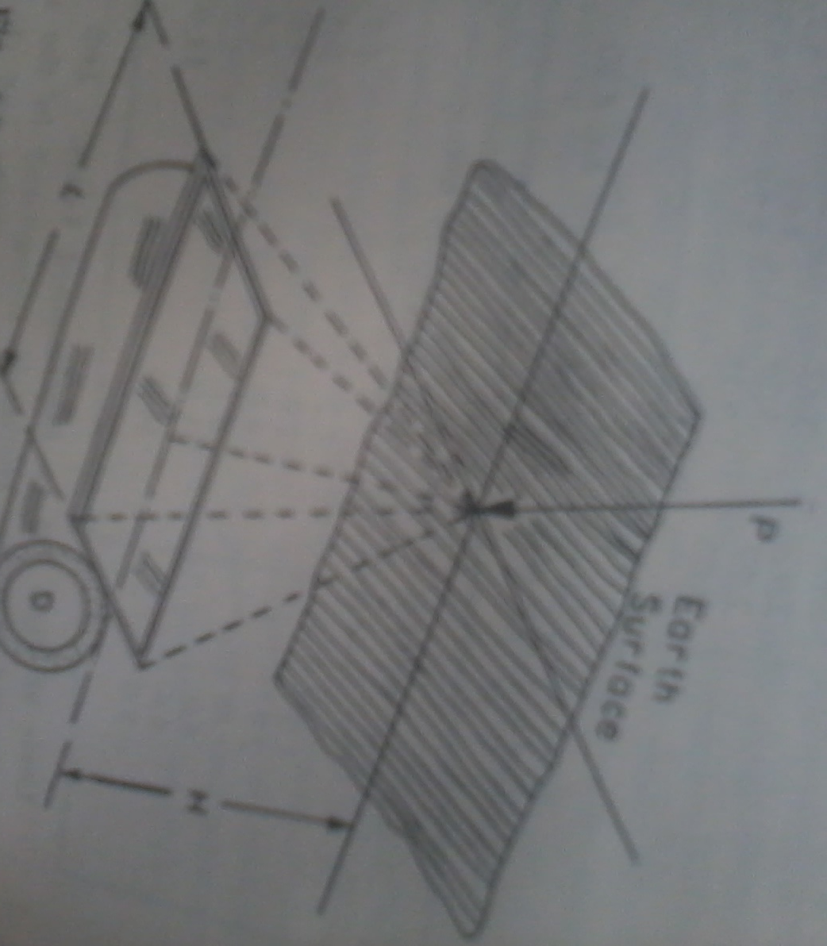
External Forces

Slide 53
WATER DISTRIBUTION SYSTEM
The distribution system is that part of the water-work which receives the water from the pumping station or from treatment plant and delivers it throughout the district to be served.
It includes, such as, reservoirs for purposes of storage, equalizing pressures and subsequent distribution, together with pipes, valves, hydrants and other appurtenance for carrying water, service pipe and meters etc.

Slide 54
Objectives of Distribution System
The main purposes of the construction of water distribution system are:
To make water available in close proximity to the consumer;
To supply water in adequate quantities according to the demand of the consumers;
To supply water with adequate pressure;
To regulate water supply as per requirement.

Slide 55
General consideration for water distribution system
The general considerations of the planning of distribution system should be observed in its design:
Circulation of water: The layout of distribution system should be such that there is free circulation of water and that the number of dead ends should be very few. Where dead ends are unavoidable, the hydrants will be provided to act as washouts.
Construction and design: The construction and design of water distribution system should be such that ample water is available at all times at desired pressure in all portion of the distribution system.

Slide 56
General consideration for water distribution system
The minimum residual pressures at ferrule point for direct supply to single-storeyed, two-storeyed and three-storeyed buildings should be respectively 7 m, 12 m and 17 m. If the available pressure in the pipe is low, it has to be boosted up with the help of fire engines in case of fire occurrence. In general, the construction and design of the water distribution system be such that it can be relied upon even for meeting future expansion programs.
Earth cushioning: The mains, which are laid under roads, should be provided with a minimum earth cushioning of 900 mm height from the top of mains. At other places, the cushioning may be of 750 mm height.

Slide 57
General consideration for water distribution system
Construction by sewage: The water pipe line should be laid above the sewers at a vertical distance of about 2 m and the horizontal distance between the water pipes and sewer should be at least 3 m. If the physical configuration of country does not permit the provision of this minimum spacing, extraordinary precautions should be taken to make the distribution system watertight to the maximum possible extent.
Fire demand: The distribution system should be so laid that the water for fire demand is available in required quantity at desired pressure at number of points along it.

Slide 58
General consideration for water distribution system
Economy: The layout and design of distribution system should be economical. The cost of distribution system forms a substantial part to extent of about 90% of the total cost of the water supply project. Hence the water distribution system should be carefully designed by taking into various factors such as pumping head, type of pipes, storage requirement, pipe diameter, etc.
Gradients: It is not necessary to lay mains at constant gradients. But the gradients of mains should in general follow the natural contour of ground. The gradient line should not rise above the hydraulic gradient line which means that at every points along the mains, there should be a positive pressure gradient than the atmospheric pressure.

Slide 59
General consideration for water distribution system
Leakage: The distribution system should be fairly watertight and the loss of water due to leakage should be brought down to the minimum possible extent.
Repairs: The distribution system should be so laid as to permit easy repairs. The broken or worn out parts of the equipments for various operations should be properly replaced.
Safety from pollution: The layout of distribution system should be such that it does not contribute to the pollution of water flowing in it.
Sanitation: The sanitation of area through which the distribution system is passing should be good so that there are no chances for water to be polluted during repairs or replacements of pipe lines.
Unsafe cross connection: The distribution system should not have any unsafe cross connection from which there are chances for contaminated water to enter it.

Slide 60
Environmental Engineering-1
CE3141
Lecture -4
Week-4, Saturday
04-04-2022

Slide 61
Methods of Distribution System
Depending upon the topography of the country, the distribution system may be classified as (i) Gravity system, (ii) System with direct pumping and (iii) System with pumping and storage.
Gravity system: A gravity system is adopted where the source of supply such as a lake or an impounding reservoir, is at a sufficient elevation with respect to the city in order to produce adequate pressure for fire and domestic service. This method, evidently, is the safest and most reliable. In this system, water is conveyed through pipe by gravity only. In case of fire, the motor pumps may be used to develop high pressures for fire fighting purpose.

Slide 62
Methods of Distribution System
System with direct pumping: In this system, water is directly pumped into the mains. Consumption is the only outlet. This method is least desirable, a failure in the power supply means breakdown of the system. Also, pressures in the mains vary with the consumption, so that under varying consumption, several pumps may be required to conform to the supply, adding to cost.

Slide 63
Methods of Distribution System
System with pumping and storage: This is also called the direct-indirect or dual system. In this, when the demand-rate exceeds the rate of pumping, the flow into the distribution system is both from the pumping station as well as the elevated reservoir. When , however, the reverse condition exist i.e., pumping is more than the demand, the excess of water is stored in the reservoir. This system, obviously, is the most economical and reliable. It provides for a uniform rate of pumping. The pumps can be operated at their rated capacities, resulting in higher efficiency and economy of operation. Also, the water stored serves as a reserve to take care of fire demands and pump breakdowns.

Slide 64
Service Reservoir
The service or distribution reservoirs are generally provided in the distribution system to store the clean treated water before it is dispatched to the consumers. These reservoirs may be constructed of brick masonry, cement concrete – plain, reinforced or pre-stressed, steel or stonemasonry.
The common materials used are cement concrete and steel. According to the situation with respect to ground, the service reservoirs are classified in the following three types: (i) surface reservoirs, (ii) elevated reservoirs and (iii) standpipes.

Slide 65
Service Reservoir
Surface Reservoirs:
Surface reservoirs are circular or rectangular in shape. These reservoirs are constructed at ground level or below ground level and hence these are also called ground reservoirs or non-elevated reservoirs. The treated water stored in these reservoirs is pumped to elevated reservoirs from which it is supplied to the consumers.
However, if surface reservoirs are located at high points in the distribution system then water may be supplied to the consumers directly from these reservoirs by gravity, as far as possible surface reservoirs should be located at high points in the distribution system.

Slide 66
Service Reservoir
Surface Reservoirs:
It is usual practice to construct a surface reservoir in two compartments, so that one can be used while the other is being cleaned or repaired. The two compartments are connected with each other by control valves. Overflow pipes are provided at full supply level so as to maintain a constant level of water in the reservoir.
Ventilators are provided in the roof slab so as to affect free circulation of air over the water surface in the reservoir. Although treated water is stored in the reservoir, yet some sludge may be present in the stored water which will be deposited in the reservoir. The deposited sludge can be removed by occasional cleaning through the washout pipes provided at the bottom of the reservoir. The outlet pipes are placed at a slightly higher level, say at least 10 cm, than that of the washout pipes.

Slide 67
Service Reservoir
Elevated Reservoirs:
Elevated reservoirs are constructed at an elevation from ground level. These reservoirs are also known as overhead tanks. These reservoirs may be rectangular, circular or elliptical in shape. However, with the advancement in structural analysis it is possible to construct the elevated reservoirs in any shape to suit the architectural requirements.

Slide 68
Service Reservoir
The various accessories provided for elevated reservoirs:
Inlet pipe for the entry of water.
Outlet pipe for the exit of water.
Overflow pipe for the exit of water above full supply level.
Ladders to reach the top of reservoir and then to the bottom of reservoir for inspection.
Manholes in top cover or roof of reservoir for providing entry to the inside of reservoir for inspection.
Ventilators for free circulation of air.
Washout pipe (or drain pipe) for removing water after cleaning of reservoir.
Water level indicator for indicating from outside the depth of water in reservoir.
A lightning conductor for protection against lightning.

Slide 69
Service Reservoir
Standpipes:
A standpipe is a vertical cylindrical tank resting just above the ground. The diameter of standpipe varies from 10 to 15 m and its height varies from 15 to 30 m. Standpipes are made of steel or R.C.C. Steel standpipes are more common as it is very difficult to construct watertight R.C.C. standpipes under heads greater than 15 m. Alike elevated reservoirs, standpipes are also provided with inlet pipe, outlet pipe, overflow pipe, washout pipe and various other accessories for their efficient working, inspection and maintenance.
However, in the case of standpipe the outlet pipe is located in the tank with its entrance being kept above the bottom of the tank at an elevation such that the storage of water created in the tank above this elevation gives the necessary pressure for distribution of water. The volume of water stored in the tank above the entrance of the outlet pipe can only be used and hence it is the useful storage of standpipe.

Slide 70
Service Reservoir
Standpipes:
On the other hand the lower portion of the storage lying below the entrance of the outlet pipe cannot be ordinarily used and it only serves as a support for the useful storage and hence it is termed as supporting storage. However, the supporting storage can also be effectively used by providing boosters or for fire protection with the help of fire engines. Further standpipes are usually located on a high ground so as to successfully utilize its entire storage.
Since large variations in pressure are undesirable in a distribution system, fluctuation of the water level in a standpipe is usually limited to 10 m or less. Generally standpipes of height more than 15 m are not economical since the lower portion of a standpipe serves only to support the upper useful portion.

Slide 71
Purposes of Service Reservoir
Following are the purposes served by the service or distribution reservoir:
If pumps are used, the provision of these reservoirs makes it possible to run pumps at uniform rate.
In case of gravity system of supply, the provision of these reservoirs will result in mains of smaller diameters.
They furnish the facility of storage of water for meeting fluctuating hourly demand of water.
They maintain constant pressure in the mains. The pressure in mains, without service reservoirs, will fall as the demand of water will increase.
They make the design and construction of treatment unit and distribution system economical.
They serve as storage for emergencies such as breakdown of pumps, bursting of mains, heavy fire demand, interruption in power supply, temporary floods, etc.

Slide 72
Service Reservoir
Location of Distribution Reservoirs:
Distribution reservoirs should be located centrally or as close as possible to the areas to be served by them. A central location of a distribution reservoir will reduce friction losses in the distribution pipes due to reduction in the length of pipes.
Further in this case the pressure over the entire distribution area will be uniform during periods of both high and low demands. On the other hand if a distribution reservoir is not located centrally there will be large head loss, and by the time water reaches the tail end of the area served by it the pressure will be too low for satisfactory supply of water to the consumers at the tail end.

Slide 73
Pressure Requirements in Distribution System
In designing water distribution systems pressure requirements for ordinary use, and for fire fighting must be considered.
In residential districts fires pressure of 60 psi at the hydrant are recommended.
In commercial districts minimum pressure of 75 psi is tolerable, but higher pressures must be provided in districts with tall buildings.
The maintenance of high pressure in mains means increased pumping cost and usually also increased leakage.
Some large cities have installed dual systems in business districts, a low-pressure system for ordinary use and a high-pressure system (150 to 300 psi) for fire fighting only.

Slide 74
Pipe Systems
The pipe system comprises of the following four units:
The supply main: the supply main or main is the direct conveyor of water from the pumping plant or the gravity conduit. It should be of sufficient size to carry the flow.
The sub-mains: The sub-mains are the secondary feeders connected to either side may be placed at about 300 m apart and should be of sufficient size to discharge domestic supply and fire flow.
Minor distributors: The minor distributors or branches make up the grid iron of pipes and supply water to the fire hydrant and service pipes of the residences and other buildings. For fire service, minimum diameter of pipe should be 150 mm and for domestic service alone 100 mm and less.
Valves: Valves are needed to operate or control the pipe system. These should be sufficient in number and suitably located.

Slide 75
Environmental Engineering-1
CE3141
Lecture -5
Week-4, Saturday
09-04-2022

Slide 76
Methods of Water Supply
Following are the two systems of supply of water which are based on the duration of supply:
Continuous Method:
In this system of supply, the water is supplied to the consumers for 24 hours of day. This is the most ideal system of supply and it should be adopted as far as possible.
The only disadvantage of this system is that considerable wastage of water occurs, if consumers do not possess civic sense regarding the importance of treated water. One recommended way to avoid this defect of the system is to supply water through meters. Whether it is desirable to install meters or not is a debatable question and hence the decision to install meters should be taken after careful considerations and deliberations.

Slide 77
Methods of Water Supply
Intermittent Method:
In this system of supply, the water is supplied during certain fixed hours of day only. The usual period is about 1 to 4 hours in the morning and about the same period in the afternoon. This system of supply of water proves to be useful for the following two conditions:
the available pressure is poor and
the quantity of water available is not sufficient to meet with various demands for water.
The working of the system is very simple. The distribution area is divided into several zones and the timings of each zone are so adjusted that good working pressures are maintained in each zone.

Slide 78
Continuous and Intermittent Supply
A continuous method of supply is always better than the intermittent method because of the following reasons:
When the supply of water is only for a few fixed hours of the day, consumers are compelled to store water for use during the non-supply hour. The domestic storage tanks built for the purpose may suffer for want of proper maintenance and attention for a lone time, resulting in a possible contamination of the water supply.
The unused water of storage tanks is most likely to be thrown out to be replaced, during the supply hour, by fresh supply of water. Evidently, this is a wasteful use of water. Also, where the supply is not metered, there is a tendency on the part of consumers to leave the taps open for all hours, resulting in additional wastage of water. The receptacles so left under public hydrants and faucets may remain overflowing, without being attended to, for a long time.

Slide 79
Continuous and Intermittent Supply
In case of fire breaks out during the non-supply hours, considerable damage would have resulted before the supply could be turned on and fire extinguished.
During the non-supply hours, pressure in the distribution mains may fall below atmospheric pressure, causing partial vacuum, sucking in air or other harmful gases from sewers running close-by and resulting in a possible contamination of the water supply.

Slide 80
Methods of Layout of Distribution Pipe
Four methods of distribution pipe laying are discussed. It may however be noted that each system has its own merits and no locality strictly adopts only one of these methods. The necessary combinations of the above methods are usually made to suit the local conditions of the area.
Dead-end method
This is also known as the tree system of layout and it consist of one supply main from which sub-mains are taken. The sub-mains again divide into several branch lines from which service connections are given to the consumer.

Slide 81
Methods of Layout of Distribution Pipe
Dead-end method
This system is suitable to old towns and cities which have been irregularly developed having no definite pattern of roads and streets.
Branch
Main
Sub- main
Cut-off valve

Slide 82
Methods of Layout of Distribution Pipe
Advantages
Following are the advantages of the dead-end method:
It is possible to work out accurately the discharge and pressure at any point in the distribution system. The design calculations are simple and easy.
The cut-off valves required in this system of layout are comparatively less in number.
The diameters of mains are to be designed for the population likely to be served by them only. This fact may make the system cheap and economical.
The laying of water pipe is simple.
By suitably locating valves, water supply can be so regulated that by closing any valve, a section of the system can be cut off for repairs without affecting the rest.

Slide 83
Methods of Layout of Distribution Pipe
Disadvantages
Following are the disadvantages of the dead-end method:
During repairs, the large portion of distribution area is affected. It results into great inconvenience to the consumers of that area.
There are many dead-ends in this system. The pipes terminate at the dead-ends and hence there is no free circulation of water. There are chances for water to be polluted due to stagnation and it may endanger the public life. For this purpose, the scour valves are provided at dead-ends and water from dead-ends is removed periodically by the operation of these valves. This measures proves to be costly as treated water is thrown to waste and it also requires careful attendance and operation of the scour valves.
The water available for fire fighting will be limited in quantity as the discharge from mains is also limited. This may prove to be serious in some roads.

Slide 84
Methods of Layout of Distribution Pipe
Grid-iron method
This is also known as the interlaced system or reticulation system. The mains, sub-mains and branches are interconnected with each other as shown in Figure
It is an improvement over the Dead End System, caused by connecting the ends of the various mains so as to eliminate the dead ends. The water then circulate freely throughout the system.
Such a system is very useful for a city laid out on a rectangular plan.
Main
Sub main

Slide 85
Methods of Layout of Distribution Pipe
Advantages
Following are the advantages of the grid-iron method:
In case of repairs, a very small portion of the distribution area will be affected.
There is free circulation of water and hence it is not liable for pollution due to stagnation.
The water is delivered at every point of distribution system with minimum loss of head.
When a fire occurs, plenty of water is available for the fighting purpose and by manipulating the cut-off valves, whole supply of water may be concentrated for this purpose.

Slide 86
Methods of Layout of Distribution Pipe
Disadvantages
Following are the disadvantages of grid-iron method:
The cost of laying water pipes is more.
The grid-iron system of layout requires longer length of pipes.
The procedure for calculating the sizes of pipes and for working out pressures at various points in the distribution system is laborious, complicated and difficult.
The valves required in this system are more in number and in fact, four valves are to be installed at every cross junction.
Use: The grid-iron system of layout is more suitable for towns having well-planned roads and streets. However, the principle of grid-iron system can be applied to the dead-end system of layout by removing dead-ends.

Slide 87
Methods of Layout of Distribution Pipe
Circular method
This is also known as the ring system and a ring of mains is formed around the distribution area as shown in Figure. This system possesses advantages and disadvantages as those of grid-iron system. The distribution area in divided into rectangular or circular blocks and the water mains are laid on the periphery of these blocks. The ring system of layout is most suitable for towns having well-planned roads and streets.
Main
Sub main

Slide 88
Methods of Layout of Distribution Pipe
Radial method
This method of layout is just the reverse of the ring method. In this system, the water is taken from the mains and pumped into the distribution reservoirs which are situated at centers of different zones as shown in Figure. The water is then supplied through radially laid pipes. The radial method of layout gives quick service and the calculations for design of size of pipes are simple. The radial method is most suitable for towns having roads laid out radially.
Distribution reservoir
A
B
Main
G
H
D
C

Slide 89
Maintenance of Distribution System
The distribution system of water supply should be maintained so that the equipment employed and the processes followed can work smoothly without interruption. A well designed and properly laid water distribution system may prove to be highly inefficient in its operation for want of proper maintenance.
Following are the important items which are to be attended during the maintenance of distribution system of water supply:
The flushing of water pipes should be carried out wherever necessary especially in case of dead-ends on lines and at places where water is supplied without the process of filtration.

Slide 90
Maintenance of Distribution System
The hydrants, valves and various other appurtenances installed on the water mains should be checked regularly and should be maintained in perfect running order.
The records regarding the lengths of pipes laid, lengths of pipe repaired or replaced, expenditure incurred, number of fire hydrants, number of service connections and all other relevant data in connection with the distribution system should be well maintained for ready reference.
The wastage of water especially of leakage through pipe joints should be brought down to the minimum possible extent by adopting suitable preventive measures.

Slide 91
Maintenance of Distribution System
The water pipes should be cleaned periodically by the use of scraping devices and the incrustations formed on the inside surface of water pipes should be removed.
The meters installed on the distribution system should be checked from time to time and the defective or unreliable meters should be immediately repaired or replaced.
The maps showing the up-to date latest layout of distribution of water pipes in the locality should be maintained in the office of the responsible authority.

Slide 92
Environmental Engineering-1
CE3141
Lecture -6
Week-4, Tuesday
12-04-2022

Slide 93
Design of Distribution System
Factors to be considered in the design of a distribution system are –
Type of flow – whether continuous or intermittent.
Method of distribution – whether by gravity or by pumping.
Probable future demand based on prospective increase in population. This also includes the industrial demand as well as the fire fighting requirements.
Period to be considered to be the life of pipes used. The system should be designed anticipating the future of the condition that will obtain near the end of the time when the amounts set aside for depreciation would have returned the first cost.

Slide 94
Design of Distribution System
The Hazen Williams equation can conveniently be used for the hydraulic design of the branched or looped networks of pipes. The Hazen Williams equation can be written in the form:
Q = 3.7 × 10⁻⁶ CD^{2.63}(H/L)^{0.54} --------------------------------- (1)
Where, Q = flows, lps
C = roughness coefficient (100 – 140 for rough to smooth pipes)
D = diameter, m
H = head loss, m
L = length of pipe, m

Slide 95
Design of Distribution System
For a definite value of C, the equation (1) can be written as:
H/L = 1.39 × 10⁻⁶ Q^{1.85}/(D^{4.87}) ---------------- (2) [For C = 130]
H/L = 1.59 × 10⁻⁶ Q^{1.85}/(D^{4.87}) --------- (3) [For C = 120]
The process involved in the design is to make a pipe layout, assume the pipe size and then work out the terminal pressure head which could be made available at the end of the each pipe section when discharging the peak flow.

Slide 96
Design of Distribution System
The available pressure heads are checked to see if they correspond to permissible residual pressure heads.
If not, the pipe size is changed and the system is reinvestigated until satisfactory conditions are obtained.

Slide 97
Design of Distribution System
Branched Network
The following design procedure may be adopted for branched network:
Collect/ prepare a map of the area to be served with roads, streets and other features and make a layout of mains, sub-mains and branches including location of valves and other appurtenances.
Estimate the pick flow at different points and determine the quantity flowing through each section of the pipe. Peak flow = average daily flow × peak factor.
Assume pipe sizes of all the pipes in the network (to calculate approximate pipe size the velocity may be assumed to be around 1 m/s).

Slide 98
Design of Distribution System
Branched Network
Calculate frictional head loss per unit length of the pipe and then multiply by pipe length of the pipe to find the total head loss.
Determine the terminal pressure head taking the change in the elevation of the pipe into account.
In case of a difference between the computed terminal pressure and the permissible pressure head, revise the pipe size.

Slide 99
Design of Distribution System
Looped Network
The determination of probable flow in each pipe in a pipe networks requires complicated and tedious trial and error solutions. In any looped pipe network two conditions must be satisfied:
The flow entering a junction must equal the flow leaving it.
The algebraic sum of the pressure drop (head loss) around any closed loop must be zero.

Slide 100
Analysis of Distribution System
Frequently, it become necessary to analyze a given distribution system in order to determine through a quick and approximate check, the pressures and flows available in any section of the system and to suggest ways to improve upon the same, if found inadequate. A few important methods are briefly discussed as below:
Equivalent pipe method
Method of sections
Hardy-Cross method

Slide 101
Analysis of Distribution System
Equivalent pipe method
This method is useful in rendering a complex network of pipes into an equivalent pipe system giving the same discharge and loss of head as in the complex system. For purpose of analysis, the entire network of pipes is considered to be split up into two portions: (i) pipe in series and (ii) pipe in parallel.
Q₁
Pipe in series: Pipes carry arbitrarily chosen values of discharge Q₁ flowing through branches AB and BD and Q₂ flowing through AC and CD in Figure. It is assumed that the loss of head for pipe in series is additive.
B
D
Q₁
Q₂
Q₁
C
A

Slide 102
Analysis of Distribution System
Knowing discharge (say Q₁) and diameters of pipe-lines AB and BD through which it flows, it is possible to determine the loss of head H₁ in their total length (AB+BD). Here, use is made of the nomograph for Hazen-Williams Formula in which C=100. A single length of equivalent pipe AD of known diameter can then be selected to give the same values of discharge Q₁ and loss of head H₁.
Pipes in parallel: In this case, head through pipes in parallel i.e., ABD and ACD is the same. If a certain loss of head (say H₁) is one assumed to occur in either arm length ABD and ACD, flows through the arms can be worked out and added together to see that the total flow corresponds nearly to the original flow Q. The size and length of a single pipeline can then be calculated to give the same discharge and loss of head.

Slide 103
Analysis of Distribution System
Method of sections
This is an approximate method but gives a quick check and is simple to follow. The method may be described in the following steps:
Cut the network of pipes by a number of sections a-a, b-b, c-c, etc. at right angles to the assumed direction of flow in Figure. Consider a proper sequence of pipes and character of district served (residential or commercial).
Calculate the quantity of water to be supplied beyond each section.
a
b
c
a
b
c

Slide 104
Analysis of Distribution System
Method of sections
Study the average available gradient. Velocity allowed in pipes is 2 to 4 ft/sec. Permissible gradient should be 1 to 3 ft per 100 ft.
Find out the number of pipes cut by each section.
Calculate the total discharge of water available at the end of each section by determining the discharge capacities and number of pipes cut at section and summing these up.
Difference between the required discharge and the calculated discharge are made up by providing suitable number of additional pipes at allowable gradients at each end of section.

Slide 105
Environmental Engineering-1
CE3141
Lecture -7
Week-5, Saturday
14-05-2022

Slide 106
Analysis of Distribution System
Hardy-Cross method
Pipe network problems in water distribution systems are usually solved by methods of successive approximation, since any analytical solution requires the use of many simultaneous equations, some of which are nonlinear. We know,
H/L = 1.59 × 10⁻⁶ Q^{1.85}/(D^{4.87}) --------- (3) [For C = 120]
The equation (3) can be written for a particular pipe as:
H = kQ^{x} ---------------------------------(4)
In which k is the constant depending on the length, diameter and roughness of the pipe as well as the fluid property, x is the component equal to 1.85 for Hazen Williums’ equation and 2 for the Manning equation.

Slide 107
Analysis of Distribution System
Hardy-Cross method
Hardy Cross developed a method of successive approximation in which the circuits are balanced, distribution of flow is determined and the above two conditions of flow are satisfied. The solutions for pipe network problem suggested by Hardy Cross requires that the flow in each pipe be assumed so that the principle of continuity is satisfies in each junction. A correction, Δ, to the assumed flow is computed successively for each pipe loop in the network until the correction is required to an acceptable value. If Q_{a} is the assumed flow, then the correction is Q – Q_{a} i.e. Q = Q_{a} + Δ --------(5)
Inserting the value of Q from equation (5) and applying the condition that the head loss around any closed loop is zero the head loss equation (4) gives: ∑k (Q_{a} + Δ)^{x} = 0 ----------- (6)

Slide 108
Analysis of Distribution System
Hardy-Cross method
Expanding equation (6) ∑kQ_{a}^{x} + x∑kΔQ_{a}^{x-1} + (x-1)/2∑kΔ²Q_{a}^{x-2} + ---- + ----- = 0 ----------------(7)
If Δ is small compared to Q, the third and all successive terms of the equation (7) may be neglected, hence,
∑kQ_{a} ^{x} + Δx∑kQ_{a}^{x-1} = 0 ------------------------------(8)
Solving equation (9) for Δ:
Δ = - ∑kQ_{a} ^{x} / x∑kQ_{a}^{x-1} or, Δ = - ∑H / (x∑H/Q_{a}) - (9)

Slide 109
Analysis of Distribution System
The procedure for Hardy Cross method
Carefully examine the network and assume reasonable rates of flow in each pipe such that inflow equals outflow at each junction.
In each loop, determine the head loss, H and H/Q for all pipes.
With due attention to sign, compute the total head loss around each circuits.
Compute ∑H/H for the same circuit without giving any consideration to sign.
The correction, Δ is computed for each loop by equation (9). The minus sign may be disregarded if the correction so obtained is made by inspection.

Slide 110
Analysis of Distribution System
The procedure for Hardy Cross method
Apply the correction to each pipe in each loop. When the sign of Δ is negative (-), decrease the clockwise flows and increase the counterclockwise flows. When the sign is positive (+), increase clockwise flows and decrease counterclockwise flows. Pipes that are common to two loops require double correction.
With adjusted flows, repeat the procedure for the second approximation. The procedure is continued until the desired accuracy is attained.

Slide 111
WATER QUALITY AND TREATMENT
The water required for public water supply scheme should be potable or wholesome water i.e. fit for drinking purposes. It is however not essential to have physically or chemically pure water. The presence of some minerals in water is required to give some taste to the water i.e. to make it palatable and they also assist in food assimilation. It will be difficult, time consuming and costly to have complete purification of the water.

Slide 112
WATER QUALITY AND TREATMENT
The impurities in water are to be removed to a certain extent only so that it does not prove harmful to the public health. The term wholesome water is used to indicate the water which is not chemically pure, but does not contain anything harmful to the human body i.e. the water in which there are no pathogenic bacteria, no toxic substances and no excessive organic matter. The term pure water is a relative term and it has to be interpreted in relation to the use of water.

Slide 113
Water Quality Parameters and Standards
The standards of water quality parameter depend on the purposes of use. These parameters are briefly described as below:
Turbidity: The term turbidity is applied to water containing suspended matter that interferes with the passage of light through the water or in which visual depth is restricted. The turbidity may be caused by a wide variety of suspended materials which range in size from colloidal to coarse dispersions, depending upon the degree of turbulence. Because of the wide variety of materials that cause turbidity in natural waters, it has been necessary to use an arbitrary standard. The standard chosen was 1 mg of SiO₂ in 1 liter distilled water and the silica used must meet certain specifications as to particle size. Now, 1 unit of turbidity = 1 mg SiO₂/L.

Slide 114
Water Quality Parameters and Standards
Total dissolved solids (TDS): Total dissolved solids comprise inorganic salts and small amount of organic matter. The common dissolved mineral salts are claimed to affect the taste, hardness, corrosion and encrustation. Dissolved inorganic substances may exert adverse effects on aquatic animals and plants and may cause irrigation problem. The amount of dissolved solid present in water is an important consideration in its suitability for domestic use. In general, water with a total solids content of less than 500 mg/l is most desirable for such purposes.

Slide 115
Water Quality Parameters and Standards
Depending on the TDS water is often classified as follows:
Excellent | TDS < 300 mg/l
Good | 300 – 600 mg/l
Fair | 600 – 900 mg/l
Poor | 900 – 1200 mg/l
Unacceptable | TDS > 1200 mg/l

Slide 116
Water Quality Parameters and Standards
Colour:
Water become coloured due to addition of various suspended matter in water. Tannins, acid and humates, from the decomposition of lignin, are considered to be the principal colour bodies. Iron is sometimes present as ferric humate and produces a colour of high potency. Colour caused by suspended matter is referred to as apparent colour and is differentiated from colour due to vegetable or organic extracts that are colloidal and which is called true colour. In water analysis it is important to differentiate between “apparent” and “true” colour.

Slide 117
Water Quality Parameters and Standards
Colour:
Waters containing natural colour are yellow-brownish in appearance. Through experience, it has been found that solution of potassium chloroplatinate (K₂ Pt Cl₆) tinted with small amounts of cobalt chloride yield colours that are very much like the natural colours. The colour produced by 1 mg/L of platinum (as K₂ Pt Cl₆) is taken as the standard unit of colour.

Slide 118
Water Quality Parameters and Standards
Tastes and odour:
The words taste and odour are often used loosely and interchangeably. Actually there are four tastes: sour, salt, sweet and bitter – strictly confined in their perception to the taste buds of the tongue. Odours appear to be without limit in number and are known to change in quality as the concentration of the odourous compounds, or the intensity of their small, is varied.

Slide 119
Water Quality Parameters and Standards
Tastes and odour:
Tastes and odours are associated with (i) decaying organic matter, (ii) living algae and other microorganisms containing essential oils and other odourous compounds, (iii) iron and manganese and other metallic products of corrosion, (iv) industrial wastes, particularly phenolic substances, (v) disinfecting chlorine and its substitute compounds and (vi) biologically nondegradable synthetic organics.

Slide 120
Water Quality Parameters and Standards
Temperature:
The most desirable range of temperatures for a public water supply is between 40 and 50⁰F. Natural waters are seldom found below 40⁰F. As the temperature rises above 50⁰F, the water becomes less palatable and less suited to certain uses. Temperatures above 80 ⁰F are undesirable, and above 90⁰ to 95⁰F the water is unfit for a public supply.

Slide 121
Water Quality Parameters and Standards
Hydrogen ion concentration, pH:
pH is a term used rather universally to express the intensity of the acid or alkaline condition of a solution. More exactly, it is a way of expressing the hydrogen ion concentration. In the field of water supplies, it is a factor that must be considered in chemical coagulation, disinfection, water softening and corrosion control. In sewage and industrial waste treatment employing biological processes, pH must be controlled within a range favourable to the particular organisms involved.

Slide 122
Water Quality Parameters and Standards
Alkalinity:
The alkalinity of water is a measure of its capacity to neutralize acids. The alkalinity is due primarily to salts of weak acids and strong bases. Such substances act as buffers to resist a drop in pH resulting from acid addition. Alkalinity is thus a measure of the buffer capacity.
Three major classes of minerals cause most of the alkalinity in natural waters: bicarbonate, carbonates and hydroxides. Other salts of weak acids, such as borate, silicates and phosphates may be present in small amounts. A few organic acids, such as humic acid, add to the alkalinity of natural waters. Excessive or insufficient alkalinity interferes with water treatment (coagulation).

Slide 123
Water Quality Parameters and Standards
Specific conductance:
The specific conductance of water is the reciprocal of the resistance in ohms of a column of the water 1 cm long and having cross section of 1 sq.cm at a specific temperature, usually 25⁰C. It is commonly reported in ohms. The specific conductance is used as a measure of the quality of the water.

Slide 124
Environmental Engineering-1
CE3141
Lecture-8
Week-5, Tuesday
17-05-2022

Slide 125
Water Quality Parameters and Standards
Hardness:
Hardness in water is that characteristic which prevent the lathering of soap. It is caused principally by the solution in water of carbonates, bicarbonates and sulphates of calcium and magnesium, although the chlorides and nitrates of these two elements and sometimes of iron and of aluminum are effective to a lesser degree in causing hardness.
The term hardness is defined as the ability of the water to cause precipitation of insoluble calcium and magnesium salts of higher fatty acids from soap.
Total hardness is expressed in various ways, the standard practice being in parts per million by weight in terms of calcium carbonate.

Slide 126
Water Quality Parameters and Standards
Various ranges of hardness of water
Class | 1 | 2 | 3 | 4
Hardness, ppm | 0 – 55 | 56 – 100 | 101 – 200 | 201 – 300
Degree of hardness | Soft | Slightly hard | Moderately hard | Very hard

Slide 127
Water Quality Parameters and Standards
Classification of hardness: Depending on soap destroying power hardness is classified as temporary hardness and permanent hardness.
The temporary hardness is also known as the carbonate hardness and it is mainly due to the presence of carbonate or bicarbonate of calcium and magnesium. It can be removed by boiling or by adding lime to the water.
The permanent hardness is also known as the non-carbonate hardness and it is due to the presence of sulphates, chlorides and nitrates of calcium and magnesium. It cannot be removed by simply boiling the water. It requires special treatment of water softening.

Slide 128
Water Quality Parameters and Standards
The diagram of carbonate hardness and non-carbonate hardness is presented in Figure.
HCO₃
Ca(HCO₃)₂, Mg(HCO₃)₃
Ca
Carbonate Hardness
CO₃
CaCO₃, MgCO₃
Mg
SO₄
CaSO₄, MgSO₄
Non-carbonate Hardness
Cl ⁻
CaCl₂, MgCl₂
NO₃
Ca(NO3)₂, Mg(NO3)₂

Slide 129
Water Quality Parameters and Standards
Principal bad effect of hardness:
The principal bad effects of hardness are given below:
Enough consumption of soap.
Clogs skin, discolours porcelain, stains and shortens fabrics, toughens and discolours vegetables.
Gives difficulty in textile and paper manufacture, tannery and other industrial processes.
Forms scales in boilers, resulting in great heat transfer losses and danger of boiler failure.

Slide 130
Water Quality Parameters and Standards
Arsenic: In Bangladesh the presence of arsenic in groundwater was first detected in 1993 at Baroghoria union of Chapai Nawabganj district. The concentration of arsenic in drinking water in excess of permissible limit is toxic to human body. According to the WHO guideline value the desirable maximum concentration of arsenic in drinking water would be 0.01 mg/l. In Bangladesh the maximum acceptable concentration in drinking water is considered to be 0.05 mg/l. Symptoms of arsenic toxicity leading to cancer may occur due to excessive intake of arsenic in the human body over a longer period of time.

Slide 131
Water Quality Parameters and Standards
Drinking water standard
Parameters |  | Standard (mg/l)
 |  | USPHS | WHO
Physical quality | Total Dissolve Solid (TDS) | 500 | 500
 | Turbidity | 10 | 5
 | Color | 20 | 15
 | Temperature | 50º F | 50º F
 | Tastes and odor | Water should be completely free from taste and odor

Slide 132
Water Quality Parameters and Standards
Drinking water standard
Parameters |  | Standard (mg/l)
 |  | USPHS | WHO
Chemical quality | Arsenic (As) | 0.01 | 0.01
 | Cyanide (Cn) | 0.01 | 0.01
 | Lead (Pb) | 0.05 | 0.05
 | Barium (Ba) | 1.00 | 1.00
 | Selenium (Se) | 0.01 | 0.01
 | Cromium (Cr) | 0.05 | 0.05
 | Cadmium (Cd) | 0.05 | 0.05
 | Silver (Ag) | 0.05 | 0.05

Slide 133
Water Quality Parameters and Standards
Drinking water standard
Parameters |  | Standard (mg/l)
 |  | USPHS | WHO
Chemical quality | Detergent (ABS) | 0.50 | 0.50
 | Chloride (Cl) | 250 | 200
 | Copper (Cu) | 1.00 | 1.00
 | Carbon-Chloroform extract (CCE) | 0.20 | 0.20
 | Iron (Fe) | 0.25 | 0.25
 | Manganese (Mn) | 0.05 | 0.05
 | Iron (Fe) + Manganese (Mn) | 0.30 | 0.30
 | Nitrate as NO3 | 45 | 45
 | Phenols | 0.001 | 0.001

Slide 134
Water Quality Parameters and Standards
Drinking water standard
Parameters |  | Standard (mg/l)
 |  | USPHS | WHO
Chemical quality | Sulphate (SO₄) | 250 | 250
 | Zinc (Zn) | 5.00 | 5.00
 | Calcium (Ca) | 80.0 | 75.0
 | Magnesium (Mg) | 80.0 | 75.0
 | Total hardness | 150 | 100
 | Total alkalinity | 120 | 100
 | Fluoride (F ⁻⁾ | 0.60 | 0.50
 | pH | 7 to 8 | 7 to 8

Slide 135
Treatment of water
Natural water contains impurities in different forms. The presence of these impurities in excess of acceptable limits make the water unfit for domestic supplies. The main objectives of water treatments are to make water potable i.e. to make water safe to drink, pleasant to taste and suitable for domestic uses.
Groundwater is usually hard but free from pathogenic bacteria and can be supplied for drinking purpose without treatment. Some tubewell water in Bangladesh may contain iron, arsenic and hardness in excess of acceptable levels, and may therefore require specific treatment. Surface water is turbid, colored and contaminated by pathogenic microorganisms and needs extensive treatment involving sedimentation, coagulation with sedimentation, filtration and disinfection.

Slide 136
Treatment of water
The type of treatment required depends on the physical chemical and biological characteristics of water. The most common steps in water treatment are clarification and disinfection.
Clarification involves removal of suspended and colloidal particles including color-producing substances by plain sedimentation, sedimentation with coagulation and filtration to remove visible impurities and make the water attractive to the consumers.
Disinfection means destruction of pathogenic organisms to make the water safe.
Sometimes invisible dissolved minerals and gases present in groundwater are required to be removed by specific treatment processes to make the water potable.

Slide 137
Treatment of water
The common water treatment methods are:
Plain sedimentation,
Coagulation with sedimentation,
Filtration and
Disinfection.
Some of the treatments process/unit operations for removal of specific impurities are (i) aeration, (ii) water softening, (iii) arsenic removal, (iv) iron removal, (v) activated carbon application (vi) fluoridation and defluoridation, (vii) demineralization and (viii) desalinization.
One or a combination of more than one treatment method is employed for water treatment depending on the quality of raw water.

Slide 138
Plain Sedimentation
Principle of particle settling in water
This is a process causing the organic or inorganic particles heavier than water to settle by retaining water in a tank or basin. These particles are held in suspension in natural water mainly by turbulence or current and when the current is retarded, the suspended particles settle at the bottom of the basin.
A particle having specific gravity of more than 1, i.e. heavier than water, tends to move downward in relatively quiescent water by the force of gravity, accelerating until the frictional resistance (drag) of the water equals the gravitational force acting upon the particle. Thereafter the particle travels with a constant vertical velocity called the ‘terminal velocity’ or ‘settling velocity’ of the particle.

Slide 139
Plain Sedimentation
The settling velocity of the particle depends upon:
Horizontal flow velocity of water
Shape and size of the particle
Specific gravity of the particle
Viscosity of water
Density of water
Temperature of water

Slide 140

Plain Sedimentation
The settling velocity of spherical particles under laminar flow conditions is given by the simplified equation:
Where, v_{s} is the settling velocity, g is acceleration due to gravity, S is specific gravity of the particle, d is diameter of the particle and γ is kinematic viscosity of water.

Slide 141
Plain Sedimentation
The above equation is called Stoke’s Law. Stoke’s Law holds good only for particle size 0.1 cm in diameter and Reynold’s number 1 or less. For large particles having diameter greater than 1 cm and Reynold’s number above 2000, Newton’s Law for frictional resistance or drag applies:
Where C_{D} is the Newton’s coefficient of drag.

Slide 142
Plain Sedimentation
The particles in between the above mentioned size or Reynold’s numbers are in transition settling. Stoke’s Law is valid for computation of settling velocity of discrete particles. Discrete particles are those which do not change size, shape and mass during settling and which do not influence each other by being too close. Particles settling under this conditions is called discrete settling.
In case of closely packed particles, the water displaced by the particles may cause additional friction and the settling velocity is reduced. This is termed as hindered settling. Hindered settling becomes noticeable when the concentration of suspended solids is greater than 2000 mg/l. This situation of high concentration of suspended solids may happen in river water during high flooding and heavy rainfall.
Sometimes settling particles may adhere to each other and grow in size and thus deviate from the settling characteristics represented by Stoke’s Law. This may occur in settling of algae or freshly formed flock by the process of flocculation with coagulant. These particles/flocks and tent to stick together and form new bigger particles which settle at a faster rate. This type of settling is called flocculent settling. Discrete, hinder and flocculent settling are shown in Figure.

Slide 143
Plain Sedimentation
Distance
Hindered settling
Discrete settling
Flocculent settling
Time
Figure: Settling of different types of particles in water

Slide 144
Plain Sedimentation
Design of sedimentation tanks
A rectangular sedimentation tank can be subdivided into four different areas comprised of an inlet, settling, outlet and sludge accumulation zones. The inlet zone serves to provide even flow distribution over the full cross section, the outlet zone collects the clarified water over the full tank width. Sludge is accumulated at the tank bottom where it is stored and removed periodically.
The efficiency of the settling tank in the removal of suspended particles can be determined using limiting settling velocity v₀ of a particle which will just travel the full depth (H) of the tank within the detention time (T). Using the dimensions and notations used in Figure, the following equations can be written: v₀ = H/T and T = V/Q = BLH/Q

Slide 145
Plain Sedimentation
from these two equations:
v₀ = Q/BL = Q/surface area.
Where, Q = flow rate, B, L and V are width, length and volume of the sedimentation zone of the settling tank.
Inflow
V₀
Settling zone
Outflow
l
Flow
Figure: Rectangular horizontal flow settling tank

Slide 146
Plain Sedimentation
The tank will remove all the particles having settling velocity v_{s}>v₀ and the particles with settling velocity v_{s}<v₀ will be removed in the proportion v_{s} : v₀. The above analysis shows that the settling efficiency depends on the ratio between the influent flow rate Q and the surface area of the tank BL, which is called the “surface loading”. Hence the efficiency of the settling tank is independent of the depth of the tank.
The higher the surface area the greater is the efficiency.
Plate settlers and tube settlers have been designed to provide a larger surface area and achieve higher efficiency.

Slide 147
Environmental Engineering-1
CE3141
Lecture-9
Week-6, Saturday
21-05-2022

Slide 148
Coagulation and Flocculation
The removal of very fine light colloidal impurities from water is difficult to achieve in practice by the process of plain sedimentation. This can be greatly expedited by the addition to water of certain chemical compound which where thoroughly mixed form wooly masses of flocculent precipitate enmeshing the suspended particles become heavier and finally settle out. These substances are called coagulants and their process of action is coagulation.

Slide 149
Coagulation and Flocculation
Principle of Coagulation
Flock formation: When coagulants are dissolved in water and thoroughly mixed with it, they produce a thick gelatinous precipitate. This precipitate is known as the flock and this flock has got the property of arresting the suspended impurities in water during its downward travel towards the bottom of tank.
Electric charges: The ions of flock are found to possess positive electric charge. Hence they will attract the negatively charged colloidal particles of clay and thus they cause the removal of such particles from water.

Slide 150
Coagulation and Flocculation
Factors Influencing Coagulation
Many factors influence the coagulation of waters. Among them, the following are important:
Kind of coagulant
Quantity of coagulant
Characteristics of water (suspended matter, pH and temperature) and
Time of mixing, flocculation and coagulation.

Slide 151
Coagulation and Flocculation
Dosage of Coagulants
This depends upon number of factors such as:
Turbidity of water
Colour of water
pH value of water
Time of settlement and
Temperature of water

Slide 152
Coagulation and Flocculation
Chemical Reactions
1. Al₂ (SO₄)₃ + 3Ca(HCO₃)₂ = Al₂(OH)₆ + 3CaSO₄ + 6CO₂
2. FeSO₄ + Ca(HCO₃)₂ = Fe(HCO₃)₂ + CaSO₄
Fe(HCO₃)₂ + 2Ca(OH) = Fe(OH)₂ + 2CaCO₃ + 2H₂O
4Fe(OH)₂ + O₂ + H₂O = 2Fe(OH)₃

Slide 153
Filtration
The process of passing the water through the beds of granular materials is known as the filtration.
The filtered water is potable and palatable and it is free from various undesirable impurities like colour, odour, turbidity, pathogenic bacteria, etc.
During the process of filtration, the following effects occur on water:
The suspended and colloidal impurities which are present in water in a finely divided state are removed to great extent.
The chemical characteristics of water are altered.
The number of bacteria present in water is also considerably reduced.

Slide 154
Filtration
The theory of filtration
It can be explained based on the following four actions:
Mechanical straining: The suspended particles which are unable to pass through the voids of sand grains are arrested and removed by the action of mechanical straining.
Sedimentation: The voids between the sand grains of filter act more or less like small sedimentation tanks. The particles of impurities, arrested in this voids, adhere to the particles of sand grains mainly for the following two reasons:
a. Due the presence of a gelatinous film or coating developed on sand grains by previously caught bacteria and colloidal matter;
b. Due to the physical attraction between the two particles of matter.
Thus the suspended impurities are removed by filter by the action of sedimentation.

Slide 155
Filtration
Biological metabolism: The growth and life process of the living cells is known as the biological metabolism. When bacteria are caught in the voids of sand grains, a zoological jelly or film is formed around the sand grains. This film contains large colonies of living bacteria. The bacteria feed on the organic impurities contained in water. They convert such impurities into harmless compounds by the complex biological reactions.
Electrolytic changes: When two substances with opposite electric charges are brought into contact with each other, the electric charges are neutralized and in doing so, new chemical substances are formed.

Slide 156
Filtration
Classification of Filters
Slow sand filter
Rapid sand filter
Pressure filter
Filters
Gravity Filters
Pressure Filters
Slow Sand Filter
Rapid Sand Filters

Slide 157
Filtration
Slow sand filter: A slow sand filter consists of the following parts:
Enclosure tank:
Made of brick masonry coated with waterproof material.
Bed slope is about 1 in 100 to 1 in 200 toward the central drain.
Depth of tank is about 2.5 m to 3.5 m.
Surface area vary from 30 m² to 2000 m² even more.

Slide 158
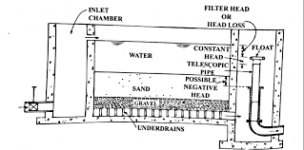
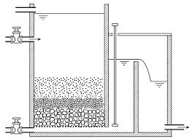
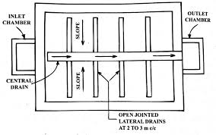
Filtration
Slow sand filter

Slide 159
Filtration
Slow sand filter: A slow sand filter consists of the following parts:
Under drainage system:
Consists of central drain and lateral drains.
Spacing of lateral drain is about 2.5 m to 3.5 m
Base material:
The base material is gravel and it is placed on the top of under drainage system.
Its depth varies from 300 mm to 750 mm in a graded layer of 150 mm from bigger size at the bottom to smaller size of gravel at topmost layer.

Slide 160
Filtration
Slow sand filter: A slow sand filter consists of the following parts:
Base material:
Layer | Depth (mm) | Material size (mm)
Topmost | 150 | 3 to 6
Intermediate | 150 | 6 to 20
 | 150 | 20 to 40
Lowest | 150 | 40 to 65
Total | 600

Slide 161
Filtration
Slow sand filter: A slow sand filter consists of the following parts:
Filter media of sand:
Depth of sand layer – 600 to 900 mm
Effective size – 0.20 mm to 0.30 mm
Uniformity coefficient – 2 to 3
The finer the sand, the better will be the efficiency of filter regarding removal of bacteria.
But in this case, the output from filter is lowered.

Slide 162
Filtration
Slow sand filter: A slow sand filter consists of the following parts:
Appurtenances:
Vertical air pipe passing through layer of sand. It helps in proper functioning of filtering layers.
The device for measuring loss of head, for controlling depth of water above sand layer and for maintaining rate of flow.
In order to maintain a constant discharge through the filter, an adjustable telescopic tube is usually adopted.

Slide 163
Filtration
Rapid sand filter:
Rules for designing under drainage system
The ratio of length of lateral drain to its diameter should not exceed 20.
The cross-sectional area of central drain should be about twice the cross-sectional area of lateral drain.
The total cross-sectional areas of perforations should be about 0.20% of the total filter area.
The cross-sectional area of a lateral drain should be about 2 to 4 times the total cross-sectional areas of perforations in it.
The perforations in the lateral drain should be of diameter 6 mm to 12 mm.
The spacing of perforations in the lateral drain should vary from 75 mm to 200 mm centre to centre.

Slide 164
Filtration
Rapid sand filter:
Base material:
The base material is gravel and it is placed on the top of under drainage system.
The gravel to be used for base material should be cleaned and free from clay, dust, silt and vegetable mater.
The gravel particles should be durable, hard, round and strong.
Its depth varies from 450 mm to 600 mm in a graded layer of 150 mm from bigger size at the bottom to smaller size of gravel at topmost layer.

Slide 165
Filtration
Difference between Slow Sand Filter and Rapid sand filter:
Item | SSF | RSF
Base material of gravel | Varies from 3 to 65 mm in size and 300 to 750 mm in depth. | Varies from 3 to 40 mm in size and 600 to 900 mm in depth.
Coagulation | Not required | Essential
Compactness | Required large area for its installation | Required small area for its installation
Construction | Simple | Complicated as underdrainage system is to be properly designed and constructed.
Cost of operation | Low | High
Economy | High initial cost of both land and material | Cheap and quite economical.
Efficiency | Very efficient in the removal of bacteria but less efficient in the removal of colour and turbidity. | Less efficient in the removal of bacteria but more efficient in the removal of colour and turbidity.
Loss of head | 150 mm to 750 mm | 3 m to 3.5 m

Slide 166
Filtration
Difference between Slow Sand Filter and Rapid sand filter:
Item | SSF | RSF
Filter material of sand | Effective size varies from 0.2 to 0.3 mm and uniformity coefficient is about 2 to3. | Effective size varies from 0.35 to 0.6 mm and uniformity coefficient is about 1.2 to 1.7.
Flexibility | Not flexible for meeting variation in demand | Quite flexible for reasonable fluctuations in demand.
Period of cleaning | 1 to 3 months | 2 to 3 days
Method of cleaning | Scraping of top layer of 15 mm to 25 mm thickness. Long and laborious method. | Agitation and back-washing with or without the help of compressed air. Short and speedy method.
Rate of filtration | 100 to 200 L/hr/m² of filter area | 3000 to 6000 L/hr/m² of filter area
Skilled supervision | Not essential | Essential
Suitability | Suitable for small towns/villages where land is cheap. | Suitable for big cities where land is high and demand of water is considerable.

Slide 167
Environmental Engineering-1
CE3141
Lecture-10
Week-6, Tuesday
24-05-2022

Slide 168
Filtration
Pressure filter
A filter is enclosed in space and the water passes under pressure greater than atmospheric pressure. This pressure can be developed by pumping and it may vary from 0.3 to 0.7 N/mm².
Construction: It is closed steel cylinders either horizontal or vertical. The diameter varies from 1.5 to 3.0 m and length or height varies from 3.5 m to 8.0 m. The manholes are provided at top for inspection.
Working: The water mixed with coagulant is directly admitted to the pressure filter. Thus the flocculation takes place inside the filter itself. In normal working condition, all valves are closed except those for raw water and filtered water. Filtered water is collected in storage tank through central drain.

Slide 169
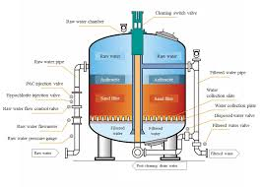
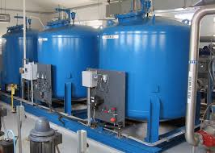
Filtration
Pressure filter

Slide 170
Filtration
Pressure filter
Cleaning: The compressed air may be used to agitate sand grains. The valves for raw water and filtered water are in closed position and those for wash-water and wash-water drain are in open position. The cleaning of pressure filters may be required more frequently.
Rate of filtration: The rate of filtration of pressure filters is high as compared to that of rapid sand filters. It is about 6000 to 15000 litres/hr/m² of filter area as compared to that of 3000 to 6000 litres/hr/m² of rapid sand filters.
Efficiency: Less efficient than the rapid sand filters in terms of bacterial load, colour and turbidity.
Suitability: Not suitable for public water supply project.

Slide 171
Filtration
Pressure filter
Advantages:
The unit is compact.
Modern filter unit does not require manual operation and supervision.
Flexible in operation because the rate of filtration can be altered by changing the compressed air pressure.
Dose not require further pumping as the filter water comes out under pressure.
It is ideal for small estate.
Require less number of fittings.
Require small space for installation.
The sedimentation and coagulation tanks are not required.
Disadvantages:

Slide 172
Filtration
Pressure filter
Disadvantages:
It is difficult to keep close watch on the performance.
It is difficult to repair.
The overall capacity is small.
They are costly and hence they cannot be recommended for treating large quantity of water.
They posses poor efficiency in the removal of bacteria and turbidity.
They require additional pumps for pumping the water in them.

Slide 173
Disinfection of water
The water should be disinfected before it enters the distribution system. The main purpose of disinfection is to prevent contamination of water during its transit from the treatment plant to the place of its consumption.
Disinfection is the process of destruction of pathogenic bacteria which is harmful for health.
On the other hand, Sterilization is the process of destruction and removal of all harmful or harmless bacteria.
The destruction and removal is brought about in several ways:
Physical removal through coagulation, sedimentation and filtration
Natural die-away of the organisms in an unfavorable environment during storage,
Destruction by chemicals

Slide 174
Disinfection of water
The materials or substances which are to be used for disinfection are called the disinfectant and the requirement of a good disinfectant are as follows:
Its dose should be such that some residual concentration is obtained to grant protection against contamination in the water during its conveyance and retention.
It should be effective in killing all the harmful pathogenic organisms from the water and make it perfectly safe for use.
It should be harmless, unobjectionable, economical and easily available.
It should be of such a nature that its strength or concentration in the treated water can be quickly determined.
It should not require skilled labour and costly equipment for its application.
It should take only reasonable time in killing the harmful pathogenic organisms at normal temperature.

Slide 175
Disinfection of water
Methods of disinfection:
Boiling method
Excess Lime treatment
Iodine and bromine treatment
Ozone treatment
Potassium permanganate
Silver treatment
Ultra-violet ray treatment
In addition to the above chemicals, certain other chemical agents can also be used as disinfectants and they include alcohols, soaps and synthetic detergents, dyes, hydrogen peroxide, various alkalies and acids, etc.

Slide 176
Disinfection of water
Following factors must be considered in applying the disinfection agents:
Concentration and type of chemical agent
Contact time
Intensity and nature of physical agent
Nature of suspending liquid
Number and types of organisms
Temperature

Slide 177
Disinfection of water
Chlorination
It is the treatment for disinfection by applying chlorine. It is widely used in large scale because of the following factors:
It is easy to apply due to relatively high solubility of about 7000 mg/L.
It is readily available as gas, liquid or powder.
It is very toxic to most of the microorganisms and thus metabolic activities are stopped.
It leaves harmless residue in solution, but it provide protection in the distribution system.
It produces desired effects which last for a long time.
The treatment by chlorination is cheap and reliable.

Slide 178
Disinfection of water
Chlorination
When chlorine is added to water , it reacts according to the following equation:
Cl2 + H2O ↔ HOCl + HCl
HOCl ↔ H⁺ + OCl⁻
The hypochlorous acid HOCl dissociates by a reversible equation into hydrogen ions. Both hypochlorous acid HOCl and hypochlorite ions Ocl⁻ are responsible for the disinfection of water.
The action of chlorine is dependent to the pH value of water.
The disinfection by chlorine is rapid when pH value of water is below 7.00.

Slide 179
Disinfection of water
Zone 1
Residual Chlorine, mg/l
Zone 2
Zone 3
Zone 4
No Demand Line
Free Residual Chlorine
Break Point
Applied Chlorine, mg/l

Slide 180
Disinfection of water
Chlorination
Zone-1: Destruction of chlorine by reducing compounds.
Zone-2: Formation of chloro-organic compounds and chloramines.
Zone-3: Destruction of chloro-organic compounds and chloramines.
Zone-4: Formation of free available chlorine.
The addition of chlorine at the break (or dip) is termed as break point chlorination or free residual chlorination.

Slide 181
Disinfection of water
Application of Chlorine
Post Chlorination: Chlorine is generally applied after all other treatments have been given to the water supply. This may be termed as post chlorination.
Pre-chlorination: It is the application of chlorine before filtration. Pre-chlorination reduces the bacterial load on filters resulting in increase filter runs, and oxidized excessive organic matter thus removing taste and odour.
Double chlorination: It is the application of chlorine at two points in the treatment process. It is essentially pre-chlorination and post chlorination.

Slide 182
Disinfection of water
Application of Chlorine
The advantages of double chlorination are:
Decrease load on the filter
Greater removal of bacteria
Greater factor of safety due to maintaining two chlorination
Control of algae and slimy growth in coagulating basins and filters.
Super chlorination: It is the application of chlorine to water of an excess amount of chlorine. The method is effective in destroying high concentration of tastes and odours in water. Bacterial removal is also high.

Slide 183
Environmental Engineering-1
CE3141
Lecture-11
Week-7, Tuesday
31-05-2022

Slide 184
Softening of water
Chemical precipitation is one of the more common methods used to soften water. Chemicals normally used are lime (calcium hydroxide, Ca(OH)2) and soda ash (sodium carbonate, Na2CO3). Lime is used to remove chemicals that cause carbonate hardness. Soda ash is used to remove chemicals that cause non-carbonate hardness.
When lime and soda ash are added, hardness-causing minerals form nearly insoluble precipitates. Calcium hardness is precipitated as calcium carbonate (CaCO3). Magnesium hardness is precipitated as magnesium hydroxide (Mg(OH)2).
There are three general methods used for water softening:

Slide 185
Softening of water
Lime process:
The principle involved is to neutralize the CO2 with Ca(OH)2, forming normal carbonates which precipitate out when present in excess and are removed by sedimentation and filtration. This process in known as Clark Process.
Reactions
Hardness Lime Precipitate
CO2 + Ca(OH)2 = CaCO3 + H2O
Ca(HCO3)2 + Ca(OH)2 = 2CaCO3 + 2H2O
Mg(HCO3)2 + Ca(OH)2 = CaCO3 + MgCO3 + 2H2O
MgCO3 + Ca(OH)2 = CaCO3 + Mg(OH)2
CO2 does not contribute to the hardness, but it reacts with the lime, and therefore uses up some lime before the lime can start removing the hardness.

Slide 186
Softening of water
Lime and Soda ash process:
Lime has no effect on sulphates of Ca and Mg, which are responsible for causing most of the non-carbonate hardness found in natural water. However, by the use of soda ash (Na₂CO₃), the non-carbonate hardness can be removed.
Reactions
(i) CaSO₄ + Na₂CO₃ = CaCO₃ + NaSO₄
(ii) MgSO₄ + Ca(OH)₂ = Mg(OH)₂ + CaSO₄
CaSO₄ + Na₂CO₃ = CaCO₃ + NaSO₄

Slide 187
Softening of water
Base Exchange process:
In this process, hard water is passed through a bed of zeolite sand (complex silicates of aluminium and sodium) whereby it exchanges its Ca and Mg for the Na in zeolite until Na become exhausted.
Reactions
CaSO₄
MgSO₄ Na₂CO₃
MgCO₃ + Na₂Al(SiO₃)₂ = [Ca/Mg]Al(SiO₃)₂ + Na₂SO₄
CaCO₃ 2NaCl
CaCl
[Ca/Mg]Al(SiO₃)₂ + 2NaCl = Na₂Al(SiO₃)₂ + [CaCl/MgCl]

Slide 188
Iron and Manganese Removal from water
Iron present in water either as Fe(HCO3)2 or FeSO4. Manganese is often associated with the iron present in water. Iron and Manganese when present in amounts greater than 0.3 ppm are objectionable because of
unpleasant taste and odour
colouring of water
deposits of iron precipitations in pipes.
The method of removal of iron and manganese are based on converting the soluble ferrous and manganese compounds to the insoluble ferric and manganese compounds and removing the precipitates so formed.

Slide 189
Iron and Manganese Removal from water
Removal process
Base exchange process:
The zeolite bed is made of manganese zeolite obtained by treating the base exchange material with manganese sulfate and potassium permanganate.
Ion exchange may also remove iron and manganese (typically used in home softening). If the water has not been exposed to oxygen, the resins in the softener will remove the iron and manganese ions from the water. If the water contains any dissolved oxygen, the resin can be fouled with iron and manganese deposits. The resin can be cleaned, but the process is expensive and the capacity of this resin is reduced with each cleaning. This method is not recommended for municipal treatment.

Slide 190
Iron and Manganese Removal from water
Removal process
Aeration:
It is an effective method in precipitating out iron when present as Fe(HCO3)2 and subsequent removal through the process at sedimentation and filtration.
If, however, iron is present as FeSO4, it would be necessary to add lime.
Iron is easily oxidized by atmospheric oxygen. Aeration provides the dissolved oxygen needed to convert the iron and manganese from ferrous and manganous (soluble) forms to insoluble oxidized ferric and manganic forms. It takes 0.14 ppm of dissolved oxygen to oxidize 1 ppm of iron, and 0.27 ppm of dissolved oxygen to oxidize 1 ppm of manganese.

Slide 191
Iron and Manganese Removal from water
Removal process
Aeration:
Oxidation of iron and manganese with air is by far the most cost-effective method since there is no chemical cost; however, there are disadvantages. The oxidation process can be slowed and the reaction tank has to be quite large (if there are high levels of manganese). In addition, small changes in water quality may affect the pH of the water and the oxidation rate may slow to a point where the plant capacity for iron and manganese removal is reduced.

Slide 192
Iron and Manganese Removal from water
Removal process
Chlorination:
Some times chlorination employed either alone or in combined with aeration. Iron and manganese in water can also be oxidized by chlorine, converting to ferric hydroxide and manganese dioxide. The precipitated material can then be removed by filtration. The higher the amount of chlorine fed, the more rapid the reaction. Most treatment plants use 1 – 2 parts of chlorine to 1 part of iron to achieve oxidation. When using this process on water containing organics such as Total organic carbon (TOC) or natural organic material (NOM), the likelihood of creating disinfection by-products (DBPs) increases.

Slide 193
Iron and Manganese Removal from water
Removal process
Permanganate :
Using potassium permanganate to oxidize iron or manganese is fairly common. Potassium permanganate oxidizes iron and manganese into their insoluble states. The dose must be great enough to oxidize all of the manganese, but not too great as this will produce a pink color in the water in the distribution system. Potassium permanganate is typically more effective at oxidizing manganese than aeration or chlorination.
Potassium permanganate is often used with manganese greensand, a granular material that is charged with potassium permanganate after the backwashing process. This method allows the oxidation process to be completed in the filter itself and is a buffer to help avoid pink water in distribution.

Slide 194
Arsenic Removal
Co-precipitation and Adsorption Processes
Water treatment with coagulant such as Al₂(SO₄)₃.18H₂O, FeCl₃, Fe₂(SO4)₃.7H₂O are effective in removing arsenic from water.
In the coagulation-flocculation process Al2(SO4)3.18H2O, FeCl2 or Fe2(SO4)3.7H2O is added and dissolve in water under efficient stirring for at least 1 minute micro-flocs are formed rapidly.
The water is then gently stirred for few minutes for agglomeration of micro-flocs into larger, easily settable flocs.
During this flocculation process al kinds of micro-particles and negatively charged ions are attached to the flocs by electrostatic attachment.
Arsenic is also adsorbed onto coagulated flocs.

Slide 195
Arsenic Removal
Co-precipitation and Adsorption Processes
Oxidation of As(III) to As(v):
H₃AsO₃ + HOCl = HAsO₄ ⁻⁻ + Cl⁻ + 3H⁺
3H₃AsO₃ + 2KMnO₄ = 3HAsO₄ ⁻⁻ + 2MnO₂⁺ + 4K⁺ + H₂O
Alum dissolution:
Al₂(SO₄)₃.18H₂O = 2Al⁺⁺⁺ + 3SO₄⁺⁺ + 18H₂O
Aluminium precipitation (acidic):
2Al⁺⁺⁺ + 6H₂O = 2Al(OH)₃ + 6H⁺
Co-precipitation:
H₂AsO₄⁻ + Al(OH)₃ = Al-As (complex) + Other products
Arsenic adsorbed on Al(OH)₃ as Al-As complex is removed by sedimentation. Filtration may also be required to ensure complete removal of all flocs.

Slide 196
Arsenic Removal
Other Methods of Arsenic Removal
Lime treatment
Naturally occurring iron
Sorptive media (Activated alumina, Al₂O₃)
Ion exchange
Membrane techniques
Microbial process
Chemical packages
Cartridge filters

Slide 197
Arsenic Removal
Lime treatment
Water treatment by addition of CaO or Ca(OH)2 also removes arsenic.
The precipitated Ca(OH)2 acts as a sorbing flocculent for arsenic.
The arsenic removal by lime is relatively low, usually between 40 to 70%.
The highest removal is achieved at pH 10.6 to 11.4.
Obviously water treated by lime would require secondary treatment in order to adjust pH to an acceptable level.

Slide 198
Arsenic Removal
Naturally occurring iron
The iron precipitates [Fe(OH)₃] formed by oxidation of dissolved iron [Fe(OH)₂] present in ground water have an affinity for the adsorption of arsenic.
Only aeration and settling of tubewell water rich in dissolved iron has been found to remove up to 25% of the arsenic present.
The iron removal plants (IRPs) in Bangladesh constructed on the principles of aeration, sedimentation and filtration have been found to remove arsenic without any added chemical.
The conventional IRPs more or less work as arsenic removal plants (ARPs) as well.

Slide 199
Arsenic Removal
Sorptive media (Activated alumina, Al₂O₃)
Activated alumina, Al₂O_{3,} having a good sorptive surface, is an effective medium for arsenic removal.
When water passes through a packed column of activated alumina, the impurities, including arsenic, present in water are adsorbed on the surfaces of activated alumina grains.
The column become gradually saturated with impurities and needs to regenerate.

Slide 200
Arsenic Removal
Ion exchange
This process is similar to activated alumina, but the medium is a synthetic resin of more well-defined ion exchange capacity.
The process is normally used for removal of specific undesirable cations or anions from water.
As the resin become exhausted, it needs to be regenerated.
Arsenic exchange:
2R-Cl + HAsO4 = R2HAsO4 + 2Cl
Regeneration:
R2HAsO4 +2Na + 2Cl = 2R-Cl + HAsO4 + 2Na

Slide 201
Arsenic Removal
Membrane Techniques
Membrane techniques like reverse osmosis and electrodialysis are capable of removing all kinds of dissolved solids including arsenic from water.
In this process water is allowed to pass through special filter media which physically retain the impurities present in water.
The water, for treatment by membrane techniques, must be free from suspended solids and the arsenic in water must be in pentavalent form.

Slide 202
Arsenic Removal
Microbial process
Microbial removal of arsenic is based on:
Microbial oxidation of As(III) to As(V) to facilitate its removal by conventional arsenic removal process.
Bio-accumulation of arsenic from the surrounding water environment.
There are number of micro-organisms capable of oxidizing arsenic at neutral pH. The common iron bacteria used to oxidize ferrous iron to ferric iron can oxidize as well as absorb arsenic. Removal of trace metals from water through accumulation in algae is well-recognized.

Slide 203
Arsenic Removal
Chemical packages
Different types of chemical packages are available in the form of tea bags, small packets and powder form for the removal of arsenic from drinking water.
The principles involved in arsenic removal by these chemicals are oxidation, sorption and co-precipitation.

Slide 204
Arsenic Removal
Cartridge filters
Filter units with cartridges filled with sorptive media or ion-exchange resins are already available in market.
These units remove arsenic like any other dissolved ions present in water.
These units are not suitable for water having high impurities or containing iron.
Presence of iron having higher affinity than arsenic can quickly saturate the media, requiring regeneration or replacement.
The initial and operating costs are high and beyond the reach of the common people.

Slide 205
Desalinization of water
There are so many processes of removing salts from the water. These are:
Distillation
Freezing
Demineralization
Electrodialysis
Membrane filtration

Slide 206
Environmental Engineering-1
CE 3141
Lecture-12
Week-8, Tuesday
07-05-2022

Slide 207
Desalination of water
Desalination can be defined as any process that removes salts from water. Desalination processes may be used in municipal, industrial, or commercial applications.
A desalination process essentially separates saline water into two parts - one that has a low concentration of salt (treated water or product water), and the other with a much higher concentration than the original feed water, usually referred to as brine concentrate or simply as ‘concentrate’.

Slide 208
Desalination Technologies
The two major types of technologies that are used around the world for desalination can be broadly classified as either thermal or membrane. Both technologies need energy to operate and produce fresh water.
Within those two broad types, there are sub-categories (processes) using different techniques. The major desalination processes are identified in Table .
Thermal Technology | Membrane Technology
Multi-Stage Flash Distillation (MSF) | Electrodialysis (ED)
Multi-Effect Distillation (MED) | Electrodialysis reversal (EDR)
Vapor Compression Distillation (VCD) | Reverse Osmosis (RO

Slide 209
Desalination Technologies
Multi-Stage Flash Distillation (MSF)
This process involves the use of distillation through several (multi-stage) chambers. In the MSF process, each successive stage of the plant operates at progressively lower pressures. The feed water is first heated under high pressure, and is led into the first ‘flash chamber’, where the pressure is released, causing the water to boil rapidly resulting in sudden evaporation or ‘flashing’. This ‘flashing’ of a portion of the feed continues in each successive stage, because the pressure at each stage is lower than in the previous stage. The vapor generated by the flashing is converted into fresh water by being condensed on heat exchanger tubing that run through each stage. The tubes are cooled by the incoming cooler feed water.

Slide 210
Desalination Technologies
Multi-Effect Distillation (MED)
Multi-effect distillation occurs in a series of vessels (effects) and uses the principles of evaporation and condensation at reduced ambient pressure. In MED, a series of evaporator effects produce water at progressively lower pressures. Water boils at lower temperatures as pressure decreases, so the water vapor of the first vessel or effect serves as the heating medium for the second, and so on. Depending upon the arrangement of the heat exchanger tubing, MED units could be classified as horizontal tube, vertical tube or vertically stacked tube bundles.

Slide 211
Desalination Technologies
Vapor Compression Distillation
The vapor compression distillation (VCD) process is used either in combination with other processes such as the MED, or by itself. The heat for evaporating the water comes from the compression of vapor, rather than the direct exchange of heat from steam produced in a boiler. Vapor compression (VC) units have been built in a variety of configurations. Usually, a mechanical compressor is used to generate the heat for evaporation. The VC units are generally small in capacity, and are often used at hotels, resorts and in industrial applications.

Slide 212
Desalination Technologies
Electrodialysis (ED) and Electrodialysis Reversal (EDR)
Electrodialysis (ED) is a voltage-driven membrane process. An electrical potential is used to move salts through a membrane, leaving fresh water behind as product water. Although ED was originally conceived as a seawater desalination process, it has generally been used for brackish water desalination .
ED depends on the following general principles:
Most salts dissolved in water are ions, either positively charged (cations), or negatively charged (anions).
Since like poles repel each other and unlike poles attract, the ions migrate toward the electrodes with an opposite electric charge
Suitable membranes can be constructed to permit selective passage of either anions or cations.

Slide 213
Desalination Technologies
Reverse Osmosis (RO) and Nanofiltration (NF)
Currently, RO is the most widely used method for desalination. The RO process uses pressure as the driving force to push saline water through a semi-permeable membrane into a product water stream and a concentrated brine stream.
Nanofiltration (NF) is also a membrane process that is used for removal of divalent salt ions such as Calcium, Magnesium, and Sulphate. RO, on the other hand, is used for removal of Sodium and Chloride. RO processes are used for desalinating brackish water (TDS>1,500 mg/l), and seawater.

Slide 214
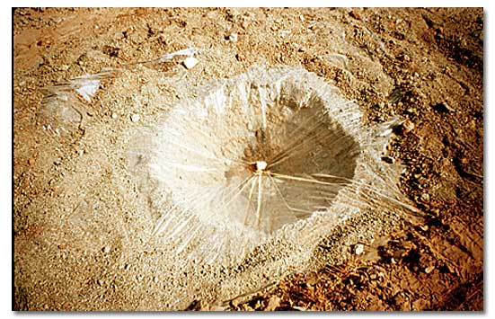
Solar Stills

Slide 215
Solar Still Background
The first known use of stills dates back to 1551 when it was used by Arab alchemists. The first "conventional" solar still plant was built in 1872 by the Swedish engineer Charles Wilson in the mining community of Las Salinas. This still was a large basin-type still used for supplying fresh water using brackish feedwater to a nitrate mining community. The plant used wooden bays which had blackened bottoms using logwood dye and alum. The total area of the distillation plant was 4,700 square meters. On a typical summer day this plant produced 4.9 kg of distilled water per square meter of still surface, or more than 23,000 liters per day. This first stills plant was in operation for 40 years!

Slide 216
Solar Stills
Emergency Survival Tool
Fortunately, there is an emergency survival technique for gathering water from our driest deserts during their most brutal seasons. It is commonly known as the solar still.
Make your own distilled water from stream or lake water, salt water, or even brackish, dirty water, using Solar Still Plans. With just a few basic building materials, a sheet of glass and some sunshine, you can purify your own water at no cost and with minimal effort.

Slide 217
Solar Still Background
Still Operation
A solar still operates on the same principle as rainwater: evaporation and condensation.
The water from the oceans evaporates, only to cool, condense, and return to earth as rain.
When the water evaporates, it removes only pure water and leaves all contaminants behind.
Solar stills mimic this natural process.

Slide 218
Solar Stills
The solar still functions under the general principle of the "greenhouse effect". Solar energy heats the ground by passing through a clear plastic barrier. Moisture from the soil then evaporates, rises and condenses on the underside of the plastic barrier above.
The still also has the ability to purify tainted water. In fact, it condenses pure water from just about anything. Even urine will produce clean, drinkable water.
CAUTION: One fluid never to be used is radiator fluid, as its toxins will vaporize and poison the water.

Slide 219
How to Make a Solar Still
Construction
Dig a pit approximately 4 feet wide and 3 feet deep. Use a shovel, hand trowel, a digging stick or even your hands in soft soil or sand. Look for a sandy wash or a depression where rainwater might collect.
In the center of the pit, dig another small hole deep enough for the water container.
Place the container inside, then run the tubing from the container to the outside of the pit. If there is tape available, tape the tubing to the inside of the container.
Blanket the pit with the plastic sheet, evenly on all sides, but not touching the bottom of the pit. Anchor the corners with rocks.

Slide 220
How to Make a Solar Still
Construction
Find a small rounded rock to place in the center of the sheet, over the water container. This will keep the plastic centered and control any flapping from the wind. Gently push down on the center weight until the sides slope to a 45º angle.
Next, secure the edges of the plastic sheet with rocks and dirt. Make sure there are no places where moisture can escape.
Close the tubing end with a knot, or double it and tie it closed.

Slide 221
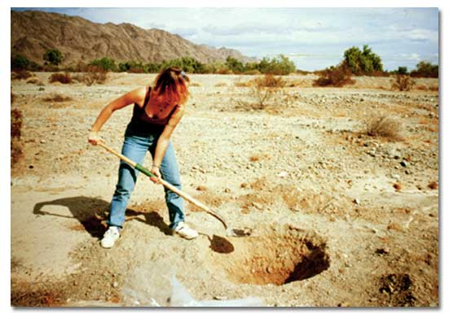
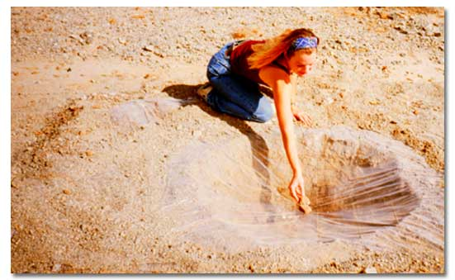
How to Make a Solar Still
Within two hours, the air inside the still will become saturated with moisture and begin to condense onto the underside of the plastic sheeting. Because of the angle of the plastic, water will run down towards the center. Finally, drops will gather and fall from the apex down into the water container. As the container fills, simply sip fresh, sterile water from the plastic tubing.
A small rounded rock placed in the center of the sheet
Digging of pit

Slide 222
How to Make a Solar Still
The solar still only takes about an hour to build. If constructed correctly, it can yield about a quart of water a day. And although the palm trees may be noticeably absent, you will have made your very own oasis in the desert, quicker than Hollywood could.
CAUTION: Solar stills are not a primary water source, nor a substitute for carrying adequate amounts of water in the desert. Always carry a minimum of one gallon per day per person.

Slide 223
How to Make a Solar Still
Example-2
A solar still works like a salt evaporation pond, except that the water that invisibly evaporates is extracted from the air; the minerals and other impurities are left behind and discarded. As the hot, moisture-laden air rises up to the slanting sheet of relatively cool glass sealed to the box, water condenses out in the form of small droplets that cling to the glass. As these droplets get heavier, they roll down the glass to the collector tube at the bottom and then out to the jug.

Slide 224
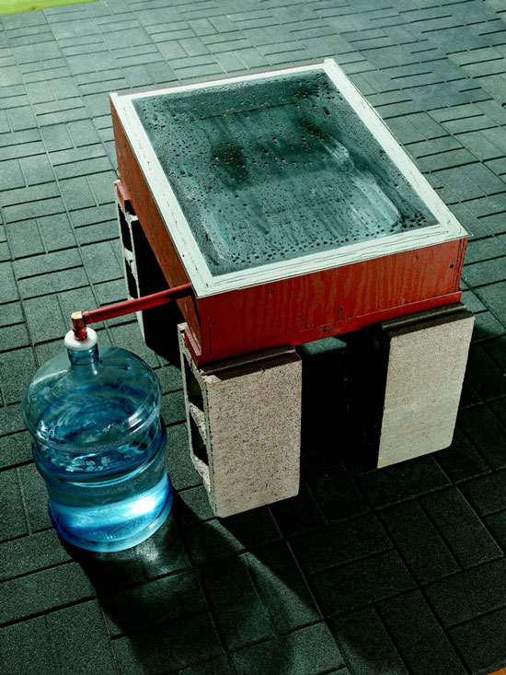
How to Make a Solar Still
The box is built from 3/4 " BC-grade plywood, painted black on the inside to absorb heat. We used a double layer of plywood on the sides to resist warping and to help insulate the box, with an insulated door at the back and a sheet of glass on top.

Slide 225
How to Make a Solar Still
Example-3
We chose to paint the inside black and use two large glass baking pans to hold the water. Glass baking pans are a safe, inexpensive container for dirty or salty water, and they can easily be removed for cleaning. We used two 10 x 15" pans, which hold up to 8 quarts of water when full. To increase the capacity of the still, just increase the size of the wooden box and add more pans.
The operation of the distiller is simple. As the temperature inside the box rises, water in the pans heats up and evaporates, rising up to the angled glass, where it slowly runs down to the collector tube and then out to a container.

Slide 226
How to Make a Solar Still
Example-3
The runoff tube is made from 1" PEX tubing. Stainless steel can also be used. However, use caution with other materials—if in doubt, boil a piece of the material in tap water for 10 minutes, then taste the water after it cools to see if it added any flavor. If it did, don’t use it.
Turn undrinkable water into pure, crystal-clear distilled water with a home-built solar still.
View step-by-step photos of how to make a solar still in the Image Gallery as well as this PDF of the DIY Solar Still Plans.

Slide 227
How to Make a Solar Still
Example-3
1. Mark and cut the plywood pieces according to the cutting list. Cut the angled end pieces with a circular saw or tablesaw set to a 9 degree angle.
2. Cut the insulation the same size as the plywood base, then screw both to the 2 x 4 supports with 2 1/2" screws.
3. Screw the first layer of front and side pieces to the base and to each other, then add the back piece. Predrill the screws with a countersink bit.
4. Glue and screw the remaining front and side pieces on, using clamps to hold them together as you predrill and screw. Use 1 1/4" screws to laminate the pieces together and 2" screws to join the corners.

Slide 228
How to Make a Solar Still
Example-3
5. Glue and screw the hinged door pieces together, aligning the bottom and side edges, then set the door in position and screw on the hinges. Add a pull or knob at the center.
6. Paint the inside of the box with black high-temperature paint. Cover the back and the door with reflective foil glued with contact cement. Let the paint dry for several days so that all the solvents evaporate off.
7. Apply weatherseal around the edges of the hinged door to make the door airtight.
8. Drill a hole for the PEX drain. The top of the PEX is 1/2" down from the top edge. Clamp a scrap piece to the inside so the drill bit doesn’t splinter the wood when it goes through.

Slide 229
How to Make a Solar Still
Example-3
9. Mark the first 19" of PEX, then cut it in half with a utility knife. Score it lightly at first to establish the cut lines.
10. Drill three 1/8" holes in the side of the PEX for screws, then insert the PEX through the hole. Butt it tight against the other side, then screw it in place, sloping it about 1/4".
11. Wipe a thick bead of silicone caulk along the top edge of the PEX to seal it against the plywood.
12. Shim the box level and tack a temporary stop to the top edge to make it easy to place the glass without smearing the caulk. Spread a generous bead of caulk on all the edges, then lay the glass in place. Tape it down around the edges with painter’s tape, then let it set up overnight.

Slide 230
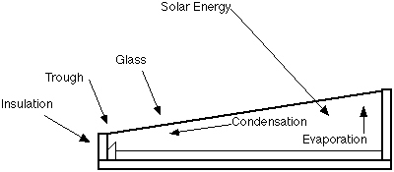
Solar Stills

Slide 231
Performance Indicators of Water Losses in Distribution System
Lecture -13
Week-9, Saturday
18-06-2022

Slide 232
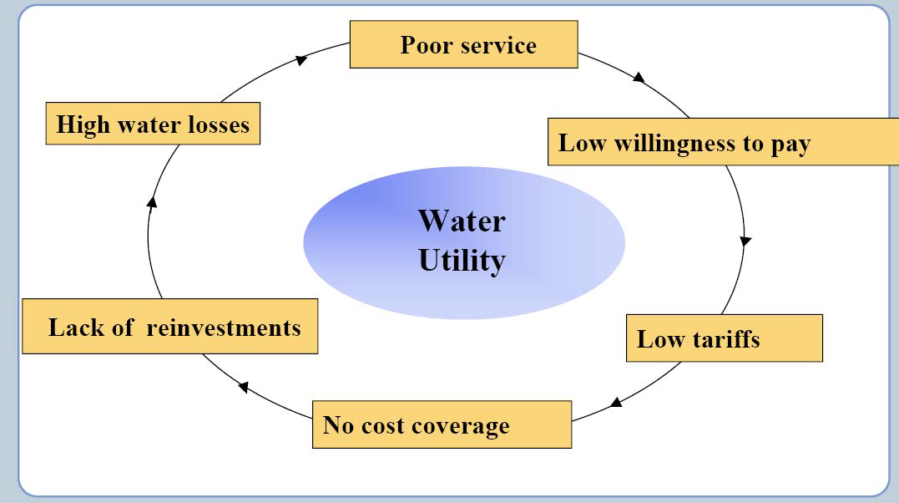
Water Loss

Slide 233
Understanding and Managing Losses in Water Distribution Networks
Step 1: Analysis of network characteristics and operating practices
Step 2: Use appropriate tools and mechanisms to suggest appropriate solutions

Slide 234
Components of Water Loss
Water Loss
Physical loss (Real loss)
Commercial loss
(Apparent loss)
Pipe breaks and leaks
Metering Errors
Storage overflows
Water Theft
House connection leaks
Billing Anomalies

Slide 235
Standard Terminologies
System Input Volume | Authorized Consumption | Billed Authorized Consumption | Billed Metered Consumption (including water exported) | Revenue Water
 |  |  | Billed Unmetered consumption
 |  | Unbilled Authorized Consumption | Unbilled Metered Consumption | Non-Revenue Water
 |  |  | Unbilled Unmetered Consumption
 | Water Losses | Apparent Losses | Unauthorized Consumption
 |  |  | Metering Inaccuracies
 |  | Real Losses | Leakage on Transmission and/or Distribution Mains
 |  |  | Leakage and Overflows at Utility’s Storage Tank
 |  |  | Leakage on Service Connections up to point of Customer Metering

Slide 236
What is Unaccounted-for-Water?
Unaccounted-for water (UFW) represents the difference between "net production" (the volume of water delivered into a network) and "consumption" (the volume of water that can be accounted for by legitimate consumption, whether metered or not).
UFW = Net production – Legitimate consumption

Slide 237
Non-Revenue Water
Non-revenue water (NRW) represents the difference between the volume of water delivered into a network and billed authorized consumption.
NRW = “Net production” – “Revenue water”
= UFW + water which is accounted for, but no revenue is collected (unbilled authorized consumption).

Slide 238
Calculating Water Loss
Water loss is expressed as
a percentage of net water production (delivered to the distribution system)
as m³/day/km of water distribution pipe system network (specific water loss)
Others
m³/day/connection
m³/day/connection/m pressure
Water loss as % of net water production is the most common.
It could be misleading for systems with different net productions with same amount of real & apparent losses.

Slide 239
Magnitude of Water Losses
Water loss levels (UFW or NRW) vary widely per country and within one country per city.
UFW values ranging from 6% to 63% have been reported (Source: Water and Wastewater Utility Data – 2nd edition 1996)
A certain level of water losses can not be avoided from a technical point of view and /or is considered acceptable from an economic point of view.

Slide 240
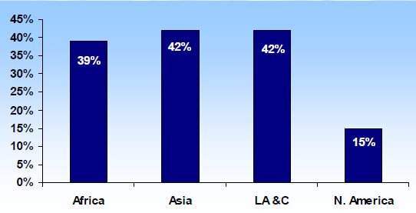
Mean UFW in Large Cities in Africa, Asia, Latin America and the Caribbean and North America

Slide 241
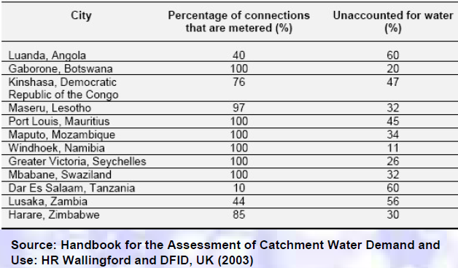
UFW in Some Southern African Cities

Slide 242
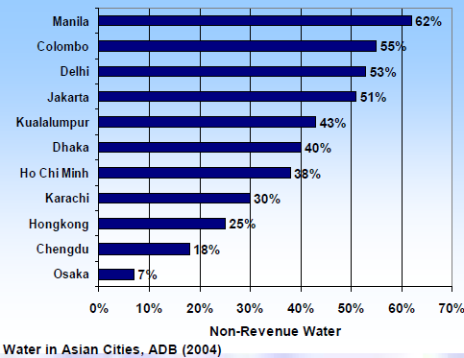
Non-revenue Water in Some Asian Cities

Slide 243
What is an Acceptable Water Loss?
It is a compromise between the cost of reducing water loss and maintenance of distribution system and the cost (of water) saved.
AWWA Leak detection and Accountability Committee (1996) recommended 10% as a benchmark for UFW.
UFW levels and action needed
< 10% Acceptable, monitoring and control
10-25% Intermediate, could be reduced
> 25% Matter of concern, reduction needed

Slide 244
Unavoidable Annual Real Losses (UARL)
It is impossible to eliminate all real losses from a distribution system
some losses are “unavoidable”
some leakages are believed to be undetectable (too small to detect) or uneconomical to repair
An estimate of Unavoidable Annual Real Losses (UARL) can help to evaluate the feasibility of real loss minimization (provides better understanding of real loss components).

Slide 245
Unavoidable Annual Real Losses (UARL)
Generalized Equation
UARL (L/day) = (A x L_{m} + B x N_{c} + C x L_{p}) x P
where,
A = specific real losses for mains (L/day/km/m pressure)
B = specific real losses for service connections (L/connection/m pressure)
C = specific real losses for underground service pipes (L/day/km/m pressure)

Slide 246
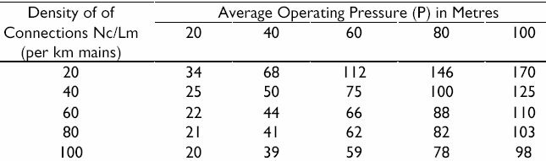
Unavoidable Annual Real Losses (UARL)
UARL (L/day) = (18 x L_{m} + 0.80 x N_{c} + 25 x L_{p}) x P
where,
L_{m} = Length of mains in km
N_{c} = Number of service connections
L_{p} = Total length in km of underground connection pipes (between the edge of the street and customer meters)
P = Average operating pressure in m
UARL in litres/service connection/day for customer meters located at edge of street

Slide 247
Unavoidable Annual Real Losses (UARL)
Problem: Determine the unavoidable annual real losses of a water supply system of 2 Km water main having 3 Km underground connection pipe for 60000 house connection. The average operating pressure is 20 m.
Solution:
UARL (L/day) = (18 x L_{m} + 0.80 x N_{c} + 25 x L_{p}) x P
where
L_{m} = Length of mains in km
N_{c} = Number of service connections
L_{p} = Total length in km of underground connection pipes (between the edge of the street and customer meters)
P = Average operating pressure in m
∴UARL (L/day) = (18 x 2000 + 0.80 x 60000 + 25 x 3000) x 20 =3180000
= 3.18 M. liter

Slide 248

The Infrastructure Leakage Index (ILI)
A better indicator
Describes the quality of infrastructure management
Is the ratio of Current Annual Real Losses to Unavoidable Annual Real Losses

Slide 249
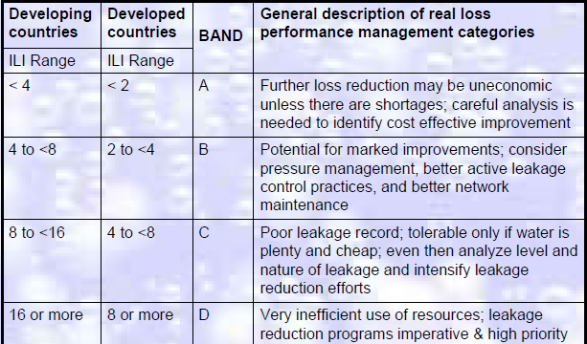
World Bank Institute Banding System to Interpret ILIs
ILI is classified into Bands A to D
Different limits for developed & developing countries
Each Band has a general description of performance
Each Band suggests a range of recommended activities

Slide 250

The Apparent Loss Index (ALI)
Similar to the concept of ILI, a index for apparent loss has been recommended by IWA task force.

Slide 251
Controlling Water Loss
Water audit or Water balance
Meter testing and repair/replacement, improving billing procedure
Leak detection and control program
network evaluation
leak detection in the field and repair
Rehabilitation and replacement program
Corrosion control
Pressure reduction
Public education program; Legal provisions
Water pricing policies encouraging conservation
Human resources development
Information system development

Slide 252
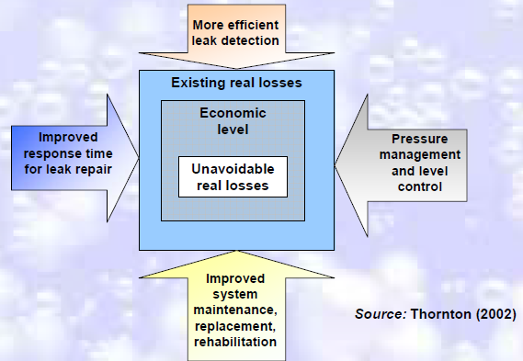
Four components of an active real loss management program

Slide 253
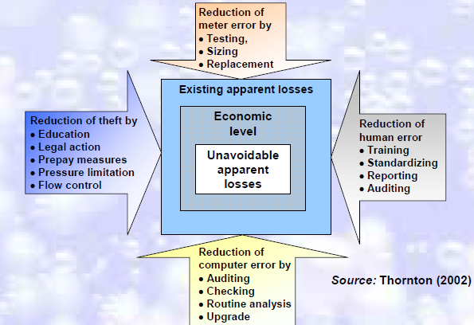
Four components of an active apparent loss management program

Slide 254
Guideline for Water Loss Level
For systems with per capita consumption of less than 150 l/day the general rule for water loss level is:
Good condition of system < 250 Litre/connection /day
Average condition 250 - 450 Litre/connection/day
Bad condition of system > 450 Litre/connection/day
Another guideline for the water loss level is the “Benchmark” Litre/km mains/day:
Good condition of system < 10,000 Litre/km main/day
Average condition 10,000 – 18,000 Litre/km main/day
Bad condition of system > 18,000 Litre/km main/day

Slide 255
Leak Detection & Control
Lecture -14
Week-9, Tuesday
21-06-2022

Slide 256
Leak Detection
Early detection of invisible leaks in a water distribution network is of great significance to most water utilities.
The delay in detection and repair of a failed water main can lead to a large amount of water loss and serious damage to infrastructure near the failure.
The control of water leaks in water distribution networks represents a critical issue for all utilities involved in drinking water supply.

Slide 257
Leak Detection
Methods of Leak Detection
Water Audits
Head Loss Ratios
Vibration monitoring
Sound monitoring

Slide 258
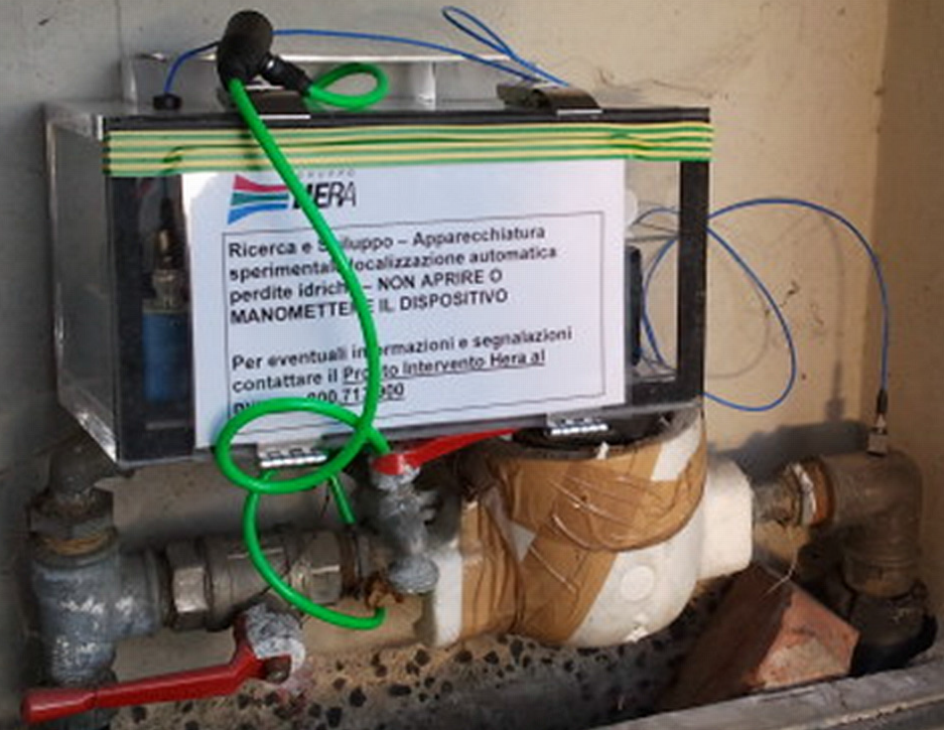
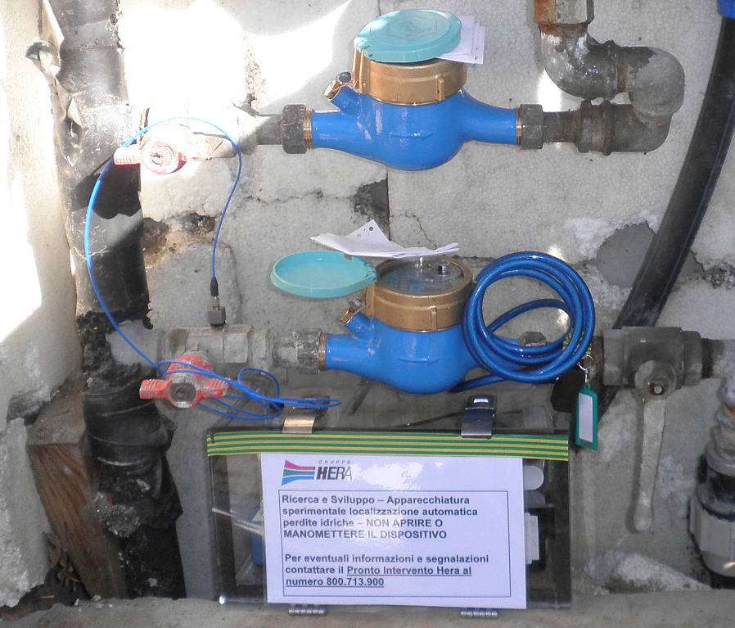
Leak Detection

Slide 259
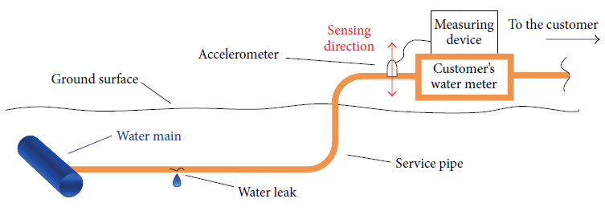
Leak Detection

Slide 260
Leak Detection
Water Audits
Water audits determine the amount of water loss in the distribution system. They can be performed on a network-wide basis or district by district.
Network-wide audits provide an overall picture of water losses in the distribution system as a whole. These audits require detailed accounting of water flow into and out of the distribution system, usually based on past meter records and flow meter accuracy checks.
The comprehensive nature of network-wide audits entails significant effort, especially for large systems.

Slide 261
Leak Detection
For district audits, the distribution system is divided into small districts or zones having approximately 20 to 30 km of water main.
Districts are isolated individually by turning off the appropriate valves except at control points where portable flow meters are installed to measure water flow over a 24-hour period.
To determine if excessive leakage exists, the ratio between the nighttime minimum rate and the average daily rate of water flow is compared to “normal” ratios or to previously measured ratios of the same district.
Flow rates from any 24-hour commercial use should be subtracted from the measured flow rates.

Slide 262
Leak Detection
Alternatively, if all service connections in the water system are metered, more accurate information about leakage can be obtained by monitoring water flow and usage in the isolated district over an extended time period.
Areas of excessive leakage in a district can be bracketed by “step testing.”
This is done by subdividing the district itself and then measuring flow rates while turning off valves to cut off different subdivisions in succession.
A significantly lower flow rate indicates excessive leakage in the last subdivision that is shut off.

Slide 263
Leak Detection
Leak-Detection Surveys
In areas that have been identified as having excessive leakage, leaks are commonly pinpointed using acoustic devices.
These devices detect the sound or vibration induced by water leaking from pressurized pipes.
Leak sounds are transmitted through the pipe itself over significant distances (depending on pipe size and type), and through the surrounding soil in the immediate area of the leak.

Slide 264
Leak Detection
Leak-Detection Surveys
Initially, leak detection crews roughly bracket leaks in water-distribution systems by listening on all accessible contact points with the distribution system such as fire hydrants and valves.
Suspected leaks are then pinpointed by listening on the ground surface directly above the pipe at very close intervals (about 1 m).
Alternatively, suspected leaks can be pinpointed automatically by using modern leak noise correlators, which have become popular in recent years.
Normally, leak noise correlators are more efficient and more accurate than listening devices.

Slide 265
Leak Detection
Leak-Detection Surveys
Leaks could also be detected using several non-acoustic techniques such as tracer gas, infrared imaging, and ground-penetrating radar.
The use of these techniques for this purpose, however, is still very limited and their effectiveness is not as well established as that of acoustic methods.

Slide 266
Detection Equipment and Techniques
Listening Devices
These devices include listening rods, aquaphones, and geophones or ground microphones, and may be either mechanical or electronic.
They use sensitive mechanisms or materials such as piezoelectric elements to sense leak-induced sound or vibration.
Modern electronic devices have signal amplifiers and noise filters to make the leak signal stand out.
The operation of listening devices is usually straightforward, but their effectiveness depends on the experience of the user.

Slide 267
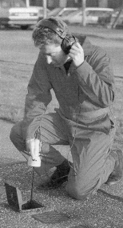
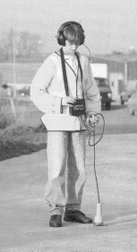
Detection Equipment and Techniques
Typical listening devices include listening rods
Ground microphones

Slide 268
Leak Noise Correlators
These are portable microprocessor-based devices that pinpoint leaks automatically based on the cross-correlation method (Figure 1).
In this method, acoustic leak signals are measured with vibration sensors or hydrophones at two pipe contact points (usually fire hydrants or valves) that bracket the location of a suspected leak.
Leak signals are transmitted from the sensors to the correlator wirelessly.
The leak is in most cases located asymmetrically between measurement points and consequently there is a time lag between the measured leak signals.

Slide 269
Leak Noise Correlators
The time lag is found from the cross-correlation function of the leak signals.
In the presence of a leak, the cross correlation function has a distinct peak at the time shift between leak signals.
The location of the leak is calculated based on an algebraic relationship between the time lag, the sensor-to-sensor distance, and the propagation velocity of sound waves in the pipe (Figure 2).
The distance between sensors is measured on site or read from distribution system maps.
Propagation velocities for various pipe types and sizes are usually available in most commercial devices, or they can be measured easily on site.

Slide 270
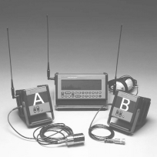
Leak Noise Correlators
A leak noise correlator is a portable microprocessor-based device that pinpoints leaks automatically.
Figure -1

Slide 271
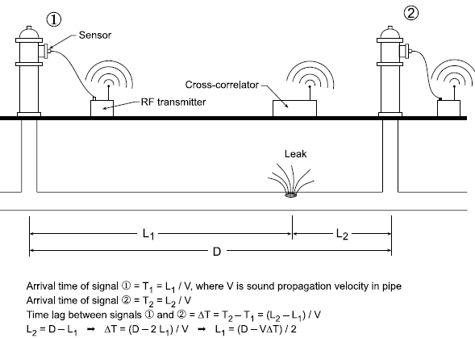
Leak Noise Correlators
Figure -2

Slide 272
Leak Detection
Tracer Gas Technique
With this technique, a non-toxic, water insoluble and lighter-than-air gas, such as helium or hydrogen, is injected into an isolated segment of a water pipe.
The gas escapes at a leak opening and then, being lighter than air, permeates to the surface through the soil and pavement.
The leak is located by scanning the ground surface directly above the pipe with a highly sensitive gas detector.

Slide 273
Leak Detection
Thermography
The principle behind the use of thermography for leak detection is that water leaking from an underground pipe changes the thermal characteristics of the adjacent soil, for example, making it a more effective heat sink than the surrounding dry soil.
The resulting thermal anomalies above pipes are detected with handheld, or vehicle or airplane-mounted infrared cameras.

Slide 274
Leak Detection
Ground-penetrating Radar
Radar can be used to locate leaks in buried water pipes either by detecting voids in the soil created by leaking water as it circulates near the pipe, or by detecting segments of pipe which appear deeper than they are because of the increase in the dielectric constant of adjacent soil saturated by leaking water.
Ground-penetrating radar waves are partially reflected back to the ground surface when they encounter an anomaly in dielectric properties, for example, a void or pipe.
An image of the size and shape of the object is formed by radar time-traces obtained by scanning the ground surface.
The time lag between transmitted and reflected radar waves determines the depth of the reflecting object.

Slide 275
Have a Break for Next Day

