Slide 1
Environmental Engineering-1
CE3141
Lecture -16
Week-11
19-07-2022

Slide 2
Problems on CE 3141
Problem -1 (Sedimentation):
Find the settling velocity of spherical discrete particles 0.05 mm in diameter, given that their specific gravity is 2.6 settling in water at a temperature of 20º C.
Solution:
Stoke’s law states that: v = gd (s-1)/18υ
Here, d = 0.05 mm, s = 2.6, g=9.81m/sec²
The kinematic viscosity, υ at 20º C = 1.003x10^{‐6} m²/s
V = 9.81×(5×10⁻⁵)²(2.6-1)/18× 1.003x10^{‐6}
= 2.17×10⁻³ m/s
Stoke’s law is valid for laminar flow, then Reynolds number is less than 0.5.
Therefore, Re should be checked:
Re = v.d/υ = 2.17x10^{‐3}x5x10^{‐5}/1.003x10^{‐6} = 0.118 (less than 0.5, OK).

Slide 3
Problems on CE 3141
Problem-2 (Sedimentation):
A sample from a river was analyzed for suspended solids. The analysis revealed that it contains 160 g/m³ suspended solids. The sanitary engineer responsible suggested clarifying this water by the sedimentation process. When the clarification rate was determined experimentally, the cumulative frequency distribution for the settling velocities of these particles showed a straight line relationship:
10 % of the particles have a settling velocity greater than 1.5 m/hr.
10 % of the particles have a settling velocity less than 0.5 m/hr.
The amount of water to be purified is 1500 m³/hour. Thus, the sanitary engineer proposed designing a sedimentation basin of length 50 m, width 25 m and depth of 3 m. assuming that this tank will work as an ideal sedimentation basin, find the suspended solids content of the effluent water.

Slide 4
Problems on CE 3141
Solution:
From the data given above, plot the cumulative frequency distribution curve for the settling velocities of these particles as shown in figure below:

Slide 5
Problems on CE 3141
The overall removal XT is given by:
X_{T} = 100 – X₀ + ʃv_{t}dx [Limit 0 to X₀]
Where:
X_{T} = overall removal
v_{o} = design settling velocity
x_{o} = removal corresponding to v_{o}.
Given that the discharge Q is equal to 1500 m³/hour and since settling velocity
v_{o} = discharge/area = Q/A and A is equal to width (W) times length (L), then:
v_{o} = Q/WL = 1500/(25x50) = 1.2 m/hour
From figure for v_{o} = 1.2 m/hr, then X_{o} = 66%
Therefore, the overall removal:
X_{T} = 100 – X_{o} + removal = 100 – 66 +(1/2)(0.37 + 1.2)x66/1.2 = 77%
Given that the suspended solids concentration entering the basin C_{i} = 160 g/m³, then the concentration of suspended solids in the effluent C_{e} could be found as: C_{e} = (1 – X_{T})C_{i} = (1 – 0.77)x160 = 36.8 g/m³

Slide 6
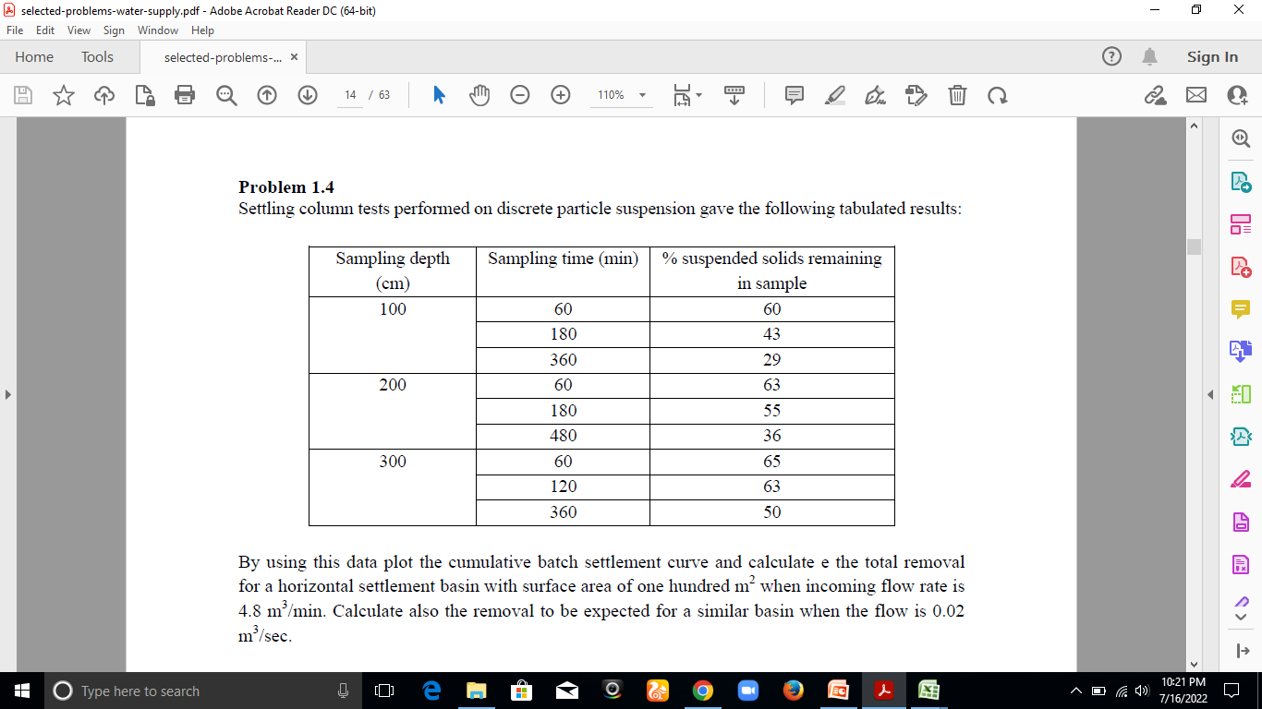
Problems on CE 3141
Problem-3 (Sedimentation):
Settling column tests performed on discrete particle suspension gave the following tabulated results:

Slide 7
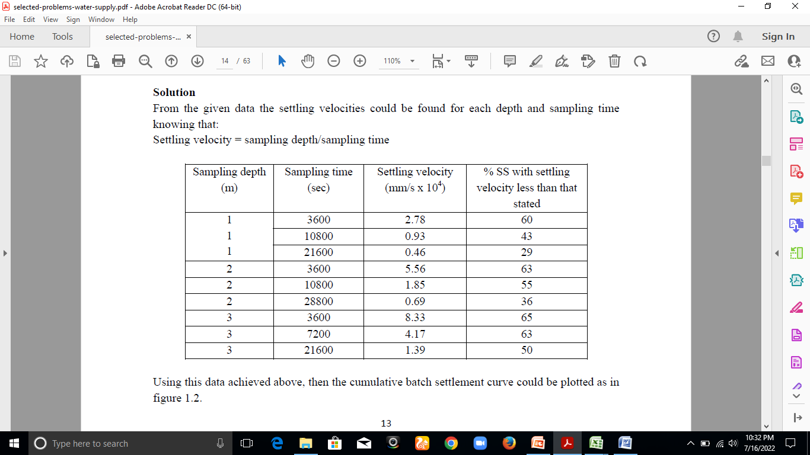
Problems on CE 3141

Slide 8
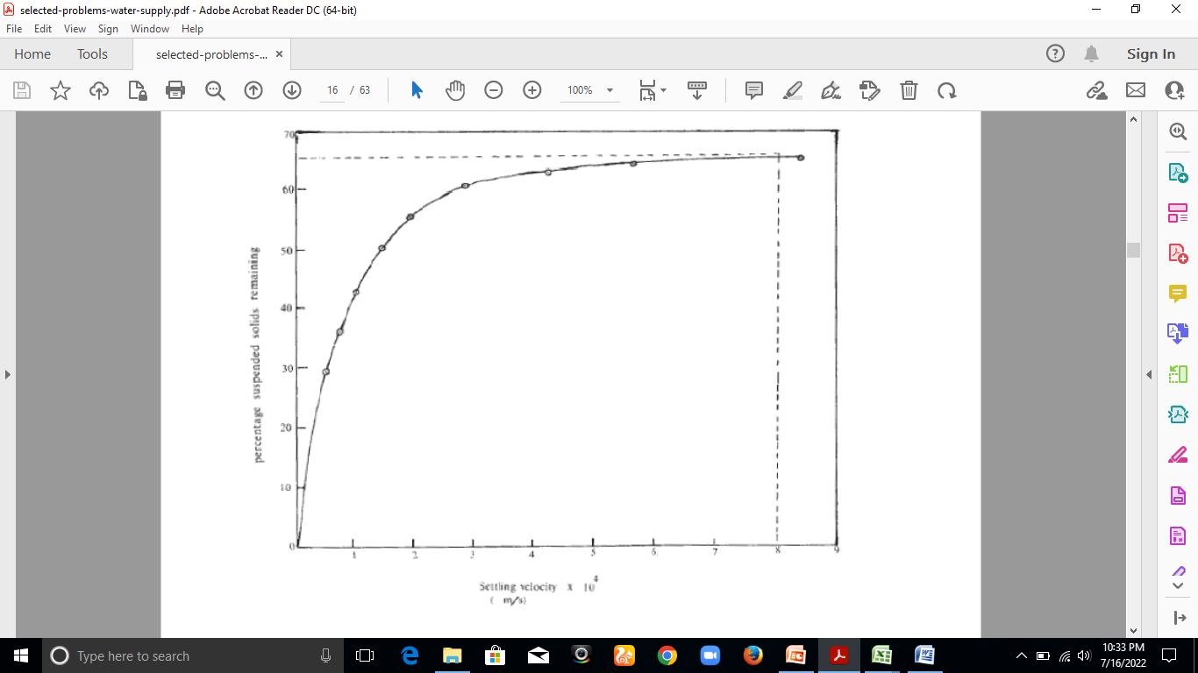
Problems on CE 3141

Slide 9
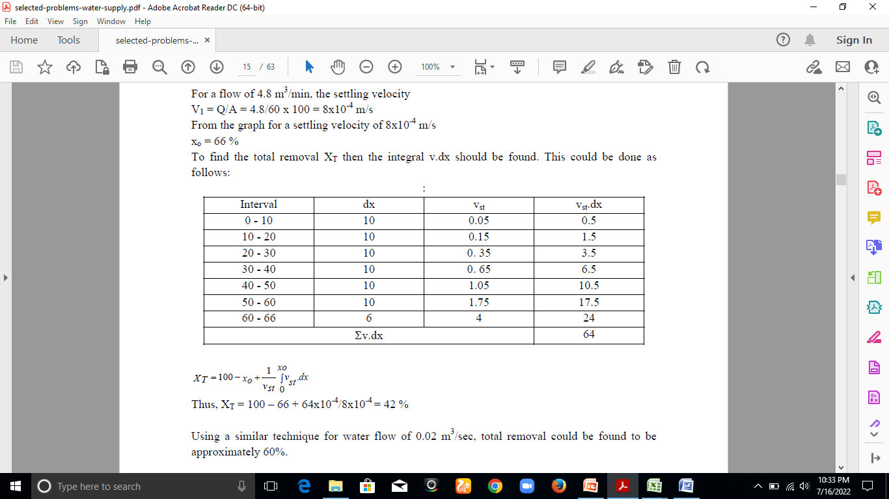
Problems on CE 3141

Slide 10
Problems on CE 3141
Problem-4 (Filtration):
Making use of the equations developed by Rose and Carman-Kozeny compute the head loss through a 0.8 m sand bed. Assume that the bed consists of uni-sized, spherical sand particles having a diameter of 0.5 mm, the kinematic viscosity is equal to 1.003x10⁻⁶ m²/s and the bed porosity is 40 percent while the rate of filtration is 250 l/m².min.

Slide 11
Problems on CE 3141
Solution:
Rose equation states that:
h = 1.067 C_{D}v²L/P⁴gdφ
Where
h = Head loss in bed, m.
v= Face velocity, m/s.
d = diameter of the particle, m.
g = Gravitational acceleration, m/s².
φ = Particle shape factor, dimensionless (= surface area of equivalent volume of sphere/actual surface area)
p = bed porosity, dimensionless (= volume of voids/total volume)
L = bed depth, m.
C_{D} = Newton's drag coefficient.

Slide 12
Problems on CE 3141
Re = Reynolds number, dimensionless.
= Vd/υ
With the above notations: then L = 0.8m, φ = 1, d = 0.5x10⁻³ m, υ = 1.003x10⁻⁶ m²/s, p = 0.4, V = 250L/m².min = 4.17x10⁻³ m³/m².sec, then:
Re = 4.17x10⁻³ x 0.5x10⁻³ / 1.003x10⁻⁶ = 2.079
C_{D} = 24/Re + 3/√Re + 0.34
= 24/2.079 + 3/√2.079 + 0.34 = 13.96
Thus, head loss by using Rose equation: h = 1.067 C_{D}v²L/P⁴gdφ
= 1.067x13.96 x (4.17x10⁻³)² x 0.8/(0.4)⁴x 9.81 x 0.5x10⁻³ x 1
=1.65 m

Slide 13
Problems on CE 3141
Using Carman-Kozeny equation the head loss is given by:
h = E(1-p)V²L/P³gdφ
Where, E = 150(1-p)/Re + 1.75 = 150(1-0.4)/2.079 + 1.75
= 45.04
Hence,
h = 45.04(1-0.4) x (4.17x10⁻³)² x 0.8/(0.4)³x 9.81 x 0.5x10⁻³ x 1
=1.20 m

Slide 14
Problems on CE 3141
Problem-5 (Filtration):
Determine the clear water head loss in a filter bed that consists of two layers of filter media; a uniform anthracite layer of depth of 0.6 m with an average particle size of 1.6 mm and a specific gravity of 1.5; the other layer is composed of uniform sand 40 cm deep with an average particle size of 0.6 mm and a specific gravity of 2; for a rate of filtration of 150 L/m²/min. The operating temperature was found to be 15ºC and the porosity is 0.35. use Rose equation for evaluating the clear water head loss.

Slide 15
Problems on CE 3141
Solution:
Rose equation states that:
h = 1.067 C_{D}v²L/P⁴gdφ
Where
h = Head loss in bed, m.
v= Face velocity, m/s.
d = diameter of the particle, m.
g = Gravitational acceleration, m/s².
φ = Particle shape factor, dimensionless (= surface area of equivalent volume of sphere/actual surface area)
p = bed porosity, dimensionless (= volume of voids/total volume)
L = bed depth, m.
C_{D} = Newton's drag coefficient.

Slide 16
Problems on CE 3141
Given that for anthracite layer: L = 0.6 m, d = 1.6x10⁻³ m
For sand layer: : L = 0.4 m, d = 0.6x10⁻³ m
For a temperature of 15ºC the kinematic viscosity equals 1.139x10⁻⁶ m²/s, V = 150 L/m².min = 2.5x10⁻³ m/sec.
a) Anthracite layer:
Re = 2.5x10⁻³ x 1.6x10⁻³ / 1.139x10⁻⁶ = 3.51
C_{D} = 24/Re + 3/√Re + 0.34
C_{D} = 24/3.51 + 3/√3.51 + 0.34 = 8.78
h_{a} =h = 1.067 C_{D}v²L/P⁴gdφ
= 1.067x8.78 x (2.5x10⁻³)² x 0.6/(0.35)⁴x 9.81 x 1.6x10⁻³ x 1
= 0.15 m

Slide 17
Problems on CE 3141
a) Sand layer:
Using the same technique of computation as above, then
Re = 1.32, C_{D} = 21.13 and h_{s} = 0.64 m
Therefore, the clear water head loss in the filter will be equal to the sum of the head loss through anthracite layer and the head loss through the sand layer.
Thus, total head loss = h_{a} + h_{s} = 0.15 + 0.64 = 0.79 m

Slide 18
Environmental Engineering-1
CE3141
Lecture -17
Week-12
26-07-2022

Slide 19
Problems on CE 3141
Problem-6 (Aeration):
Calculate the saturation concentration of oxygen in pure water at 20ºC exposed to air at a pressure of 101.3 kPa. Assume that dry air contains 20.948 percent oxygen by volume. Determine also Henry’s constant for these conditions and Bunsen absorption coefficient.
Solution:
The saturation concentration is given by:
C_{s} = K_{D} MWx(P-P_{w})/RT

Slide 20
Problems on CE 3141
Where:
C_{s} = Saturation concentration, g/m³.
K_{D} = Distribution coefficient.
MW = molecular weight of the gas, g.
R = Universal gas constant ( = 8.3143 J/K.mole).
T = Absolute temperature, K.
x = volumetric composition.
P = Partial pressure of the respective gas in the gas phase, Pa.
P_{w} = water vapor pressure, Pa.
Therefore, T = 20 + 273.16 = 293.16 K; for this temperature from tables for oxygen the distribution coefficient K_{D} = 0.0337 and p_{w} = 2.33 kPa, MW of oxygen = 32.

Slide 21
Problems on CE 3141
Thus, C_{s}= 0.0337×32×0.20948 × (101.3 – 2.33)×10³/(8.3143 × 293.16) = 9.2 g/m³
Henry’s constant could be found from the formula:
kH = K_{D}MW/RT
= 0.0337×32× 0.20948 / (8.3143 × 293.16)
= 4.4×10⁻⁴ g/J
Bunsen absorption coefficient is given by:
K_{b}= K_{D}T₀/T
= 0.0337×273.16/293.16
= 0 0314

Slide 22
Problems on CE 3141
Problem-7 (Aeration):
In a water installation, ground water with oxygen content of 10% saturation and at a temperature of 25ºC is aerated by using a cascade aerator, consisting of 3 identical steps, which is capable of raising its content from zero to 30% saturation. Determine the oxygen concentration of the effluent.
Solution:
From the penetration theory, the efficiency coefficient of the cascade is given by:
K = (C_{e}- C_{i})/(C_{s}-C_{i})

Slide 23
Problems on CE 3141
Where:
K = efficiency coefficient.
C_{e} = Effluent concentration, g/m³.
C_{i} = Influent concentration, g/m³.
C_{s} = Saturation concentration, g/m³.
Thus, given that for each step: C_{e} = 0.3C_{s}, C_{i} = 0, then:
K = (0.3C_{s} – 0)/(C_{s} – 0) = 0.3
The above equation could be written as:
C_{e} = C_{i} + K ( C_{s} - C_{i})

Slide 24
Problems on CE 3141
Effluent from the first step:
C_{e1} = 0.1C_{s} + 0.3 ( C_{s} - 0.1C_{s}) = 0.37 C_{s}
Effluent from the second step:
C_{e2} = 0.37C_{s} + 0.3 (C_{s} - 0.37C_{s}) = 0.559 C_{s}
Effluent from the third step:
C_{e3} = 0.559C_{s} + 0.3 (C_{s} - 0.559C_{s}) = 0.691 C_{s}
But at 25º C, from tables, C_{s} = 8.4 g/m³
Therefore, the effluent from the third step of the cascade will have a concentration of 0.691x8.4 = 5.8 g/m³.

Slide 25
Problems on CE 3141
Problem-8 (Softening):
Laboratory tests on a sample of water gave the following tabulated results:
Calculate the total hardness, carbonate and noncarbonated hardness.
Determinations | Concentration, g/m³
Ca⁺⁺ | 140
Mg⁺⁺ | 24.3
HCO₃⁻ | 305
CO₂ | 12

Slide 26
Problems on CE 3141
Solution:
The concentrations in eq./m³ can be found by using the formula eq/m³ = (g/m³)/equivalent weight, as seen from the table below:
Determinations | Concentration, g/m³ | Equivalent weight | Concentration, eq./m³
Ca⁺⁺ | 140 | 20 | 7
Mg⁺⁺ | 24.3 | 12.15 | 2
HCO₃⁻ | 305 | 61 | 5
CO₂ | 12

Slide 27
Problems on CE 3141
Total hardness = carbonate hardness + non-carbonate hardness = 7 + 2 = 9 eq/m³
Carbonate hardness = 5 eq/m³
Non-carbonate hardness = 9 - 5 = 4 eq/m³

Slide 28
Problems on CE 3141
Problem-9 (Softening):
Given the tabulated analytical results for a water sample:
Compute the water total hardness, carbonate and noncarbonated hardness expressed as mg/L CaCO₃ of this water sample.
Determinations | Concentration, g/m³
Ca⁺⁺ | 80
Mg⁺⁺ | 12.15
HCO₃⁻ | 305
CO₂ | 12

Slide 29
Problems on CE 3141
Solution:
Concentrations expressed as mg/L CaCO₃ can be computed from the equations: mg/L CaCO₃ =mg/L x (50/equivalent weight) = meq. X 50
Total hardness = 200 + 50 = 250 mg/L CaCO₃
Carbonate hardness = 250 mg/L CaCO₃
Non-carbonate hardness = 250 - 250 = 0
Parameters | Concentration, g/m³ | Equivalent weight | Concentration, eq./m³ | Concentration, mg/L as CaCO₃
Ca⁺⁺ | 80 | 20 | 4 | 200
Mg⁺⁺ | 12.15 | 12.15 | 1 | 50
HCO₃⁻ | 305 | 61 | 5 | 250
CO₂ | 12 | 222 | 0.55 | 28

Slide 30
Problems on CE 3141
Problem-10 (Softening):
A sample of water is found to contains following dissolving salts in milligrams per litre Mg(HCO₃)₂ = 73, CaCl₂ = 111, Ca(HCO₃)₂ = 81, MgSO₄ = 40 and MgCl₂ = 95. Calculate temporary and permanent hardness and total hardness.
Solution:
Name of the hardness causing salts | Amount of the hardness causing salts(mg/Lit) | Molecular weight of hardness causing salts | Amounts equivalent to CaCO3 (mg/Lit)
Mg(HCO₃)₂ | 73 | 146 | 73×100/146 = 50
CaCl₂ | 111 | 111 | 111×100/111 = 100
Ca(HCO₃)₂ | 81 | 162 | 81×100/162 = 50
MgSO₄ | 40 | 120 | 40×100/120 = 33.33
MgCl₂ | 95 | 95 | 95×100/95= 100

Slide 31
Problems on CE 3141
Temporary hardness = Mg(HCO₃)₂ + Ca(HCO₃)₂
= 50 + 50 = 100 mg/Lit.
Permanent hardness = CaCl₂ + MgSO₄ + MgCl₂
= 100 + 33.3 + 100
= 233.3mg/Lit.
Total hardness = Temporary hardness + Permanent hardness = 100 + 233.3 = 333.3 mg/Lit.

Slide 32
Problems on CE 3141
Problem-11 (Softening):
A sample of water is found to contains following dissolving salts in milligrams per litre Mg(HCO₃)₂ = 16.8, MgCl₂ = 12.0, MgSO₄ = 29.6 and NaCl = 5.0. Calculate temporary and permanent hardness of water
Solution:
Name of the hardness causing salts | Amount of the hardness causing salts(mg/Lit) | Molecular weight of hardness causing salts | Amounts equivalent to CaCO₃ (mg/Lit)
Mg(HCO₃)₂ | 16.8 | 146 | 16.8×100/146 = 11.50
MgCl₂ | 12.0 | 95 | 12×100/95 = 12.63
MgSO₄ | 29.6 | 120 | 29.6×100/120 = 24.66
NaCl | 5.0 | NaCl does not contribute any hardness to water hence it is ignored.
Temporary hardness = Mg(HCO₃)₂ = 11.50mg/Lit.
Permanent hardness = MgCl₂ + MgSO₄ = 12.63 + 24.66 = 37.29mg/Lit.

Slide 33
Problems on CE 3141
Problem-12 (Softening):
50 ml of standard hard water containing 1 gram of pure CaCO₃ per liter consumed 20 ml of EDTA. 50 ml of hard water consumed 25 ml of same EDTA solution EBT indicator. Calculate the total hardness of water sample in ppm.
Solution:
Strength of standard hard water sample (CaCO₃ solution),M₁
= (Weight of CaCO₃ × 1000)/ (Mol. wt of CaCO₃ × 1000)
= (1 gm × 1000)/(100×1000) = 0.01 M
Strength of EDTA solution M₂ = V₁M₁/V₂ = 50 × 0.01/20 = 0.025 M where, V₁ = Volume of standard hard water (50 ml),
M₁ = Strength of standard hard water (0.01M)
V₂ = Volume of EDTA solution (20 ml),
M₂ =Strength of EDTA solution =?

Slide 34
Problems on CE 3141
Solution:
Calculation of total hardness, M₃ = V₂M₂
= 25 × 0.025/50
= 0.0125 M
Where, V₂ = Volume of EDTA solution (25 ml),
M₂ =Strength of EDTA solution= 0.025M
V₃ = Volume of sample hard water (50 ml)
M₃ = Strength of sample hard water =?
Total Hardness = 0.0125×10⁵ ppm
= 0.0125×100 (Mol. Wt of CaCO₃)×1000 (ml) ppm
= 1250 ppm.

Slide 35
Problems on CE 3141
Problem-12 (Disinfection):
Compute the contact time required to achieve a 99.99 percent kill or disinfecting a microorganism system, given that the rate constant (to base 10) equals 0.06 sec⁻¹.
Solution
Chick’s law assumes that the distribution of microorganisms is controlled by process of diffusion, and it states that:

Slide 36
Problems on CE 3141

Slide 37
Problems on CE 3141

Slide 38
Problems on CE 3141

Slide 39
Problems on CE 3141

Slide 40
Problems on CE 3141

Slide 41
Problems on CE 3141

Slide 42
Problems on CE 3141

Slide 43
Problems on CE 3141

