Slide 1
Experiment No. 03
Experiment Name: Observation of Hydraulic Jump
1.Introduction
In an open channel when a supercritical flow is made to change abruptly to subcritical flow, the result is usually an abrupt rise of the water surface. This feature is known as the hydraulic jump. It results when there is a conflict between upstream and downstream controls which influence the same reach of the channel. For example, if the upstream control causes supercritical flow and downstream control dictates subcritical flow, then this conflict can be resolved by a hydraulic jump, which passes the flow from one flow regime to other. Hydraulic jump is useful in dissipation of excess energy in flows over dams, weirs, spillways and other hydraulic structures to prevent scouring downstream, maintaining high water levels in channels for irrigation and other water distribution purposes.
This experiment is dealing with how the Hydraulic Jump is created and the characteristics.

Slide 2
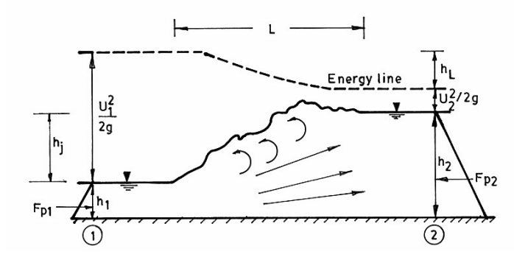
Fig.1. Hydraulic Jump in a horizontal rectangular channel

Slide 3
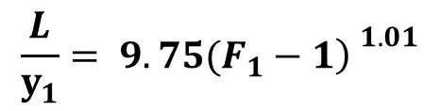
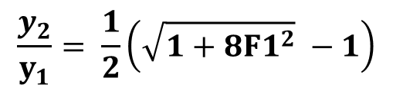
2.Working Formula:
2.1 Initial and sequent depths
Consider a hydraulic jump on a horizontal floor in a rectangular channel as shown in figure. The depth of flow before the jump is known as the initial depth (y₁) and the depth after the jump is known as the sequent depth (y₂). The relation between them is given below:
$$\frac{y_{2}}{y_{1}}= \frac{1}{2}\left(\sqrt{1+8{F1}^{2}} −1\right)$$
F1 = Froude Number of the approaching flow
2.2 Length of the jump (L)
The length of a hydraulic jump is the horizontal distance from the front face of the jump to a point immediately downstream from the roller.
$$\frac{L}{y_{1}}= 9.75(F_{1}−1{\left) \right.}^{1.01}$$

Slide 4
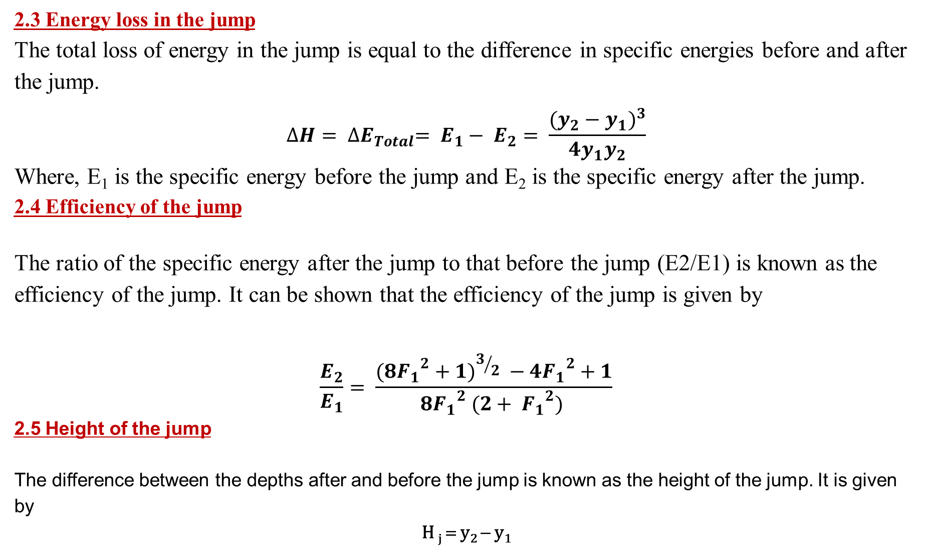
2.3 Energy loss in the jump
The total loss of energy in the jump is equal to the difference in specific energies before and after the jump.
$$∆H= ∆E_{Total}= E_{1}− E_{2}= \frac{(y_{2}−y_{1})^{3}}{4{y_{1}y}_{2}}$$
Where, E₁ is the specific energy before the jump and E₂ is the specific energy after the jump.
2.4 Efficiency of the jump
The ratio of the specific energy after the jump to that before the jump (E2/E1) is known as the efficiency of the jump. It can be shown that the efficiency of the jump is given by
$$\frac{E_{2}}{E_{1}}= \frac{(8{F_{1}}^{2}+1)^{3/{2 }}−4{F_{1}}^{2}+1}{8{F_{1}}^{2} (2+ {F_{1}}^{2}) }$$
2.5 Height of the jump
The difference between the depths after and before the jump is known as the height of the jump. It is given by
H _{j} = y₂ − y₁

Slide 5
3. Objectives of the experiment
1. To observe the movement of hydraulic jump for different downstream conditions
2. To determine the height, length, type, energy losses and efficiency of the jump
3. To plot E₂/E₁, H_{j}/E₁, y₁/E₁, y₂/E₁ vs F₁ in one plain graph paper
4. To plot L/y₁, L/y₂, L/H_{j} vs F₁ in one plain graph paper
5. To plot L vs H_{j} in a log-log paper
6. To plot y₁ vs y₂ for different values of Q in a plain graph paper

Slide 6
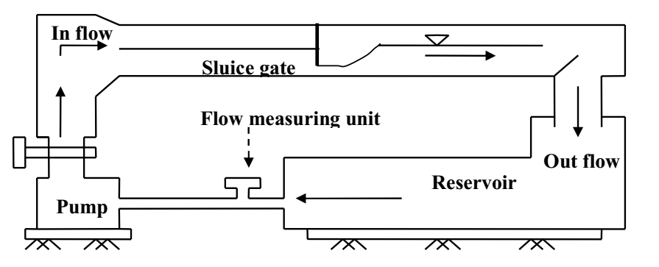
4. Experiment setup
Fig.2: Setup for a hydraulic jump

Slide 7
4.1 Required apparatus:
Flume
Pump
Flow measuring unit
Reservoir
Water meter.

Slide 8

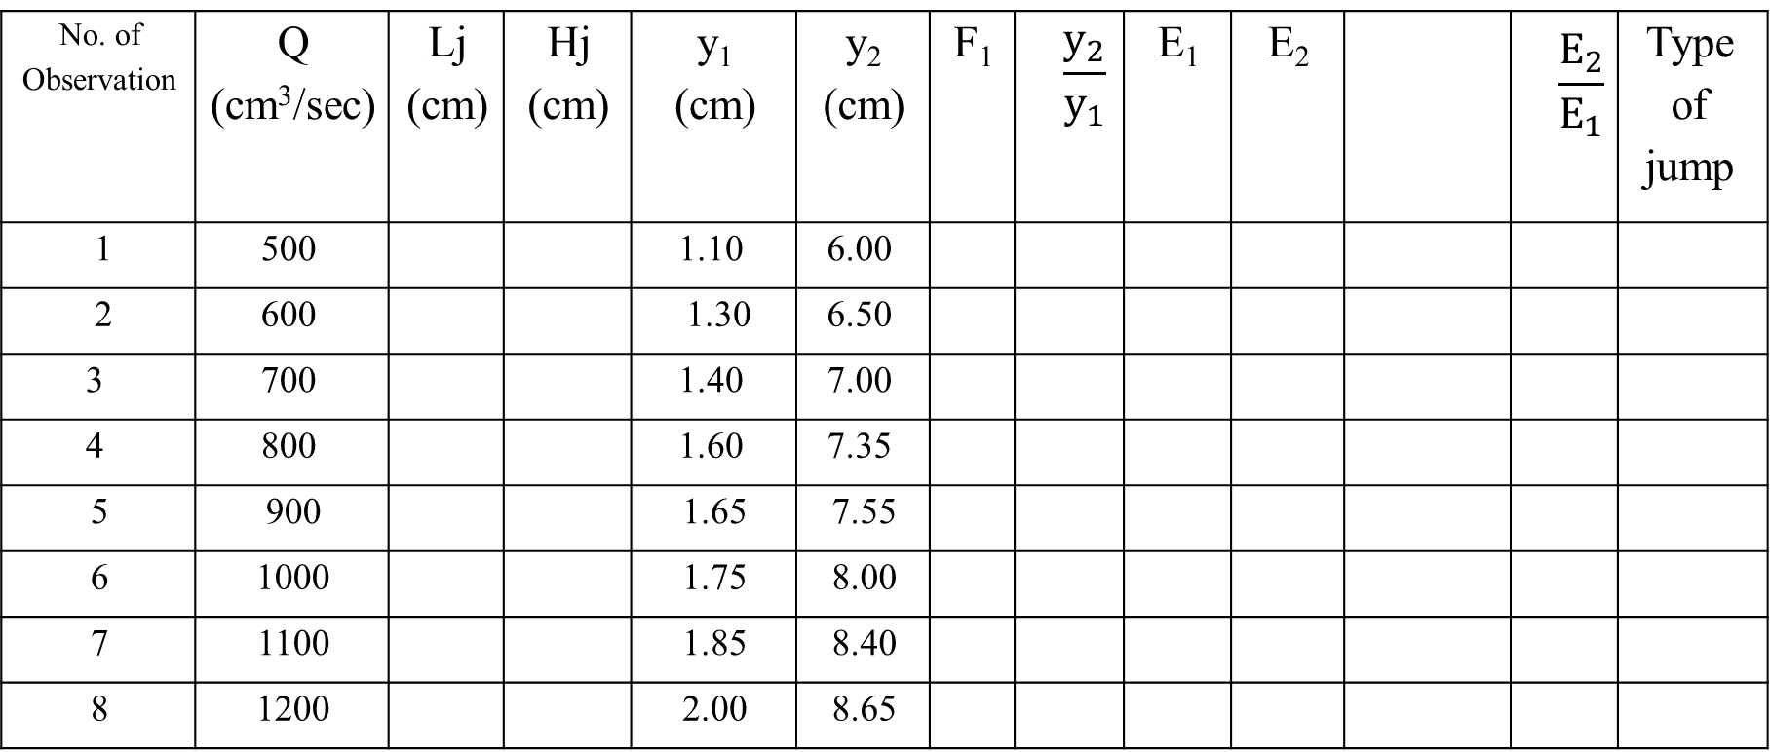
5. DATA SHEET
Type of jump | $$\frac{E_{2}}{E_{1}}$$ |  | E₂ | E₁ | $$\frac{y_{2}}{y_{1}}$$ | F₁ | y₂ (cm) | y₁ (cm) | Hj (cm) | Lj (cm) | Q (cm³/sec) | No. of Observation
 |  |  |  |  |  |  | 6.00 | 1.10 |  |  | 500 | 1
 |  |  |  |  |  |  | 6.50 | 1.30 |  |  | 600 | 2
 |  |  |  |  |  |  | 7.00 | 1.40 |  |  | 700 | 3
 |  |  |  |  |  |  | 7.35 | 1.60 |  |  | 800 | 4
 |  |  |  |  |  |  | 7.55 | 1.65 |  |  | 900 | 5
 |  |  |  |  |  |  | 8.00 | 1.75 |  |  | 1000 | 6
 |  |  |  |  |  |  | 8.40 | 1.85 |  |  | 1100 | 7
 |  |  |  |  |  |  | 8.65 | 2.00 |  |  | 1200 | 8

Slide 9







7. Table for graph plotting
Q (cm3/sec) | F₁ |  |  |  |  |  |  |  | No. of Observation
 |  |  |  |  |  |  |  |  | 1
 |  |  |  |  |  |  |  |  | 2
 |  |  |  |  |  |  |  |  | 3
 |  |  |  |  |  |  |  |  | 4
 |  |  |  |  |  |  |  |  | 5
 |  |  |  |  |  |  |  |  | 6
 |  |  |  |  |  |  |  |  | 7
 |  |  |  |  |  |  |  |  | 8

Slide 10
Graphs
A graph of variation of (E2/E1, Hj/E1, Y1/E1, Y2/E1) with respect to Froude number of approaching , F1
A graph of variation of (Lj/Y1, Lj/Y2, Lj/Hj) with respect to Froude number of approaching , F1
Log log graph (X axis =Hj), (Y axis = Lj)
Normal graph of variation of y1 with respect to y2

Slide 11
Assignments:
1. What are the different types of jumps according to USBR classification?
2. Why does the energy loss occur in hydraulic jumps? Is it really an energy loss?
3. What is tail water depth? Explain why a hydraulic jump moves upstream when the tail water depth is greater than the sequent depth and vice versa.

