Slide 1
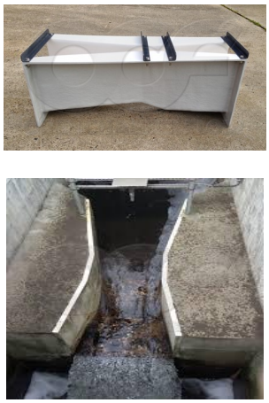
Experiment No. 02
Flow through a Parshall flume

Slide 2
1.Introduction
The problem with a Venturi flume is that there is a relatively small head difference between the upstream section and the critical section. This problem can be overcome by designing a flume which has a contracted throat section in which critical flow occurs followed by a short length of supercritical flow and a hydraulic jump at the exit section.
A flume of this type was designed by R.L. Parshall and is widely known as the Parshall flume. Practically this type of flume is used in small irrigation canals for flow measurement purpose.
It is better than all other devices discussed before as it is more accurate, can withstand a relatively high degree of submergence over a wide range of backwater condition downstream from the structure and it acts as a self-cleaning device due to the fact that high velocity washes out the debris and sediments present in the flow.
However, when a heavy burden of erosion debris is present in the stream, the Parshall flume becomes invalid, because deposition of debris will produce undesirable result.
Another problem which arises with this flume is that the fabrication is complicated and also fabrication should be done as per requirement. This experiment deals with the measurement of discharge using a Parshall flume.

Slide 3
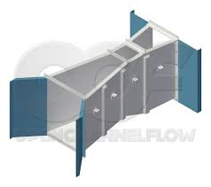
Parshall flume :
A Parshall flume consists of a broad flat converging section, a narrow downward sloping throat section and an upward sloping diverging section. The reason of downward sloping throat section is to increase the head difference between the upstream section and the critical section.
The upward slope in the diverging section is given to produce a high tailwater depth which reduces the length of the supercritical flow region.
The Parshall flume is a fixed hydraulic structure originally developed to measure surface water and irrigation flows.
The Parshall flume is now frequently used to measure industrial discharges, municipal sewer flows, and influent / effluent at wastewater treatment plants. Of all the flumes, the Parshall flume is the most recognized and commonly used.

Slide 4
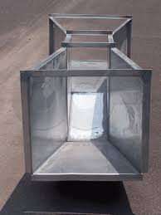
Development of the Parshall Flume
Development of the Parshall flume began in 1915 by Dr. R. L. Parshall of the U.S. Soil Conservation Service. Using the sub-critical Venturi flume as his starting point, Dr. Parshall introduced several radical modifications with his Improved Venturi Flume – the most greatest of which was a drop in elevation through the throat of the flume. The drop produced supercritical flow through the throat of the flume. With supercritical flow, only one head measurement is necessary to determine the flow rate, greatly simplifying the use of the flume.

Slide 5
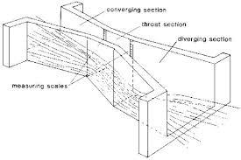
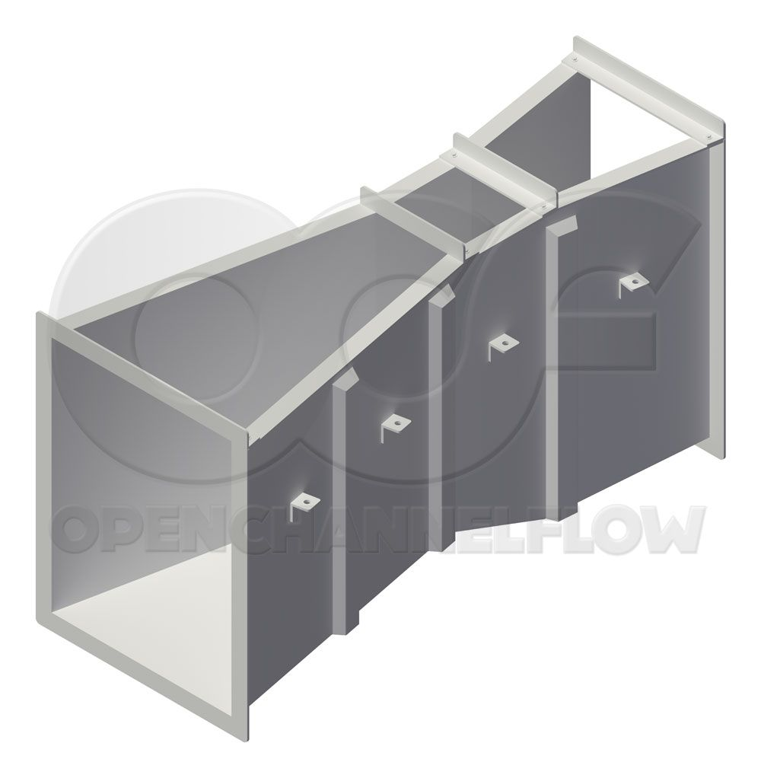
Design of the Parshall Flume
The design of the Parshall flume consists of a uniformly converging upstream section, a short parallel throat section (the width of which determines the flume size), and a uniformly diverging downstream section. The floor of the flume is flat in the upstream section, slopes downward in the throat, and then rises in the downstream section; ending with a downstream elevation below that of the upstream elevation.
2.1 Design of Parshall flume

Slide 6
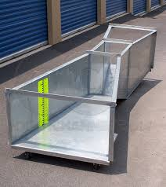
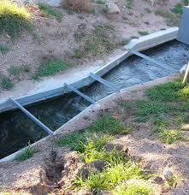
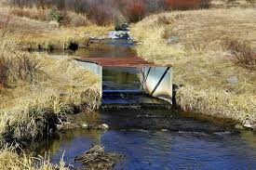
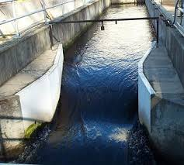
Design of the Parshall Flume Contd…

Slide 7
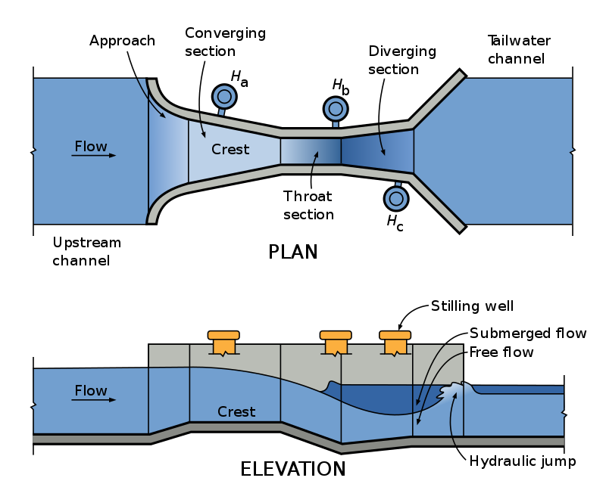
Design of the Parshall Flume Contd…
2.2 Plan and elevation of parshall flume

Slide 8
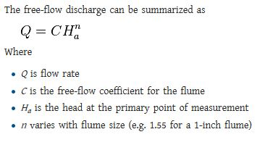
The Parshall flume is a calibrated device i.e. there exists a definite depth-discharge relationship for the flume. So, analytic determination of theoretical discharge is not required for this flume.
In case of Free flow condition:

Slide 9
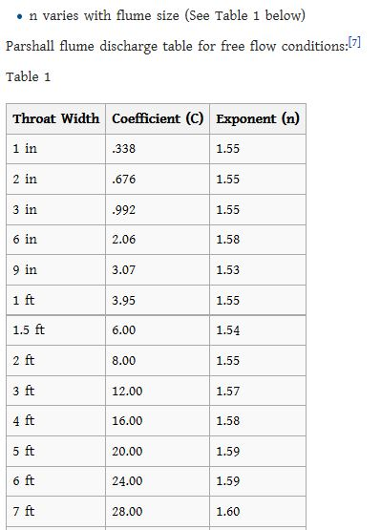
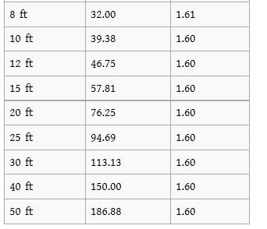

The values of C and n depend on the throat width and are given in the following table
Table -1
Qth=4w${Ha}^{1.522}w^{0.026}$
In the above, Q is the free discharge in cfs, W is the width of the throat in ft and Ha is the gage reading in ft.

Slide 10
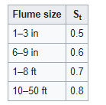
Coefficient of discharge:
If the actual discharge Qa is measured by the water meter, the coefficient of discharge is given by
Cdf = Qa/Qtf (at free flow condition)
Cds = Qa/Qts (at submerged flow condition)
In case of Submerged flow condition:
The percentage of submergence for the Parshall flume is given by 100H_{b}/Ha. Hb is the downstream depth measured from the invert datum. When the percentage of submergence exceeds 0.6, the discharge through the Parshall flume is reduced.
Table 2
The discharge (Q) can be found using the following:
Q_{net}= Q_{free flow} - Q_{correction}
Q_{correction}= M (0.000132 H_{a}^{2.123} e^{9.284St})
Where Q is in ft³/s, Ha is in feet.

Slide 11
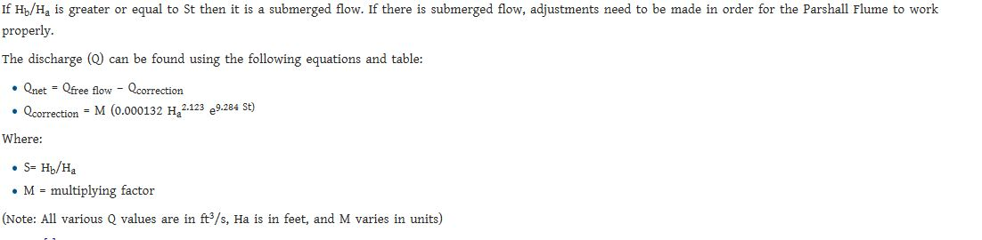
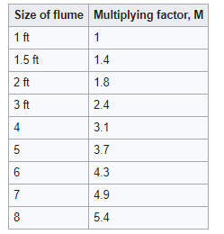
In case of Submerged flow condition:
For submerged flow, a depth of flow needs to be taken upstream (H_{a}) and downstream (H_{b})
Table-3

Slide 12
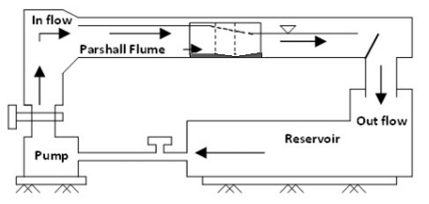
2. Objectives of the experiment:
1. Observation of the flow characteristics for the increasing upstream level
2. Observation of the effect of submergence
3. To plot actual discharge with respect to theoretical discharge and to determine the value of Co-efficient of discharge
4. Determination of the exponent of H_{a}
3. Experiment setup
2.3 Setup for flow through a parshall flume

Slide 13
4.Requried apparatus:
Parshall flume
Flow measuring unit
Pump
Reservoir
Water meter

Slide 14
5.Working Procedure:
Free flow condition:
Measure the Ha
Record Qa
Compute Qtf
Compute Cdf
For Submerge Condition:
Measure the Ha and Hb
Compute Qtf
Compute Submergence Hb/Ha
Find Qcorrection
Find Qts
Record Qa
Find Cds

Slide 15
5. DATA SHEET
Channel with, b=7.60 cm
Throat width, w=3.10 cm
No of Obs. | Actual Discharge Q_{a (cm3/s)} | Free flow condition |  |  |  | Submerged flow condition |  |  |  |  | Mean C_{ds}
 |  | Ha (cm) | Q_{thf} _{(cm3/s)} | C_{df} | Mean C_{df} | Ha (cm) | Hb (cm) | Submergence (%) =Ha/Hb*100 | Q_{th} _{(cm3/s)} | C_{ds}
1. | 500 | 7.0 |  |  |  | 7.50 | 3.35
2. | 600 | 8.0 |  |  |  | 8.40 | 3.90
3. | 700 | 8.7 |  |  |  | 8.85 | 4.15
4. | 800 | 9.4 |  |  |  | 9.70 | 5.0
5. | 900 | 10.0 |  |  |  | 10.20 | 5.50
6. | 1000 | 11.00 |  |  |  | 11.30 | 5.90

Slide 16
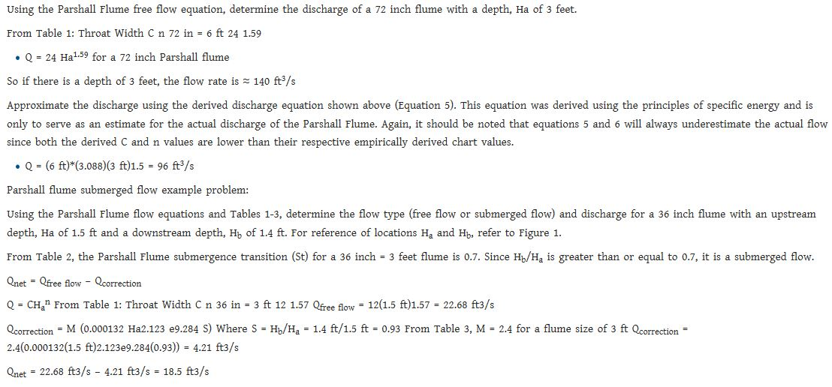
Example of Calculation

Slide 17
6. Calculation
All graphs are here
8. Results
9. Discussion

Slide 18
Assignment:
1. What are the advantage, disadvantage and use of a Parshall flume?
2. What is the difference between free and submerged flows?
3. How can you produce submerged flow in a laboratory flume?
4. What is the effect of submergence on the flow?

