Slide 1
Experiment No.:03 Experiment Name: Flow Through Cut-Throat Flume. Experiment Date: 21-06-2022
Md. Sohel Rana Lecturer Department of Civil Engineering Rajshahi University of Engineering & Technology(RUET)

Slide 2
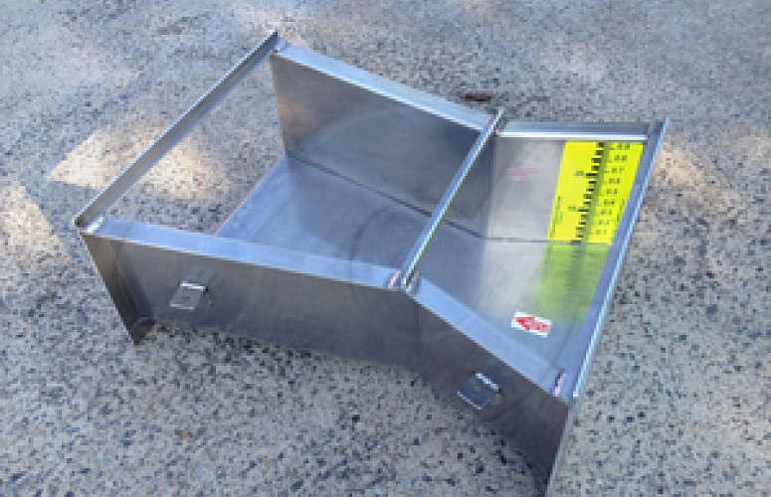
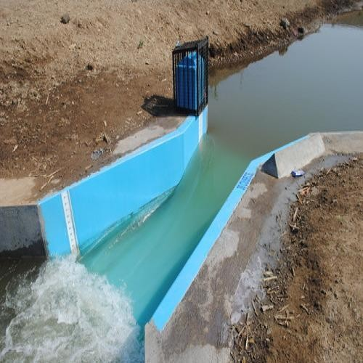
Figure: Cut- Throat Flume

Slide 3
1. Introduction
Although a Parshall flume gives very accurate measurement of discharge, the problem of the flume is that the fabrication of such a flume is complicated and also the fabrication should be done as per requirement. The cut throat flume is an attempt to improve on the Parshall flume mainly by simplifying the construction details. So the flume is economical and normally used in straight sections of small irrigation channels for flow measuring purpose. The angles of divergence and convergence remain same for all flumes. So the size of the flume can be changed by merely moving the vertical walls in or out. This experiment deals with the measurement of discharge using a cut throat flume.

Slide 4
The Cut throat flume is a class of flow measurement flume developed during 1966/1967 that is used to measure the flow of surface waters, sewage flows, and industrial discharges. Like other flumes, the Cut throat flume is a fixed hydraulic structure. Using vertical sidewalls throughout, the flume accelerates flow through a contraction of sidewalls until the flow reaches the "throat" of the flume, where the flow is then expanded. Unlike the Parshall flume, the Cut throat flume lacks a parallel-walled throat section and maintains a flat floor throughout the flume

Slide 5
Theory
Description of the Flume
The Cut throat flume has a flat bottom, vertical walls and a zero length throat section. The details of the standard shape of a cut throat flume are shown in Fig 1. It can operate either as a free or submerged flow structure. Under free flow condition critical depth occurs in the vicinity of the neck. Any flume length from 45 cm to 3 m can be used while neck widths between 2.5 cm and 1.8 m have been investigated.

Slide 6
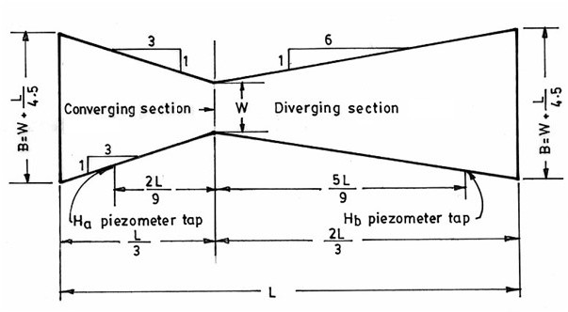
Fig. 1 Flow through a cut throat flume

Slide 7
Theoretical discharge at free flow condition
The theoretical discharge through cut throat flume for free flow condition is given by Q_{tf} = CH_{a}^{n} (1)
Where, C is the free flow coefficient given by
C = KW^{1.025} (2) K is the flume length coefficient,
W is the width of the neck,
n is an exponent and
H_{a} is the upstream flow depth, measured at a distance of 2L/9 form the throat, as shown in Fig. 1. The values of K and n are obtained from Fig. 3 for a given flume length.

Slide 8
Submergence ratio and submerged flow condition
In order to ensure free flow condition, the ratio between the water depths at the exit and entrance, i.e. the submergence ratio (H_{b}/H_{a}) should not exceed a certain limit, called the transition submergence, S_{t}, which can be determined from Fig. 3. If the submergence ratio exceeds the transition submergence, the flow condition is said to be submerged flow condition.

Slide 9
Coefficient of discharge
The actual discharge always varies with the theoretical discharge of the flume. So the introduction of a coefficient of discharge is necessary. If the actual discharge Q_{a} is measured by the water meter, the coefficient of discharge is given by
C_{df}= Q_{a}/Q_{tf} (at free flow condition) (3)

Slide 10
2. Objectives of the experiment
To determine the theoretical discharge at the free flow condition.
To determine the submergence ratio and to check the effect of submergence.
To determine the coefficient of discharge C_{d}.
To verify the values of coefficient C and exponent n.

Slide 11
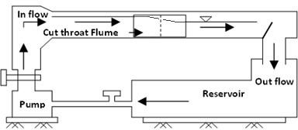
3. Experiment setup
The experiment setup is given below
Fig. 2 Setup for flow through a cut throat flume

Slide 12
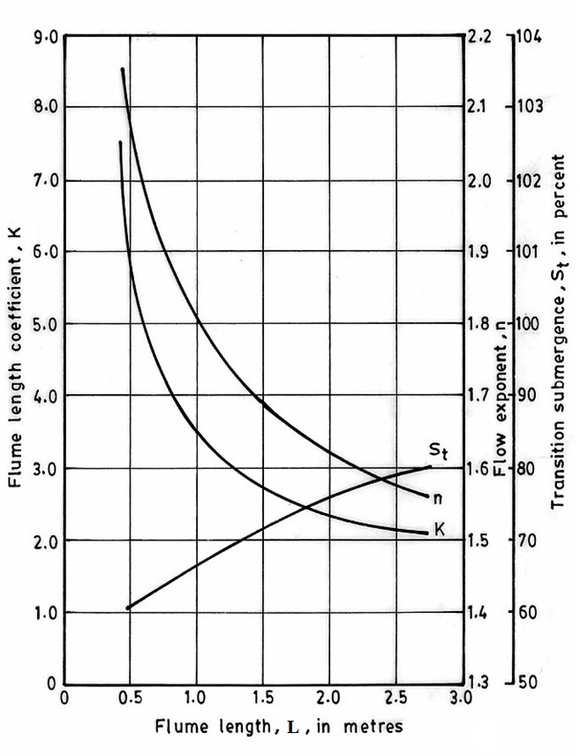
Fig. 3 Generalized free flow coefficients and exponents and S_{t} for cut-throat flumes

Slide 13
4. Required Apparatus
Cut throat flume
Flow measuring unit
Pump
Reservoir
Water meter

Slide 14
5. Experimental Procedure
To determine the theoretical discharge for the free flow condition
Measure the head H_{a}.
Determine the values of K and n from Fig. 2.
Determine the value of C using Eq. (3).
Determine the theoretical discharge using Eq. (1).
To determine the submergence ratio and check the effect of submergence
Measure the heads H_{a} and H_{b} and determine the submergence ratio H_{b}/H_{a}.
Determine the transition submergence S_{t} from Fig. (3).
If submergence ratio exceeds S_{t}, the flow is submerged.

Slide 15
Experimental Procedure (Contd….)
To determine the coefficient of discharge, measure the actual discharge from the water meter and calculate C_{df} using Eq. (3)
To verify the values of C and n
Plot Q_{a}vs H_{a} in a log log paper.
Slope of the plotted line gives the value of n.
Using the value of n for any set of values of Q_{a} and H_{a}, find C using Eq. (1).

Slide 16
Shape of Q vs H_{a} graph????
In plain and log-log graph paper

Slide 17
6. Experimental Data Sheet
Throat width, W= m Flume Length, L= m
From graph, k= , n= , S_{t} =
SL No | Qa (m3/s) | H_{a} (m) | C | Qtf (m³/s) | Cdf | H_{b} (m) | Submergence Ratio, H_{b}/H_{a} | Comments on submergence

Slide 18
7. Sample Calculation
(Graph must be added between sample calculation and results)
8. Results

Slide 19
9. Discussion on Results
10. Assignment
What are the advantages, disadvantages and use of a cut throat flume?
Which one of the three flow measuring devices, viz. Venturi flume, Parshall flume and cut throat flume, seems to be the best in project of Bangladesh? Justify your answer.

