Slide 1

Group-2
Rajshahi University of Engineering & Technology
DEPARTMENT OF CIVIL ENGINEERING

Slide 2
Course code: CE 3218
Course Title : Reinforced Concrete Sessional-II
Submitted By
1700074,1700075,1700076,1700077,
1700078,1700079,1700080,1700081,
1700082,1700083,1700084,1700085,
1700086
Submitted To
Dr. Abu Sufian Md. Zia Hasan
Professor, Civil Engineering
Rajshahi University of Engineering & Technology
Group: 02

Slide 3
PRESENTATION ON
Footing Design of a Two Storied Residential Building

Slide 4
What is footing
Footing is a part of foundation which is constructed with reinforced concrete or brickwork masonry and acts as a base to the floor columns and floor walls.
The main function of footing is to transfer the vertical loads directly to the soil.

Slide 5
Some pictures of footing in RUET

Slide 6
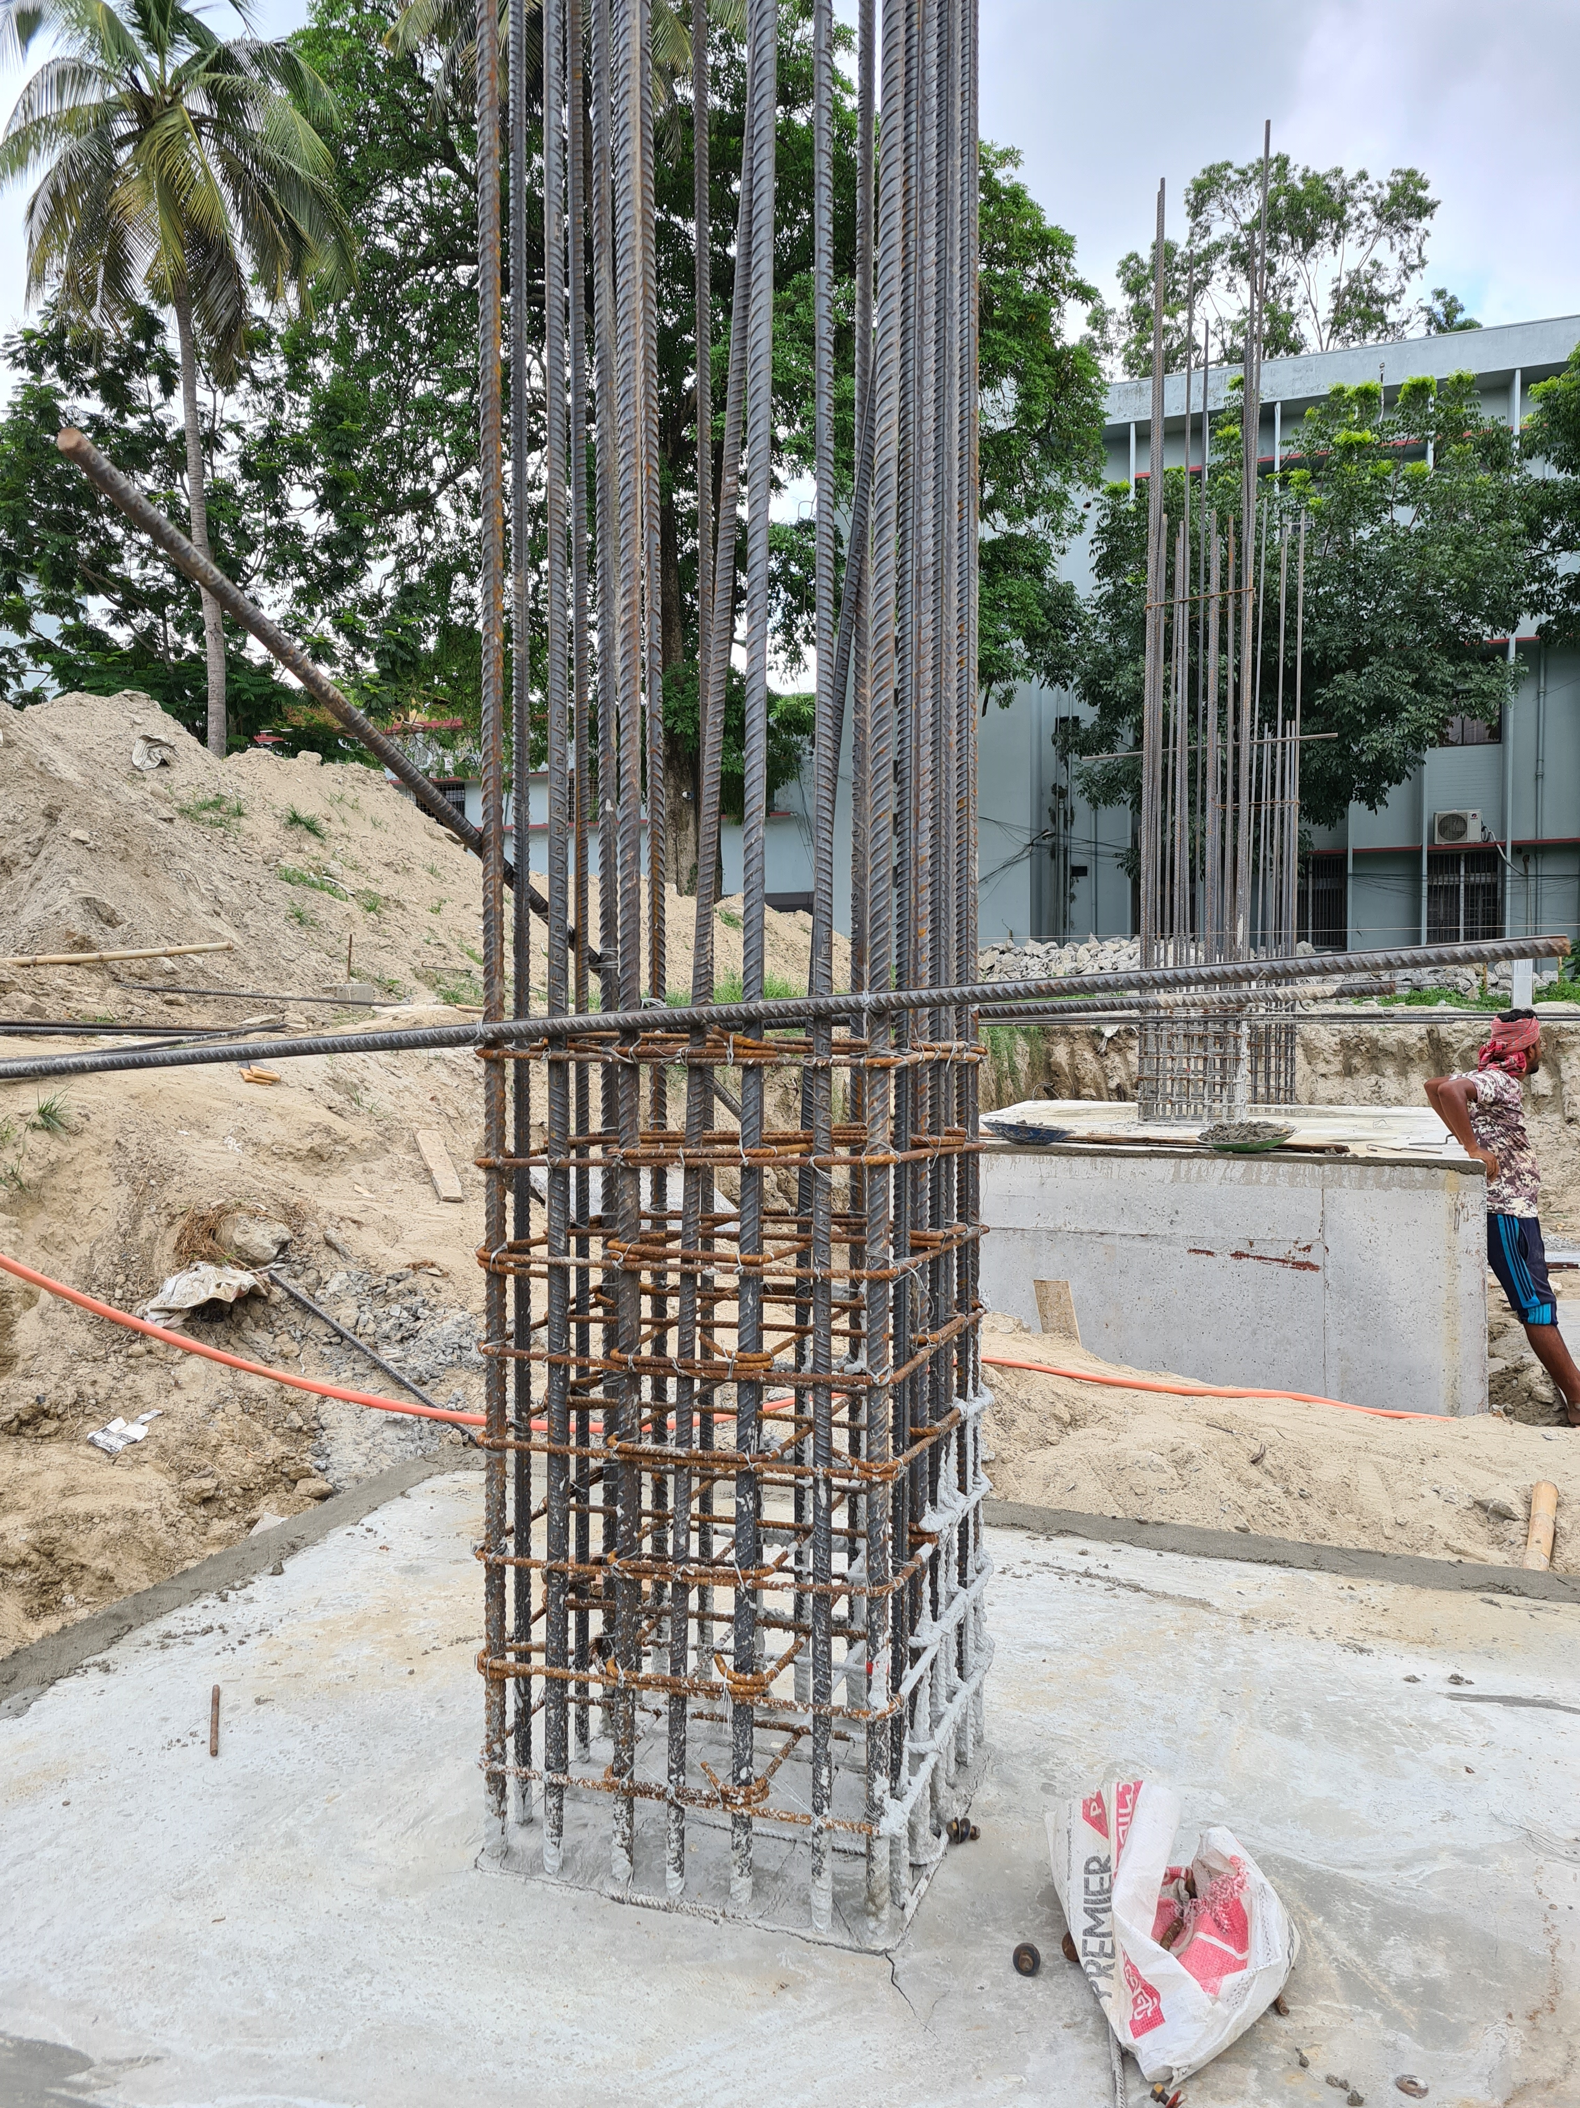
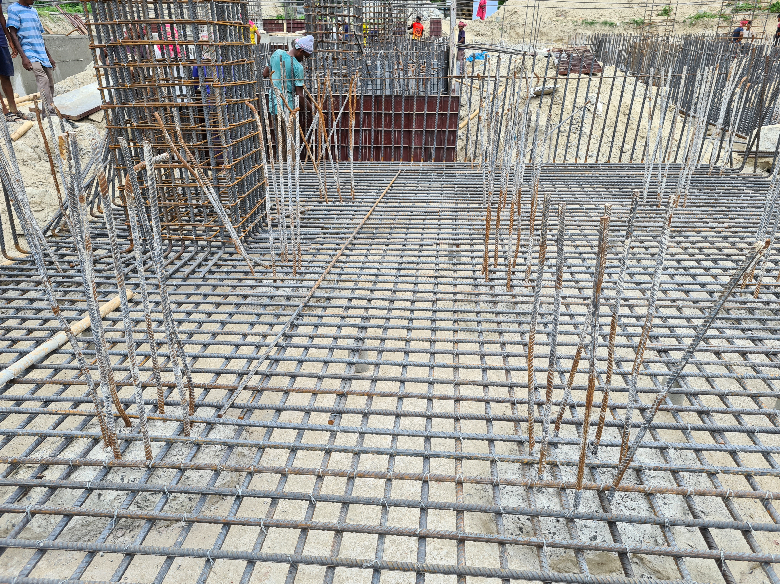

Slide 7
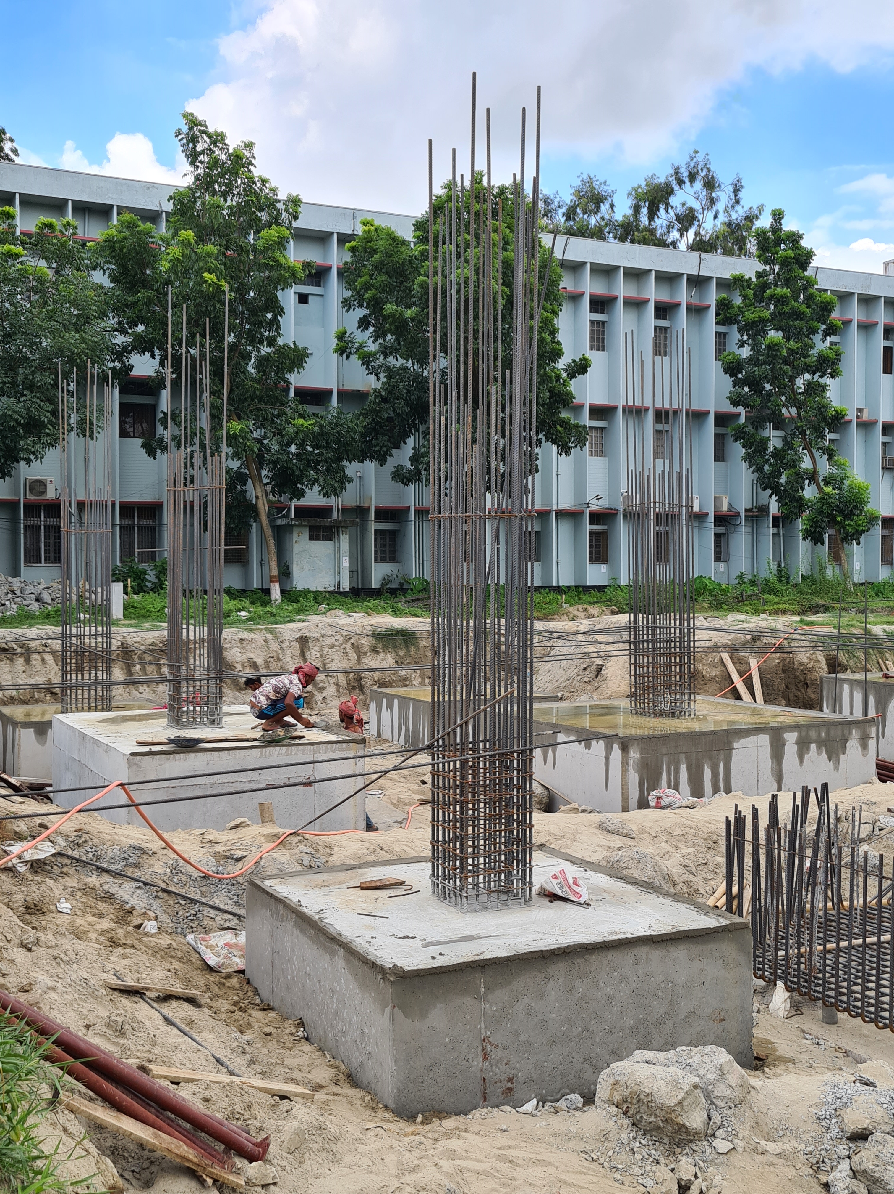

Slide 8
The objectives of footing
To distribute the load of structure over the large bearing area.
To prevent unequal settlement.
To prevent the lateral movement of the supporting material.
To increase the stability of the structure as a whole.

Slide 9
Types of footing
Wall footing
Single column footing
Combined footing
Strap footing
Mat or raft footing

Slide 10
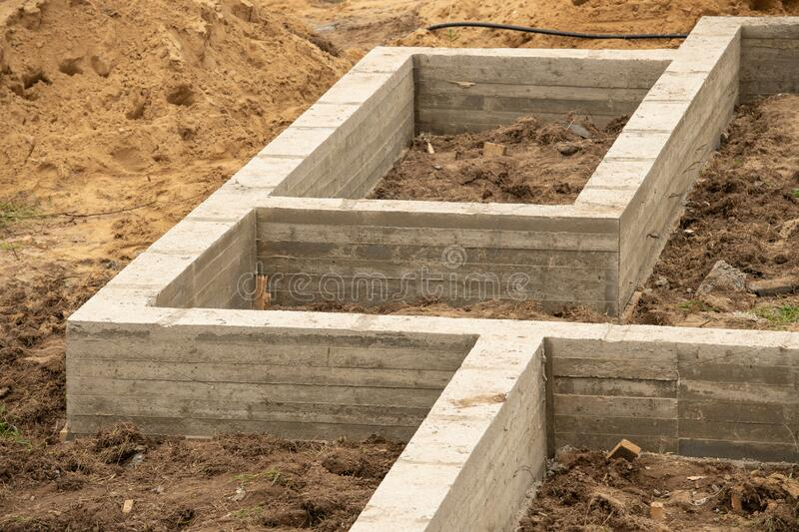
Wall footing
A wall footing is a continuous strip of reinforced concrete wider than the wall that distributes pressure.

Slide 11
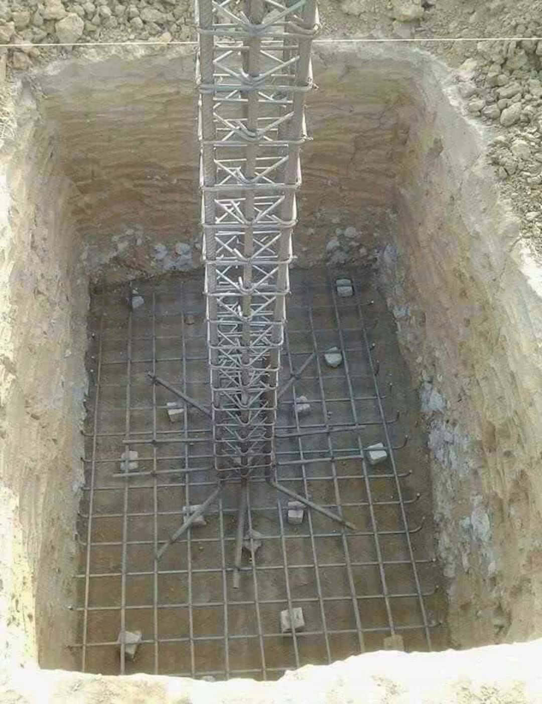
Single column footing
They are usually square, sometimes rectangular and represent the simplest and most economical type.
When footing is provided to support an individual column, it is called isolated or single column footing.

Slide 12
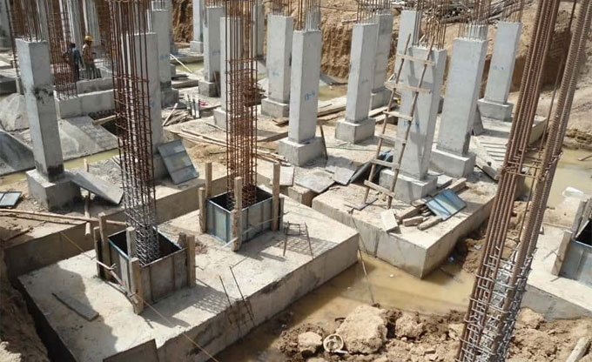
Combined footing
Combined footings are constructed for two or more columns when they are close to each other and their foundations overlap.

Slide 13
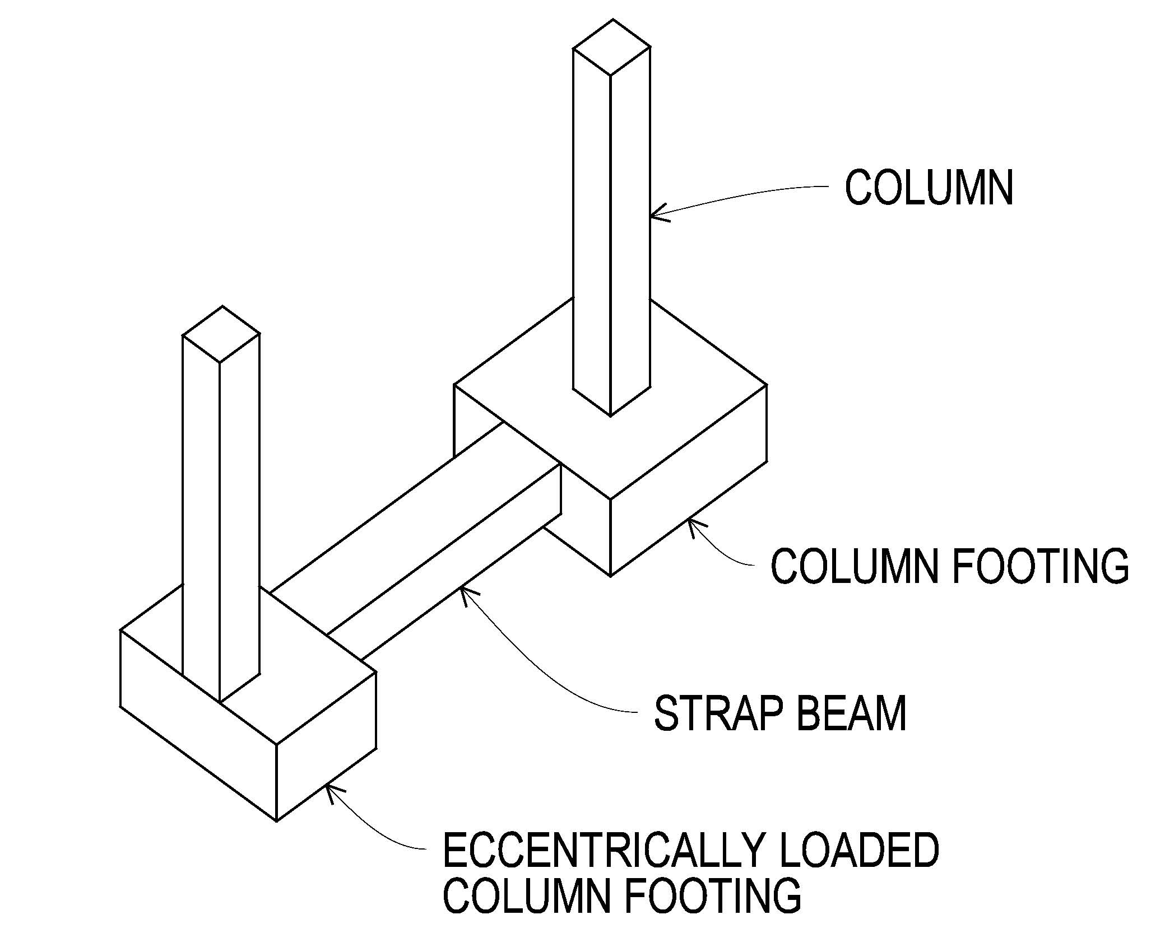
Strap footing
It consists of two single column footing connected with a structural strap. The strap connects the footing such that they behave as one unit.
A strap footing is more economical than combined footing.

Slide 14
Mat or raft footing
It is a large soil reinforced concrete slab that extends under the entire building and consequently distributes the load of the structure over the maximum available area. Such foundation minimizes differential settlement.
A mat is required when the allowable soil pressure is low or where the columns and walls are so close that individual footings overlap or nearly touch each other.

Slide 15
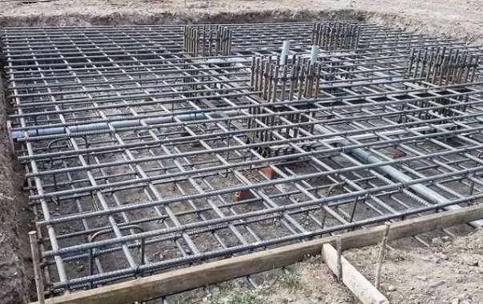

Slide 16
Types of failure of a footing
There are three types of failure of a footing-
General shear failure
Local shear failure
Punching shear failure

Slide 17
Footing design of a two storied residential building

Slide 18
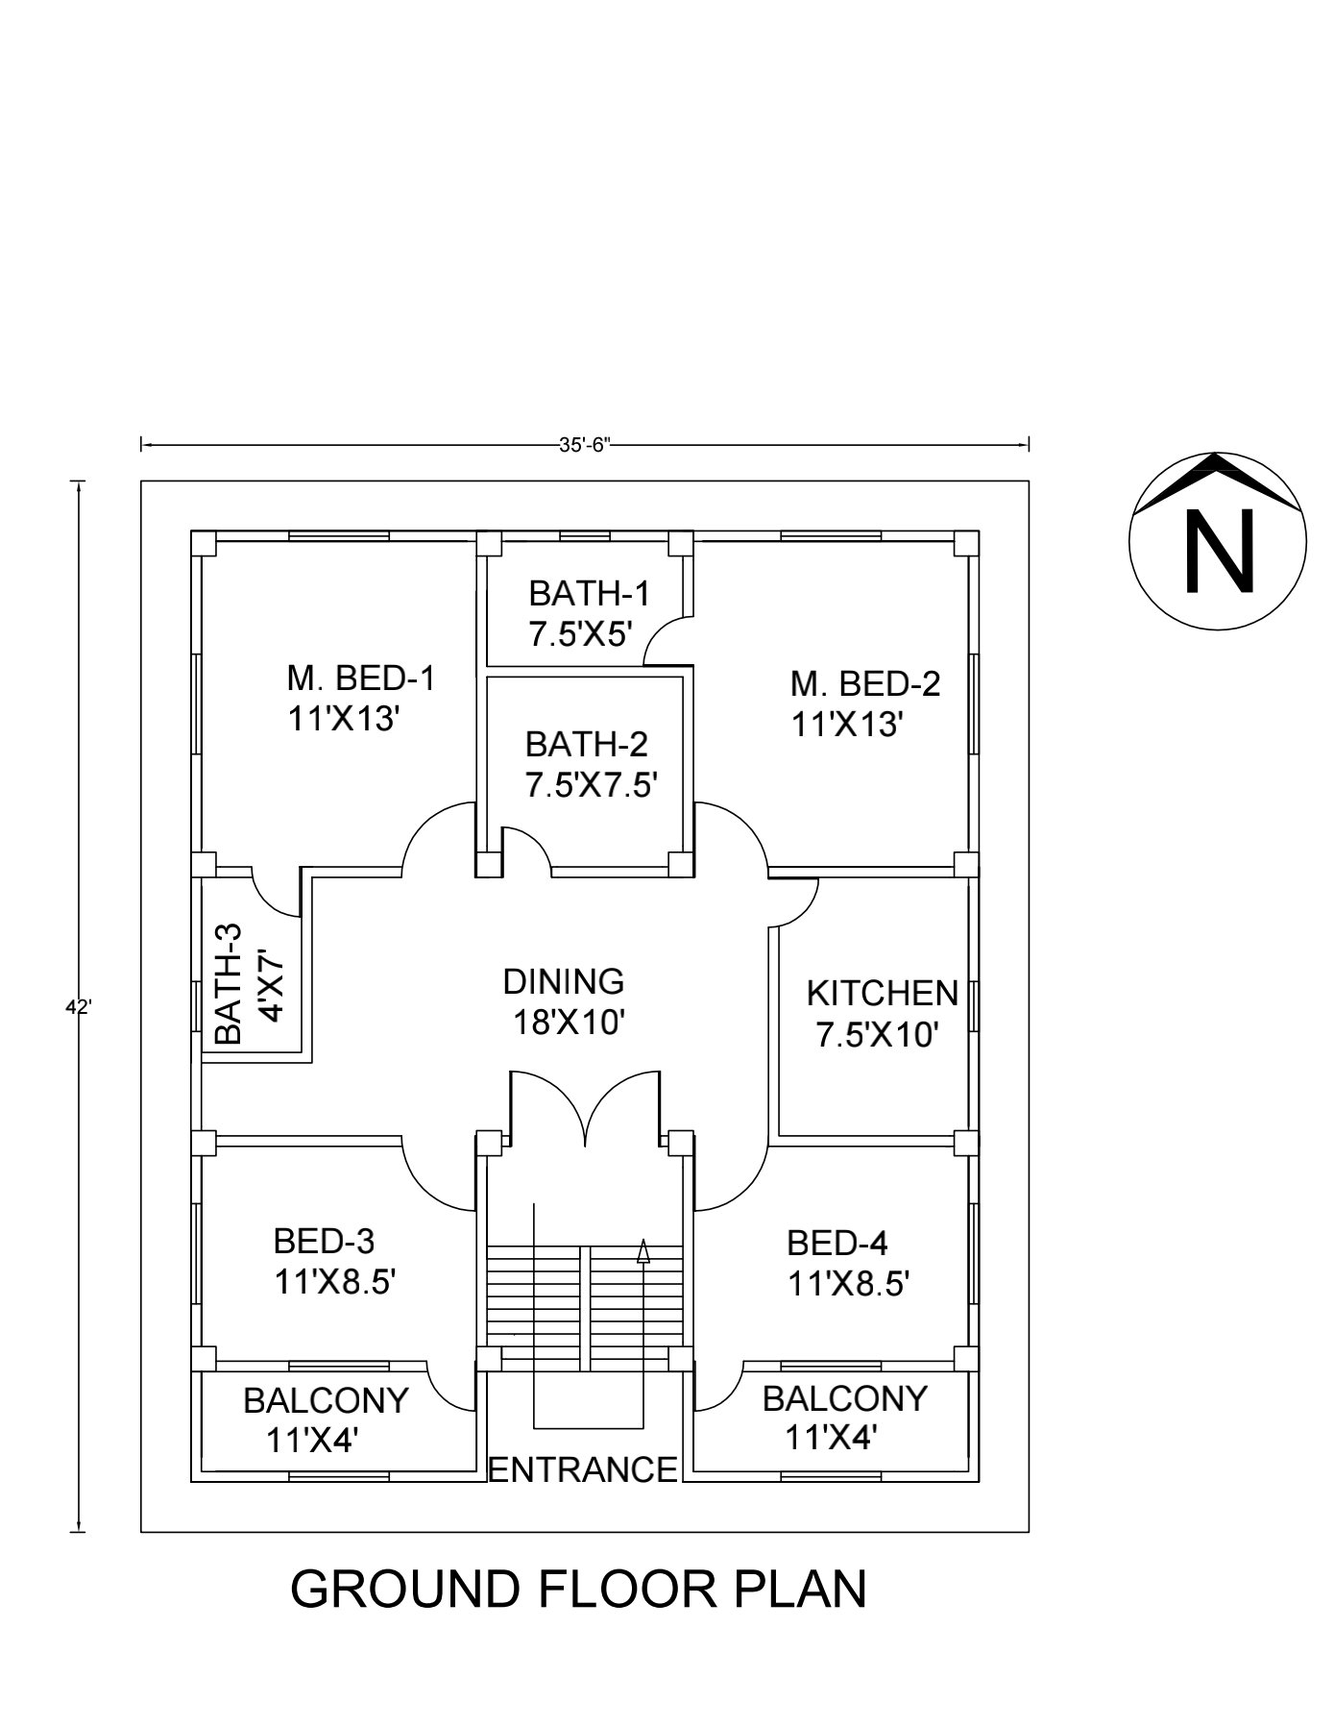
Ground floor plan

Slide 19
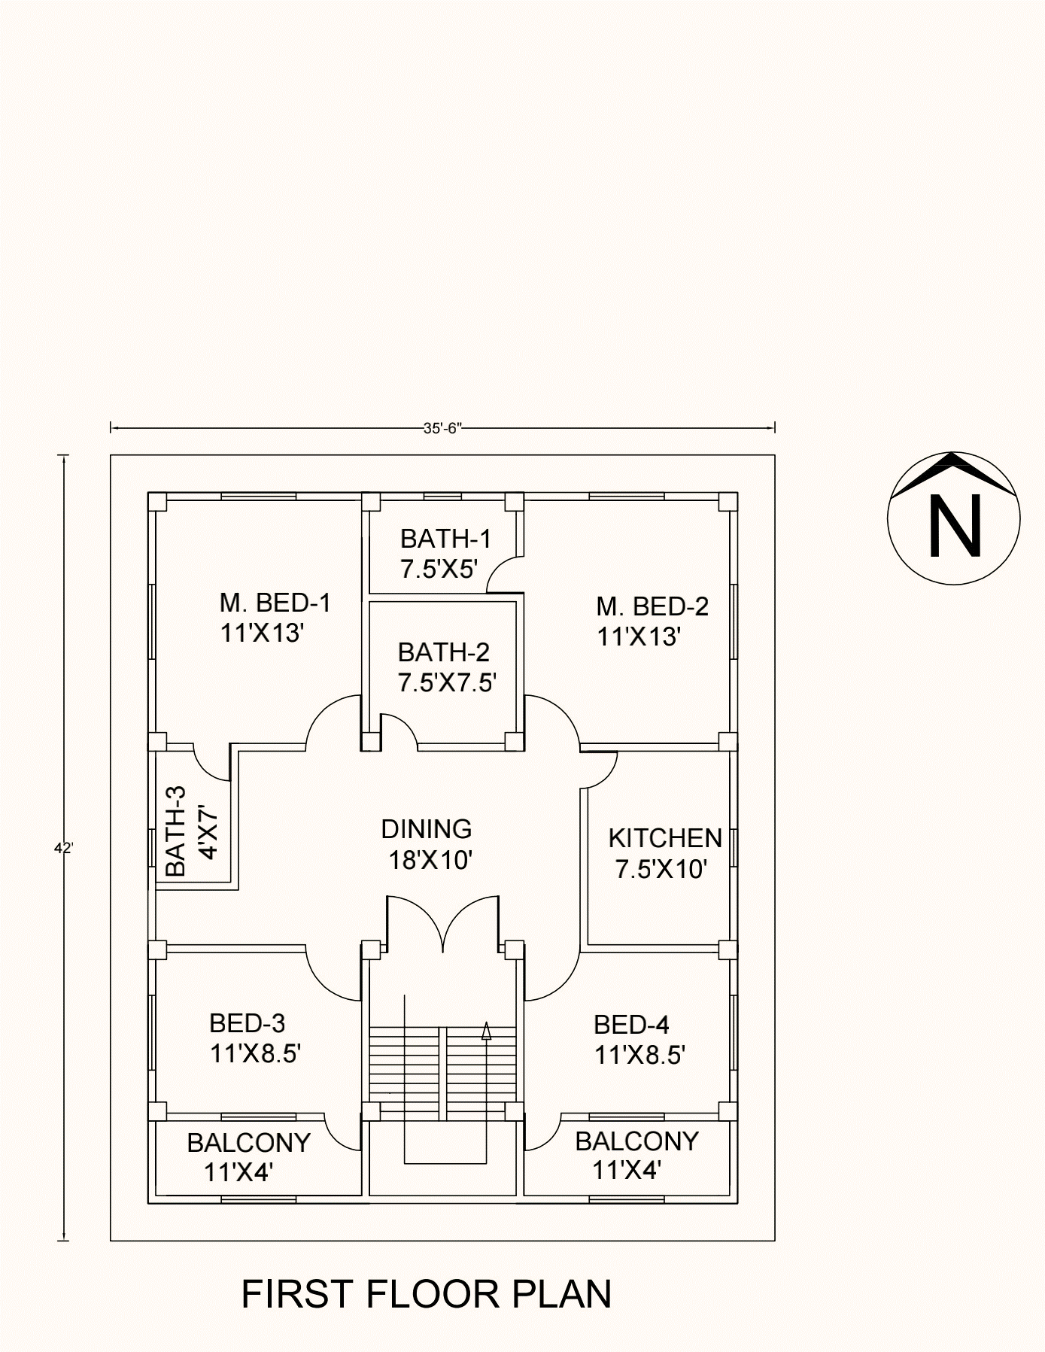
First floor plan

Slide 20
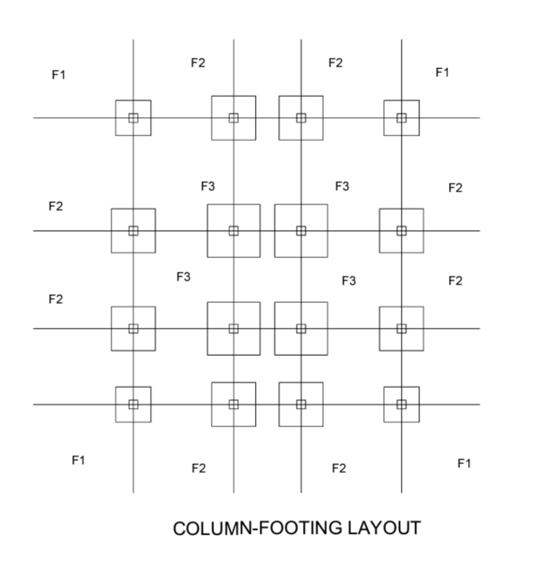
Column footing layout

Slide 21
The design steps
Calculation of ultimate bearing capacity
Punching shear check
Beam shear check
Moment Calculation
Reinforcement Calculation
Working Diagram

Slide 22
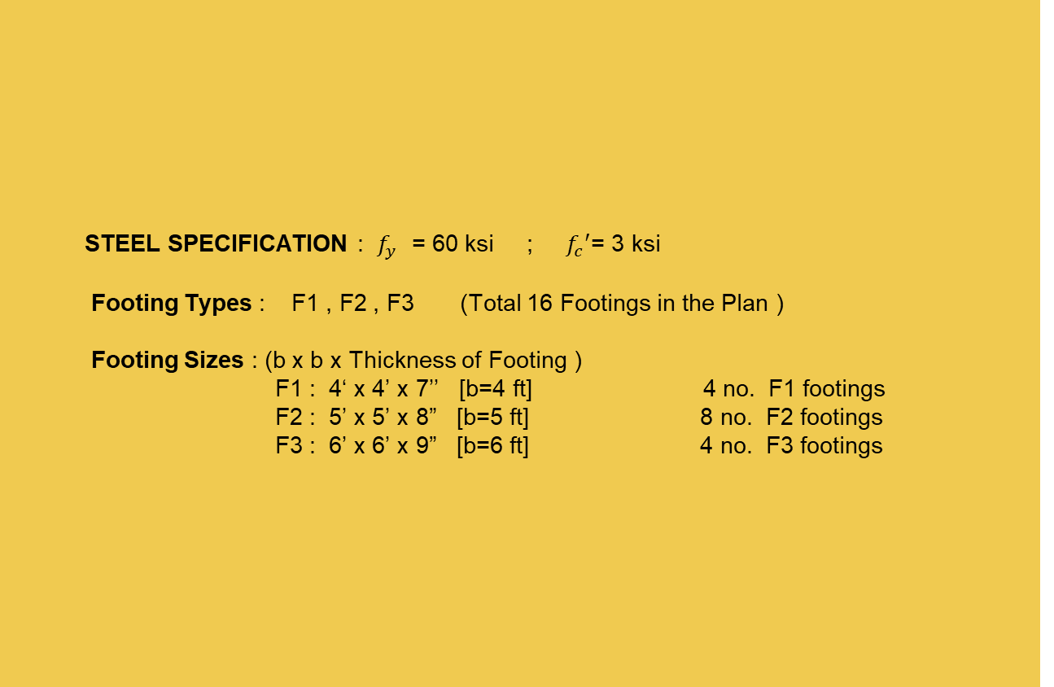
STEEL SPECIFICATION : $f_{y}$ = 60 ksi ; $f_{c}′$= 3 ksi
Footing Types : F1 , F2 , F3 (Total 16 Footings in the Plan )
Footing Sizes : (b x b x Thickness of Footing )
F1 : 4‘ x 4’ x 7’’ [b=4 ft] 4 no. F1 footings
F2 : 5’ x 5’ x 8” [b=5 ft] 8 no. F2 footings
F3 : 6’ x 6’ x 9” [b=6 ft] 4 no. F3 footings
Specifications For Footing
Allowable Bearing Capacity of Soil : q_{all} = 2 k/ft²
Depth of Footing : D_{f} = 5 ft

Slide 23

Specifications For Footing
Fill of Soil on the top of footings : (D_{fill} )
F1 : (5 - $\frac{7}{12}$) = 4.42 ft
F2 : (5 - $\frac{8}{12}$) = 4.33 ft
F3: (5 - $\frac{9}{12}$) = 4.25 ft
Column Size :
C1 : ${12}^{′′}$x ${12}^{′′}$
C2 : ${12}^{′′}$x ${12}^{′′}$
C3 : ${12}^{′′}$x ${12}^{′′}$
For all columns ,
a = 12 inch = 1 ft (Minimum according to BNBC )
Load Data :
F1 : Dead Load = 14 kips , Live Load = 8 kips
F2 : Dead Load= 20 kips , Live Load = 12 kips
F3 : Dead Load = 30 kips , Live Load = 18 kips

Slide 24


12 in.
F1 Footing Design
$$D_{f}=5 ft$$
7 in.
$q_{all}$ = 2 k/${ft}^{2}$
b = 4 ft

Slide 25
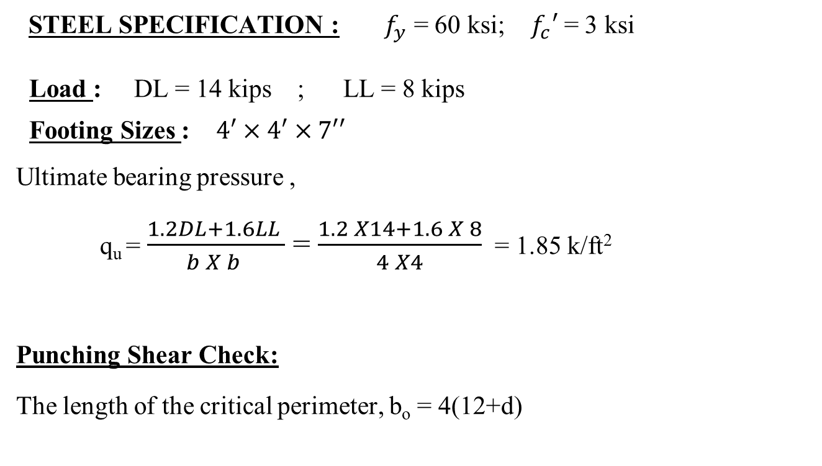
STEEL SPECIFICATION : $f_{y}$ = 60 ksi; $f_{c}′$ = 3 ksi
Load : DL = 14 kips ; LL = 8 kips
Footing Sizes : $4′×4′×7′′$
Ultimate bearing pressure ,
q_{u} = $\frac{1.2DL+1.6LL }{b X b }$ = $\frac{1.2 X14+1.6 X 8}{4 X4}$ = 1.85 k/ft²
Punching Shear Check:
The length of the critical perimeter, b_{o} = 4(12+d)
F1 Footing Design
f
g
a
12’’
b
c
d
d₁
d
1.5ft
e
h
4 ft

Slide 26
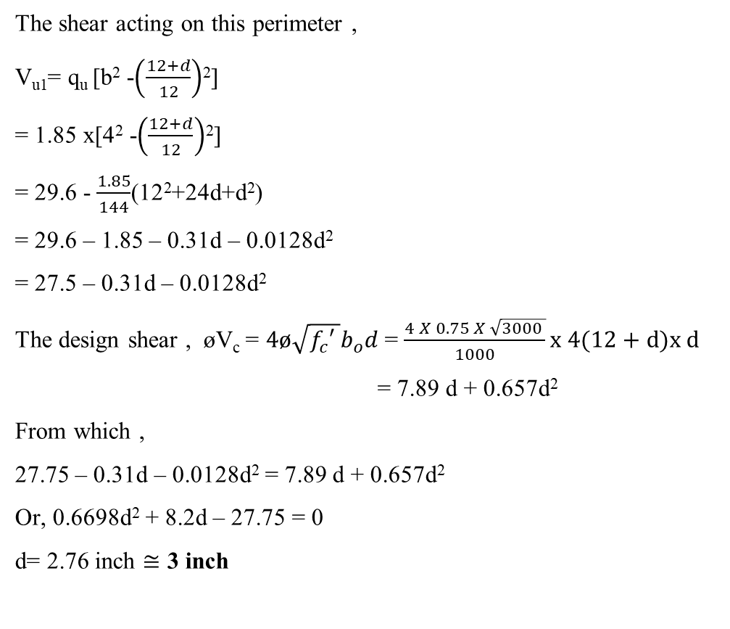
The shear acting on this perimeter ,
V_{u1}= q_{u} [b² -$\left(\frac{12+d}{12}\right)$²]
= 1.85 x[4² -$\left(\frac{12+d}{12}\right)$²]
= 29.6 - $\frac{1.85}{144}$(12²+24d+d²)
= 29.6 – 1.85 – 0.31d – 0.0128d²
= 27.5 – 0.31d – 0.0128d²
The design shear , øV_{c} = $4ø\sqrt{f_{c}′ }b_{o}d$ = $\frac{4 X 0.75 X \sqrt{3000 }}{1000}x 4(12+d)x d$
= 7.89 d + 0.657d²
From which ,
27.75 – 0.31d – 0.0128d² = 7.89 d + 0.657d²
Or, 0.6698d² + 8.2d – 27.75 = 0
d= 2.76 inch $≅$ 3 inch
F1 Footing Design

Slide 27
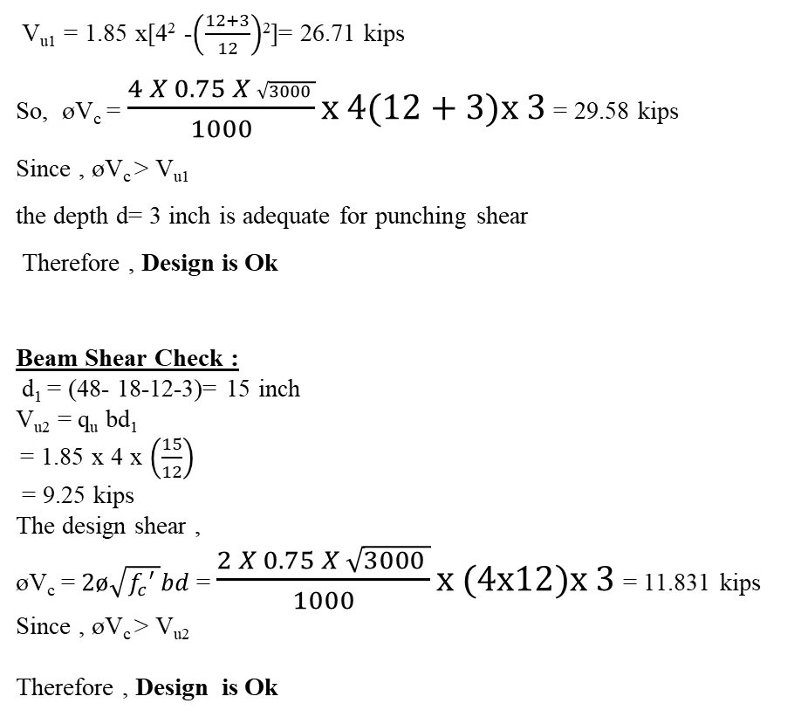
V_{u1} = 1.85 x[4² -$\left(\frac{12+3}{12}\right)$²]= 26.71 kips
So, øV_{c} = $\frac{4 X 0.75 X \sqrt{3000 }}{1000}x 4(12+3)x 3$ = 29.58 kips
Since , øV_{c} > V_{u1}
the depth d= 3 inch is adequate for punching shear
Therefore , Design is Ok
Beam Shear Check :
d₁ = (48- 18-12-3)= 15 inch
V_{u2} = q_{u} bd₁
= 1.85 x 4 x $\left(\frac{15}{12}\right)$
= 9.25 kips
The design shear ,
øV_{c} = $2ø\sqrt{f_{c}′ }bd$ = $\frac{2 X 0.75 X \sqrt{3000 }}{1000}x (4x12)x 3$ = 11.831 kips
Since , øV_{c} > V_{u2}
Therefore , Design is Ok
F1 Footing Design

Slide 28
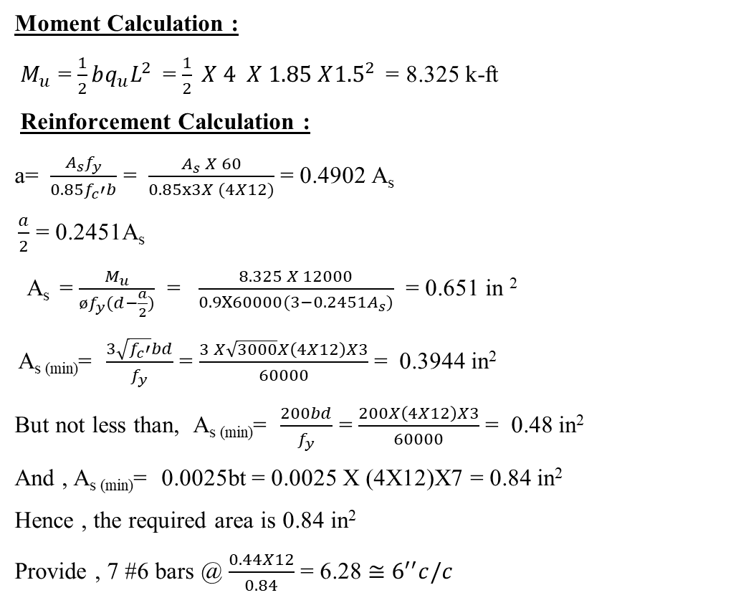
Moment Calculation :
$M_{u}$ = $\frac{1}{2}bq_{u}L^{2}$ = $\frac{1}{2} X 4 X 1.85 X{1.5}^{2}$ = 8.325 k-ft
Reinforcement Calculation :
a= $\frac{A_{s}f_{y}}{0.85f_{c}′b}$ = $\frac{A_{s} X 60}{0.85x3X (4X12)}$ = 0.4902 A_{s}
$\frac{a}{2}$ = 0.2451A_{s}
A_{s} = $\frac{M_{u}}{øf_{y}(d−\frac{a}{2})}$ = $\frac{8.325 X 12000}{0.9X60000(3−{0.2451A}_{s})}$ = 0.651 in ²
A_{s (min)}= $\frac{3\sqrt{f_{c}′}bd}{f_{y}}$ = $\frac{3 X\sqrt{3000}X\left(4X12\right)X3}{60000}$ = 0.3944 in²
But not less than, A_{s (min)}= $\frac{200bd}{f_{y}}$ = $\frac{200X\left(4X12\right)X3}{60000}$ = 0.48 in²
And , A_{s (min)}= 0.0025bt = 0.0025 X (4X12)X7 = 0.84 in²
Hence , the required area is 0.84 in²
Provide , 7 #6 bars @ $\frac{0.44X12}{0.84}$ = 6.28 $≅$ $6^{′′}c/c$
F1 Footing Design

Slide 29
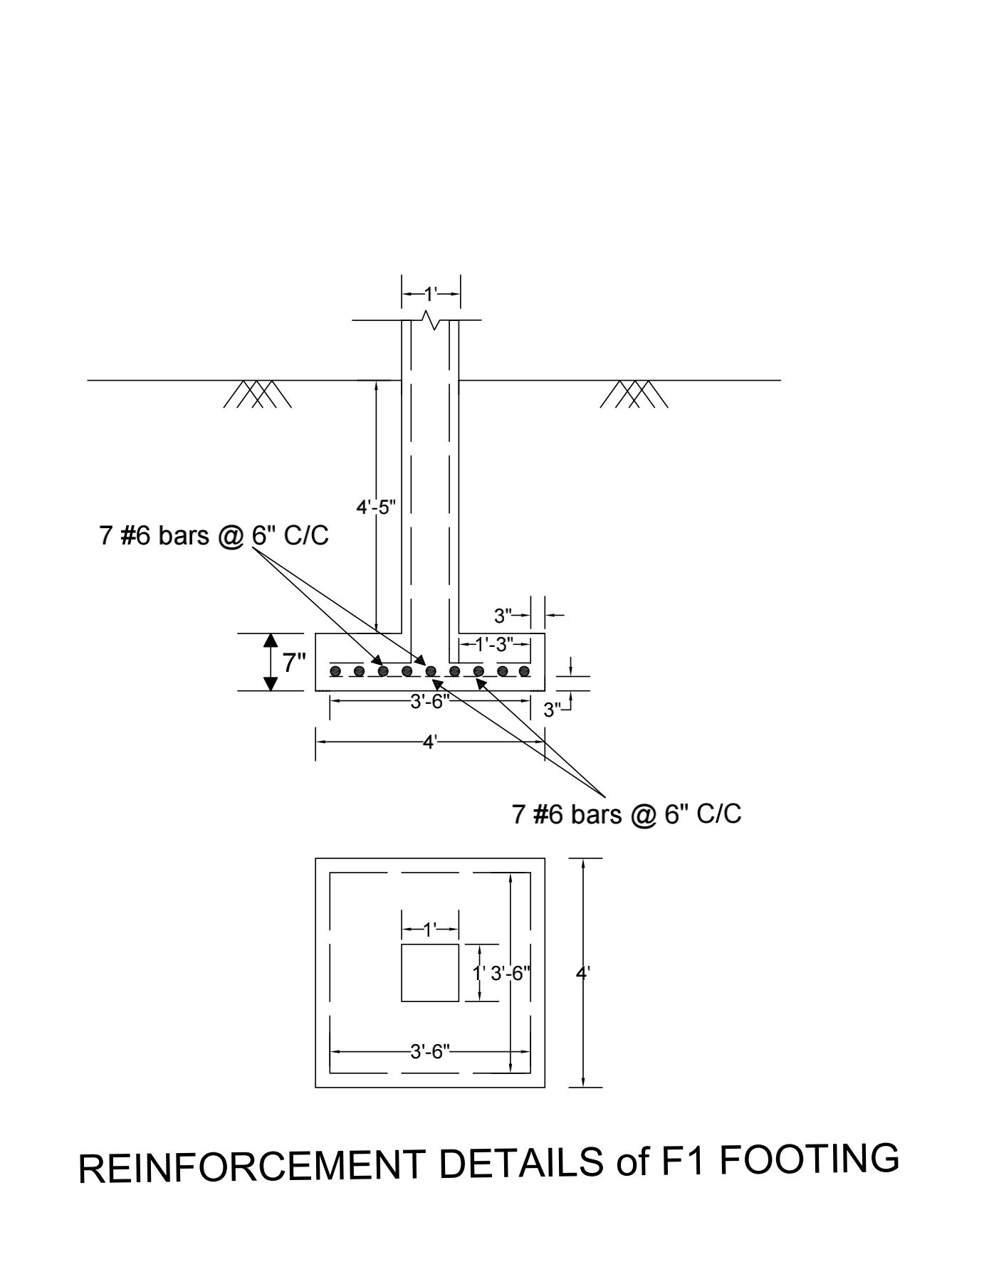
REINFORCEMENT DETAILS of F1 FOOTING

Slide 30


F2 Footing Design
12 in.
$$D_{f}=5 ft$$
8 in.
$q_{all}$ = 2 k/${ft}^{2}$
b = 5 ft

Slide 31
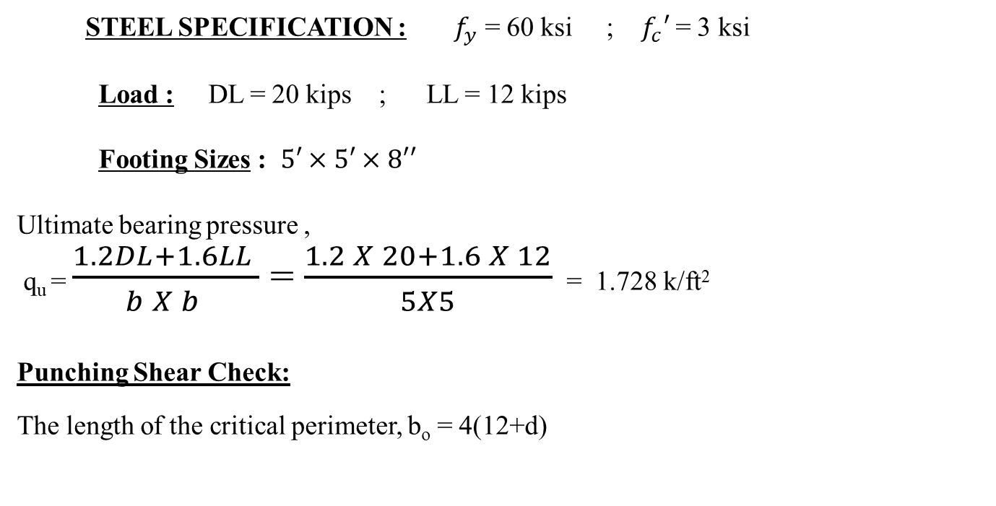
STEEL SPECIFICATION : $f_{y}$ = 60 ksi ; $f_{c}′$ = 3 ksi
Load : DL = 20 kips ; LL = 12 kips
Footing Sizes : $5′×5′×8′′$
Ultimate bearing pressure ,
q_{u} = $\frac{1.2DL+1.6LL }{b X b }$ = $\frac{1.2 X 20+1.6 X 12}{5X5}$ = 1.728 k/ft²
Punching Shear Check:
The length of the critical perimeter, b_{o} = 4(12+d)
F2 Footing Design
f
g
a
12’’
b
c
d
d₁
d
2 ft
e
h
5 ft

Slide 32
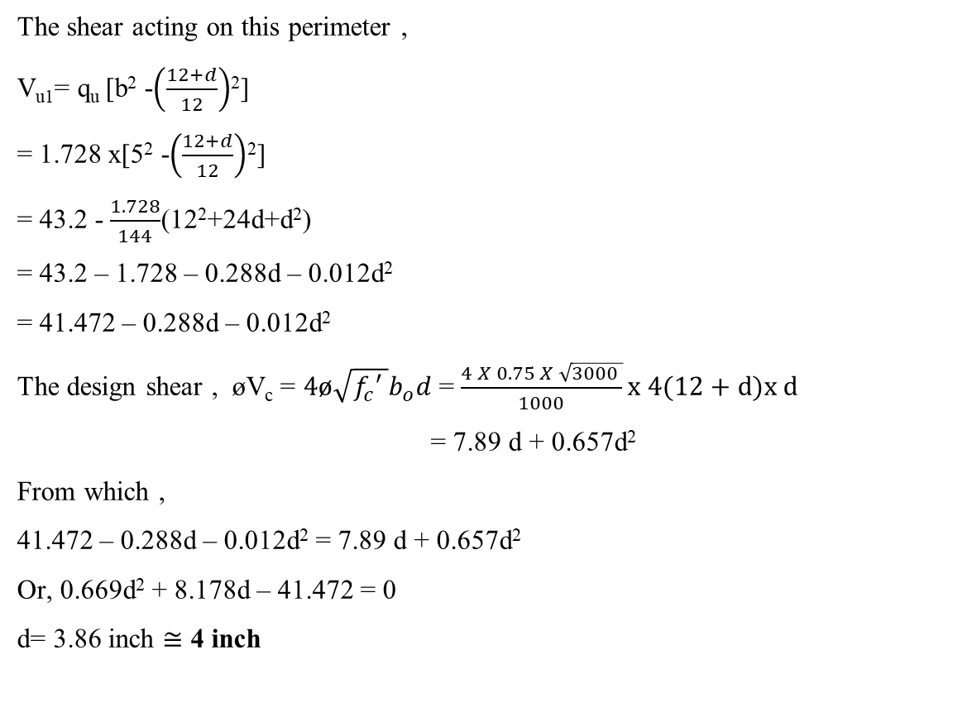
The shear acting on this perimeter ,
V_{u1}= q_{u} [b² -$\left(\frac{12+d}{12}\right)$²]
= 1.728 x[5² -$\left(\frac{12+d}{12}\right)$²]
= 43.2 - $\frac{1.728}{144}$(12²+24d+d²)
= 43.2 – 1.728 – 0.288d – 0.012d²
= 41.472 – 0.288d – 0.012d²
The design shear , øV_{c} = $4ø\sqrt{f_{c}′ }b_{o}d$ = $\frac{4 X 0.75 X \sqrt{3000 }}{1000}x 4(12+d)x d$
= 7.89 d + 0.657d²
From which ,
41.472 – 0.288d – 0.012d² = 7.89 d + 0.657d²
Or, 0.669d² + 8.178d – 41.472 = 0
d= 3.86 inch $≅$ 4 inch
F2 Footing Design

Slide 33
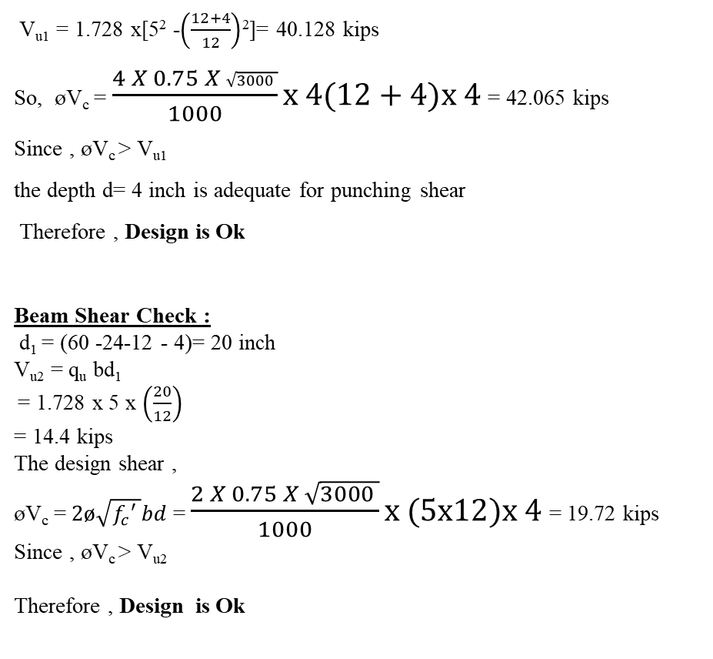
V_{u1} = 1.728 x[5² -$\left(\frac{12+4}{12}\right)$²]= 40.128 kips
So, øV_{c} = $\frac{4 X 0.75 X \sqrt{3000 }}{1000}x 4(12+4)x 4$ = 42.065 kips
Since , øV_{c} > V_{u1}
the depth d= 4 inch is adequate for punching shear
Therefore , Design is Ok
Beam Shear Check :
d₁ = (60 -24-12 - 4)= 20 inch
V_{u2} = q_{u} bd₁
= 1.728 x 5 x $\left(\frac{20}{12}\right)$
= 14.4 kips
The design shear ,
øV_{c} = $2ø\sqrt{f_{c}′ }bd$ = $\frac{2 X 0.75 X \sqrt{3000 }}{1000}x (5x12)x 4$ = 19.72 kips
Since , øV_{c} > V_{u2}
Therefore , Design is Ok
F2 Footing Design

Slide 34
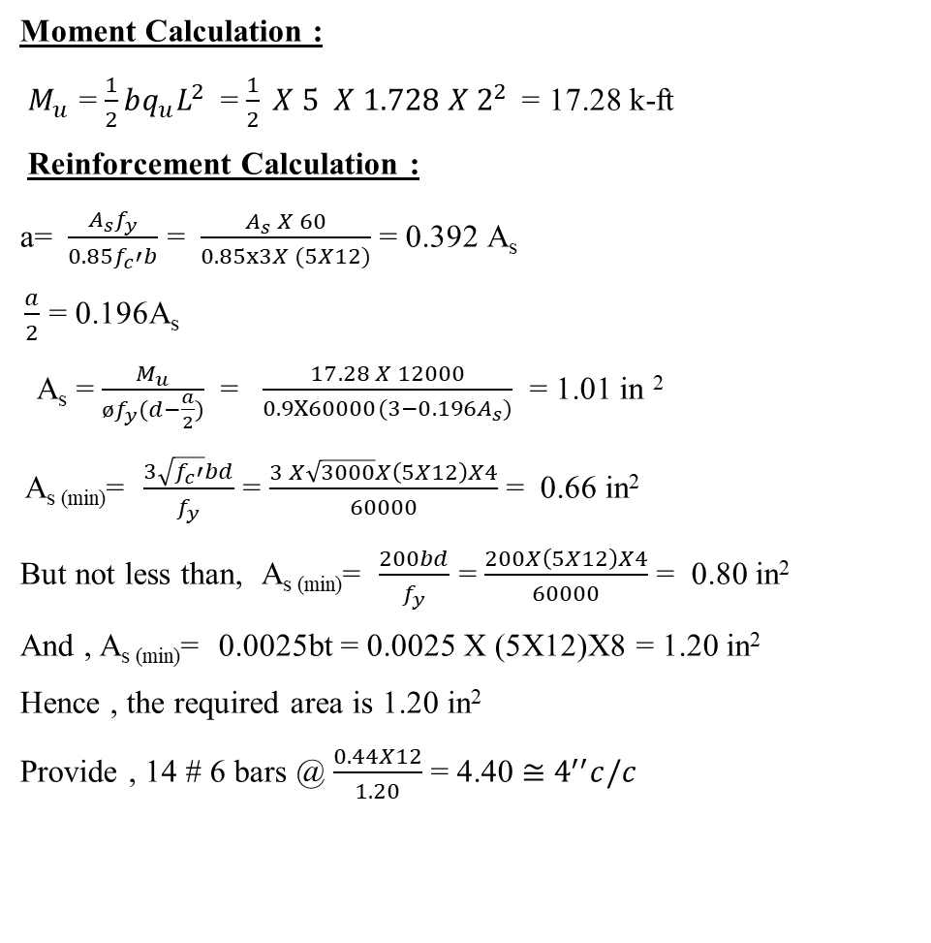
Moment Calculation :
$M_{u}$ = $\frac{1}{2}bq_{u}L^{2}$ = $\frac{1}{2} X 5 X 1.728 X{ 2}^{2}$ = 17.28 k-ft
Reinforcement Calculation :
a= $\frac{A_{s}f_{y}}{0.85f_{c}′b}$ = $\frac{A_{s} X 60}{0.85x3X (5X12)}$ = 0.392 A_{s}
$\frac{a}{2}$ = 0.196A_{s}
A_{s} = $\frac{M_{u}}{øf_{y}(d−\frac{a}{2})}$ = $\frac{17.28 X 12000}{0.9X60000(3−{0.196A}_{s})}$ = 1.01 in ²
A_{s (min)}= $\frac{3\sqrt{f_{c}′}bd}{f_{y}}$ = $\frac{3 X\sqrt{3000}X\left(5X12\right)X4}{60000}$ = 0.66 in²
But not less than, A_{s (min)}= $\frac{200bd}{f_{y}}$ = $\frac{200X\left(5X12\right)X4}{60000}$ = 0.80 in²
And , A_{s (min)}= 0.0025bt = 0.0025 X (5X12)X8 = 1.20 in²
Hence , the required area is 1.20 in²
Provide , 14 # 6 bars @ $\frac{0.44X12}{1.20}$ = 4.40 $≅$ $4^{′′}c/c$
F2 Footing Design

Slide 35
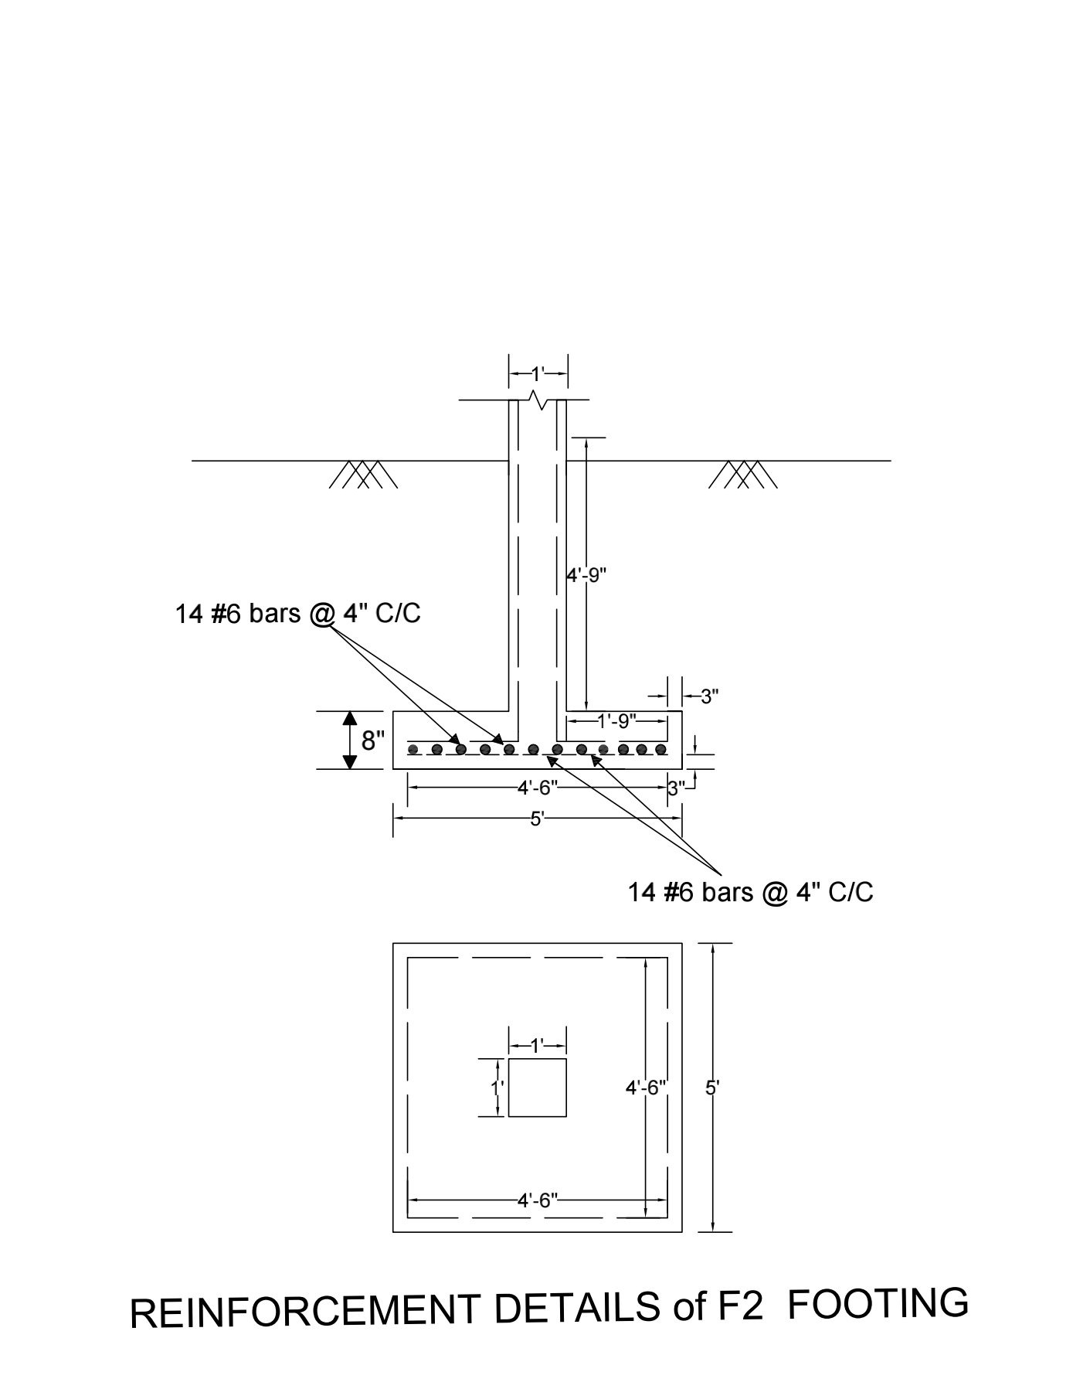
REINFORCEMENT DETAILS of F2 FOOTING

Slide 36


12 in.
F3 Footing Design
$$D_{f}=5 ft$$
9 in.
$q_{all}$ = 2 k/${ft}^{2}$
b = 6 ft

Slide 37
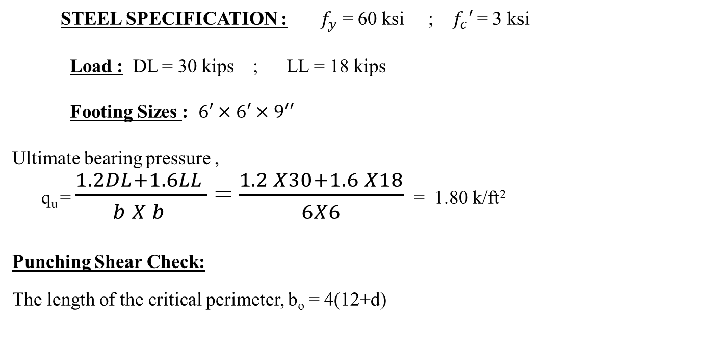
STEEL SPECIFICATION : $f_{y}$ = 60 ksi ; $f_{c}′$ = 3 ksi
Load : DL = 30 kips ; LL = 18 kips
Footing Sizes : $6′×6′×9′′$
Ultimate bearing pressure ,
q_{u} = $\frac{1.2DL+1.6LL }{b X b }$ = $\frac{1.2 X30+1.6 X18}{6X6}$ = 1.80 k/ft²
Punching Shear Check:
The length of the critical perimeter, b_{o} = 4(12+d)
F3 Footing Design
f
g
a
12’’
b
c
d
d₁
d
2.5 ft
e
h
6 ft

Slide 38
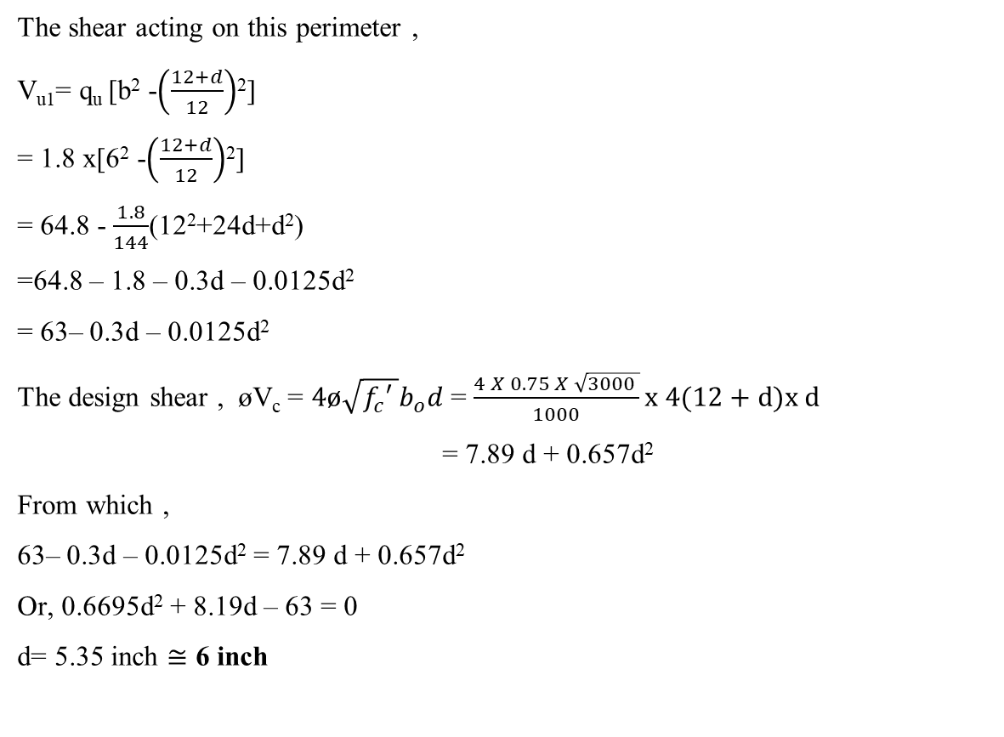
The shear acting on this perimeter ,
V_{u1}= q_{u} [b² -$\left(\frac{12+d}{12}\right)$²]
= 1.8 x[6² -$\left(\frac{12+d}{12}\right)$²]
= 64.8 - $\frac{1.8}{144}$(12²+24d+d²)
=64.8 – 1.8 – 0.3d – 0.0125d²
= 63– 0.3d – 0.0125d²
The design shear , øV_{c} = $4ø\sqrt{f_{c}′ }b_{o}d$ = $\frac{4 X 0.75 X \sqrt{3000 }}{1000}x 4(12+d)x d$
= 7.89 d + 0.657d²
From which ,
63– 0.3d – 0.0125d² = 7.89 d + 0.657d²
Or, 0.6695d² + 8.19d – 63 = 0
d= 5.35 inch $≅$ 6 inch
F3 Footing Design

Slide 39
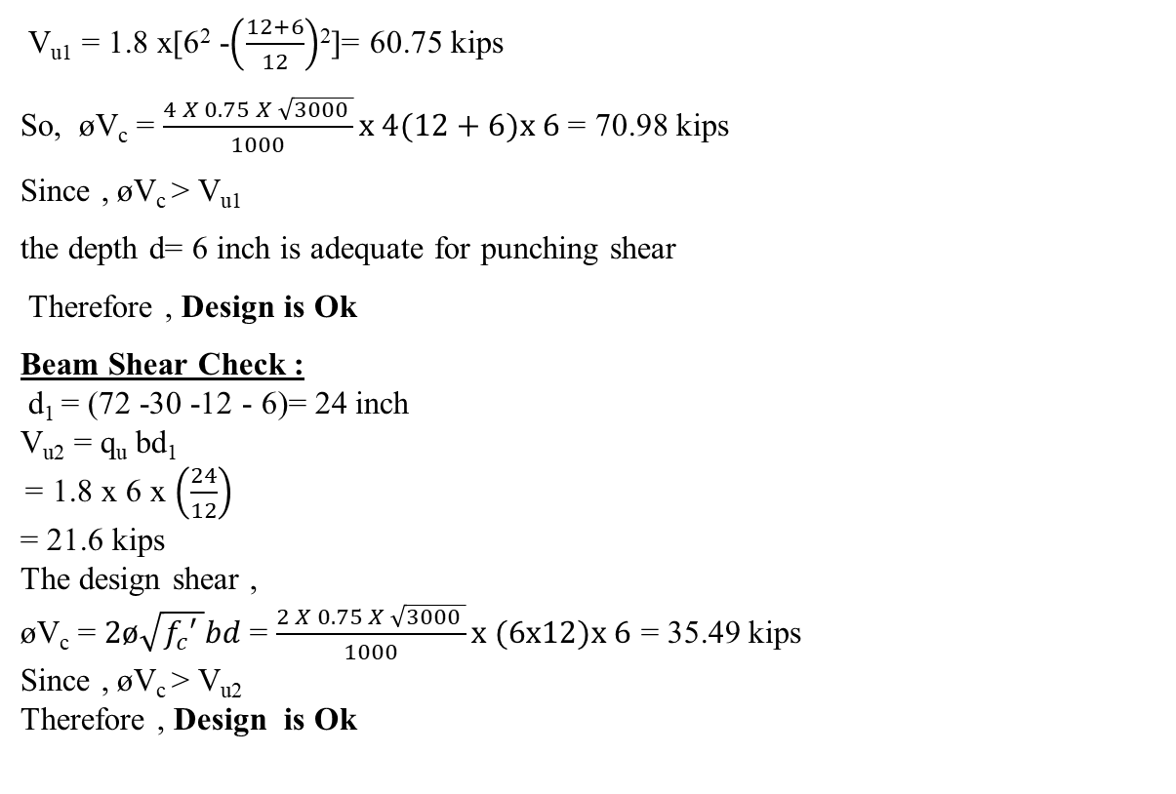
V_{u1} = 1.8 x[6² -$\left(\frac{12+6}{12}\right)$²]= 60.75 kips
So, øV_{c} = $\frac{4 X 0.75 X \sqrt{3000 }}{1000}x 4(12+6)x 6$ = 70.98 kips
Since , øV_{c} > V_{u1}
the depth d= 6 inch is adequate for punching shear
Therefore , Design is Ok
Beam Shear Check :
d₁ = (72 -30 -12 - 6)= 24 inch
V_{u2} = q_{u} bd₁
= 1.8 x 6 x $\left(\frac{24}{12}\right)$
= 21.6 kips
The design shear ,
øV_{c} = $2ø\sqrt{f_{c}′ }bd$ = $\frac{2 X 0.75 X \sqrt{3000 }}{1000}x (6x12)x 6$ = 35.49 kips
Since , øV_{c} > V_{u2}
Therefore , Design is Ok
F3 Footing Design

Slide 40
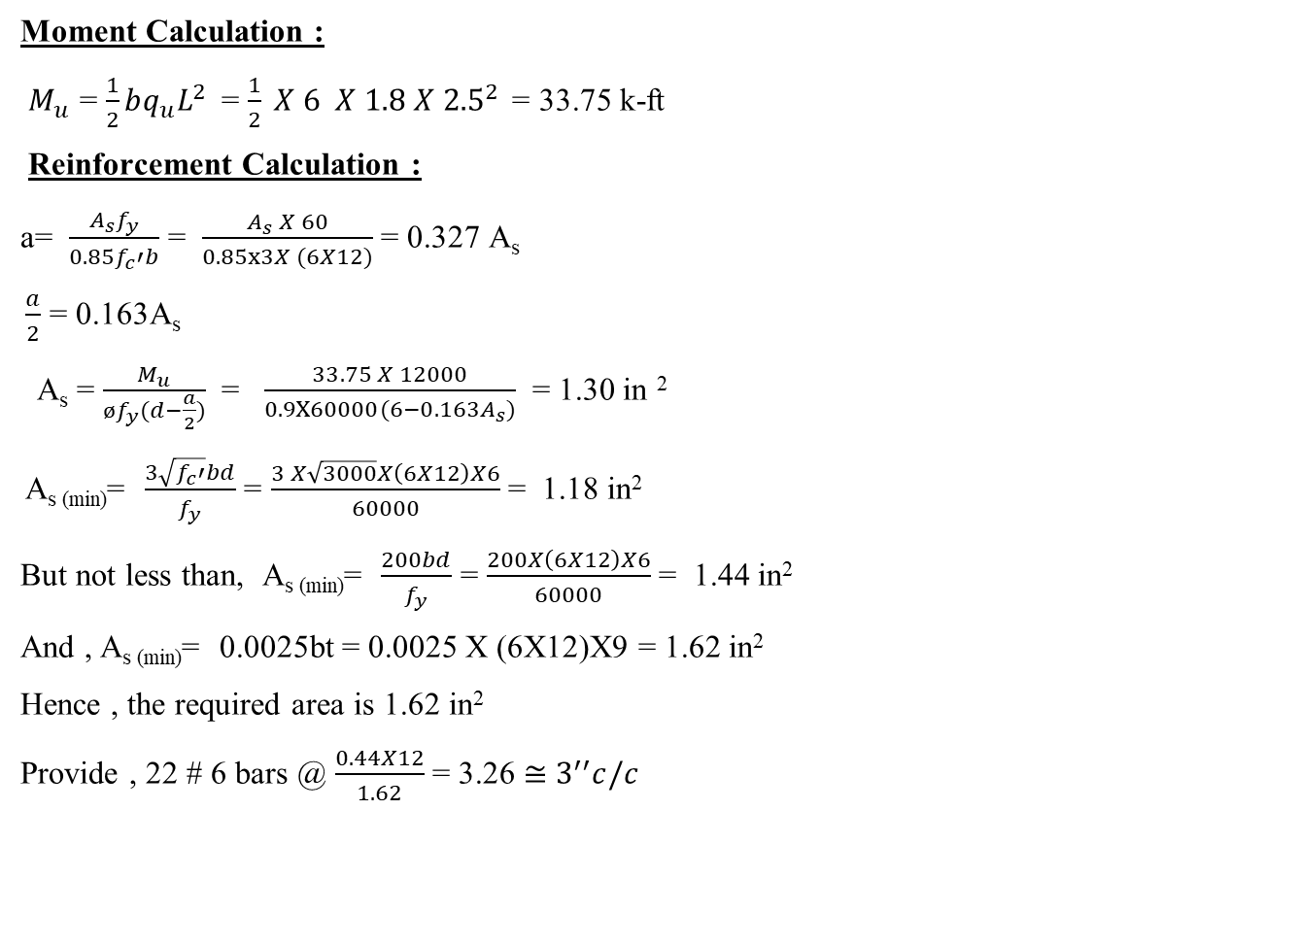
Moment Calculation :
$M_{u}$ = $\frac{1}{2}bq_{u}L^{2}$ = $\frac{1}{2} X 6 X 1.8 X{ 2.5}^{2}$ = 33.75 k-ft
Reinforcement Calculation :
a= $\frac{A_{s}f_{y}}{0.85f_{c}′b}$ = $\frac{A_{s} X 60}{0.85x3X (6X12)}$ = 0.327 A_{s}
$\frac{a}{2}$ = 0.163A_{s}
A_{s} = $\frac{M_{u}}{øf_{y}(d−\frac{a}{2})}$ = $\frac{33.75 X 12000}{0.9X60000(6−{0.163A}_{s})}$ = 1.30 in ²
A_{s (min)}= $\frac{3\sqrt{f_{c}′}bd}{f_{y}}$ = $\frac{3 X\sqrt{3000}X\left(6X12\right)X6}{60000}$ = 1.18 in²
But not less than, A_{s (min)}= $\frac{200bd}{f_{y}}$ = $\frac{200X\left(6X12\right)X6}{60000}$ = 1.44 in²
And , A_{s (min)}= 0.0025bt = 0.0025 X (6X12)X9 = 1.62 in²
Hence , the required area is 1.62 in²
Provide , 22 # 6 bars @ $\frac{0.44X12}{1.62}$ = 3.26 $≅$ $3^{′′}c/c$
F3 Footing Design

Slide 41
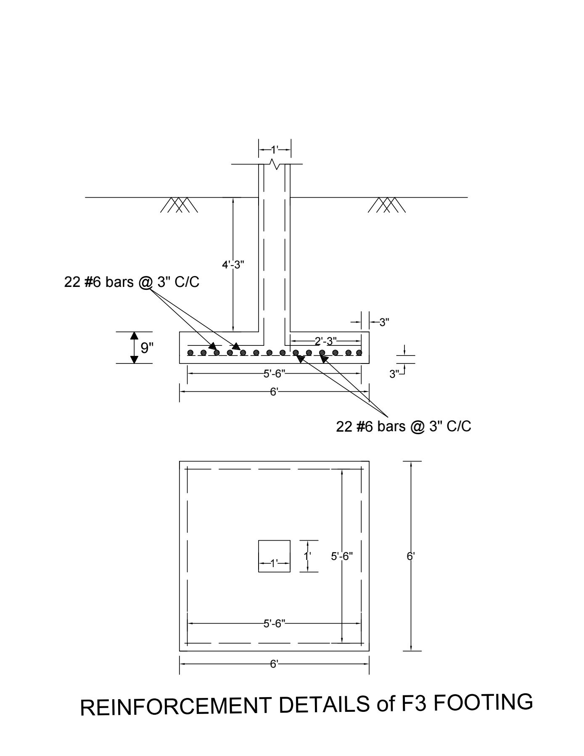
REINFORCEMENT DETAILS of F3 FOOTING

Slide 42
Conclusions
Footing is one of the most necessary element of Civil Engineering since all the structures are to be built on sub-structure.
The structure may be strong but for the durability and stability of the structure its footing needs to be strong enough for which one should have thorough knowledge of foundation engineering.
All the load of structure is lastly transmitted to the column footing so it should have enough strength to take that load without any settlement of the footing.

Slide 43
Thank you

