Slide 1
Girder Bridge
Roll
130001-130010

Slide 2

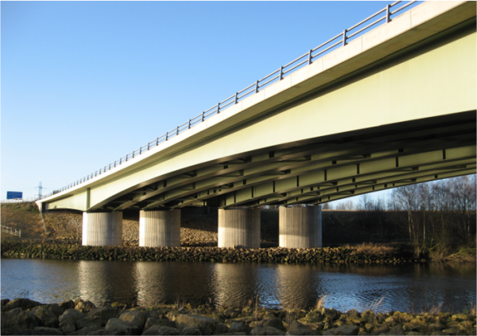
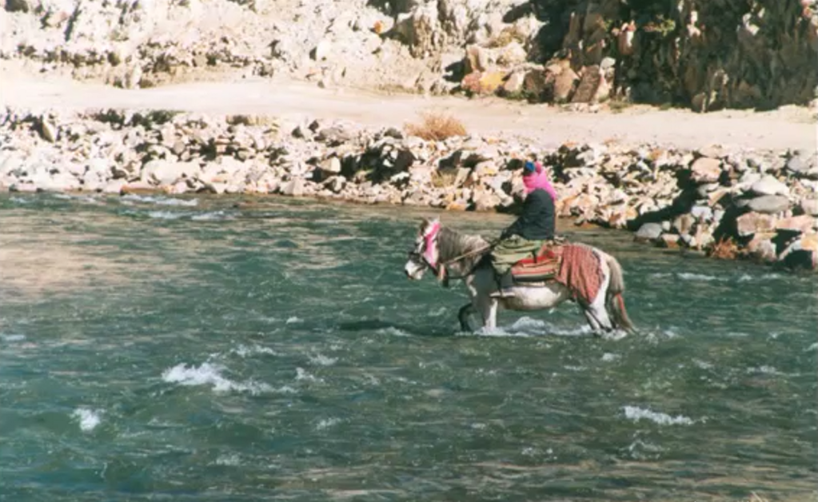
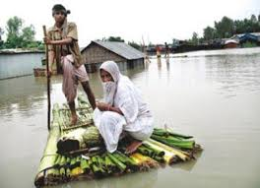

Bridge is a structure having an opening not less than 6.1m for carrying the road traffic or other moving loads over a depression or obstruction in such as channel ,road or railway.
-LGED

Slide 3

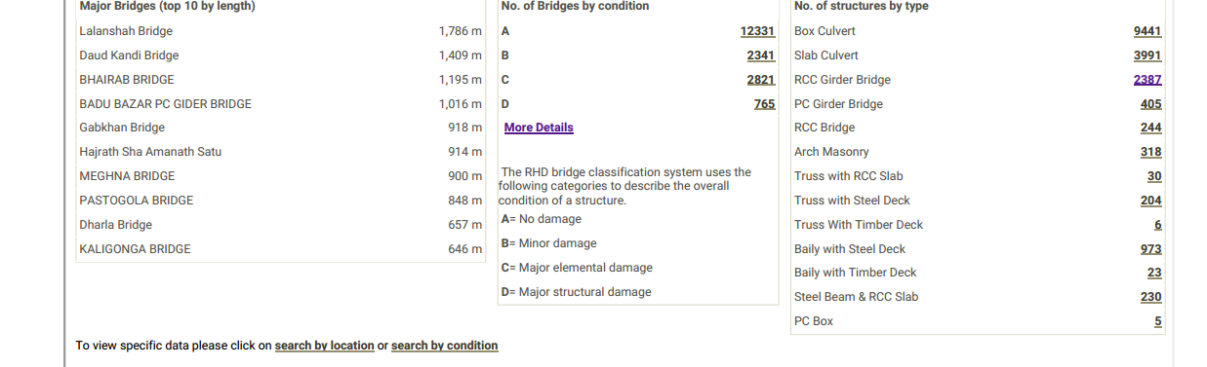
Bridge is an elevated structure

Slide 4
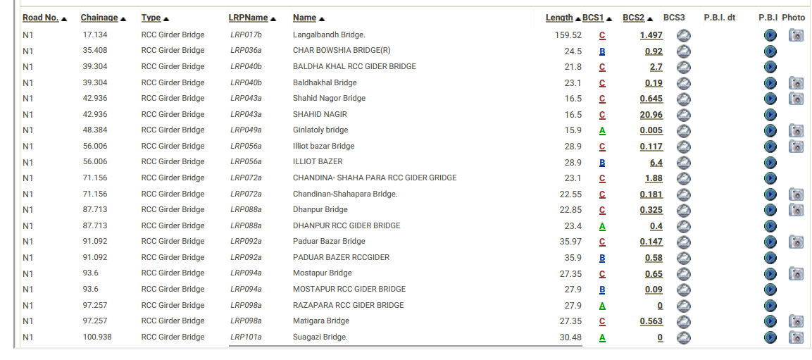

Slide 5
Girder bridge, in general is a bridge that uses girder as the means of supporting the deck
Beam bridge
Girder bridge
Box girder Plate girder
Box girder: Main beam comprise girders in the shape of hollow box.
Example: Flyover.
Plate girder: deck is supported on the top of two or more plate
girders and may act compositely.
Example: Rail bridge.Example: Rail bridge.

Slide 6

Different elements of
Girder bridge

Slide 7
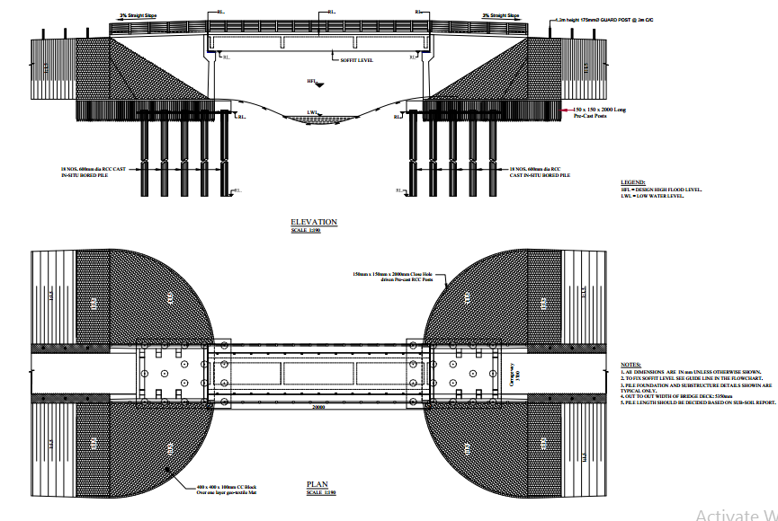

Slide 8

OUTLINE of design criteria
Super structure
Length and site selection of bridge
Longitudinal profile grade
Cross slope
Deck type & geometry
RC girder
Bridge bearing.
Sub structure
Pile
Abutment
& considered loading

Slide 9
Design criteria. According to LGED
Length of bridge:
Lacey, Laursen and Blench’s method are popular in subcontinent.
Where Lecey’s method is more popular in Bangladesh.
To design girder bridge several factors are considered. Such as
              Scour depth for non-cohesive soil( using Lacey’s method)
              Scour depth for cohesive soil( using farrady & Charlton’s method)
              Hydraulic factors
Selection criteria of the length of the bridge incorporating the above factors are given in flow chart-

Slide 10
Is channel is ill defined?
Channel
width<12m?
Provide Bridge
NO
yes
Provide Culvert
Find alternative location if needed
Data Collection
Map
Geological & hydrological data
Survey
Topographical Survey
Cross section
HFL,LWL

Slide 11
Design
Maximum minimum discharge
Determine effective linear waterway with regime width of channel
Final bridge location and length is found
Is it Navigable?
NO
yes
Provide free board
Provide clearance concerning local authority
Is it in a scour zone?
Use lacey’s method for sandy soil
Use faraday & Charltons method for clay soil
To calculate scour depth
Toe side of pile cap should not be exposed more than 1m due to scouring at extreme flood

Slide 12

Longitudinal profile grade:
It is suggested to adjust the height difference between the finished road surface at abutment and the top elevation of the approach road by providing slope with a maximum grade of 3% in the tangent line.
Deck type & geometry:
The overall deck width is 5.350 with carriage way width 3.70 m and sidewalk 0.60 m on both sides. 0.25 m high curbs measured over deck concrete excluding wearing course has been provided.
Cross-slope/ camber:
2% cross-slope has been provided in the deck to ensure effective drainage of the straight bridge.

Slide 13
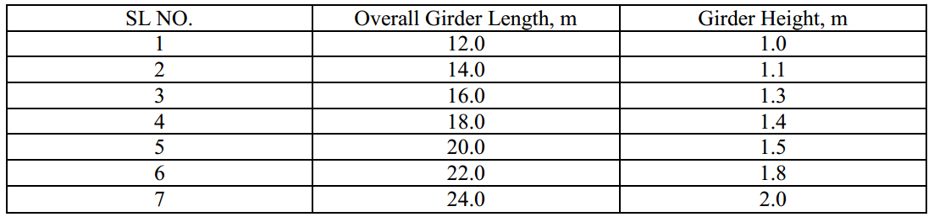
RC GIRDER
Seven different heights of RC girder sections have been provided as shown in table
ABUTMENT
Abutment have been designed without counter fort except 7m height.
3 counter forts have been provided at wings only.

Slide 14
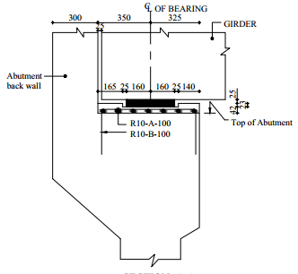
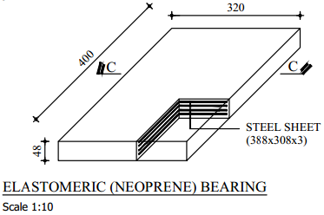
Bridge bearing
Reinforced elastrometric bearings have been provided below each girder end.
Internal structure is like a sandwich of mild steel and rubber moulded as one unit.
Compress on vertical load and accommodate horizontal rotation.
Provides lateral shear and movement.
Best economical solution for large span bridge and seismic load.

Slide 15
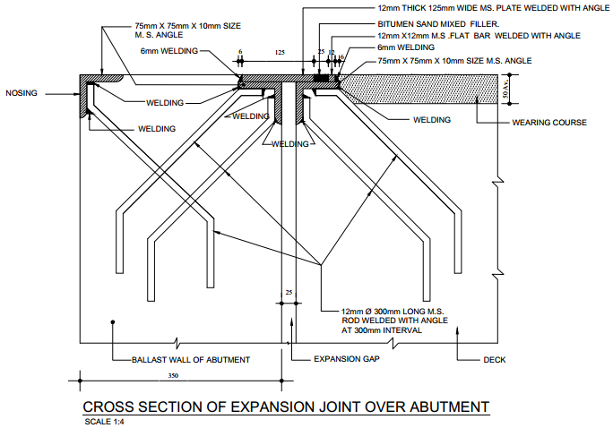
Expansion Joint
To absorb heat induced expansion , vibration , squishing
To allow movements due to ground settlement or earthquakes.

Slide 16
Considered Loads
Permanent loads
Dead load of structural components
Dead load of wearing surface & nonstructural attachments
Earth pressure (vertical & horizontal) & surcharge load
Transient loads
Vehicular load
      braking force
      Centrifugal force
      Collision force
Earthquake load
Wind load
Temperature gradient load
Thermal shrinkage & expansion load
Creep
Settlement load

Slide 17
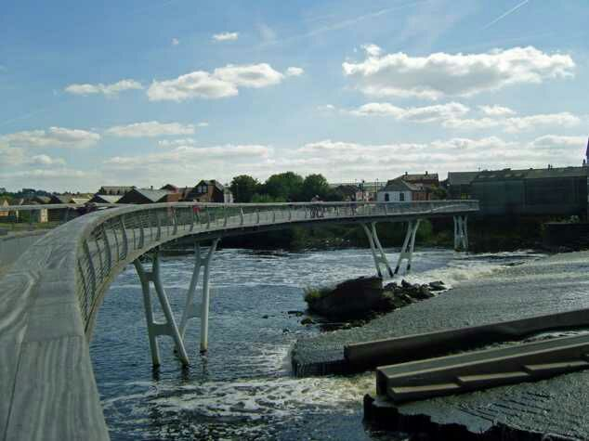
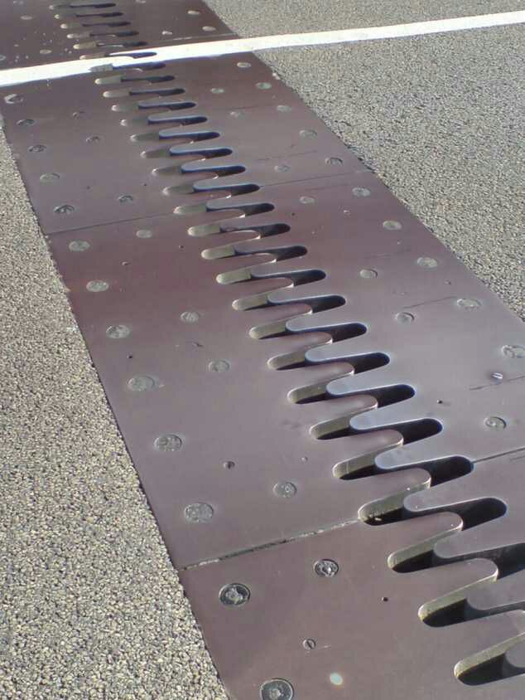
Thermal effect
Deformation due to rise and fall of effective bridge temperature, is calculated to each support position considering Zero movement point(ZMP) at the cg of deck for each simply supported span separately.
There are two types of temperature loading effects considered-
i.Change in effective bridge temp. causing expansion and contraction
ii.Difference in temperature between top and bottom surface of deck
It is also transferred by elastometric bearings.

Slide 18
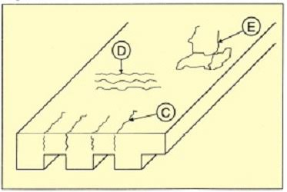

Shrinkage & creep effect
Longitudinal forces generated due to restraint of the of the horizontal deformation are
transferred to the substructure through bearings.
Remedy :
i. Stitching staple ii. Non-shrinkage grout or ‘epoxy’

Slide 19
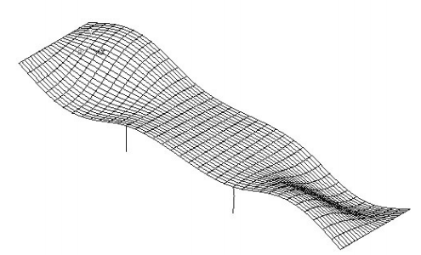
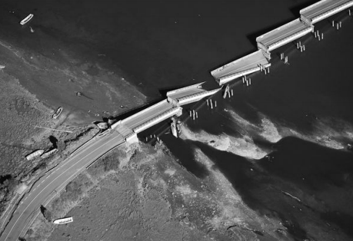
Effect & failure due to seismic loading
Seismic wave (s wave) strikes the deck laterally and the deck fails because its rigidity to that wave.

Slide 20
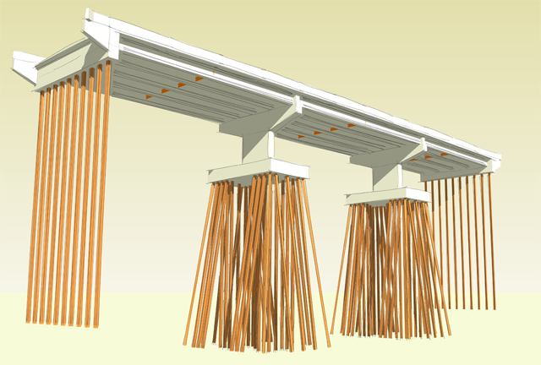
Pile
Pile is a type of deep foundation which is provided when the bearing is very much inefficient to resist the total load coming from structure. Deep foundation or piles are provided below 6 to 8 m abutment-wing wall involved bridge.
Two types of piling : I. Precast pile II. In-situ cast pile

Slide 21
Siltation difficulties
Formation
It occurs during the casting of in-situ pile
Due to siltation a loose layer of soil developed which may cause settlement, if it is end bearing pile
Indicator of siltation
When actual volume of concrete is less than the calculated volume
Prevention
By using bentonite slurry to stable the hole

Slide 22


