Slide 1
Common Reasons of
Bridges Failure
Roll:130061-130073

Slide 2
Outlines:
Definition of bridge
Types of bridges
Load consideration
Common reasons of bridge failure
Conclusion

Slide 3
Definition:
A bridge is a structure to provide a passage over an obstacle without closing the way beneath.
The obstacle may be a river, a canal etc.
Nowadays bridge are useful in traffic operation like flyover bridge, foot over bridge etc.

Slide 4
Types of bridges (based on type of super structure)
Arch Bridge
Girder Bridge
Truss Bridge
Suspension Bridge
Cable-Stayed Bridge

Slide 5
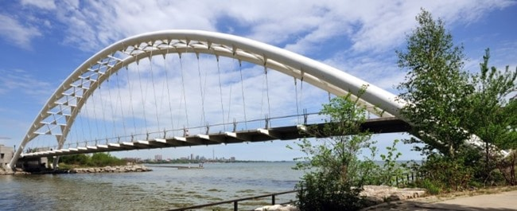
Arch Bridge
Arch bridge is curve shaped bridge, in which horizontal thrust is developed and is restrained by the abutments
at each end of the bridge.

Slide 6
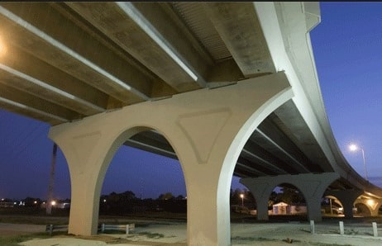
Girder Bridge
In case of Girder Bridge, the deck slab is supported by means of girders. Load coming from the deck are taken by girder and transferred them to the piers and abutments.

Slide 7
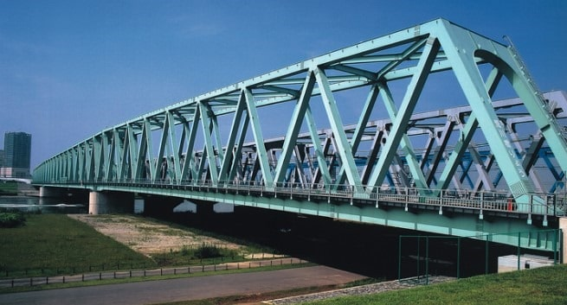
Truss Bridge
Truss is member consisting connected elements to form triangular units. In case of truss bridge the super structure is provided with trusses.

Slide 8

Suspension Bridge
In case of Suspension bridge, deck slab is suspended with the help of cables and suspenders. These will give good appearance. For long span bridges, this type of suspension is suitable.

Slide 9
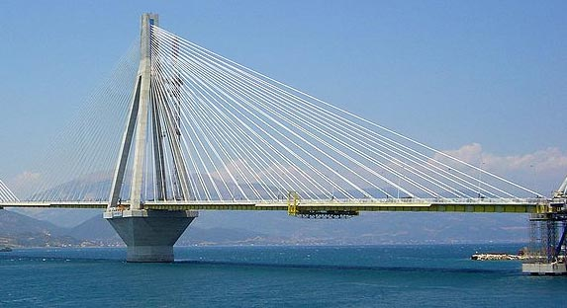
Cable-Stayed Bridge
Similar to suspension bridges except they only need one tower. The cables are attached directly from the tower to the roadway.

Slide 10
Load consideration
Dead Load
Live Load
Dynamic Load
Other Loads

Slide 11
Common reasons of bridge failure
Low grade materials
Construction incidents
Earthquakes
Design flaws and manufacturing errors
Defective design

Slide 12
Low grade materials
A bridge is as strong as its materials.
When a bridge is well funded and high quality materials are used, then we can conclude that it will last longer.
Lower-grade materials may save a lot of money in the initial phase, but the long-term effect may be more costly.
This was a problem in the 1967 Silver Bridge collapse over the Ohio River.

Slide 13
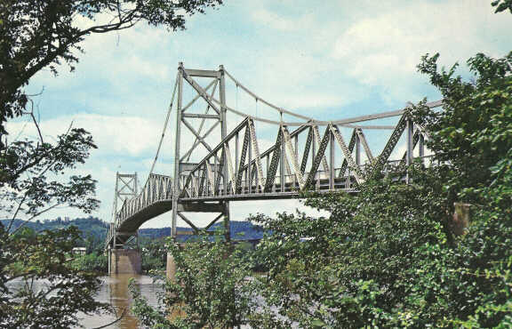
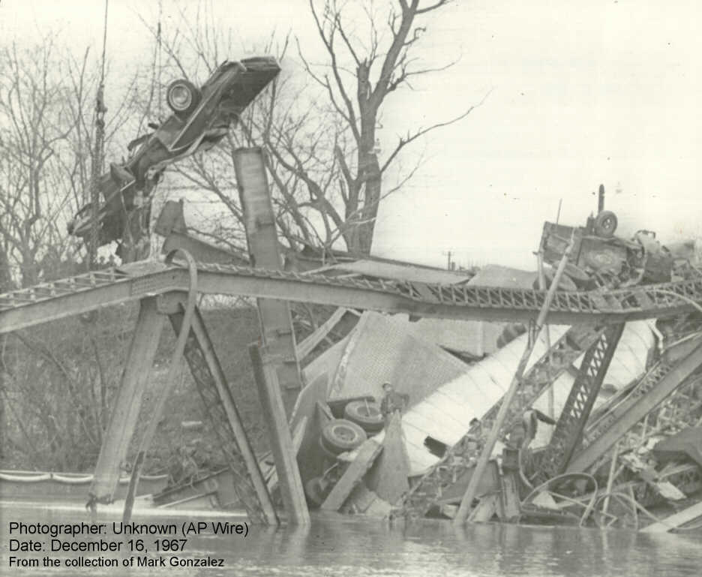
Silver Bridge over the Ohio River
Silver Bridge collapse over the Ohio River

Slide 14
Construction incidents
Back in 1907, an epic bridge failure happened during construction in Quebec City.
Designers were made aware that the bridge weighed eight million pounds more than estimated at a certain point in the construction process.
Not long after, the structure came down, killing 75 workers.
In the end, it was determined that the beams were not adequate to handle the additional eight million pound load.

Slide 15
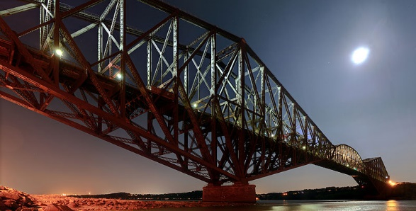
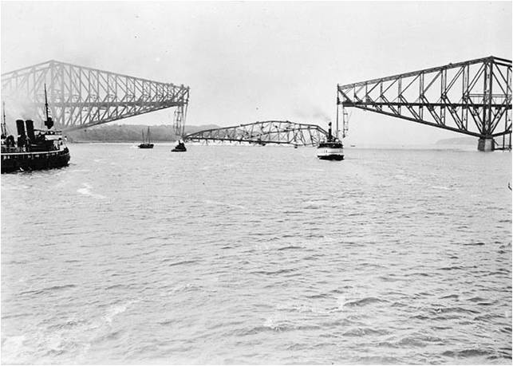
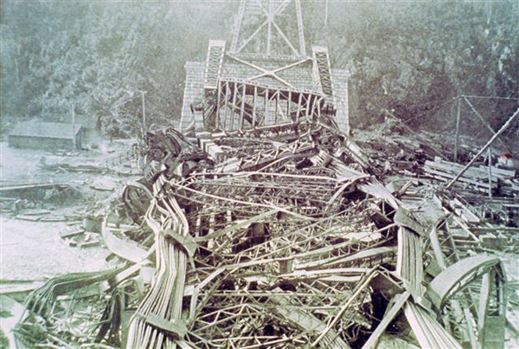
Collapse of The Quebec City Bridge
Quebec City Bridge

Slide 16
Earthquakes
Bridge collapses caused by earthquakes can be devastating.
Bridge engineers have found ways to build bridges that are lighter and add flexibility and rigidity in the right places that make it more likely to survive even the most violent quakes and aftershocks.
San Francisco – Oakland Bay Bridge that fell down during the Loma Prieta earthquake in 1989.
Fortunately, the devastating collapse cost only a single life.

Slide 17
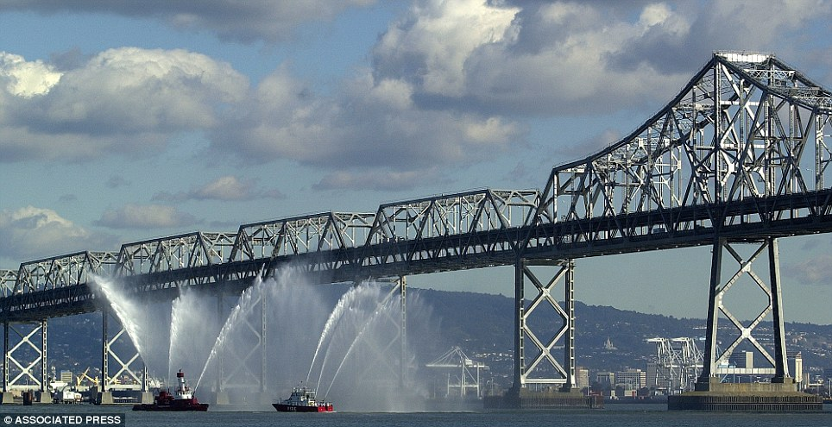
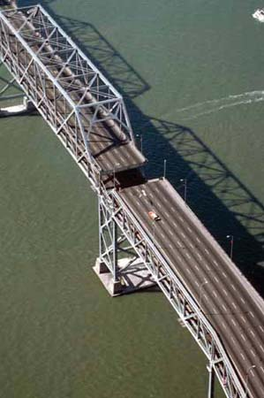
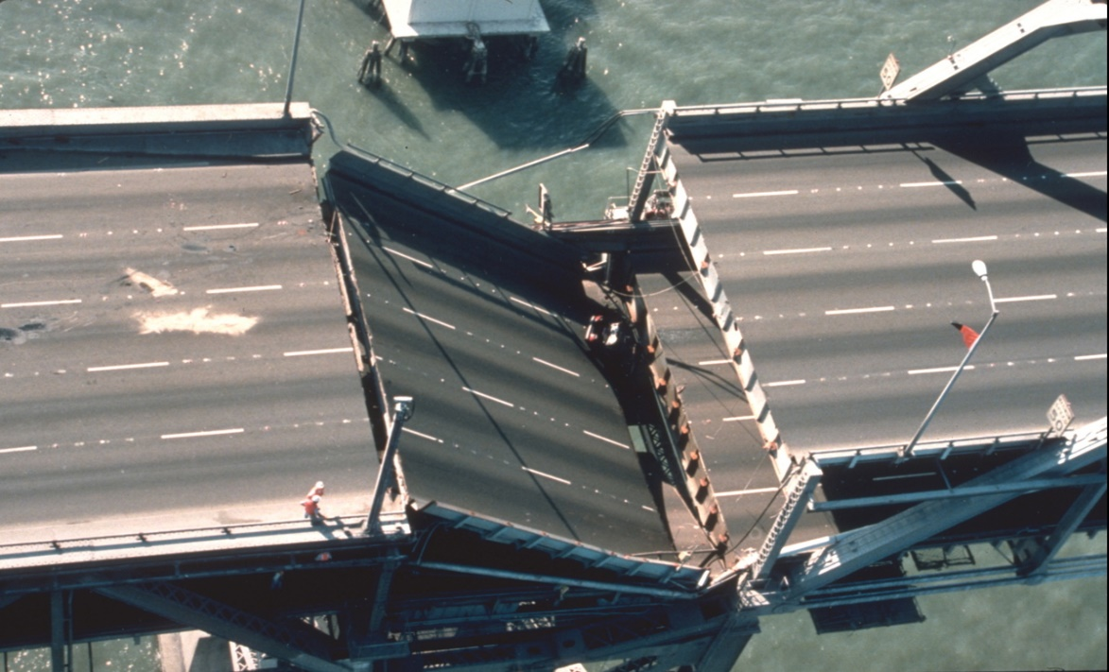
San Francisco-Oakland Bay Bridge Collapse
San Francisco-Oakland Bay Bridge

Slide 18
Design flaws and manufacturing errors
some bridges fail almost immediately after completion due to significant design errors or issues associated with materials used in the construction process.
The Tacoma Narrows Bridge was built in Washington state in 1940.
Almost four months after opening to the public, it collapsed into the water.
A design flaw caused it to shake violently in the wind.
This bridge, nicknamed “Galloping Gertie,” is still referenced in engineering textbooks as an example of how not to build bridges in extreme wind areas.

Slide 19
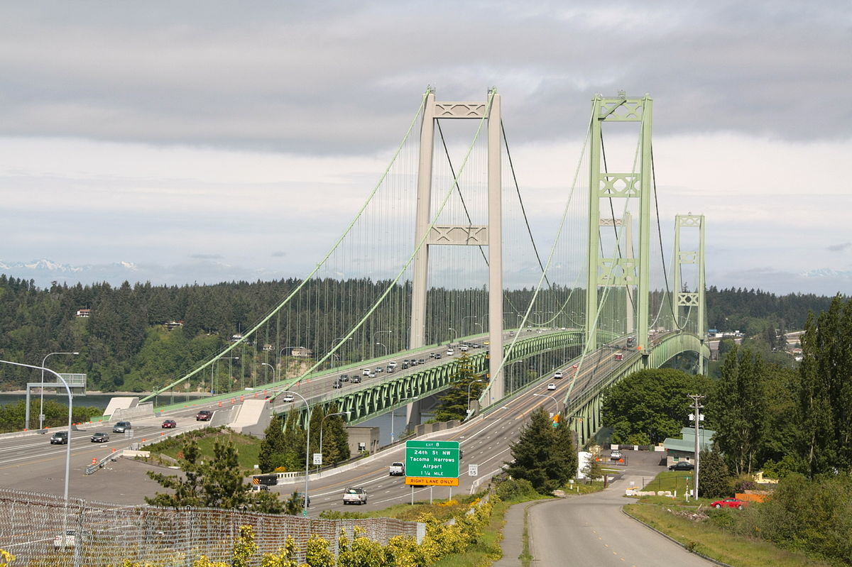
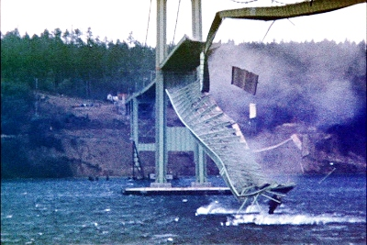
Tacoma Narrows Bridge
Tacoma Narrows Bridge Collapse

Slide 20
Defective design
We cannot simply take out the possibility of human error when it comes to bridge design. The construction can be done correctly with high quality materials; however, all these will amount to nothing if the design is not perfect. When the bridge is not designed properly to support weight, the result could include fatalities and property damage.

Slide 21
Conclusion
The best way to avoid bridge failures is to expect them to happen and plan for them. It’s the only way to protect the public from injuries, loss of life, property damage, and destruction.

Slide 22
Thanks For
Your
Kind Attention

