Slide 1
Presentation
On
Bridge and bridge failure study
Presented by:
Group: B4
Roll No: 130100-10

Slide 2
Introduction
Bridges are being extensively used in our country in highway and rural roads. Its uses are increasing day by day because of its durability, rigidity, economy and aesthetic beauty. It is a structure which provides passage facilities over an obstacle without closing the way beneath.The required passage may be for a road,railway,a canal,a pipeline.The obstacle to be crossed may be a river,railway,valley.
Failure of bridge hinders the transportation with a region thoroughly and separate it from other region also make obstruct in economic system. Engineering is usually about avoiding failures and investigating why failures occur and ways to fix the problem.

Slide 3
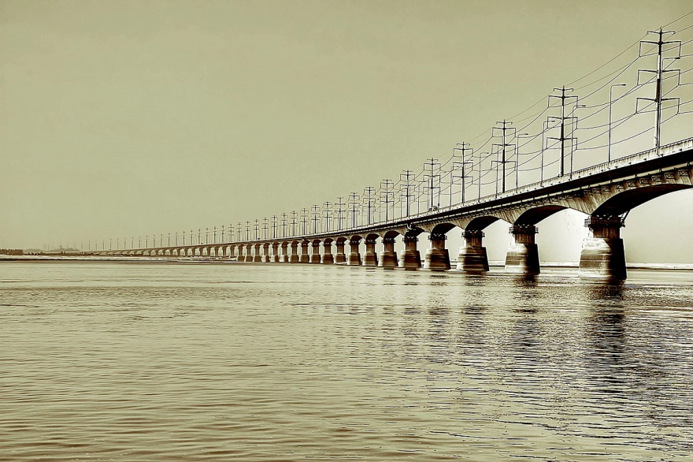
Definition of bridge
The Association of American State Highway and Transportation Officials (AASHTO) defines a bridge as
‘‘a structure, including supports, erected over a depression or an obstruction such as water, highway, or railway,having a track or passageway for carrying traffic or other moving loads and having an opening measured along the center of the roadway of more than 6 m between under-copings of abutments or spring lines of arches, or extreme ends of openings for multiple boxes; it may also include multiple pipes where the clear distance between openings is less than half of the smaller contiguous opening.’’(AASHTO, 1999).

Slide 4
COMPONENTS OF BRIDGE
The bridge structure comprises the following term-
a) Decking, consists of slab, girder & railing.
b) Bearing for decking.
c) Abutment & piers.
d) Wing wall & returns.
e) Foundation for the abutment, piers, wind wall and returns.
f) River training work, like revetment for slope and abutments apron for bed level.
g) Approaches to the bridges to connect the bridge proper to the roads on either site.

Slide 5
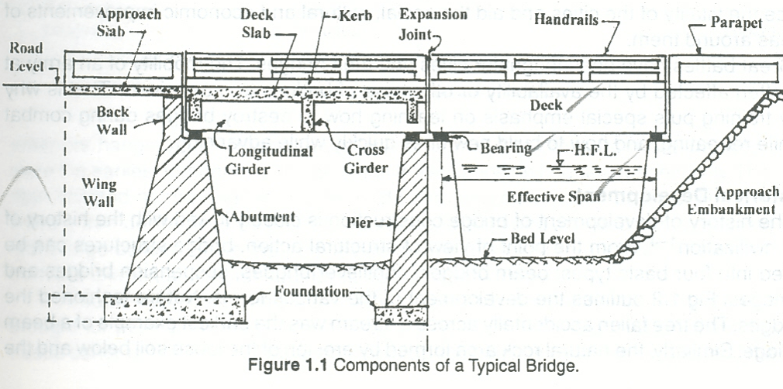

Slide 6
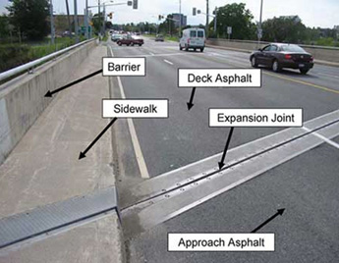
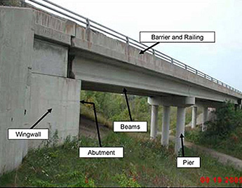

Slide 7
TYPES OF BRIDGES Bridge may be classified in many ways , as below:
According to function:
Aqueduct: Canal over a river
Viaduct: road or railway over a valley.
Pedestrian bridge
Highway bridge
Railway bridge
Pipeline bridge.
According to material of construction of super structure:
Timber
Masonry
According to span length:
Culvert:(less than 8m)
Minor bridge :( 8-30 m)
Major bridge:(above 30m)
Long span bridge:(above 120m).

Slide 8
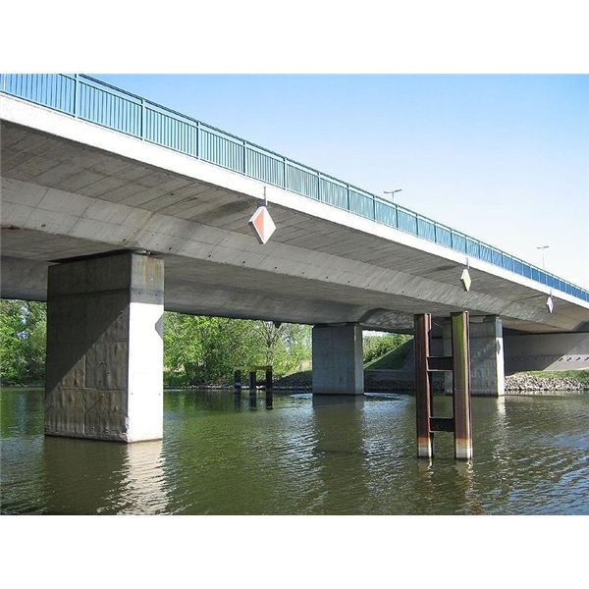
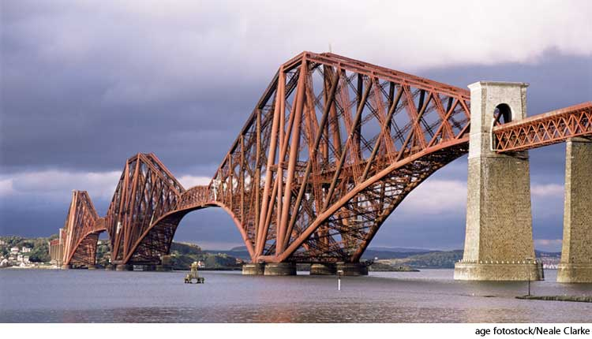
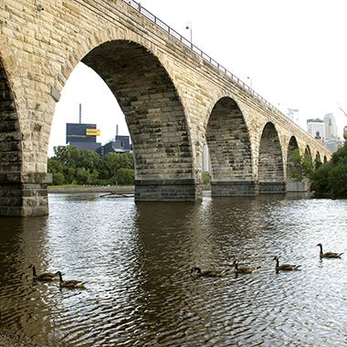
Beside that classification bridge may be classified mainly in six type:
2.Cantilever Bridge
1.Beam Bridge
3.Arch Bridge

Slide 9
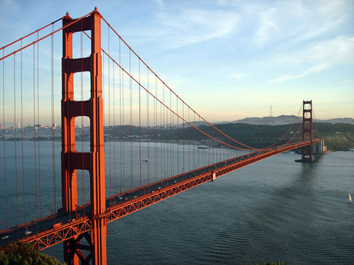
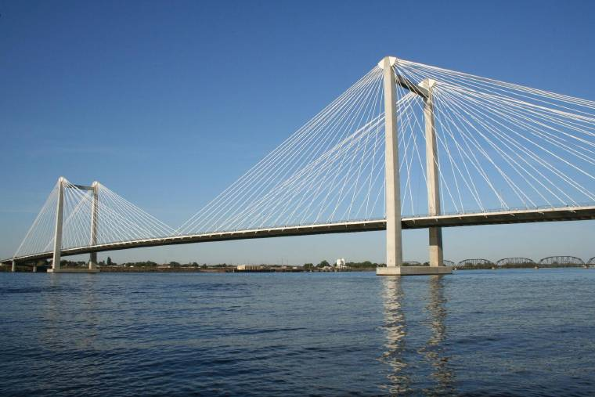
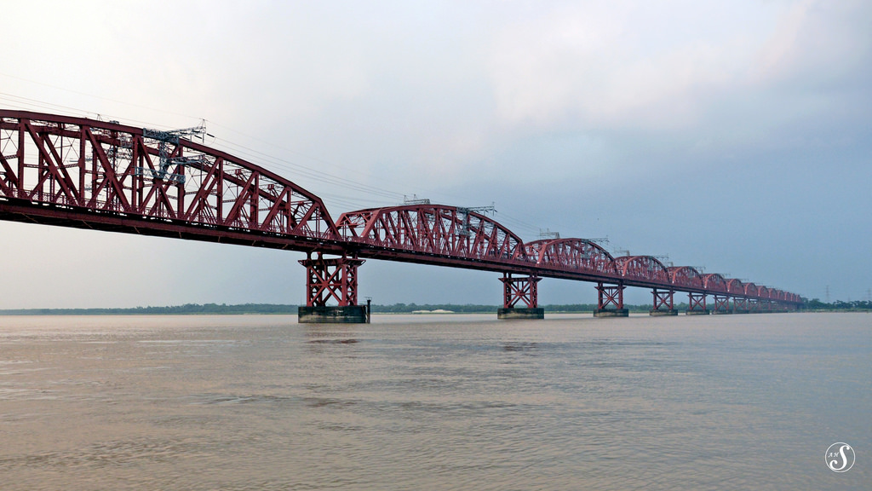
4.Suspension Bridge
5.Cable-Stayed bridge
6.Truss bridge

Slide 10
SELECTION OF BRIDGE SITE :
It may not be possible always to have a wide choice of sites for a bridge .This is particularly so in case of bridges in urban areas and flyovers .For river bridge in rural areas usually a wide choice may be available
The characteristics of an ideal site for a bridge a
river are:
A straight reach of the river
Steady river flow without serious whirls and cross current s
A narrow channel with firm banks
Suitable high banks above high flood level on each side
Rock or other hard inerodible strata close to the river bed level
Proximity to a direct alignment of the road to be connected
Absence of share curve s in the approaches
Avoidable of excessive under water construction .

Slide 11
SITE DATA
The following data need to collect after the selection of proper site of the bridges on the stream-
1) Map and stream cross section.
2) Longitudinal profile alone the bed at bridge.
3) Available high water marks.
4) Water level and discharge data available for nearly station.
5) Navigational requirement, if any, of the stream.

Slide 12
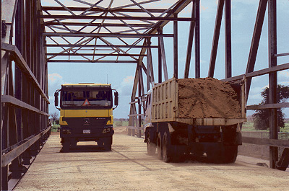
LOADING ON BRIDGES
Dead Load
Live Load
Buoyancy Pressure
Centrifugal force
Earth Pressure
Seismic load
Water pressure
Wind load
Thermal forces
Figure : Live Load

Slide 13
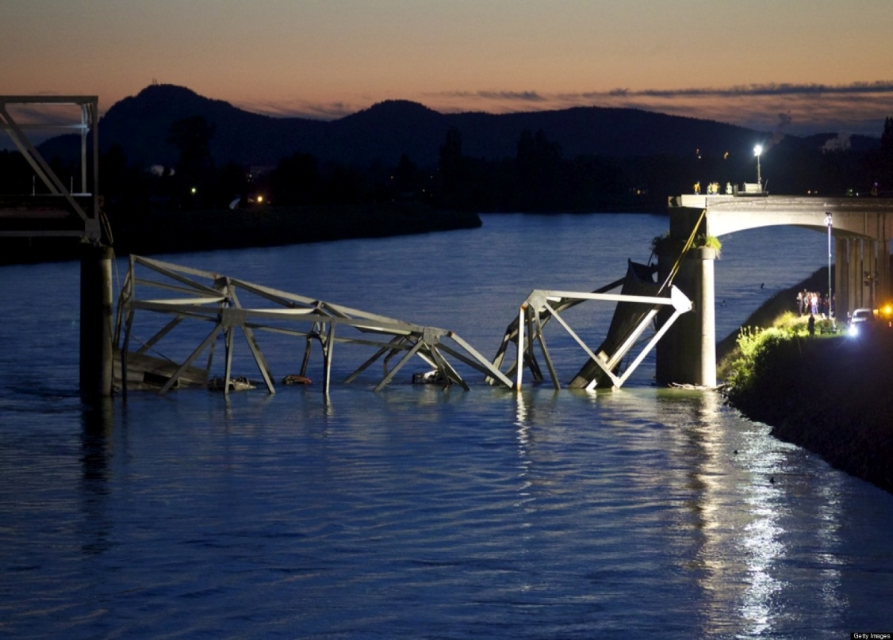
BRIDGE FAILURE:
When a bridge collapses , many lives are put at risk.
Bridge collapse is one of the most dangerous types of structural failure that can occur.
Causes of Bridge failure
Earthquake
Fire
Boat impact
Flood
Construction accidents
Manufacturing defects
Design defects
Poor maintenance
Figure: Bridge Failure

Slide 14
CAUSES AND MECHANISMS OF BRIDGE FAILURES:
Failures of bridges have occurred ever since bridge building started thousands of years ago. A large part of the technical knowledge associated with bridge engineering today is based on the past failures of bridges. In the past century, bridge engineers learned substantially from studying historical failures of bridges.
The more common causes and mechanisms of some bridge failures around the world are classified as
Natural factors:
(flood, scour, earthquake, landslide, wind, etc.)
Human factors:
(improper design and construction method, collision, overloading, fire, corrosion, lack of inspection and
maintenance, etc.)

Slide 15
Scour
Scour is a phenomenon in which the level of the riverbed becomes lower under the effect of water erosion, leading to the exposure of bridge foundations. This happens either because of the increase of flow speed around the river piers or because of the long time erosion of the riverbed
Landslide:
moving slope-forming materials, when hitting the bridge may lead to severe damage or even collapse of the bridge.
Earthquake:
Earthquakes lead to vertical and horizontal ground motions that can result in the failure of bridges. The most common damage includes shear-flexural failure of the bridge pier columns, expansion joint failure, shear key Failure, and girder sliding in the transverse or longitudinal directions due to weak connections between girders and bearing
Wind:
Forces and vibrations induced by wind have led to a large number of failures. Wind induced aerostatic and aerodynamic forces are major design challenges in designing bridges, especially for flexible long-span bridges.

Slide 16
Cyclone:
In addition to the high pressure due to extreme winds in case of cyclones, the hydrodynamic forces caused by storm surge resulting from the tropical cyclones cause severe damages in the bridges in coastal areas.
MANMADE FACTORS:
Design and construction errors
Many bridges have collapsed due to the imperfect design; use of materials with poor quality Use of an inappropriate construction method have led to bridge collapses in the construction phase
Overloading
Incorrect assumption of loads is another major cause of collapse. Truck overloading usually cause fatigue problems in bridge.
In some extreme cases, the weight of the overloaded trucks may exceed the load -carrying capacity of the bridge indirectly cause bridge collapse the edge components and can shorten the service life of bridges.

Slide 17
COLLISION:
Collision due to vessel impact causes serious damages to bridges.
Lack of inspection and maintenance:
Usually bridges are designed and constructed to serve for a long time, at least 100 years. However, bridges in service are constantly subject to not only dead and live loads, but also attack by the environment. As a result, bridges experience progressive deterioration.
Fire:
Fires on bridges are commonly caused by the collision of vehicles such as fuel tankers or freight trucks and multiple vehicle collisions or construction accidents

Slide 18
COLLAPSE OF BRIDGES IN BANGLADESH:
Thousands of bridges, which form important part of the rail and road infrastructure, have been constructed in Bangladesh over the last few decades. Every year, several bridges face distress due to natural or man-made factors mentioned in the earlier sections.
HARDINGE BRIDGE (1933 AND 1971):
During its 100 years of service two major failure events occurred, one is natural (not of the bridge structure, but of the river training works) and the other (of the bridge superstructure and substructure) is manmade. On 25thof September, 1933, the turbulent flow resulting from a flood destroyed the right guide bank.to.(After the incident, immediate actions were taken by dumping of stones to restore the river training work (Ghoshal 2015). The second major damage occurred during the War of Liberation of Bangladesh in 1971. One of the 18.3 m steel spans – the 9thspan from Bheramara side - fell off due to direct missile hit and the 12thspan was blown off by explosives placed on the bridge span by the army as a part of war strategy.

Slide 19
KARNAPHULI BRIDGE (1991):
Just after two years of opening, on the night following 29thApril, 1991, at around 3:05 am, a Category V super cyclone hit the coastal areas of Bangladesh with wind speed up to 225 kmph accompanied with storm surges up to 6m high. A 100-ton floating crane Shaktiman, which was anchored at the Chittagong port, was uprooted, moved a few kilometers upstream with the surge water and hit one of the suspended spans, removing the 100 m long steel trusses from their bearings
TURAG-BHAKURTA BRIDGE (1995 AND 1998):
the bridge experienced a flood in 1995 and as a result, the scour depth at pier-1 reached the pile length (6 m) which led to the settlement of the pier along with the adjacent deck and girder
DECK GIRDER BRIDGE NEAR AMIN BAZAR DHAKA:
Failed due to poor detailing of deep girders making it difficult to compact the concrete, as a result of which the girder developed wide cracks at the bottom.
Noyarhat Bridge near Dhaka
Flood water washed away the caissons.

Slide 20
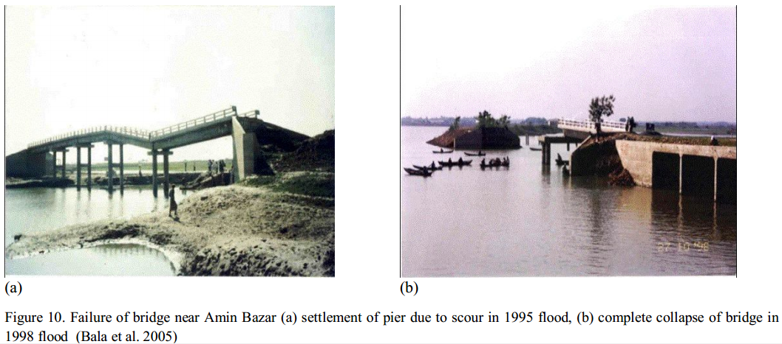

Slide 21
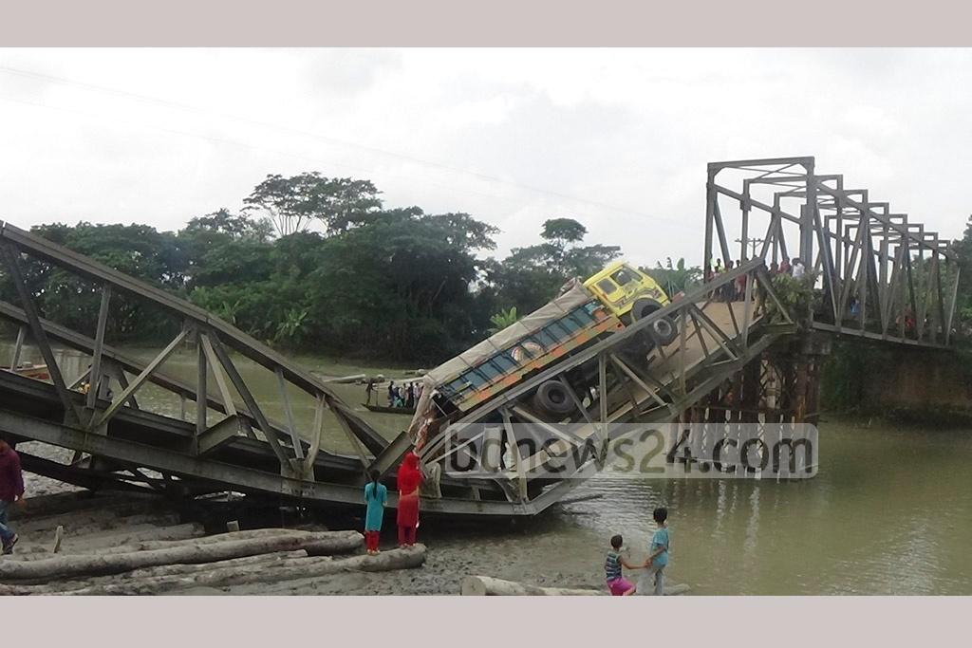
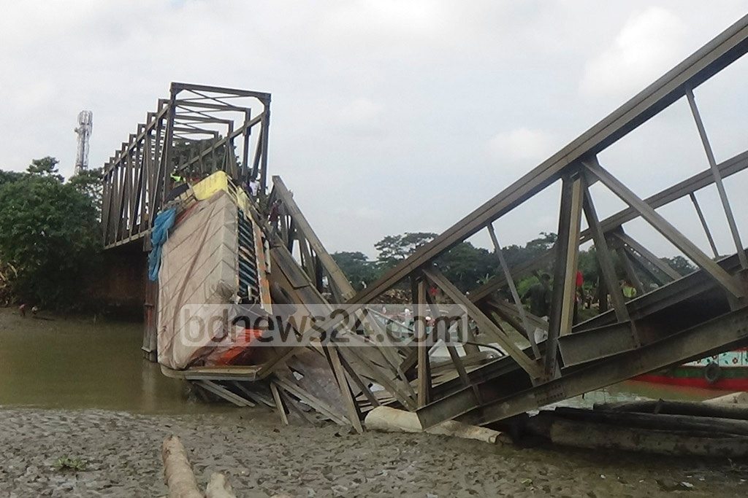
Fig: A truck hangs from a bailey bridge collapsed due to heavy load,at Shariatpur,
(October 29,2016)

Slide 22
MAINTENANCE OF BRIDGES
The bearings of girders should be coated with oil from time to time.
The floor system of approaches and bridges should be properly maintained.
The entire drainage system should be inspected for its proper functioning.
The movement of foundations, if any, should be carefully inspected and all attempts should be made to stop such further movement.

Slide 23
CONCLUSION
Bridges connect destinations. Bridges are assets to mankind and have to last for generations as the construction of bridge influences the whole ecosystem and the change is permanent. So proper planning to adapt the bridge into the natural ecosystem has to be done. The scope of Bridge Engineering is ever booming and technology used in bridge building is also getting sophisticated.

Slide 24
References:
1. Victor, D.J. 1973,Essentials of bridge engineering, 4th edn, OXFORD & IBH PUBLICATION CO. PVT. LTD. New Delhi.
2. Ponnuswamy, S 1986, Bridge Engineering, 7th edn, Tata McGraw Hill,New Delhi.
3. Choudhury, J.R. & Hasnat, A 2015 ‘Bridge collapses around the world: Causes and Mechanism’,IABSE-JSCE joint conference on Advance Bridge Engineering-|||,At Dhaka,Bangladesh,pp. 27-33.

Slide 25
Any
Question???

Slide 26
Thanks
For
Your Patience!!!

