Slide 1
INTRODUCTION AND COMPARISON STUDY BETWEEN SLAB BRIDGE AND DCEK GIRDER BRIDGE
Presented by-
Group No.B5
Roll no-
130112 130117
130113 130118
130114 130119
130115 120013
130116 120037

Slide 2
What is bridge?
A bridge is a structure providing passage over an obstacle without closing the way beneath. The required passage may be for a road, a railway, pedestrians, a canal or a pipe line.

Slide 3
What is concrete bridge?
A concrete bridge is a structure made from concrete and built for the purpose of covering a certain distance.
Concrete bridges allow vehicles or people to cross over physical obstructions, such as lakes, rivers valleys or roads.

Slide 4
Introduction to principle components of RC bridge…
Span:The distance between two bridge supports.
Bridge deck:The load bearing floor of a bridge which carries and spreads the loads to the main beam.
Beam:A rigid, usually horizontal structural element.

Slide 5
Introduction to principle components of RC bridge…
Abutment:A support of bridge which may carry a horizontal force as well as weight.
Pier:A vertical supporting structure such as pillar.
Expansion joints:These are provided to accommodate the translations due to possible shrinkage and expansions due to temperature changes.

Slide 6
According to super structure the types of bridge are…
1.Slab bridge 5.Truss bridge
2.Beam bridge 6.Suspention bridge
3.Girder bridge 7.Cable bridge
4.Arch bridge
We will discuss about slab bridge and deck girder bridge.

Slide 7
Slab bridge
Definition:
A slab bridge is a short span bridge consisting of a reinforced concrete slab resting on abutments.
A slab bridge consists of two parts-
1.Super structure: a) rail
b) rail post
c) curb or edge beam
d) slab
2.Sub structure: a) abutment

Slide 8
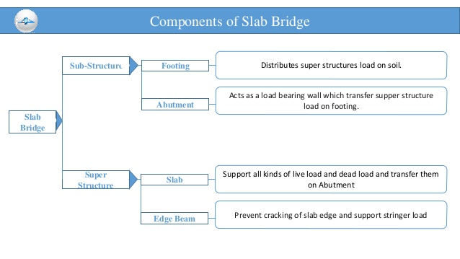

Slide 9
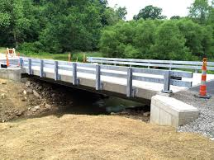

Slide 10
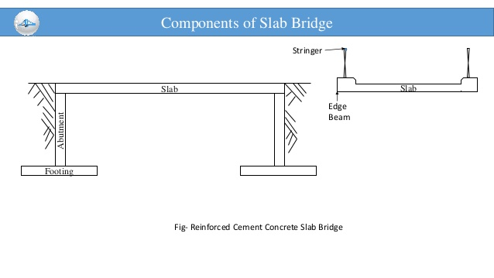

Slide 11
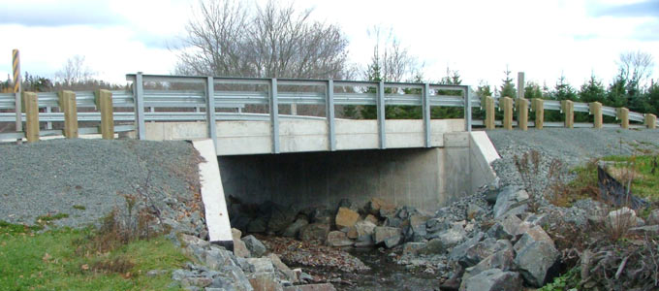

Slide 12
Deck girder bridge
Definition:
A deck girder bridge in general is a bridge that uses girder as the means of supporting the deck.
A deck girder bridge consists of the following components-
a) Rail e) Deck slab
b) Rail post f) Interior girder
c) Side walk g) Exterior girder
d) Kerb h) Abutment

Slide 13
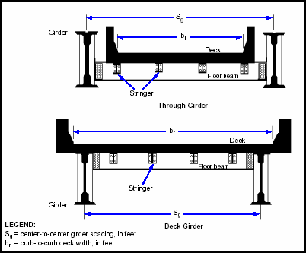

Slide 14
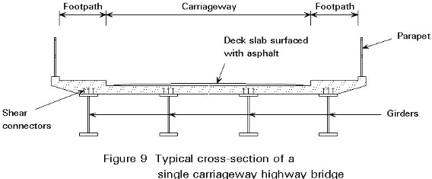

Slide 15
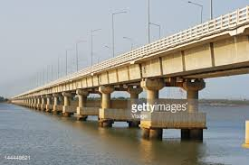

Slide 16
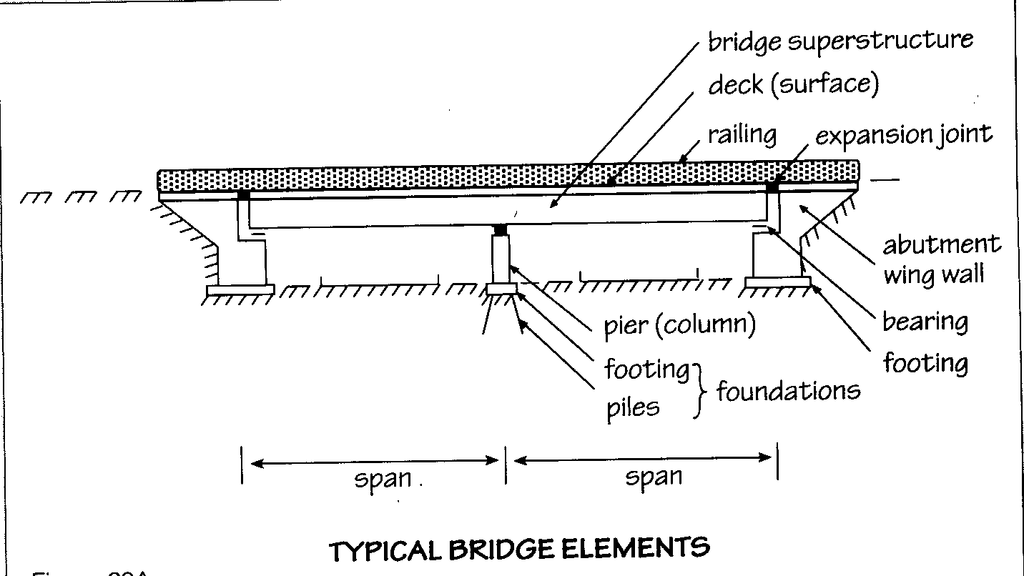

Slide 17
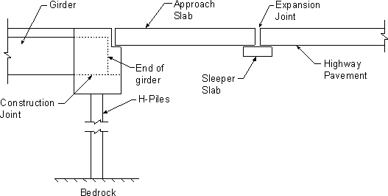

Slide 18
Comparison between Slab bridge and Deck girder bridge…
Slab bridge …
1.Simpest type of bridge.
2. Adopted for small bridges and culverts
3.Span is up to 9m.

Slide 19
Deck girder bridge…
1.Complex type of bridge.
2.Adopted for large bridges, rivers , culverts
3.Span is between 10 to 60 m .
4.Can be extending up to 250 m in continuous construction.
Finally, we can conclude that both slab and deck bridge in compairing with small or large span,play an important role in modern communication system.

Slide 20
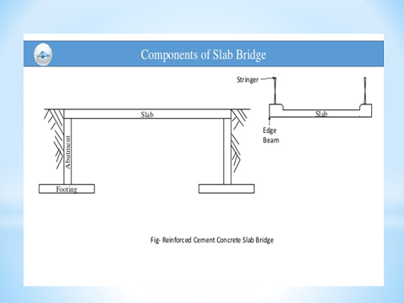
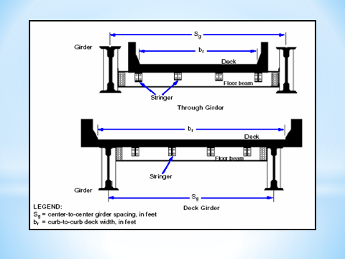

Slide 21
Thank You Everybody

