Slide 1
Introduction to Bridges
Reinforced Concrete Sessional-II
CE 3218

Slide 2
BRIDGE
A bridge is a structure built to span a physical obstacle (such as a body of water, valley, road, or rail) without blocking the way underneath.
It is constructed for the purpose of providing passage over the obstacle, which is usually something that is otherwise difficult or impossible to cross.
There are many different designs of bridges, each serving a particular purpose and applicable to different situations.

Slide 3
BRIDGE
Designs of bridges vary depending on factors such as
the function of the bridge,
the nature of the terrain where the bridge is constructed and anchored, and
the material used to make it, and
the funds available to build it.

Slide 4
PARTS OF A BRIDGE
There are different types of bridge. Different bridge types contain different parts. Followings are the main parts of a bridge:
Guard rail
Deck
Abutment
Pile
Pier
Girder
Rail Track

Slide 5
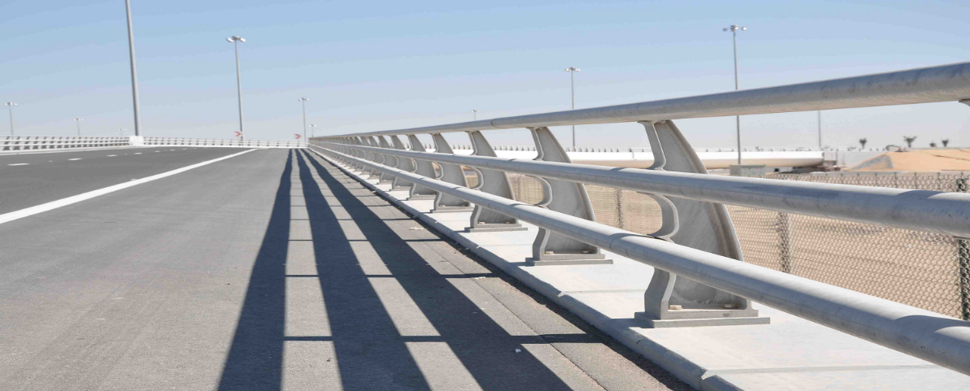
PARTS OF A BRIDGE
Guard rail

Slide 6
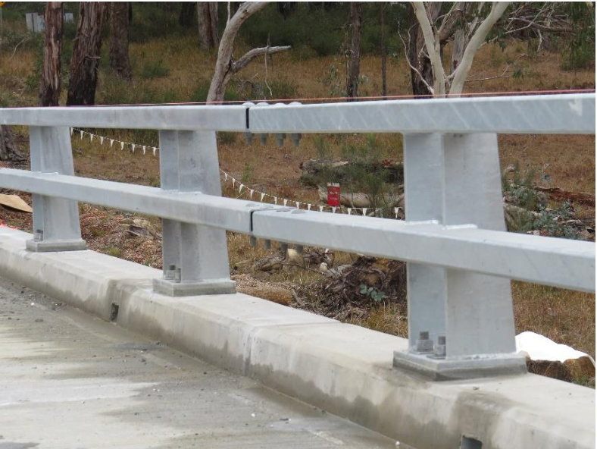
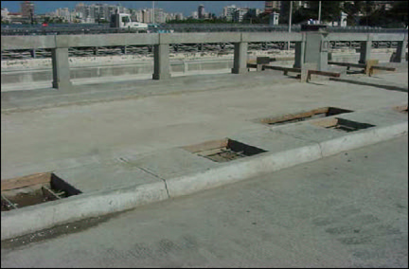
PARTS OF A BRIDGE
Curb

Slide 7
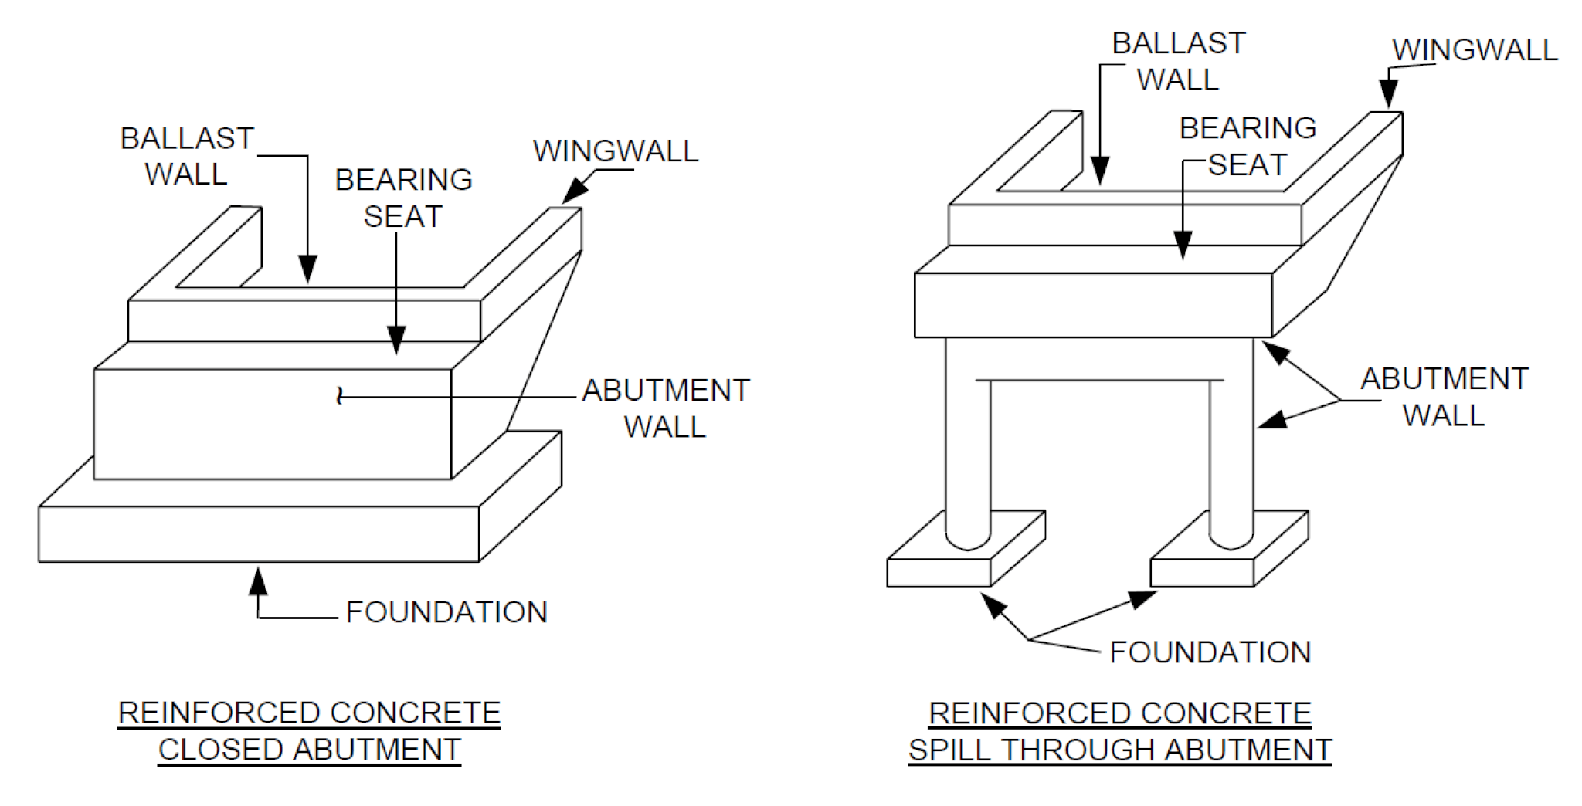
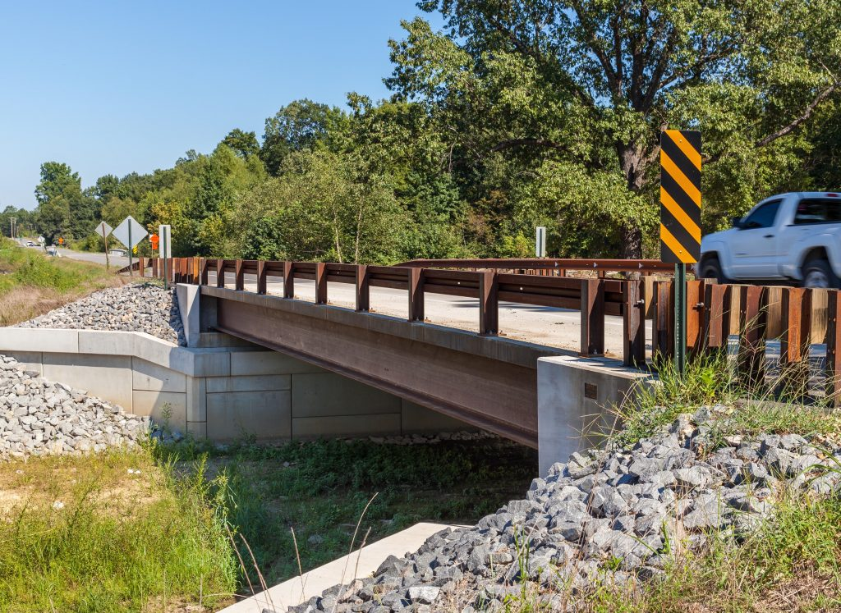
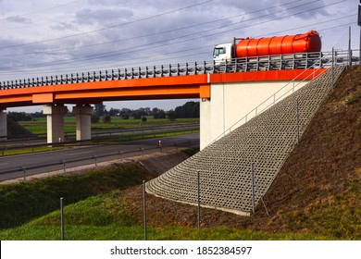
PARTS OF A BRIDGE
Abutment
The support provided at the two ends of a bridge is known as an abutment.

Slide 8
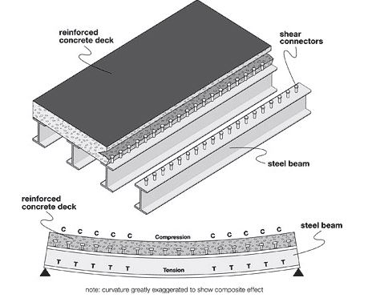
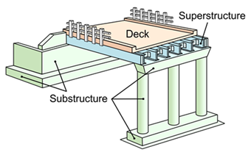
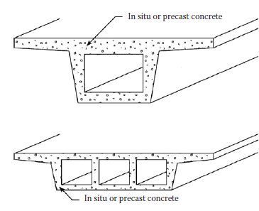
PARTS OF A BRIDGE
Deck
A deck is a fundamental part of any bridge to pass vehicle, goods, people etc. from one side to another.

Slide 9
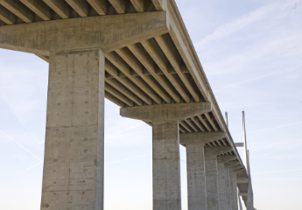
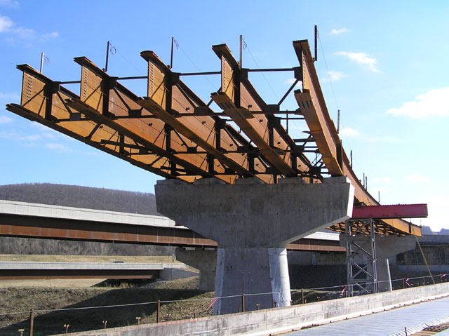
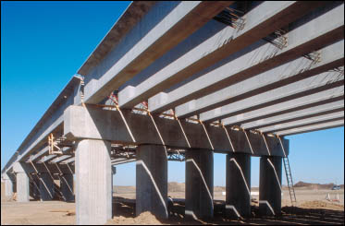
PARTS OF A BRIDGE
Girder (Box or I-joist)
Just like the beam, girder is used in the bridge. It can be two types I-joist and Box. This name has been given because of their shape. I-joist girder type is commonly used in bridges. Box girder can be precast or cast in place and it is generally existing in prestressed condition.

Slide 10
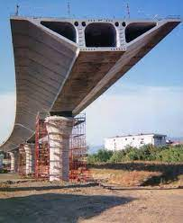
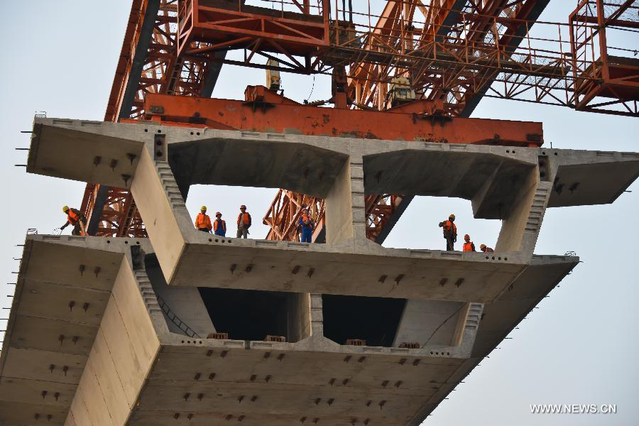
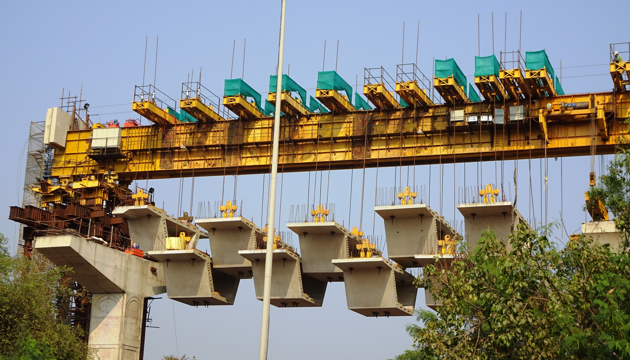
PARTS OF A BRIDGE
Girder (Box or I-joist)
Just like the beam, girder is used in the bridge. It can be two types I-joist and Box. This name has been given because of their shape. I-joist girder type is commonly used in bridges. Box girder can be precast or cast in place and it is generally existing in prestressed condition.

Slide 11
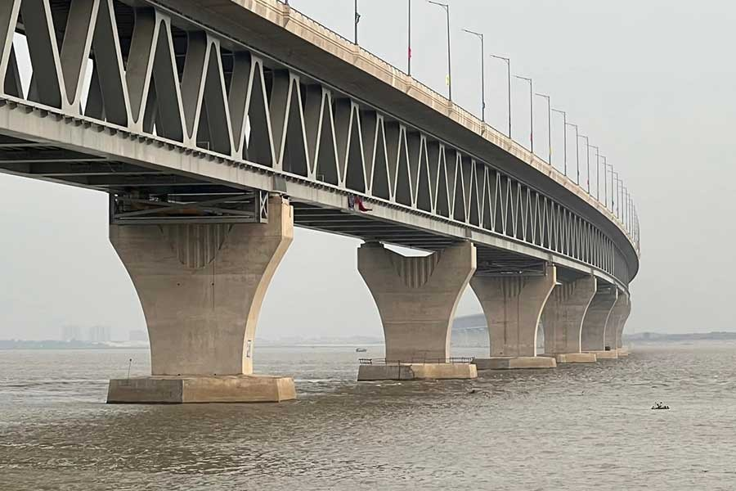
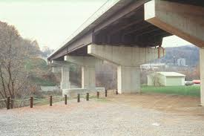
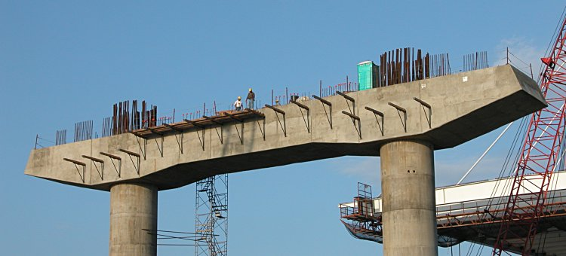
PARTS OF A BRIDGE
Pier
Pier is the compression member which stay above the pile and make the structure stable. Pier generally provides for span at intermediate points.

Slide 12
PARTS OF A BRIDGE
Piers perform two main functions:
Transferring superstructure vertical loads to the foundation.
Resisting to the horizontal forces acting on the bridges.
For bridge pier to pier, distance is the span. Water pressure is the extra pressure which acts onto the pier laterally.

Slide 13
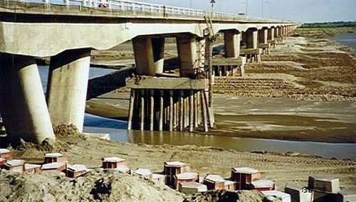
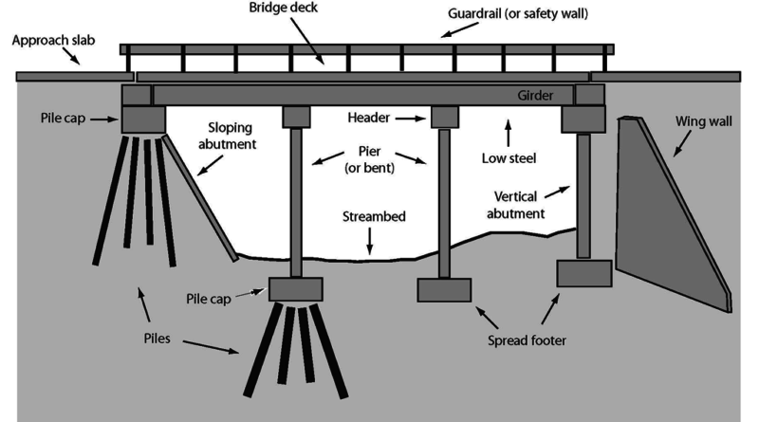
PARTS OF A BRIDGE
Pile
For the bridge with pier, the pile is a fundamental component. Pile type foundation is generally needed when the upper soil layer is loose. Pile depth depends on the soil layer. To find the hard soil layer which will make the structure stable, the pile is usually extended to some depth into the hard soil layer.

Slide 14
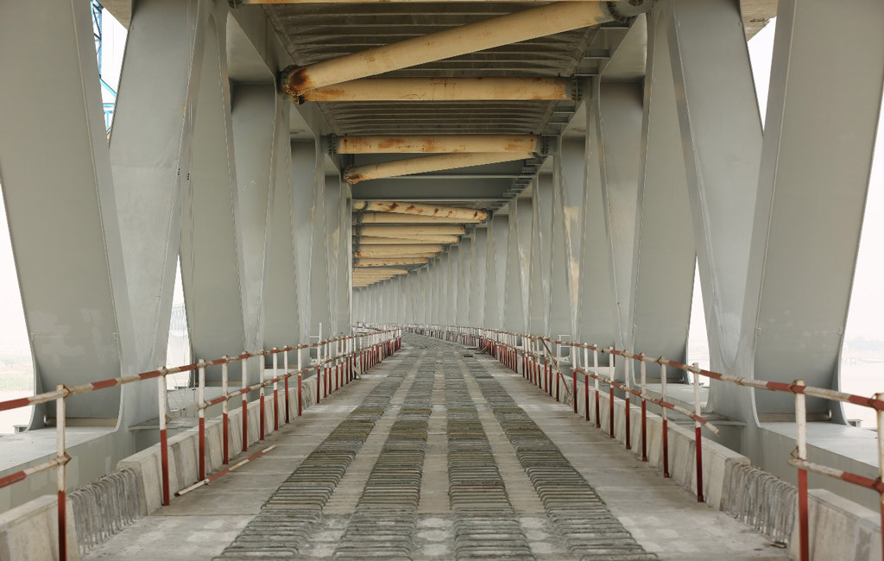
PARTS OF A BRIDGE
Rail Track
Normally Road traffic is the main vehicle onto the bridge but if the train needs to be passed through that bridge rail track is the extra component.

Slide 15
Types of Bridges
Followings are the main types of bridges.
Truss Bridge
Arch Bridges
Suspension Bridges
Cable-Stayed Bridges
Slab Bridges
Box Girder Bridges

Slide 16
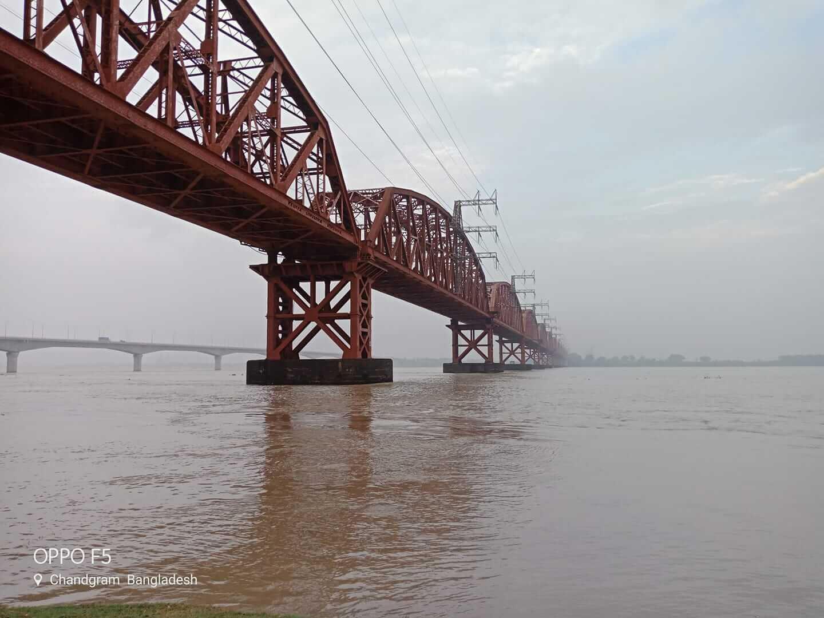
Types of Bridges
Truss Bridges
Bridges with truss are made by steel two force member with only tension and compression. No bending moment is allowed in this structure. Most stable structural shape for truss is triangular.

Slide 17
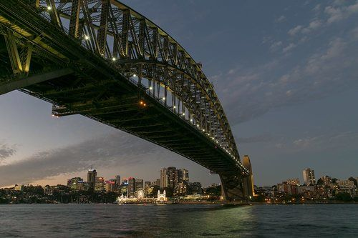
Types of Bridges
Arch Bridges
Arch bridge mainly exists in compression. Utilizes an aerodynamic system with torsional rigidity

Slide 18
Types of Bridges
Arch Bridges
Arch bridge mainly exists in compression. Utilizes an aerodynamic system with torsional rigidity

Slide 19
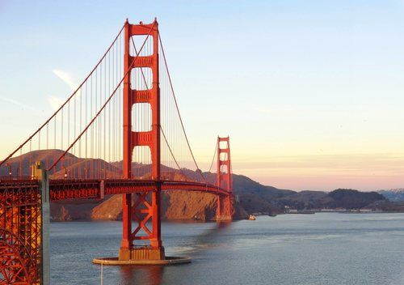
Types of Bridges
Suspension Bridges
In suspension bridges, long spans can be provided which is essential in many situations. It gives freedom to the engineer to provide a long span with the help of a cable.

Slide 20
Types of Bridges
Followings are the Basic components of a suspension bridge Structural system:
Stiffening Girder/ Trusses: Longitudinal structures support and distribute moving vehicle loads. Secure aerodynamic stability of the structure.
Main Cables: Main cables are connected to girders through hanger rope. These hanger ropes transfer the loads from girder to the main cables. The main function of these main cables to carry these loads to the main towers.
Main Towers: Main cables are supported by these intermediate vertical structures and transfer the total load of the bridge to the foundation.

Slide 21
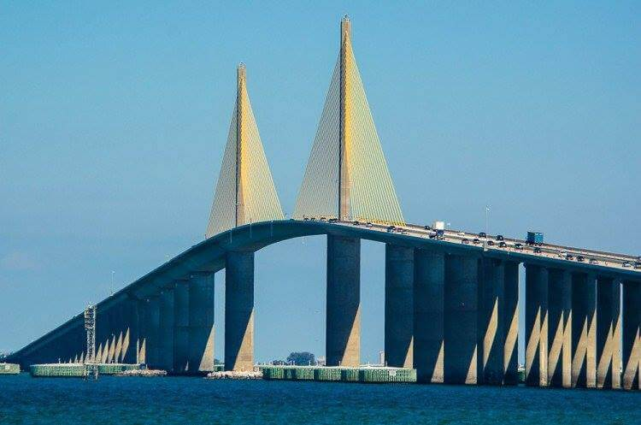
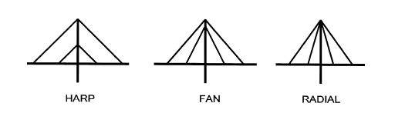
Types of Bridges
Cable-Stayed Bridges
It has a lot of similarities to the suspension bridge. But there are few differences between a suspension bridge and cable-stayed bridge. In this case, bridge mainly carries the vertical loads acting on the girder. The purpose of the stay cables is to provide intermediate support for the girder and it helps to span a long distance.

Slide 22
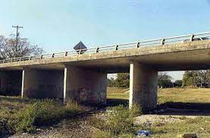
Types of Bridges
Slab Bridges
It is the most common type of bridge. Use in every place where the span is not so long.

Slide 23
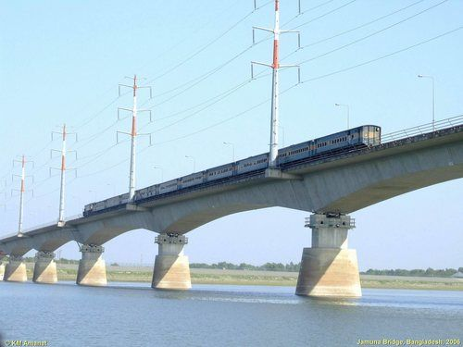
Types of Bridges
Box Girder Bridges
It's a box type girder different from normal I girder and it can easily resist more amount of torsion. This type of bridge contains top deck, vertical web, bottom slab. Box girder bridge can be subdivided into three basic categories:
Single cell box.
Multicell box.
Box with struts supporting a cantilever deck.

Slide 24
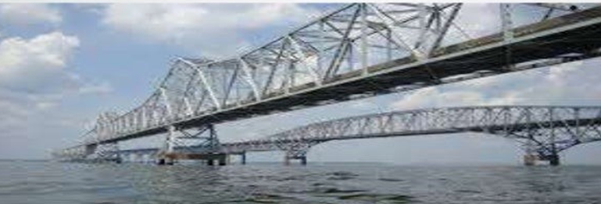
Fixed Bridges
Majority of bridges are fixed, with no moveable parts to provide higher clearance for river/sea transport that is flowing below them. They are designed to stay where they are made to the point they are deemed unusable or demolished.

Slide 25
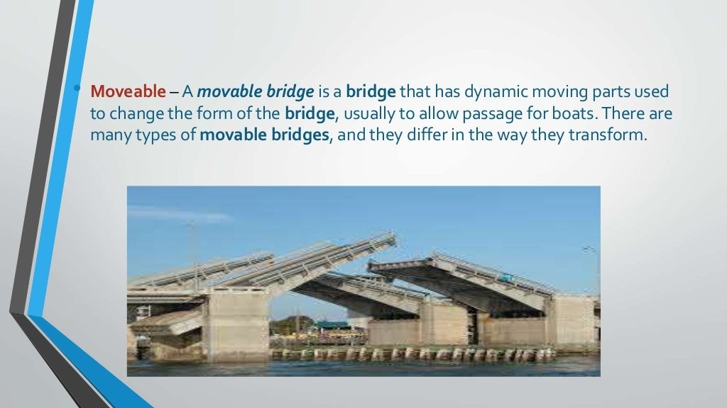
Movable Bridges
A movable bridge is a bridge that has dynamic moving parts used to change the form of the bridge, usually to allow passage for boats. There are many types of movable bridges, and they differ in the way they transform.

Slide 26
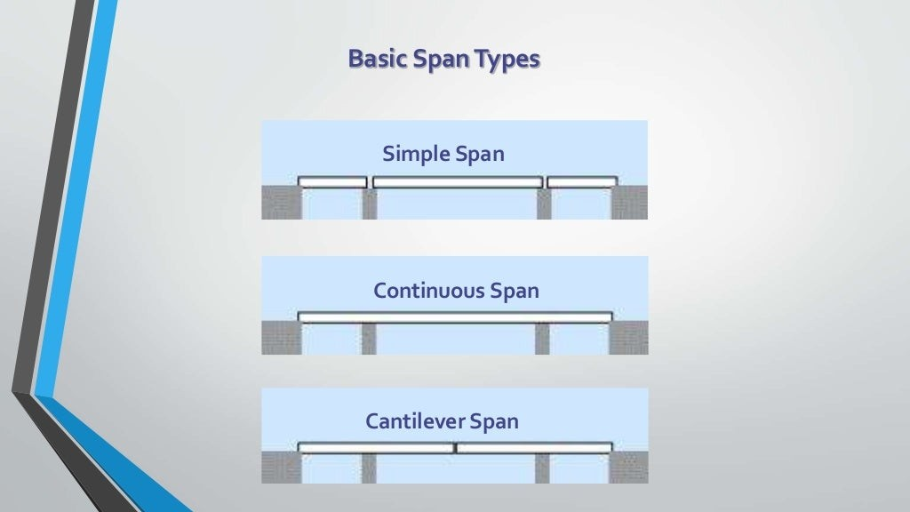
Span Type

Slide 27
SITE SELECTION FOR BRIDGE
The characteristics of an ideal site for a bridge across a river are
A straight reach of the river.
Steady river flow without cross currents
A narrow channel with firm banks
Suitable high banks above high flood level on each side.
Rock or other hard in erodible strata close to the river bed level.
Absence of sharp curves in the approaches;
Absence of expensive river training works;
Avoidance of excessive underwater construction

