Slide 1
CE 4111 Structural Analysis – III
Dr. Md. Kamruzzaman
Professor, Dept. of Civil Engineering
Rajshahi University of Engineering & Technology (RUET)

Slide 2
SFD & BMD Techniques
First Task is to Find the Reactions -
Consider Each Span as Free Body;
End Shares are First Determined as Caused by the Loads Alone on Each Span;
Following… End Shares Caused by the End Moments are Computed;
These Two Shears are Added Algebraically to Obtain the Net End Shear for Each Span.
An Algebraic Summation of the End Shears at Any Support Will Give The Total Reaction.

Slide 3
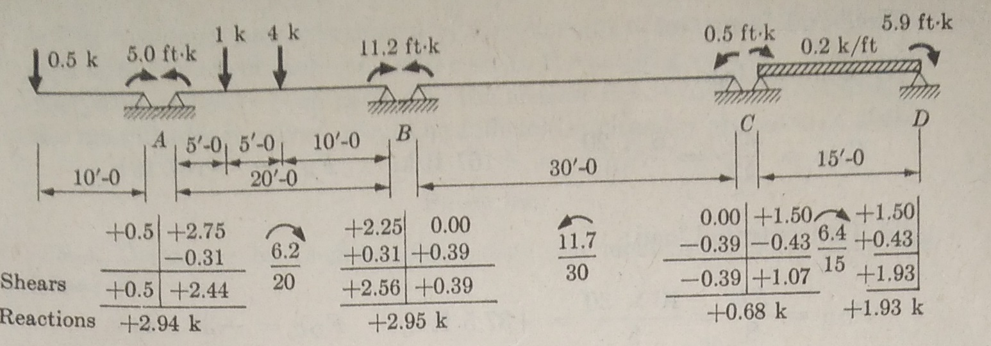
SFD & BMD

Slide 4
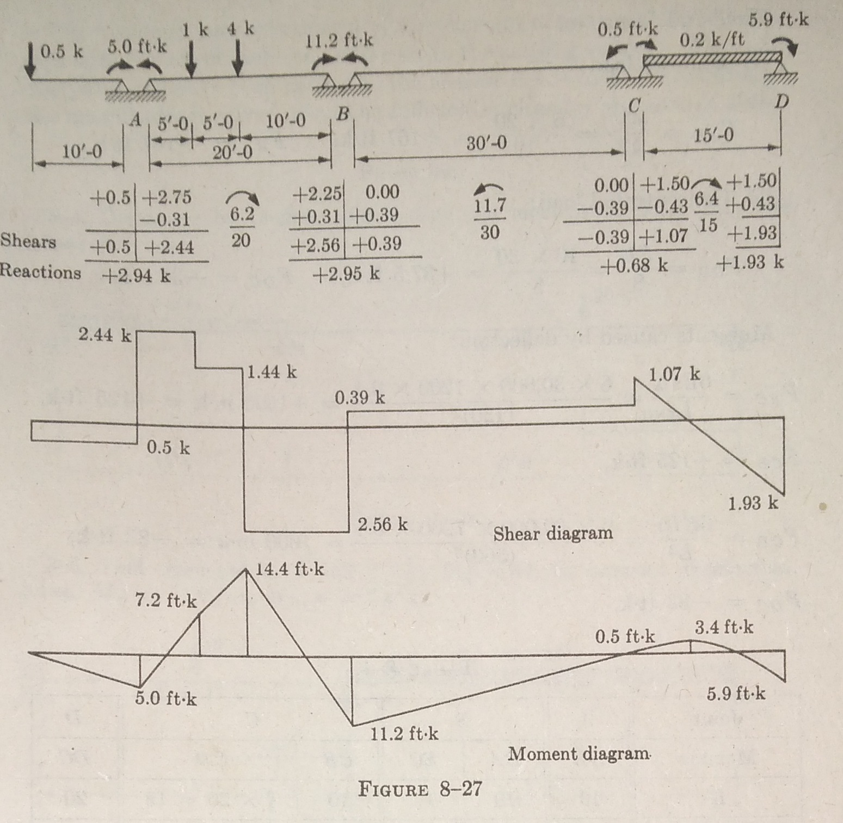
SFD & BMD

