Slide 1
CE 4111
Structural Analysis and Design-III
Contact hours/week : 4 Credit: 4.00
Syllabus:
1. Moment distribution method
2. Slope deflection method
3. Stiffness matrix method
4. Flexibility matrix method
5. Structural forms
Ref:
Indeterminate Structural Analysis, By J. Sterling Kinney
Statically Indeterminate Structures, By Chu Kia Wang
Analysis of framed Structures, By James Gere
Basic Structural Analysis, By C.S. Reddy
Analysis of Structures Vol II, By Vazirani

Slide 2
MOMENT DISTRIBUTION METHOD
Displacement method
Definitions, explanations, specialties & limitations of Displacement method
Since forces (reactions) are unknown in the force method likewise in the displacement method displacements are unknown. In displacement method we proceed in the reverse order i.e. first determine the displacements and then proceed with the computation of reactions and stresses. This very method of calculation of unknowns in the structure is called Displacement Method also called stiffness method.
The main specialties of this method is that when the member is more restrained then less is the unknown since the restraining provides us with the known condition called boundary condition. As for instance, say we have a bar with its end free. Then there is degree of kinematic indeterminacy 6 which is maximum no. of unknown if we proceed with displacement method. But say the same bar is fixed at one end then it becomes cantilever. Here degree of indeterminacy is only 3. The no. of unknowns decreased to 3 from 6. Also this method is very suitable for computer programming.
But as a limitation, it is difficult to analyze the degree of freedom by visual inspection.

Slide 3
Kinematic indeterminacy (Degrees of freedom)
In the displacement method, primary unknowns are joint displacements which are commonly referred to as the Degrees of Freedom (DOF) of the structure. It is also called Kinematic Indeterminacy. It is necessary to consider all the independent DOFs while writing the equilibrium conditions. These degrees of freedom are specified at joints, supports and at the free ends. It is very necessary to find all DOFs by visual inspection since each DOF is the unique displacement in the given structure.

Slide 4
MOMENT DISTRIBUTION METHOD
The moment distribution method is a structural analysis method for statically indeterminate beams and frames developed by Hardy Cross. It was published in 1930 in an ASCE journal. The method only accounts for flexural effects and ignores axial and shear effects. From the 1930s until computers began to be widely used in the design and analysis of structures, the moment distribution method was the most widely practiced method.
Introduction
In the moment distribution method, every joint of the structure to be analysed is fixed so as to develop the fixed-end moments. Then each fixed joint is sequentially released and the fixed-end moments (which by the time of release are not in equilibrium) are distributed to adjacent members until equilibrium is achieved. The moment distribution method in mathematical terms can be demonstrated as the process of solving a set of simultaneous equations by means of iteration.
The moment distribution method falls into the category of displacement method of structural analysis.
In order to apply the moment distribution method to analyse a structure, the following things must be considered
Fixed end moments
Fixed end moments are the moments produced at member ends by external loads when the joints are fixed.

Slide 5
Flexural stiffness
The flexural stiffness (EI/L) of a member is represented as the product of the modulus of elasticity (E) and the second moment of area (I) divided by the length (L) of the member. What is needed in the moment distribution method is not the exact value but the ratio of flexural stiffness of all members.
Distribution factors
When a joint is released and begins to rotate under the unbalanced moment, resisting forces develop at each member framed together at the joint. Although the total resistance is equal to the unbalanced moment, the magnitudes of resisting forces developed at each member differ by the members' flexural stiffness. Distribution factors can be defined as the proportions of the unbalanced moments carried by each of the members. In mathematical terms, distribution factor of member
Carryover factors
When a joint is released, balancing moment occurs to counterbalance the unbalanced moment which is initially the same as the fixed-end moment. This balancing moment is then carried over to the member's other end. The ratio of the carried-over moment at the other end to the fixed-end moment of the initial end is the carryover factor.
Sign convention
Once a sign convention has been chosen, it has to be maintained for the whole structure. The traditional engineer's sign convention is not used in the calculations of the moment distribution method although the results can be expressed in the conventional way.

Slide 6
Distribution Factor
Distribution factor is the ratio according to which an externally applied unbalanced moment M at a joint is apportioned to the various members meeting at the joint.
p
E
A
B
K=1
K=2
1
3
K=AE/L
B
A
2
D
M
P_{A}=⅓ P
P_{B}=⅔ P
4
C
DF_{AB}=3/10
DF_{AC}=4/10
DF_{AD}=2/10
DF_{AE}=1/10
The distribution factor for any member at a joint is equal to the stiffness of the member divided by the sum of the stiffness of all the members at the joint.

Slide 7
Stiffness and Carry-over factor
Carry-over factor
M
A
B
θ_{A}
M_{F}
L
M/EI
M_{F} /EI
Carry-over factor = 1/2
The carry-over factor is that factor by which the developed moment at the rotated end of a member may be multiplied to give the induced moment at the fixed or restrained end.

Slide 8
Stiffness
M
A
B
θ_{A}
M/2
L
M/EI
M /2EI
Absolute stiffness K = 4EI/L
Absolute stiffness is the value of the moment, applied at the simply supported end of a member, necessary to produce a rotation of 1 radian of this simple supported end, no translation of either end being permitted and the far end being either simply supported, restrained or fixed.

Slide 9
FIXED END MOMENTS
p
w
L/2
PL/8
PL/8
WL²/20
WL²/30
L
L
p
a
b
w
L/2
7WL²/960
Pab²/L²
Pba²/L²
23WL²/960
L
L
w
w
WL²/12
WL²/12
L/2
5WL²/96
L
5WL²/96
L
w
a
b
11WL²/192
L/2
5WL²/192
L
Ma(2b-a)/L²
Mb(2a-b)/L²
L

Slide 10
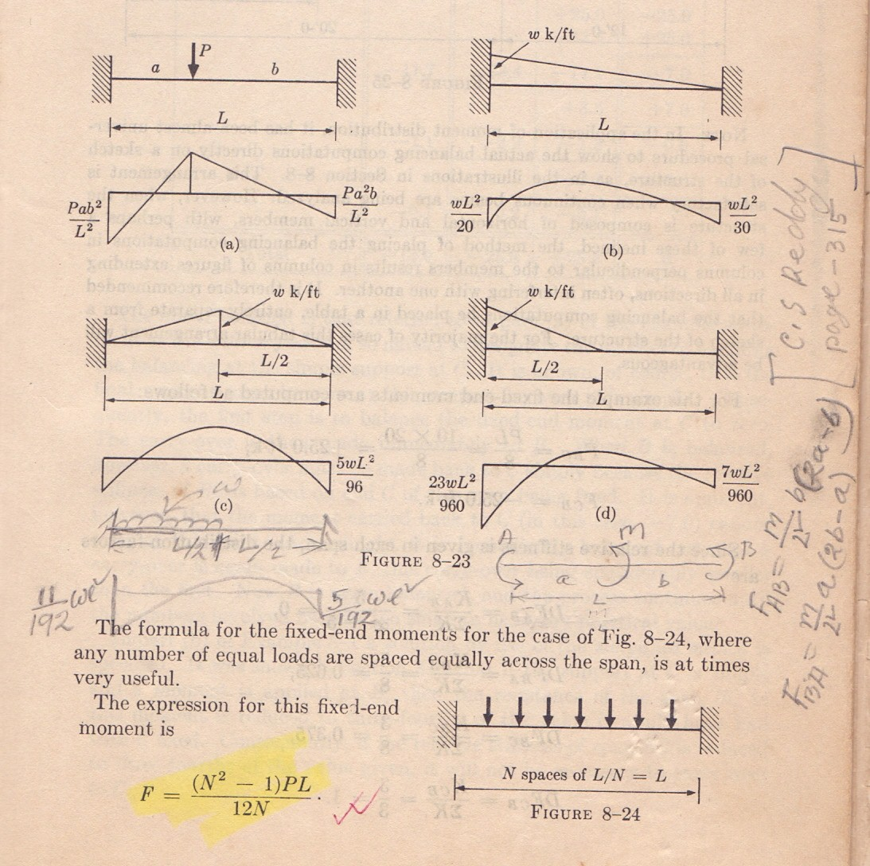
J.S. Kinney
Page No. 313

Slide 11
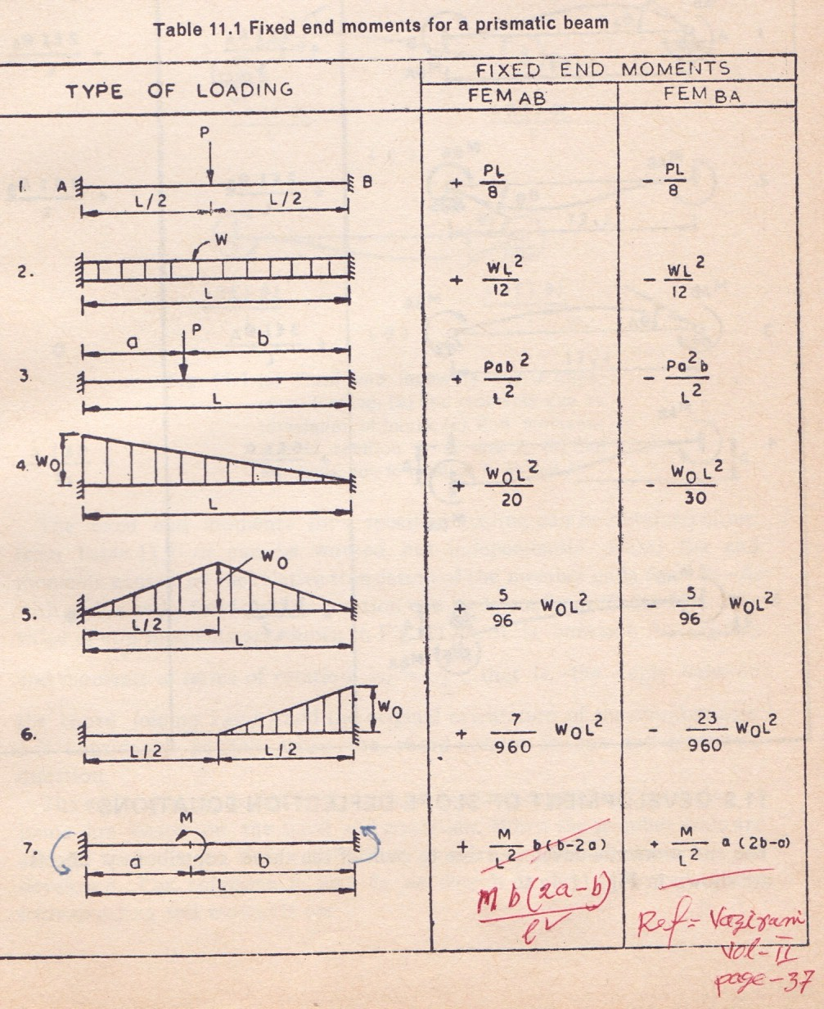
C.S. Reddy
Page No. 315

Slide 12

MOMENT DISTRIBUTION METHOD
150 kN
15 kN/m
10 kN/m
3 m
A
B
C
D
I
I
I
8 m
6 m
8 m
Statement of Basic Principles
Consider the continuous beam ABCD, subjected to the given loads, as shown in Figure above. Assume that only rotation of joints occur at B, C and D, and that no support displacements occur at B, C and D. Due to the applied loads in spans AB, BC and CD, rotations occur at B, C and D.
In order to solve the problem in a successively approximating manner,
it can be visualized to be made up of a continued two-stage problems
viz., that of locking and releasing the joints in a continuous sequence.

Slide 13


150 kN
15 kN/m
10 kN/m
3 m
A
B
C
D
I
I
I
8 m
6 m
8 m
Step I
The joints B, C and D are locked in position before any load is applied on the beam ABCD; then given loads are applied on the beam. Since the joints of beam ABCD are locked in position, beams AB, BC and CD acts as individual and separate fixed beams, subjected to the applied loads; these loads develop fixed end moments.
80 kN.m
15 kN/m
10 kN/m
-80 kN.m
53.33 kN.m
53.33 kN.m
A
B
112.5kN.m
112.5 kN.m
C
D
8 m
150 kN
8 m
3 m
B
C
6 m

Slide 14
In beam AB
Fixed end moment at A = -wl²/12 = - (15)(8)(8)/12 = - 80 kN.m
Fixed end moment at B = +wl²/12 = +(15)(8)(8)/12 = + 80 kN.m
In beam BC
Fixed end moment at B = - (Pab²)/l² = - (150)(3)(3)²/6²
= -112.5 kN.m
Fixed end moment at C = + (Pab²)/l² = + (150)(3)(3)²/6²
= + 112.5 kN.m
In beam CD
Fixed end moment at C = -wl²/12 = - (10)(8)(8)/12 = - 53.33 kN.m
Fixed end moment at D = +wl²/12 = +(10)(8)(8)/12 = + 53.33kN.m

Slide 15
Step II
Since the joints B, C and D were fixed artificially (to compute the fixed-end moments), now the joints B, C and D are released and allowed to rotate. Due to the joint release, the joints rotate maintaining the continuous nature of the beam. Due to the joint release, the fixed end moments on either side of joints B, C and D act in the opposite direction now, and cause a net unbalanced moment to occur at the joint.
150 kN
15 kN/m
10 kN/m
3 m
A
B
C
D
I
I
I
8 m
6 m
8 m
Released moments -80.0
+112.5
-112.5
+53.33
-53.33
Net unbalanced moment
+32.5
-59.17
-53.33

Slide 16
Step III
These unbalanced moments act at the joints and modify the joint moments at B, C and D, according to their relative stiffnesses at the respective joints. The joint moments are distributed to either side of the joint B, C or D, according to their relative stiffnesses. These distributed moments also modify the moments at the opposite side of the beam span, viz., at joint A in span AB, at joints B and C in span BC and at joints C and D in span CD. This modification is dependent on the carry-over factor (which is equal to 0.5 in this case); when this carry over is made, the joints on opposite side are assumed to be fixed.
Step IV
The carry-over moment becomes the unbalanced moment at the joints to which they are carried over. Steps 3 and 4 are repeated till the carry-over or distributed moment becomes small.
Step V
Sum up all the moments at each of the joint to obtain the joint moments.

Slide 17
Problem No. 1
3k/ft
A
6k
(I)
B
(2I)
C
12ft
8ft
8ft
Relative stiffness K
Fixed end moment

Slide 18
A
B
C
 | Joint | A | B |  | C
 | Member | AB | BA | BC | CB
 | K | 1 | 1 | 1.5 | 1.5
 | D.F.
--- | 0.4 | 0.6 | 1
1st cycle | FEM Balance | 36 | -36 | 12 | -12
---
9.6
14.4
12
2nd cycle | CO Balance | 4.8 | ---- | 6 | 7.2
---
-2.4
-3.6
-7.2
3rd Cycle | CO Balance | -1.2 | --- | -3.6 | -1.8
---
1.44
2.16
1.8
 | Total | 39.6 | -27.36 | 27.36 | 0.0
3k/ft
A
6k
Draw SFD & BMD
Assignment No. 1

