Slide 1
CE 4111
Structural Analysis and Design-III
Contact hours/week : 4 Credit: 4.00
Syllabus:
1. Moment distribution method
2. Slope deflection method
3. Influence lines
4. Stiffness matrix method
5. Flexibility matrix method
6. Structural forms
Ref:
Indeterminate Structural Analysis, By J. Sterling Kinney
Statically Indeterminate Structures, By Chu Kia Wang
Analysis of framed Structures, By James Gere
Basic Structural Analysis, By C.S. Reddy
Analysis of Structures Vol II, By Vazirani

Slide 2
MOMENT DISTRIBUTION METHOD
Displacement method
Definitions, explanations, specialties & limitations of Displacement method
Since forces (reactions) are unknown in the force method likewise in the displacement method displacements are unknown. In displacement method we proceed in the reverse order i.e. first determine the displacements and then proceed with the computation of reactions and stresses. This very method of calculation of unknowns in the structure is called Displacement Method also called stiffness method.
The main specialties of this method is that when the member is more restrained then less is the unknown since the restraining provides us with the known condition called boundary condition. As for instance, say we have a bar with its end free. Then there is degree of kinematic indeterminacy 6 which is maximum no. of unknown if we proceed with displacement method. But say the same bar is fixed at one end then it becomes cantilever. Here degree of indeterminacy is only 3. The no. of unknowns decreased to 3 from 6. Also this method is very suitable for computer programming.
But as a limitation, it is difficult to analyze the degree of freedom by visual inspection.

Slide 3
Kinematic indeterminacy (Degrees of freedom)
In the displacement method, primary unknowns are joint displacements which are commonly referred to as the Degrees of Freedom (DOF) of the structure. It is also called Kinematic Indeterminacy. It is necessary to consider all the independent DOFs while writing the equilibrium conditions. These degrees of freedom are specified at joints, supports and at the free ends. It is very necessary to find all DOFs by visual inspection since each DOF is the unique displacement in the given structure.

Slide 4
Module 5 : Force Method - Introduction and applications Lecture 2 : The Force Method Objectives In this course you will learn the following Concept of force method for analysis of statically indeterminate structure. Selection of the basic determinate structure. Illustration of force method by numerical examples. 5.3 The Force Method The force method is used to calculate the response of statically indeterminate structures to loads and/or imposed deformations. The method is based on transforming a given structure into a statically determinate primary system and calculating the magnitude of statically redundant forces required to restore the geometric boundary conditions of the original structure. The force method (also called the flexibility method or method of consistent deformation ) is used to calculate reactions and internal forces in statically indeterminate structures due to loads and imposed deformations. The basic steps in the force method are as follows: (a) Determine the degree of static indeterminacy, n of the structure. (b) Transform the structure into a statically determinate system by releasing a number of static constraints equal to the degree of static indeterminacy, n. This is accomplished by releasing external support conditions or by creating internal hinges. The system thus formed is called the basic determinate structure . (c) For a given released constraint j, introduce an unknown redundant force corresponding to the type and direction of the released constraint. (d) Apply the given loading or imposed deformation to the basic determinate structure . Use suitable method (given in Chapter 4) to calculate displacements at each of the released constraints in the basic determinate structure . (e) Solve for redundant forces ( j =1 to n ) by imposing the compatibility conditions of the original structure. These conditions transform the basic determinate structure back to the original structure by finding the combination of redundant forces that make displacement at each of the released constraints equal to zero. It can thus be seen that the name force method was given to this method because its primary computational task is to calculate unknown forces , i.e. the redundant forces through . 5.3.1 Selection of the basic determinate structure There is no limit to the number of different basic determinate structure that can be generated for a given structure. The choice of structure, however, must ensure that the primary system is stable. In addition, it is recommended that the basic determinate structure be chosen to minimize computational effort and maximize computational accuracy. (a) Stability of Basic determinate structure It is not sufficient merely to release the correct number of statical constraints in generating a basic determinate structure. Care must be taken to ensure that the basic determinate structure is stable. This fact is explained in the Table 5.1 where any arbitrary release of constraint can result into the unstable basic determinate structure. T

Slide 5
MOMENT DISTRIBUTION METHOD
The moment distribution method is a structural analysis method for statically indeterminate beams and frames developed by Hardy Cross. It was published in 1930 in an ASCEjournal.^{[1]} The method only accounts for flexural effects and ignores axial and shear effects. From the 1930s until computers began to be widely used in the design and analysis of structures, the moment distribution method was the most widely practiced method.
Introduction
In the moment distribution method, every joint of the structure to be analysed is fixed so as to develop the fixed-end moments. Then each fixed joint is sequentially released and the fixed-end moments (which by the time of release are not in equilibrium) are distributed to adjacent members until equilibrium is achieved. The moment distribution method in mathematical terms can be demonstrated as the process of solving a set of simultaneous equations by means of iteration.
The moment distribution method falls into the category of displacement method of structural analysis.
In order to apply the moment distribution method to analyse a structure, the following things must be considered
Fixed end moments
Fixed end moments are the moments produced at member ends by external loads when the joints are fixed.

Slide 6
Flexural stiffness
The flexural stiffness (EI/L) of a member is represented as the product of the modulus of elasticity (E) and the second moment of area (I) divided by the length (L) of the member. What is needed in the moment distribution method is not the exact value but the ratio of flexural stiffness of all members.
Distribution factors
When a joint is released and begins to rotate under the unbalanced moment, resisting forces develop at each member framed together at the joint. Although the total resistance is equal to the unbalanced moment, the magnitudes of resisting forces developed at each member differ by the members' flexural stiffness. Distribution factors can be defined as the proportions of the unbalanced moments carried by each of the members. In mathematical terms, distribution factor of member
Carryover factors
When a joint is released, balancing moment occurs to counterbalance the unbalanced moment which is initially the same as the fixed-end moment. This balancing moment is then carried over to the member's other end. The ratio of the carried-over moment at the other end to the fixed-end moment of the initial end is the carryover factor.
Sign convention
Once a sign convention has been chosen, it has to be maintained for the whole structure. The traditional engineer's sign convention is not used in the calculations of the moment distribution method although the results can be expressed in the conventional way.

Slide 7
Distribution Factor
Distribution factor is the ratio according to which an externally applied unbalanced moment M at a joint is apportioned to the various members mating at the joint.
p
E
A
B
K=1
K=2
1
3
K=AE/L
B
A
2
D
M
P_{A}=⅓ P
P_{B}=⅔ P
4
C
DF_{AB}=3/10
DF_{AC}=4/10
DF_{AD}=2/10
DF_{AE}=1/10
The distribution factor for any member at a joint is equal to the stiffness of the member divided by the sum of the stiffness of all the members at the joint.

Slide 8
Stiffness and Carry-over factor
Carry-over factor
M
A
B
θ_{A}
M_{F}
L
M/EI
M_{F} /EI
Carry-over factor = 1/2
The carry-over factor is that factor by which the developed moment at the rotated end of a member may be multiplied to give the induced moment at the fixed or restrained end.

Slide 9
Stiffness
M
A
B
θ_{A}
M/2
L
M/EI
M /2EI
Absolute stiffness K = 4EI/L
Absolute stiffness is the value of the moment, applied at the simply supported end of a member, necessary to produce a rotation of 1 radian of this simple supported end, no translation of either end being permitted and the far end being either simply supported, restrained or fixed.

Slide 10
FIXED END MOMENTS
p
w
L/2
PL/8
PL/8
WL²/20
WL²/30
L
L
p
a
b
w
L/2
7WL²/960
Pab²/L²
Pba²/L²
23WL²/960
L
L
w
w
WL²/12
WL²/12
L/2
5WL²/96
L
5WL²/96
L
w
a
b
11WL²/192
L/2
5WL²/192
L
Mb(2a-b)/L²
Ma(2b-a)/L²
L

Slide 11
a
b
Ma(2b-a)/L²
Mb(2a-b)/L²
L
a
b
Ma(2b-a)/L²
Mb(2a-b)/L²
L
L

Slide 12
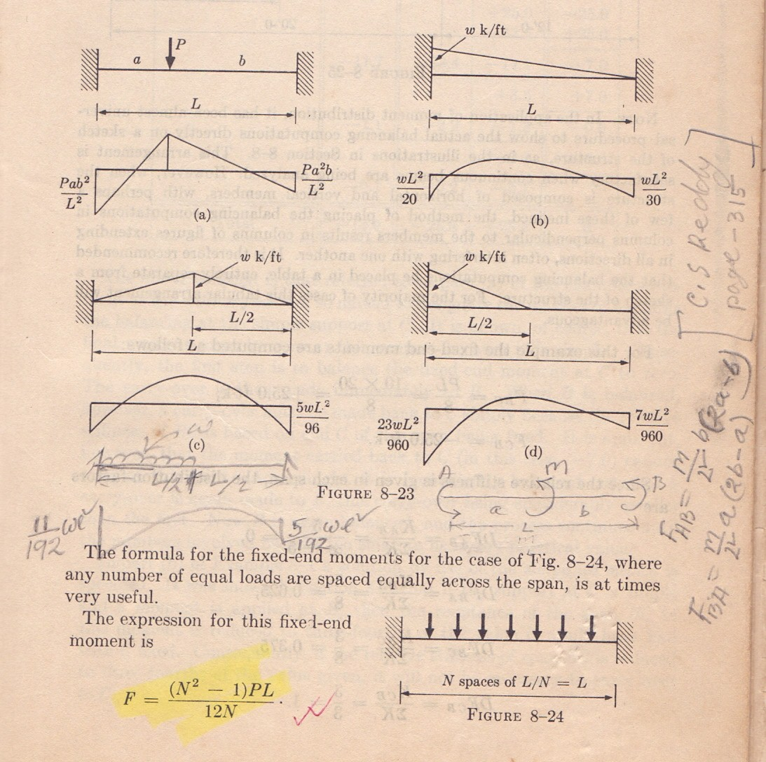
J.S. Kinney
Page No. 313

Slide 13
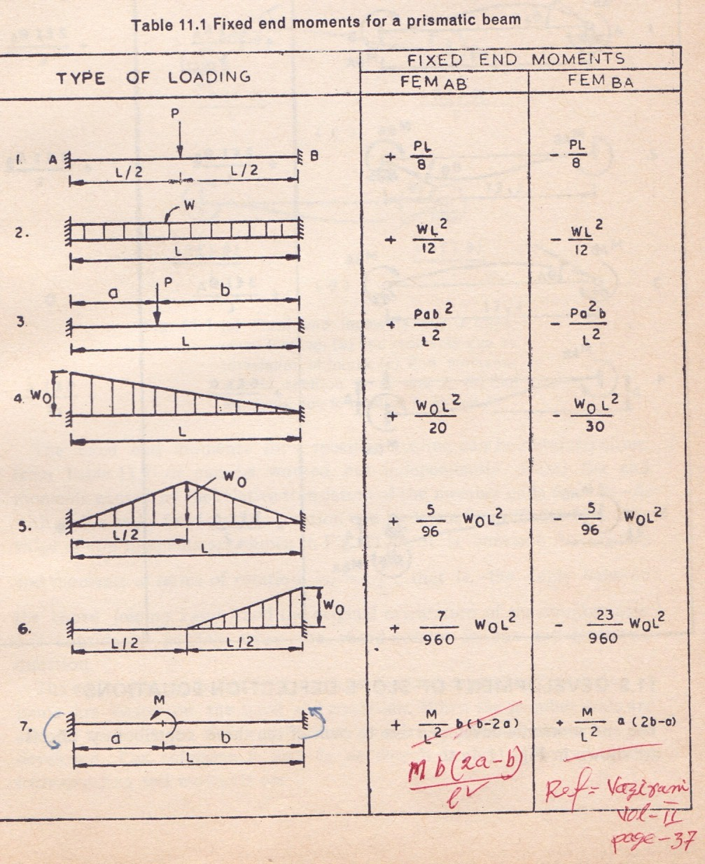
C.S. Reddy
Page No. 315

Slide 14

MOMENT DISTRIBUTION METHOD
150 kN
15 kN/m
10 kN/m
3 m
A
B
C
D
I
I
I
8 m
6 m
8 m
Statement of Basic Principles
Consider the continuous beam ABCD, subjected to the given loads, as shown in Figure below. Assume that only rotation of joints occur at B, C and D, and that no support displacements occur at B, C and D. Due to the applied loads in spans AB, BC and CD, rotations occur at B, C and D.
In order to solve the problem in a successively approximating manner,
it can be visualized to be made up of a continued two-stage problems
viz., that of locking and releasing the joints in a continuous sequence.

Slide 15


150 kN
15 kN/m
10 kN/m
3 m
A
B
C
D
I
I
I
8 m
6 m
8 m
Step I
The joints B, C and D are locked in position before any load is applied on the beam ABCD; then given loads are applied on the beam. Since the joints of beam ABCD are locked in position, beams AB, BC and CD acts as individual and separate fixed beams, subjected to the applied loads; these loads develop fixed end moments.
80 kN.m
15 kN/m
10 kN/m
-80 kN.m
53.33 kN.m
53.33 kN.m
A
B
112.5kN.m
112.5 kN.m
C
D
8 m
150 kN
8 m
3 m
B
C
6 m

Slide 16
In beam AB
Fixed end moment at A = -wl²/12 = - (15)(8)(8)/12 = - 80 kN.m
Fixed end moment at B = +wl²/12 = +(15)(8)(8)/12 = + 80 kN.m
In beam BC
Fixed end moment at B = - (Pab²)/l² = - (150)(3)(3)²/6²
= -112.5 kN.m
Fixed end moment at C = + (Pab²)/l² = + (150)(3)(3)²/6²
= + 112.5 kN.m
In beam CD
Fixed end moment at C = -wl²/12 = - (10)(8)(8)/12 = - 53.33 kN.m
Fixed end moment at D = +wl²/12 = +(10)(8)(8)/12 = + 53.33kN.m

Slide 17
Step II
Since the joints B, C and D were fixed artificially (to compute the fixed-end moments), now the joints B, C and D are released and allowed to rotate. Due to the joint release, the joints rotate maintaining the continuous nature of the beam. Due to the joint release, the fixed end moments on either side of joints B, C and D act in the opposite direction now, and cause a net unbalanced moment to occur at the joint.
150 kN
15 kN/m
10 kN/m
3 m
A
B
C
D
I
I
I
8 m
6 m
8 m
Released moments -80.0
+112.5
-112.5
+53.33
-53.33
Net unbalanced moment
+32.5
-59.17
-53.33

Slide 18
Step III
These unbalanced moments act at the joints and modify the joint moments at B, C and D, according to their relative stiffnesses at the respective joints. The joint moments are distributed to either side of the joint B, C or D, according to their relative stiffnesses. These distributed moments also modify the moments at the opposite side of the beam span, viz., at joint A in span AB, at joints B and C in span BC and at joints C and D in span CD. This modification is dependent on the carry-over factor (which is equal to 0.5 in this case); when this carry over is made, the joints on opposite side are assumed to be fixed.
Step IV
The carry-over moment becomes the unbalanced moment at the joints to which they are carried over. Steps 3 and 4 are repeated till the carry-over or distributed moment becomes small.
Step V
Sum up all the moments at each of the joint to obtain the joint moments.

Slide 19
1.3 SOME BASIC DEFINITIONS
In order to understand the five steps mentioned in section 1.2, some words need to be defined and relevant derivations made.
1.3.1 Stiffness and Carry-over factor
M
θ_{A}
M_{F}
L
M/EI
M_{F} /EI
Carry-over factor = 1/2
The carry-over factor is that factor by which the developed moment at the rotated end of a member may be multiplied to give the induced moment at the fixed or restrained end.

Slide 20
Stiffness
M
θ_{A}
M/2
L
M/EI
M /2EI
Absolute stiffness K = 4EI/L
Absolute stiffness is the value of the moment, applied at the simply supported end of a member, necessary to produce a rotation of 1 radian of this simple supported end, no translation of either end being permitted and the far end being either simply supported, restrained or fixed.

Slide 21
Problem No. 1
3k/ft
A
6k
(I)
B
(2I)
C
12ft
8ft
8ft
Relative stiffness K
Fixed end moment

Slide 22
 | Joint | A | B |  | C
 | Member | AB | BA | BC | CB
 | K
 | D.F.
 | FEM Balance
 | CO Balance
 | CO Balance
 | Total

Slide 23
A
B
C
 | Joint | A | B |  | C
 | Member | AB | BA | BC | CB
 | K | 1 | 1 | 1.5 | 1.5
 | D.F.
--- | 0.4 | 0.6 | 1
1st cycle | FEM Balance | 36 | -36 | 12 | -12
---
9.6
14.4
12
2nd cycle | CO Balance | 4.8 | ---- | 6 | 7.2
---
-2.4
-3.6
-7.2
3rd Cycle | CO Balance | -1.2 | --- | -3.6 | -1.8
---
1.44
2.16
1.8
 | Total | 39.6 | -27.36 | 27.36 | 0.0
3k/ft
A
6k
Draw SFD & BMD
Assignment No. 1

Slide 24
 | Joint | A | B |  | C
 | Member | AB | BA | BC | CB
 | K
 | D.F.
 | FEM Balance
 | CO Balance
 | CO Balance
 | Total

Slide 25
Assignment No. 1
L/2

Slide 26
Problem No. 2
2k/ft
4k
15k
EI is constant
E
D
C
B
A
3ft
8ft
4ft
10ft
15ft
Calculate:
1. Relative stiffness
2. Fixed end moments
Relative stiffness K
Fixed end moment

Slide 27
4k
15k
2k/ft
E
D
C
B
A
 | Joint | A | B |  | C |  | D
 | Member | AB | BA | BC | CB | CD | DC | DE
 | K | 1 | 1 | 1.5 | 1.5 | 1.25 | 1.25 | ---
 | D.F. | --- | 0.4 | 0.6 | 0.55 | 0.45 | 1 | ---
1st cycle | FEM Balance | -22.5 | 15 | --- | --- | -26.67 | 13.33 | -12
---
-6
-9
14.67
12
-1.33
---
2nd cycle | CO Balance | -3 | --- | 7.33 | -4.5 | -0.66 | 6
---
-2.93
-4.4
2.84
2.32
-6
3rd cycle | CO Balance | -1.46 | --- | 1.42 | -2.2 | -3 | 1.16
---
-0.57
-0.85
2.86
2.34
-1.16
 | Total | -26.96 | 5.5 | -5.5 | 13.67 | -13.67 | 12 | -12
2k/ft
4k
15k
Draw SFD & BMD

Slide 28
Assignment No. 2
5k each
L/2

Slide 29
Support Settlement
M
A
Δ
B
V
M
V
L
M /EI
Δ
M/EI
(If one support is hinge)

Slide 30
Stiffness
M
θ_{A}
L
M/EI

Slide 31
Problem No.3
12k
A
E=30000ksi I=200in⁴
∆_{B}=0.2" θ_{A}=0.0015rad (cw)
B
C
6’
D
(I)
0.2"
(I)
(I)
15ft
12ft
10ft
Calculate:
1. Relative stiffness
2. Fixed end moments
Relative stiffness K
Fixed end moment
FEM due to settlement
FEM due to rotation
FEM due to load

Slide 32
Modified stiffness method
 | Joint | A | B |  | C |  | D
 | Member | AB | BA | BC | CB | CD | DC
 | K | 1 | 1 | 1.25 | 1.25 | 1.5 | 1.5
 | Modified K | 1 | 1 | 1.25 | 1.25 | 1.125 | 1.5
 | D.F. | --- | 0.44 | 0.56 | 0.53 | 0.47 | 1
1st cycle | FEM Balance | 1.85 | 10.19 | -28.93 | -28.93 | 17.28 | -11.52
---
8.26
10.48
6.17
5.48
11.52
2nd cycle | CO Balance | 4.13 | --- | 3.08 | 5.24 | 5.76
---
-1.36
-1.72
-5.83
-5.17
3rd cycle | CO Balance | -0.68 | --- | -2.92 | -0.86 | ---
---
1.28
1.64
0.46
0.4
 | Total | 5.3 | 18.37 | -18.37 | -23.75 | 23.75
12k
A
B
C
D
Draw SFD & BMD

Slide 33
Problem No. 4
A
12ft
2k/ft
5k each
B
C
E
20k-ft
6ft
Calculate:
1. Relative stiffness
2. Fixed end moments
8ft
8ft
16ft
6ft
3k/ft
D
Relative stiffness K
Fixed end moment

Slide 34
A
B
E
C
D
 | Joint | A | B |  |  | C |  |  | D | E
 | Member | AB | BA | BC |  | CB | CD | CE | DC | EC
 | K | 2 | 2 | 1.5 |  | 1.5 | 2 | 1.5 | 2 | 1.5
 | D.F. | --- | 0.57 | 0.43 |  | 0.3 | 0.4 | 0.3 | ---- | 1
1st Cycle | FEM Balance | ---- | ---- | 13.33 | -20 | -29.33 | -3.15 | 38.88 | 10.35 | -38.88
---
3.8
2.87
-1.92
-2.56
-1.92
---
38.88
2nd Cycle | CO Balance | 1.9 | --- | -0.96 |  | 1.44 | ---- | 19.44 | -1.28 | -0.96
---
0.55
0.41
-6.26
-8.36
-6.26
---
0.96
3rd Cycle | CO Balance | 0.27 | --- | -3.13 |  | 0.2 | ---- | 0.48 | -4.18 | -3.13
---
1.78
1.35
-0.2
-0.28
-0.2
---
3.13
 | Total | 2.17 | 6.13 | 13.87 | -20 | -36.07 | -14.35 | 50.42 | 4.89 | 0.0

Slide 35
Draw SFD & BMD
Assignment No. 4

Slide 36
Assignment No. 4

Slide 37
Support Settlement
M
A
Δ
B
V
M
V
L
M /EI
Δ
M/EI
(If one support is hinge)

Slide 38
Stiffness
M
θ_{A}
L
M/EI

Slide 39
BCS
W #/ft
A
B
L
Wl²/12
- Wl²/12
------
Wl²/12
Wl²/24
------
------
------
___________
___________
Wl²/8
00

Slide 40
Assignment No. 5
C
D
B
A
E
Δ_{A} or Δ_{E} or Δ_{D}

Slide 41
3k/ft
20k
2k/ft
6k
A
18k
(3I)
B
(10I)
C
(2I)
D
E
12ft
12ft
12ft
4ft
8ft
3ft

Slide 42
Problem no.-6
20K
8ft
B
C
(1.5I)
(I)
Calculate:
1. Relative stiffness
2. Fixed end moments
(I)
15ft
A
D
20ft
K = I/L
M_{BC} = Pab²/L²

Slide 43
 | Joint | A | B |  | C |  | D
 | Member | AB | BA | BC | CB | CD | DC
 | K
 | D.F.
1st Cycle | FEM Balance
2nd Cycle | CO Balance
3rd Cycle | CO Balance
Total

Slide 44
 | Joint | A | B |  | C |  | D | E
 | Member | AB | BA | BC | CB | CD | DC
 | K | 4 | 4 | 4.5 | 4.5 | 4 | 4
 | D.F | ------ | 0.47 | 0.53 | 0.53 | 0.47 | -----
1st Cycle | FEM Balance | ------ | ------ -18.0 | 38.4 -20.4 | -57.6 30.5 | ------ 27.1 | ----- ------
2nd cycle | CO Balance | -9.0 ----- | ------ -7.17 | 15.25 -8.08 | -10.2 5.81 | ----- 4.39 | 13.55 -------
3rd cycle | Co Balance | -3.59 ----- | ------- -1.37 | 2.91 -1.54 | -4.04 2.14 | ------ 1.9 | 2.2 ------
Total |  | -12.59 | -26.54 | 26.54 | -33.39 | 33.39 | 15.75

Slide 45
Total |  | -12.59 | -26.54 | 26.54 | -33.39 | 33.39 | 15.75
2.60
B
C
3.28
AJR=0.68
B
C
∆
p
B
C
A
D
A
D
SAY : 50K-FT

Slide 46
Distribution for sidesway
 | Joint | A | B |  | C |  | D
 | Member | AB | BA | BC | CB | CD | DC
 | K | 4 | 4 | 4.5 | 4.5 | 4 | 4
 | D.F | ------ | 0.47 | 0.53 | 0.53 | 0.47 | -----
CJF= 9.66
B
C
B
C
1st Cyc | FEM Balan | -50 ------ | -50 23.5 | -------- 26.5 | ------ 26.5 | -50 23.5 | -50 ------
2nd cyc | CO Balan | 11.75 ----- | ------ -6.23 | 13.25 -7.02 | 13.25 -7.02 | ----- -6.23 | 11.75 -------
3rd cyc | Co Balan | -3.11 ----- | ------- 1.65 | -3.51 1.86 | -3.51 1.86 | ------ 1.65 | -3.11 ------
A
D
 | Total | -41.36 | -31.08 | 31.08 | 31.08 | -31.08 | -41.36
Z= 0.07
Z X moment from second balance | -2.90 | -2.18 | 2.18 | 2.18 | -2.18 | -2.90
Moment from first balance | -12.59 | -26.54 | 26.54 | -33.39 | 33.39 | 15.75
Z=AJR/CJF = 0.07
Final moment | -15.49 | -28.72 | 28.72 | -31.21 | 31.21 | 12.85
Assignment No. -6

Slide 47
Assignment No. -6
P
10ft
15ft
12ft

Slide 48
Problem no. 7
E
12ft
2k/ft
15k
B
C
7ft
20ft
Calculate:
1. Relative stiffness
2. Fixed end moments
10k
8ft
A
D
 | Joint | A | B |  |  | C |  | D | E
 | Mem | AB | BA | BE | BC | CB | CD | DC | EB
 | K | 4 | 4 | 5 | 3 | 3 | 4 | 4 | 5
 | D.F | 1 | 0.33 | 0.42 | 0.25 | 0.43 | 0.57 | ----- | ------
1st Cyc | FEM Balance | 17.42 -17.42 | -19.91 -15.43 | ---- -19.64 | 66.67 -11.69 | -66.67 28.67 | ------ 38 | ----- ------ | --- -----
2nd cyc | CO Balance | -7.72 7.72 | -8.71 -1.85 | ------ -2.36 | 14.33 -1.41 | -5.84 2.51 | ----- 3.33 | 19 ------- | -9.82 ------
3rd cyc | Co Balance | -0.93 0.93 | 3.86 -1.69 | ------- -2.15 | 1.25 -1.27 | -0.7 0.30 | ------ 0.40 | 1.66 ------ | -1.18 -----
 | Total | 00 | -43.73 | -24.15 | 67.88 | -41.73 | 41.73 | 20.66 | -11

Slide 49
 | Joint | A | B |  |  | C |  | D | E
 | Mem | AB | BA | BE | BC | CB | CD | DC | EB
 | Total | 00 | -43.73 | -24.15 | 67.88 | -41.73 | 41.73 | 20.66 | -11
E
AJR=16.16
∆
15k
P
B
C
A
D
F_{AB} = 100k-ft (say) F_{BE}= ??

Slide 50
 | Joint | A | B |  |  | C |  | D | E
 | Memb | AB | BA | BE | BC | CB | CD | DC | EB
 | K | 4 | 4 | 5 | 3 | 3 | 4 | 4 | 5
 | D.F | 1 | 0.33 | 0.42 | 0.25 | 0.43 | 0.57 | ----- | ------
1st Cyc | FEM Balance | 100 -100 | 100 18.5 | -156 23.5 | ---- 14 | -------- -43 | 100 -57 | 100 ------ | -156 -----
2nd cyc | CO Balance | 9.25 -9.25 | -50 23.6 | ------ 30.03 | -21.5 17.87 | 7.00 -3 | ----- -4 | -28.5 ------- | 11.75------
3rd cyc | Co Balance | 11.8 -11.8 | -4.62 2 | ------- 2.58 | -1.5 1.54 | 8.93 -3.84 | ------ -5.09 | -2 ------ | 15 -----
CJF
 | Total | 00 | 89.48 | -99.89 | 10.41 | -33.91 | 33.91 | 69.5 | -129.2
 |  |  | Z= 0.506
Z X moment of second balance |  | 00 | 45.27 | -50.54 | 5.25 | -17.12 | 17.12 | 35.09 | -65.37
Moment of first balance |  | 00 | -43.73 | -24.15 | 67.88 | -41.73 | 41.73 | 20.66 | -11
Final moment | 00 | 1.54 | -74.69 | 73.13 | -58.85 | 58.85 | 55.75 | -76.37
CJF=31.94
Z=AJR/CJF=0.506
Assignment No. -7

Slide 51
Assignment No. -7
2k/ft
15k
20ft

Slide 52
Problem no. 8
2K/ft
B
C
(I)
(I)
20ft
(I)
Calculate:
1. Relative stiffness
2. Fixed end moments
A
D
20ft
10ft
15ft
 | Joint | A | B |  | C |  | D
 | Member | AB | BA | BC | CB | CD | DC
 | K | 4.47 | 4.47 | 5 | 5 | 4 | 4
 | D.F | ------ | 0.47 | 0.53 | 0.56 | 0.44 | 1
1st Cyc | FEM Balance | ------ ------ | ------ -31.33 | 66.67 -35.34 | -66.67 37.34 | ------ 29.33 | ----- ------
2nd cyc | CO Balance | -15.66 ----- | ------ -8.77 | 18.67 -9.9 | -17.67 9.9 | ----- 7.77 | 14.66 -14.66
3rd cyc | Co Balance | -4.38 ----- | ------- -2.33 | 4.95 -2.62 | -4.95 6.88 | -7.33 5.4 | 3.88 -3.88
 | Total | -20.04 | -42.43 | 42.43 | -35.17 | 35.17 | 00

Slide 53
 | Joint | A | B |  | C |  | D
 | Member | AB | BA | BC | CB | CD | DC
 | Total | -20.04 | -42.43 | 42.43 | -35.17 | 35.17 | 00
20.36
19.64
2K/ft
AJR=3.18
B
C
13.30
C
16.48
B
A
D

Slide 54
∆
B’’
0.5∆
∆
1.12∆
B’
C’’
C
P
B
1.25∆
C’
0.75∆
F_{BC}=F_{CB}= 6EI(1.25∆)/L² = 50kft
 | Joint | A | B |  | C |  | D
 | Member | AB | BA | BC | CB | CD | DC
 | K | 4.47 | 4.47 | 5 | 5 | 4 | 4
 | D.F | ------ | 0.47 | 0.53 | 0.56 | 0.44 | 1
1st Cyc | FEM Balance | -35.84 --------- | -35.84 -6.65 | 50 -7.51 | 50 -10 | -32 -8 | -32 32
2nd cyc | CO Balance | -3.33 ----- | ------ 2.35 | -5 2.65 | -3.75 -6.86 | 16 -5.39 | -4 4
3rd cyc | Co Balance | 1.17 ----- | ------- 1.61 | -3.43 1.82 | 1.32 -1.86 | 2 -1.46 | -2.69 2.69
 | Total | -40 | -38.53 | 38.53 | 28.85 | -28.85 | 00

Slide 55
3.37
3.37
 | Total | -40 | -38.53 | 38.53 | 28.85 | -28.85 | 00
C
CJF=9.58
B
5.61
C
3.97
B
A
D
Z= 0.332
 | Joint | A | B |  | C |  | D
 | Member | AB | BA | BC | CB | CD | DC
 | Total | -40 | -38.53 | 38.53 | 28.85 | -28.85 | 00
 |  | Z=0.332
Z x second balance |  | -13.28 | -12.79 | 12.79 | 9.58 | -9.58 | 00
Moment form first balance | -20.04 | -42.43 | 42.43 | -35.17 | 35.17 | 00
Final moment | -43.32 | -55.22 | 55.22 | -25.59 | 25.59 | 00
Assignment No. -8

Slide 56
Assignment No. -8
Q
P
6ft
8ft
D
B
C
(I)
(I)
25ft
(I)
A
E
20ft
10ft
10ft

