Slide 1

Environmental Engineering Sessional- II CE 4142
Course Co-ordinator:
Dr. Anupam Chowdhury
Associate Professor
Department of Civil Engineering
Rajshahi University of Engineering & Technology
Email: anupam.19ce@gmail.com

Slide 2
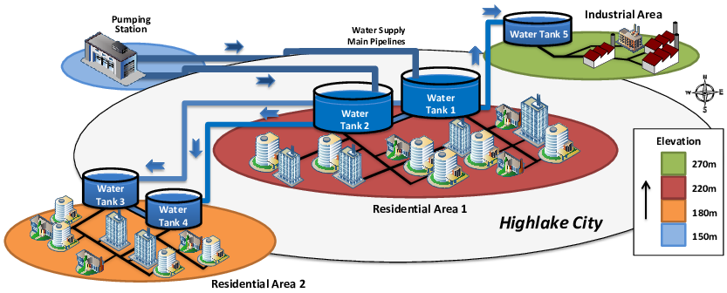
Design of Water Supply System (WSS)

Slide 3
Purposes of Water Supply System Design
To make water available in close proximity to the consumers
To supply water in adequate quantities according to the demand of the consumers
To supply water with adequate pressure
To regulate water supply as per requirement

Slide 4
Classification of WSS
Gravity flow system
System with direct pumping
System with pumping and storage

Slide 5
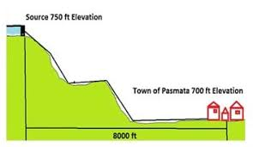
Classification of WSS
Gravity flow system

Slide 6
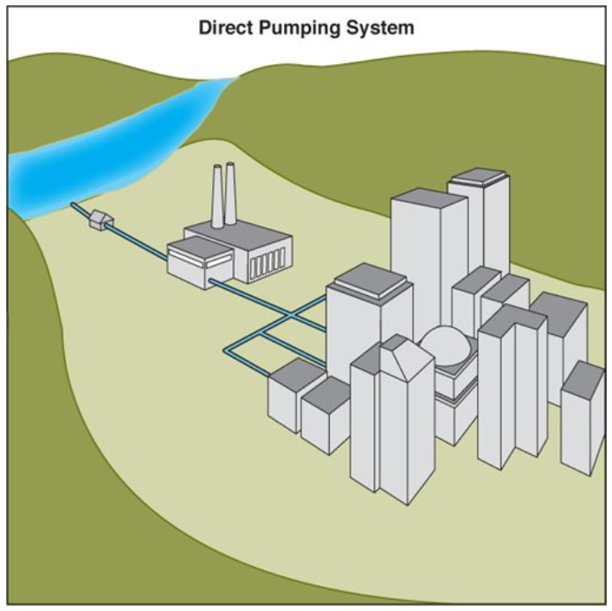
Classification of WSS
System with direct pumping

Slide 7
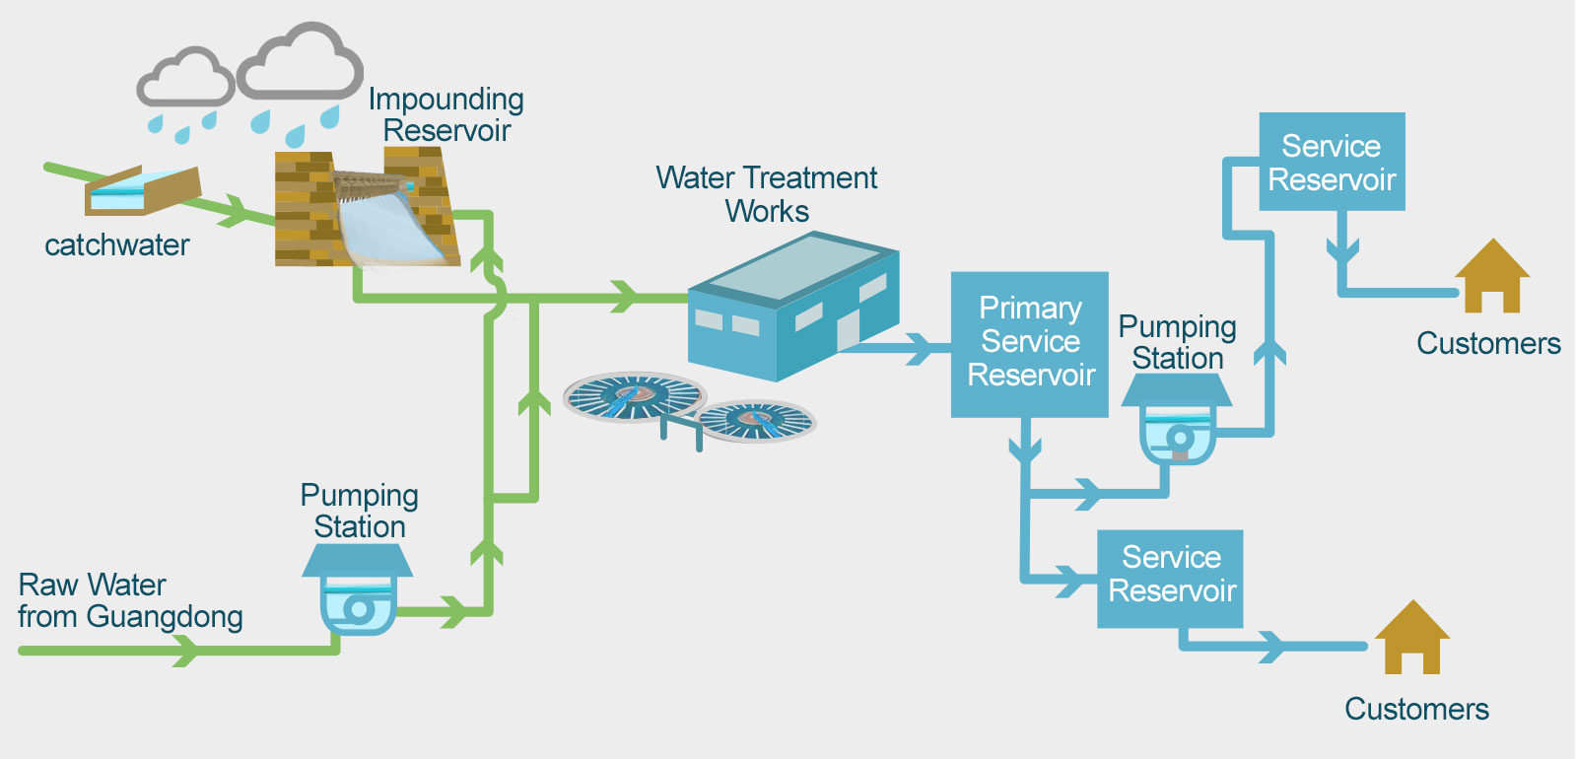
Classification of WSS
System with pumping and storage

Slide 8
Distribution of WSS Network
Branched distribution network
Looped distribution network

Slide 9
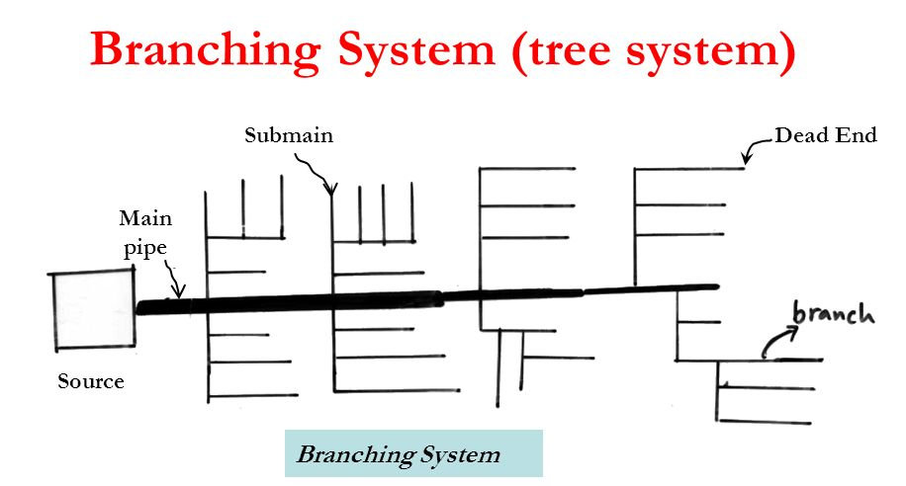
Distribution of WSS Network
Branched distribution network
Suitable for developing areas with an irregular pattern of road network

Slide 10
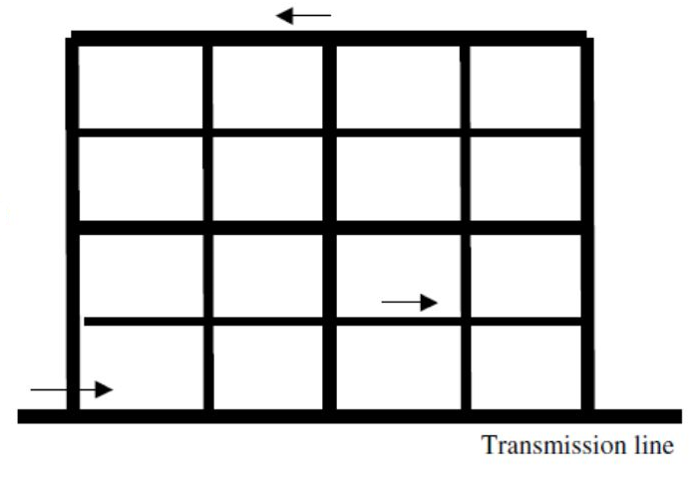
Distribution of WSS Network
Looped distribution network
Suitable for well-planned developed areas with a definite pattern of road network

Slide 11
WSS Design Consideration
Peak factor: Daily peak factor varies from 1.3-1.5
Water consumption per capita per day in Bangladesh:
Areas | Water consumption (lpcd) | Peak factor, k
Rural areas | 50 | 3
Upazila towns | 100 | 2
Zilla towns | 120 | 2
City corporations | 180 | 1.5

Slide 12
WSS Design Consideration
Design flow:
Q = f q P_{f} / (1-0.01 w)
Here,
Q = peak design flow per day
P_{f} = design population
f = peak factor
q = average water consumption per capita per day
W = loss and wastage of water in percent
Future design population:
P_{f} = P_{p} (1 + r)^{n}
Here, P_{p} = present population, n = design periods, r = annual growth rate of population

Slide 13
WSS Design
Hazen Williams Equation:
Q = 3.7 x 10⁻⁶ C D^{2.63} (H/L)^{0.54}
Here,
Q = flows, lps
C = roughness coefficient (ranges from 100 – 140)
D = diameter of pipe, mm
H = head loss, m
L = length of pipe, m
For C = 130, H/L = 1.39 x 10⁶ Q^{1.85} / D^{4.87}
For C = 120, H/L = 1.59 x 10⁶ Q^{1.85} / D^{4.87}

Slide 14
Branched Network System Design
Design Procedure:
1. Collect/prepare a map of the area to be served with roads, streets and other features. Then make a layout of mains, sub-mains and branches including location of valves and other appurtenances.
2. Estimate the peak flow at different points. Peak flow = average daily flow x peak factor
3. Assume pipe sizes of all the pipes in the network. Assume velocity to be around 1 m/s.
4. Calculate frictional head loss per unit length of pipe using Hazen William’s equation and then multiply by the pipe length to find the total head loss.
5. Determine the terminal pressure head taking the change in the elevation of the pipe into account.
6. In case of a difference between the computed terminal pressure and the permissible pressure head, revise the pipe size.

Slide 15
Branched Network System Design
Pipe Sizes:
Supply line | Pipe dia | Length
Main line | 100 mm – 150 mm | 400 m
Sub-main line | 50 mm – 75 mm | 200 m
Branch line | 25 mm – 50 mm | 100 m

Slide 16
Branched Network System Design
Design Specifications:
Design velocity = 1 m/s
Required pressure head = 18 m
Supply pressure head = 25 m
Annual growth rate = 3%
Roughness coefficient = 120
Average daily flow = 130+last two digit of Roll No. (lpcd)
Design period = 25 years
Peak factor = 1.5
Assume, no wastage of water

Slide 17
Branch Network Design
Branched distribution network

Slide 18
Branched Network System Design
Design Calculation:
Main | Sub-main | Branch | Pp | Pf | Q | D | H_{L} | P_{T} = H_{A} - H_{L} | Check, P_{T} > H_{R} | Remarks
M1 | SM1 | B11 |  |  |  |  |  |  |  | OK
 |  | B12
 | SM2 | B21

Slide 19
Report Submission Deadline
4th Cycle

Slide 20
Any Question?
Thank you

