Slide 1
PLASTERING

Slide 2
Introduction
Plastering is the process of covering rough surfaces with a plastic material to obtain an even, smooth, regular, clean & durable surfaces.
On the other hand we say that: Plaster is made by working together a mixture of materials which may be cement, lime, fine aggregates(usually sand) and water.

Slide 3
OBJECTIVES OF PLASTERING
To obtain an even, smooth, regular, clean and durable surface.
To conceal defective workmanship and covers up and cheap quality material.
To provide a satisfactory base for decorating the surface by white washing, colour washing, distempering or painting.
External plastering known as rendering is done to protect the external surfaces against penetration of rain water & other atmospheric agencies.

Slide 4
CHARATERISTICS OF GOOD PLASTERING
It should be hard & durable.
It should possess proper workability.
It should be possible to apply it during all weather conditions.
It should protect the external surfaces from rain water.
5. It should be cheap.

Slide 5
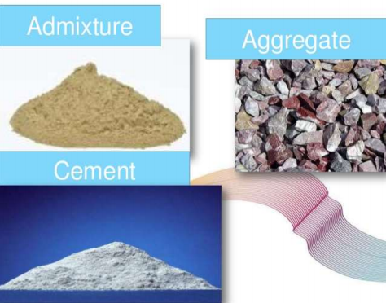
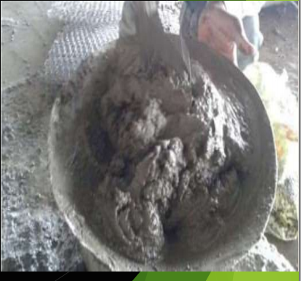
PLASTERING MATERIALS
MIXER OF PLASTERING MATERIALS
Sand

Slide 6
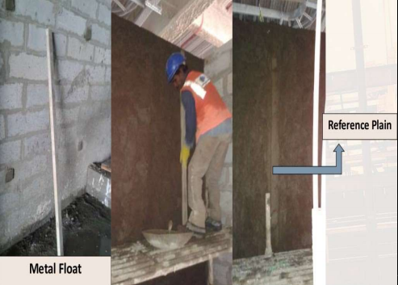
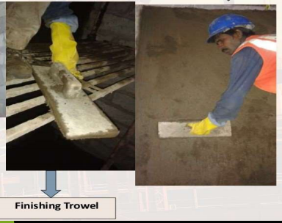
PLASTERING TOOLS

Slide 7
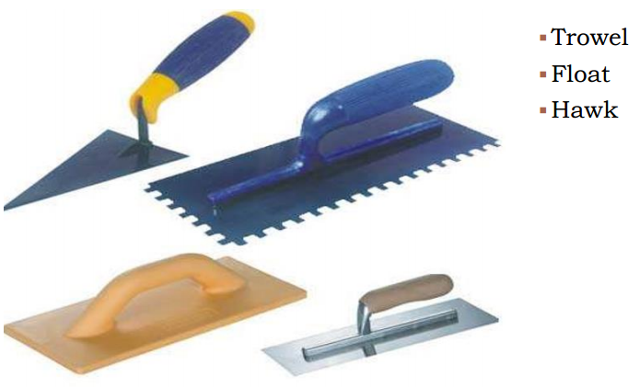
PLASTERING TOOLS
Float
Hawk
Trowel
Float

Slide 8
DIFFERENCE BETWEEN MORTAR & PLASTER
Mortars are used in masonry for joining stones, bricks, blocks etc.
Plasters are used for rendering on the outside and inside of walls.
The differences between mortar and plaster lie in the capacity of plasters to take better finish, which depend to a very large extent on the type of sand used in the mix.

Slide 9
TYPES OF PLASTERING
Lime Plaster
(b) Cement Plaster
(c) Mud Plaster
(d) Stucco Plaster

Slide 10
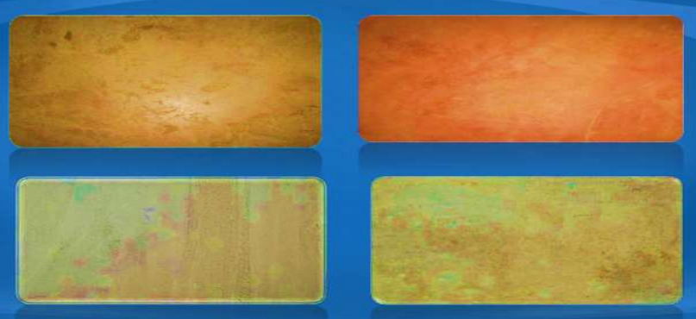
LIME PLASTER

Slide 11
LIME PLASTER
▪ When lime is used as the binding materials, it is called lime plaster.
▪ Lime plaster is type of plaster composed of hydrated lime, sand and water.
▪ Mortar for lime plaster is usually prepared by mixing sand and lime in equal proportions. Cement is small quantity added to the mixture to improve its strength.

Slide 12
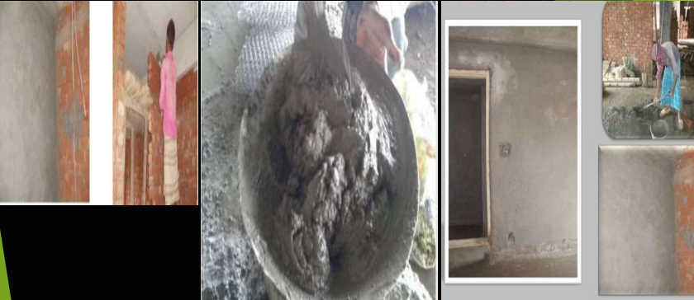
CEMENT PLASTER

Slide 13
CEMENT PLASTER
When cement is used as the binding materials, it is called cement plaster. It is especially suited for damp condition.
Cement plaster is usually applied in one coat.
The thickness of coat can be 12mm, 15mm or 20mm depending upon the site conditions and type of building.
When the thickness of plaster is more than 15mm. It is desired to apply plaster in two coats.

Slide 14
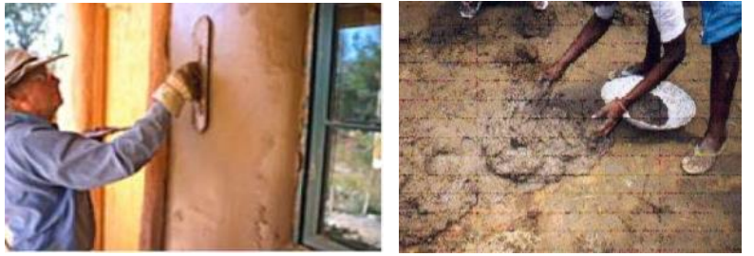
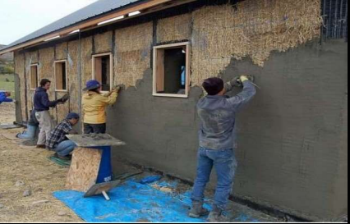
MUD PLASTER

Slide 15
MUD PLASTER
The surface to be plastered is prepared exactly in the same manner as that for lime plaster.
Mud plaster is generally applied in two coats, the first coat being 18mm thick while the thickness of the second coat is kept 6mm.

Slide 16
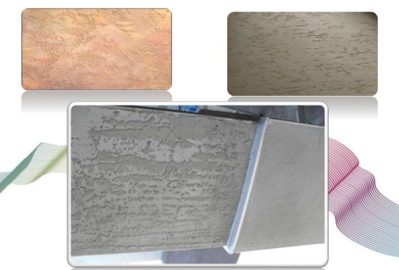
STUCCO PLASTER

Slide 17
STUCCO PLASTER
▪ Stucco is the name given to a decorative type of plaster which gives an excellent finish.
▪ Stucco plaster can be used for interior as well as exterior surfaces.
▪ It is usually laid in three coats making the total thickness of the plaster to about 25mm .the first coat is called the scratch coat ; the second a finer coat , also known as the brown coat, and the third is called white coat or finishing coat.

Slide 18
DEFECTS IN PLASTERING
Cracking
Efflorescence
Falling out of plaster

Slide 19
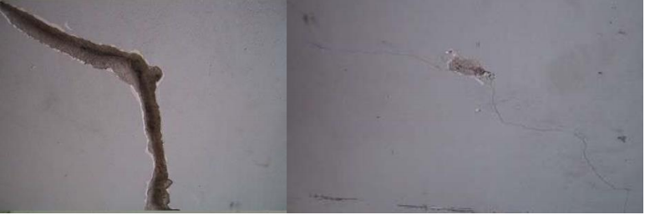
CRACKING
Excessive shrinkage of plaster due to the application of mortar in thick coats.

Slide 20
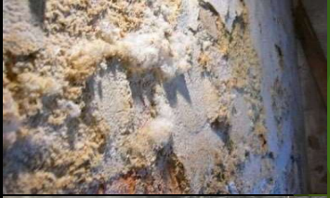
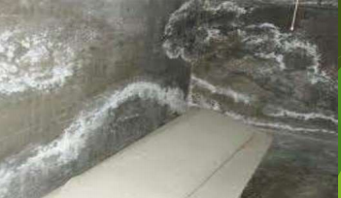
EFFLORESCENCE

Slide 21
EFFLORESCENCE
If soluble salts are present in bricks or in the mortar, they absorb moisture from atmosphere and go into solution which appears on the surface in the form of whitish substance as the moisture dries out and the salt crystallize.

Slide 22
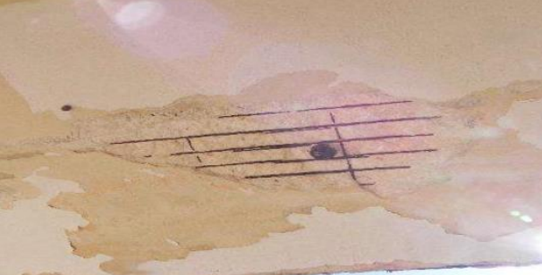
FALLING OUT OF PLASTER

Slide 23
FALLING OUT OF PLASTER
The adhesion of the plaster to the background may not be perfect.
The suction of the backing materials may not be uniform.
In-adequate curing.
The bond between successive coat of plaster may not be uniform.

Slide 24
POINTING

Slide 25
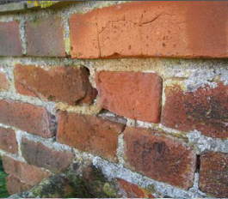
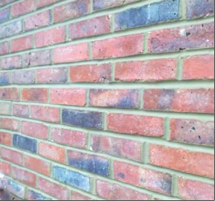
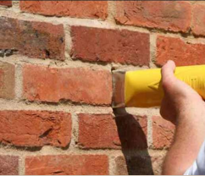
POINTING WORKS

Slide 26
INTRODUCTION
Pointing, in building maintenance, the technique of repairing mortar joints between bricks or other masonry elements.
When aging mortar joints crack and disintegrate, the defective mortar is removed by hand or power tool and replaced with fresh mortar, preferably of the same composition as the original.

Slide 27
OBJECTIVES
This treatment not only protects the joint from the adverse effect of atmosphere but also magnifies the appearance of the surface by exhibiting the pattern of the joints, their thickness, colours and texture prominently.

Slide 28
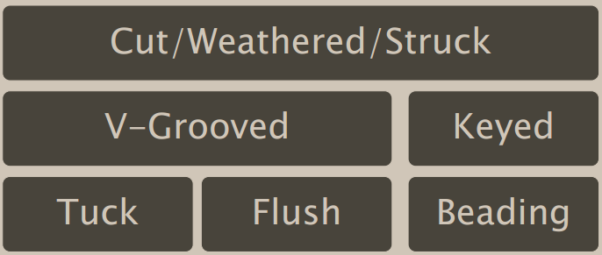
TYPES

Slide 29
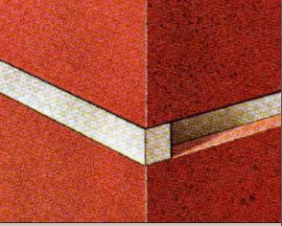
FLUSH POINTING
The mortar is pressed into the raked joints and finished off flush with the edges of the bricks or stones, so as to give a smooth appearance. The edges are then neatly trimmed with a trowel and straight edge.

Slide 30
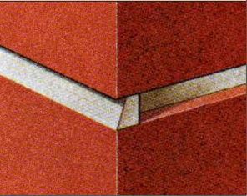
CUT/WEATHERED POINTING
The mortar is first pressed into the raked joints. While the mortar is still green, the top of the horizontal joints is neatly pressed back by 3-6 mm with the pointing tool. Thus the joint is finished sloping from top of the joint to its bottom.

Slide 31
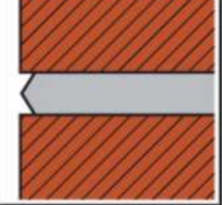
V-GROOVED POINTING
This type of pointing is made similar to keyed or grooved pointing by suitably shaping the end of the steel rod to be used for forming the grooving.

Slide 32
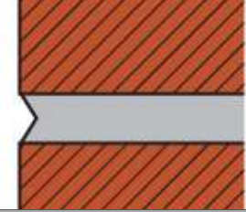
KEYED POINTING
The mortar is pressed into the raked joints and finished off flush with the face of the wall. a groove is formed by running the bent end of a small steel rod (6mm in diameter) straight along the centre line of the joints. The vertical joints are also finished in the same manner.

Slide 33
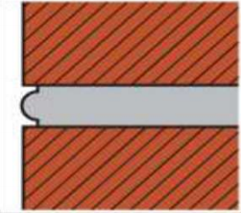
BEADED POINTING
The mortar is pressed in the raked joints and finished off flush with the face of the wall. A steel rod having its end suitably shaped is run straight along the centre line of joints to form the beading.

Slide 34
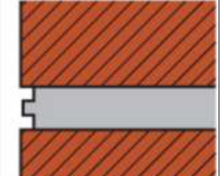
TUCK POINTING
The mortar is first pressed in the raked joints and there after it is finished flush with the face of the wall. The top and bottom edges of the joints are cut parallel so as to have a uniformly raised band about 6mm high and 10mm in width.

Slide 35
THANK YOU

