Slide 1
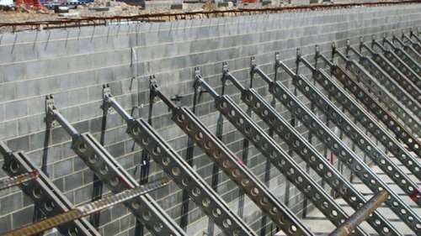
SHORING AND UNDERPINNING
content :
Shoring (uses and types)
Underpinning (purpose and types)

Slide 2
SHORING
It is the means of providing support to get stability of a structure temporarily under certain circumstances during construction, repair or alteration. It is the construction of temporary structure to support temporarily unsafe structure. It is lateral support to wall.
Such circumstance arises when;
The stability of a structure is endangered due to removal of a defective portion of the structure.
The stability of a structure is endangered due to unequal
settlement during construction itself or in long run.
Certain alterations are to be done in present structure itself, eg: remodeling of walls, changing position of windows etc.
Alterations are carried out in adjacent building for
remodeling, strengthening of foundation, etc.

Slide 3
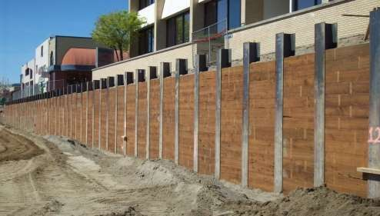
USES
1. When a wall shows sign of bulging out due to bad workman ship.
2. When a wall cracks due to unequal settlement of foundation and cracked
wall needs repairing.
When an adjacent structure is to be dismantled.
When opening are to be made or enlarged in the wall.

Slide 4
Following point should be noted in case shoring
Material : The shoring can be carried out either in the form of timber or steel tubes or in a combination of timber and steel
Duration : There is no limit for the duration of shoring it ranges from weeks to years
Requirements: the load coming on the shoring varying widely in nature. So the requirements of each case of shoring should be studied and design accordingly .
Approval: the shoring should be carried out of as per prevailing rules and regulation of local authority.

Slide 5
INSTALLATION OF SHORING
For shoring timber or steel tubes may be used. Sometimes both are used in combination. If timber is used its surface should be coated with a preservative so as to protect against wet rot.
The shoring should be designed based on the load it has to sustain and duration of load.
Shoring may be given internally or externally depending on the case and in certain cases they may be provided on either side of the wall to produce additional stability.
Shoring should be installed only after getting the permission if necessary, of the local authorities.
There is no time limit to which the shoring has to be kept, it may range from weeks to years depending on the case.

Slide 6
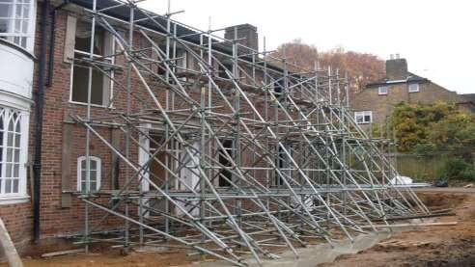
SHORES ARE OF THREE TYPES:
Raking or inclined shores
Flying or horizontal shores
Dead or vertical shores
RAKING OR INCLINED SHORING:
Ranking shores is a system of giving temporary support to an unsafe wall.
Rakers are to be inclined in the ground at 45º. However the angle may be between 45º and 75º.
For tall buildings, the length of the raker can be reduced by introducing rider raker.
Rakers should be properly braced at intervals.
The size of the rakers is to be decided on the basis of anticipated thrust from the wall.
The centre line of a raker and the wall should meet at floor level. 6.Shoring may be spaced at 3 to 4.5m spacing to cover longer length of the bar.
The sole plate should be properly embedded into the ground on an inclination and should be of proper section and size.
Wedges should not be used on sole plates since they are likely to give way under vibrations that are likely to occur.

Slide 7
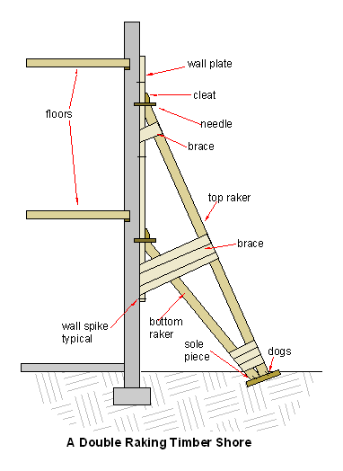
A raking shore consists of following components .
Rakers / inclined members
Wall plate
Needles
Cleats
Bracing
Sole plate
In this arrangement the incline support are given to the external wall from the ground ,a raking shore consist of wall plate
The wall plate is placed against the wall and secure by meeting of a needle which penetrate into the wall for a distance of 15 cm

Slide 8
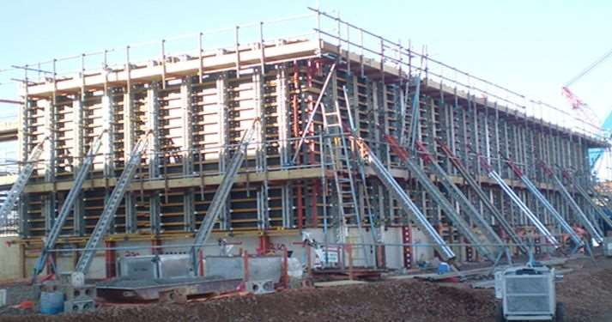
Practical view of raking shore

Slide 9
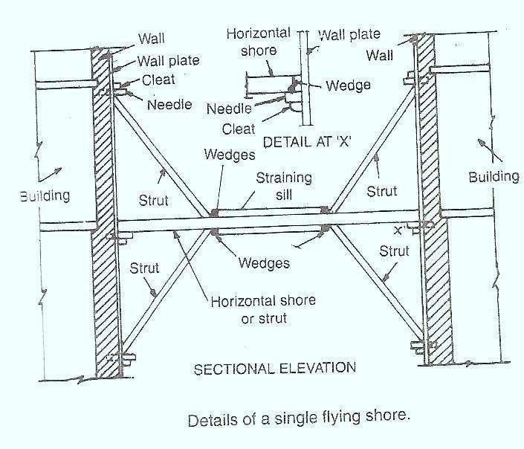
FLYING / HORIZONTAL SHORES - Flying or Horizontal Shores, in this type horizontal supports are provided for supporting temporarily the parallel walls of the two adjacent buildings, which may tend to collapse or damage when one of the intermediate buildings has to be pulled down and rebuilt.

Slide 10
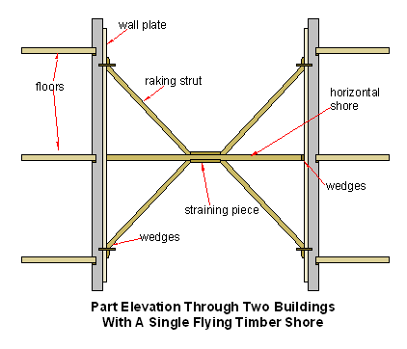
It is the arrangement of the horizontal support are given to parallel walls which have become unsafe due to removal or collapse of intermediate building
A single flying shore consist of wall plate needles struts folding wedges the flying shore should have a depth not less than 1/30th of the span and width not less than 1/50th of its length
the center line of flying shore and wall should meet at the floor level

Slide 11
The following points should be considered as
The center line of flying shore and wall plate should meet at the level
Large factor of safety should be adopted
The struts are generally inclined at 45 degree and should not be stripper than 60 degree
The distance is 9-12m,a compound or double flying shore is provided

Slide 12
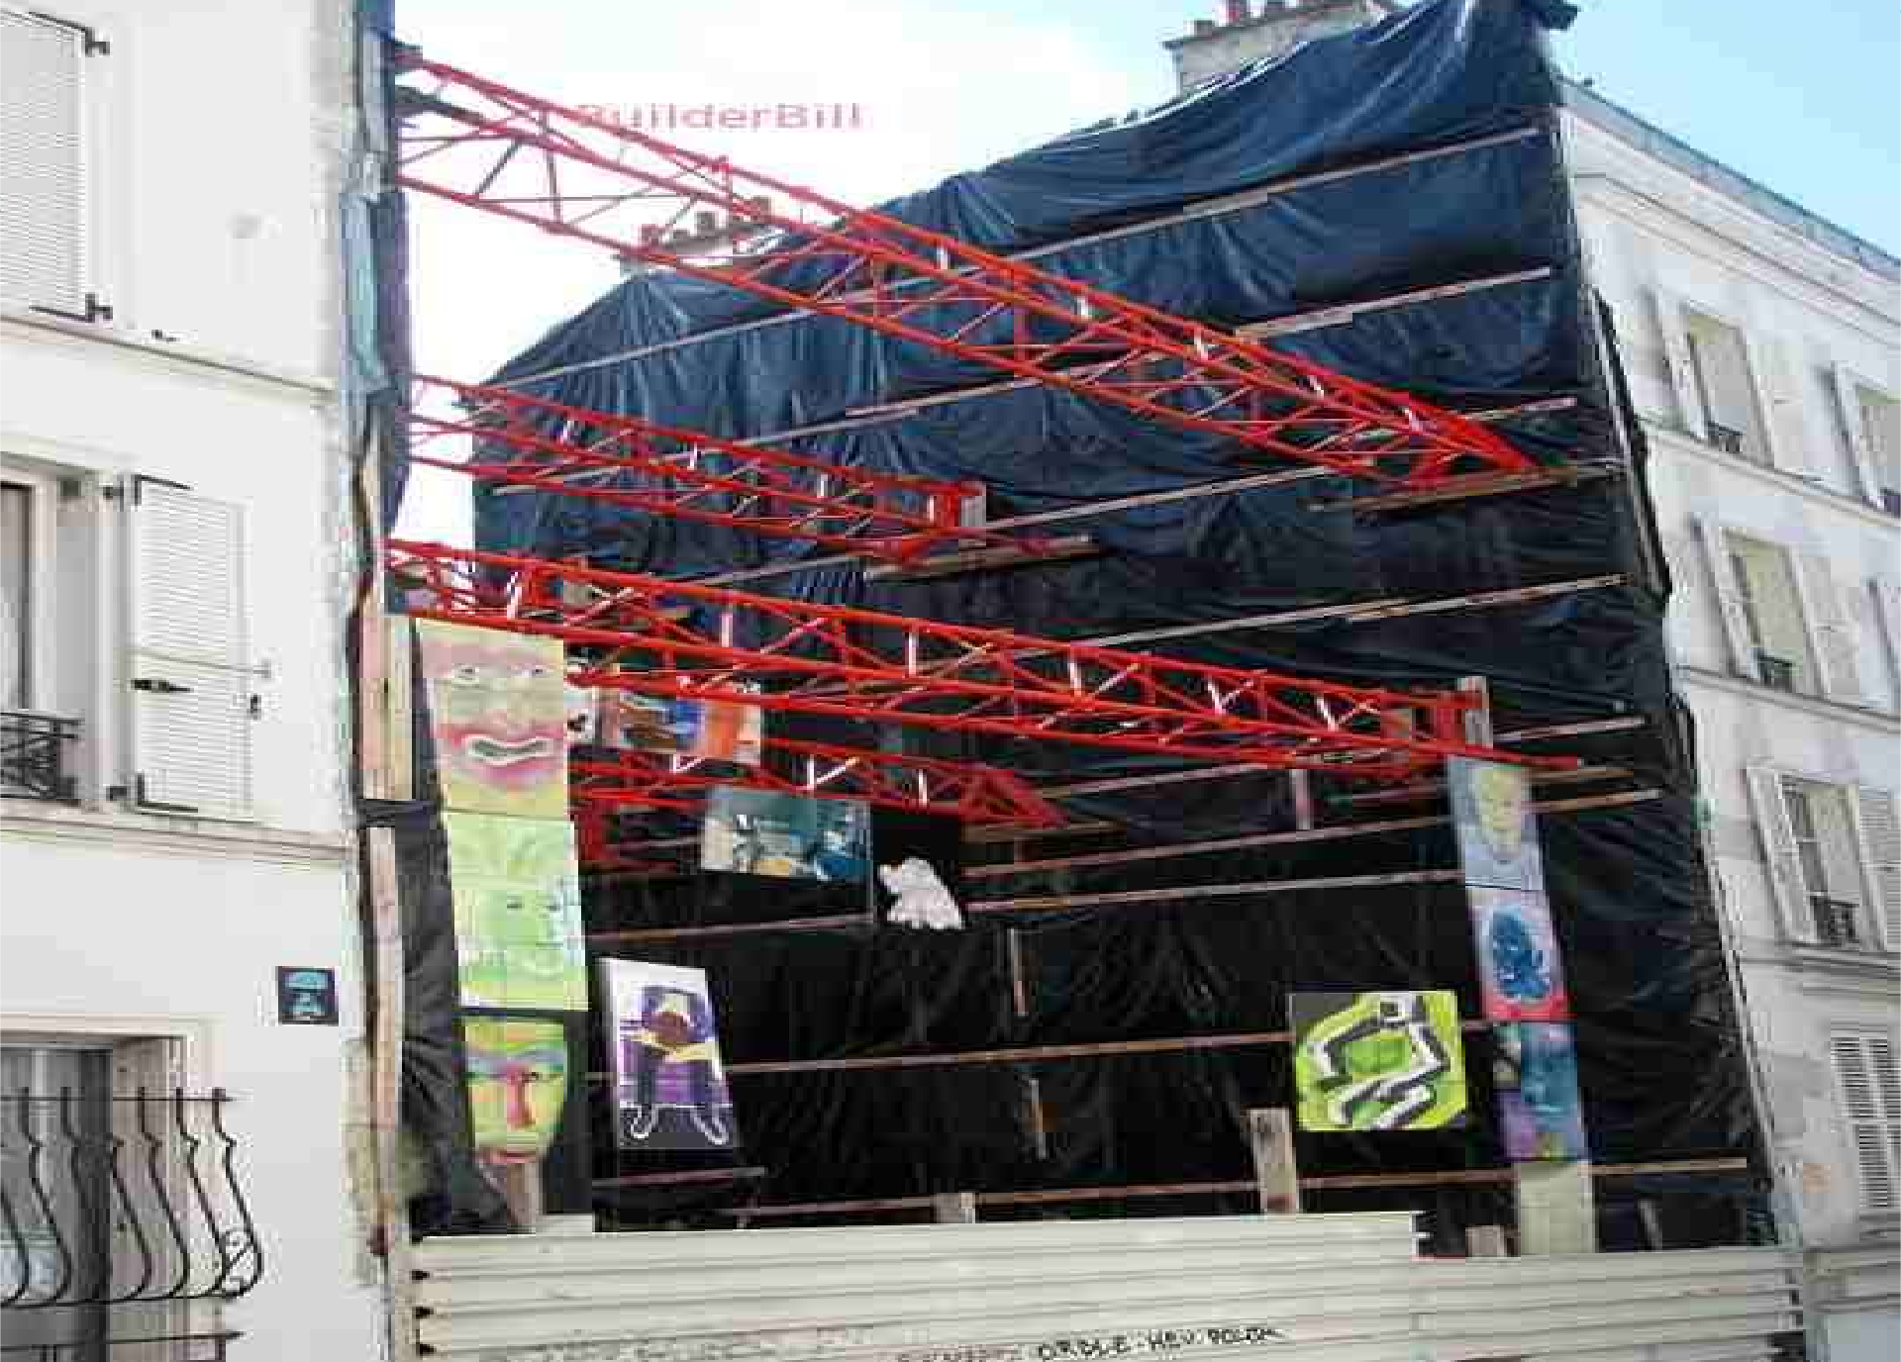
PRACTICAL VIEW OF FLYING SHORE

Slide 13
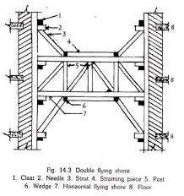
Double flying shoring
Double or compound flying shore is a combination of two single flying shores combined together by posts and braced

Slide 14
DEAD SHORES - Dead Shores or Vertical Shores, In this system of shoring, the vertical
members known as ‘dead shores’ are used to support temporarily the walls, roofs,
floors, etc., by providing horizontal members known as needle. objectives:
(i) To rebuild the lower part of a defective load bearing wall
To rebuild (or replace) or deepen the existing foundations, which have either become
unsafe or require strengthening for carrying heavier loads
To provide large openings in the existing walls such as doors, windows, shop fronts or garages at a lower level.

Slide 15

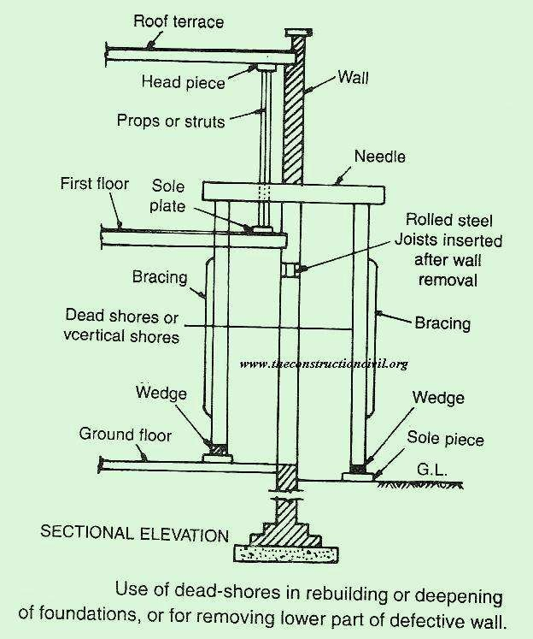

Slide 16
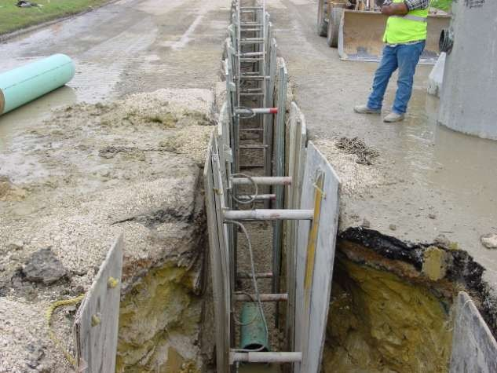
DEAD OR VERTICAL SHORING

Slide 17
UNDERPINNING
It is the method of supporting the structures while providing new foundations or carrying out repairs and alterations without disturbing the stability of existing structures.
It is carried under following conditions:
When a building with deep foundation is to be constructed adjoining a building which is built on shallow footings. Here the shallow footings should be strengthened first.
In order to protect an existing structure from the danger of
excessive or differential settlement of foundation.
In order to improve the bearing capacity of foundation so as to sustain heavier loads for which deepening or widening of foundation is done.
In order to provide a basement for an existing structure.

Slide 18
PRECAUTIONARY MEASURES
Before implementing appropriate underpinning measures the following important points should be carefully attended:
The existing structure should be fully examined carefully and appropriate underpinning method should be adopted.
All poor masonry work, such as joints, cracks, plastering should be rectified before.
Necessary shoring and struting should be done such that existing structure is safe.
Urgent repair like grouting of cracks, insertion of rod between walls , etc. should be carried out before commencing underpinning.
Adequate care should be taken to ensure that there should be no movement of structure for which levels should be marked.
Underpinning process is not a science but an art should be exercised depending on the situation.

Slide 19
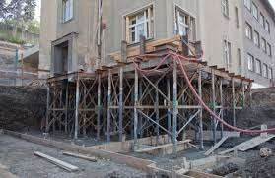
This is how underpinning looks like

Slide 20
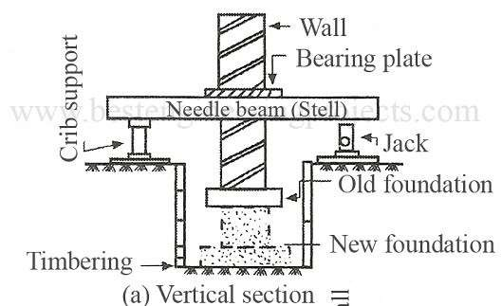
METHODS OF UNDERPINNING
PIT METHOD
PILE METHOD
PIT METHOD - In this method, the entire length of foundation is divided into sections of 1.2 to
1.5 m lengths . One section is taken at one time.
For each section, a hole is made in the wall, above plinth level , the needle is inserted in the hole. Needle may be made up of timber or steel section. Bearing plates are placed above needle to support the masonry above it.

Slide 21
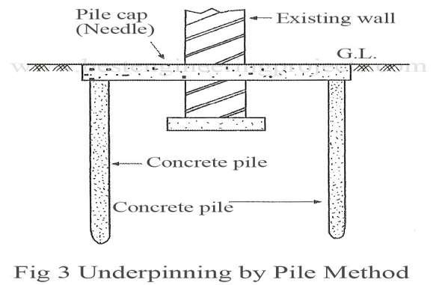
The foundation pit is then excavated to desired level and new foundation is laid . When the
work on one section is over, work on next section is taken up.
PILE METHOD – In this method, piles are driven at regular interval along both the side of wall. The piles are connected by concrete or steel needle, penetrating through the wall. These beams incidentally acts as pile caps also. this method is very helpful in clayey soil, and water logged areas. The existing foundation is very much relieved of the load.

Slide 22
CHEMICAL METHOD
 In this method the foundation soil is consolidated by employing chemicals.
 Perforated pipes are driven in an inclined direction beneath the foundation . The slopes are provided such that the entire area under the existing footing comes under the area used to be strengthened.
 After the pipes are installed, solution of sodium silicate in water is injected through the pipes. This is a two-injection method. The pipes are withdrawn and at the time of withdrawal of pipes, calcium or magnesium chloride is injected through pipes.
 Chemical reaction takes place between these two chemicals and the soil is strengthened by consolidation. This method is suitable for granular soils

