Slide 1

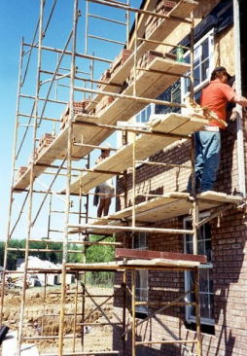
Scaffolding

Slide 2
What Is Scaffolding?
Scaffolding is a temporary structure having platforms raised up as the building increases in height. It enables to work at different stages of a building.

Slide 3
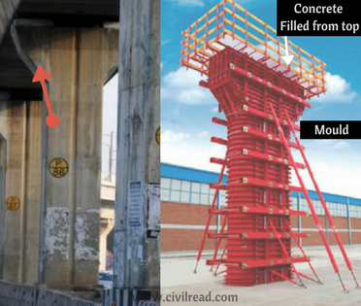
Difference between Formwork, Shuttering, Staging, Centering and Scaffolding
Formwork:
It is a temporary structure which is used as a mould to pour the concrete. It is a vertical or horizontal arrangement made to keep concrete in position until it gains strength & shape.

Slide 4
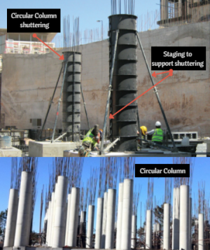
Difference between Formwork, Shuttering, Staging, Centering and Scaffolding
Shuttering:
It is a part of formwork, or you may call it as derivative of formwork. Shuttering is a vertical temporary arrangement which is arranged to bring concrete in a desired shape

Slide 5
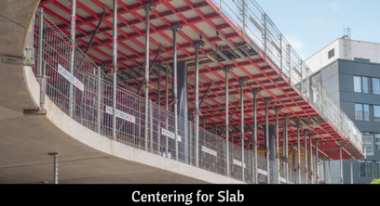
Difference between Formwork, Shuttering, Centering and Scaffolding
Centering:
Centering is a temporary arrangement & part of formwork which is arranged to support horizontal members.

Slide 6
Types of Scaffolding
Brick-layer’s Scaffold
Mason’s Scaffold
Steel/ Tubular Scaffold
Needle Scaffold
Wooden Scaffold

Slide 7
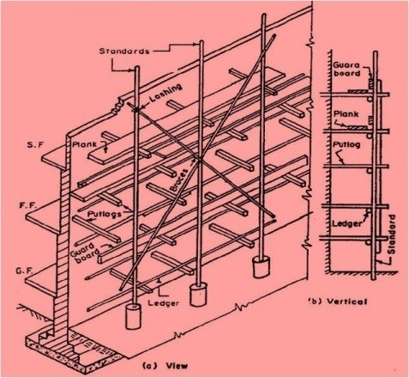
Brick-layer’s Scaffold

Slide 8
Brick-layer’s Scaffold
It consists of vertical members called Standards.
Standards are connected to each other by longitudinal horizontal members called Ledgers.
Transverse horizontal members are called Putlogs are fastened on the ledgers at one end and into the duct at the other end. They are provided to support the working platform.
In high scaffolding cross bracing are used to stiffen the temporary structure.

Slide 9
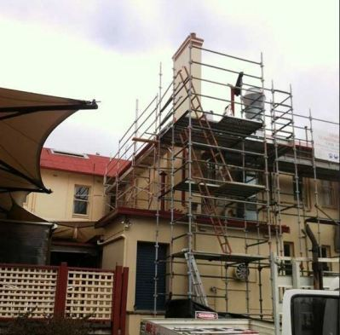
Mason’s Scaffold

Slide 10
Mason’s Scaffold
Since it is difficult to leave duct into the stone masonry for the putlogs, therefore two forms of standards, ledgers and braces are used.
One is placed close to the wall and another at a distance of 1.5m from the first one. Thus this scaffold is independent of the stone wall.

Slide 11
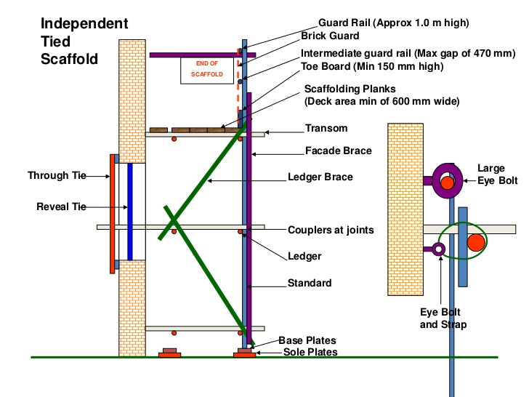
Steel/ Tubular Scaffold

Slide 12
Steel/ Tubular Scaffold
It is similar to timber scaffold while in this case wooden members are replaced by 38mm to 64mm diameter steel tubes and instead of rope steel fittings are used for connecting members.
In this type of scaffold vertical tubes are spaced at 2.5 to 3.0 m. Each standard is welded to a base plate.
Ledgers connecting the standard are 1.8 m spaced vertically.
Putlogs are 1.2 to 1.8 m in length.

Slide 13
Advantage of Steel/ Tubular Scaffold over Wooden Scaffold
Steel Scaffolding’s Erection and dismantling is rapid.
It has greater strength and durability and fire resisting qualities.
Although due to its higher initial cost initially, but considering its several advantages and increased number of reuses, it proves to be economical in the long run. Hence it is extensively used these days.

Slide 14
Needle Scaffold
It is to be provided for a building on the side of a busy street where the construction of ordinary scaffolding will obstruct the traffic on road.
In this type of scaffolding instead of fixing the standard into the ground, it is placed at some height above the ground level. The platform on which stands are placed is called needle. A needle is a cantilever structure, made of timber, projected out from the ducts in wall.
To prevent lifting up of the needle, the inside end of the needles are supported by struts wedged between the needles and the head pieces.

Slide 15
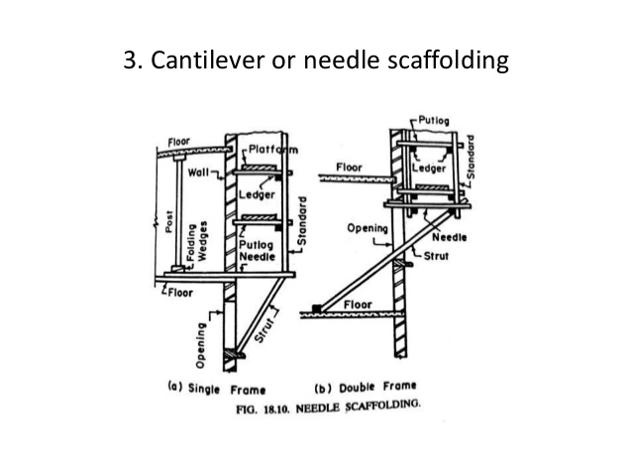
Needle Scaffold

Slide 16
Thank you!!

