Slide 1
STAIR

Slide 2
Definition
A stair may be defined as series of steps suitably arranged for the purpose of connecting different floors of a building.
Stair may also be defined as an arrangement of treads, stringers, newel posts, hand rails and baluster, so designed and constructed as to provide an easy and quick access to the different floors, rendering comfort and safety to the users.
The enclosure containing the complete stairway is termed as staircase.
Stairs may be made from various materials like timber, stones, bricks, steel, plain concrete or reinforced concrete.
The selection of the type of material to be used depends upon the aesthetical importance, funds available, durability desired and fire resisting qualities expected.

Slide 3
Location of Stairs
The location of stairs in a building requires careful consideration.
In the advent of fire or any such calamity, stairs provide the only means of communication and as such they are so located as the serve the purpose for which they are provided.
In public building it should be located near the main entrance and in residential building it should be placed centrally so as to provide easy access from all the rooms and to maintain privacy at the same time.

Slide 4
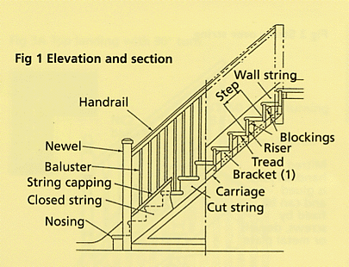
Technical Terms

Slide 5
Technical Terms cont…
Steps is a portion of a stairway comprising the tread and riser which permits ascent or descent from one floor to another.
Tread is the horizontal upper part of a step on which foot is placed in ascending or descending stairway.
Riser is the vertical portion of a step providing support to the tread.
Flight is a series of steps without an platform, break or landing in their direction.
Landing is a platform or resting place provided between two flights. A landing extending right across a stair case is termed as half space landing and the one extending only half across a stair case is called a quarter-space landing.

Slide 6
Technical Terms cont…
Nosing is the outer projecting edge of a tread. Nosing is usually rounded to give good architectural effect to the treads and makes the stair-case easy to negotiate.
Line of Nosing is an imaginary line touching the nosing of each tread and is parallel to the slope of the stair.
Winders are tapering steps which are provided for changing the direction of a stair.
Going of step is the run of a step in a stair or the width of the tread between two successive treads.

Slide 7
Technical Terms cont…
Rise of steps is the vertical distance between the upper surface of the successive treads.
Soffit is the under surface of a stair.
Pitch or slope is the angle which the line of nosing of the stair makes with the horizontal.
Stringers are the sloping wooden members providing support for the steps.
Hand rails is provided to render assistance in negotiating a stairway. It is supported on balustrades and usually run parallel to the slope of the stair.
Balustrade usually consists of a row of balusters surmounted by a rail and is provided to perform the function of a fence or guard for the users of the stair-way.

Slide 8
Technical Terms cont…
Newel is a wooden or metallic post supporting the hand rail and is usually provided at the hand, foot or at points where the balustrade changes its direction.
Head room or Head way is the clear vertical distance between the tread of a step and the soffit of the flight immediately over it.

Slide 9
Requirements of A Good Stair
It should be so located that sufficient light and ventilation is ensured in the stairway. If possible it should be located centrally so as to be easily accessible from the different corners of the building.
Width of a stair varies with the situation and the purpose for which it is provided. In public building, where there is a regular traffic of people using the stair-way, its width should be sufficient while in a residential building it may be just the minimum. The usually adopted average value of the stair width for public and residential building is 1.8 m and 90 cm respectively.
For the comfortable ascent of stair-way the number of steps in a flight should be restricted to a maximum of 12 and a minimum of 3.

Slide 10
Requirements of A Good Stair
The pitch of long stair should be made flatter by introducing landings to make the ascent less tiresome and less dangerous. In general, the slope of stair should never exceed 40⁰ and should not be flatter than 25⁰ .
The head room or the clear distance between the tread and the soffit of the flight immediately above it should not be less than 2.14 m.
The stair should preferably be constructed of materials which possess fire-resisting qualities.
The open well stairs should be provided with balustrade so as to minimize the danger of accidents.
The width of landing should not be less than the width of stair.

Slide 11
Requirements of A Good Stair
The introduction of winders in stair should be avoided as far as possible. They are liable to be dangerous and involve extra expense in construction. They are difficult to carpet and are especially unsuitable for public buildings.
The rise and tread of each step of a stair should be of uniform dimensions throughout. The ratio of the ‘going’ and the ‘rise’, of a step should be so proportioned as to ensure a comfortable access to the stairway.

Slide 12
Fixing ‘Going’ and ‘Rise’ of A Step
The size of a tread and riser varies with the situation of the stair and the purpose for which it has to be provided.
In general, the following thumb rules are considered as a guide to obtain a satisfactory result:
(Going in cm) + (2 X Rise in cm) = 60
(Going in cm) X (Rise in cm) = 400 to 410 approx.
Adopt the standard size of going and rise as 30 cm and 14 cm respectively and for each 25 mm deducted from going, add 12 to 13 mm to the rise.
In addition to empirical rules described above, the following rules must be kept in view while deciding the step size.
For residential buildings the size of step is 25 cm X 16 cm.
For public buildings the adopted size varies from 27 cm X 15 cm to 30 cm X 13 cm

Slide 13
Classification
The different forms of stairs may be classified under the following main heads:
Straight stairs
Dog-legged stairs
Open-newel stairs
Geometrical stairs
Circular stair
Bifurcated stairs

Slide 14
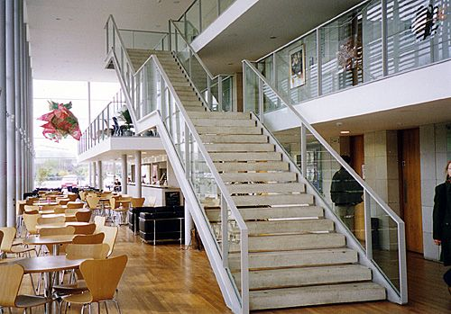
Straight Stairs
The most obvious use of the straight stair is to form an access to entrance, porch or portico.
Straight stair cannot be avoided in places, where the stair-case hall is long and narrow and the possibility of any other form of stair may not be practically possible.
In this form of stair, all the steps rise in the same direction.
If the ascending is steep, the straight flight may be broken at an intermediate landing.

Slide 15
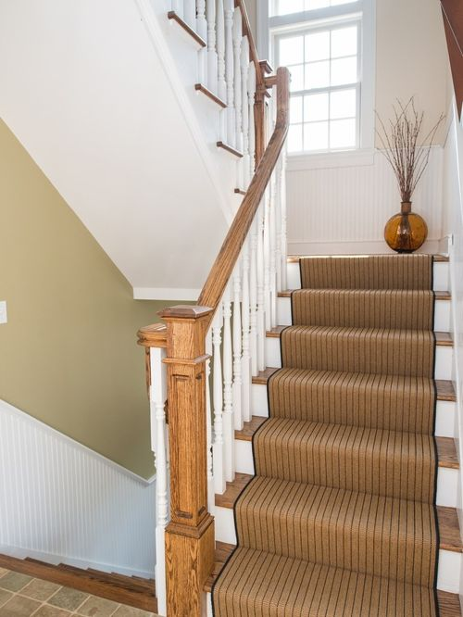
Dog-legged Stairs
It consists of two straight flights of steps with abrupt turn between them.
Usually, a level landing is placed across the two flights at the change of direction.
This type of stair is useful where the width of the stair-case hall is just sufficient to accommodate two widths of stair.

Slide 16
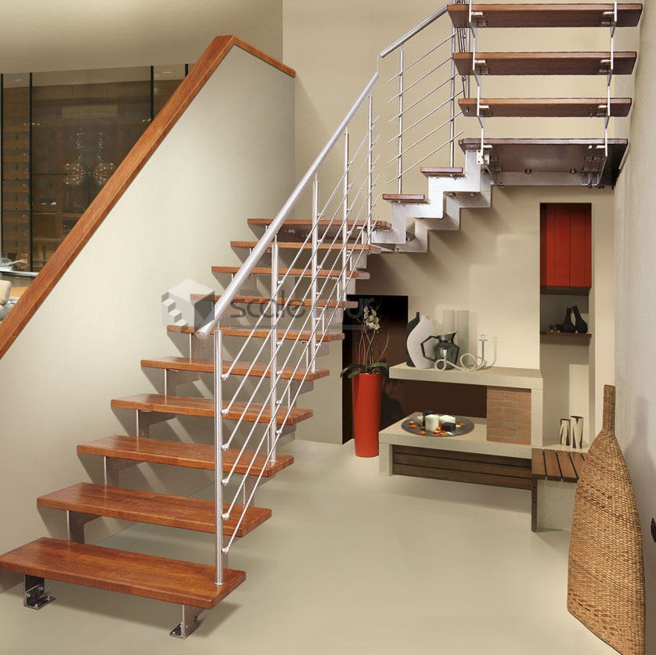
Open-newel Stairs
It consists of two or more straight flights arranged in such a manner that a clear space called a ‘well’ occurs between the backward and the forward flights.

Slide 17
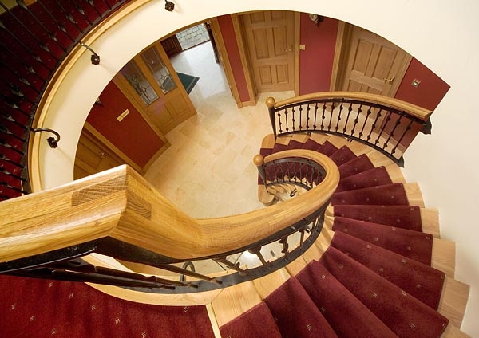
Geometrical Stairs
This is similar to the open-newel stair with the difference that the open well between the forward and the backward flight curved. In this form of stair, the change in direction is obtained through winders.

Slide 18
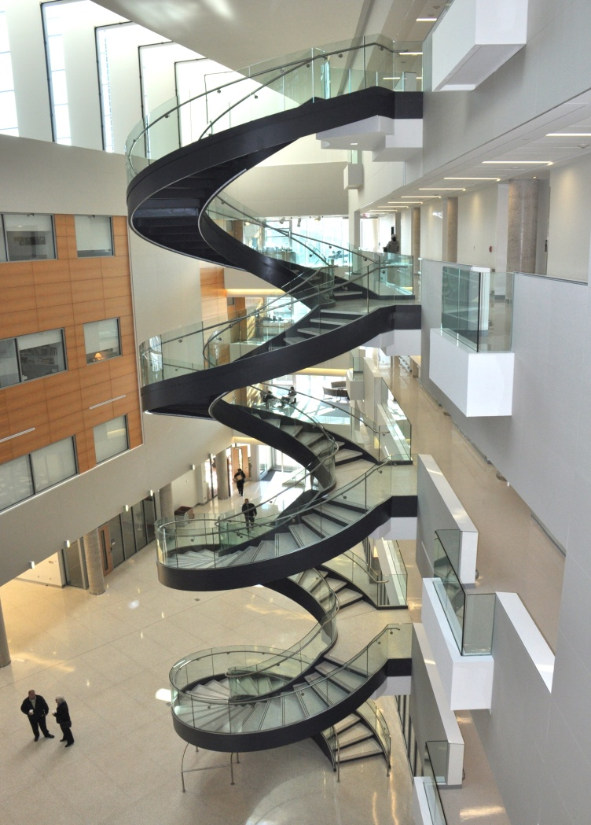
Circular Stairs
Circular stair is commonly provided at the backside of a building for rendering access to its various floors for the service purposes. The circular stairs are commonly constructed in R.C.C. cast iron or stone. In this form of stairs all the steps radiate from a newel post or well hole, in the form of winders.

Slide 19
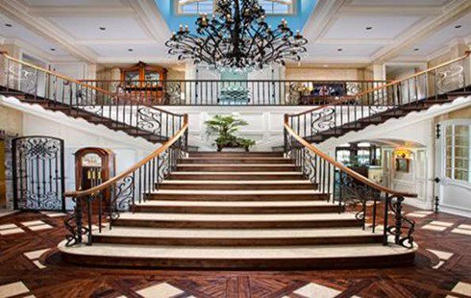
Bifurcated Stairs
This type of stair is provided in modern public buildings. In this type of stairs, the flights are so arranged that there is a wide flight at the start which is sub-divided into narrow flights at the mid-landing. The two narrow flights start from either side of the mid-landing.

Slide 20
Stairs of Different Materials
The commonly adopted materials in the construction of stairs are-
Wood
steel
stone
Cast-iron
Plain concrete or reinforced concrete
Brick work or reinforced brick work

Slide 21
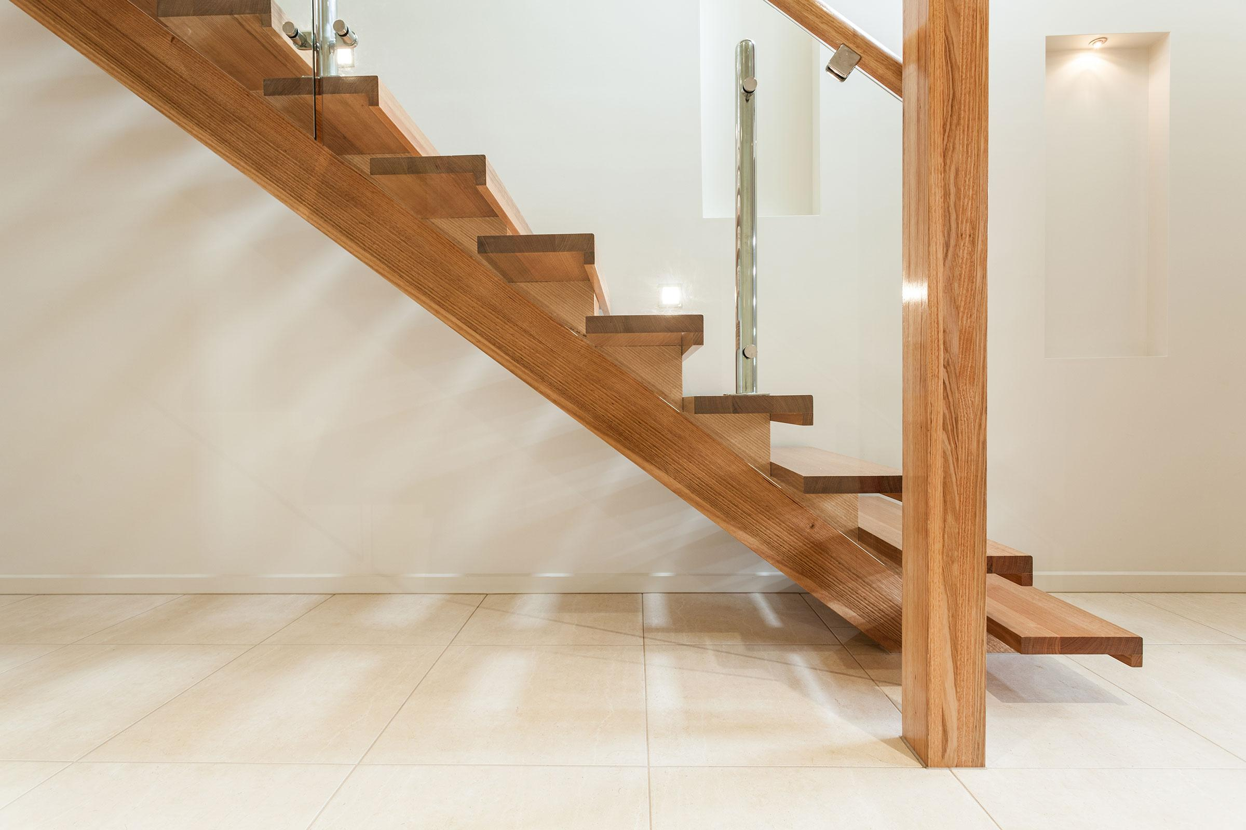
Wooden stairs
Timber is mainly used for stair construction where fire-resistance is not of much consideration.
Timber stairs are cheap, easy in construction and maintenance and light in weight.

Slide 22
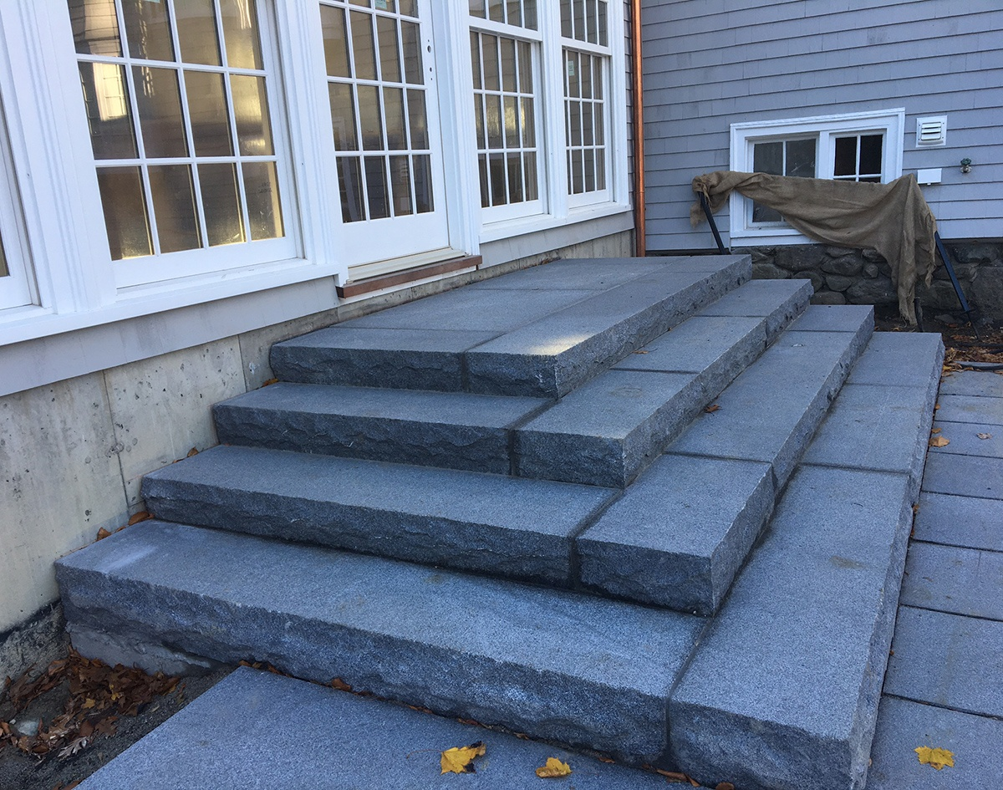
Stone stairs
Stair made out of hard, strong, resistant to wear stones are found to be durable and fire resisting. They are commonly constructed in workshops, warehouse and other public buildings. Their usage in residential building is generally restricted to outside stairs.

Slide 23
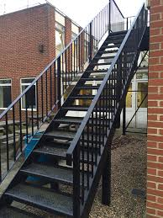
Metal stairs
They are usually fabricated from steel and cast iron and their use is generally restricted to factories, godowns etc. In its simplest form, a metal stair consists of steel stringer to which steel angles are riveted or welded and metal treads are provided over them.

Slide 24
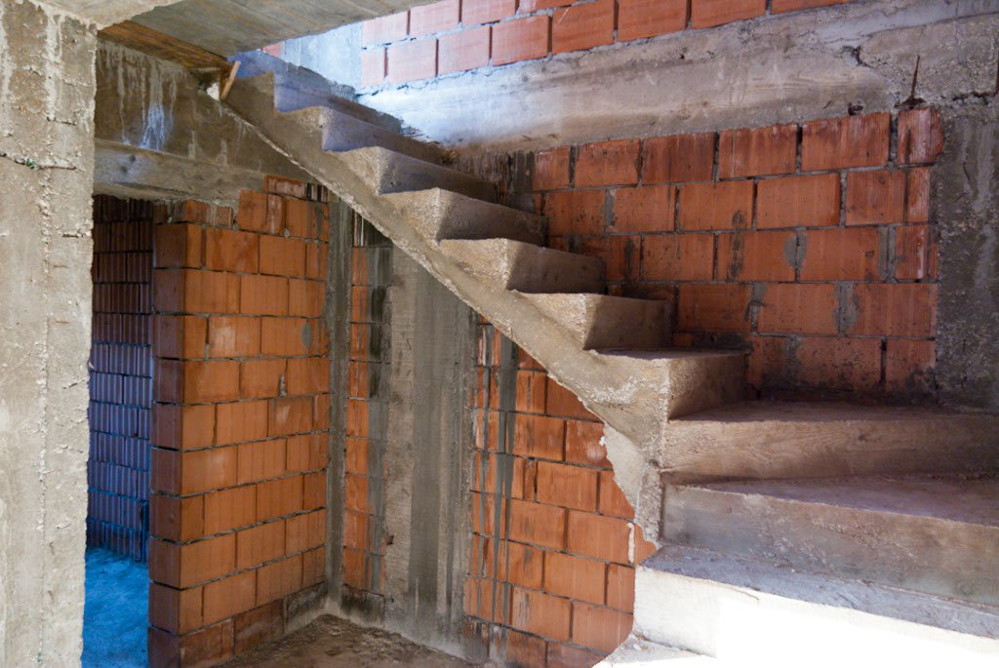
Reinforced Concrete Stairs
Reinforced concrete stairs predominate the stairs made from wood, stone or metal. This is because of the various advantages R.C.C. has over other materials. Reinforced concrete is perhaps the most suitable of all the said materials for the construction of stairs. R.C.C. stairs can be moulded in any desired form to suit the requirements of the architect.

Slide 25
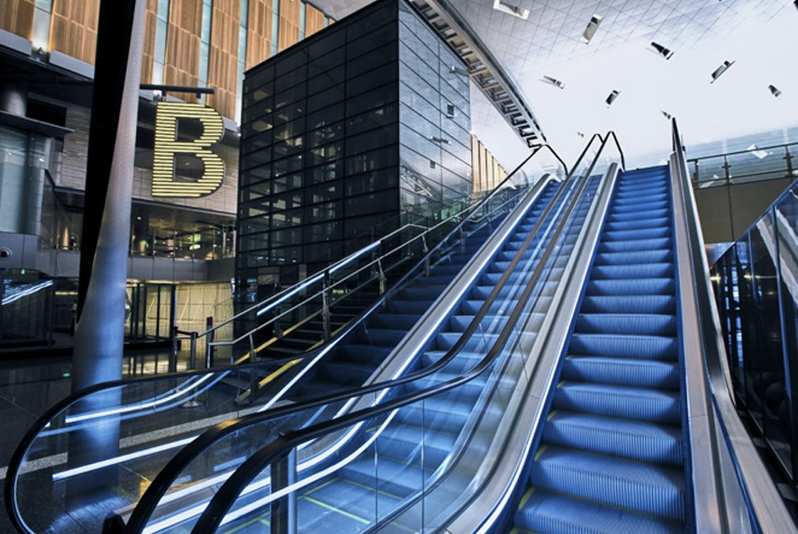
Escalators
A power driven, inclined, continuous stair way, used for raising or lowering passengers, is called an escalator. The stair way has continuous operation without the need for operators. The main components of an escalator are a steel trussed frame work, hand rails and an endless belt of steps.

Slide 26
THANK YOU

