Slide 1
Chapter = 1
Overview of C

Slide 2
History of C
The root of all modern languages is ALGOL, introduced in the early 1960s.
In 1967, Martin Richards developed a language called BCPL (Basic Combined Programming Language) primarily for writing system software.
In 1970, Ken Thompson created a language using many features of BCPL and called it simply B.
B was used to create early versions of UNIX operating system at Bell Laboratories.
Later, B language was modified by Dennis Ritche and implemented in Bell Laboratories in 1972.
Due to the development of B, it is known as C.

Slide 3
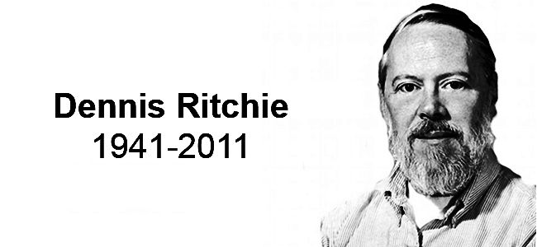
Dennis Ritchie : C programming language

Slide 4
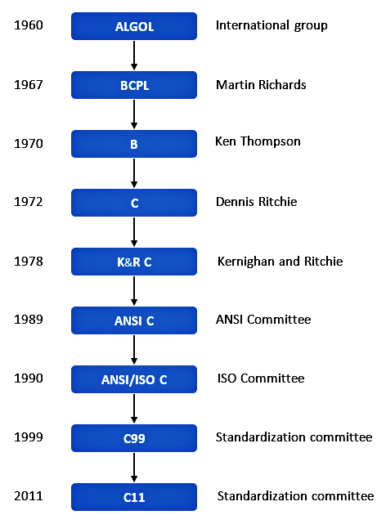

Slide 5
Importance of C
It is a robust language whose rich in built in functions and operators can be used to write any complex program.
C compiler combines the capabilities of an assembly language with the features of a high level language.
C is well suited for writing system software and business packages.
Programs written in C are efficient and fast.
C is highly portable. This means that C programs written for one computer can be run on another with little or no modification.
C language is well suited for structural programming.

Slide 6
Simple Program 1: Printing a Message
main ()
{
printf(“my first program in CE 2201”);
}

Slide 7
Explanation
The first line informs the system that the name of the program is main and the execution begins at this line.
The main() is a special function used by the C system to tell the computer where the program starts.
Every program must have exactly one main() function.
If we use more than one main() function, the compiler can not understand which one marks the beginning of the program.
The empty pair of parentheses immediately following main indicates the function main has no arguments or parameters.

Slide 8
Explanation
The opening brace “{“ in the second line marks the beginning of the function main and the closing brace “}” in the last line indicates the end of the function.
All the statement between these two braces form the function body.
Function body contains a set of instructions to perform the given task.
printf(“my first program in CE 2201”);
Printf function causes everything between the starting and the ending quotation marks to be printed out.

Slide 9
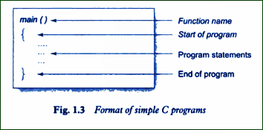

Slide 10
Basic Knowledge related to Computer
CPU
RAM
ROM
Compiler
Interpreter
Bit
Byte
Low Level Language
High Level Language

