Slide 1
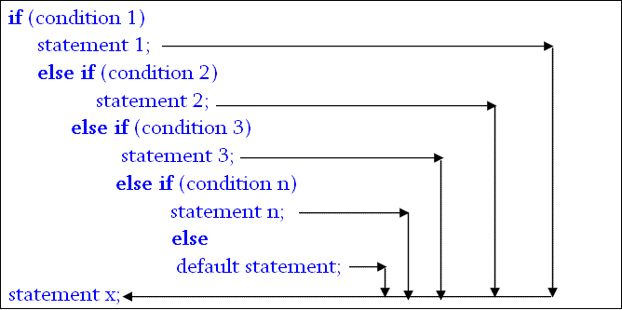
else if ladder (format)

Slide 2
else if ladder
When multipath decisions are involved, else if ladder is used.
The conditions are evaluated from the top of the ladder to downwards.
As soon as true condition is found, the statement associated with it executed and the control is transferred to the statement-x skipping rest of the ladder.
When all n conditions become false, then the final else containing the default statement will be executed.

Slide 3
Write a C program to find the grade according to obtained marks according to the following table using else if ladder
Numerical grade | Letter grade | Grade point
80% or above | A⁺ (A Plus) | 4.0
75% to less than 80% | A (A Regular) | 3.75
70% to less than 75% | A⁻ (A Minus) | 3.5
65% to less than 70% | B⁺ (B Plus) | 3.25
60% to less than 65% | B (B Regular) | 3.0
55% to less than 60% | B⁻ (B Minus) | 2.75
50% to less than 55% | C⁺ (C Plus) | 2.5
45% to less than 50% | C(C Regular) | 2.25
40% to less than 45% | D | 2.0
Less than 40% | F | 0

Slide 4
Write a C program to find the attendance marks according to percentage of days present using the following table using else if ladder
Attendance | Marks
90% and above | 10%
85% to less than 90% | 9%
80% to less than 85% | 8%
75% to less than 80% | 7%
70% to less than 75% | 6%
65% to less than 70% | 5%
60% to less than 65% | 4%
Less than 60% | 0%

Slide 5
An electronic power distribution company charges its domestic consumers as follows. Write a program that can read the customer number and power consumed and prints the amount to be paid by the customer.
Consumption Unit | Rate of Charge
0-200 | 0.50 per unit
201-400 | 100 plus 0.65 per unit excess of 200
401-600 | 230 plus 0.80 per unit excess of 400
601 and above | 390 plus 1.00 per unit excess of 600

Slide 6
Switch statement
Complexity of a program increases dramatically when the number of alternatives increases.
The program becomes difficult to read and follow.
At times, it may confuse even the person who designed it.
In this cases, multiway decision statement switch is used.
The switch statement tests the value of a given variable (or expression) against a list of case values and when a match is found, a block of statements associated with that case is executed.

Slide 7
switch (expression)
{
case value-1:
block-1
break;
case value-2:
block-2
break;
………………….
default:
default-block
break;
}
statement-x;

Slide 8
The expression is an integer expression or characters.
value-1, value-2……. are constants or constant expression and are known as case levels.
Each of these values should be unique within a switch statement.
block-1, block-2………. are statement lists and may contain zero or more statements.
Note that case lebels end with a colon (:)
When the switch is executed, the value of the expression is successfully compared against the values value-1,value-2….
If a case is found whose value matches with the value of expression, then the block of statements that follows the cases are executed.
The break statement at the end of each block signals the end of a particular case and causes an exit from the switch statement, transferring the control to the statement-x following the switch.

Slide 9
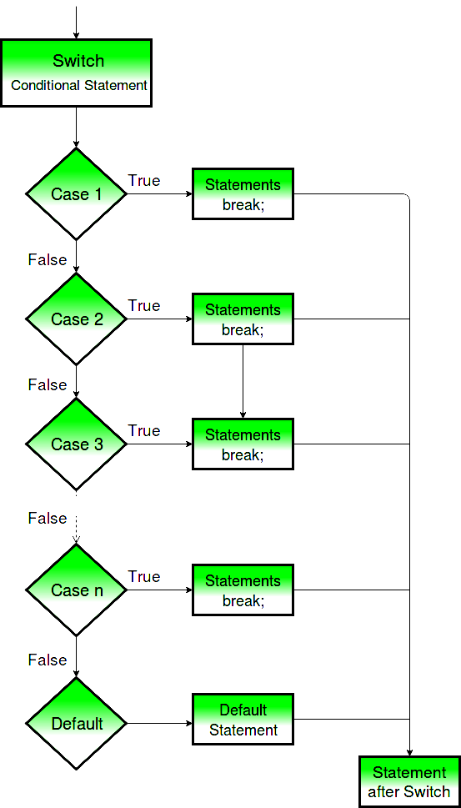

Slide 10
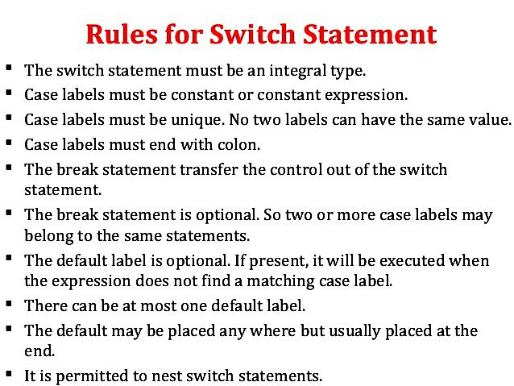

Slide 11
Switch statement
The grading is done according to the following rules:
Average Marks | Grade
80-100 | Honors
60-79 | First Division
50-59 | Second Division
40-49 | Third Division
0-39 | Fail

Slide 12
Switch statement
Using a conversion statement: index= marks/10;
Marks | Index
100 | 10
90-99 | 9
80-89 | 8
70-79 | 7
60-69 | 6
50-59 | 5
40-49 | 4
30-39 | 3
20-29 | 2
10-19 | 1
0 | 0

