Slide 1

Chapter 6
Decision Making and Looping

Slide 2
Write a C program to find the sum of squares of all integers between 1 and 10

Slide 3
Sum of squares of all integers between 1 and 10
…………….
sum = 0 ;
n = 1;
loop:
sum = sum + n*n
if (n==10)
{goto print;}
else
{ n = n+1;
goto loop; }
print:

Slide 4
Sum of squares of all integers between 1 and 10
This program does the following things:
Initializes the variable n
Computes the square of n and adds it to sum
Tests the value of n to see whether it is equal to 10 or not, then the program prints the results.
If n is less than 10, then it is incremented by one and the control goes back to compute the sum again.

Slide 5
Looping
In looping, a sequence of statements are executed until some conditions for termination of the loop are satisfied.
A program loop therefore consists of two segments:
Body of the loop
Control Statement
The control statement tests certain conditions and then directs the repeated execution of the statements contained in the body of the loop.
Depending on the position of the control statement in the loop, control structure is classified as:
Entry-controlled loop
Exit-controlled loop

Slide 6
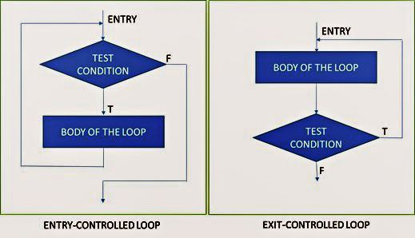
Differentiate Between Entry Controlled and Exit Controlled Loop

Slide 7
Entry Controlled Loop | Exit Controlled Loop
Control conditions are tested before the start of the loop execution | Control conditions are tested at the end of the body of the loop execution.
If conditions are not satisfied, then the body the loop will not be executed. | Body is executed unconditionally for the first time.
Also known as Pre-test loop | Also known as Post-test loop
for loop, while loop | do…………..while loop

Slide 8
Infinite Loop in C
A loop that repeats indefinitely and never terminates is called an Infinite loop.
Loops that go on executing forever and never terminates because of lack of an exit condition are called infinite loops.
Sometimes we create these loops by mistake, while sometimes we deliberately create them in our program.
Let’s take some examples and see what kind of mistakes can lead to infinite loop.

Slide 9
Infinite Loop in C
int i;
for(i = 0; i < 100; i--)
{
printf("%d\n", i);
}

Slide 10
Infinite Loop in C
According to condition given, the loop will execute until (i < 100).
Initially, the value of i is 0 and after each iteration, its value is decremented in the update expression (i--)
So the value of i will never be greater than 100.
Hence the condition (i < 100) will always be true.
To make it finite we should use i++ instead of i--.

Slide 11
Steps of Looping Process
Setting and initialization of a condition variable
Execution of the statements in the loop
Test for a specified value of the condition variable for execution of the loop
Incrementing or updating the condition variable

Slide 12
Steps of Looping Process
Setting and initialization of a condition variable
Execution of the statements in the loop
Test for a specified value of the condition variable for execution of the loop
Incrementing or updating the condition variable

Slide 13
Types of Statement
while statement
do statement
for statement
break statement
goto statement
continue statement

Slide 14
While Statement (format)
while (test condition)
{
body of the loop;
}

Slide 15
While Statement
While is an entry-controlled loop statement
The test condition is evaluated and if the condition is true, then body of the loop is executed
After execution of the body, the test condition is once again evaluated and if it is true, the body is executed once again.
The process of repeated execution of the body continues until the test condition finally becomes false and the control is transferred out of the loop.

Slide 16
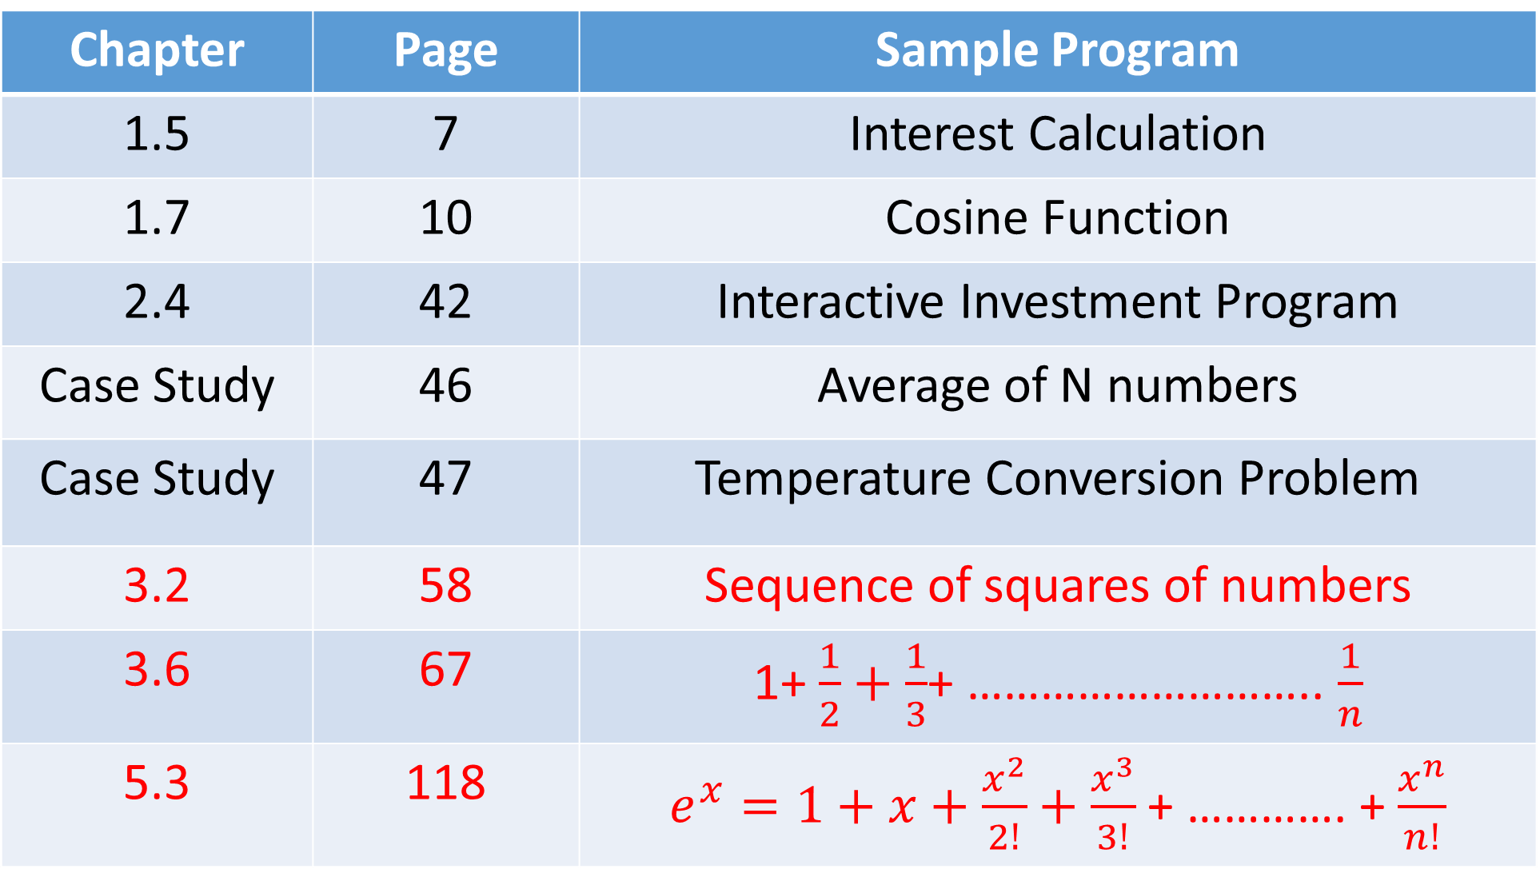
Chapter | Page | Sample Program
1.5 | 7 | Interest Calculation
1.7 | 10 | Cosine Function
2.4 | 42 | Interactive Investment Program
Case Study | 46 | Average of N numbers
Case Study | 47 | Temperature Conversion Problem
3.2 | 58 | Sequence of squares of numbers
3.6 | 67 | 1+ $\frac{1}{2}+\frac{1}{3}$+ ……………………….. $\frac{1}{n}$
5.3 | 118 | $e^{x}=1+x+\frac{x^{2}}{2!}+\frac{x^{3}}{3!}$ + …………. + $\frac{x^{n}}{n!}$

