Slide 1
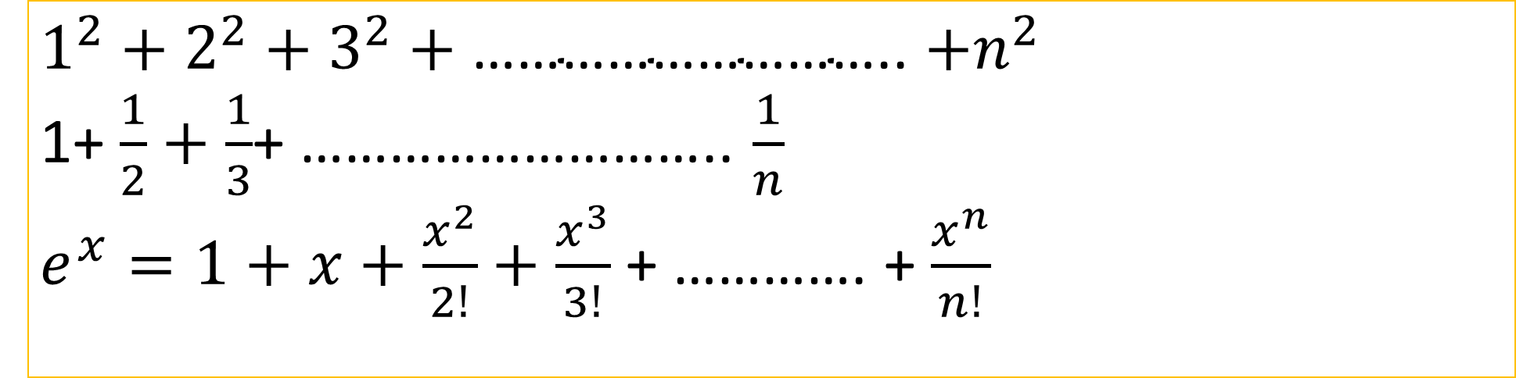
Sum of Series using while loop
$$1^{2}+2^{2}+3^{2}+\text{………………………..}{+n}^{2}$$
1+ $\frac{1}{2}+\frac{1}{3}$+ ……………………….. $\frac{1}{n}$
$e^{x}=1+x+\frac{x^{2}}{2!}+\frac{x^{3}}{3!}$ + …………. + $\frac{x^{n}}{n!}$

Slide 2
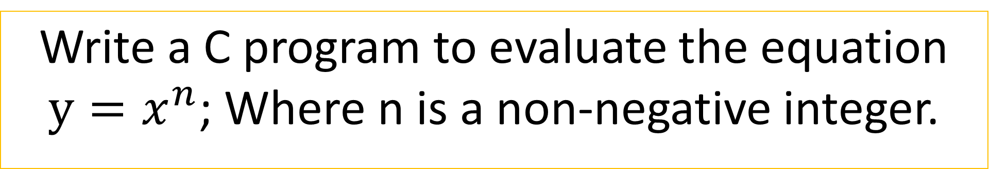
Program 6.1 (Page 154)
Write a C program to evaluate the equation $y=x^{n}$; Where n is a non-negative integer.

Slide 3
do statement (format)
do
{
body of the loop;
}
while (test-condition);

Slide 4
do statement (format)
In case of do statement, the program proceeds to evaluate the body of the loop first.
At the end of the loop, the test condition in the while statement is evaluated.
If the condition is true, the program continues to evaluate the body of the loop once again.
This process continues as long as the condition is true.
When the condition becomes false, the loop will be terminated and the control goes to the statement that appears immediately after the while statement.

Slide 5
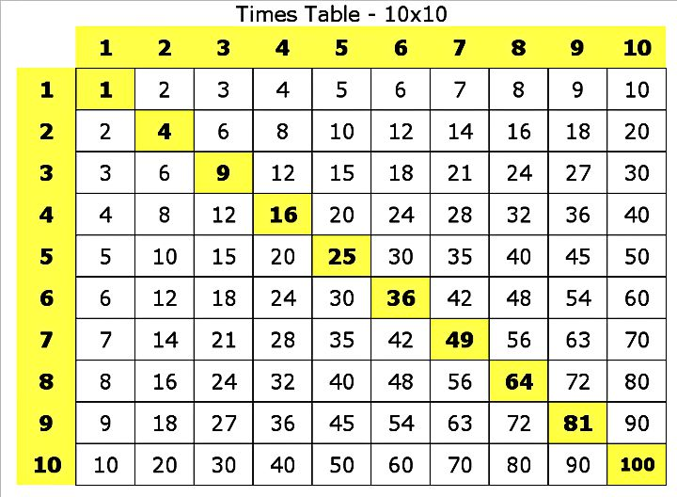
Program 6.2 (Page 156)
Write a C program to print multiplication table from 1×1 to 12×10.

Slide 6
Multiplication table
This program contains two do…….while loops in nested form.
The outer loop is controlled by the variable row and executed 12 times.
The inner loop is controlled by the variable column and is executed 10 times, each time the outer loop is executed.
That is, the inner loop is executed a total of 120 times, each time printing a value in the table.

Slide 7
for statement
for loop is entry controlled loop that provides a more concise loop control structure.
General format
for (initialization ; test-condition ; update expression)
{
Body of the loop;
}

Slide 8
for statement
The initialization statement is executed only once.
Then, the test condition is evaluated.
If the test condition is false, for loop is terminated.
But if the test condition is true, codes inside the body of loop is executed and the update expression is updated.
This process repeats until the test condition is false.
The for loop is commonly used when the number of iterations is known.

Slide 9
for loop
Sum of Natural Numbers Using for Loop

Slide 10
break statement | goto statement | continue statement
When break statement is encountered inside a loop, the loop is immediately existed and the program continues with the statement immediately following the loop. | goto statement can transfer the control to any place in a program. | continue causes the loop to be continued with the next iteration after skipping any statements in between.
exit | transfer | skip

Slide 11
