Slide 1
Program 6.4: Write a C program to print all the prime numbers between 1 and n, where n is the value supplied by the user
Enter the value of m and n:
1
20
The prime numbers are
2 3 5 7 11 13 17 19
The total prime numbers are= 8
Process returned 32 (0x20) execution time : 3.128 s
Press any key to continue.

Slide 2
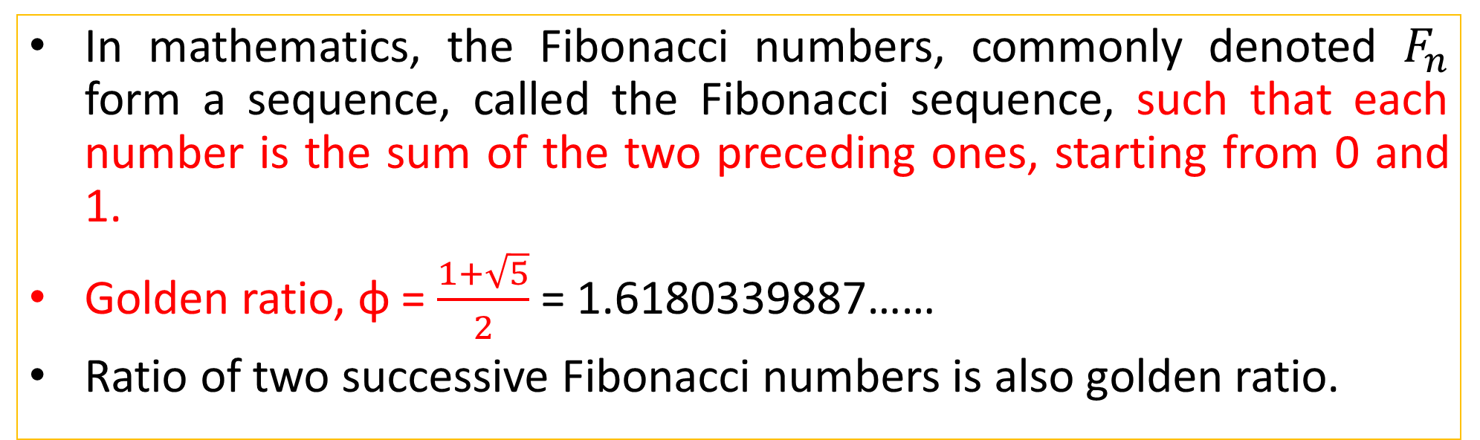
Fibonacci Numbers and Golden Ratio
In mathematics, the Fibonacci numbers, commonly denoted $F_{n}$ form a sequence, called the Fibonacci sequence, such that each number is the sum of the two preceding ones, starting from 0 and 1.
Golden ratio, ɸ = $\frac{1+\sqrt{5}}{2}$ = 1.6180339887……
Ratio of two successive Fibonacci numbers is also golden ratio.
F₀ | F₁ | F₂ | F₃ | F₄ | F₅ | F₆ | F₇ | F₈ | F₉ | F₁₀ | F₁₁ | F₁₂ | F₁₃ | F₁₄ | F₁₅ | F₁₆ | F₁₇ | F₁₈ | F₁₉ | F₂₀
0 | 1 | 1 | 2 | 3 | 5 | 8 | 13 | 21 | 34 | 55 | 89 | 144 | 233 | 377 | 610 | 987 | 1597 | 2584 | 4181 | 6765

Slide 3
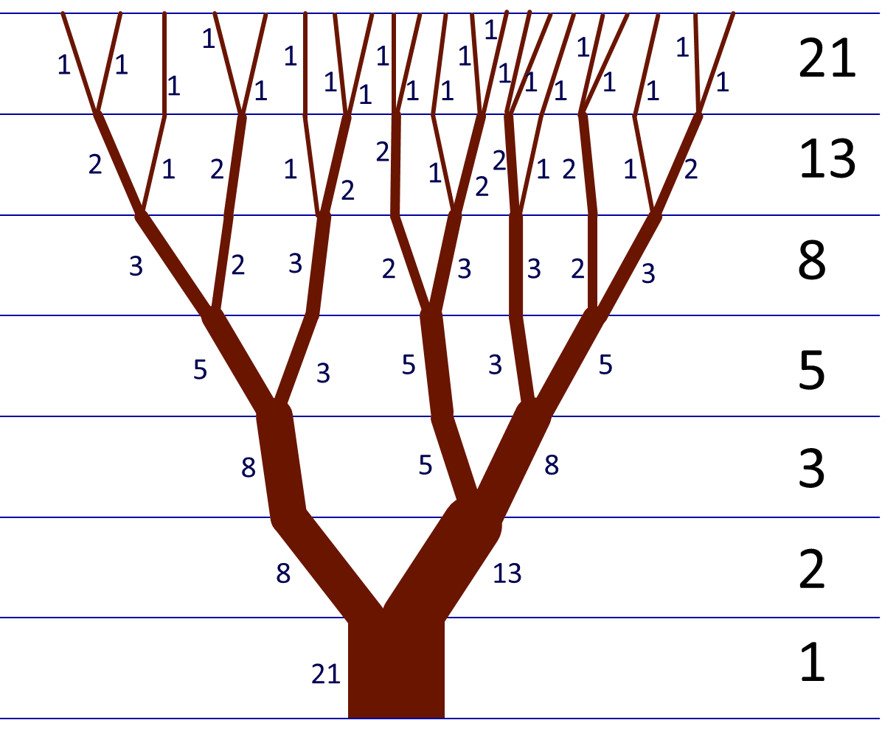
Golden Ratio in Nature
https://io9.gizmodo.com/5985588/15-uncanny-examples-of-the-golden-ratio-in-nature

Slide 4
Program 6.5: Write a C program to print nth Fibonacci number
Fibonacci Series using for loop
Fibonacci Series using while loop
https://www.programiz.com/c programming/examples/fibonacci-series
Output:
Enter a positive number: 100
Fibonacci Series: 0, 1, 1, 2, 3, 5, 8, 13, 21, 34, 55, 89,
Process returned 100 (0x64) execution time : 1.510 s
Press any key to continue.

Slide 5
Exercise Program 6.2: The factorial of an integer m is the product of consecutive integers from 1 to m. That is, factorial m = m! = m*(m-1)*(m-2)………….*1. Write a program that computes and prints a table of factorials for any given m. [4th year Backlog 2017]

Slide 6
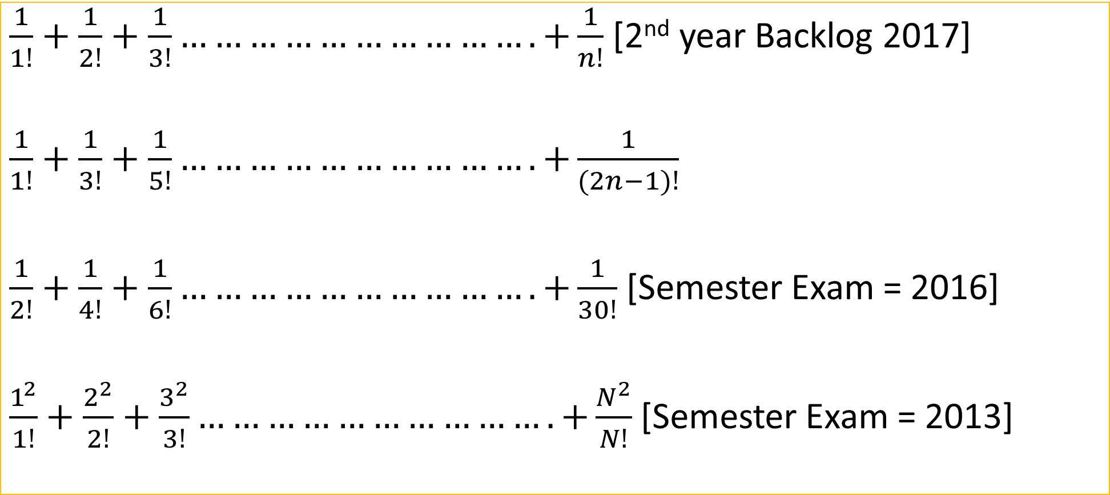
Series of Factorial Numbers
$\frac{1}{1!}+\frac{1}{2!}+\frac{1}{3!}………………………….+\frac{1}{n!}$ [2nd year Backlog 2017]
$\frac{1}{1!}+\frac{1}{3!}+\frac{1}{5!}………………………….+\frac{1}{(2n−1)!}$
$\frac{1}{2!}+\frac{1}{4!}+\frac{1}{6!}………………………….+\frac{1}{30!}$ [Semester Exam = 2016]
$\frac{1^{2}}{1!}+\frac{2^{2}}{2!}+\frac{3^{2}}{3!}………………………….+\frac{N^{2}}{N!}$ [Semester Exam = 2013]

Slide 7
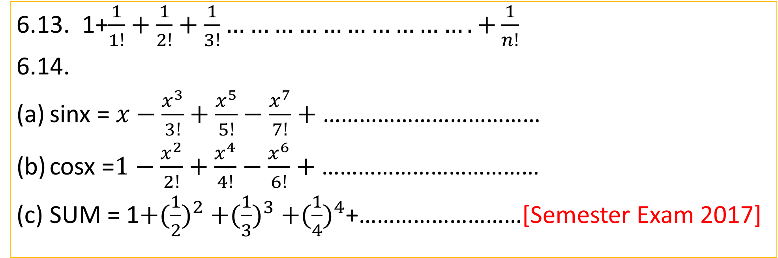
Programming Exercises: Series of Numbers
6.13. 1+$\frac{1}{1!}+\frac{1}{2!}+\frac{1}{3!}………………………….+\frac{1}{n!}$
6.14.
sinx =$x−\frac{x^{3}}{3!}+\frac{x^{5}}{5!}−\frac{x^{7}}{7!}+\text{………………………………}$
cosx =$1−\frac{x^{2}}{2!}+\frac{x^{4}}{4!}−\frac{x^{6}}{6!}+\text{………………………………}$
SUM = 1${+(\frac{1}{2})}^{2}{+(\frac{1}{3})}^{3}{+(\frac{1}{4})}^{4}$+………………………[Semester Exam 2017]

Slide 8
Review Questions 6.13
Write a for statement to print each of the following sequences of integers.
1,2,4,8,16,32
1,3,9,27,81,243
-4,-2,0,2,4
-10,-12,-14,-18,-26,-42

Slide 9
1 2 4 8 16 32
#include<stdio.h>
void main()
{
int i,s;
for(i=0;i<=5;i++)
{s=pow(2,i);
printf("%d\t",s);
}
}

Slide 10
1 3 9 27 81 243
#include<stdio.h>
void main()
{
int i,s;
for(i=0;i<=5;i++)
{s=pow(3,i);
printf("%d\t",s);
}
}

Slide 11
-4 -2 0 2 4
#include<stdio.h>
void main()
{
int i;
for(i=-4;i<=4;i=i+2)
{
printf("%d\t",i);
}
}

Slide 12
-10 -12 -14 -18 -26 -42
#include<stdio.h>
void main()
{ int i, s=-10;
printf("%d\t",s);
for(i=1;i<=5;i++)
{ s=-10-pow(2,i);
printf("%d\t",s);}}

Slide 13
Review Questions 6.10
Compare in terms of their functions, the following pairs of statements:
while and do….while
while and for statement
break and goto statement
continue and goto statement

