Slide 1
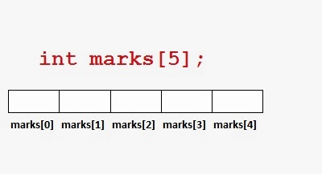
Chapter 7 Array

Slide 2
Information from BTRC
OPERATOR | SUBSCRIBER (IN MILLIONS)
Grameen Phone Ltd. (GP) | 58.689
Banglalink Digital Communications Limited | 31.309
Robi Axiata Limited (Robi) | 26.443
Airtel Bangladesh Limited (Airtel) | 8.049
Pacific Bangladesh Telecom Limited (Citycell) | 0.000
Teletalk Bangladesh Ltd. (Teletalk) | 3.791
Total | 128.281

Slide 3
Concept of Array
So far, we have used only the fundamental data types, namely char, int, float, double.
They are constrained by the fact that, a variable of these types can store one value at any given time.
Therefore, they can be used only to handle limited amounts of data.
In many applications, however, we need to handle a large volume of data in terms of reading, processing and printing.
To process, such large amounts of data, we need a powerful data type that facilitate efficient storing, accessing and manipulations of data items.
C supports a derived data type known as array that can be used for such applications.

Slide 4
Practical Examples where concept of Array can be used
List of temperatures recorded every hour in a day, or a month or a year.
List of employees in a an organization.
List of products and their cost sold by a store.
Test scores of a class of students.
List of customers and their telephone numbers
Table of daily rainfall data.

Slide 5
Array
An array is a fixed-size sequenced collection of elements of the same data type.
It is simply a grouping or like-type data.
Types of array:
One dimensional array
Two dimensional array
Multidimensional array

Slide 6
One-Dimensional Array
For example, if we want to represent a set of five numbers say 35,40,20,57,19 by an array variable number as follows: int number[5]
The computer reserves five storage locations as shown below:
Storage Location | Assigned Values
number[0] | 35
number[1] | 40
number[2] | 20
number[3] | 57
number[4] | 19

Slide 7
Declaration and Initialization of One-Dimensional Array
The general form of any array declaration is:
Datatype Variable-name[size]
Data type used can be int, float or char and the size indicates the maximum number of elements that can be stored inside the array.
For example float height[60]; declares the height to be an array containing 60 real elements.
An array can be initialized at either of the following stages:
At compile time
At run time

Slide 8
Initialization of One-Dimensional Array
int number[3]={0,0,0};
This statement will declare the variable number as an array of size 3 and will assign zero to each element.
float total[5]={0.0,15.75,-10};
This statement will initialize the first three elements to 0.0, 15.75 and -10 and the remaining two elements to zero.
int number[3]={10,20,30,40};
If we have more initializers than the declared size, the compiler will produce an error. It will not work and illegal in C.

Slide 9
Run Time Initialization
int x[3];
scanf(“%d %d %d”, &x[0], &x[1], &x[2]);
The statements will initialize array elements with the values entered through the keyboard.
int m[3];
for(i=0;i<3,i++)
{
scanf(“%d”, &m[i]);
}

Slide 10
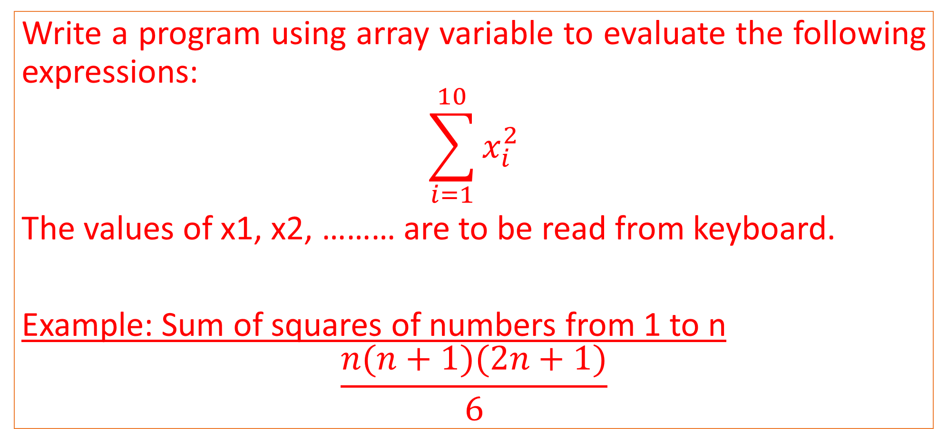
Program 7.1 (Page 196)
Write a program using array variable to evaluate the following expressions:
$$\sum_{i=1}^{10}{x_{i}^{2}}$$
The values of x1, x2, ……… are to be read from keyboard.
Example: Sum of squares of numbers from 1 to n
$$\frac{n(n+1)(2n+1)}{6}$$

Slide 11
Program 7.2 (Page 199)
Given below is the list of marks obtained by a class of 50 students in an annual examination.
43 65 51 27 79 11 56 61 52 09 25 36 07 49 55 63 74 81 49 37
40 49 16 75 87 91 33 24 58 78 65 56 76 67 45 54 35 63 12 21
73 49 51 19 39 49 68 93 85 59
Write a program to count the number of students belonging to each of following groups of marks:
0-9, 10-19, 20-29 .....100.

