Slide 1
Two-Dimensional Arrays
Employer | Item 1 | Item 2 | Item 3
Sales girl#1 | 310 | 275 | 365
Sales girl#2 | 210 | 190 | 325
Sales girl#3 | 405 | 235 | 240
Sales girl#4 | 260 | 300 | 380

Slide 2
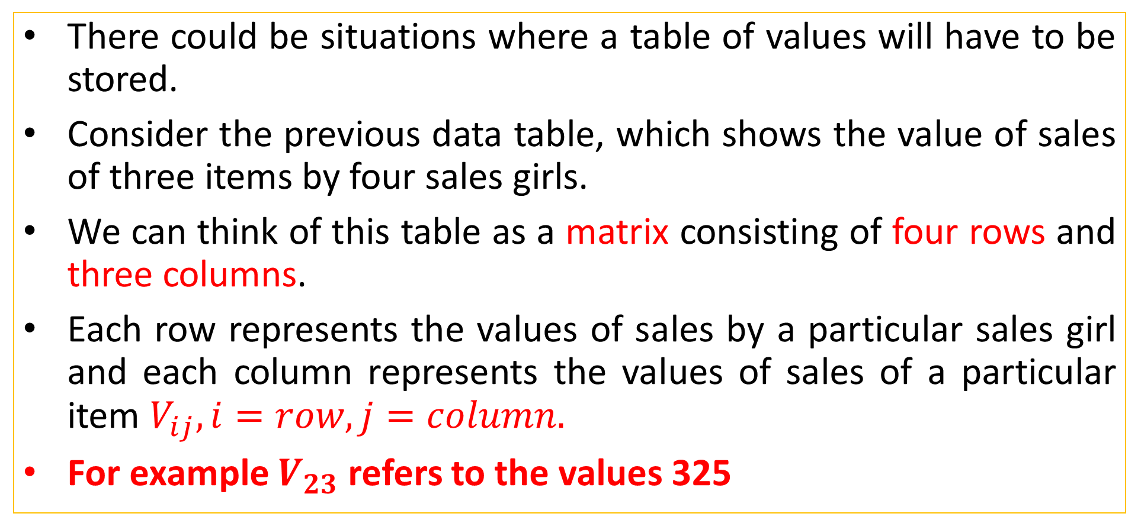
Two-Dimensional Arrays
There could be situations where a table of values will have to be stored.
Consider the previous data table, which shows the value of sales of three items by four sales girls.
We can think of this table as a matrix consisting of four rows and three columns.
Each row represents the values of sales by a particular sales girl and each column represents the values of sales of a particular item $V_{ij}, i=row, j=column.$
For example $V_{23}$refers to the values 325

Slide 3
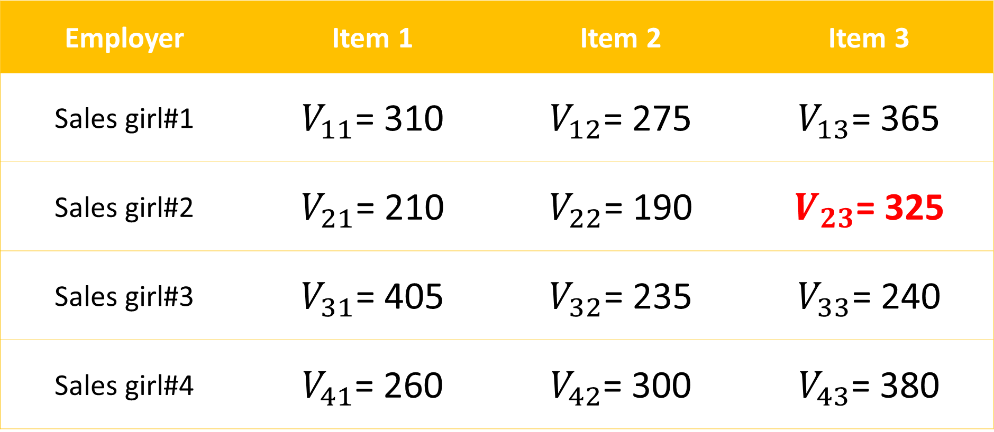
Employer | Item 1 | Item 2 | Item 3
Sales girl#1 | $V_{11}$= 310 | $V_{12}$= 275 | $V_{13}$= 365
Sales girl#2 | $V_{21}$= 210 | $V_{22}$= 190 | $V_{23}$= 325
Sales girl#3 | $V_{31}$= 405 | $V_{32}$= 235 | $V_{33}$= 240
Sales girl#4 | $V_{41}$= 260 | $V_{42}$= 300 | $V_{43}$= 380
The table discussed above can be defined in C as:
V [4][3]

Slide 4
Two-Dimensional Arrays
Two dimensional arrays are declared as follows:
type array_name[row_size][column_size]
Example:
int a[2][2];
int b[3][2];
a[2][2] means number of elements = 4
b[3][2] means number of elements = 6

Slide 5
Two-Dimensional Arrays
a[2][2]
a[0][0] | a[0][1]
a[1][0] | a[1][1]
b[3][2]
b[0][0] | b[0][1]
b[1][0] | b[1][1]
b[2][0] | b[2][1]

Slide 6
Assigning values to Two-Dimensional Arrays
At the time of array declaration:
int a[2][2]={10,20,30,40};
This statement will assign values in the order:
a[0][0]=10, a[0][1]=20, a[1][0]=30, a[1][1]=40
After array declaration:
int a[2][2];
a[0][0]=10;
a[0][1]=20;
a[1][0]=30;
a[1][1]=40;

Slide 7
Assigning values to Two-Dimensional Arrays
At the time of program execution:
int a[3][3];
for(i=0;i<3;i++)
{
for(j=0;j<3;j++)
{
scanf(“%d”, &a[i][j]);
}
}

Slide 8
i loop | j loop | Elements a[i][j]
i = 0 | j = 0 | a[0][0]
i = 0 | j = 1 | a[0][1]
i = 0 | j = 2 | a[0][2]
i = 1 | j = 0 | a[1][0]
i = 1 | j = 1 | a[1][1]
i = 1 | j = 2 | a[1][2]
i = 2 | j = 0 | a[2][0]
i = 2 | j = 1 | a[2][1]
i = 2 | j = 2 | a[2][2]

Slide 9
Matrix Program: Addition
Write a C program to add three matrices a[2][2], b[2][2], c[2][2].
Steps:
for loop to enter the value of each matrix.
for loop to calculate the addition
For loop to show the result in the output screen.

Slide 10
Matrix Program: Multiplication
Write a C program to multiply two matrices a[3][3], b[3][3].
Steps:
for loop to enter the value of each matrix.
for loop to calculate the addition
For loop to show the result in the output screen.

Slide 11
Matrix Program: Multiplication (Working)
a matrix |  |  | b matrix
00 | 01 | 02 | 00 | 01 | 02
10 | 11 | 12 | 10 | 11 | 12
20 | 21 | 22 | 20 | 21 | 22
c matrix
00*00+01*10+02*20 | 00*01+01*11+02*21 | 00*02+01*12+02*22
10*00+11*10+12*20 | 10*01+11*11+12*21 | 10*02+11*12+12*22
20*00+21*10+22*20 | 20*01+21*11+22*21 | 20*02+21*12+22*22

Slide 12
Matrix Program: Multiplication (Working)
i loop | j loop | k loop
i = 0; i<3; i++ | j = 0; j<3; i++ | k = 0; k<3; i++
0 | 0 | 0
0 | 0 | 1
0 | 0 | 2
{c[i][j] = c[i][j]+a[i][k]*b[k][j];}}}

