Slide 1
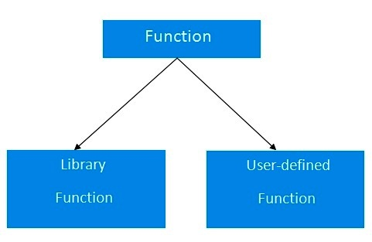
CHAPTER 9 USER-DEFINED FUNCTIONS

Slide 2
Introduction
One of the strength of C language is C functions.
C function can be classified into two categories, namely, library functions and user defined functions.
However, they have been primarily limited to three functions, namely main, printf and scanf.
main is an example of user-defined functions.
We have also used other user defined functions such as sqrt, cos etc.
However, a user-defined function can later become a part of the C program library.

Slide 3
Need for User defined Functions
While it is possible to code any program utilizing only main function, it leads to a number of problems.
The program may become too large and complex.
As a result, the task of debugging, testing and maintaining becomes difficult.
If a program is divided into functional parts, then each part may be independently coded and later combined into a single unit.
This independently coded programs are called subprograms that are much easier to understand, debug and test.
In C such subprograms are referred to as functions.

Slide 4
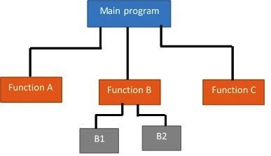
Top-down modular programming using functions

Slide 5
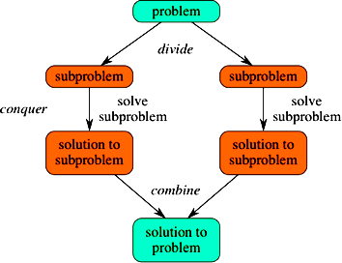
“Divide-and-Conquer”

Slide 6
Modular Programming
Modular programming is a strategy applied to the design and development of software systems.
It is defined as organizing a large program into small, independent program segments called modules, that are separately named and individually callable program units.
These modules are carefully integrated to become a software system that satisfies the system requirements.
It is basically a “divide-and-conquer” approach to problem solving.

Slide 7
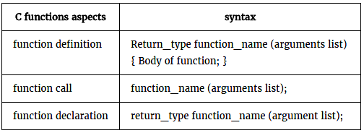
Elements of User-Defined Functions
Function Definition
Function Call
Function Declaration

Slide 8
Function Definition
A function definition, also known as function implementation shall include the following elements:
Function Header | Function Body
Function Name | Local Variable Declaration
Function Type | Function Statements
List of Parameters | Return Statements

Slide 9
#include<stdio.h>
void add(int x, int y)
{
int result;
result = x+y;
printf("Sum of %d and %d is %d \n", x,y,result);
}
void main()
{
add(10,20);
add(30,40);
add(50,60);
}

Slide 10
Function Call
Function call is statement, so it should end with semicolon.
It should be carefully remember that, user defined function can not call main function.

