Slide 1
/* Example of Function Elements*/
Function Definition:
Function definition is nothing but actual Function.
Function Prototype:
A function prototype is simply the declaration of a function that specifies function's name, parameters and return type. It doesn't contain function body.
A function prototype gives information to the compiler that the function may later be used in the program. It is consist of:
return type
function name
parameter list
terminating semicolon

Slide 2
/* Example of Function Elements*/
Function call :
To use a function, you will have to call that function to perform the defined task.
When a program calls a function, the program control is transferred to the called function.
Return Statement:
The return statement terminates the execution of a function and returns a value to the calling function.
The program control is transferred to the calling function after return statement.

Slide 3
Category of Functions
Functions with no arguments and no return values.
Functions with arguments and no return values.
Function with arguments and one return value.
Function with no arguments but return a value.
Function that return multiple values.

Slide 4
Functions with no arguments and no return values
When a function has no arguments, it does not receive any data from the calling function.
Similarly, when it does not return a value, the calling function does not receive any data from the called function.
In fact, there is no data transfer between the calling function and the called function.

Slide 5
Functions with arguments and no return values.
We could make the calling function to read data from the terminal and pass it on the called function.
The nature of data communication between the calling function and the called function with arguments but no return value is single or one-way type communication.

Slide 6
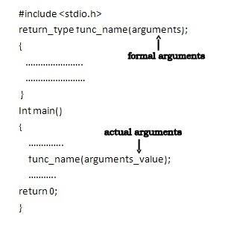
Actual arguments and formal arguments

Slide 7
Actual arguments and formal arguments
The variables declared in the function prototype or definition are known as Formal arguments and the values that are passed to the called function from the main function are known as Actual arguments.
Order, number, and type of the actual arguments in the function call must match with formal arguments of the function.
If there is type mismatch between actual and formal arguments, the unmatched formal arguments are initialized to some garbage values.
Remember, no error message will be generated.

Slide 8
Function with arguments and one return value.
Such functions will have two-way data communication between calling function and called function.
a value | b value | return value | main()
10 | 20 | return(sum) | gtotal = 30+10 = 40
10 | 20 | return(0) | gtotal = 0+10 = 10
10 | 20 | return(10) | gtotal = 10+10 = 20

Slide 9
Recursion
When a called function in turn calls another function, a process of “chaining” occurs.
Recursion is a special case of this process, where a function calls itself.
main()
{
printf(“This is an example of recursion \n”);
main();
}

Slide 10
Working of Recursion
Assume, n = 3, the statement fact = n*factorial(n-1); will be executed for n = 3 that is fact = 3*factorial(2);
The expression on the right-hand side includes a call to factorial with n = 2.
This call will return the value 2*factorial(1)
Once again, factorial is called with n = 1.
This time, the function returns 1.
fact = 3*factorial(2) = 3*2*factorial(1) = 3*2*1 = 6

