Slide 1
Bisection Method
This method is based on Intermediate Value Theorem (IVT)
It states that, if a function f(x) is continuous between a and b, and f(a) and f(b) are of opposite signs, then there exists at least one root between a and b.
Let us consider, f(a) be negative and f(b) be positive.
Then the root lies between a and b and its approximate value is given by xo= (a+b)/2
If f(xo)=0, we conclude that xo is a root of the equation f(x)=0
Otherwise, the root lies either between xo and b or between xo and a depending on whether f(xo) is negative or positive.

Slide 2
Table: Bisection method applied to f(x) = x² - 3.
a | b | f(a) | f(b) | c = (a + b)/2 | f(c) | Update | new b − a
1.0 | 2.0 | -2.0 | 1.0 | 1.5 | -0.75 | a = c | 0.5
1.5 | 2.0 | -0.75 | 1.0 | 1.75 | 0.062 | b = c | 0.25
1.5 | 1.75 | -0.75 | 0.0625 | 1.625 | -0.359 | a = c | 0.125
1.625 | 1.75 | -0.3594 | 0.0625 | 1.6875 | -0.1523 | a = c | 0.0625
1.6875 | 1.75 | -0.1523 | 0.0625 | 1.7188 | -0.0457 | a = c | 0.0313
1.7188 | 1.75 | -0.0457 | 0.0625 | 1.7344 | 0.0081 | b = c | 0.0156
1.71988 | 1.7344 | -0.0457 | 0.0081 | 1.7266 | -0.0189 | a = c | 0.0078

Slide 3
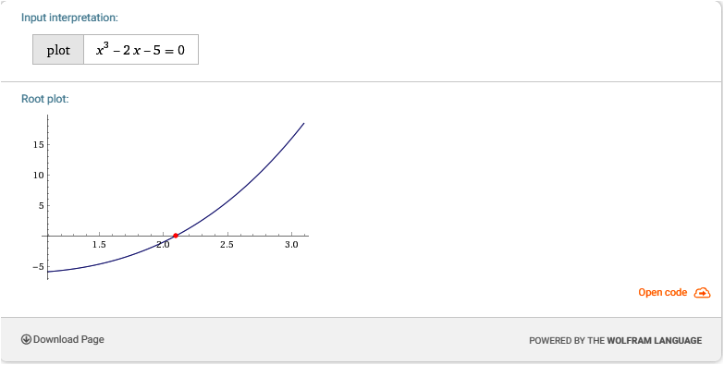
https://www.wolframalpha.com

