Slide 1
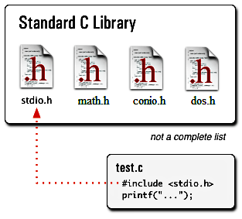
#include<stdio.h>
Preprocessor reads #include and it understands that there is something which has to be included.
Next it reads (<) and it understand that the file which has to be included is in a special place defined by the operating system where header files for the C library are held.
Then it will search the file named stdio.h and then it will copy the contents.
stdio.h stands for Standard Input Output
h stands for Header file (Library functions are grouped category wise and stored in different files known as header files)

Slide 2
List of inbuilt C functions in stdio.h file ((Text Book = 489)
printf() This function is used to print the character, string, float, integer, octal and hexadecimal values onto the output screen
scanf() This function is used to read a character, string, numeric data from keyboard.
getc() It reads character from file
gets() It reads line from keyboard
getchar() It reads character from keyboard

Slide 3
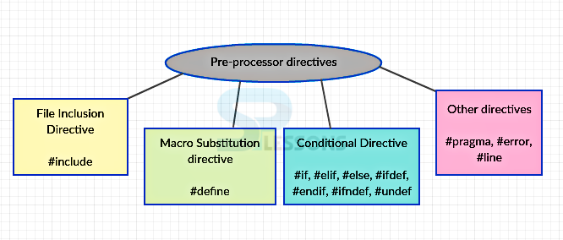
Preprocessor in C
The C Preprocessor is not a part of the compiler, but is a separate step in the compilation process.
In simple terms, a C Preprocessor is just a text substitution tool and it instructs the compiler to do required pre-processing before the actual compilation.
C Preprocessor is referred to as CPP.
All preprocessor commands begin with a hash symbol (#).
For readability, a preprocessor directive should begin in the first column.

Slide 4
Return Statement (return 0;)
In C and C++ programs the main function is of type int and therefore it should return an integer value.
The return value of the main function is considered the "Exit Status" of the application.
On most operating systems returning 0 is a success status like saying "The program worked fine".

Slide 5
main Function
C permits different forms of main statement. Following forms are allowed
main()
int main()
void main()
main (void)
void main (void)
int main(void)

Slide 6
main Function
void main()
The return type of the function "main" is void, i.e. it does not return anything to the OS.
Nothing has been said about the arguments in main, which means that you can either pass the arguments to main or not pass anything at all.
int main(void)
The return type of the function is "int", i.e. it is supposed to return an integer value to the OS.
"void" means that you're not allowed to pass any argument to the main. Doing this would result into a compiler error.

Slide 7
main Function
int main()
The return type of the function is "int", i.e. it is supposed to return an integer value to the OS.
Nothing has been said about the arguments in main, which means that you can either pass the arguments to main or not pass anything at all
void main(void)
The return type of the function "main" is void, i.e. it does not return anything to the OS.
"void" means that you're not allowed to pass any argument to the main. Doing this would result into a compiler error.

Slide 8
Simple Program 2: Printing a Message
#include<stdio.h>
int main ()
{
printf(“my first program in CE 2201”);
return 0;
}

Slide 9
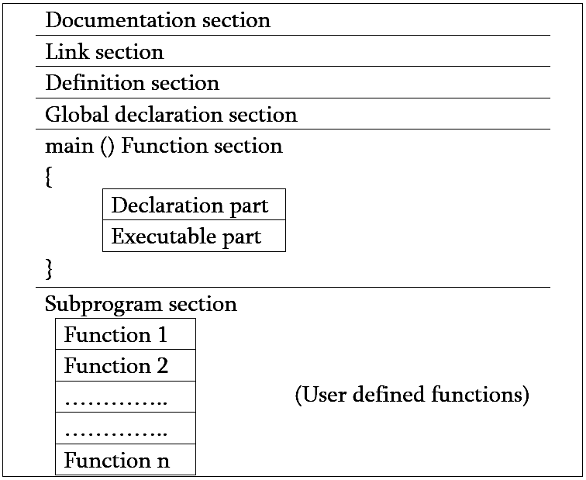

Slide 10
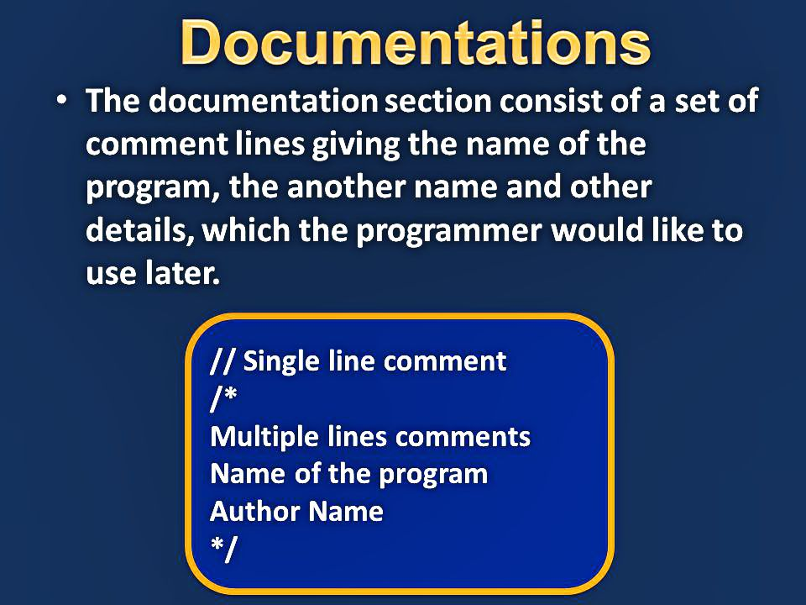
Basic Structures of C program

Slide 11
Basic Structures of C program
Link section provides instructions to the compiler to link functions from the system library.
Definition section defines all the symbolic constants
There are some variables that are used in more than one function. Such variables are called global variables and are declared in the global declaration section that is outside of all the functions. This section also declares all the user defined functions.
Every C program must have one main() function section. This section contains two parts: declaration part and executable part. The declaration part declares all the variables used in the executable part.
All statements in the declaration and executable parts end with a semicolon ;

Slide 12
Executing a C program
Creating the Program
Compiling the Program
Linking the program with functions that are needed from the C library
Executing the Program.

