Slide 1
Simple Linear Regression
Regression analysis makes use of mathematical models to describe relationships.
Linear regression attempts to model the relationship between two variables by fitting a linear equation to observed data.
Linear regression models are often fitted using the least squares approach.
Linear regression is widely used in biological, behavioral and social sciences to describe possible relationships between variables.
Some important Application:
Epidemiology
Finance
Environmental science
Artificial intelligence (AI) such as machine learning

Slide 2
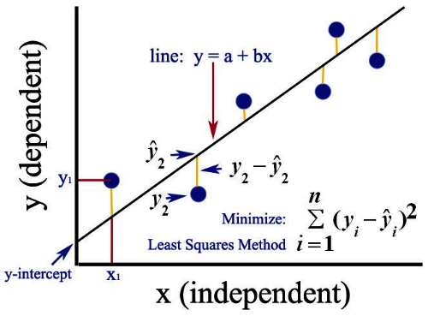
Least Squares Method

Slide 3
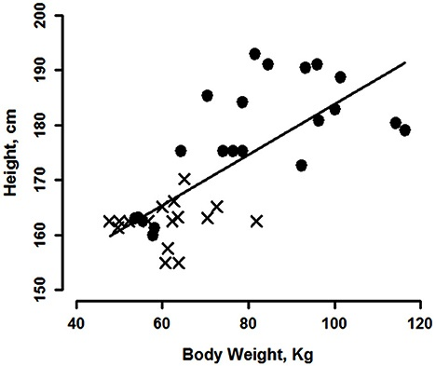
Practical Examples

Slide 4
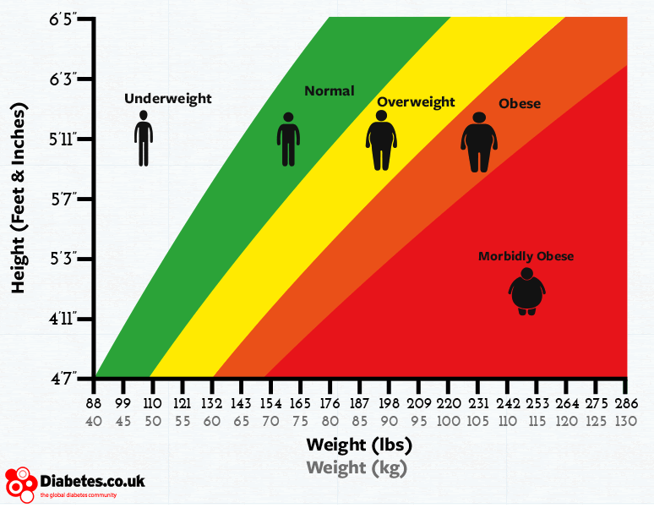
Practical Examples

Slide 5
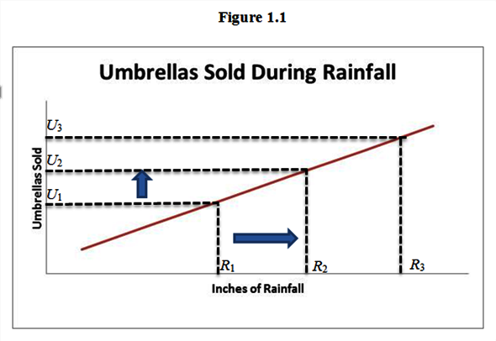
Practical Examples

Slide 6
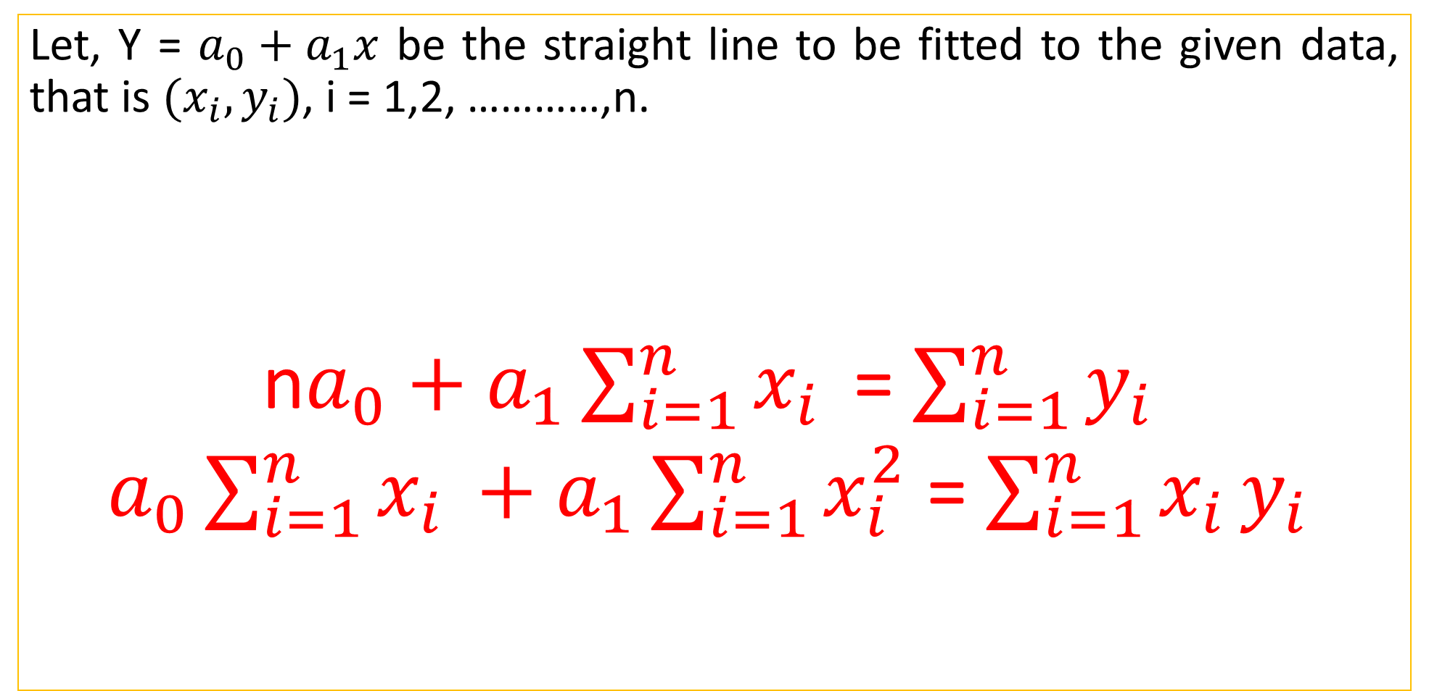
Fitting a Straight Line
Let, Y = $a_{0}+a_{1}x$ be the straight line to be fitted to the given data, that is $(x_{i},y_{i})$, i = 1,2, …………,n.
n$a_{0}+a_{1}\sum_{i=1}^{n}{x_{i }}$ = $\sum_{i=1}^{n}{y_{i }}$
$a_{0}\sum_{i=1}^{n}{x_{i }}+a_{1}\sum_{i=1}^{n}{x_{i}^{2}}$ = $\sum_{i=1}^{n}{{x_{i }y}_{i }}$

Slide 7
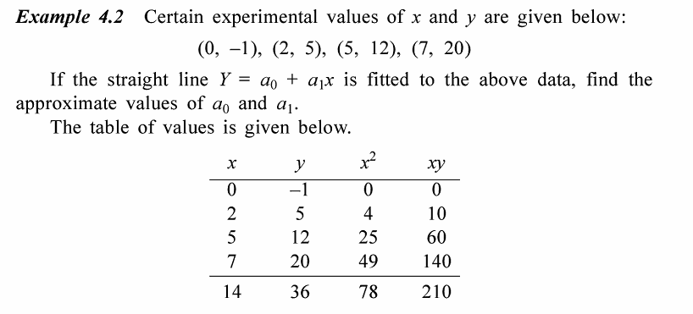
S.S Sastry (129)

Slide 8
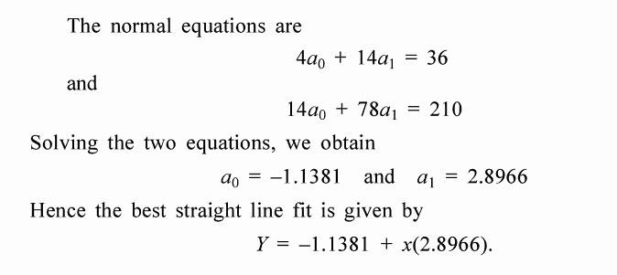
S.S Sastry (129)

Slide 9
C programming for Linear Regression Analysis
for(i=0;i<=n-1;i++)
Let us consider, n = 4
Value of i | Element | X Value | Element | Y Value
0 | x[0] | 0 | y[0] | -1
1 | x[1] | 2 | y[1] | 5
2 | x[2] | 5 | y[2] | 12
3 | x[3] | 7 | y[3] | 20

Slide 10
C programming for Linear Regression Analysis
for(i=0;i<=n-1;i++)
{
sumx = sumx +x[i];
sumx2 = sumx2 +x[i]*x[i];
sumy = sumy +y[i];
sumxy = sumxy +x[i]*y[i];
}

Slide 11
C programming for Linear Regression Analysis
i Value | sumx | sumx2 | sumy | sumxy
0 | 0+0 | 0+0*0 | 0-1 | 0+0
1 | 0+2 | 0+2*2 | 0-1+5 | 0+2*5
2 | 0+2+5 | 4+5*5 | 0-1+5+12 | 10+5*12
3 | 0+2+5+7 | 29+7*7 | 0-1+5+12+20 | 70+7*20
Result | 14 | 78 | 36 | 210

Slide 12
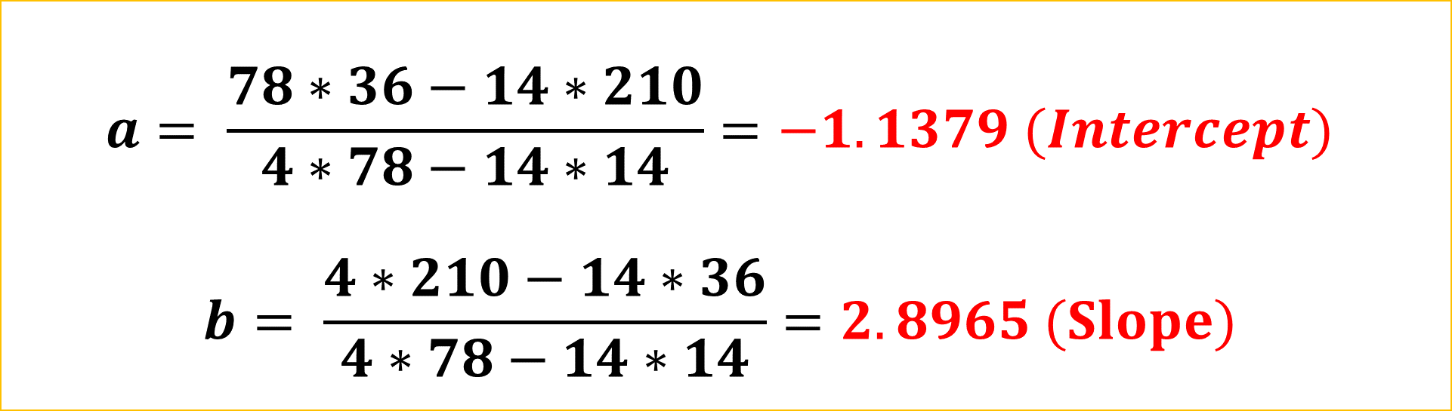
C programming for Linear Regression Analysis
a=((sumx2*sumy -sumx*sumxy)*1.0/(n*sumx2-sumx*sumx)*1.0);
b=((n*sumxy-sumx*sumy)*1.0/(n*sumx2-sumx*sumx)*1.0);
printf("\n\n The line is Y=%3.3f +%3.3f X", a , b);
$$a= \frac{78∗36−14∗210}{4∗78−14∗14}=−1.1379 (Intercept)$$
$$b= \frac{4∗210−14∗36}{4∗78−14∗14}=2.8965 (Slope)$$

