Slide 1
Chapter 2
CONSTANTS, VARIABLES AND DATA TYPES

Slide 2
Character Set
Every C program contains statements.
These statements are constructed using words and these words are constructed using characters from C character set.
Character Set | Examples
Alphabets | Lower case Letters: a,b,c,……….,y,z. Upper Case Letters: A,B,C,………….,Y,Z.
Digits | Digits - 0, 1, 2, 3, 4, 5, 6, 7, 8, 9
Special Characters | ~ @ # $ % ^ & * ( ) _ - + = { } [ ] ; : ' " / ? . > , < \ | tab
White space Characters. | \b \t \v \r \f \n \\ \’ \" Double quote \? \0

Slide 3
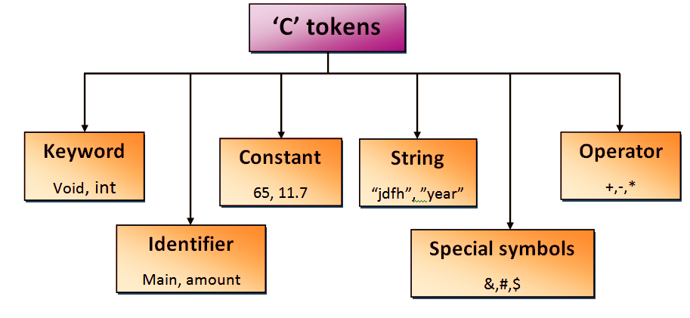
C Tokens
C tokens are the basic buildings blocks in C language which are constructed together to write a C program.
Each and every smallest individual units in a C program are known as C tokens.

Slide 4


Slide 5
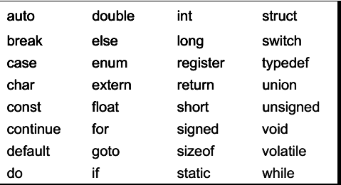
Keywords
All keywords have fixed meanings and these meanings cannot be changed.
All keywords must be written in lowercase.

Slide 6
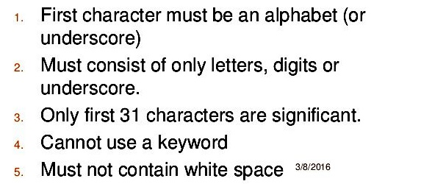
Identifiers
Identifiers refer to the name of variables, functions and arrays.
These are user-defined names and consists of a sequence of letters and digits, with a letter as a first character.

Slide 7
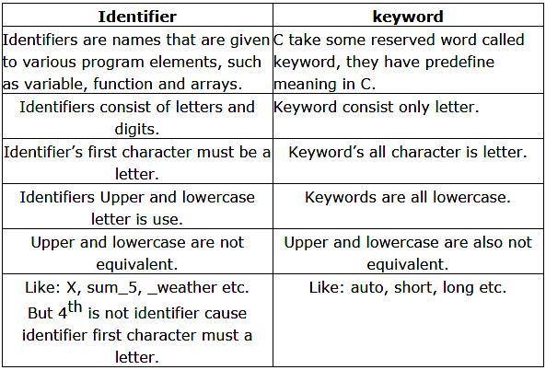
Difference between Keyword and Identifier

Slide 8
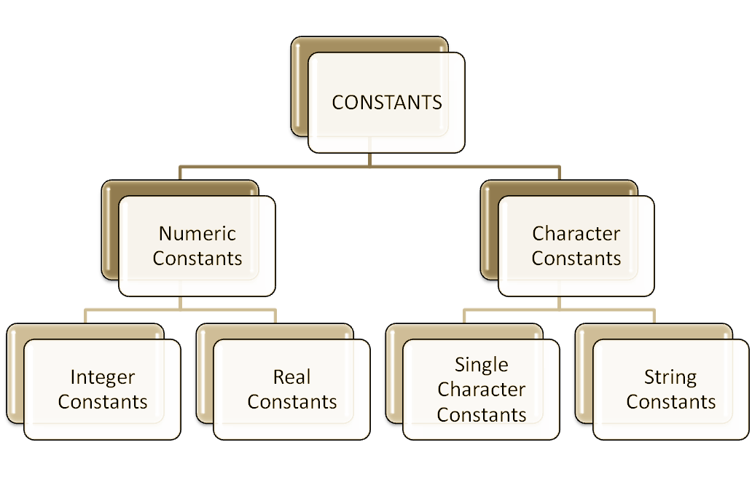
Constants
Constants refer to fixed values that the program may not alter during its execution.

Slide 9
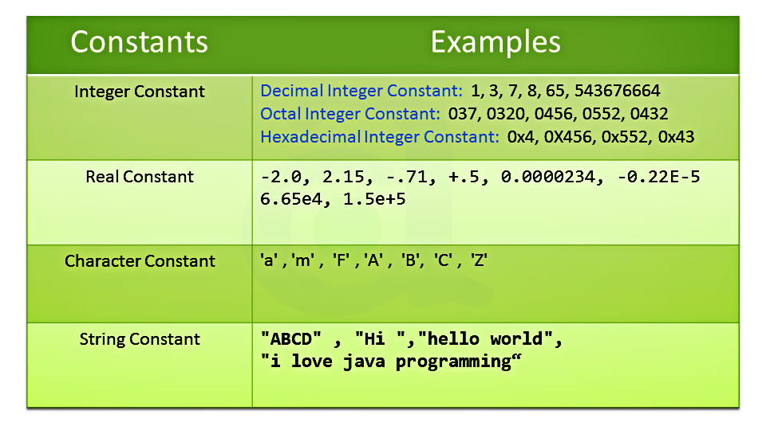

Slide 10
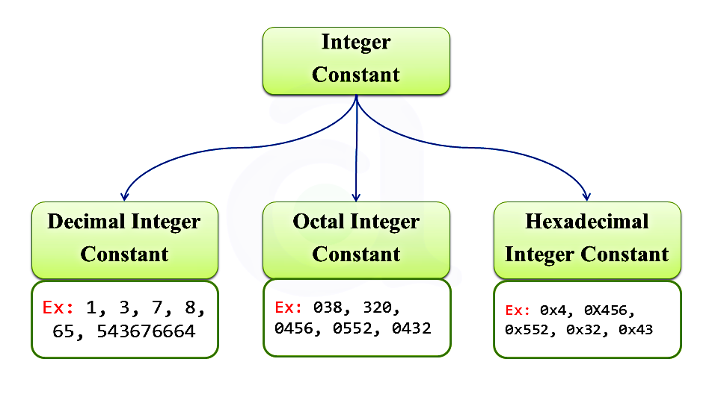
Integer Constants

Slide 11
Integer Constants
Decimal constant consists of a set of digits 0 through 9, preceded by an optional –or + sign.
An octal integer constant consists of any combination of digits from the set 0 through 7, with an leading 0.
A sequence of digit preceded by Ox or OX is considered as hexadecimal. They may also include alphabets A through F or a through f. The letter A through F represent the numbers 10 through 15.

Slide 12
Why do we use hexadecimal number system?
It is much easier for humans to read hexadecimal numbers than binary numbers.
For example, the hexadecimal number 0x2F5B translates to the binary number 0010 1111 0101 1011.
https://www.binaryhexconverter.com/binary-to-hex-converter
A common use of hexadecimal numbers is to describe colors on web pages. Each of the three primary colors (i.e., red, green and blue) is represented by two hexadecimal digits to create 255 possible values, thus resulting in more than 16 million possible colors.

Slide 13
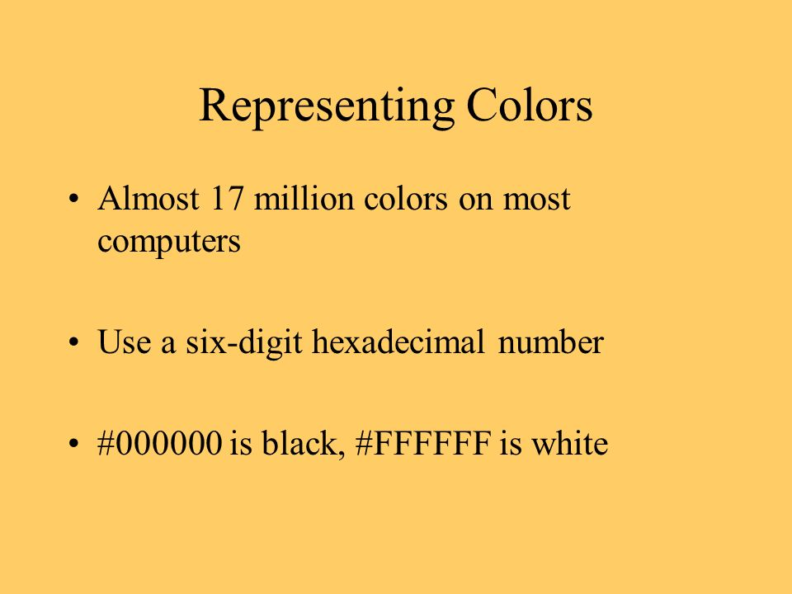


Slide 14
