Slide 1
32 bit and 64 bit Processor
A 32-bit system can access 2³² (4,294,967,296) memory addresses.
A 64-bit machine could theoretically access 18,446,744,073,709,551,616 memory addresses.
32-bit is a type of CPU can transfer 32 bits of data per clock cycle while 64-bit is a type of CPU can transfer 64 bits of data per clock cycle.
While many 32-bit programs can run on a 64-bit operating system (OS), 64-bit programs are not compatible with 32-bit operating systems.
Windows 95, 98, and XP are all 32-bit operating systems.
Windows Vista, Windows 7, and Windows 8 also come in 64-bit versions.
Clock cycle: amount of information that the CPU can process every time it performs an operation

Slide 2
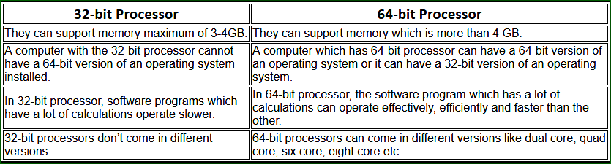
32 bit and 64 bit Processor

Slide 3
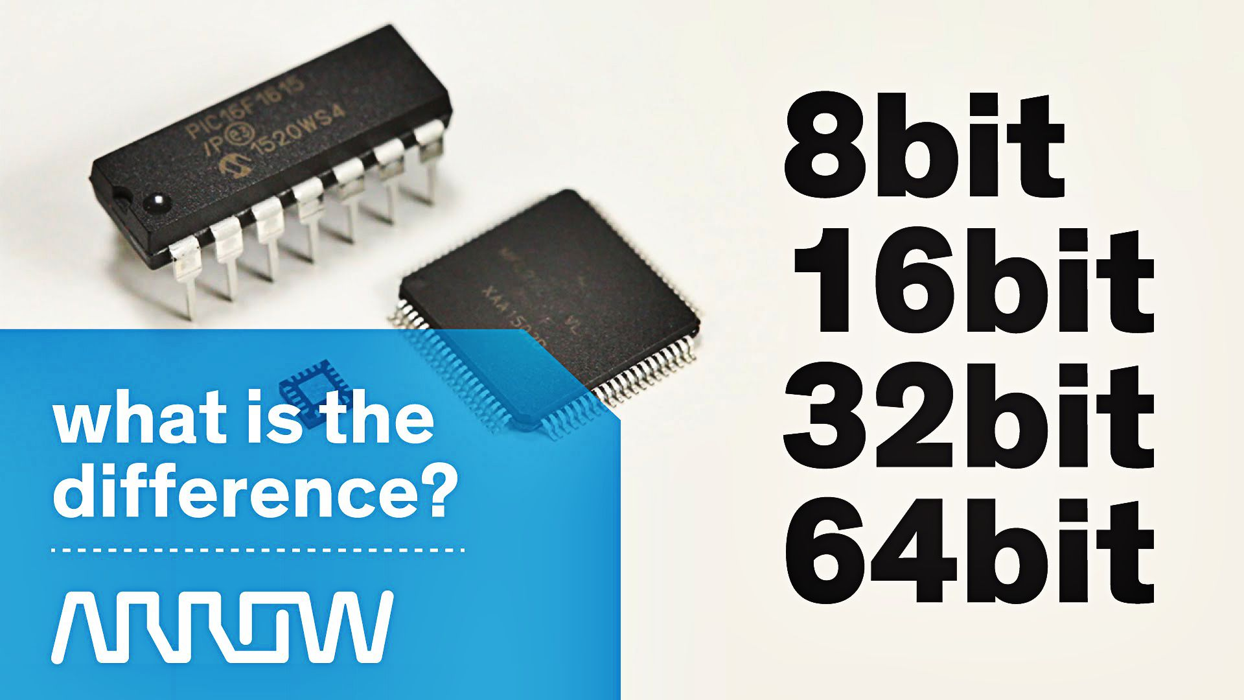
‘’The largest integer value that can be stored is machine-dependent’’- Why?

Slide 4
Qualifiers
The largest integer value that can be stored is 32767 on 16-bit machines and 2147483647 on 32-bit machines.
It is also possible to store larger integer constants on these machines by appending qualifiers such as U,L and UL to the constants.
Examples:
56789U
987612347UL
9876543L

Slide 5
Program 2.1: Representation of Integer Constants on a 16-bit computer
#include<stdio.h>
void main()
{
printf("Integer values\n\n");
printf("%d %d %d\n", 32767,32767+1,32767+10);
printf("\n");
printf("Long integer values\n\n");
printf("%ld %ld %ld\n", 32767L,32767L+1L,32767L+10L);
}
Output
Integer values
32767 -32768 -32759
Long integer values
32767 32768 32777

Slide 6
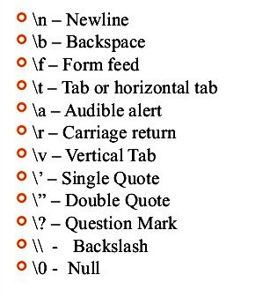
Backslash Character Constant
C supports some special backslash character constants that are used in output functions.
For example, the symbol \n stands for newline character

Slide 7
Variable: Rules for naming variables:
In programming, a variable is a container (storage area) to hold data.
Variable names are just the symbolic representation of a memory location.
Variable must begin with a letter. It must not start with a digit.
In naming variables, alphabetic character a-z, A-Z, digit (0-9) and underscore ( _ ) can be used. Except underscore, other special character can’t be used.
There must not have any blank space in a variable name.
Uppercase and lowercase are significant in naming variable.
Keywords can not be used as variables.
Any number of character is allowed in naming variable. However, ANSI standard recognizes a length of 31 character. Normally 8 character is preferable.

Slide 8
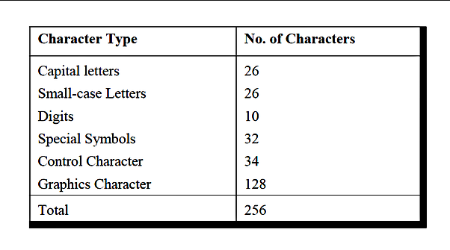
List of Characters in C programming

Slide 9
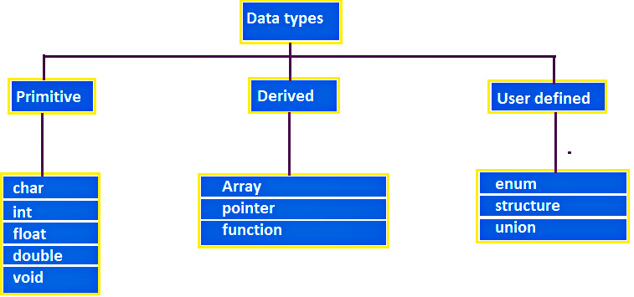
Data Types

Slide 10
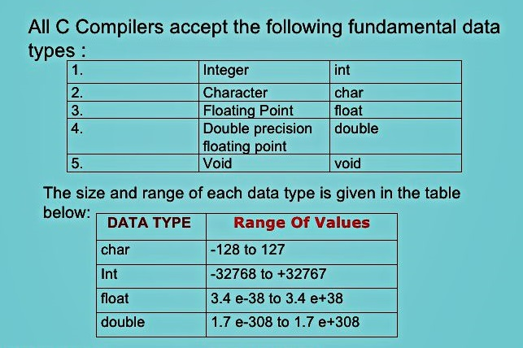
Primary or Fundamental Data types

Slide 11
Assignments
What is the basic difference between signed and unsigned type integer?
What is the basic difference between signed and unsigned type character?
What is the basic difference among float, double, long double data type?
Define void data type.

